Slide 1
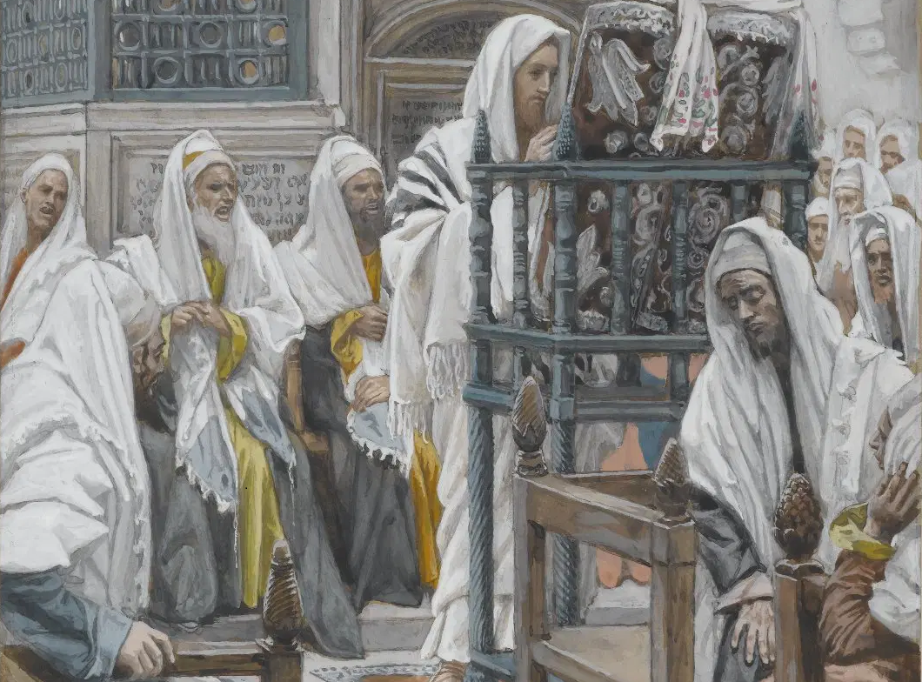
Messiah in the Tanach, 03
A Short Course for Men

Slide 2
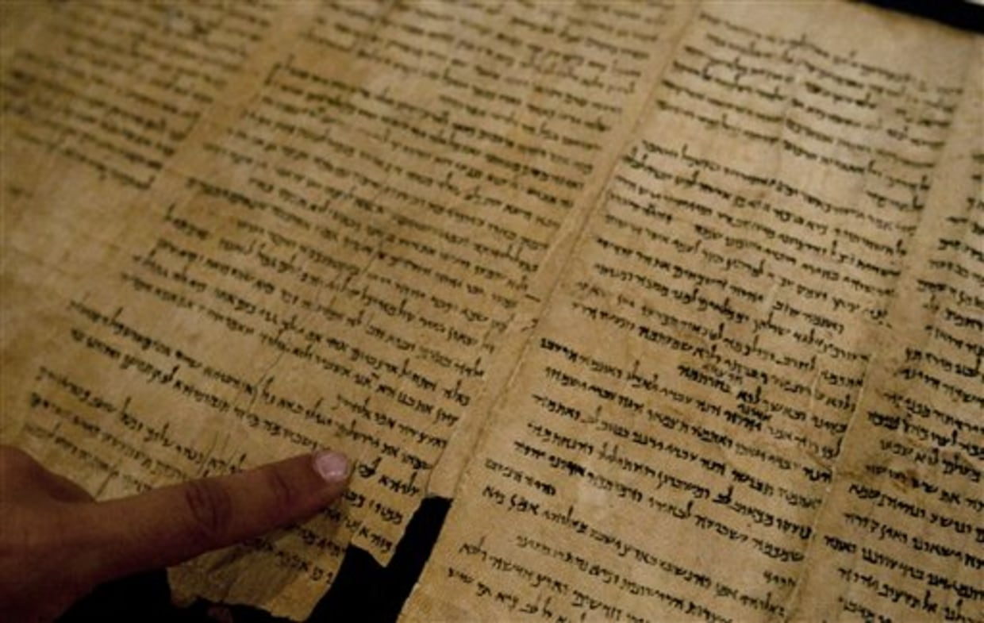
Three apparent predictions
Texts viewed by some Jews as messianic.
Definitions:
● The text:
● Innertext:
● Intertext:
● Predictive:
● Historic:
● Messianic:
Writing in a document.
Texts in a same document.
One text referring to another.
About some future figure.
A prediction already fulfilled.
About an end-times king.

Slide 3
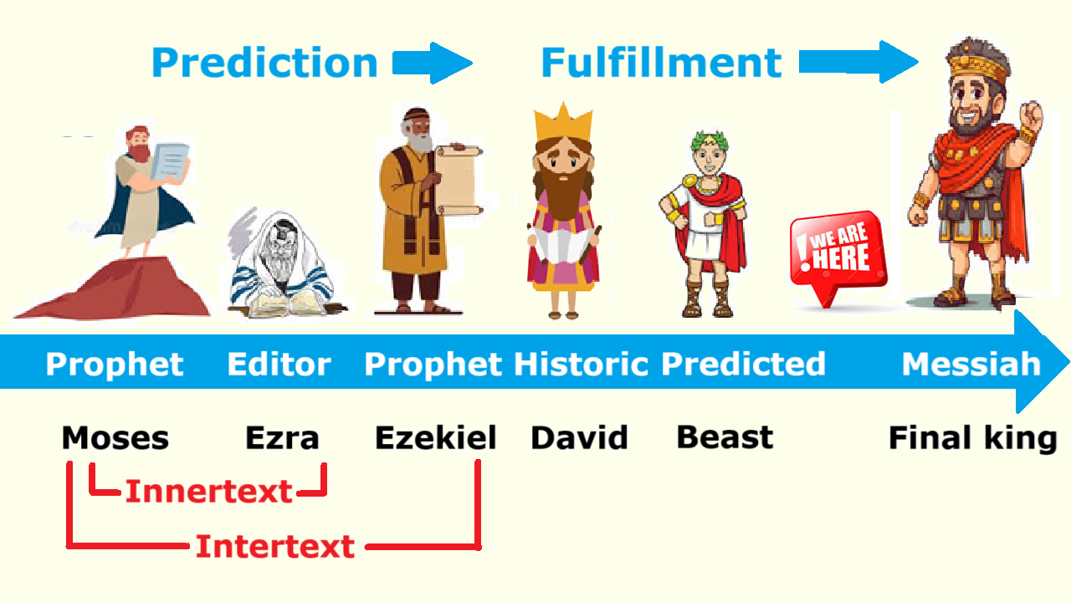

Slide 4
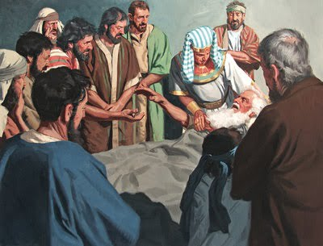
Genesis 49:8-11 (NJPS 1985)
⁸ You, O Judah, your brothers shall praise;
Your hand shall be on the nape of your foes;
Your father’s sons shall bow low to you.
⁹ Judah is a lion’s whelp;
On prey, my son, have you grown.
He crouches, lies down like a lion,
Like a lioness*—who dare rouse him?
* It is the females who hunt for their pride…

Slide 5
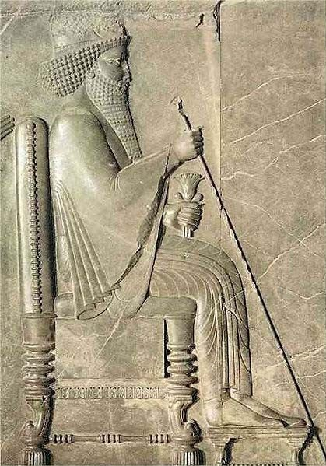
Genesis 49:8-11 (NJPS 1985)
¹⁰ The scepter shall not depart from Judah,
Nor the ruler’s staff from between his feet;
So that tribute shall come to him*
And the homage of peoples be his.
¹¹ He tethers his ass to a vine,
His ass’s foal to a choice vine;
He washes his garment in wine,
His robe in blood of grapes.
* shiloh as shai loh … following the Midrash.

Slide 6
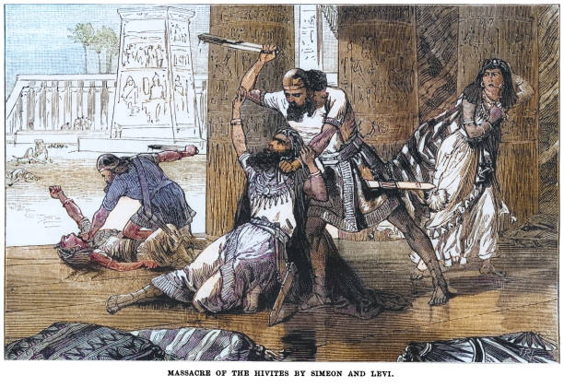
Genesis (NJPS 1985)
34²⁵ Simeon and Levi, two of Jacob’s sons, brothers of Dinah, took each his sword, came upon the city unmolested, and slew all the males.
35²² While Israel stayed in that land, Reuben went and lay with Bilhah, his father’s concubine; and Israel found out.
● Judah’s older brothers disqualified.

Slide 7
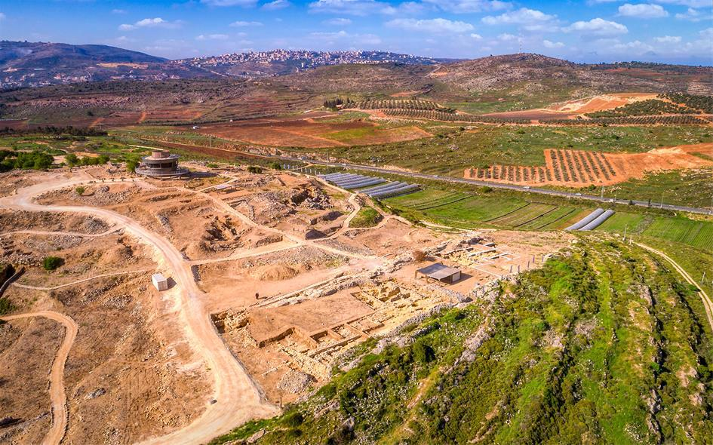
Who/What was Shilo?
● ‘Until he comes to Shilo.’ (šilô ≠ šîlōh)
● Targums: ‘Shilo is his name’ referring to Isa. 9:6 ‘peace’ & Mic. 5:5 (šālôm).
● Calvin: ‘his son’, šil + ô. But šil ≠ ‘son’.
● 30+ Non-Masoretic manuscript variants read šlh = archaic še (‘which’), followed by some Targums and by some Greek versions: ‘which belongs to him’.

Slide 8
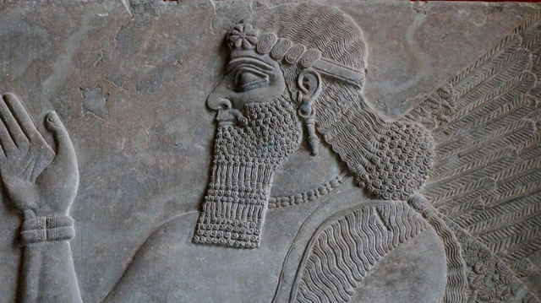
Ezekiel 21:27[32] (NJPS 1985)
³² Ruin, an utter ruin I will make it.
It [royalty, v. 26] shall be no more until he comes to whom it rightfully belongs;
and I will give it to him.
● Intertext confirmation of Gen. 49:10.
● King Zedekiah was removed (21:24-27).
● To Nebuchadnezzar? Or to Messiah?
● Talmud: This was never fulfilled.

Slide 9
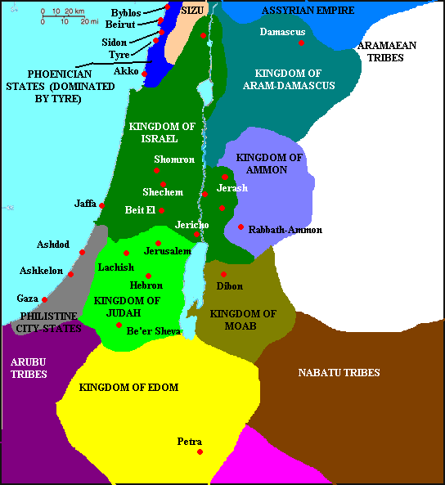
Numbers 24:14-19 (NJPS 1985)
¹⁴ Let me inform you of what this people will do to your people in days to come…
¹⁵ Word of one who hears God’s speech…
¹⁶ What I behold will not be soon: …
A scepter comes forth from Israel…
¹⁷ It smashes … Moab … Edom … Seir…
¹⁸ A victor issues from Jacob…
¹⁹ Amelek … is to perish forever.

Slide 10
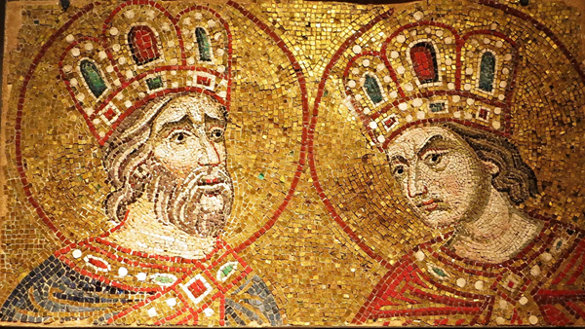
Numbers 24:14-19 (NJPS 1985)
● Concerns Israel, which would someday be led by a royal figure (‘scepter’).
● This had to be David or someone(s)
in his lineage.
● Moab and Edom would gain their freedom after King Solomon’s reign but would later be subjugated again.

Slide 11
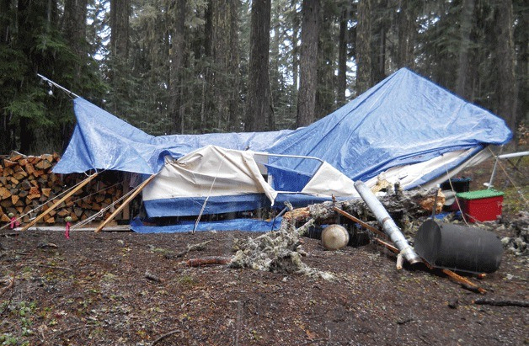
Amos 9:11-12 (NJPS 1985)
¹¹ In that day, I will set up again the fallen booth of David: I will mend its breaches and set up its ruins anew. I will build it firm as in the days of old,
¹² So that they shall possess the rest of Edom, And all the nations once attached to My name.
● An 8th century BCE intertextual allusion to Numbers 24:14-19.

Slide 12
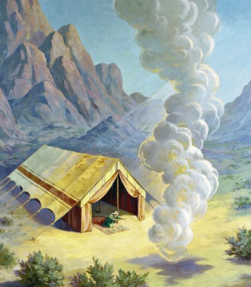
Deuteronomy 18:18-19 (NJPS 1985)
¹⁸ I will raise up for them from among their own people a prophet like yourself, in whose mouth I will put My words and who will speak to them all that I command;
¹⁹ and anybody who fails to heed the words [the prophet] speaks in My name,
I Myself will call to account.
● See Deut. 34:10-12

Slide 13
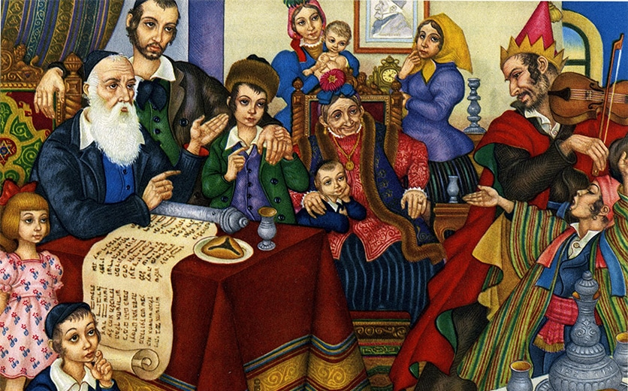
Deuteronomy 18:18-19. Views:
● Medieval Jews: Joshua or Jeremiah.
But see Deut. 34:9-10.
● ‘Prophet’ = collective for all prophets.
But none ruled over kings and priests.
● Both historic and messianic.
Majority view, but no clear examples.
● Messianic alone. A unique figure, like Moses and ruling over nations.

Slide 14
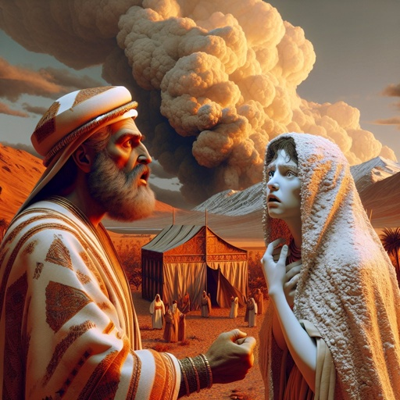
Numbers 12:5-8 (NJPS 1985)
⁵ [Adonai] came down in a pillar of cloud, stopped at the entrance of the Tent, and called out, “Aaron and Miriam!” The two of them came forward;
⁶ [God] said, “Hear these My words: When prophets of [Adonai] arise among you, I make Myself known to them in a vision, I speak with them in a dream.

Slide 15
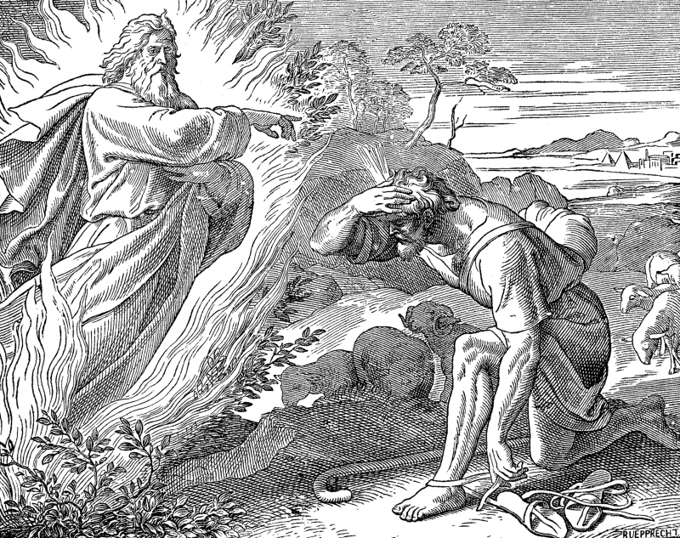
Numbers 12:5-8 (NJPS 1985)
⁷ Not so with My servant Moses; he is trusted throughout My household.
⁶ With him I speak mouth to mouth, plainly and not in riddles, and he beholds the likeness of [Adonai]. How then did you not shrink from speaking against My servant Moses!”
● [Adonai]: NJPS reads “יהוה”.

Slide 16
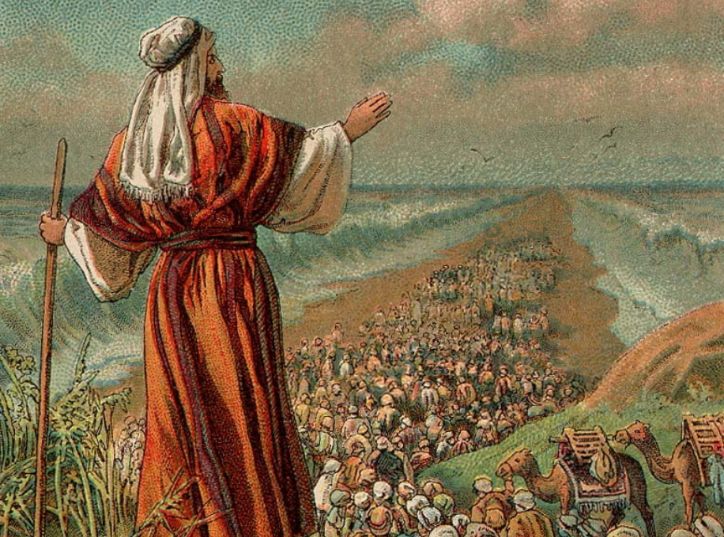
Deut. 34:10-12 (NJPS 1985)
¹⁰ Never again did there arise in Israel a prophet like Moses—whom [Adonai] singled out, face to face,
¹¹ for the various signs and portents that [Adonai] sent him to display in the land of Egypt, …
¹² and for all the great might and awesome power that Moses displayed before all Israel.

Slide 17
Deut. 18 intertextual support
● Num. 12:5-8 defines how Moses unique.
● Deut. 31:33 ‘man of God’ (1X) appendix?
● Deut. 34:10-12 was not yet written.
● Deut. 34:5-6. Grave site long forgotten.
● Deut. 34:10 “Never again did there arise in Israel a prophet like Moses” (NJPS).
“Never since has there arisen a prophet in Israel like Moses” (NRSVue).

Slide 18
Tentative conclusion
● There are apparent messianic passages in the Tanach.
● Later Tanach writers viewed these as messianic prophecies.
● Jewish commentators did the same.
● First-century Jews awaited a messiah.
● (Christians understood messianic passages to be previews of Jesus.)

Slide 19

http://tanach.site

Slide 20
…
¹ …
¹ …
● …:
● …:
● …:
…
…
…

Slide 21
…
¹ Verse
¹ Verse
● Text: …

Slide 22
¹ Verse
¹ Verse
● Text: …

Slide 23
Titre
● …
● ...
● ...
● ...
● ...

Slide 24
Titre
● …: …
● …: …
● …: …
● …: …
● …: …
● …: …
● …: …
● …: …

Slide 25
Discuss
?
● …
● …
● …
● …

