Slide 1
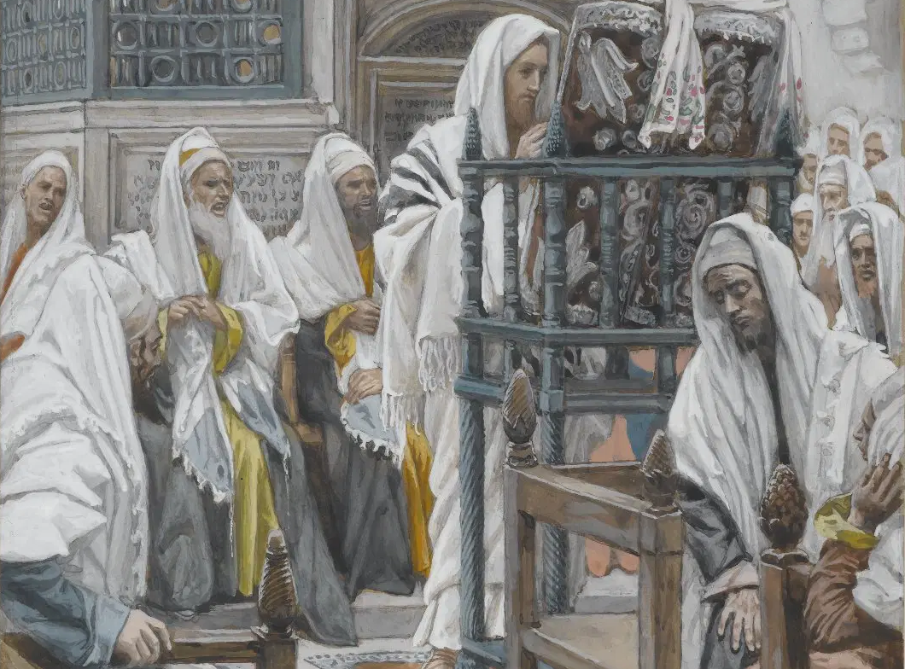
Messiah in the Tanach, 04
A Short Course for Men

Slide 2
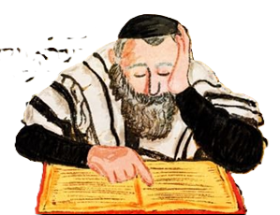
Messianic theme of the Canon
● Law (Torah)
● Prophets
● Former prophets
● Latter prophets
● Minor prophets
● Writings

Slide 3
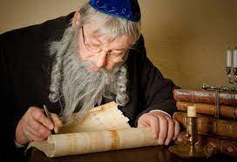
7 Questions
1 How was the Tanach canon decided?
2 How was the Tanach canon divided?
3 How was the Tanach canon messianic?
4 How was each Tanach book messianic?
5 What was ‘messiah’ in the Torah?
6 What was ‘messiah’ in the Prophets?
7 What was ‘messiah’ in the Writings?

Slide 4
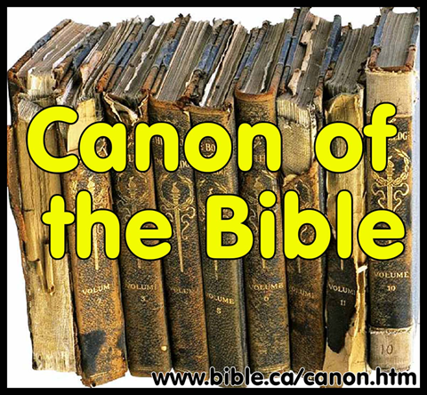
Observations
● The Torah was canon by the 5th BCE
● The Prophets were canon by the 3^{d} BCE.
● The Writings were canon by 90 CE.
● Arranged by historical period and size.
● Edited to have thematic “seams.”
● All Israel agreed on the Tanach books.
● Attesting to the Holy Spirit’s witness.
● All books have some messianic content.

Slide 5
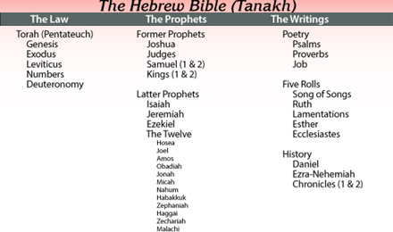

Slide 6
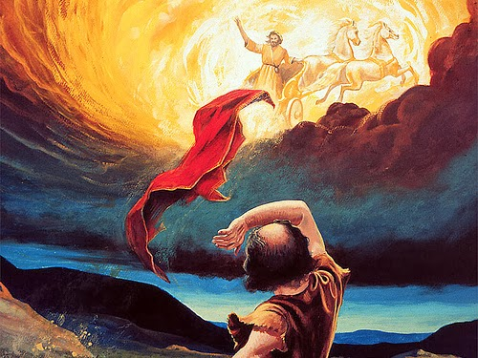
From Law to Prophets
Moses had laid his hands on Joshua … no prophet like Moses. Deut 34.9-12
The LORD spoke to Joshua. Josh 1:1
From Prophets to Writings
Remember the law of Moses … I will send you Elijah the prophet. Mal 4:1-6
Blessed is the man who … delights in the LORD’s law day & night. Psa 1:1-2

Slide 7
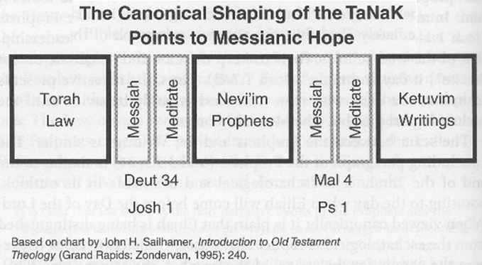

Slide 8
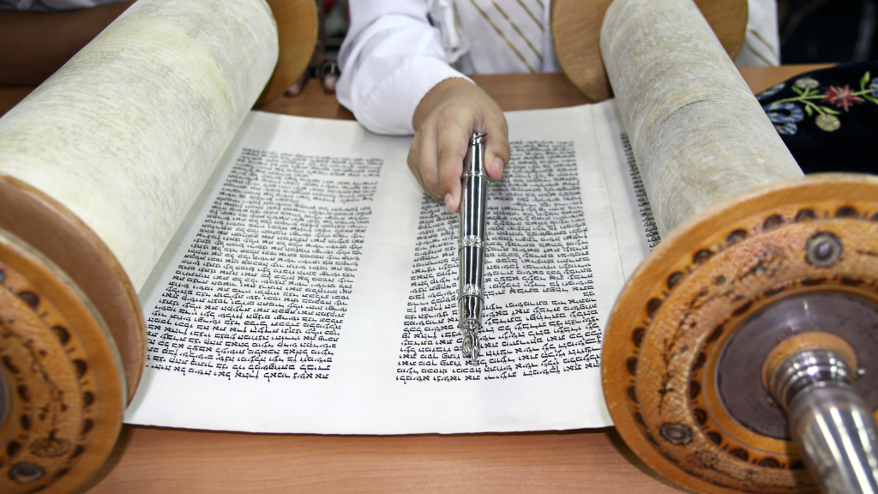
Messianic texts in the Torah
¹ “Assemble yourselves that I may tell you what will befall you in the days to come.” Gen 49
¹⁴ “I advise you what this people will do to your people in the days to come.” Num 24
²⁹ “In the days to come evil will befall you, because you will do evil.” Deut 31

Slide 9
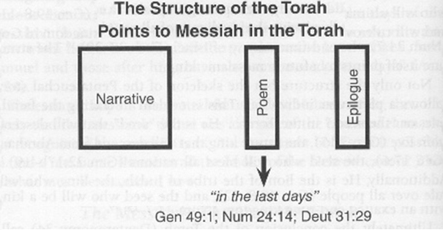
Rydelnik, 2010

Slide 10
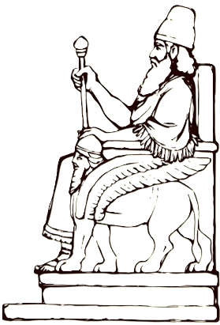
Messianic theme in the Torah
¹⁰ The scepter will not depart from Judah, nor the ruler's staff from between his feet, until he comes to whom it belongs; the nations will obey him. Genesis 49
⁷ “His king shall be higher than [Gog], and his kingdom shall be exalted.”
Numbers 24

Slide 11
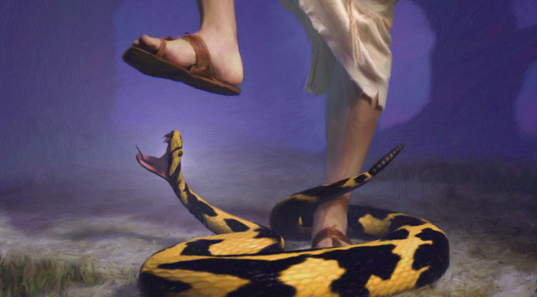
Messianic theme in the Torah
¹⁵ “He shall bruise your head, and you shall bruise his heel.” Gen 3
⁸ “I will give … to your offspring after you … all the land of Canaan, for an everlasting possession...” Gen 17
¹⁵ “God will raise up for you a prophet like me from among you.” Deut 18

Slide 12
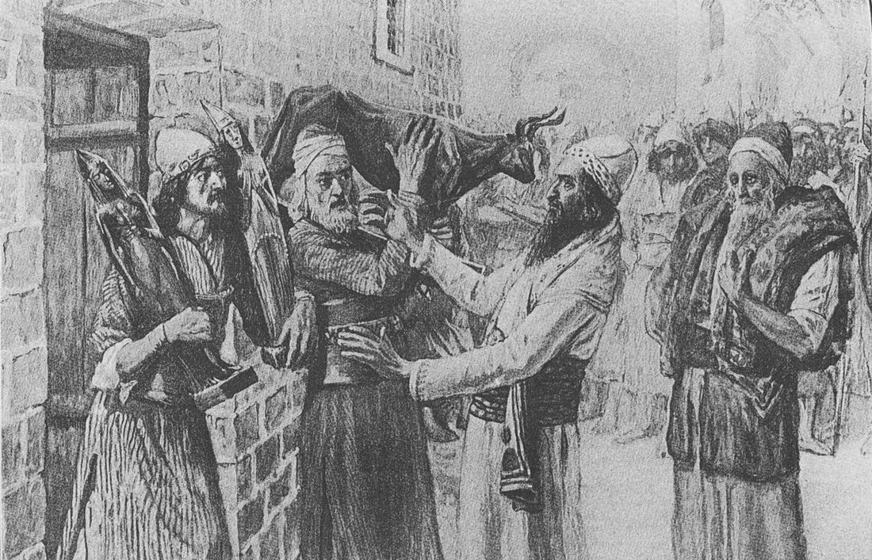
Messianic theme, former Prophets
⁶ “In those days there was no king in Israel. Everyone did what was right in his own eyes” Judges 17 [Before David]
³⁰ “The people of Dan set up the carved image for themselves, and Jonathan … and his sons were priests to the tribe of the Danites until the day of the captivity of the land.” Judges 18 [After David]

Slide 13
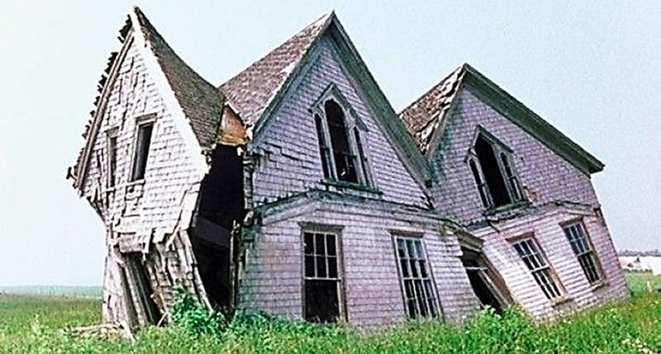
Messianic theme, former prophets
¹¹ “I will raise up the booth of David that is fallen … and rebuild it as in the days of old” Amos 9
¹⁶ “Your house and … kingdom shall be made sure forever before me. Your throne shall be established forever.” 2 Samuel 7
● Throne: Every Davidic king was a potential end-times Messiah.

Slide 14
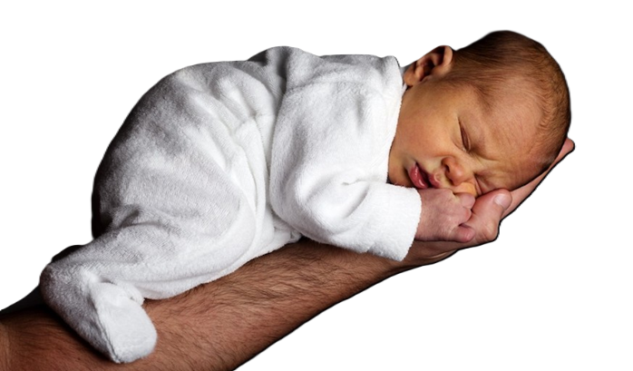
Messianic theme, Latter prophets
⁶ “To us a child is born, to us a son is given; and the government shall be upon his shoulder… ⁷ on the throne of David and over his kingdom … and forevermore.” Isaiah 9
¹ “Behold my servant, … my chosen …;
I have put my Spirit upon him; he will bring forth justice to the nations.” Isa 42

Slide 15
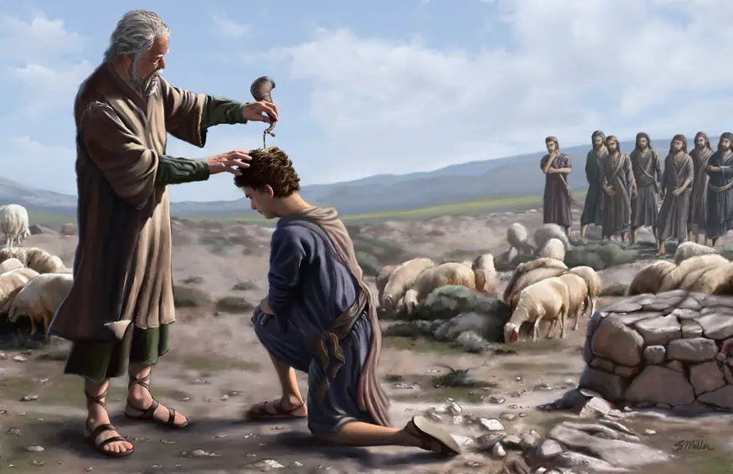
Messianic theme, Latter prophets
⁶ “My servant … to bring back … Israel;
I will make you as a light for the nations, that my salvation may reach to the end of the earth.” Isaiah 49
¹ “The Spirit of the Lord GOD is upon me … The LORD has anointed me ² to proclaim the year of … favor, and the day of vengeance of our God” Isaiah 61

Slide 16
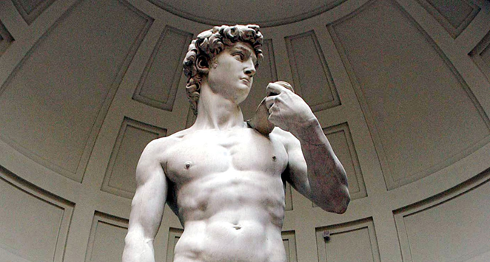
Messianic theme, Latter prophets
⁵ “I will raise up for David a righteous Branch, and he shall reign as king …
in the land.” Jer 23
⁹ “They shall serve the LORD their God and David their king.” Jer 30
³¹ “Behold, the days are coming, … when I will make a new covenant with … Israel and … Judah.” Jer 31

Slide 17
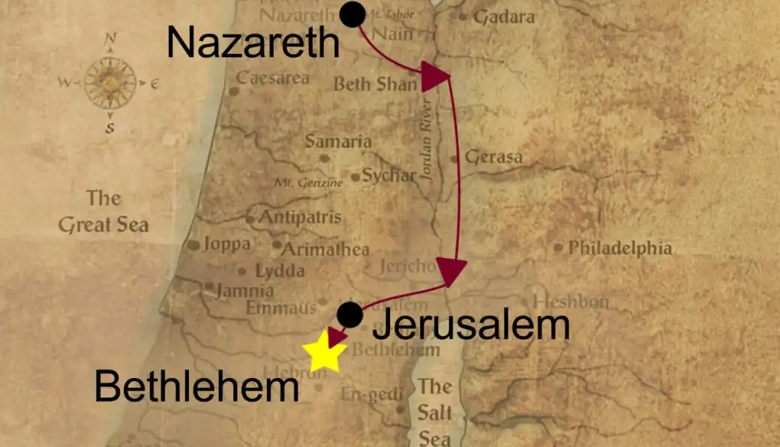
Messianic theme, Minor prophets
⁵ “The children of Israel shall return and seek the LORD their God, and David their king, … in the latter days” Hosea 3
² “Bethlehem …, from you shall come forth for me one who is to be ruler in Israel, whose coming is from old, from ancient days.” Micah 5

Slide 18
Messianic theme, Minor prophets
¹⁰ “I will pour out on the house of David and the inhabitants of Jerusalem a spirit of grace and pleas for mercy, so that, when they look on me, on him whom they have pierced, they shall mourn for him, as one mourns for an only child, and weep bitterly over him, as one weeps over a firstborn.” Zecharia 12
¹ “.” …

Slide 19
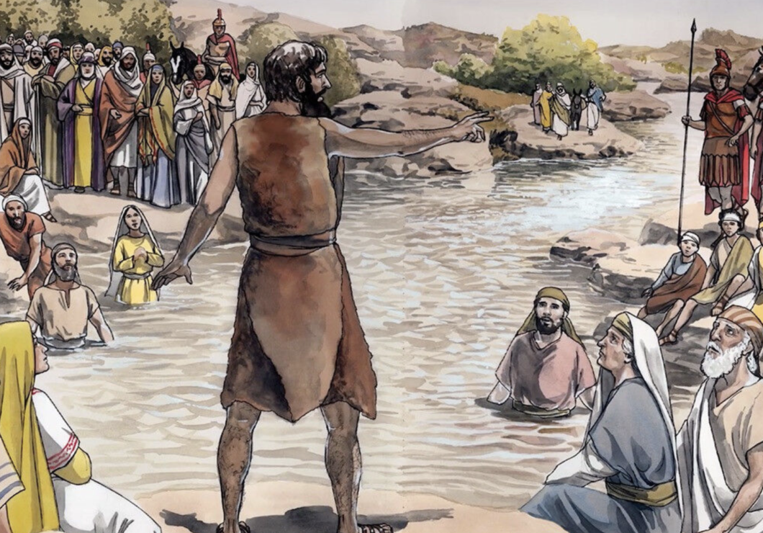
Messianic theme, Minor prophets
⁵ “Behold, I will send you Elijah the prophet before the great and awesome day of the LORD comes. ⁶ And he will turn the hearts of fathers to their children and the hearts of children to their fathers, lest I come and strike the land with a decree of utter destruction.” Malachi 4
¹ “.” …

Slide 20
Messianic theme, Writings
²⁷ “I will make him the firstborn, the highest of the kings of the earth. ²⁸ My [loyalty] I will keep for him forever.” Ps 89
²⁵ “I know that my Redeemer lives, and at the last he will stand upon the earth. ²⁶ And after my skin has been thus destroyed, yet in my flesh I shall see God.” Job 19

Slide 21
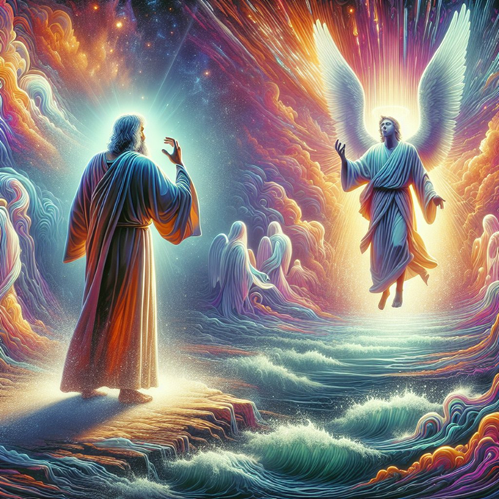
Messianic theme, Writings
¹³ “I saw in the night visions… with the clouds of heaven there came one like a son of man… ¹⁴ And to him was given dominion and glory and a kingdom, that all peoples, nations, and languages should serve him; his dominion is an everlasting dominion, which shall not pass away.” Daniel 7

Slide 22
7 Tentative Conclusions
● Tanach = Law + Prophets + Writings.
● Hebrew: Torah + Navi’im + Kethuvim.
● Written in Hebrew & inspired by God.
● Divided by time period and by size.
● Books had to have a messianic hope.
● Prophets expanded Torah’s messianism.
● The Tanach foresees a final Messiah.
● Every king was a potential final Messiah.

Slide 23
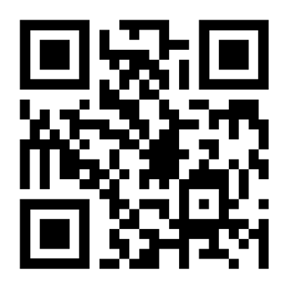
http://tanach.site

