Slide 1
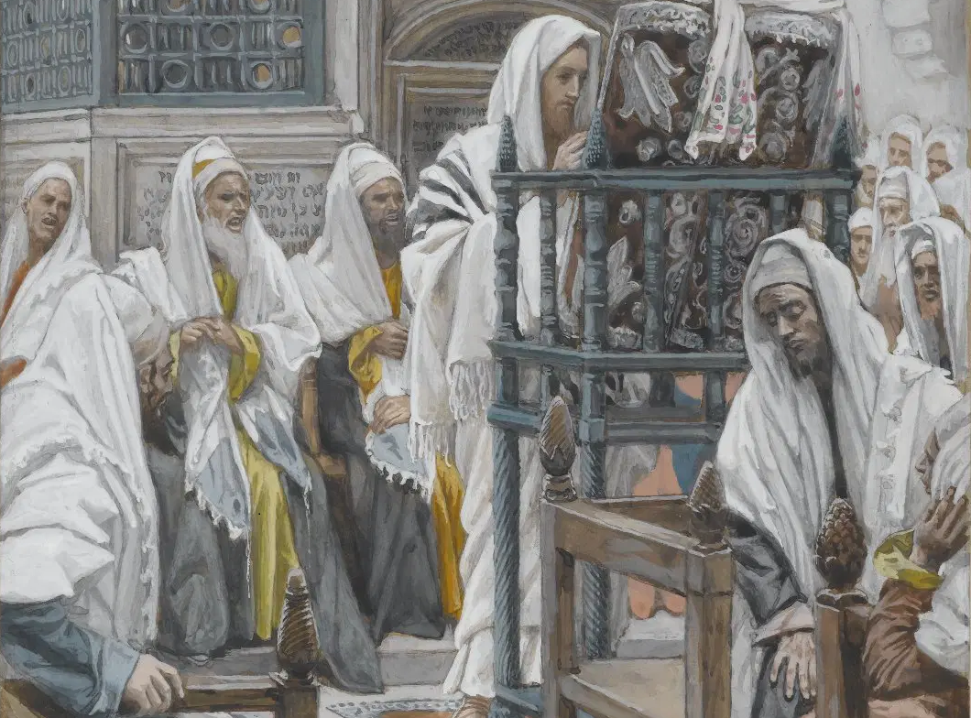
Messiah in the Tanach, 05
A Short Course for Men

Slide 2
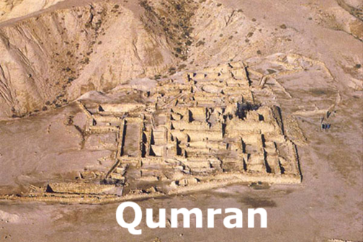
Second Temple Period Perspectives on Messiah in the Tanach
● The separatist Qumran community had clear messianic expectations.
● The orthodox Rabbis also had clear messianic expectations.
● Their texts borrow language and ideas from the Hebrew Tanach.
● Jews in Jesus’ day read these texts.

Slide 3
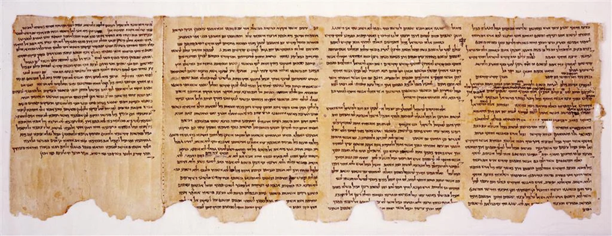
1QS IX 9–11 (Community Rule)
“...until the coming of the prophet and the Messiahs of Aaron and Israel.”
עַד בּוֹא הַנָּבִיא וּמְשִׁיחֵי אַהֲרוֹן וְיִשְׂרָאֵל
● Prophet:
● Messiahs:
● Aaron:
● Israel:
The (expected) prophet
Anointed (kings)
Priestly function
(Davidic) king

Slide 4
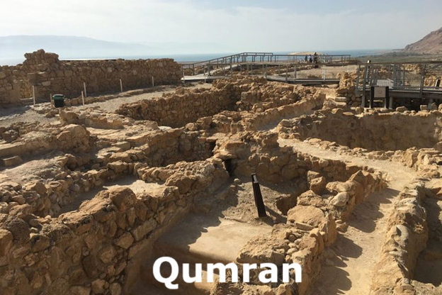
4Q285 (Fragment 5)
“And the King, the Messiah, will work vengeance upon his enemies…”
וְיַעֲשֵׂה הַמֶּלֶךְ הַמָּשִׁיחַ נְקָם בְּאֹיְבָיו
“And he will kill the prince of the congregation, the Branch of David…”
וְהִמְתּוּ נָשִׂיא הָעֵדָה צֶמַח דָּוִד

Slide 5
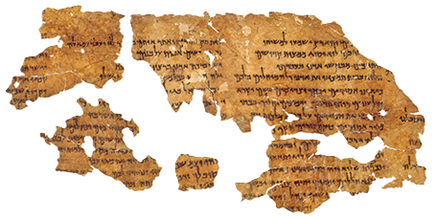
4Q521 (Messianic Apocalypse)
“He will heal the wounded, and revive the dead, and proclaim good news to the poor, and open the eyes of the blind.”
יְבַשֵּׂר עֲנָוִים וְיִפְקַח עִוְרִים יְבַשֵּׂר עֲנָוִים וְיִפְקַח עִוְרִים
● Heal:
● Revive:
● Proclaim:
● Open eyes:
Compare Isaiah 35 & 61
NT: John’s query to Jesus
NT: Jesus’ reply to John
NT: Jesus’ final miracle

Slide 6
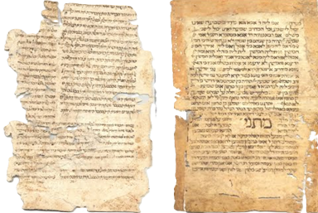
Talmud: Sanhedrin 98b
Rabbi Ḥanina said: “The name of the Messiah is Menachem ben Ḥizkiyah.”
Rabbi Yehudah says: “His name is Shiloh, as it is said, ‘Until Shiloh comes’ (Genesis 49:10).
● The Tannaitic period (roughly 10–220 CE) preserved in the Mishnah, Tosefta, and early strata of the Talmud.

Slide 7
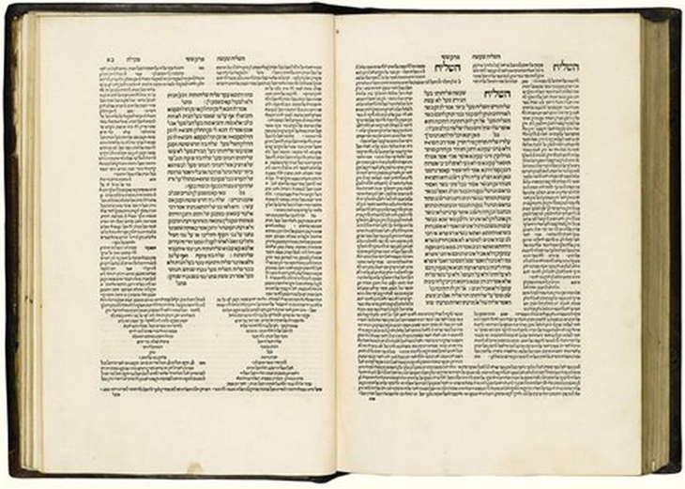
Talmud: Berakhot 34b
Shmuel said: “The only difference between this world and the days of the Messiah is [the end of] subjugation to foreign kingdoms.”
אמר שמואל: אין בין העולם הזה לימות המשיח אלא שעבוד מלכויות בלבד
● Not a miraculous overhaul of nature but a political transformation.

Slide 8
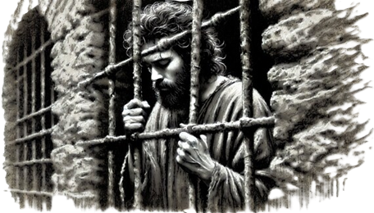
John the Baptizer (Mt 11 ESV 2016)
³ Now when John heard in prison about the deeds of the Christ, he sent word by his disciples and said to [Jesus],
“Are you the one who is to come, or shall we look for another?”
● Heard:
● The one:
● Another:
About Jesus’ miracles
The end-times Messiah
Who would conquer

Slide 9
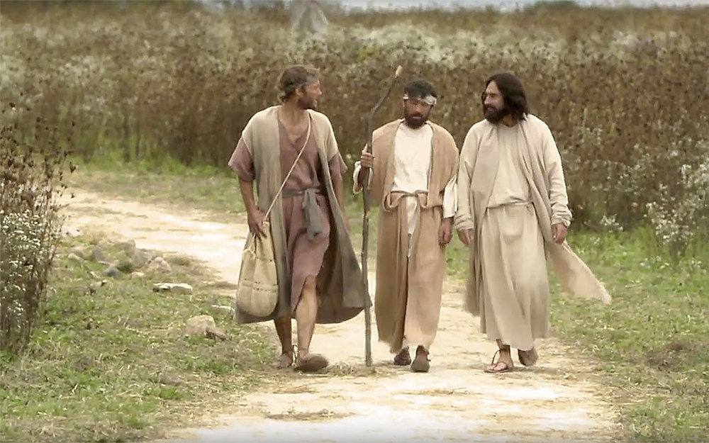
Jesus About Himself (ESV 2016)
²⁶ Was it not necessary that the Messiah should suffer these things and enter into his glory?”
²⁷ And beginning with Moses and all the Prophets, he interpreted to them in all the Scriptures the things concerning himself. Luke 24
● Necessary:
● Interpret:
Scripture must come true.
Needed perspective.

Slide 10
Jesus About Himself (ESV 16)
⁴⁴ “I spoke to you while I was still with you, that everything written about me in the Law of Moses and the Prophets and the Psalms must be fulfilled.”
⁴⁵ Then he opened their minds to understand the Scriptures… Luke 24
● Written:
● Opened:
Law, Prophets, Writings
Not only to political parts

Slide 11
Jesus About Himself (Lk 24 ESV 16)
⁴⁶ “Thus it is written, that the [Messiah] should suffer and on the third day rise from the dead,
⁴⁷ and that repentance for the forgiveness of sins should be proclaimed in his name to all nations.
● Dead:
● Nations:
Messiah had to die & rise.
Must be done before Messiah will bring worldwide peace.

Slide 12
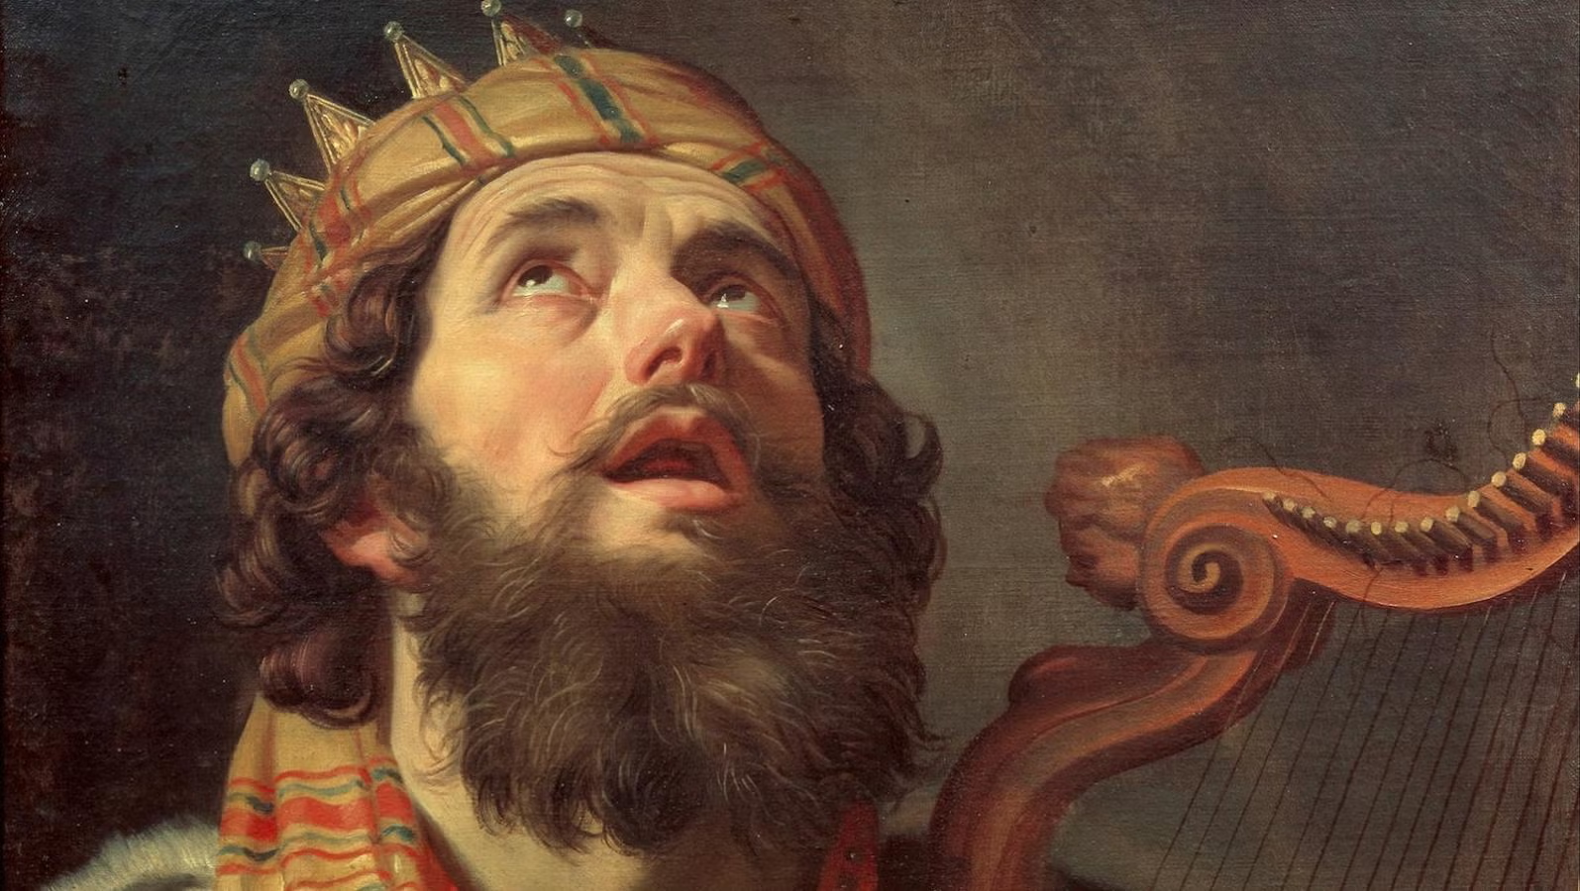
Psalm 16 (NJPS 1985)
¹⁰ For You will not abandon me to Sheol,
or let Your faithful one see the Pit.
¹¹ You will teach me the path of life.
In Your presence is perfect joy.
● Sheol:
● Pit:
● Life:
● Joy:
Place where the dead go.
A physical grave or tomb.
Opposite of death.
Place where the living go.

Slide 13
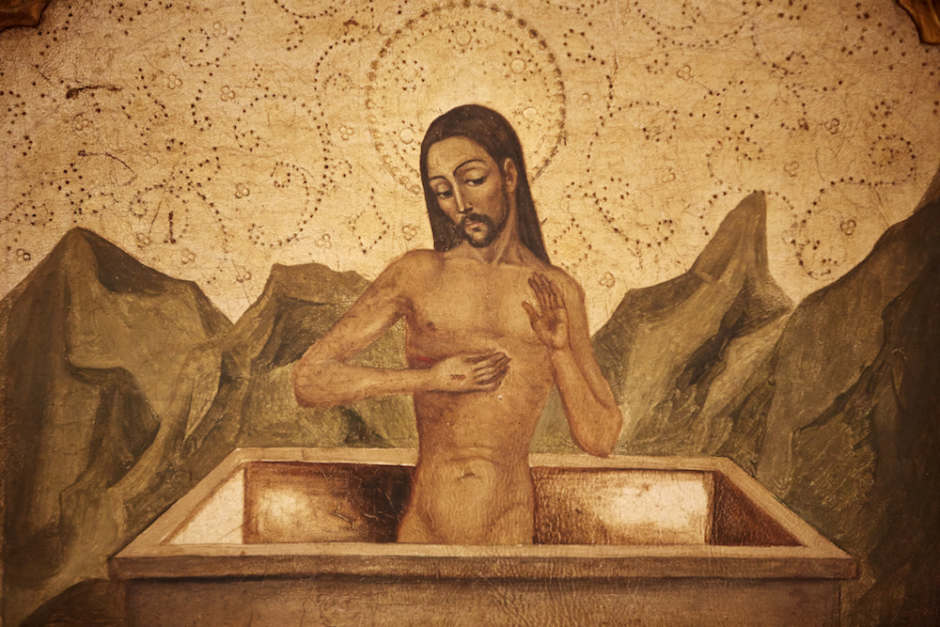
Peter (Acts 2, re: Psa 16)
²⁹ The patriarch David … ³⁰ being
a prophet, and knowing that God had sworn with an oath …
³¹ foresaw and spoke about the resurrection of the [Messiah], that he was not abandoned to Hades, nor did his flesh see corruption.
● Resurrection:
● Hades:
Messiah would rise.
He would first die.

Slide 14
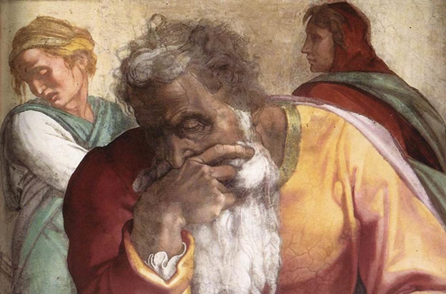
Peter (1 Pet 1 ESV 2016)
¹⁰ The prophets who prophesied about the grace that was to be yours searched and inquired carefully,
¹¹ inquiring what person or time the Spirit of [Messiah] in them was indicating when he predicted the sufferings of [Messiah] and the subsequent glories.
● He:
The LORD’s Spirit was foretelling.

Slide 15
Psalm 110 (NJPS 1985)
¹ The LORD said to my lord,
“Sit at My right hand
while I make your enemies your footstool.”
נְאֻ֤ם יְהֹוָ֨ה ׀ לַֽאדֹנִ֗י שֵׁ֥ב לִֽימִינִ֑י עַד…
● LORD:
● lord:
● while:
YHWH, God’s proper name.
’adon, title of superior rank.
‘ad, or ‘until’.

Slide 16
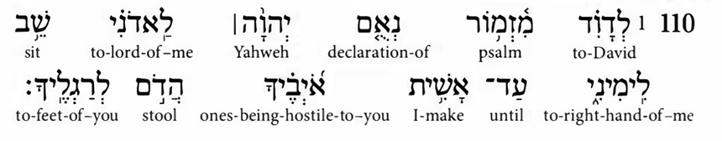
Psalm 110 in the NT (Matt 22 ESV)
⁴² “What do you think about the [Messiah]? Whose son is he?” They
said to him, “The son of David.”
⁴⁵ If then David calls him Lord, how is he his son?”
● Lord:
● Son:
’adoni = ‘my lord’ ≠ ’Adonay, but identical consonants: ’dny
Hebraism = ‘descendent’

Slide 17
Peter (Acts 2 ESV 2016)
³³ Exalted at the right hand of God…
³⁴ David did not ascend into the heavens …
³⁶ God has made him both Lord and Christ, this Jesus whom you crucified.”
● Exalted:
● David:
● Lord:
Psalm 110.1, ‘Sit @ right hand.’
Died and went into Sheol.
Post-exaltation.

Slide 18
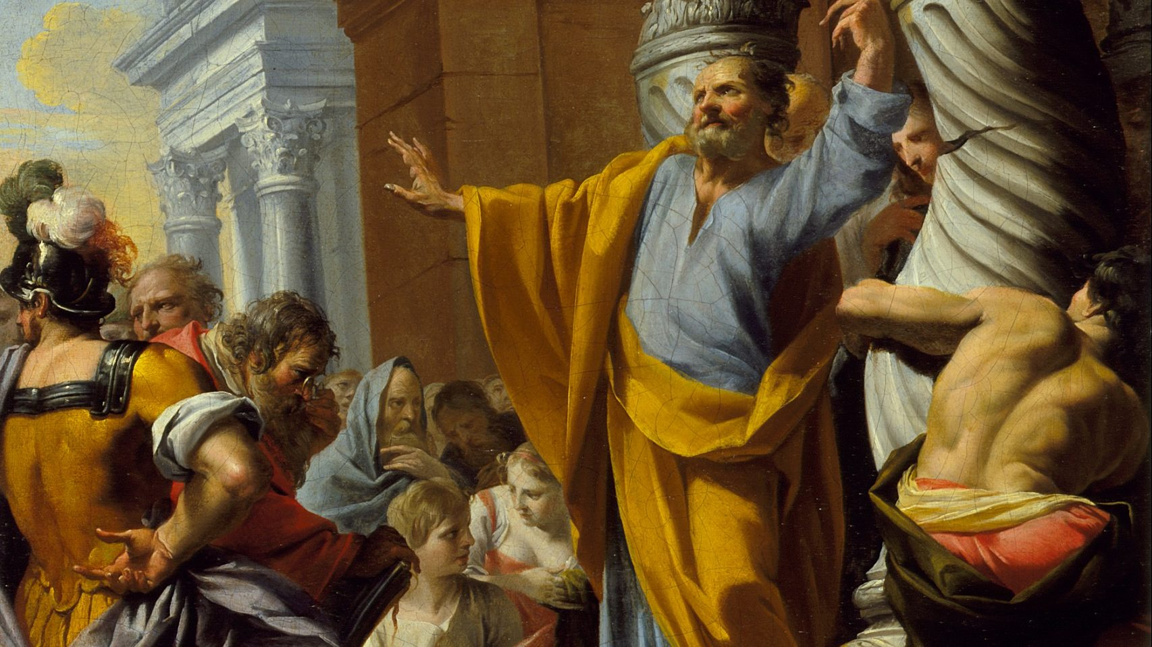
Peter (Acts 3 ESV 2016)
¹⁸ What God foretold by the mouth of all the prophets, that his [Messiah] would suffer, he thus fulfilled.
¹⁹ Repent therefore… ²⁰ that he may send the [Messiah] appointed for you, Jesus, whom heaven must receive until the time for restoring all the things.

Slide 19
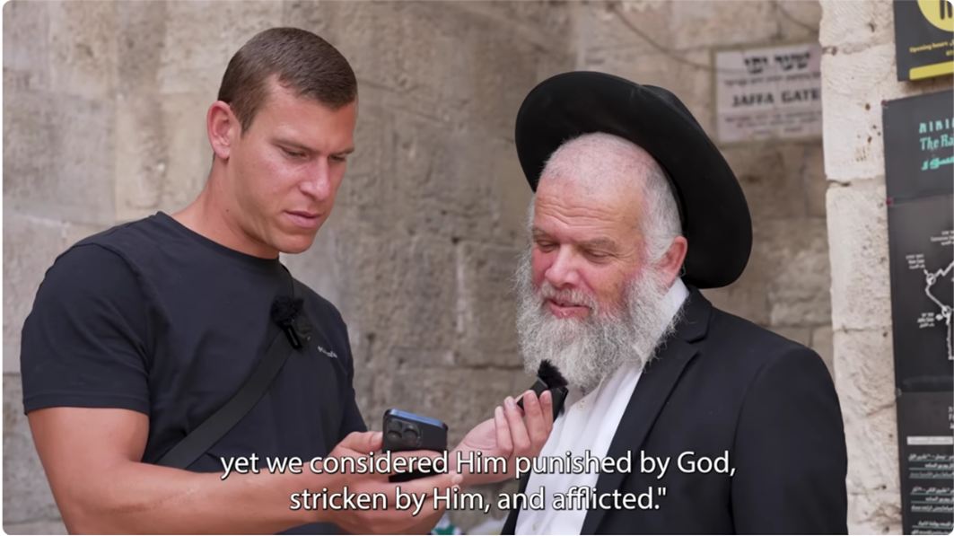
Isaiah 53 (NJPS 1985)
⁷ He was maltreated, yet he was submissive, …
Like a sheep being led to slaughter, … He did not open his mouth.
⁸ By oppressive judgment he was taken away, …
For he was cut off from the land of the living…

Slide 20
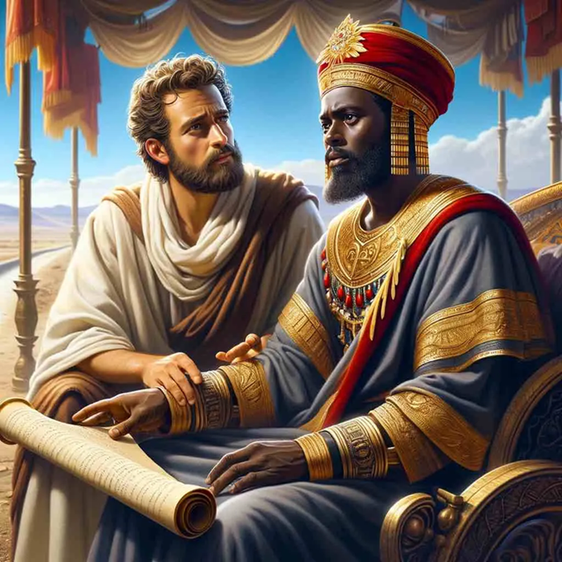
Philip (Acts 8 ESV 2016)
³⁴ The eunuch said to Philip, “About whom, I ask you, does the prophet say this, about himself or about someone else?”
³⁵ Philip opened his mouth, and beginning with this Scripture he told him the good news about Jesus.
● Prophet:
● Scripture:
Isaiah
53:7-8 LXX Greek version

Slide 21
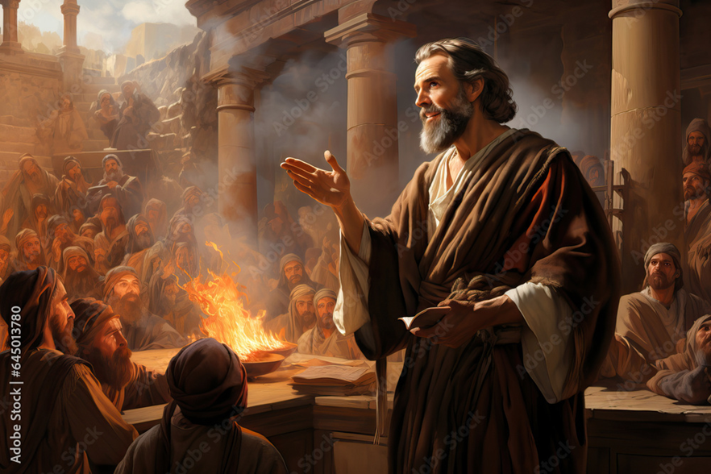
Paul (Acts 17, ESV 2016)
¹ There was a synagogue of the Jews.
² And Paul went in, as was his custom, and on three Sabbath days he reasoned with them from the Scriptures,
³ explaining and proving that it was necessary for the [Messiah] to suffer and to rise from the dead.

Slide 22
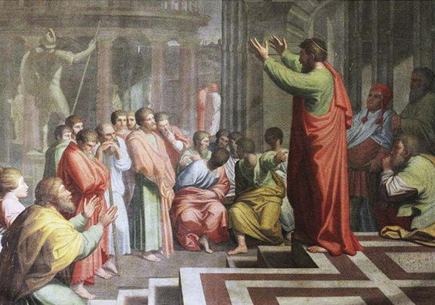
Appolos (Acts 18, ESV 2016)
²⁴ Apollos, a native of Alexandria, came to Ephesus. He was an eloquent man, competent in the Scriptures.
²⁷ When he arrived, he greatly helped those who through grace had believed, ²⁸ for he powerfully refuted the Jews in public, showing by the Scriptures that the [Messiah] was Jesus.

Slide 23
Conclusion
● Skeptics accuse Jesus, his apostles, or the NT writers of fabricating their reports of Jews responding to Jesus’ messianic pretensions.
● More likely, 2nd temple era Jews held the entire Tanach to be both predictive and messianic.

Slide 24
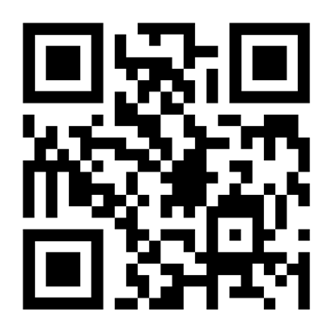
http://tanach.site

