Slide 1
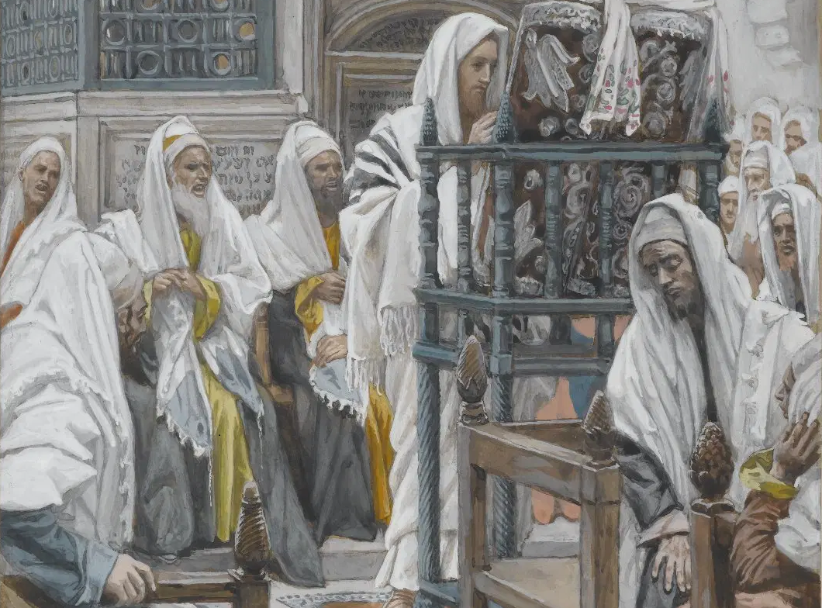
Messiah in the Tanach, 06
A Short Course for Men

Slide 2

Queries
● Did NT writers quote the Tanach with original authors’ intended meaning?
● Did NT writers force their own meanings onto the Tanach?
● Did NT writers employ a Jewish ‘midrashic’ method of interpretation?
● Are NT writers’ quotations from the Tanach valid?

Slide 3
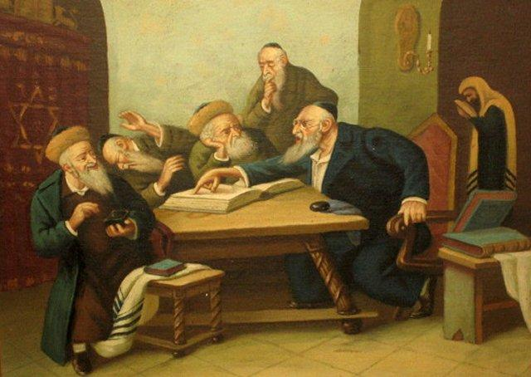
Midrash
To interpret texts allegorically*, or parts of sentences or atomistically**, without regard to context, to historical occasion, or to authors’ intent, thus turning history or poetry into predictive prophecies.
*Assigning unrelated meanings.
**Single letters, words, or phrases

Slide 4
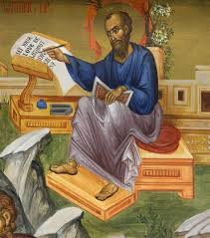
New Testament Midrash?
Some conservative scholars defend midrashic interpretation by asserting:
● The Holy Spirit guided NT authors
to assign messianic meanings to the Tanach for our edification.
● NT authors employed midrashic methods because their Jewish readers considered this to be acceptable.

Slide 5
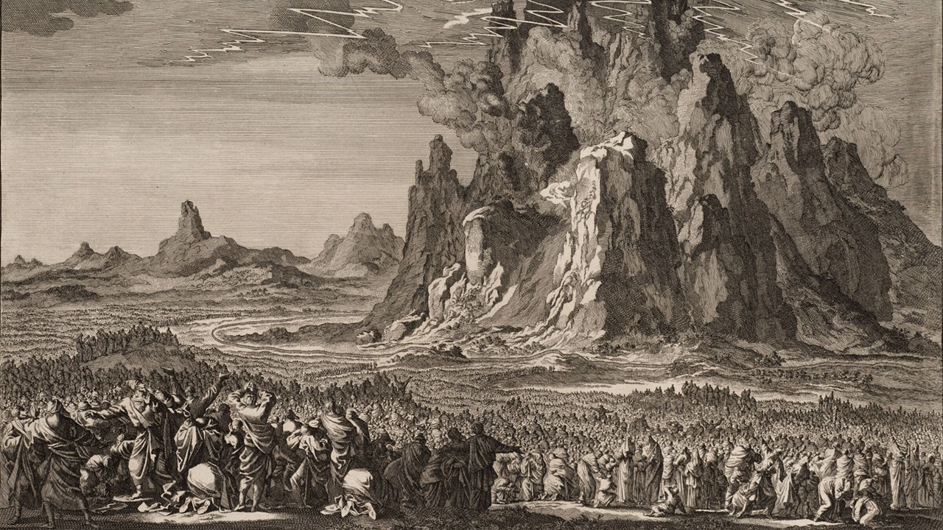
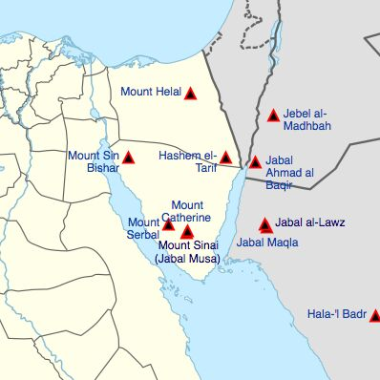
New Testament Allegory
Now this is an allegory: these women are two covenants… Hagar is Mount Sinai in Arabia and corresponds to the present Jerusalem,
for she is in slavery with her children.
But the other woman corresponds to the Jerusalem above; she is free, and she is our mother.
Galatians 4:24-26

Slide 6
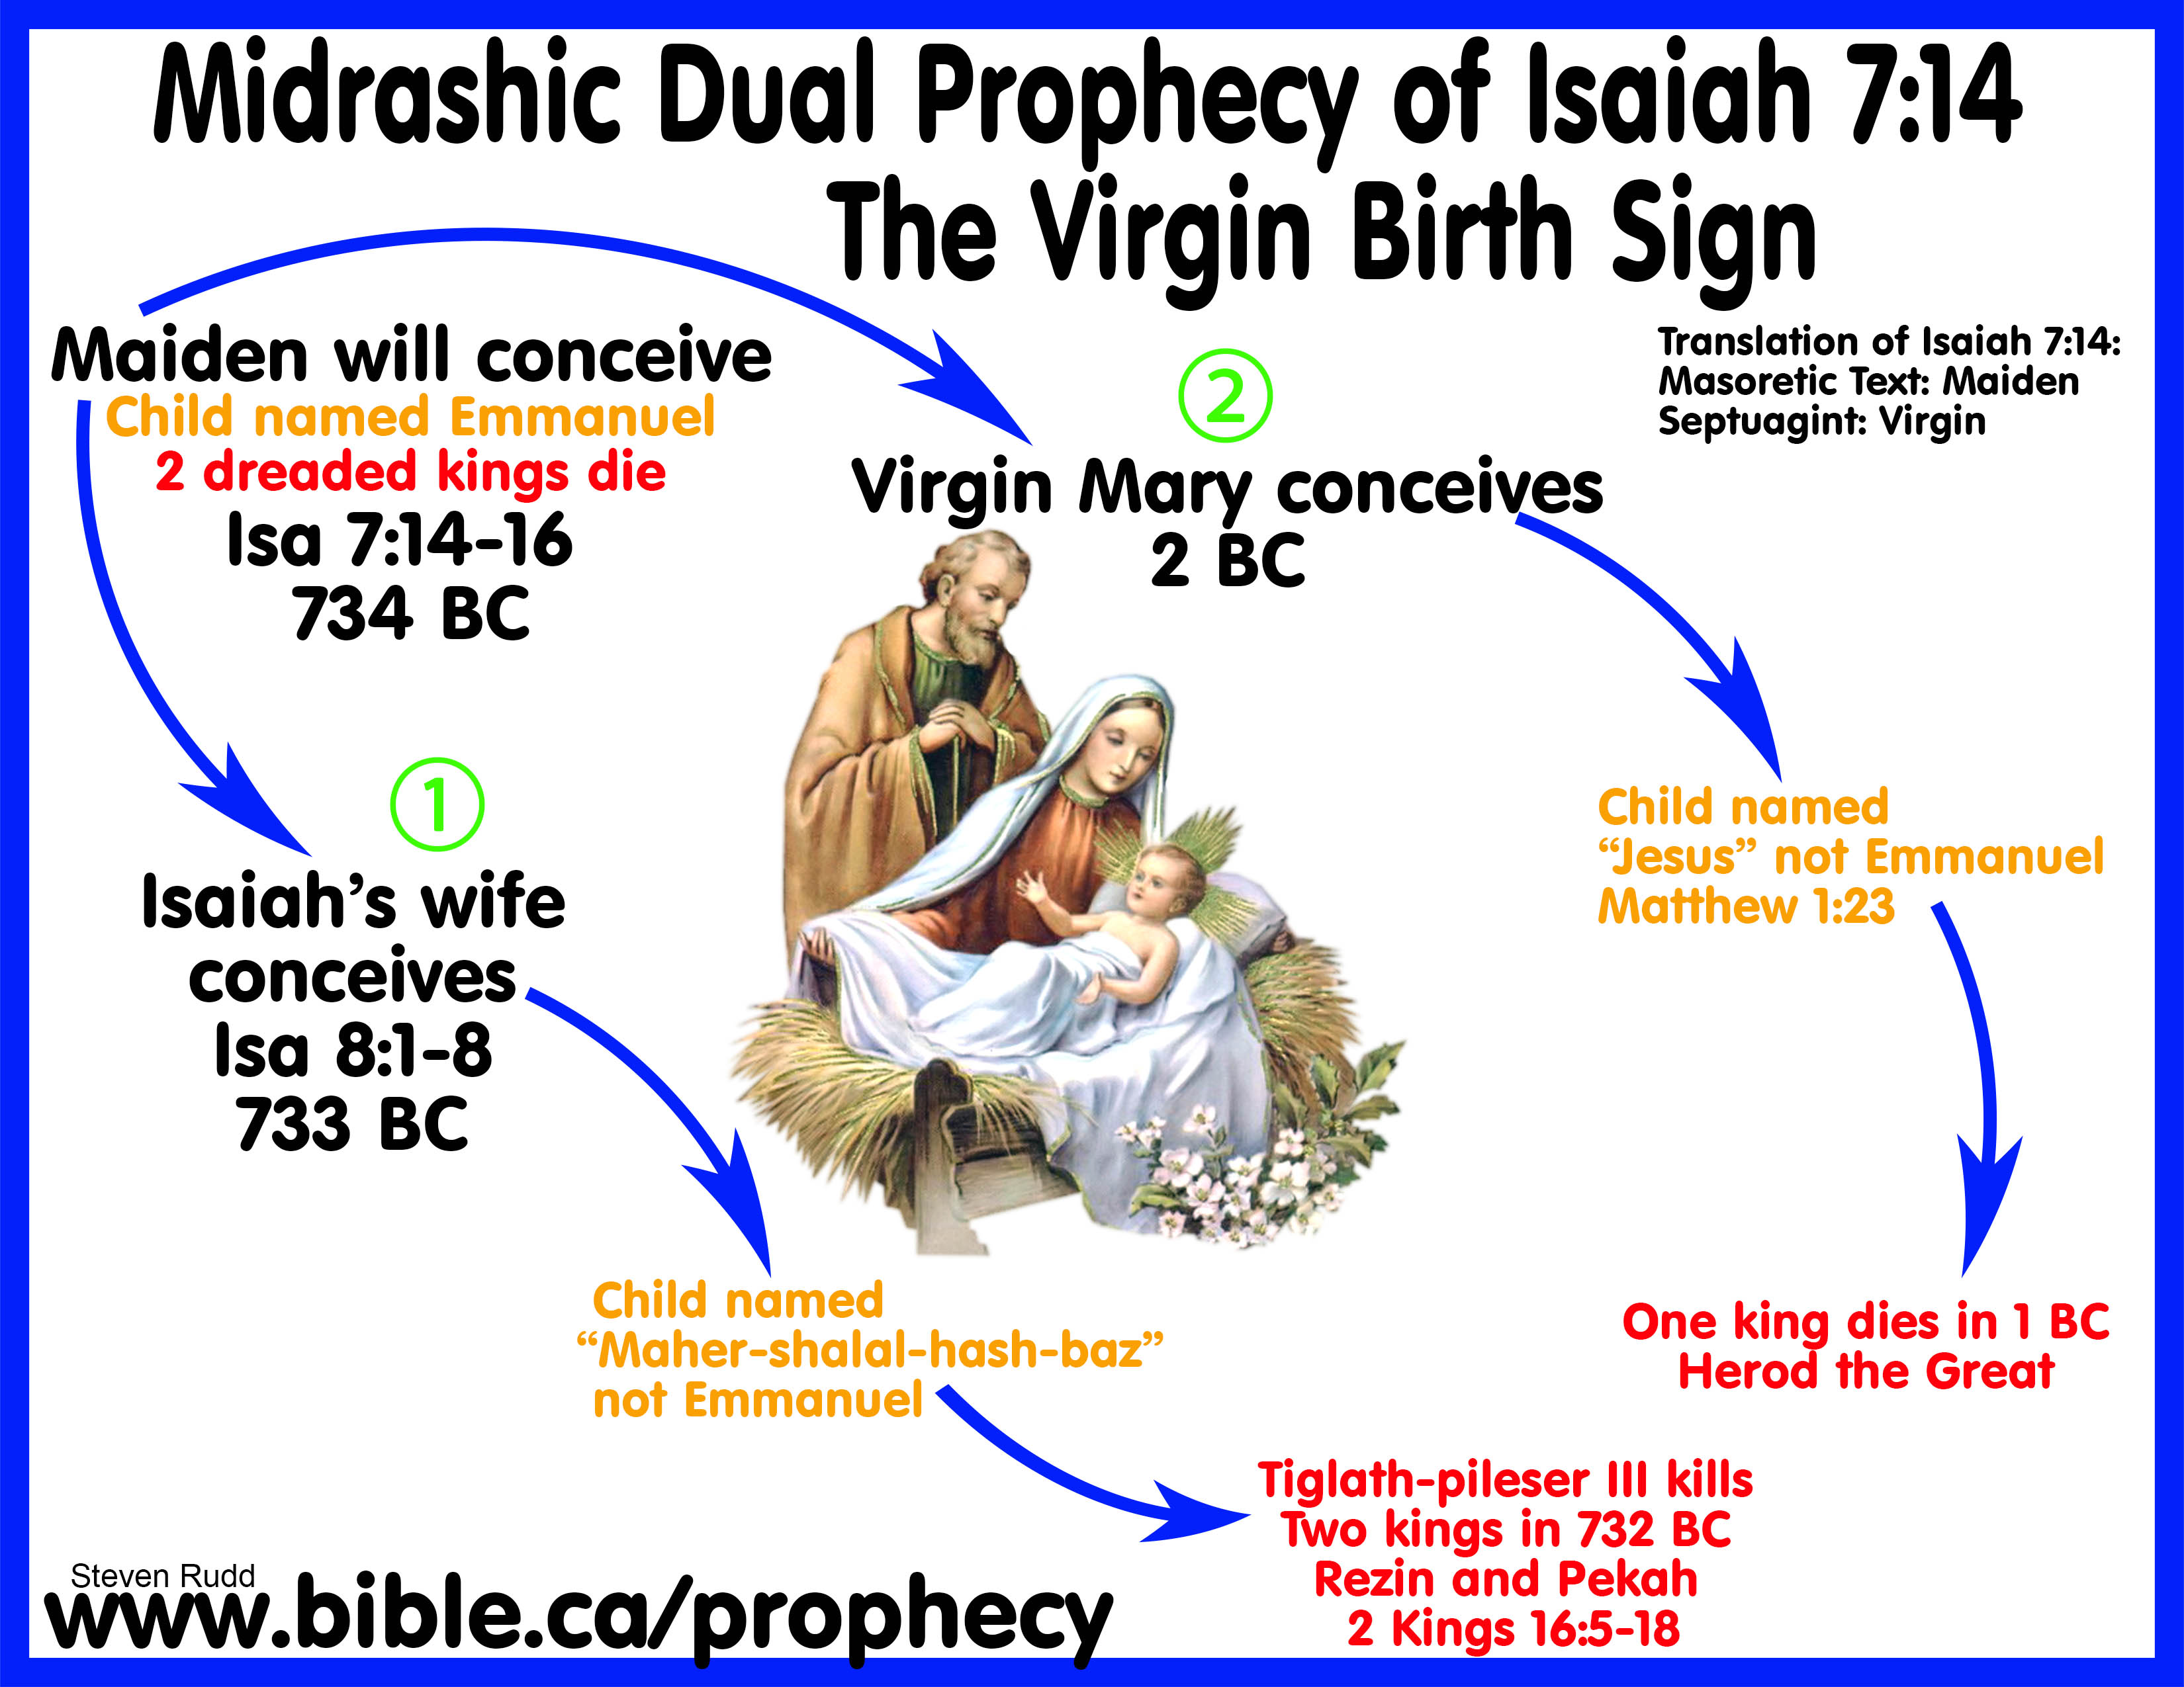
Four NT Messianic Interpretations
● Direct fulfillment:
Micah 5:2 in Matt 2:5
● Typical fulfillment:
Hosea 11:1 in Matthew 2:15
● Applicational fulfillment:
Jeremiah 31:15 in Matthew 2:16
● Summary fulfillment:
No specific text in Matthew 2:19-23

Slide 7
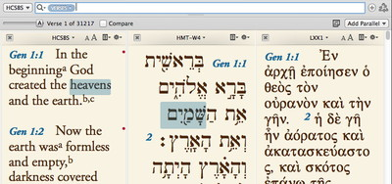
Bible versions in this session
Tanach: New Jewish Publication Society Translation, 1985.
Biblia Hebraica Stuttgartensia: Eds. Karl Elliger et al., 1968-1998.
Septuagint: LXX, ed. Alfred Rahlfs, 1935.
New Testament: New Revised Standard Version Updated Edition, 2022.
Novum Testamentum Graece: 28th edition. Eds. Kurt Aland et al., 2012.

Slide 8
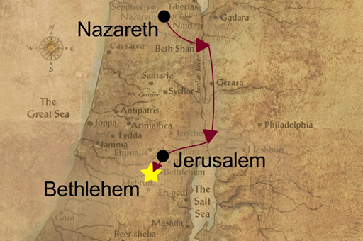
Direct fulfillment
And you, O Bethlehem of Ephrath,
Least among the clans of Judah,
From you one shall come forth
To rule Israel for Me—
One whose origin is from of old,
From ancient times.
Micah 5:2 [Hb. 5:1] NJPS

Slide 9
Direct fulfillment
‘And you, Bethlehem, in the land of Judah,
are by no means least among the rulers of Judah,
for from you shall come a ruler
who is to shepherd my people Israel.’
Matthew 2:5 NRSVue

Slide 10
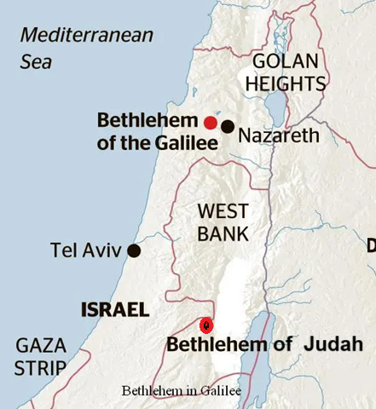
Two Bethlehem towns
● Ephrath was in the fertile Judean hill country, near the main trade route.
● Bethlehem of Judea/Ephrath lies 10 km (6 miles) south of Jerusalem.
● Not Bethlehem of Galilee (in Zebulun), near Nazareth in the north, mentioned in Joshua 19:15 as part of the tribal allotments.

Slide 11
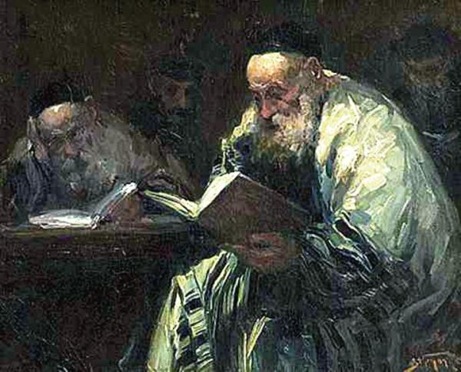
Messianic Bethlehem
● Targum Pseudo-Jonathan [7th to 12th centuries CE] on Gen 35.21 = Migdal Edar (‘flock tower’) = “the place from whence the Messiah shall be revealed in the last days.”
● Jerusalem Talmud, Berakoth 5a states, “The King Messiah … From the royal city of Bethlehem in Judah.”

Slide 12
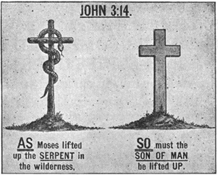
Typical fulfillment
● Types are not common in the NT.
● ‘A light to the nations’ (Isa 49:6) a type of Jesus in Acts 13:47.
● Melchizedek (Psalm 110:4) a type of the Son of God (messiah) in Hebrews 7:1-3.
● Types are identified as such in the NT.
● Similarities are not necessarily types.

Slide 13

Typical fulfillment
I fell in love with Israel
When he was still a child;
And I have called [him] My son
Ever since Egypt. NJPS
When Israel was a child, I loved him,
and out of Egypt I called my son. NRSVue
Hosea 11:1

Slide 14
Typical fulfillment
● “Thus says יהוה: Israel is My first-born son.” NJPS Exodus 4:22-23
● Balaam: “Their King’s acclaim in their midst. … God who freed them [Heb. ‘him’] from Egypt… Their ruler shall rise… They shall devour enemy nations.”
● Israel had no king at that time.

Slide 15
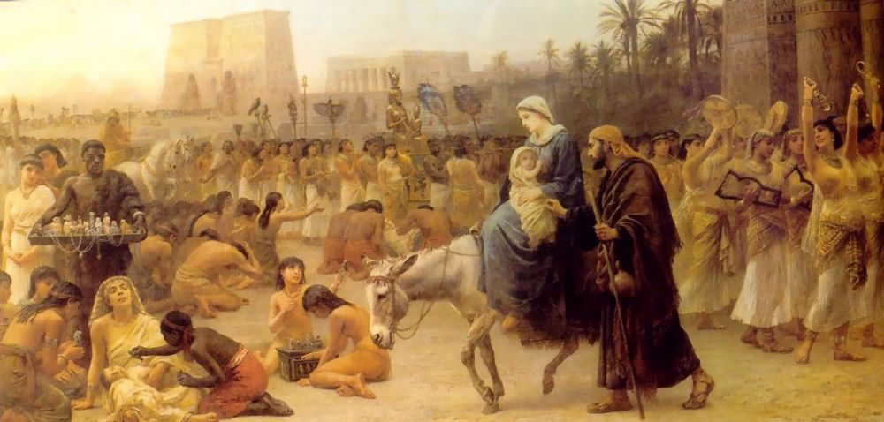
Typical fulfillment
Then Joseph got up, took the child and his mother by night, and went to Egypt and remained there until the death of Herod.
This was to fulfill what had been spoken by the Lord through the prophet, “Out of Egypt I have called my son.”
Matthew 2:14-15

Slide 16
Applicational fulfillment
Thus said GOD:
A cry is heard in Ramah—
Wailing, bitter weeping—
Rachel weeping for her children.
She refuses to be comforted
For her children, who are gone.
Jeremiah 31:15 NJPS

Slide 17
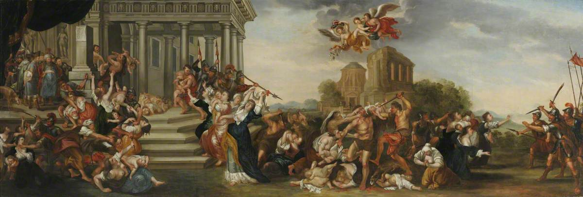
Applicational fulfillment
“Then what had been spoken through the prophet Jeremiah was fulfilled:
‘A voice was heard in Ramah,
wailing and loud lamentation,
Rachel weeping for her children;
she refused to be consoled,
because they are no more’.”
Matthew 2:17-18 NRSVue

Slide 18
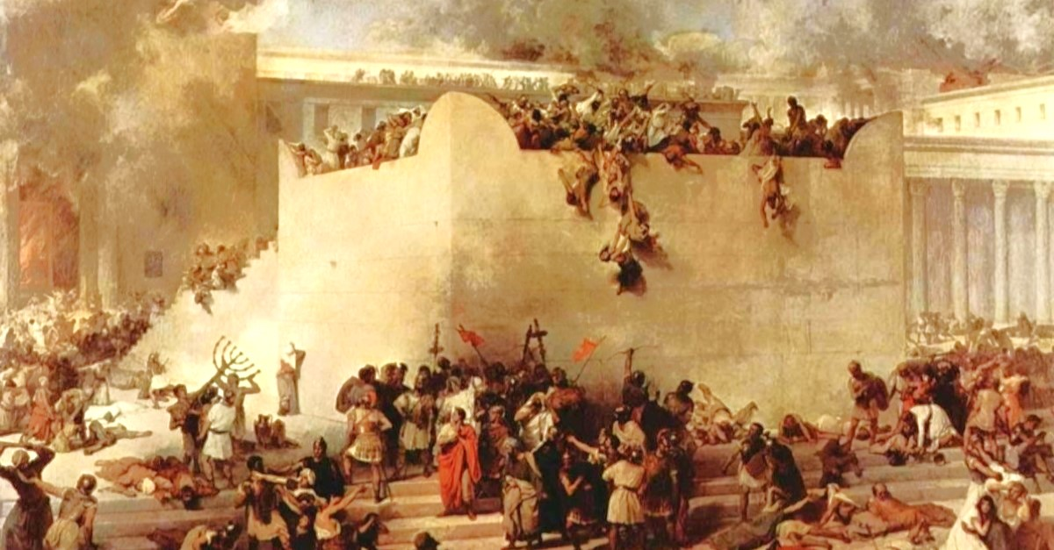
Jeremia 31
● Jeremia was speaking about the far future: “He who scattered Israel will gather him, and will keep him” (v. 10).
● He stopped to weep over Israel’s dead and exiled young people.
● Spoke of Rachael as Israel’s ancestral mother (birthed Joseph and Benjamin).
● Matthew knew Jeremiah’s context.

Slide 19
Applicational fulfilment
● Proto-rabbinic use of scripture paid attention to context and true meaning.
● Midrash was a medieval (CE) method, meant to show continued relevance of scripture.
● Applicational fulfilment is the most common interpretive method used in the New Testament.

Slide 20
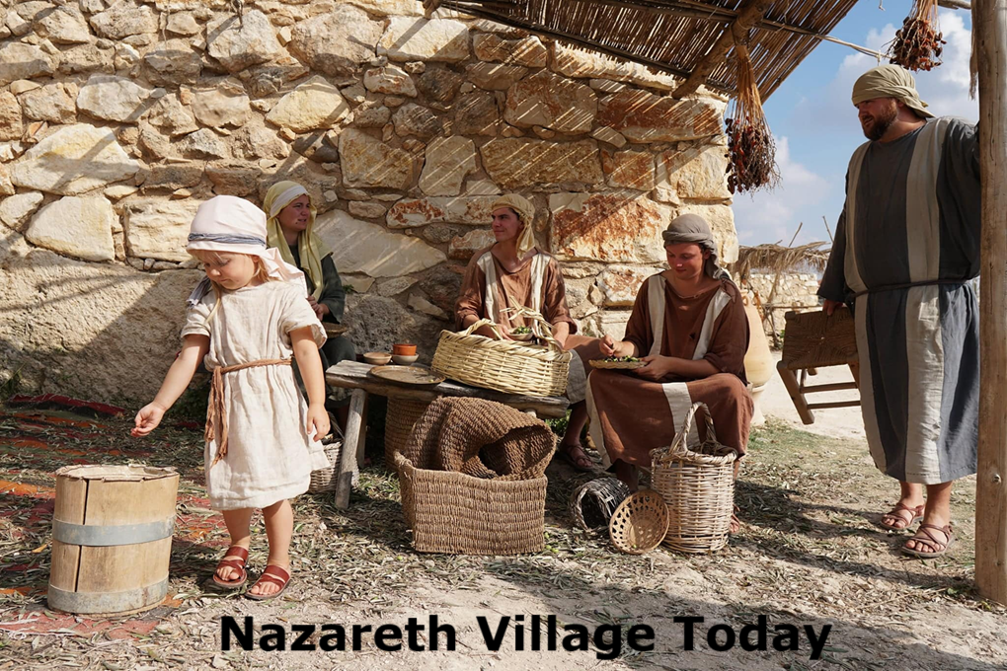
Summary fulfillment
And after being warned in a dream, he went away to the district of Galilee.
There [Joseph] made his home in a town called Nazareth, so that what had been spoken through the prophets might be fulfilled, “He will be called a Nazarene.”
Matthew 2:22b-23 NRSVue
● There is no such verse in the Tanach.

Slide 21
Summary fulfillment
● Prophets: plural. All other quotes in Matthew reference a single prophet.
● Quote: All other prophetic quotes in Matthew are introduced by ‘saying’.
● Branch? neṣer (Isa 11:1). But there is no mention of branch here.
● Nazarite? nāzîr (Jud 13:7). = Samson. Different root Nazareth (nṣrt).

Slide 22
Summary fulfillment
● In Matthew’s day, ‘Nazarene’ was a term of derision. ‘Hick, bumkin, peasant.’
● “This man was with Jesus the Nazarene.” Matt 26:71 NRSVue
● “Can anything good come out of Nazareth?” John 1:46
● “No prophet is to arise from Galilee.” Jn 7:52

Slide 23
Summary fulfillment
● “A pack of evil ones [maul] my hands and feet.” NJPS Psalm 22.17 [En 22.16]
● “You know my reproach, my shame, my disgrace” Psalm 69.20 [En 69.19]
● “Thus said GOD… To the despised one.” Isaiah 49:7
● “He was despised, shunned by others, A man of suffering.” Isaiah 53:3

Slide 24
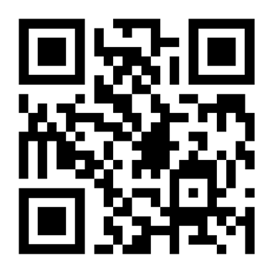
http://tanach.site

