Slide 1
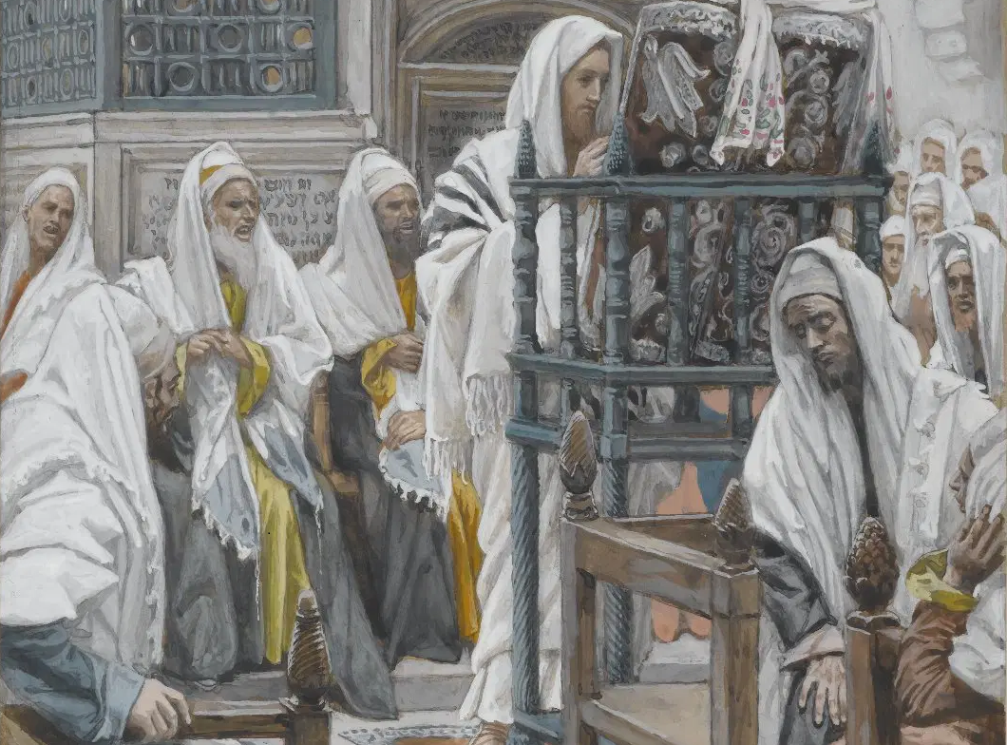
Messiah in the Tanach, 07
A Short Course for Men

Slide 2
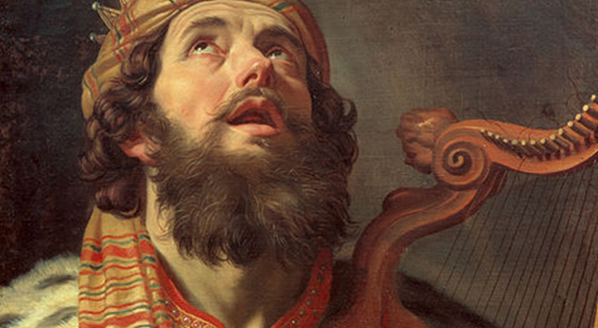
Psalm 22:16
“A company of evildoers encircles me; they have pierced my hands and feet.” NRSVue (2022)
“A pack of evil ones closes in on me,
like lions [they maul*] my hands and feet.” NJPS (1985)
*Note: “With Rashi; cf. Isa. 38.13”.

Slide 3
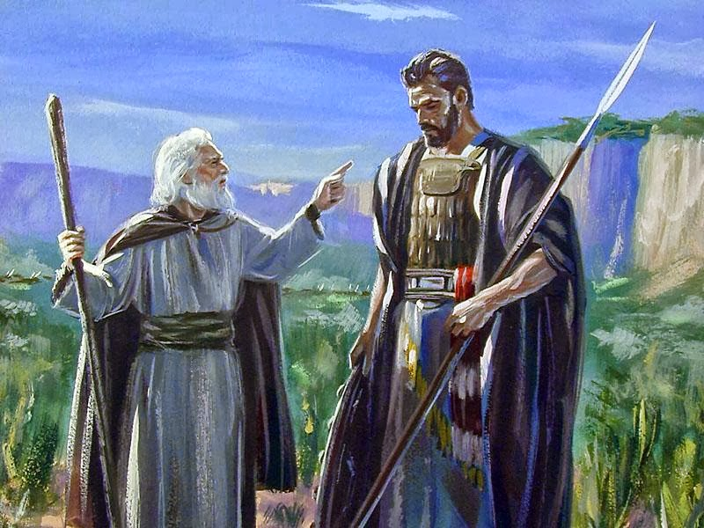
Isaiah 7:14
“The Lord himself will give you a sign. Behold, the virgin shall conceive and bear a son.” NRSVue (2022)
“Look, the young woman is with child and about to give birth to a son.” NJPS (1985)
● When were these predictions fulfilled?

Slide 4
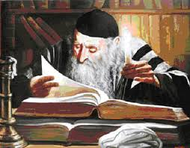
Who was Rashi (רש"י)?
● Rabbi Shlomo (Soloman) Yitzhak
● Salomon ben Isaac de Troyes
● Circa 22 February 1040 – 13 July 1105.
● Wrote commentaries on the Tanach.
● Using Hebrew, Aramaic & (old) French.
● Wrote commentaries on the most of the Babylonian Talmud.
● Included in all printed Talmuds.

Slide 5

Sensus Plenior (‘fuller meaning’)
● Future (of messiah) or historical?
● Dual fulfillment? (near and far term)
● Typical? (similar far-term fulfillment)
● Midrashic? (arbitrary assertion)
● Medieval and later rabbis.
● Rationalist, anti-supernaturalist.
● Certain Catholics and Protestants.
● Why?

Slide 6
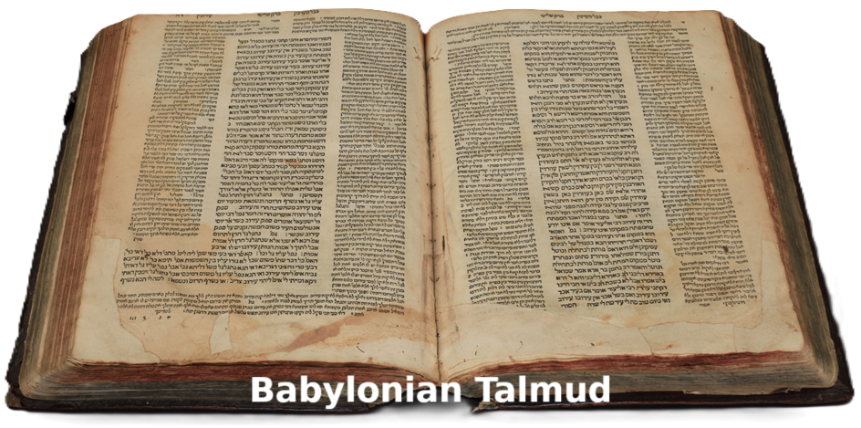
Classic rabbinical PRDS methods
P peshat = simple, i.e., plain meaning.
R remez = hint, allusion to other texts.
D derash = search, i.e., political relevance & application.
S sod = secret, ie mystical interpretation.
● In the Babylonian Talmud, Shabbat 63a, Rashi comments, “A verse cannot depart from its plain meaning (pashat).”

Slide 7
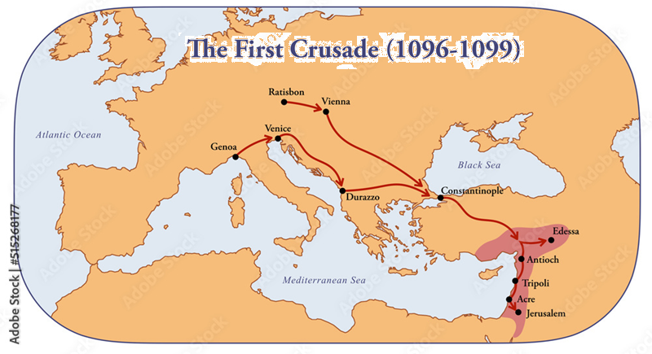
11th century France
● Jews and Catholics enjoyed cordial social and economic relations.
● Until the 1st French crusade in 1096 CE.
● Jewish-Christian debates intensified, and religious tractates were published.
● Stupid crusaders destroyed Moslems, Jews and eastern Christians, alike.
● Jewish communities were in distress.

Slide 8
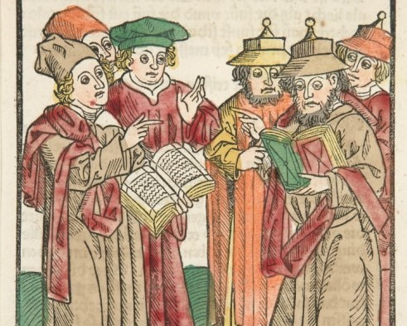
Jewish-Christian debates
● Was Jesus the awaited Messiah?
● Christians appealed to allegory.
● Rashi appealed to the biblical text.
● When dealing with Christians, Rashi equated plain meaning (peshat) with historical fulfillment.
● With persecuted Jews, he taught “the future hope of the Jewish people.”

Slide 9
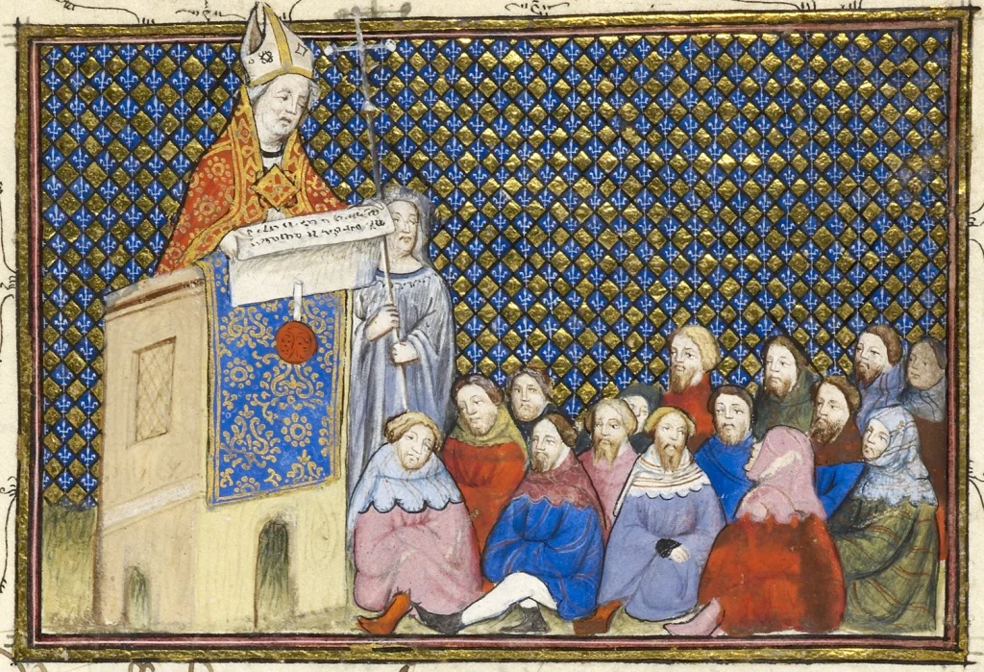
Jewish-Christian debates
● Passages which Christians related to Jesus’ first coming, Rashi interpreted as fulfilled before Jesus’ lifetime.
● Rashi combined peshat with derash. Thus, the child born to Ahaz’ ‘young woman’ became the crown prince.
● Other passages he relates to a yet unfulfilled future for national Israel.

Slide 10

Tanach: “And a shoot shall spring forth from the stem of Jesse, a twig from his roots.” Isaiah 11:1
Rashi: “If you say, ‘The glory has ceased and the dominion has departed from the house of David,’ know that it is not so. Rather, a shoot shall spring forth from the stem of Jesse.” Comm. Isa. 11.1

Slide 11

Since Rashi
● Jewish commentators reject midrash for peshat, interpreted to be fulfilled historically by Israel or by David, otherwise by Israel’s future glory.
● Most Catholic commentators parroted Rashi, although some departed from him on messianic texts.

Slide 12
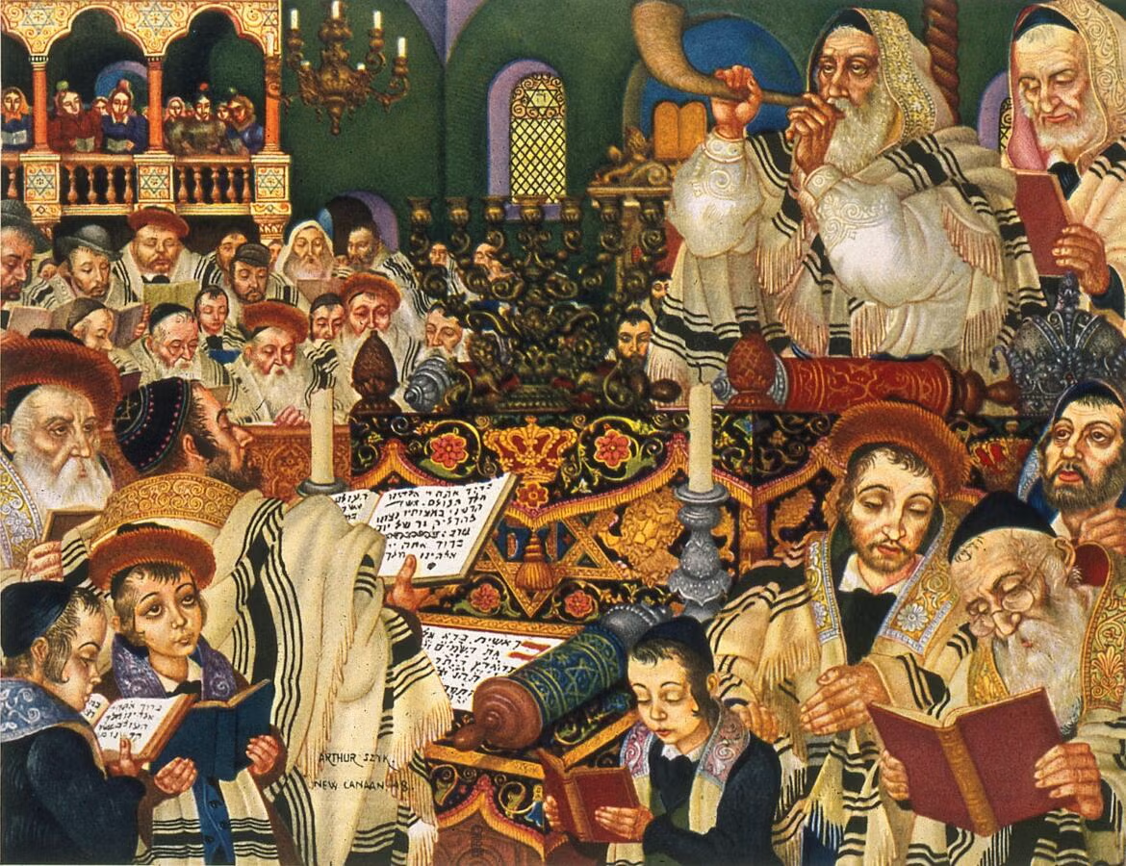
● Reformers learned Hebrew from rabbis who taught Rashi. This contributed to Christianity’s doctrine of Hebraica veritas, accepted as the Word of God.
● Thus, polemical Jewish exegesis led Christians to their anti-messianic, historical interpretations of messianic texts, such that the literal sense equates to the historical sense.

Slide 13
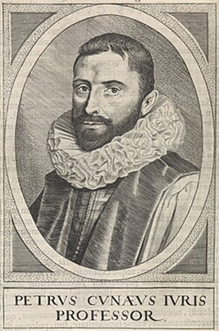
Quandary
● If the Tanach was fulfilled historically, then how does it predict Messiah?
● Petrus Cunaeus (Dutch,
1586-1638) appealed to a
messianic kabbalah (oral
tradition) passed down
along side the Tanach,
separately from oral Law.

Slide 14
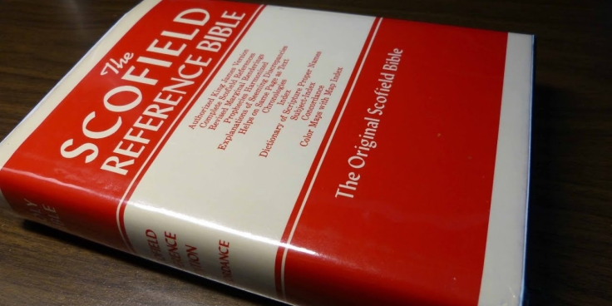
Religious authority
Religion Scripture Tradition
● Judaism
● Islam
● Catholic
● Orthodox
● Protestant
● Evangelical
Tanach
Quran
Bible+Apoc.
Bible+Pseud.
Bible 66-book
Bible 66-book
Talmud
Hadith
Papal edict
Ignatius
Theology
Scofield

Slide 15
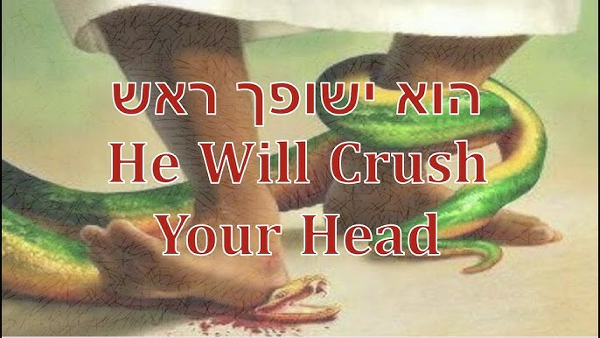
Genesis 3:15
“They shall strike at your head,
And you shall strike at their heel.” NJPS
“He shall bruise your head,
and you shall bruise his heel.” NRSVue
● Midrash: “This is the King Messiah.”
● David Kimchi: “Messiah, the Son of David, … shall wound Satan.” 1928-2010

Slide 16
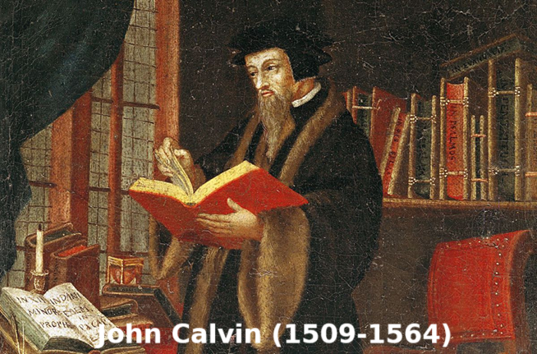
● Rashi: “You will bite him on the heel, and … you will kill him.” (Naturalistic)
● Calvin: “There should always be the hostile strife between the human race and serpents.” Comm Gen, 1:167
● Walton: “A continual, unresolved conflict… It is … haphazard to adopt a messianic interpretation.” NIV App Comm (2001), 226, 235-36

Slide 17
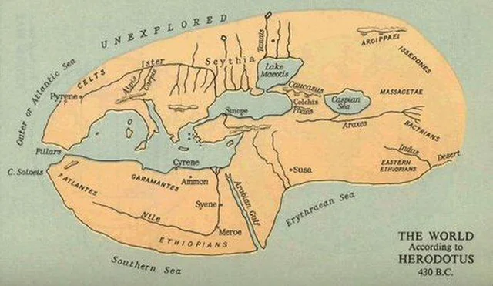
Psalm 2:8
“Ask it of Me,
and I will make the nations your domain;
your estate, the limits of the earth.” NJPS
● Midrash: God, speaking to the Messiah, says: The nations, already they are thine inheritance.” Tehillim 2:10
● Rashi: “It is proper to interpret it as referring to David himself.” On Psalm 2

Slide 18
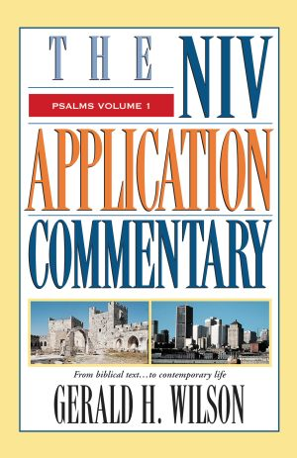
● Gerald Wilson: “A psalm regarding the powers and blessing of the human David kings.”
He identifies Psalm 2 as part
of the “liturgy at the enthronement
of the Davidic king in preexilic times.” Psalms, NIV App Comm (2004), 44

Slide 19

Isaiah 9:6 [Hb 9:5]
“A child has been born to us …
a peaceable ruler.” NJPS
● Midrash: “I have yet to raise up the Messiah, of whom it is written.” Dt Rab 1:20
● Rashi: “The Holy One, blessed is he, … called Hezekiah’s name, ‘the prince of peace.” Comm on Isa 9:5

Slide 20
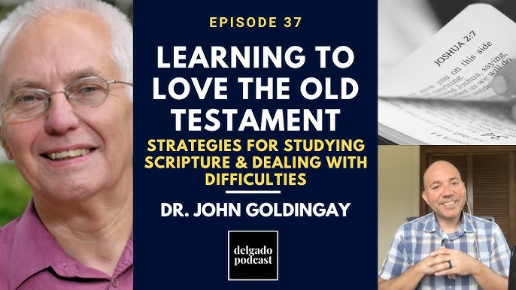
● P. D. Wegner: Identified the child as having one very long theophoric name: “A wonderful planner is the mighty God; the Father of eternity [is] a prince of peace.” In VT 42 (1992), 111-12.
● John Goldengay: “The verses do not function as messianic predictions in this context.” Isaiah New Intl Bib Comm (2001), 176.

Slide 21
Isaiah 42:1-9
¹ “This is My servant, whom I uphold,
My chosen one, in whom I delight.
I have put My spirit upon him,
He shall teach the true way to the nations”
NJPS
● Midrash: “Behold my servant, the Messiah, whom I bring, my chosen one, in whom one delights.” Jonathan 42:1

Slide 22
“All these goodly promises are in the decree of the King, the King of kings,
who will fulfill them for the lord Messiah.”
Tehillim 2:9 in Midrash on Psalm 1:40-41.
● Rashi: “Israel is called ‘My chosen one.’ (Psalm 135:4)… ‘For the sake of My servant Jacob and Israel My chosen one.’” Followed by Goldengay (239) and JDW Watts, Isaiah 34-66 (1987), 119.

Slide 23
Conclusion
● In Jewish-Christian debates, medieval Christians appealed to allegory.
● Whilst medieval Jews invented Midrash.
● Rashi corrected both by insisting on peshat, the plain meaning of texts.
● However, Rashi applied the plain meaning to history or to the end-times.
● Self-loathing evangelicals do the same.

Slide 24

http://tanach.site

