Slide 1
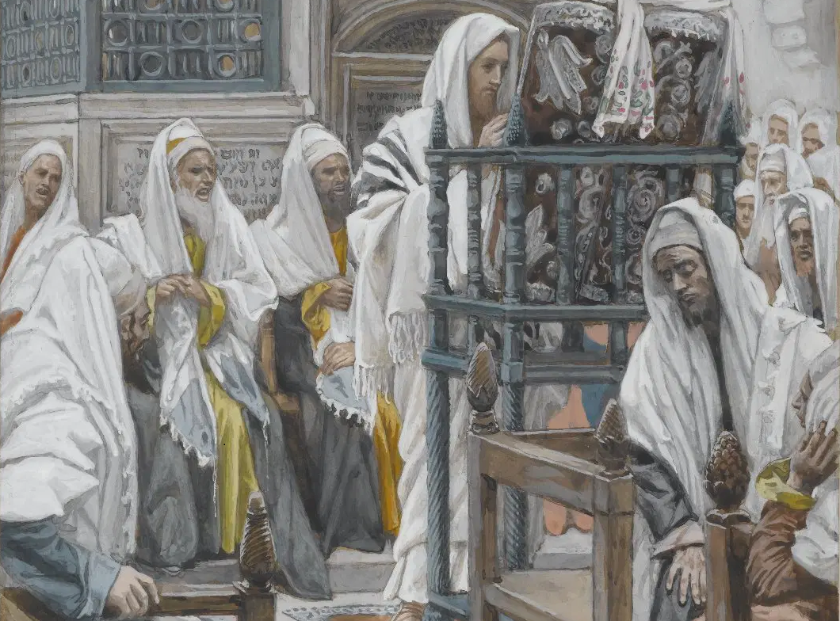
Messiah in the Tanach, 08
A Short Course for Men

Slide 2
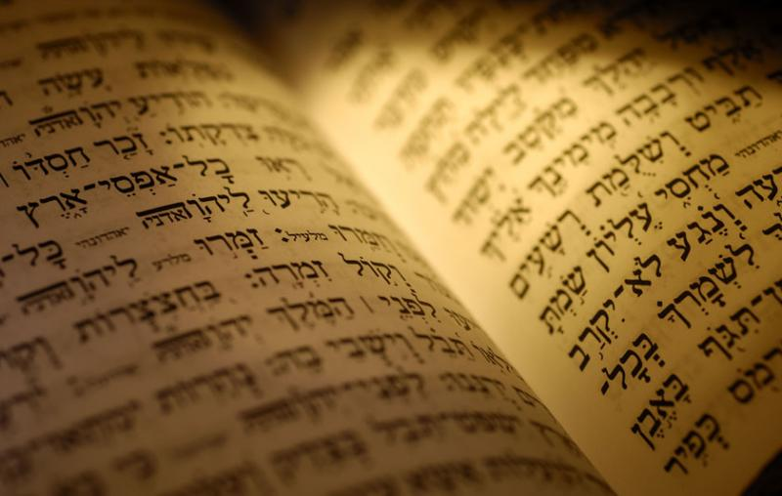
Introduction
● Skeptics deny that the Tanach has any real Messianic predictions.
● Some evangelicals view messianic texts as historical allusions.
● Scholars say that Jesus was mistaken, or he played to people’s ignorance.
● How can we show that there are real messianic predictions in the Tanach?

Slide 3
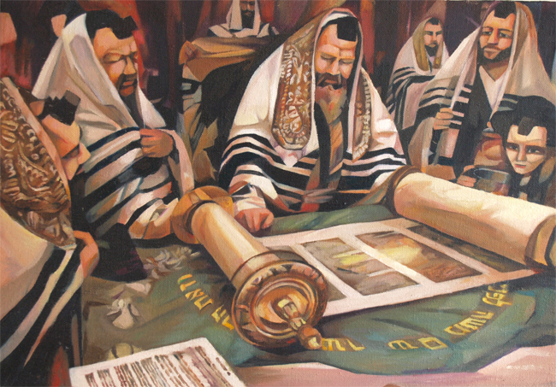
Test texts
● The Law: Genesis 3:14-15
● The Prophets: Isaiah 7:14
● The Writings: Psalm 110
Referring to:
● Context: Immediate content meaning
● Innertext: Author’s wider theme
● Intertext: Other book’s citation
● Without: referring to the New Testament

Slide 4
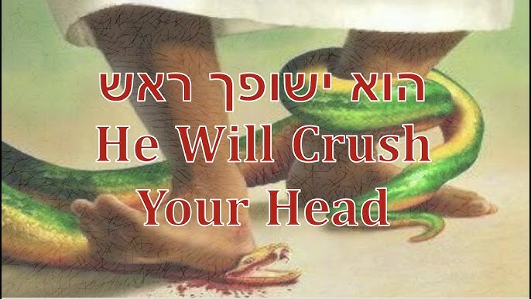
The Law: Genesis 3:14-15
¹⁴ Then God יהוה said to the serpent …
¹⁵ “I will put enmity
Between you and the woman,
And between your offspring and hers;
They shall strike at your head,
And you shall strike at their heel.” NJPS
● They … their: Hebrew = singular.

Slide 5
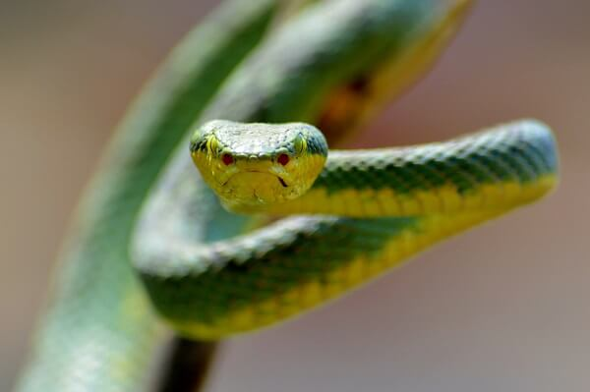
Notes 1
● “Proto Evangelium”?
● Skeptics deny that this is messianic.
● Naturalistic view: humans versus serpents in common life.
● “seed” = collective singular noun.
(But singular in 4:25 = Seth.)
● Theme: God extends mercy in judgement: Gen, 4.15, 6.18, 12.1-9, 19.16

Slide 6
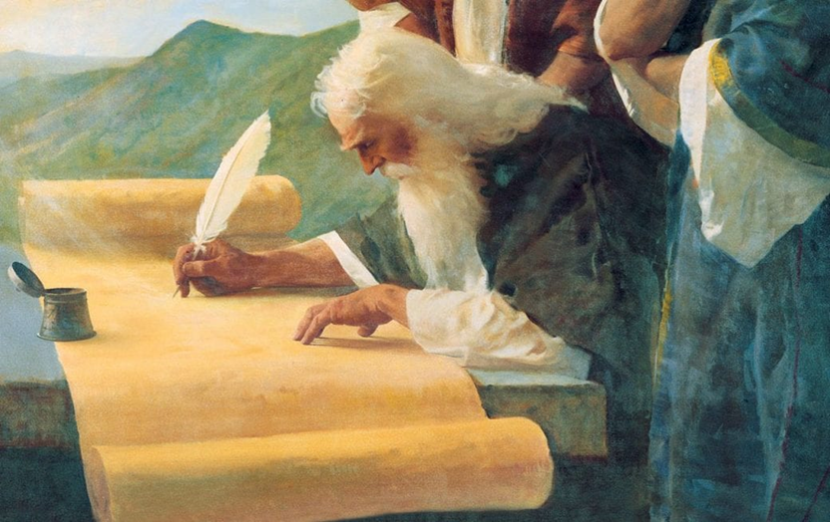
Notes 2
● Interpretation: author’s intent & original readers’ understanding.
● Skeptics deny that this is messianic.
● Symbolical view: There is a perpetual struggle without hope of relief.
● Sensus plenior view: Naturalistic: snakes bite humans, and humans kill snakes.
● If naturalistic, then no messianic intent.

Slide 7
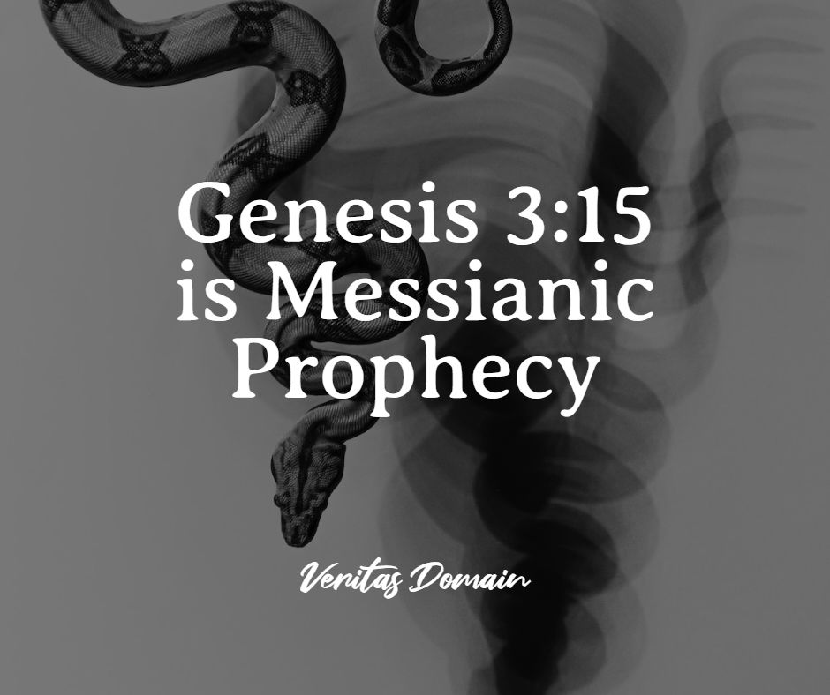
Notes 3
● Messianic view: Predicts future coming of an individual who dies while gaining victory over the Serpent.
● Caution: Does not teach virgin birth, nor a non-lethal bite to the heel.
● Thesis: The Genesis author intended
to introduce a future redeemer, and will identify him in the rest of the Torah.

Slide 8
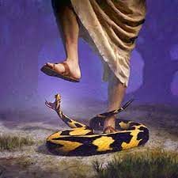
Context
● Addressed to an intelligent being.
● Enmity is between moral agents.
● Mutually mortal blows = individuals.
● The woman’s seed/offspring = Seth… Noah… Abraham… Isaac… Judah… David… Solomon… (Messiah).
● The serpent’s seed/offspring = Cain… Nephilim… Amalek… all disbelievers…

Slide 9
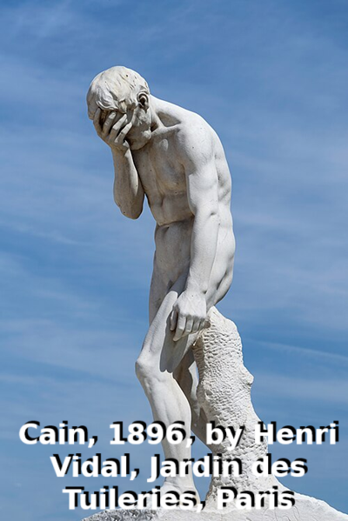
Innertext
● Mercy in the midst of judgement:
●“The LORD put a mark on Cain,” Gn 4.15.
● “I establish my covenant with you,” Noah, Gen 6.18.
● “In you all the families of the earth shall be blessed,” Gen 12.3.
●“I will … remember the covenant with their forefathers,” Lev 26.40.

Slide 10
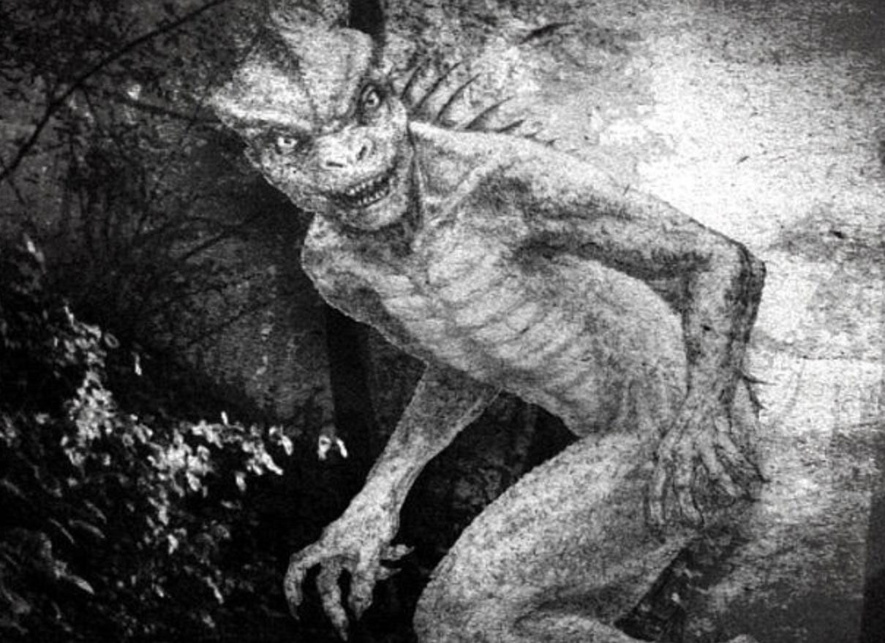
Intertext 1
● The Serpent = Leviathan, Isa 27.1
● “The fleeing serpent,” Job 26.13
● “You were an anointed guardian cherub … till unrighteousness was found in you,” Eze 28.12-14
● “Dust shall be the serpent's food,” Isa 63
● “Your offspring shall possess his enemies’ gate” Gen 22.17f

Slide 11
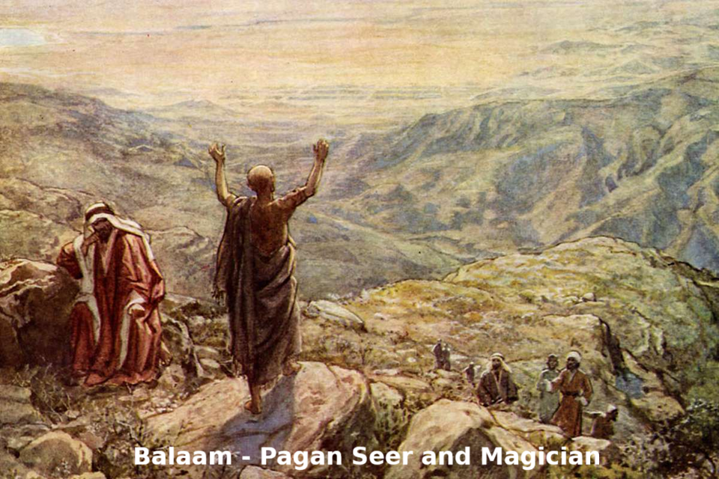
Intertext 2
● ‘Seed’ = royal offspring, 2 Samuel 7.12
● “The vision of the Almighty… O Israel”
● “His king shall be higher than Agag …”
● “what his people will do to your people in the latter days …”
● “a scepter shall rise out of Israel …”
● “it shall crush the forehead of Moab”
Numbers 24.5

Slide 12
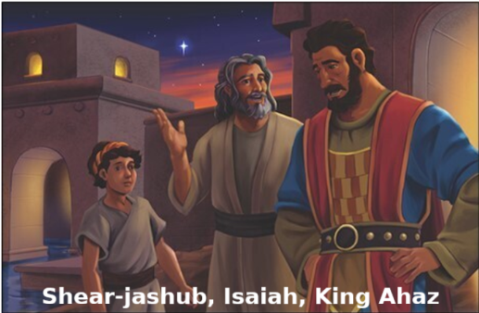
The Prophets: Isaiah 7:14
¹³ “Listen, House of David…
¹⁴ Assuredly, my Sovereign will give you a sign nonetheless!
Look, the young woman is with child and about to give birth to a son.
Let her name him Immanuel*.” NJPS 1985
*Immanuel: Meaning “with us is God.”

Slide 13
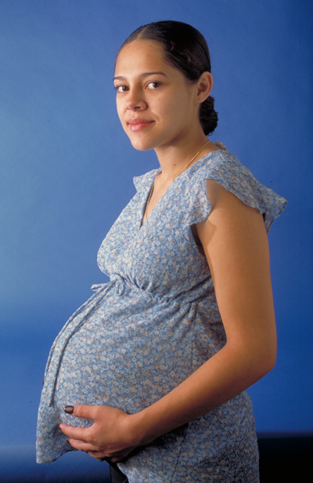
Notes 1
● Skeptics doubt that belief in the virgin birth be necessary to Christian faith,
for:
● Isa 7 was fulfilled in King Ahaz’ court.
● ’Almah = ‘young woman’ not ‘virgin’.
● ‘The child’ = Ahaz’ or Isaiah’s son.
● Sensus plenior = Matthew wrote a midrash about Jesus & Isaiah 7.

Slide 14
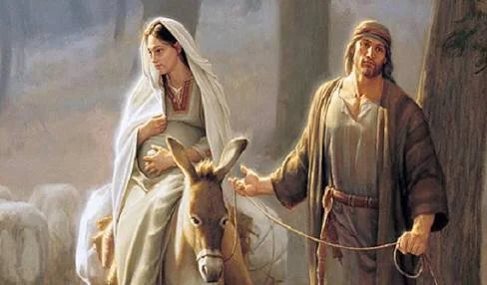
Notes 2
Views on what is a ’Almah:
● Direct prediction: the virgin Mary.
● Historical fulfillment: Ahaz’ concubine.
● Sensus plenior: also applied to Mary.
● LXX: Greek parthenos, never pregnant.
● Acquila: Greek neannis, young woman.
● Hebrew: ‘almah = girl at puberty not (yet) sexually active.

Slide 15
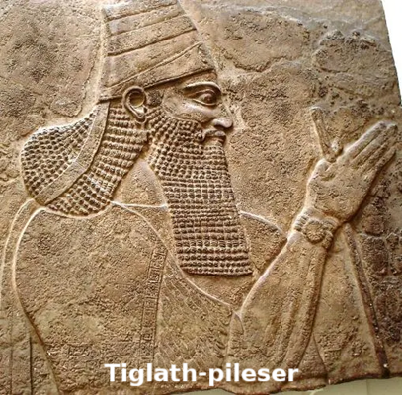
Context
● Tiglath-pileser of Assyria invaded the northern kingdom of Israel in 731 BC.
● Destroyed the monarchy by 721 BC.
● Ashurbanipul completed exile, 669 BC.
● Uzziah of Judah, Rezin of Syria and Pekah of Israel attack Jerusalem in 734, threaten to end House of David.
● Wicked Ahaz had burned his son.

Slide 16
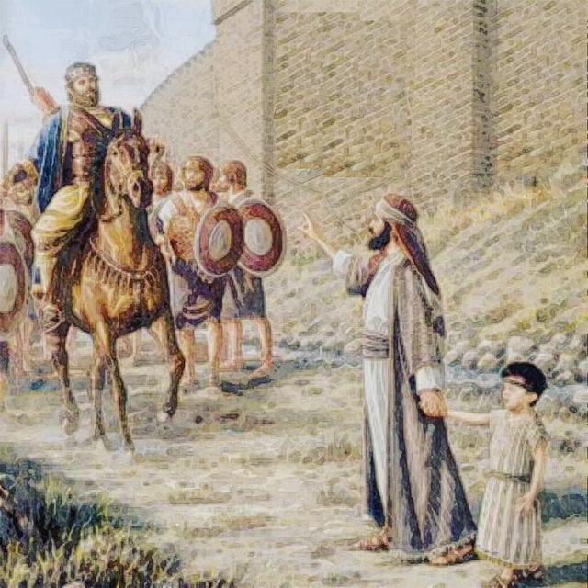
Content
● Isaiah & his young son Shear-Jashub come to Ahaz.
● Isaiah predicts three signs:
● Mid-range (7:7-9): Within 65 years, Ephraim will no longer a people.
● Long range (7:10-15): A pregnant virgin!
● Short-range (7:16-25): Before Shear-Jashub matures, Assyria will invade.

Slide 17
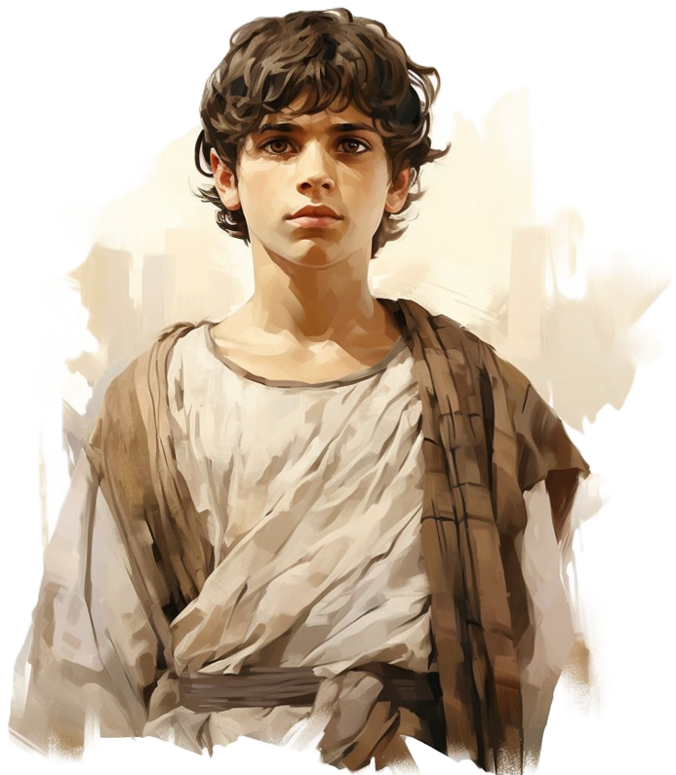
Innertext
For a child has been born to us,
A son has been given us.
And authority has settled on his shoulders… Isaiah 9:5 [Hb 9:5] NJPS
Upon David’s throne and kingdom,
That it may be firmly established… 9:7[6]
● Throne: Davidic covenant confirmed.

Slide 18

Innertext
But a shoot shall grow out of the stump of Jesse… Isaiah 11:1 NJPS
The spirit of GOD shall alight upon him;
A spirit of wisdom and insight… 2
Nations shall seek his counsel
And his abode shall be honored… 10
● Jesse: King David’s father. Messiah will be descended from David.

Slide 19
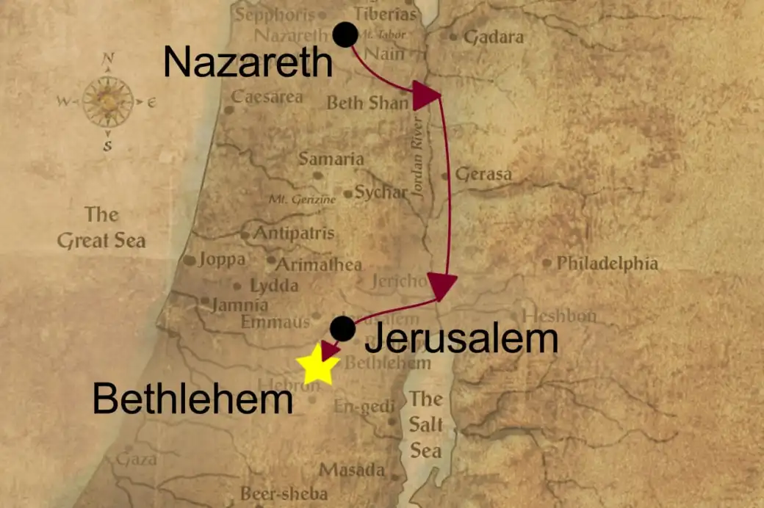
Intertext
And you, O Bethlehem of Ephrath…
From you one shall come forth
To rule Israel for Me—
One whose origin is from of old… NJPS
Truly, [God] will leave them [helpless]
Until she who is to bear has borne… Micah 5:2-3 [Hb 1-2]
● Micah: A contemporary of Isaiah.

Slide 20
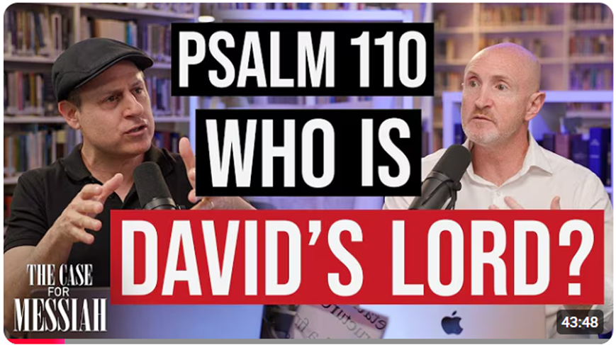
The Writings: Psalm 110 [LXX 109]
¹ Of David. A psalm.
The LORD said to my lord,
“Sit at My right hand
while I make your enemies your footstool.” NJPS 1985
● LORD: The divine Name, YHWH.
● lord: Someone of superior status.

Slide 21
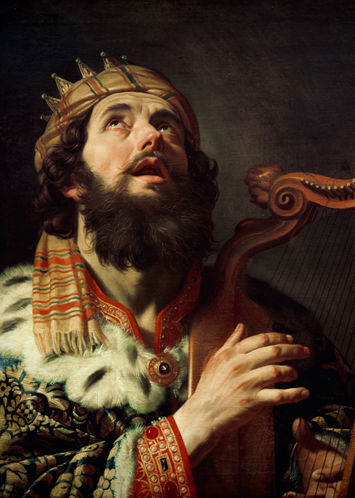
Notes 1
● Written by King David (Le-Dawid).
Views:
● Not written by David. (But no proof.)
● David called himself ‘my lord’. (No e.g.)
● David abdicated to Solomon.
● David foresaw a greater king.
● David predicted a/the Messiah.
● my lord: In Joshua 5:14 = divine title.

Slide 22
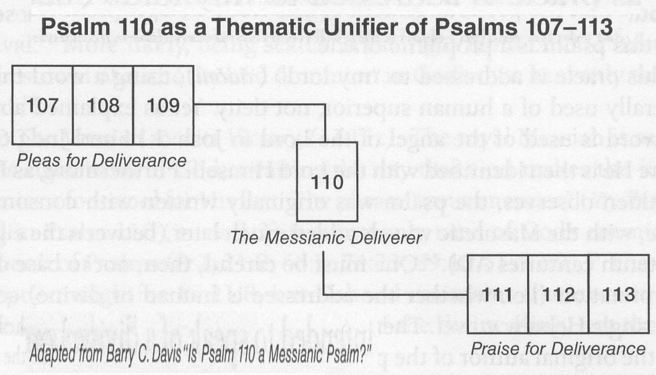
Notes 2
● Author’s intent: “The last word of David … God … has made with me an everlasting covenant.” 2 Sam 23:1-5
● Postexilic redaction: Deepened and clarified the Psalms’ messianic intent.
● Psalms 107-109: Pleas for deliverance.
● Psalm 110: The deliverer foretold.
● Psalms 111-113: Praise for deliverance.

Slide 23
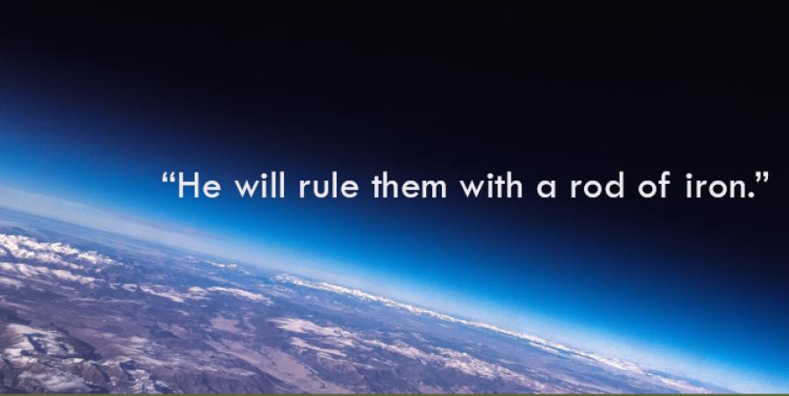
Context
● ‘My lord’ is superior to David.
● He shares in Yhwh’s authority.
● Rules in Zion over enemies.
● People submit to his power.
● Performs priestly work. See 2 Sam 8.18
● Protected by Adonay.
● Judges nations and rulers.
● Only the Messiah fits this profile.

Slide 24
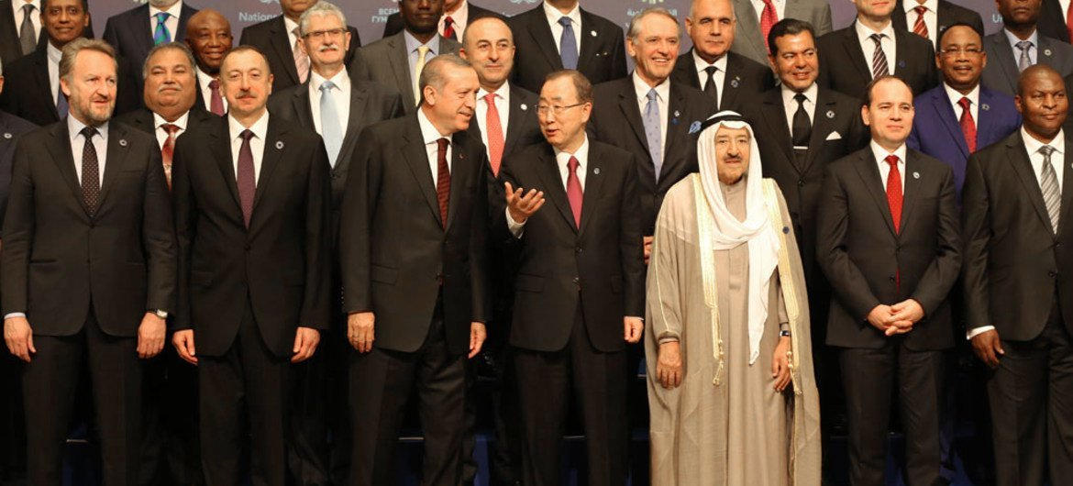
Innertext
² Kings of the earth take their stand,
and regents intrigue together
against the LORD and against His anointed… Psalm 2 NJPS
⁷ The LORD said to me, “You are My son … ⁸ I will make the nations your domain;
your estate, the limits of the earth.
● Only the Messiah fits this profile.

Slide 25
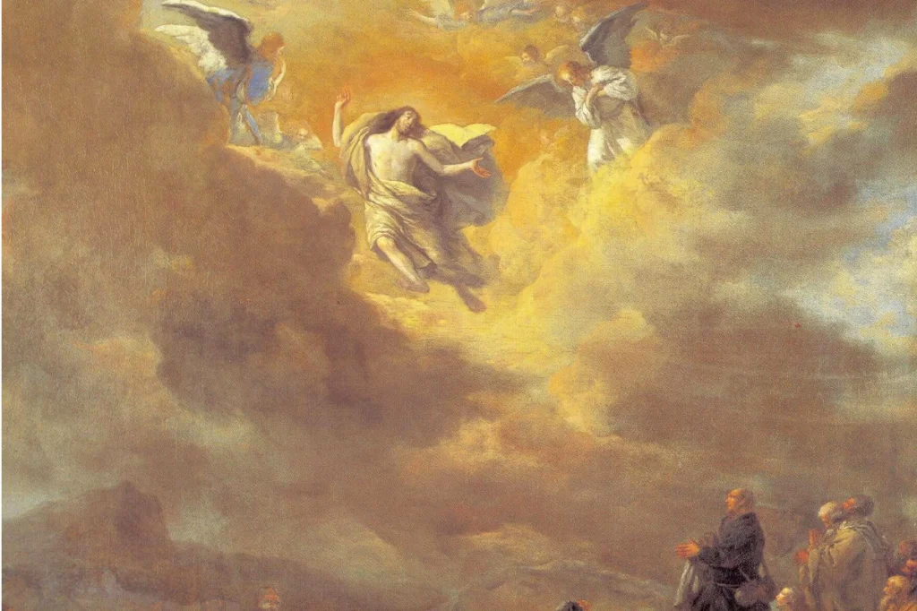
Intertext
⁹ Thrones were set in place,
And the Ancient of Days took His seat.
¹² As I looked on, in the night vision,
One like a human being
Came with the clouds of heaven…
¹⁴ All … nations … must serve him.
His dominion … shall not pass away.
Daniel 9 NJPS

Slide 26
Conclusion
● The Law: Genesis 3:14-15
● The Prophets: Isaiah 7:14
● The Writings: Psalm 110
● The three divisions of the Tanach present messianic predictions.
● Context, innertext and intertext confirm and amplify the messianic message.
● Only the Messiah can fulfill these texts.

Slide 27

http://tanach.site

