Slide 1
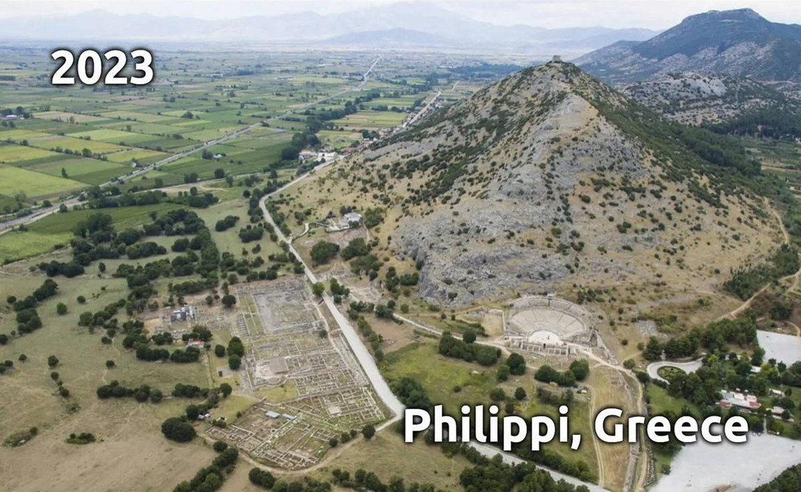
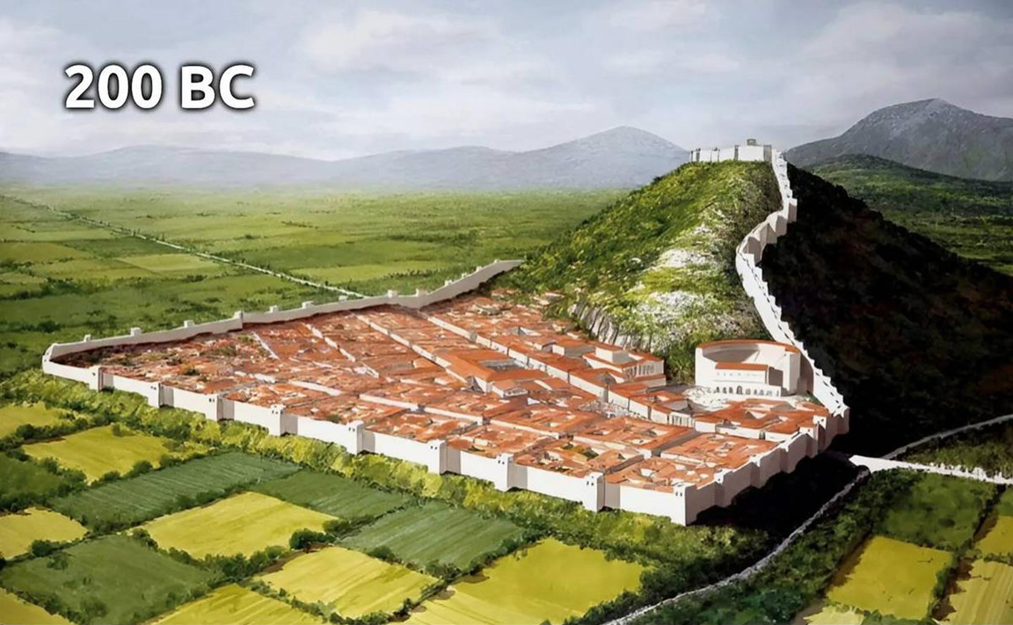
Epistle to the Philippians
A Short Course for Men

Slide 2
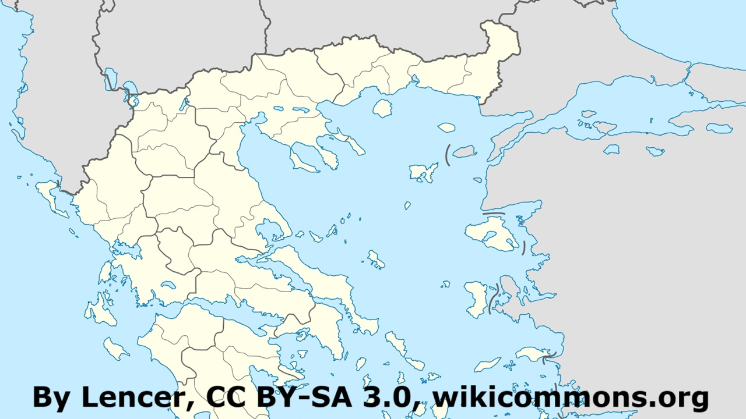
History of Phillipi, Macedonia
● Founded c. 360 BC as Crenides.
● Conquered by Phillip II in 356 BC.
● Roman conquest, 168 BC.
● Roman colony, 42 BC.
● Evangelized by Paul, c. AD 49.
● Destroyed by earthquake, AD 619.
● Abandoned after Ottoman conquest.
● UNESCO world heritage site, AD 2016.

Slide 3
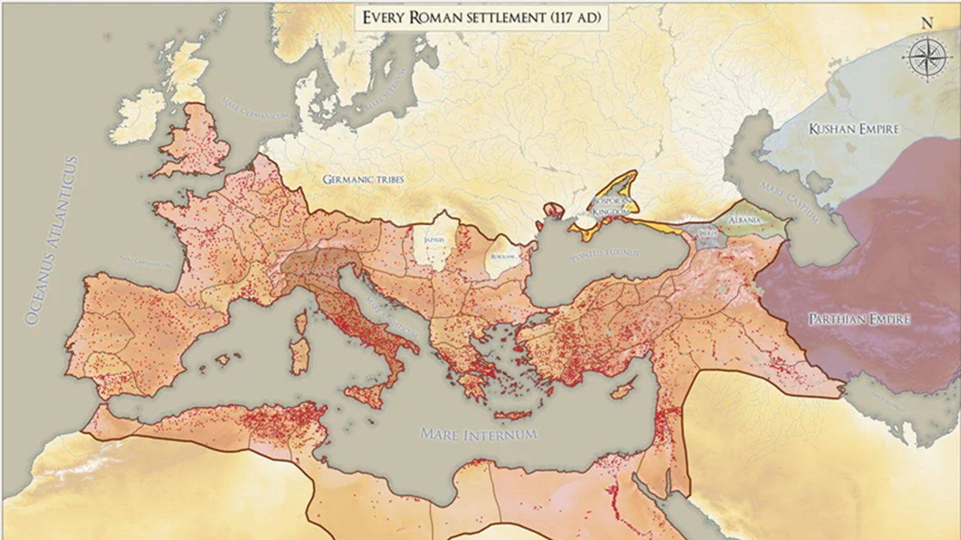
Roman Colonies in 1st century AD
● Strategy to secure conquered lands.
● Settled by citizens, military veterans.
● Settlers granted land.
● Tasked with spreading Latin & laws.
● Right to vote.
● Municipal (urbs) governance.
● Often exempted from Roman taxes.
● Specific religious rites & ceremonies.

Slide 4
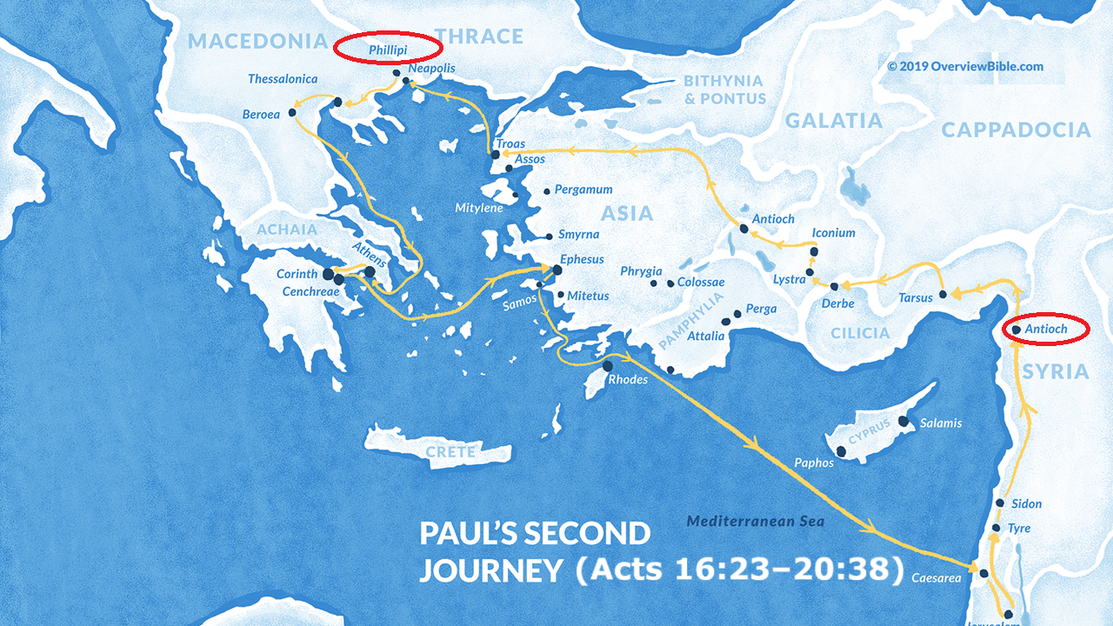
Paul’s church-planting journeys
AD 44–50: Antioch, Seleucia, Salamis and Paphos
AD 50–53: Iconium, Lystra, Derbe, Perga, Attalia, Troas, Philippi
AD 53–58: Thessalonica, Berea, Corinth, Ephesus, Jerusalem
Paul’s imprisonments
● Caesarea for about two years, where he was held despite being found innocent by Governor Felix, who hoped for a bribe to secure his release.
● Paul was then sent to Rome, where he spent two years under house arrest.

Slide 5
Acts 16:12-40
¹² Philippi … is a leading city of that district of Macedonia, a Roman colony. We stayed in this city for some days.
¹³ On the Sabbath day we went outside the city gate to the side of the river, where we thought there would be a place of prayer…

Slide 6
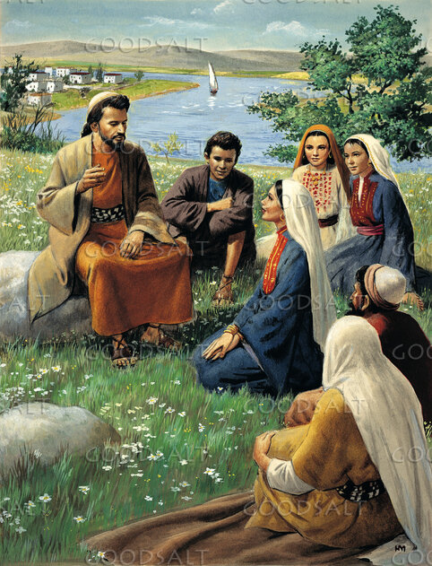
We sat down and began to speak to the women who had assembled there.
¹⁴ A woman named Lydia, a dealer in purple cloth from the city of Thyatira, a God-fearing woman, listened to us. The Lord opened her heart to respond to what Paul was saying.
● Purple cloth:
● God-fearing:
Expensive. Wealthy.
A Gentile convert.

Slide 7
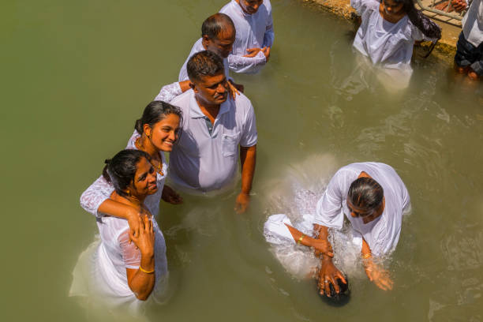
¹⁵ After she and her household were baptized, she urged us, “If you consider me to be a believer in the Lord, come and stay in my house.” She persuaded us.
¹⁶ Now as we were going to the place of prayer, a slave girl met us who had a [python] spirit that enabled her to foretell the future by supernatural means.

Slide 8
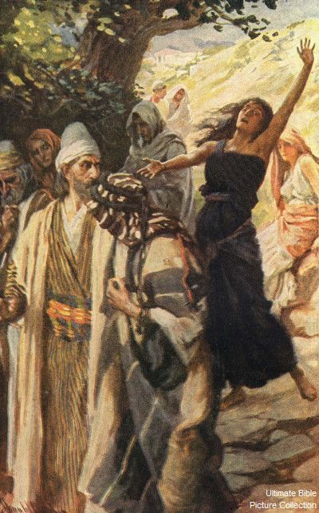
¹⁷ She followed behind Paul and us and kept crying out, “These men are servants of the Most High God, who are proclaiming to you the way of salvation!”
¹⁸ She continued to do this for many days. But Paul became greatly annoyed, and turned and said to the spirit, …
● Alternative: “[a] way of salvation.”

Slide 9
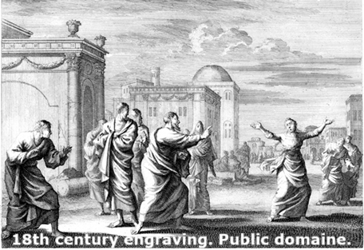
“I command you in the name of Jesus Christ to come out of her!” And it came out of her at once.
¹⁹ But when her owners saw their hope of profit was gone, they seized Paul and Silas and dragged them into the marketplace before the authorities.
● Marketplace: agora, city center.

Slide 10
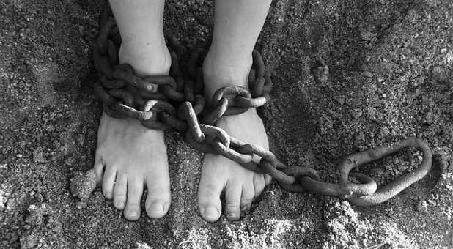
Dealing with common spirits
● They do or say something unusual.
● They speak truth inaccurately.
● They seek attention from humans.
● Oppressed humans act involuntarily.
● This becomes annoying to believers.
● They submit to the Name Jesus Christ.
● They must leave when commanded.
● They move others to react adversely.

Slide 11
²⁰ When they had brought them before the magistrates, they said, “These men are throwing our city into confusion.
They are Jews ²¹ and are advocating customs that are not lawful for us to accept or practice, since we are Romans.”
● Magistrates:
● Not lawful:
Justice of the peace.
Romans practiced idolatry.

Slide 12
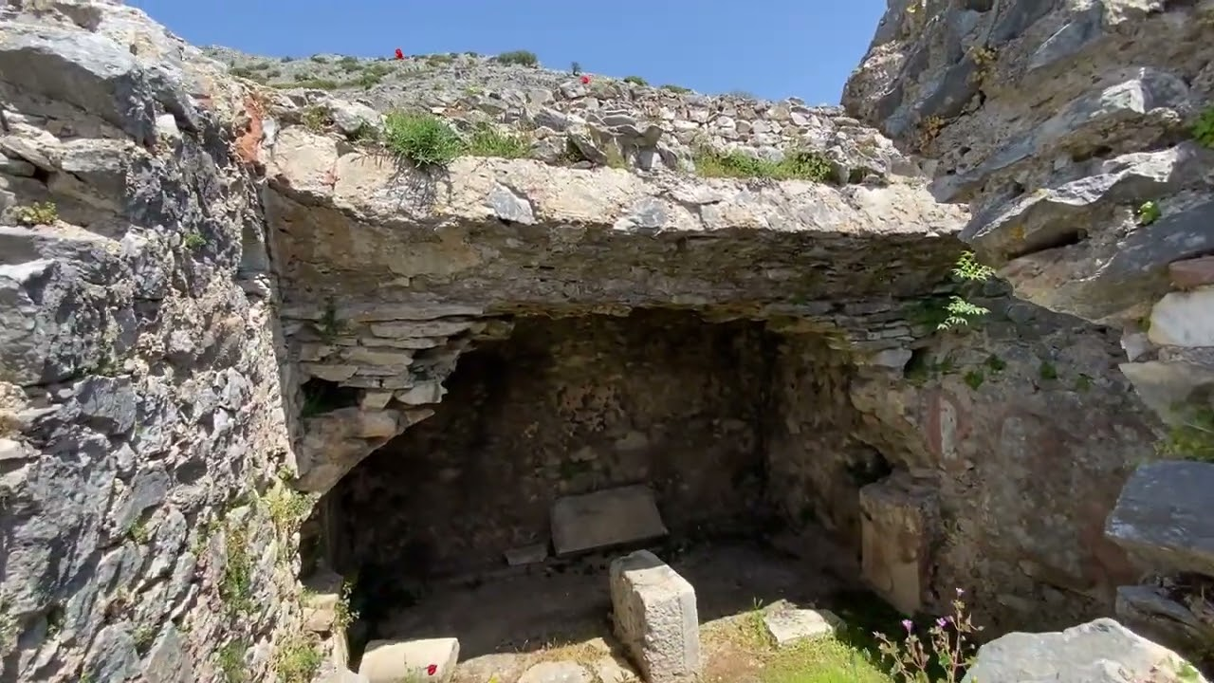
²² The crowd joined the attack against them, and the magistrates tore the clothes off Paul and Silas and ordered them to be beaten with rods.
²³ After they had beaten them severely, they threw them into prison and commanded the jailer to guard them securely.
● Beaten:
● Jailer:
Illegal against Roman citizens.
See verses 25 through 40.

Slide 13
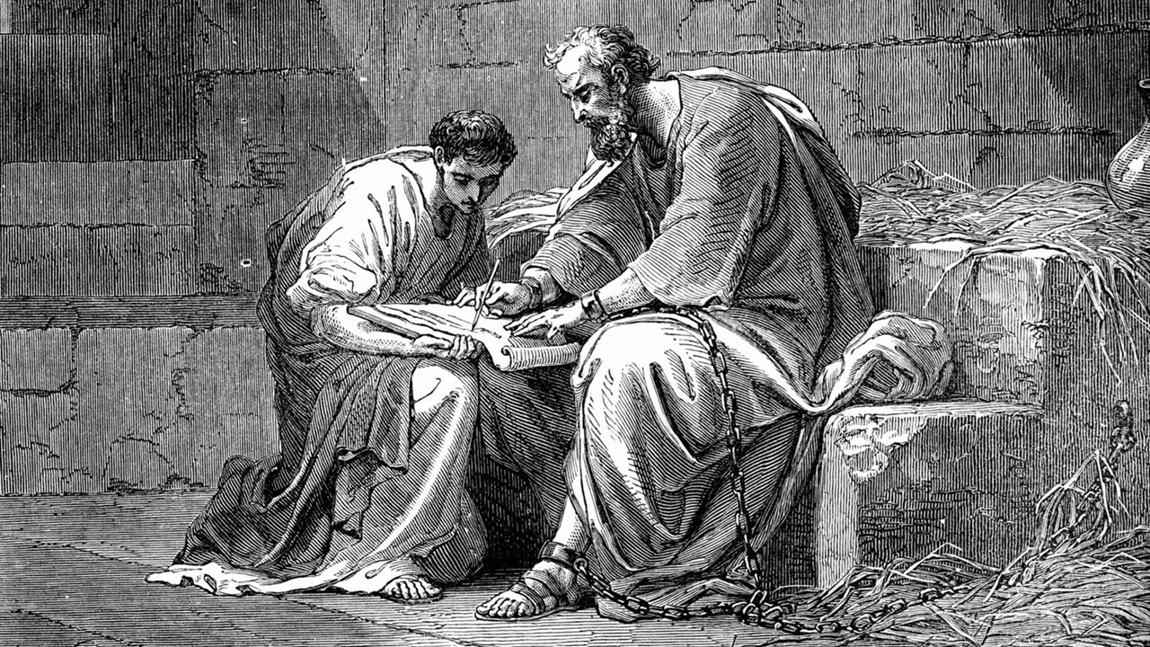
Philippians 1:13-14
¹³ The whole imperial guard and everyone else knows that I am in prison for the sake of Christ,
¹⁴ and most of the brothers and sisters, having confidence in the Lord because of my imprisonment, now more than ever dare to speak the word fearlessly.
● Prison: At Ephesus, Caesarea or Rome.

Slide 14
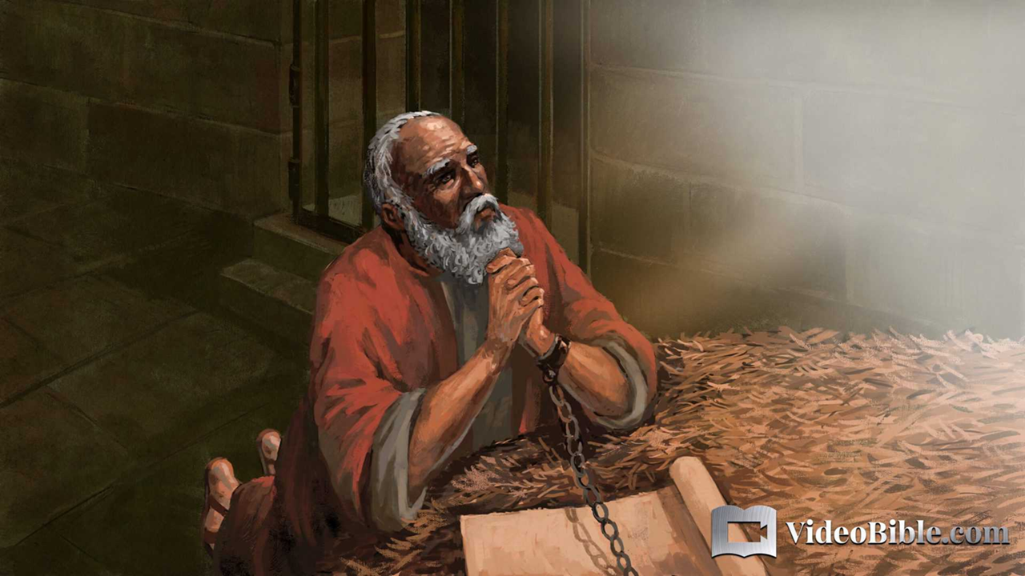
Philippians 1:3-5
³ I thank my God every time I remember you. ⁴ I always pray with joy in my every prayer for all of you ⁵ because of your participation in the gospel from the first day until now.
● Joy: Contentment in spite of troubles.
● Prayer: Jews prayed in the morning and in the evening.

Slide 15
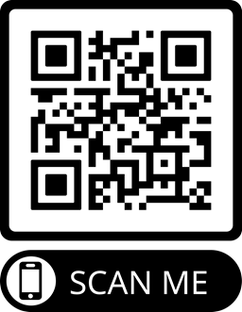
Assignment
● Read the entire epistle his week.
● Study 1:1-11 at netbible.org
● Visit http://philippians.site
● Memorize one verse.

Slide 16
¹ Verse
¹ Verse
● Text

Slide 17
…
¹ …
¹ …
● Text: …

