Slide 1
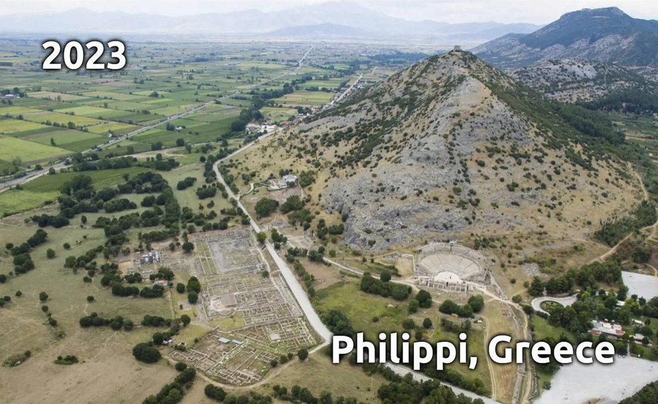
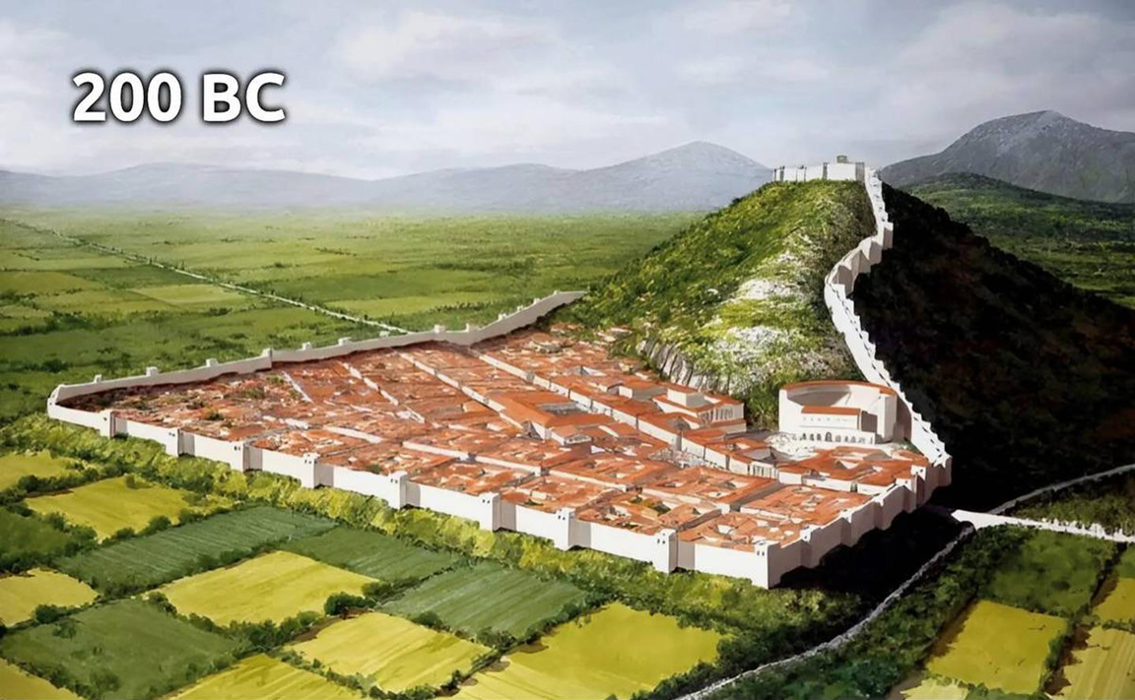
Epistle to the Philippians 4:1-9
A Short Course for Men

Slide 2
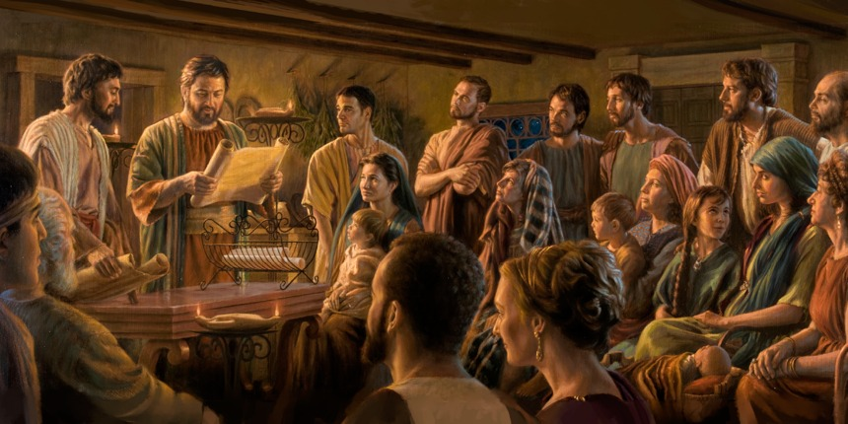
STRUCTURE
l. Thankful Prayer (1:1-11)
II. Paul's Missionary Report (1:12-26)
III. God’s Call to Be Holy (1.27–2:30)
IV. Doctrinal Polemics (3:1–4:1)
V. Joyful Partnership (4:2-23)

Slide 3
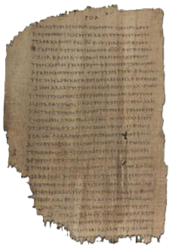
OUTLINE
Joyful partnerships (4:1-23)
God’s spiritual provision (4:2-9)
(Cause and effect)
Imperatives (1-6)
Outcome (7)
Imperatives (8)
Outcome (9)
God’s material provision (4:10-23)
Papyrus 𝔓46, circa 175–225

Slide 4
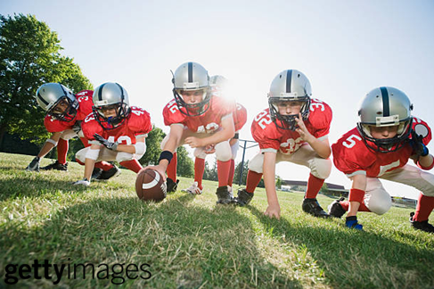
Stand firm!
¹ My dear friends, I love you and long to see you, because you give me joy and prove that the Lord will reward me.
So, remain faithful to the Lord in the same way that I do.
● Joy:
● Crown:
● Remain:
Now and at Jesus’ return.
Victor’s wreath (stephanos).
‘Stand firm’, not dissuaded.

Slide 5
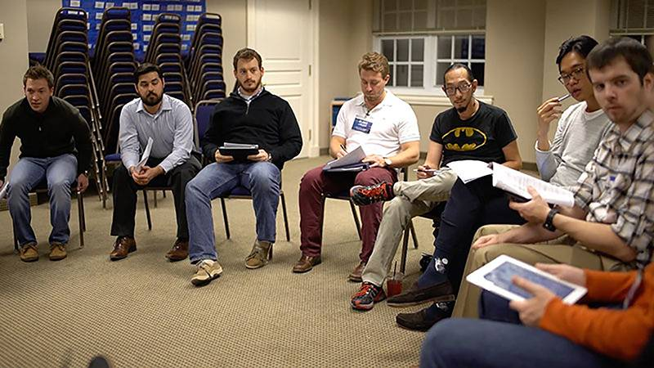
Discuss
What challenges to the gospel did Paul have in mind, which he expressed in the previous three chapters?
● From Judaizers?
● From legalists?
● From mystics?
● From perfectionists?

Slide 6
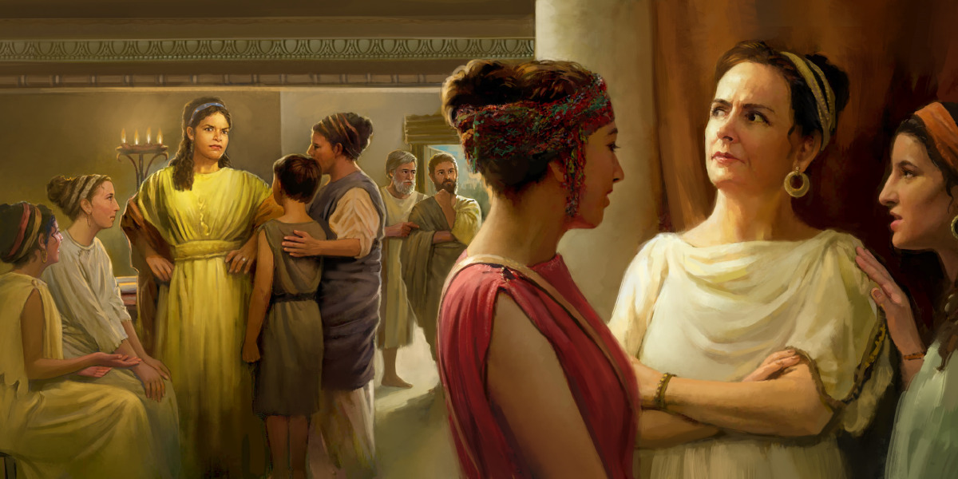
Imperative
² I urge both Euodia and Syntyche to agree together as fellow Christians.
³ And I request of you, my loyal partner, to help them to do so.
● Agree:
● Loyal:
● Partner:
‘to think the same thing’.
1st character requirement.
‘Yoke-mate’. No rank.

Slide 7
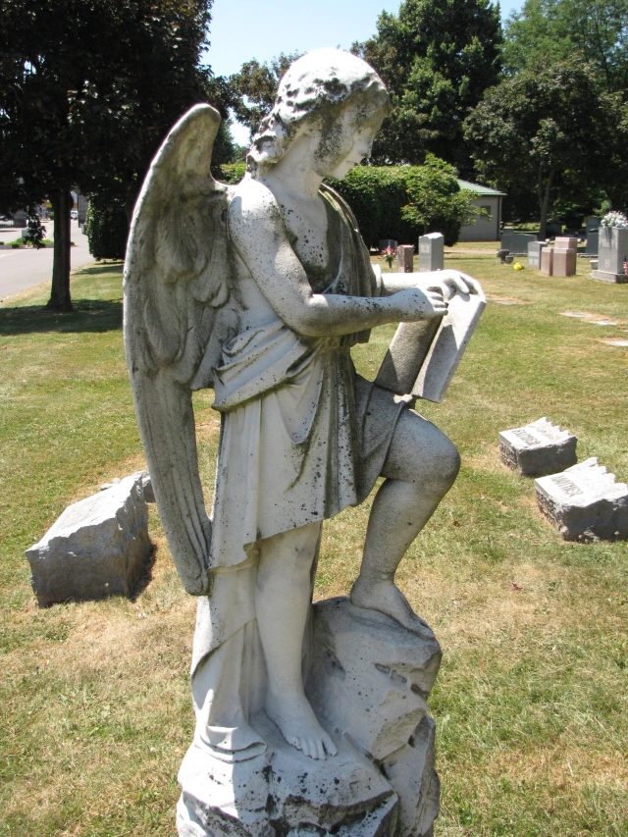
Consequence
They contended for the gospel along with me, and also with Clement and my other co-workers,
whose names remain recorded in the Book of Life.
● Contend:
● Co-workers:
● Names:
Against antagonists.
Not merely our ‘helpers’.
He knows us personally.

Slide 8
Imperative & consequence
⁴ Keep rejoicing all the time because you belong to the Lord! I repeat: Rejoice because the Lord is nearby!
⁵ In that way everyone will experience how reasonable you are!
● Always:
● Know:
● Gentle:
In every circumstance.
Personally, by experience.
Free of anger and disdain.

Slide 9
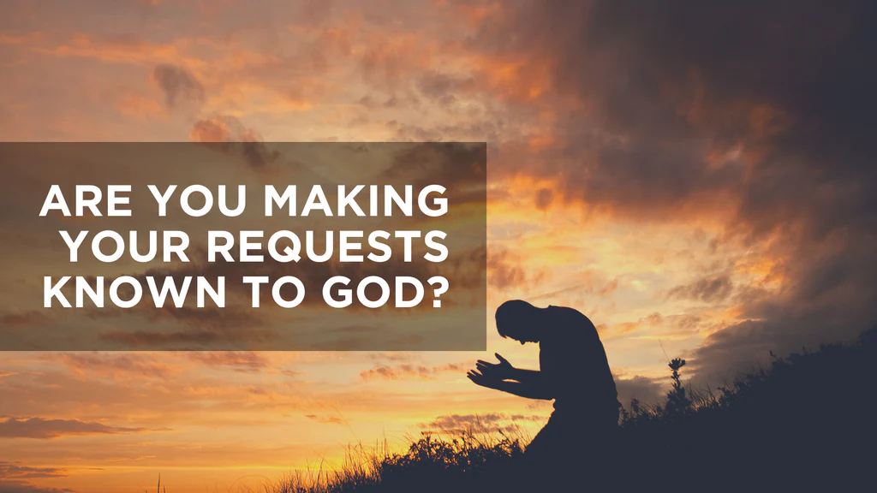
Imperative
⁶ Stop worrying about things. Instead, pray about things by
making specific requests to God, and by thanking him for what he does.
● Worry:
● Request:
● Thank:
Fear causes doubt.
What we want God to do.
This is all he wants from us.

Slide 10
Make a God-sized request
● For a family member.
● For a personal need or desire.
● For city or state government.
● For legal, social or cultural change.
● For the gospel in hard places.
● For someone in poor health.
● For an opportunity to share Jesus.
Ask for something unlikely. Shout Amen!

Slide 11
Consequence
⁷ Then God will cause you to experience peace which will protect your feelings and thoughts,
in ways which surpass your ability to understand mentally.
● Peace:
● Heart:
● Thought:
● Mental:
Opposite of worry.
Emotions.
Mental models & worldview.
Mental processes.

Slide 12
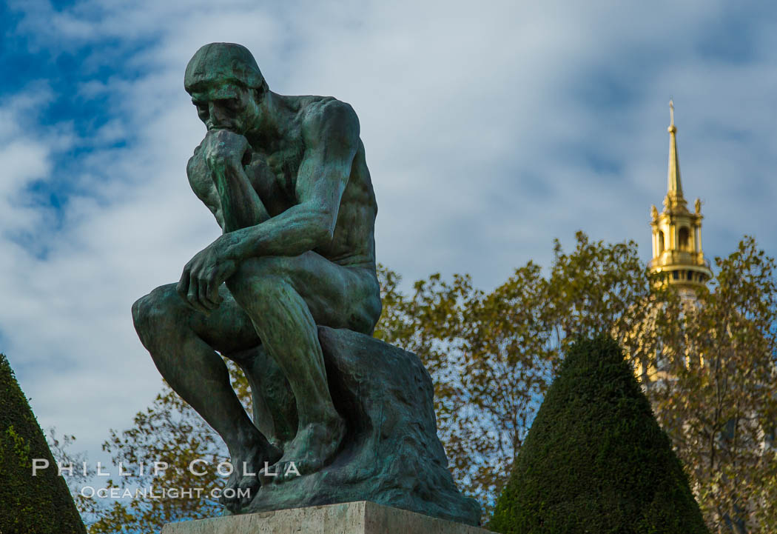
Imperative
⁸ In conclusion, dear friends, keep thinking logically about things which are:
● True
● Respectable
● Honest
● Holy
● Pleasing
● Admirable
● Virtuous
● Praiseworthy

Slide 13
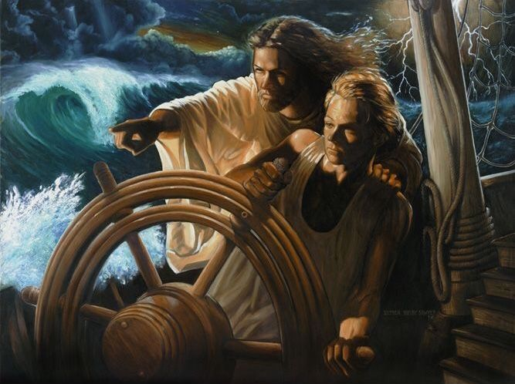
Imperative & consequence
⁹ Keep practicing the things which you learned, received, heard and saw from
me!
Then God, who gives that peace, will always be with you.
● Learned:
● Received:
● Heard:
● Saw:
Discipleship (=Matt 28:19).
Take ownership.
Sound advice.
Love in action.

Slide 14
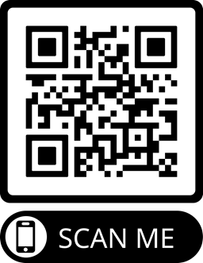
Assignment
● Read chapter 4 this week.
● Study 4:10–23 at www.netbible.org
● Visit http://philippians.site
● Memorize one verse.

Slide 15
…
¹ …
¹ …
● …:
● …:
● …:
…
…
…

Slide 16
…
¹ …
¹ …
● …:
● …:
● …:
…
…
…

Slide 17
¹ Verse
¹ Verse
● Text: …

Slide 18
Titre
● …
● ...
● ...
● ...
● ...

Slide 19
Titre
● …: …
● …: …
● …: …
● …: …
● …: …
● …: …
● …: …
● …: …

Slide 20
Discuss
?
● …
● …
● …
● …

