Slide 1
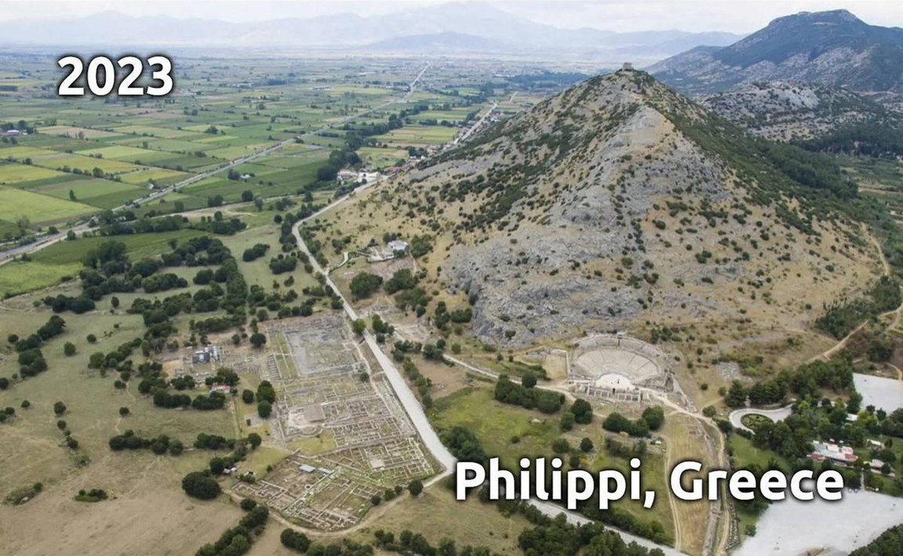
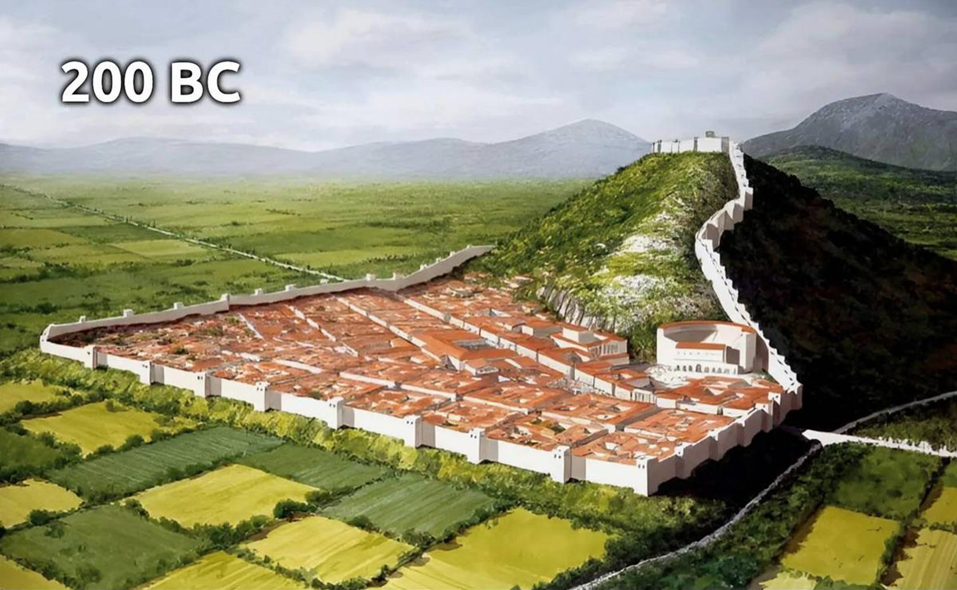
Epistle to the Philippians 4:10-23
A Short Course for Men

Slide 2
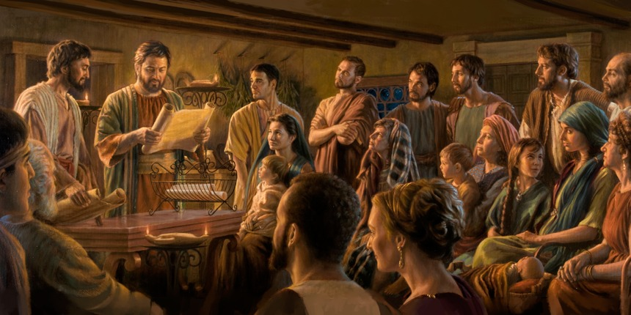
STRUCTURE
l. Thankful Prayer (1:1-11)
II. Paul's Missionary Report (1:12-26)
III. God’s Call to Be Holy (1.27–2:30)
IV. Doctrinal Polemics (3:1–4:1)
V. Joyful Partnership (4:2-23)

Slide 3
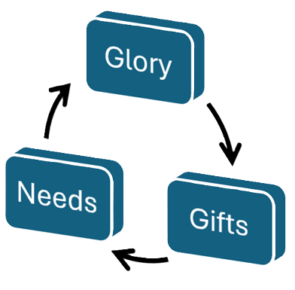
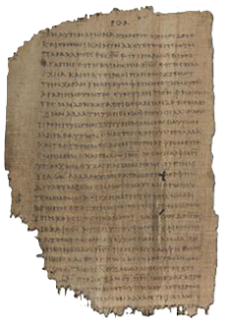
OUTLINE
Joyful partnerships (4:1-23)
God’s spiritual provision (4:2-9)
God’s material provision (4:10-23)
Workers’ needs (4:10-13)
Givers’ gifts (4:14-18a)
God’s glory (4:14b-20)
Papyrus 𝔓46, circa 175–225

Slide 4
The needy rejoice
¹⁰ The Lord causes me to rejoice greatly that you now have already revived your concern for me.
Although you were concerned for me, you had no opportunity to send help for me.
● Rejoice:
● Concern:
● Opportunity:
Timeless verb form.
‘Thinking about’.
To send someone.

Slide 5
The needy remain content
¹¹ I do not talk about my needs, for I have learned to be content regardless.
^{12a} I know how to survive, and I know how to thrive.
● Needs:
● Survive:
● Thrive:
Hierarchy of needs.
When poor.
When prospering.

Slide 6
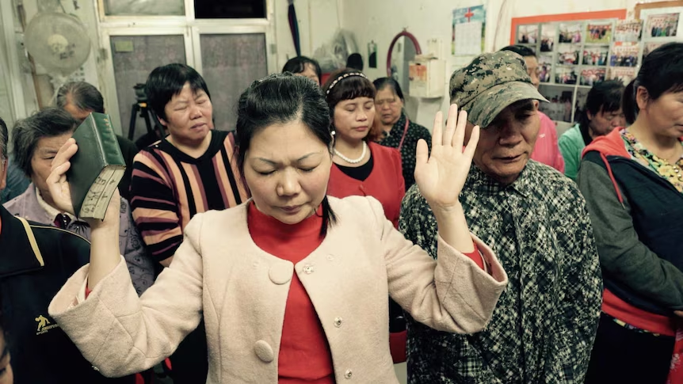
Workers’ needs
● Transport
● Lodging
● Food & drink
● Clothing
● Tools & materials
● Health & medical
● Taxes & fees
● Bibles & books
● Helpers
● Works of mercy
Increasing number of ‘missionaries’ are self-supporting, applying low-cost, reproducible methods, as Paul did.

Slide 7
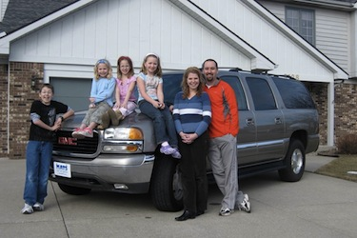
Organizational Requirements
● Administration
● Salary & pension
● Vehicle & home
● Retirement
● Insurances
● Children’s ed.
● Bibles & books
● Furlough
● Works of mercy
● Field projects
● Institutions
● Worker subsidies
Dual purposes: Maintain the mission, and control personnel through threat of withholding funds.

Slide 8
The needy remain strong
^{12b} In everything, I have learned the secret both to be filled and to go hungry, both to abound and to be in need.
¹³ I am able to do all this by Messiah who strengthens me.
● Secret:
● Able:
● Strengthens:
‘Initiated’.
Inner strength.
Outer source (dynamis)

Slide 9
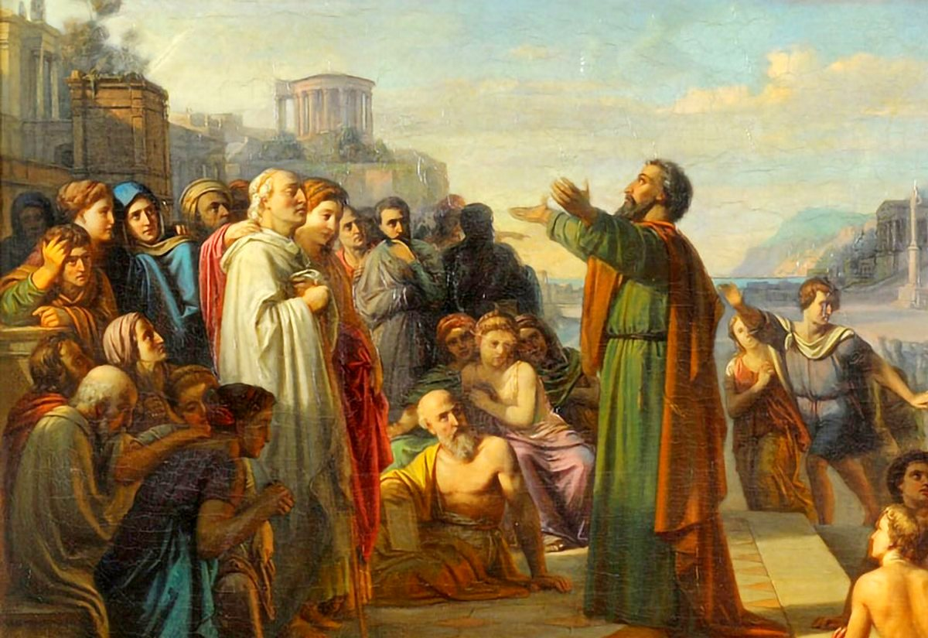
Givers enjoy sharing
¹⁴ Still, you did well by sharing with me in my trouble.
¹⁵ And you Philippians know that when I first left Macedonia to spread the Good News, you were the only church that shared with me in the matter of giving and receiving.
● Church:
● Receiving:
2 Corinthians 11:8-9
Who? From whom?

Slide 10
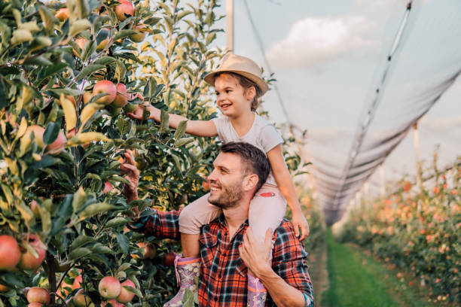
Givers meet needs
¹⁶ You also know that, while I was in Thessalonica, you sent help once and twice to meet my needs.
¹⁷ I am not hoping for another gift from you, but to gather more fruit for your account.
● Gift:
● Fruit:
● Account:
Work for free, not a salary.
More work gets more results.
Givers share in rewards.

Slide 11
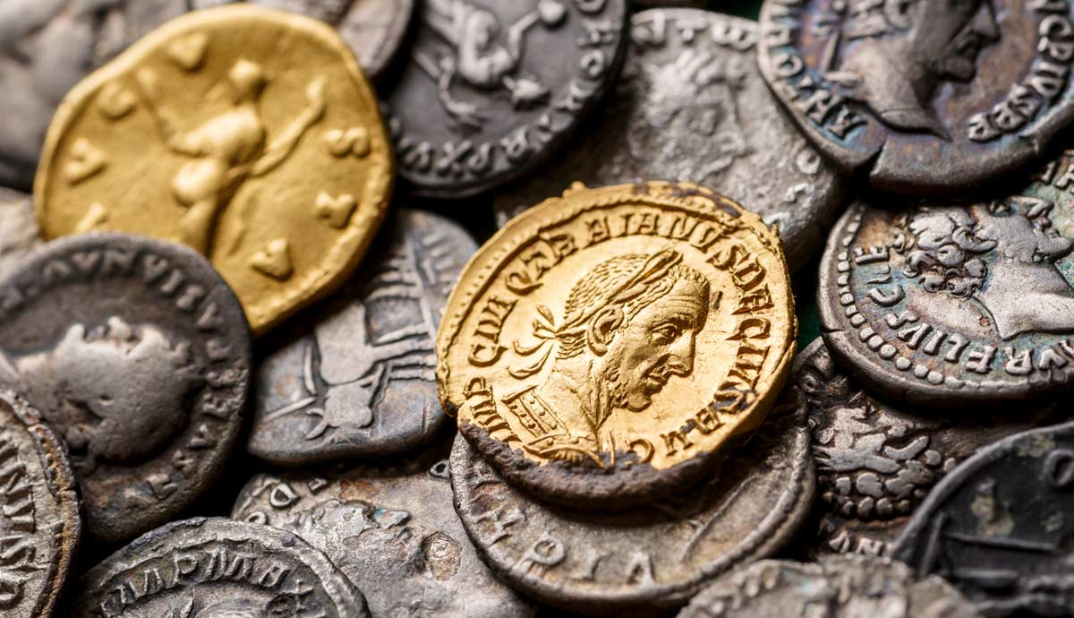
Receivers reply to givers
¹⁸ I have received the full sum, and my needs are more than met.
I have all that I need, having received from Epaphroditus what you sent: a fragrant offering, a sacrifice acceptable and pleasing to God.
● Acceptable:
● Pleasing:
Ritually clean.
Beyond the minimum.

Slide 12
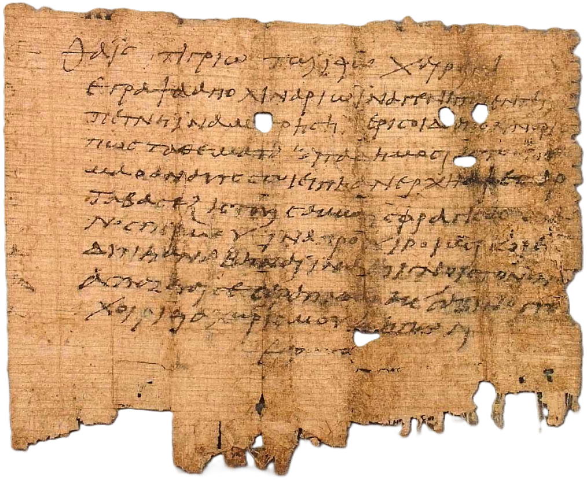
Permutatio
“From Lucius Argentarius, banker in Philippi, to Gaius Numularius, banker in Rome, greetings. On the Kalends of April, in the consulship of Titus Flavius and Marcus Aurelius, I have received from Epaphroditus Philippius the sum of 1,000 denarii. Pay to Epaphroditus Philippius the said sum of 1,000 denarii, less the customary fee of 2%, upon presentation of this letter in Rome. Sealed by Lucius Argentarius, witnessed by Quintus Fabius.”

Slide 14
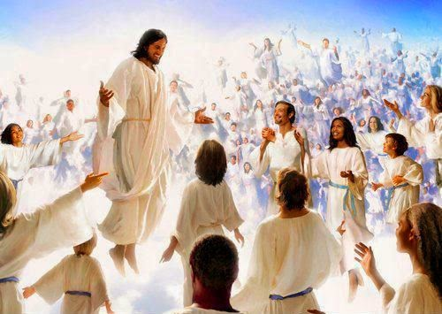
Receivers edify givers
¹⁹ And my God will supply your every need from his amazing riches because you belong to Messiah Jesus.
And we shall be amazed at God our Father forever and ever. Amen!
● My god:
● Amazing:
● Amazed:
To whom I pray.
‘In glory’, near to him.
Enjoying him more than…

Slide 15
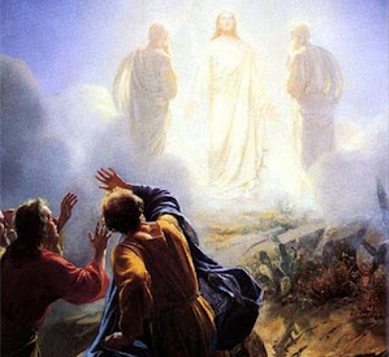
‘In glory’
● Moses and Elijah appeared in glory with Jesus atop Mount Hermon. Luke 9³¹
● The body is sown in dishonor … raised in glory. 1Cor 15⁴³
● The ministry of righteousness exceeds in glory that of condemnation. 2Cor 3⁹
● When Christ appears, you also will appear with him in glory. Col 3⁴
● Came in the flesh, taken up in glory. 1Tim 3¹⁶

Slide 16
They greet one another
²¹ Greet every one of Messiah Jesus’ holy people. The Christians who are here with me greet you.
²² All the holy people here greet you, especially those who work in Caesar’s household.
● Greet:
● Holy :
Sign of affection or of respect.
Belonging exclusively to…

Slide 17
Bless each other
²³ “I pray that the Lord, Messiah Jesus, give you grace by the Spirit who dwells among you. Amen.”
● Grace:
● Spirit:
Powerful love.
Each one’s spirit? Attitude?
The Spirit who is in you?
Your community attitude?

Slide 18
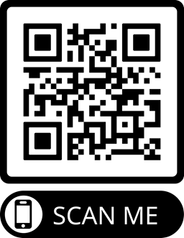
Assignment
● Read chapter 4 this week.
● Study 4:10–23 at www.netbible.org
● Visit http://philippians.site
● Memorize one verse.

Slide 19
…
¹ …
¹ …
● …:
● …:
● …:
…
…
…

Slide 20
…
¹ …
¹ …
● …:
● …:
● …:
…
…
…

Slide 21
¹ Verse
¹ Verse
● Text: …

Slide 22
Titre
● …
● ...
● ...
● ...
● ...

Slide 23
Titre
● …: …
● …: …
● …: …
● …: …
● …: …
● …: …
● …: …
● …: …

Slide 24
Discuss
?
● …
● …
● …
● …

