Slide 1
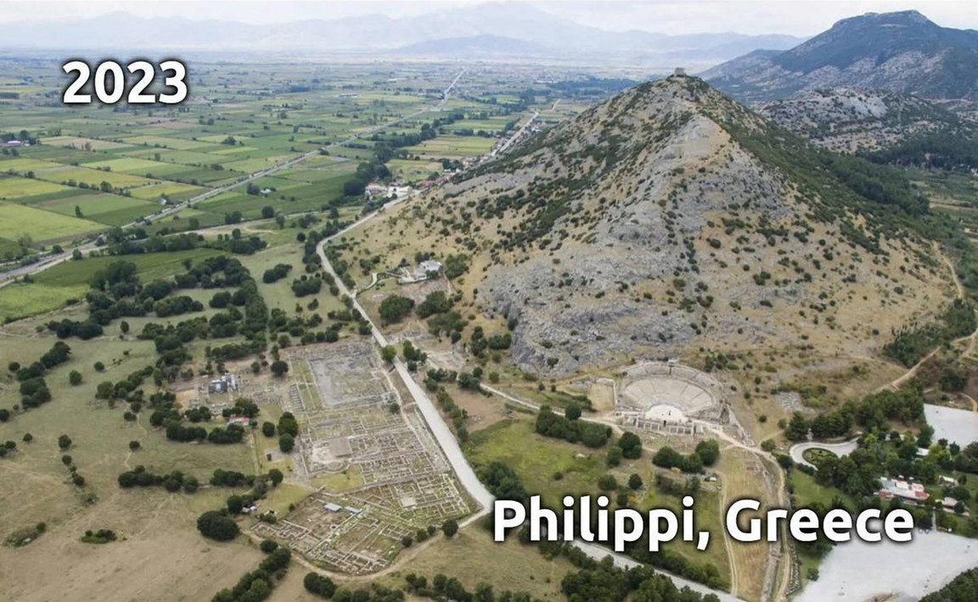
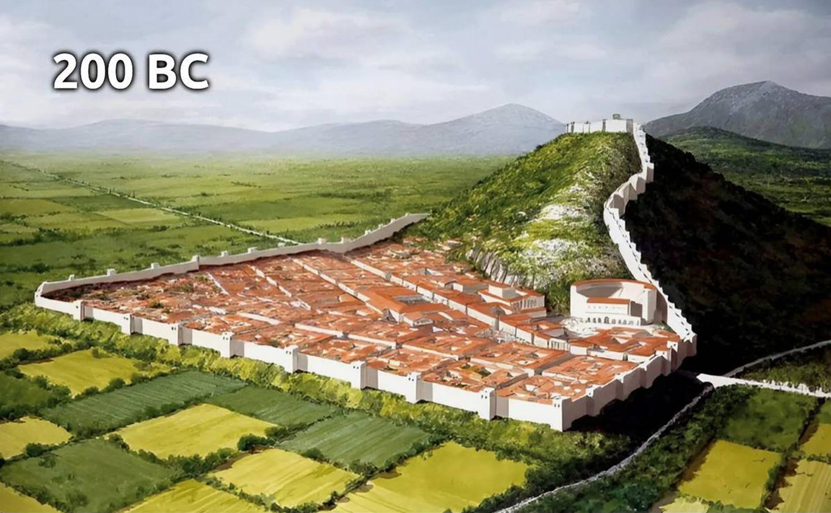
Epistle to the Philippians 1:1-11
A Short Course for Men

Slide 2
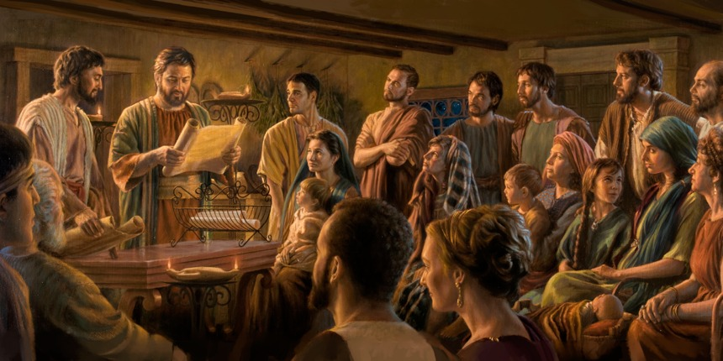
What did Paul want us to learn?
● Our eternal and temporal identities. 1:1
● How to partake of God’s grace. 2, 7
● How to pray to get results. 3, 9
● Partnership in gospel ministry. 5, 7
● How to stay hopeful. 6, 9
● How to approve what is best. 10
● How to remain pure and blameless. 10
● How to become spiritually fruitful. 11

Slide 3
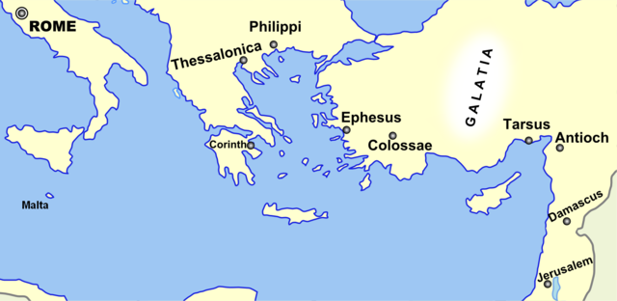
Known persons at Philippi
● Paul, Timothy, Silas and Luke(?).
● Lydia, ‘brothers and sisters’
● Slave girl and owners
● Jailer and household
● Saints, overseers and deacons
● Epaphroditus
● Euodia and Syntyche

Slide 4
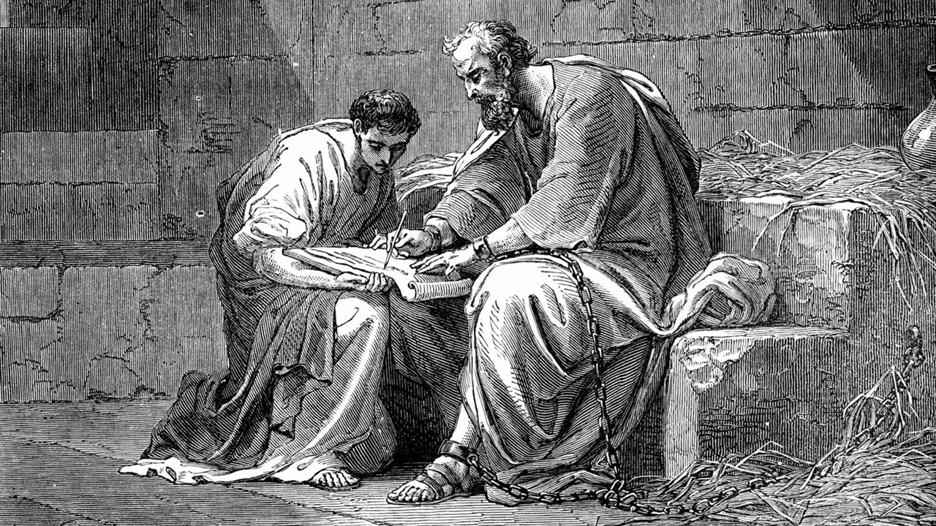
Philippians chapter 1
¹ We are Paul and Timothy. We serve God’s Messiah Jesus. We are writing this to Messiah Jesus’ dedicated followers who reside in Phillipi City. These include your overseers and appointed workers.
Elders
● Overseers:
● Deacons:
Speaking gifts: guidance.
Serving gifts: provision.

Slide 5
² We want you to experience the kindness and peace which God our Father and our Lord Jesus Messiah give.
● Kindness:
● Peace:
● God:
● Lord:
● Jesus:
● Messiah:
Grace = power to do good.
Harmonious relations.
Creator, Provider, Protector.
Rightful Commander.
Fully human.
Promised Savior-King.

Slide 6
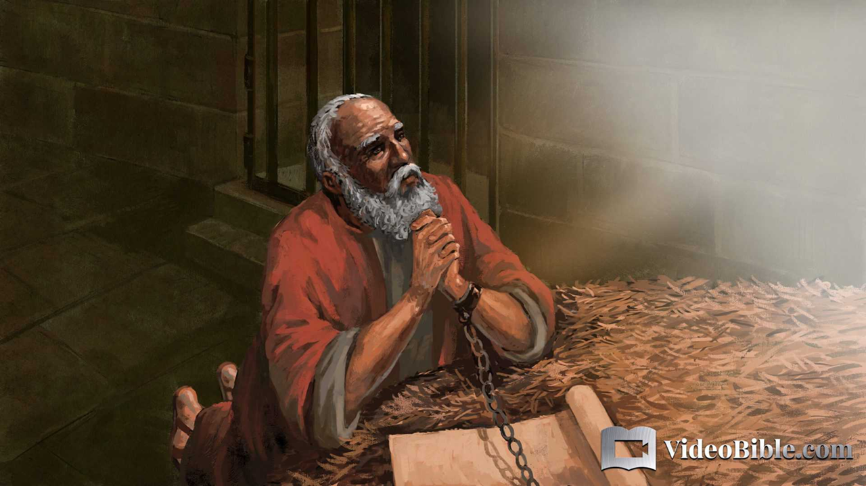
³ I always thank my God, every time I mention you ⁴ during my daily prayers.
I pray joyfully, ⁵ because you and I have remained partners in announcing the Good News, from the early days until now.
● Thank:
● Pray:
● Partners:
Reflecting ‘grace’ to God.
Making requests to God.
Sharing costs and benefits.

Slide 7
Pray for results
● Hope: Grace and peace.
● Thanks: Past & recent results.
● Prayers: Regular and spontaneous.
● Confident: God completes his work.
● Joy: Fruit of the Holy Spirit.
● Request: Love, know, discern, approve, remain pure, blameless.
● God: Glory and praise.

Slide 8
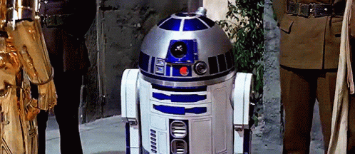
R²D²

Slide 9
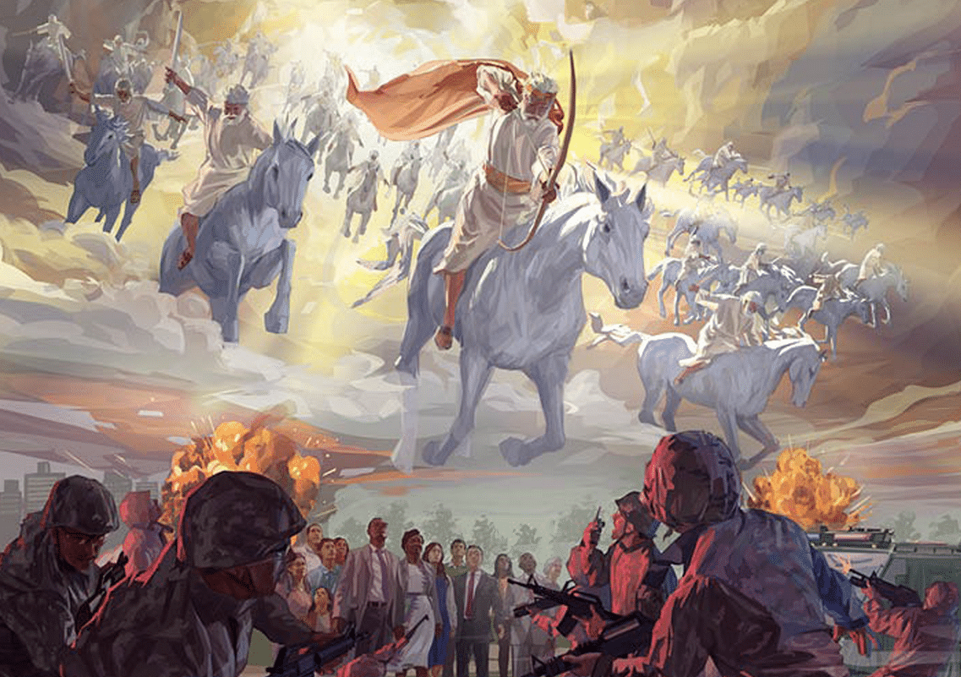
⁶ This persuades me that he who began this good work amongst you will mature it until Messiah returns.
● Persuade:
● Good:
● Work:
● Amongst:
● Mature:
● Returns:
Based on evidence.
Useful for purpose.
Ergon, energetic activity.
Group efforts.
Moving towards a goal.
When what task is complete?

Slide 10
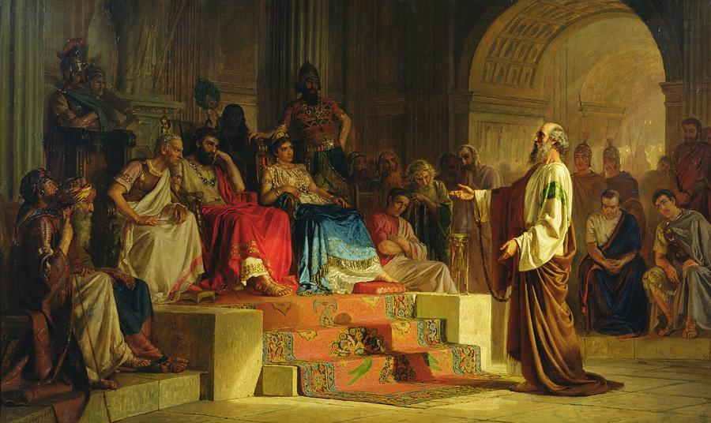
⁷ It is my right to continue thinking this about you all, because you are always on my mind.
Whether I am in prison, or I am defending and explaining the Good News, you all kindly remain my partners.
● Think:
● Defend:
● Explain:
Spiritual includes mental.
Answering detractors.
What is the gospel’s content?

Slide 11
⁸ God is my witness! He sees how much I long for you with the affection which Messiah Jesus gives me for you all.
⁹ I also pray for this: that your love continue increasing more and more, along with understanding and all insight.
● Affection:
● Love:
● Insight:
‘Intestines’, emotional love.
Agape, volitional love.
Moral discernment.

Slide 12
¹⁰ This will always enable you to approve the things which are most important. As a result, you will remain pure and blameless until Messiah returns.
¹¹ This is because you are motivated to do righteous work, which comes through obeying Jesus Messiah, which brings glory and praise to God.
● What is the ultimate test of morality?

Slide 13
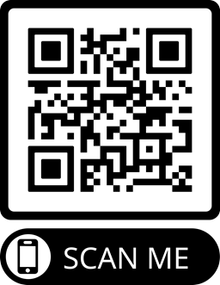
Assignment
● Read the entire epistle his week.
● Study 1:12-30 at netbible.org
● Visit http://philippians.site
● Memorize one verse.

Slide 14
¹ Verse
¹ Verse
● Text

Slide 15
…
¹ …
¹ …
● Text: …

