Slide 1
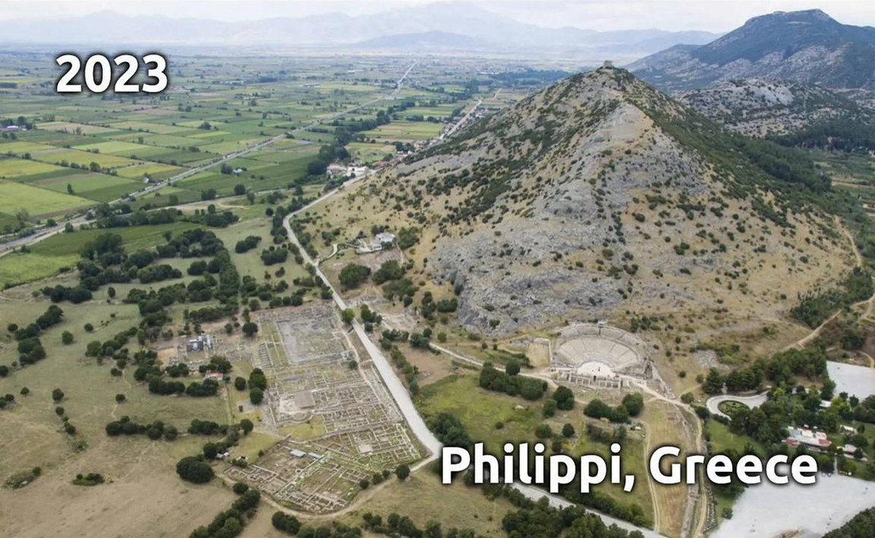
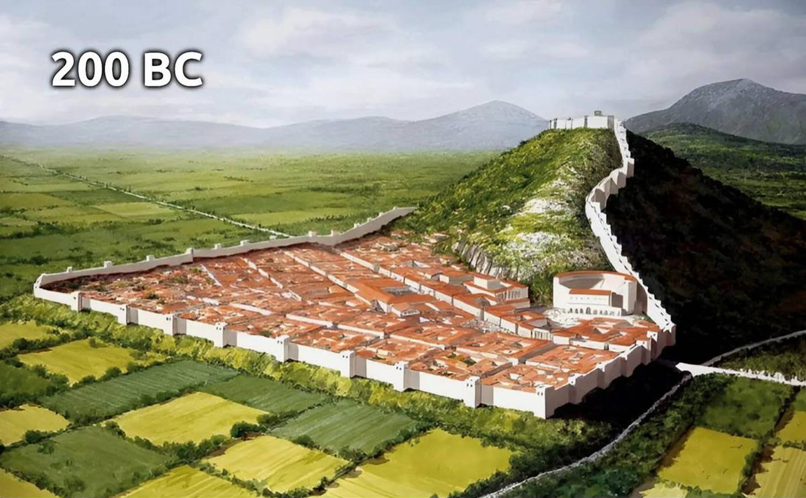
Epistle to the Philippians 1:12-26
A Short Course for Men

Slide 2
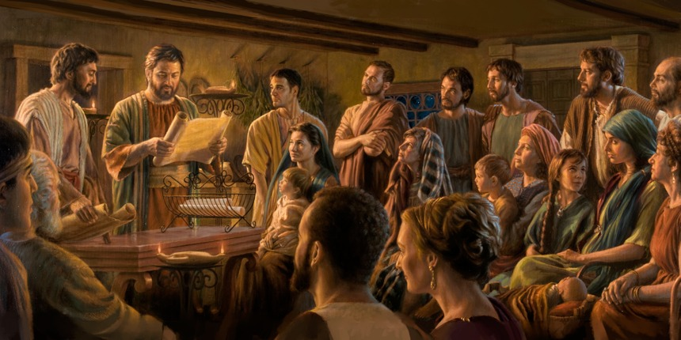
STRUCTURE
l. Thankful Prayer (1:1-11)
II. Paul's Missionary Report (1:12-26)
III. God’s Call to Be Holy (1.27–2:30)
IV. Doctrinal Polemics (3:1–4:1)
V. Joyful Partnership (4:2-23)

Slide 3
Outline
Paul’s Missionary Report 1:12-26
Current conditions 12-17
Gospel progress 12-14
Advance with adversity 15-17
Constant attitude 18-26
Joy from the Lord 18-20
Death or more fruit 21-24
Progress and joy 25-26

Slide 4
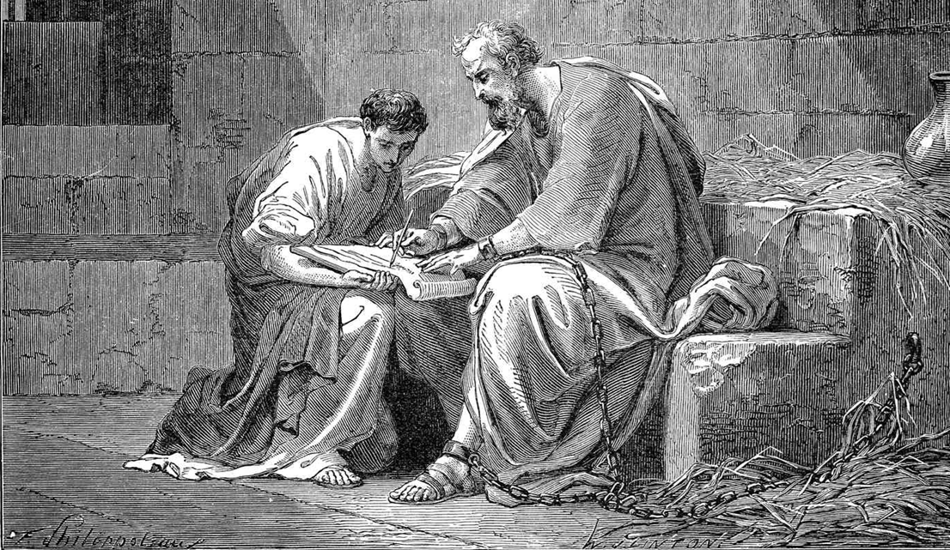
12-17 Current conditions
¹² Dear friends, I want you to know that my situation has actually allowed the Good News to spread farther.
¹³ As a result, it has become clear, to the imperial guards, and to everyone else, that I am confined in chains as a Christian.
● Describe Paul’s situation.

Slide 5
“I want you to know”
‘I often intended to come to you’ Rom 1:13
‘All passed through the sea’ 1 Cor 10:1
‘Grace … among the churches’ 2 Cor 8:1
‘Happened to advance the gospel’ Phil 1:12
‘The struggle I have for you’ Col 2:1

Slide 6
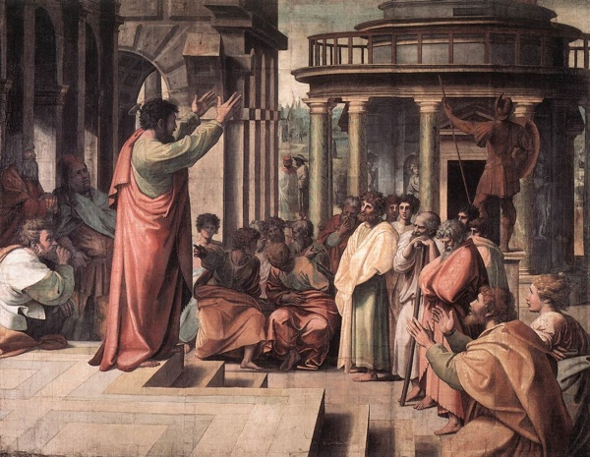
¹⁴ Also, my being in chains has caused most of the Lord’s people fearlessly to dare to speak the Lord’s message.
¹⁵ Of course, some folk who announce the Messiah do so because they are envious and quarrelsome, but others do so with pure motives.
● What is the Lord’s message?
● Envious of what? While quarrelsome?

Slide 7
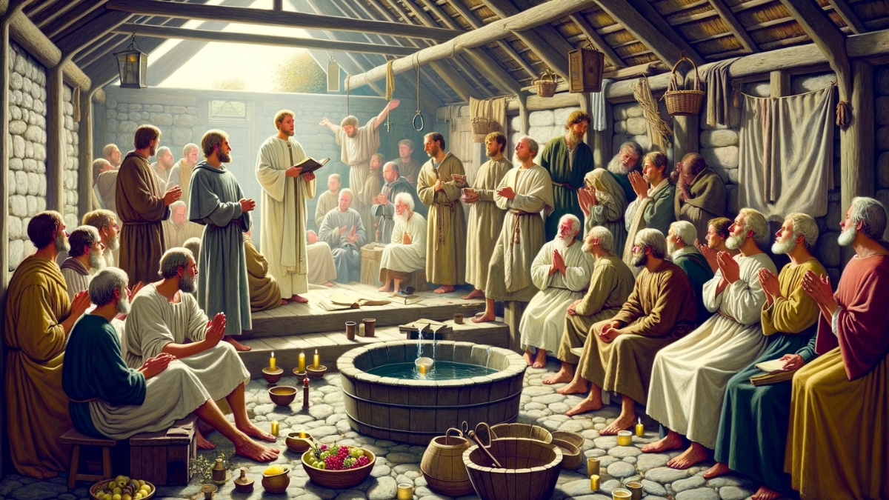
¹⁶ These folk love me, knowing that my purpose is to defend the Good News.
¹⁷ But those others announce the Messiah with selfish motives, not pure motives, supposing that they can cause me more trouble while I am in confine-ment.
● Defend from what?
● More trouble from whom?

Slide 8
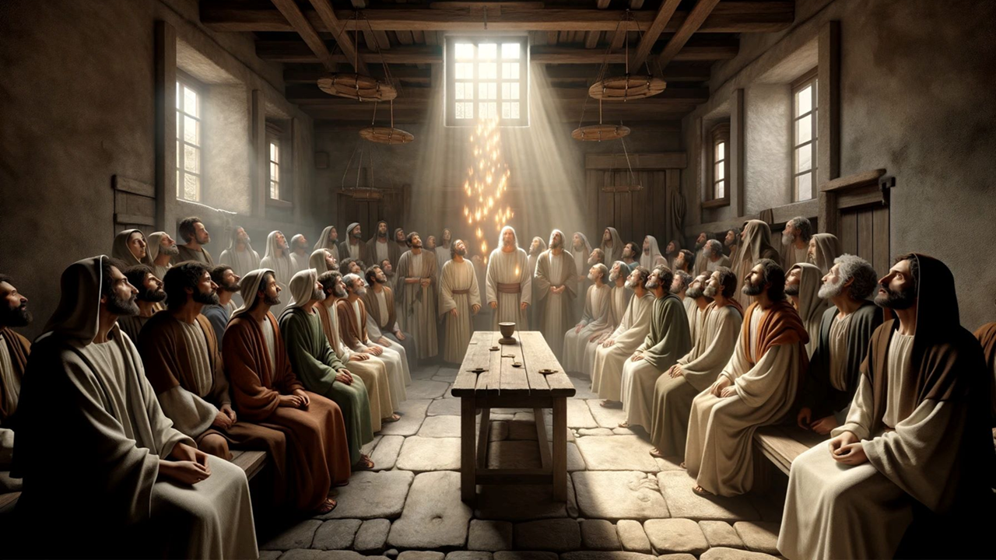
18-26 Constant attitude
¹⁸ So what? Well, by all means, whether by pretext or in sincerely, folk are announcing the Messiah.
In this I rejoice.
● Why Messiah? Why not God, the Lord, or just Jesus?
● What was the ‘issue’ about Paul and Messiah Jesus in the early church?

Slide 9
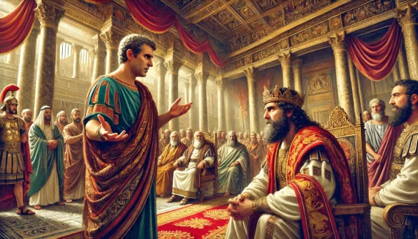
Moreover, I shall soon rejoice, ¹⁹ because I know that this will result in my release through your prayers and through the help which Messiah Jesus’ Spirit gives me.
● What did Jesus say to his apostles about when they would have to give a defense before kings? Matt 10:15-20

Slide 10
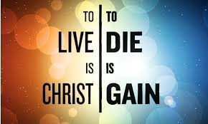
²⁰ Anyway, this is what I except and hope for. This is because I am never reticent, but with all boldness, as in the past so now, too, I will exalt Christ in my body, whether by life or by death.
²¹ After all, I live only to serve Christ, and when I die, he will reward me.
● Hendiadys: ‘expect and hope’.

Slide 11
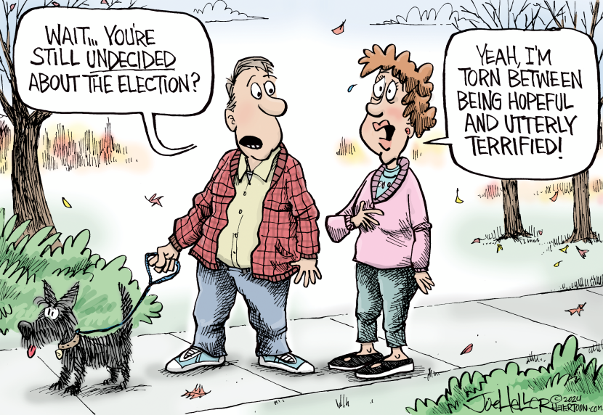
²² Thus, the life which I lead in my body allows me to do more productive work, yet which I should choose I do not know.
²³ I am torn betwixt the two: I would prefer to die and go be with Christ, which would be better for me, ²⁴ but for me to remain in my body would be better for you.
● Better: In what ways?

Slide 12
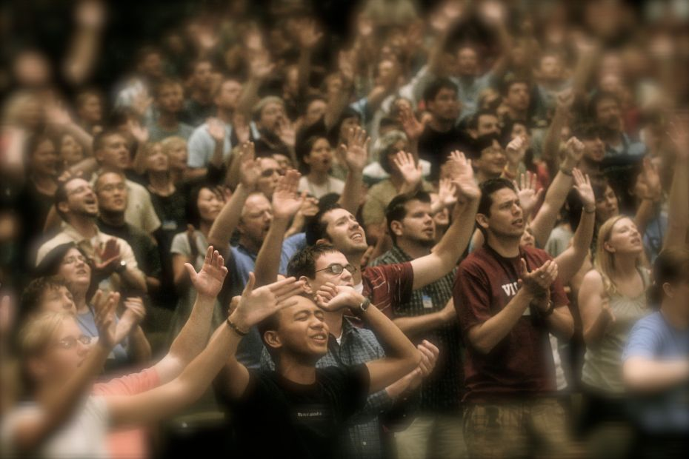
²⁵ This convinces me that I shall remain and continue helping you increase the joy which faith gives.
²⁶ As a result, you will boast more about Messiah Jesus because of me when I come again to you.
● What are some reasons for which we ought to reverse our illnesses?

Slide 13
Assignment
● Read the entire epistle this week.
● Study 1:27–2:4 at netbible.org
● Visit http://philippians.site
● Memorize one verse.

Slide 14
¹ Verse
¹ Verse
● Text

Slide 15
…
¹ …
¹ …
● Text: …

