Slide 1
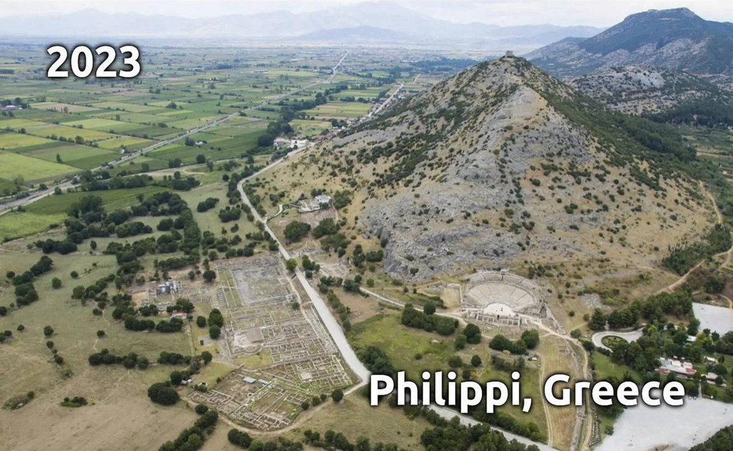
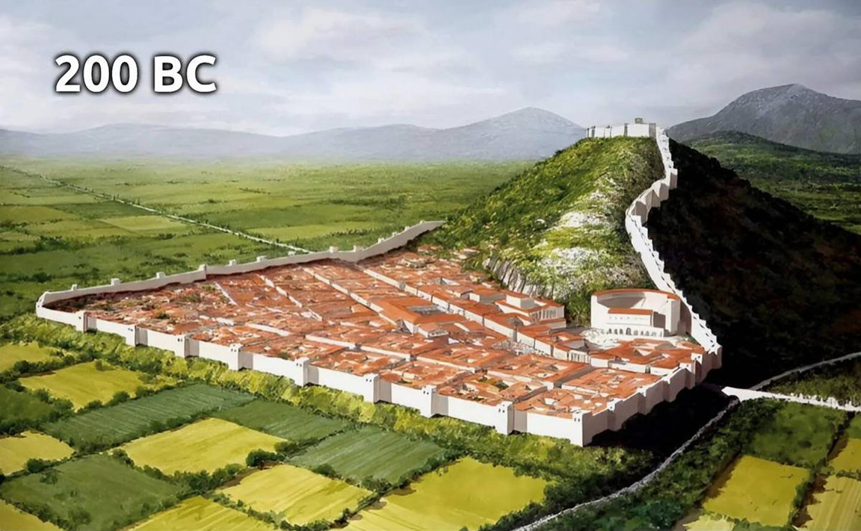
Epistle to the Philippians 1:27–2:4
A Short Course for Men

Slide 2
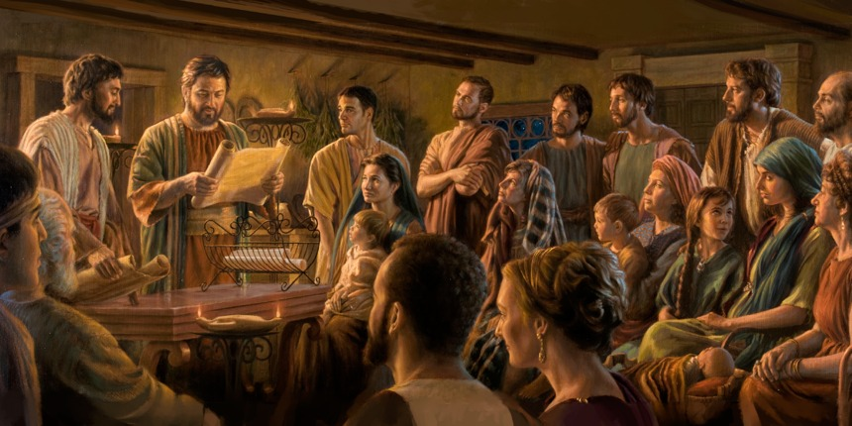
STRUCTURE
l. Thankful Prayer (1:1-11)
II. Paul's Missionary Report (1:12-26)
III. God’s Call to Be Holy (1.27–2:30)
IV. Doctrinal Polemics (3:1–4:1)
V. Joyful Partnership (4:2-23)

Slide 3
OUTLINE
God’s Call to be Holy 1:27-2:30
Christian Community 1:27-2:4
Tenacity 1:27-28
Suffering 1:29-30
Unity 2:1-4
Christian Humility 2:5-11
Christian Obedience 2:12-18

Slide 4
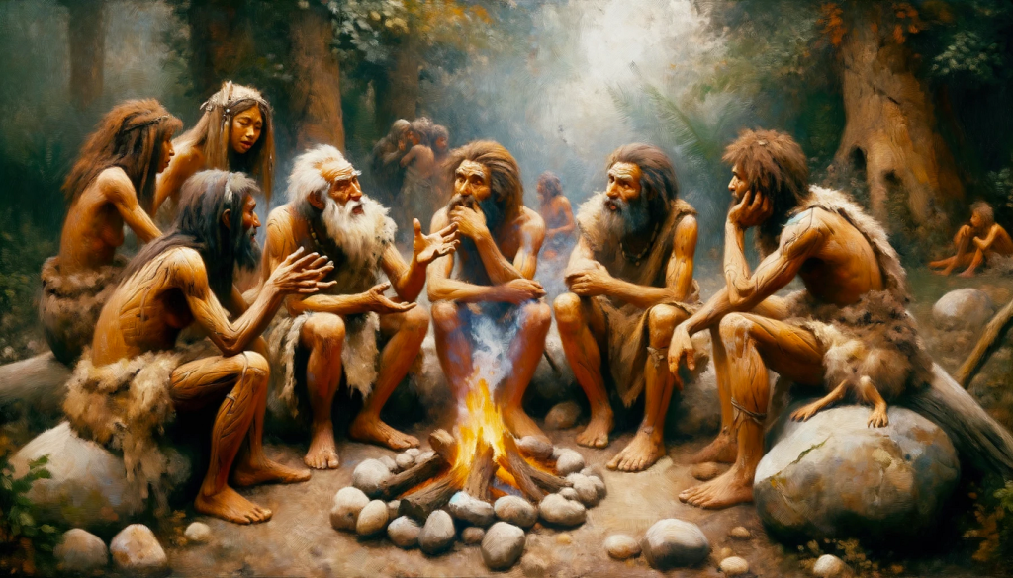
Bible Translation Guidelines
● Human languages carry four kinds of information: actors, actions, relations, and abstracts (e.g., love).
● Languages arrange ideas by grammar, syntax (word order), and discourse.
● Words have denotation (cognitive referents) and connotation (subjective feelings).

Slide 5
● No two languages have word-for-word exact correspondence.
● Where the Greek NT translates the Hebrew OT, there is always difference.
● All translations are paraphrases.
● A version which claims to be an exact translation is fibbing.
● Most Bible translations are sufficient to communicate essential truth.

Slide 6
Good Translations
● Preserve all the information from the original.
● Include no extraneous information.
● Employ normal speech patterns in the readers’ language.
● Adjusted to readers’ or hearers’ ability to understand.

Slide 7
New translations are needed for
● The illiterate and oral learners.
● Age and education levels.
● Liturgical (church) usage.
● The highly literate.
● Scholars and exegetes.
● Different ethnic and faith backgrounds.
● Changes in language and discoveries.

Slide 8
Mistranslations
● Seminarians who know a little Greek.
● Sects promoting weird doctrines.
● Ignorant of advances in linguistic, textual, and cultural studies.
● Atheists and religious missionaries twisting texts to support their ideas.
● Christians seeking to preserve or to promote denominational practices.

Slide 9
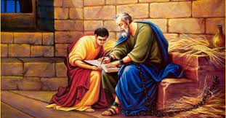
Philippians 1:27–2:4
In the original Greek, 1:27-29 forms one long sentence, and 2:1-4 another long sentence.

Slide 10
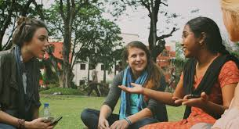
After reading each slide, reply to these three queries:
● What do we learn from these words?
● What must we believe or trust?
● What must we do or obey?

Slide 11
Greek-English word-for-word
1 ²⁷ Only worthily of-the evangel of-the Christ make-yourselves-citizens, so whether coming and seeing, whether absenting, I-am-hearing the things about you, that you-are-standing in one spirit, one-psyche, together-contending in-the faithfulness of-the evangel …

Slide 12
Christian Tenacity
1 ²⁷ Only, keep on dwelling together in a way which honors the Good News about Messiah, so that, whether or not I come see you,
I shall hear about you that you stand together with one purpose, helping each other to remain faithful to the Good News.
● Dwelling: politeo, to dwell as citizens.

Slide 13
Greek-English word-for-word
²⁸ and not being-intimidated in nothing under the opposers, which-thing is for-them proof of-perdition, but of-you of-salvation, and that-thing from God;

Slide 14
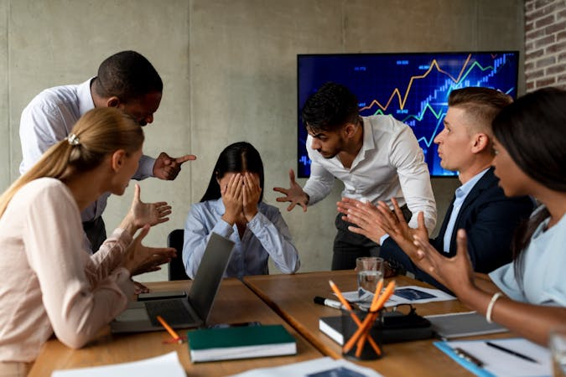
²⁸ Do not be intimidated in any way by those who oppose you. Your faith in the Good News means that they are lost, and that it is God who has saved you.
● Frightened:
● Oppose:
● Faith:
● Means:
● Lost/saved:
That you might be wrong.
Jews, Romans, Judaizers.
Faithful, versus merit.
‘is your sign’ (to them).
God’s choice.

Slide 15
Greek-English word-for-word
²⁹ that to-you it-was-gifted the for Christ, not only the unto him agony having, but also the for him to-be-suffering, ³⁰ the same agony having, sort you-are-seeing in me and now you-are-hearing in me.

Slide 16
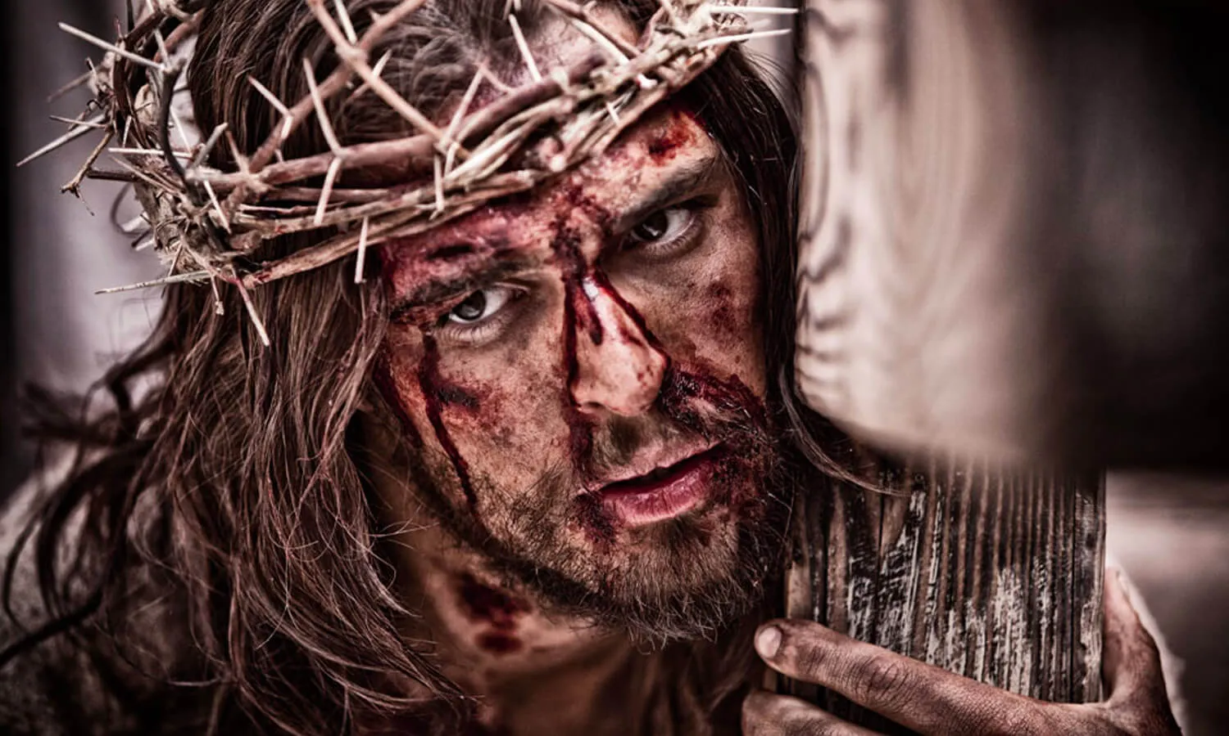
Christian Suffering
²⁹ This is because God has given to you, for Messiah’s sake, not only to believe in him, but also to suffer for him.
³⁰ Thus, you have the same struggle which you saw me have, and now hear that I have.
● Suffer:
● Struggle:
Rejection, grief, loss, pain.
For grace, against legalists.

Slide 17
Greek-English word-for-word
2 ¹ that to-you it-was-gifted the for Christ, not only the unto him agony having, but also the for him to-be-suffering,
² make-full of-me the joy so the same-thing you-think, the same love you-having, harmonious-ones, the one-thing you-be-thinking,

Slide 18
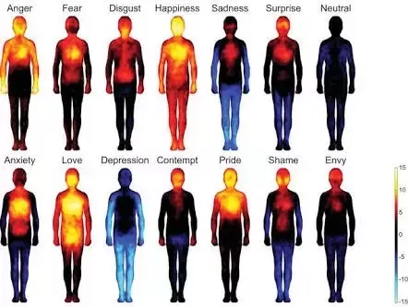
Christian Unity
2 ¹ Messiah comforts us Christians, we sense the Father’s love for us, the Holy Spirit draws us together, and we have heart-felt affection for others.
² So, give me more joy by thinking about the same things. Have the same love, the same purpose, thinking about one thing: our struggle, …

Slide 19
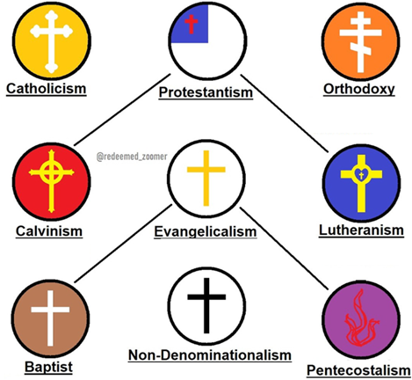
Christian Struggles
● Fleshly desires: addictive food & drink, immoral relations, illegal activities.
● The world and the devil: political conflict, religions & ideologies, hostile authorities, deceiving spirits.
● Christian deviants: legalists, charlatans, priest-craft, enthusiasts, antinomians (lawless), theological systems.

Slide 20
Greek-English word-for-word
³ nothing by-rivalry nor by vainglory but by-the humility one-another you-are-considering they-surpassing yourselves,
⁴ not the own-things each-one watching but also the-things of-others each-ones.

Slide 21
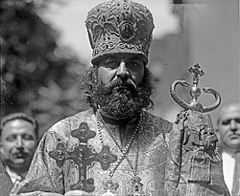
³ Do not do anything from self-interest or vain-glory, Instead, serve one another by treating others as more important than ourselves.
⁴ Whilst each one is meeting his own needs, we should, each one, also be meeting others’ needs.
● Meet needs: scopeo, ‘watching’.
● 2:1-4: One long Greek sentence.

Slide 22
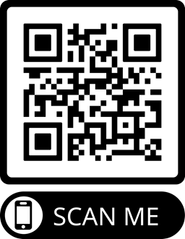
Assignment
● Read the entire epistle this week.
● Study 2:5-11 at www.netbible.org
● Visit http://philippians.site
● Memorize one verse.

Slide 23
Titre
● …
● ...
● ...
● ...
● ...

Slide 24
Titre
¹ Verset
¹ Verset
● Texte

Slide 25
¹ Verse
¹ Verse
● Text

