Slide 1
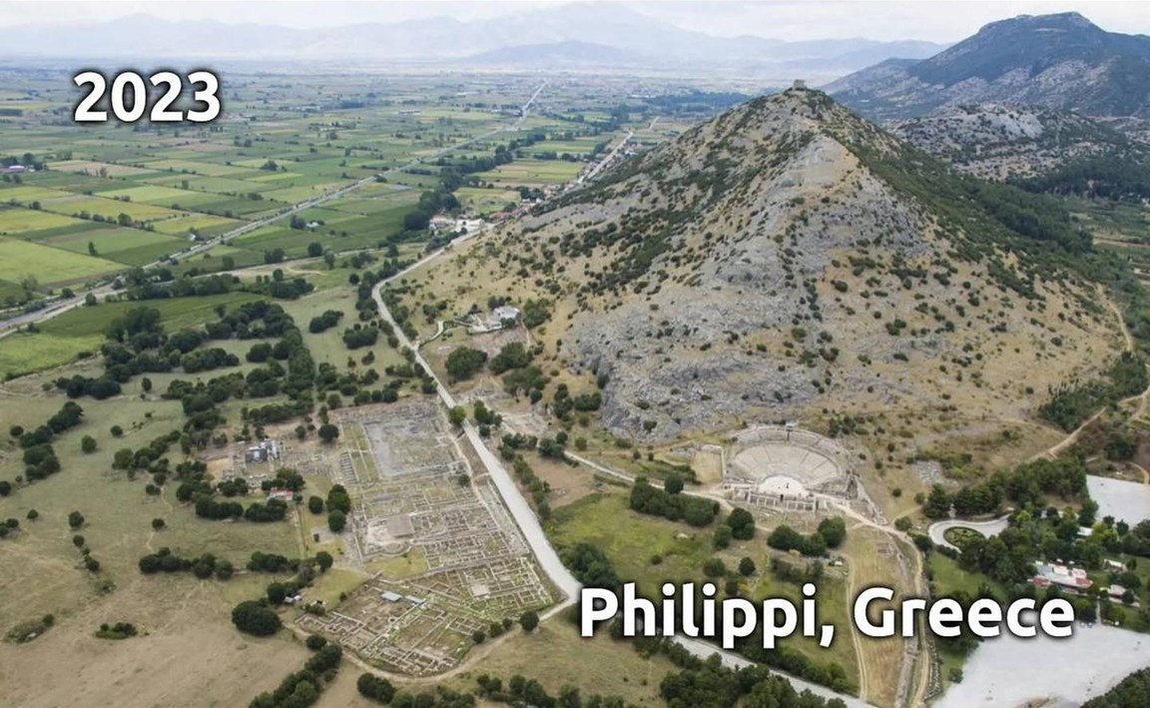
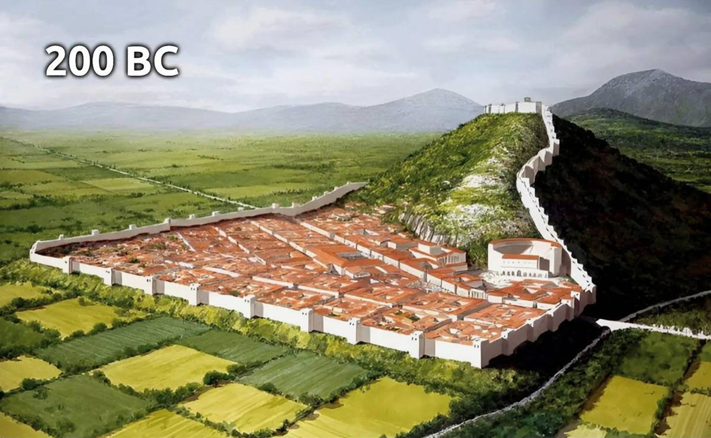
Epistle to the Philippians 2:5-11
A Short Course for Men

Slide 2
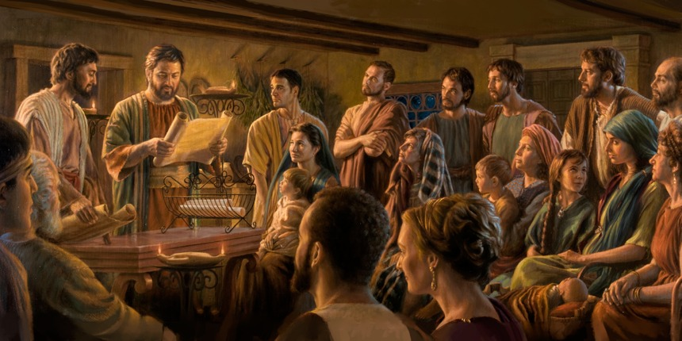
STRUCTURE
l. Thankful Prayer (1:1-11)
II. Paul's Missionary Report (1:12-26)
III. God’s Call to Be Holy (1.27–2:30)
IV. Doctrinal Polemics (3:1–4:1)
V. Joyful Partnership (4:2-23)

Slide 3
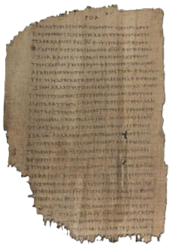
OUTLINE
God’s Call to be Holy 1:27-2:30
Christian Humility 2:5-11
Paul’s exhortation 5
Jesus’ example 6-11
As God 6-7a
As Man 7b-8
Jesus’ exaltation 9-11
Christian Obedience 2:12-18
Papyrus P46 2nd century

Slide 4
Paul’s exhortation 5
⁵ [For] This you-be-thinking [~Think] in you, which also in Christ Jesus.
⁵ Keep thinking this among you: that which Messiah Jesus was thinking.
⁵ Keep thinking this about yourselves: that which you think about Messiah Jesus.

Slide 5
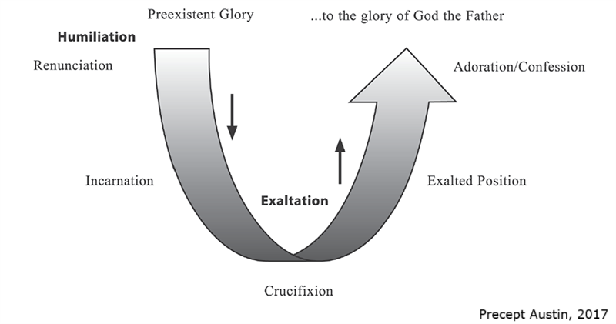
Humiliation, stage one
Divine humiliation 6-7a
who in the form of God existing
not an advantage considered his being equal with God
but nothing he made himself
the form of a servant adopting

Slide 6
Humiliation, stage two
Human humiliation 7b-8
in likeness of men becoming
and in appearance being found as man
he humbled himself
becoming obedient to death

Slide 7
Jesus’ example as God 6
⁶ Who in form of-God existing,
Not property he-regarded
The to-be equally to-God,
⁶ Although he was real God,
He did not regard being God’s equal,
Something which he had to retain.
● Real: morphé. (‘form’ implies fake.)

Slide 8
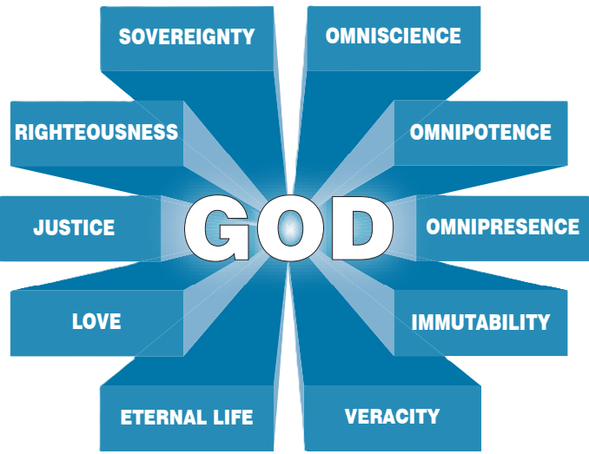
The Essence of God
● Sovereignty: All authority
● Righteousness: Always right
● Justice: Always fair
● Love: Always good
● Eternal life: Always alive

Slide 9
The Essence of God
● Omniscience: All knowing
● Omnipotence: All powerful
● Omnipresence: Always everywhere
● Immutability: Never changing
● Veracity: Always truthful

Slide 10
Jesus’ example as God 7a
^{7a} But himself emptied,
Form of-servant taking,
In similarity of-humans [~of a human]
becoming, …
^{7a} Instead, he divested himself
By becoming a real servant.
He became human in every way, …
● Emptied: ➔ Theological speculation.

Slide 11
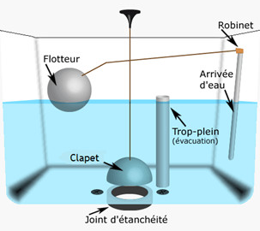
Kenosis theories
● Chalcedonian (AD 451). Fully God and fully human, Jesus experienced authentic human limitations.
● Radical (19th cent). Jesus abandoned some divine attributes such as omniscience or omnipotence.
● Example. The prime pattern of self-sacrificing humility.

Slide 12
Jesus’ example as Man 7b-8
^{7b} And outwardly found as human,
⁸ He-humbled himself
Becoming obedient until death,
And death of-cross.
^{7b} And having appeared as a human being, ⁸ He humbled himself,
By becoming obedient unto death.
Death on a cross!

Slide 13
Jesus’ exaltation 9
⁹ So, also the God him above-upped
And graced to-him the [~a] name
The above every name.
⁹ Wherefore the God also highly exalted him,
And has given to him the Name
Which is above every other name.
● Name: real personal presence

Slide 14
Jesus’ exaltation 10
¹⁰ So-that in the name of-Jesus
Every knee bend
of-those-above-sky and of-those-upon land, and of-those-under-ground.
¹⁰ As a result, at Jesus’ Name
Every knee must bend to give him honor,
in heaven, on earth, and underground.
● Result: hina, purpose or result clause.

Slide 15
Jesus’ exaltation 11
¹¹ And every tongue out-same-speak that Lord (is) Jesus Messiah,
Unto glory of-God of-Father.
¹¹ And everyone must admit verbally that Jesus Messiah is the Lord.
This glorifies God his Father.
● Lord: predicate nominative, definite

Slide 16
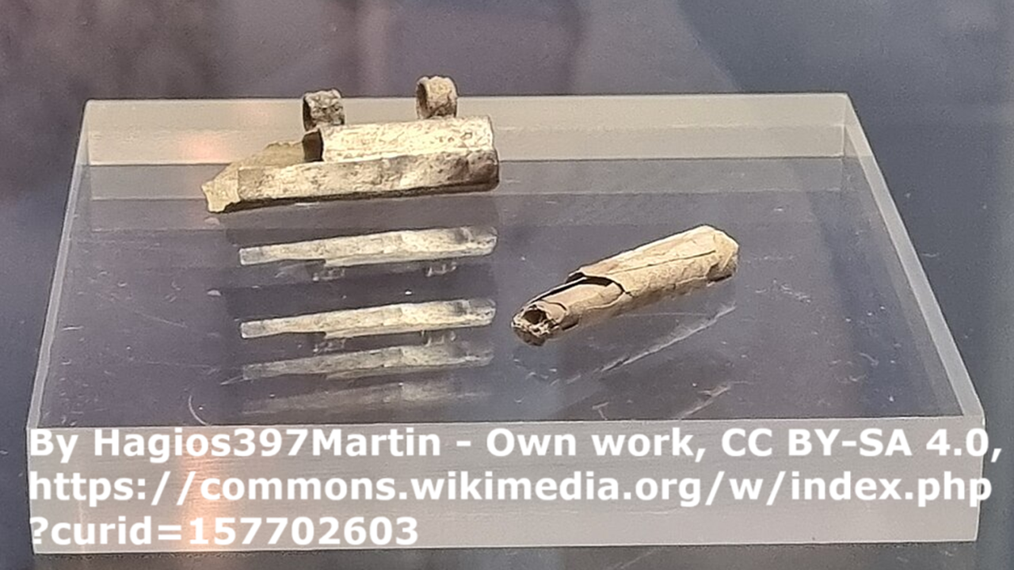
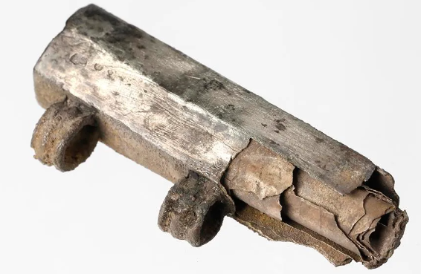
Frankfurt silver inscription
Mid-third century. Discovered 2018 at Frankfurt.
[In the name?] of St. Titus.
Holy, holy, holy!
In the name of Jesus Christ, Son of God!
[...]
That at the name of Jesus Christ every knee should bow, of those in heaven, and on earth, and under the earth, and every tongue should confess…
Lines 1–3, 13–18
[in nomi?]NE SANCTI TITĪ
AGIOS AGIOS AGIOS
[in] NOMINE IHS XP DEI F(ilii)
[...]
QVONIAM IHS XP OMNES{T} GENVA FLECTENT CAELESTES TERRESTRES ET INFERI ET OMNIS LINGVA CONFITEATVR
Lines 1–3, 13–18

Slide 17
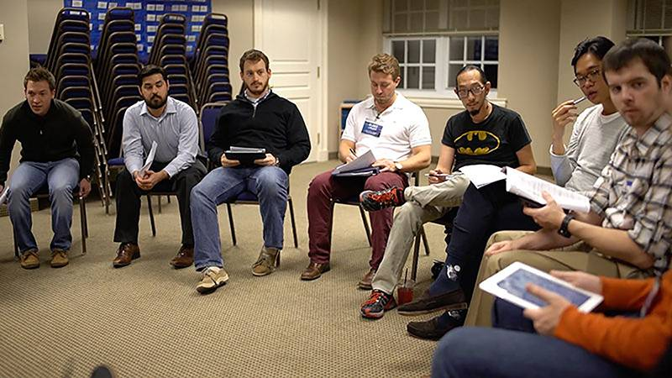
Discuss
When you choose to serve others, what is likely to happen to you?
● Powerful people will despise you.
● Others will ignore you as useless.
● Leaders will exploit you to their gain.
● God will teach you insights and skills.
● God will exalt your influence.
● You learn to exalt other humble folk.

Slide 18
Assignment
● Read the entire epistle this week.
● Study 2:12-18 at www.netbible.org
● Visit http://philippians.site
● Memorize one verse.

Slide 19
Titre
● …
● ...
● ...
● ...
● ...

Slide 20
Titre
¹ Verset
¹ Verset
● Texte

Slide 21
¹ Verse
¹ Verse
● Text

