Slide 1
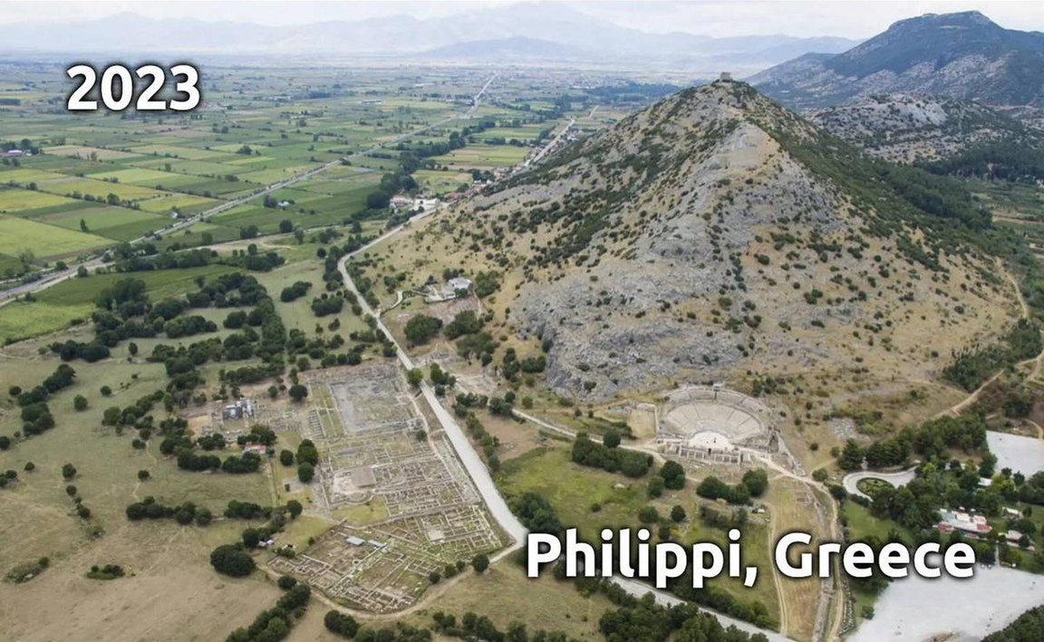
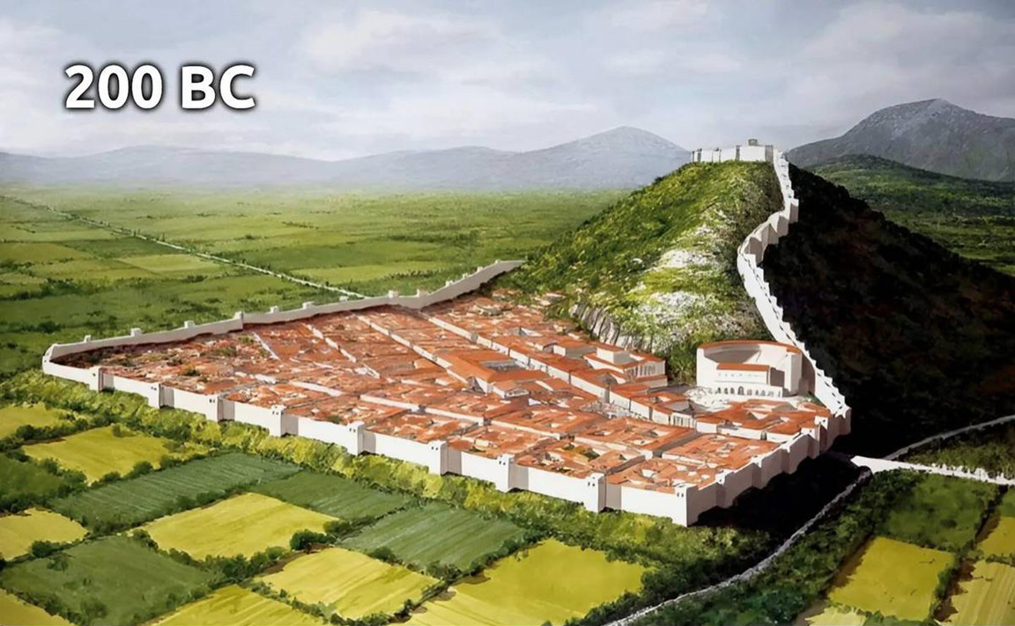
Epistle to the Philippians 2:12-18
A Short Course for Men

Slide 2
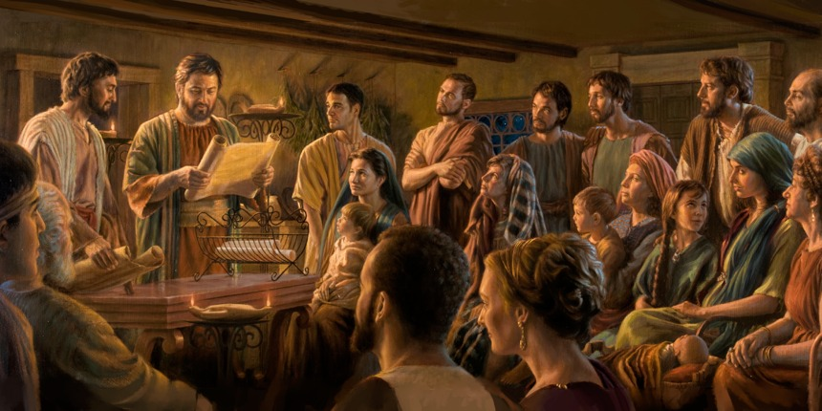
STRUCTURE
l. Thankful Prayer (1:1-11)
II. Paul's Missionary Report (1:12-26)
III. God’s Call to Be Holy (1.27–2:30)
IV. Doctrinal Polemics (3:1–4:1)
V. Joyful Partnership (4:2-23)

Slide 3
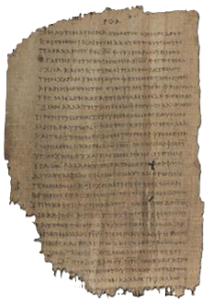
OUTLINE
God’s Call to be Holy 1:27-2:30
Christian Citizenship 1:27-2:4
Christian Humility 2:5-11
Christian Obedience 2:12-18
Work 2:12-13
Character 2:14-16
Sacrifice 2:17-18
Christian Service 2:19-30
Papyrus 𝔓46, circa 175–225

Slide 4
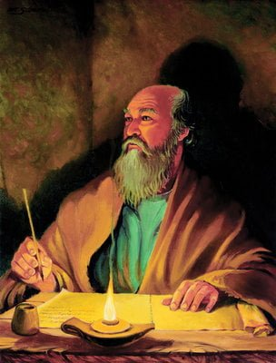
Christian obedience: Work
¹² So then, you whom I love, since you have always obeyed, not only when I was present with you, but much more now that I am absent from you,
continue putting your salvation to work.
● Obey:
● Present/absent:
● Continue:
Hear and do
Par·ousia/ap·ousia
Progressive tense

Slide 5
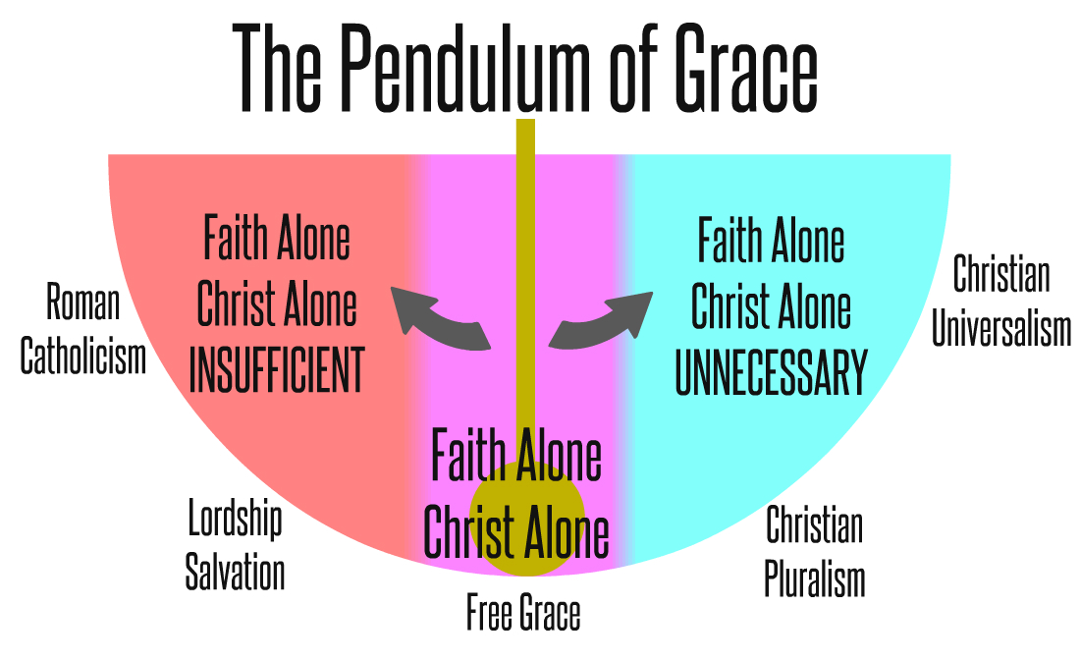
Work theories
● Earn your salvation by your own effort.
● Keep your salvation by your own effort.
● Earn rewards in heaven by good deeds.
● Already saved, collaborate with God.
● Already saved, collaborate with others.
● Realize the benefits of free salvation.
● Continue putting salvation to work.

Slide 6
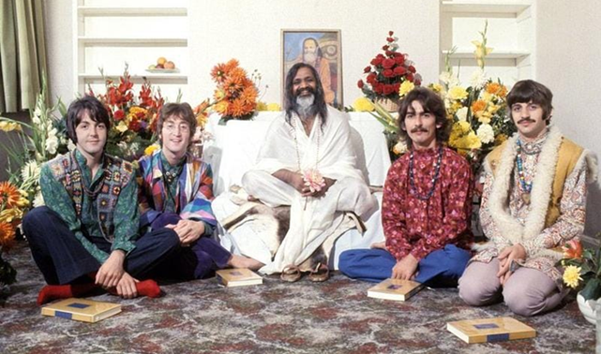
Christian obedience
● ‘Saved by grace through faith(fulness)’.
● ‘If you love me, then you will obey me.’
● ‘Teach them to obey my commands.’
● ‘Believe in God, believe also in me.’
● Jesus gave 300+ commands. See site.
● Conversion: Repent, believe, baptized, and receive the Holy Spirit. Mk 1⁵ Ac 2³⁸
● Obedience: Faithful loyalty in action.

Slide 7
Christian Salvation
● Initial: Repent and believe the gospel.
● Power: Break harmful addictions.
● Spiritual: Defeat the devil and demons.
● Growth: Character development.
● Health: Healing and sanity.
● Social: Community change.
● Church: Peaceful collaboration.
● Forever: Everlasting life.

Slide 8
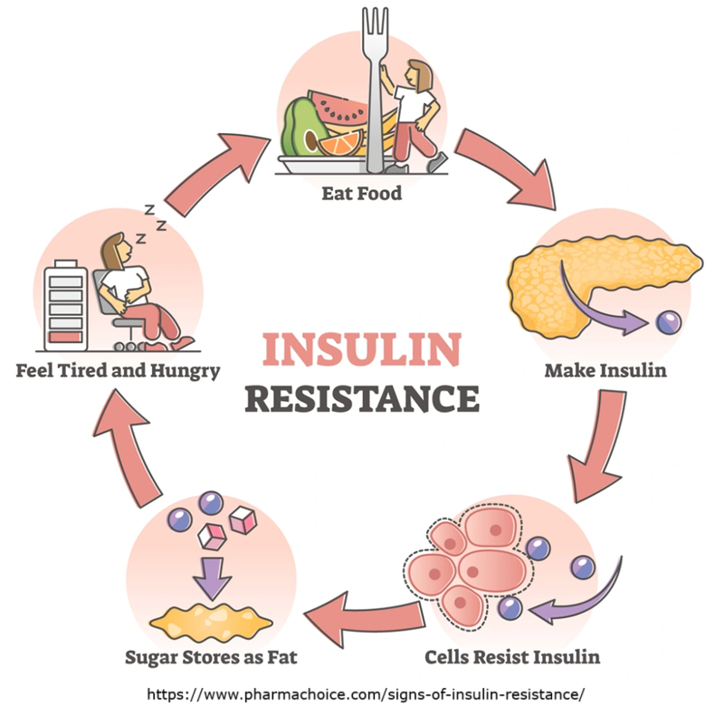
Causes of disease
● Malnutrition: Lacking nutrients.
● Infection: Pathogens parasites, bacteria, viruses
● Toxins: Venoms, chemicals, poisons.
● Stress: Biochemical perturbance.
● Metabolic: Insulin resistance caused by high-glycemic foods (sugar), ➔ obesity, strokes, dementia, heart failure, tumors.
● Spiritual: Spite, vengeance, scorn.

Slide 9
Christian obedience: Work
¹³ For God is the one working among you, both to be willing and to be doing what delights him.
● God:
● Working/doing:
● Willing:
● Delights:
‘Let go and let God.’
energèo, energizing.
Set motivating goals.
Joyfully obedient.

Slide 10
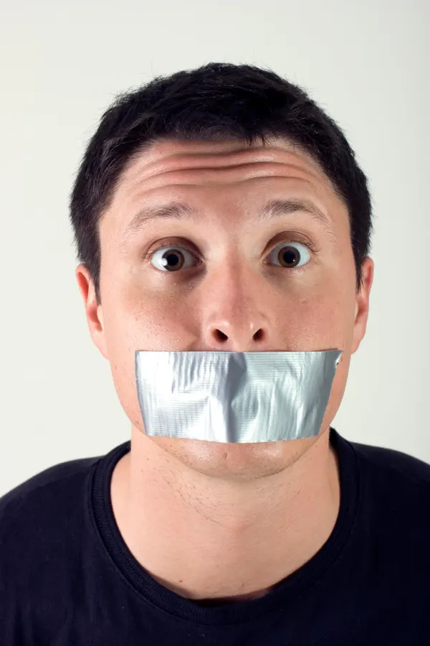
Christian obedience: Character
¹⁴ Continue doing everything without grumbling or disputing.
● Continue:
● Everything:
● Grumbling:
● Disputing:
● Advice:
Progressive tense.
Speech and conduct.
Expressing discontent.
dialogismos.
Assume that the Holy Spirit is speaking to our leaders.

Slide 11
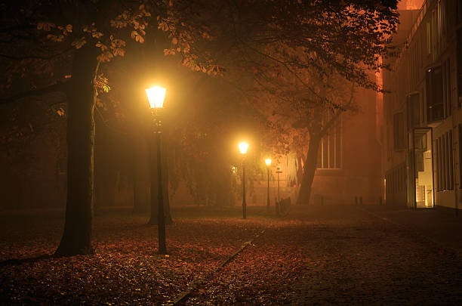
Christian obedience: Character
¹⁵ As a result, you will become blameless and faultless, God’s innocent children, in the midst of a crooked, perverted generation, among whom you shine as lamps in the world system.
● Result:
● Crooked:
● Perverted:
Hina, either purpose or result.
Lawless, criminal behavior.
Immoral behavior.

Slide 12
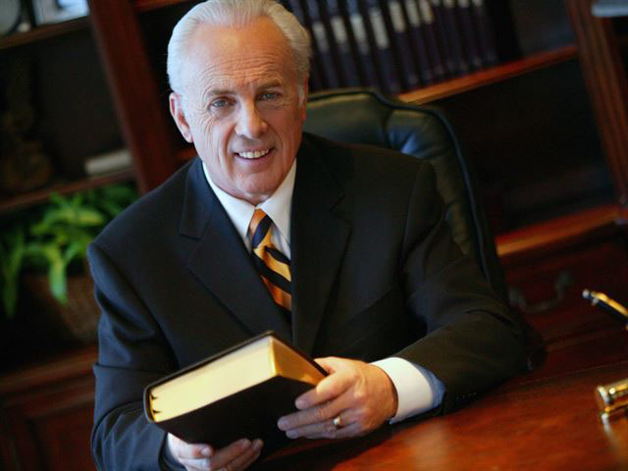
Christian obedience: Character
¹⁶ You do this by holding firmly to Jesus’ message about everlasting life.
As a benefit to me, I shall exalt when Messiah returns, because I neither ran nor worked without results among you.
● Message:
● Life:
● Exalt:
From Jesus & about Jesus.
Resurrection and kingdom.
To be very glad.

Slide 13
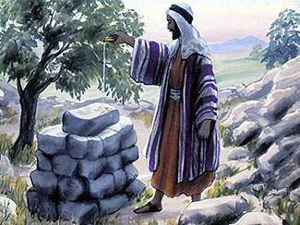
Christian obedience: Sacrifice
¹⁷ Even though my life is like an offering poured out as a sacrifice, as I serve God by strengthening your loyal faith in Jesus…
● Sacrifice:
● Serving:
● Faith:
It costs us to please God.
Leitourgia, done for God.
Pistis, faithfulness.

Slide 14
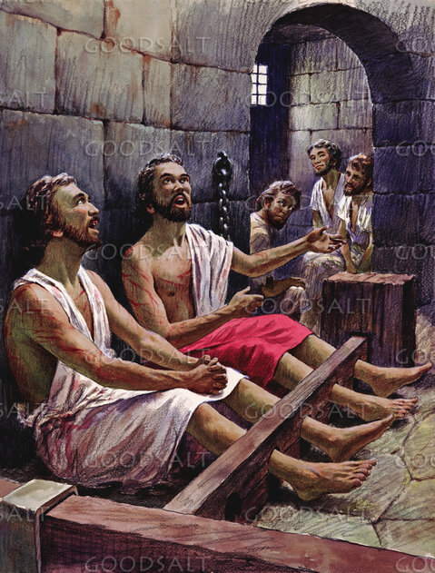
Christian obedience: Sacrifice
I rejoice alone, and I rejoice with you all. ¹⁸ In the same way, you, too, rejoice, and you rejoice with me.
● Rejoice:
● With:
Xairō, to be glad. A promise of Jesus (Jn 15¹¹ 16²⁴), and a ‘fruit’ of the Holy Spirit (Ga 5²⁴).
Syn·xairō.

Slide 15
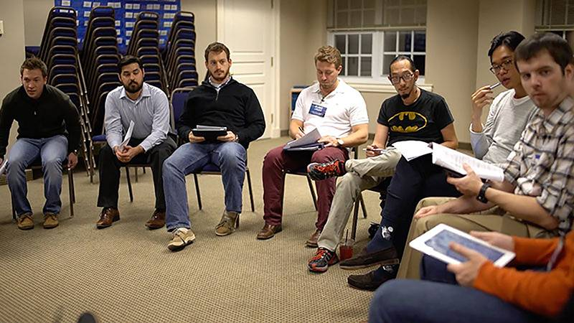
Discuss
How shall we react to the next change which our elders may propose?
● Stand our ground against them?
● Marshall arguments and debate them?
● Try to understand their point of view?
● Try something new & see how it goes?
● Take our tithes and change church?
● Cave in to their ‘manipulation’?

Slide 16
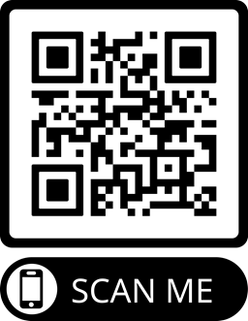
Assignment
● Read the entire epistle this week.
● Study 2:19-30 at www.netbible.org
● Visit http://philippians.site
● Memorize one verse.

Slide 17
Titre
● …
● ...
● ...
● ...
● ...

Slide 18
Titre
● …: …
● …: …
● …: …
● …: …
● …: …
● …: …
● …: …
● …: …

Slide 19
Titre
¹ Verset
¹ Verset
● Texte

Slide 20
¹ Verse
¹ Verse
● Text

Slide 21
Discuss
?
● .
● .
● .
● .

