Slide 1
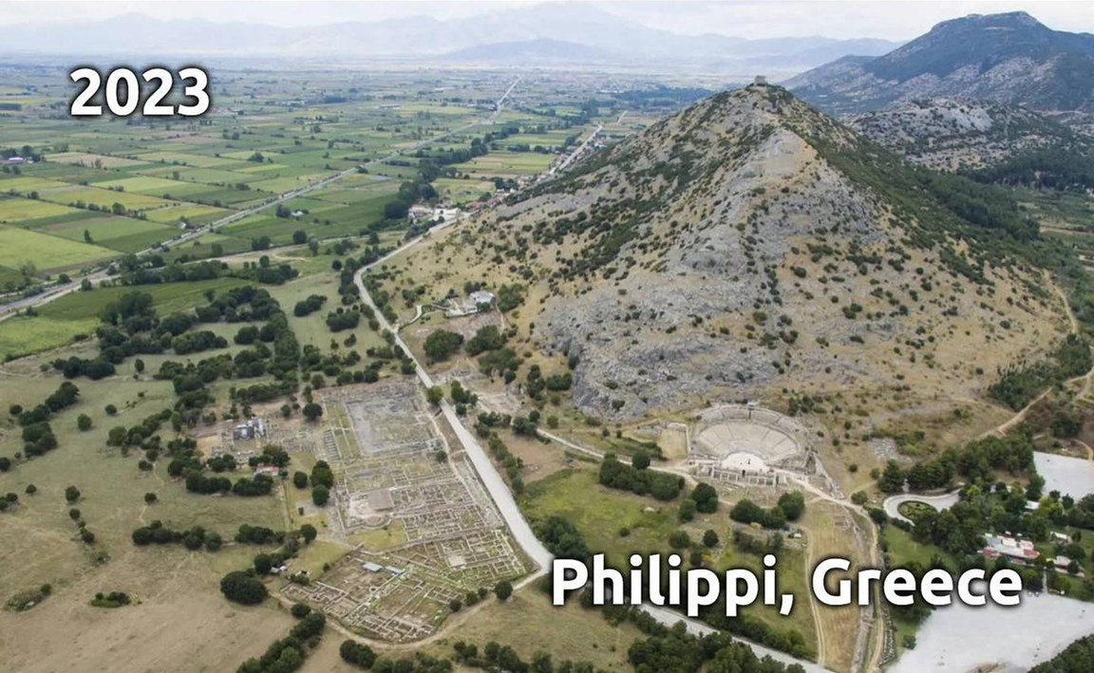
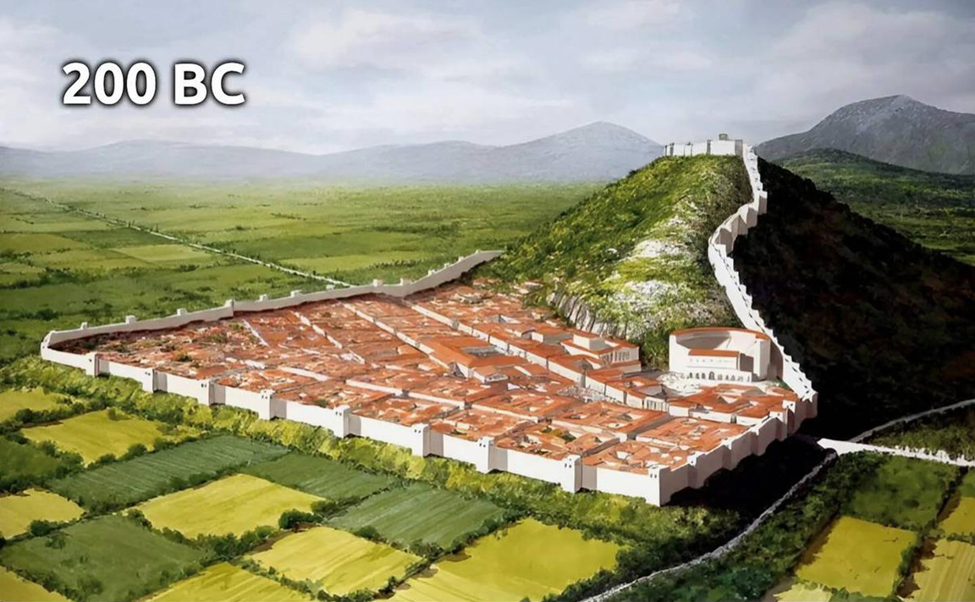
Epistle to the Philippians 2:19-30
A Short Course for Men

Slide 2
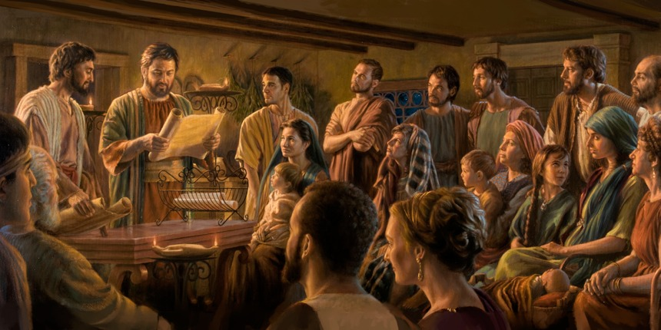
STRUCTURE
l. Thankful Prayer (1:1-11)
II. Paul's Missionary Report (1:12-26)
III. God’s Call to Be Holy (1.27–2:30)
IV. Doctrinal Polemics (3:1–4:1)
V. Joyful Partnership (4:2-23)

Slide 3
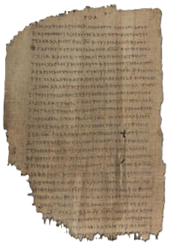
OUTLINE
God’s Call to be Holy 1:27-2:30
Christian Citizenship 1:27-2:4
Christian Humility 2:5-11
Christian Obedience 2:12-18
Christian Service 2:19-30
Paul 2:19, 23-24
Timothy 2:20-22
Epaphroditus 2:25-30
Papyrus 𝔓46, circa 175–225

Slide 4
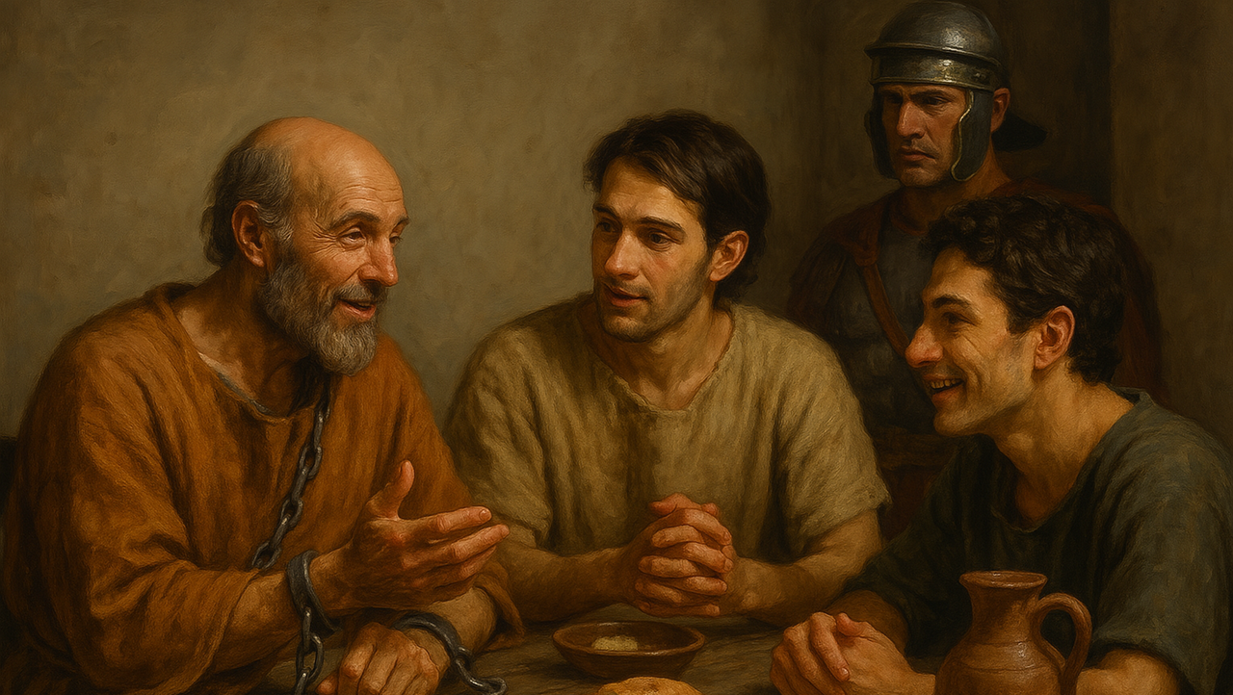
The Team
● Paul:
● Timothy:
● Epaphroditus:
● Philippians:
Jew, apostle, 60s?
Mixed, trainee, 30s?
Greek, helper, 20s?
Mixed congregation.

Slide 5
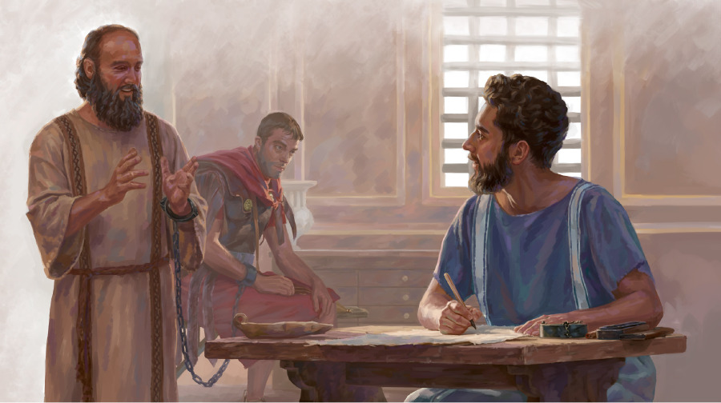
Paul
¹⁹ I hope that the Lord Jesus will soon allow me to send Timothy to you, so that I can be glad to know how things are with you.
● Hope:
● Send:
● Glad:
● Know:
Pray and let the Lord decide.
Make opportunities for others.
Genuine interest in people.
Inquire and listen.

Slide 6
Timothy
²⁰ I currently have no other likeminded companion who genuinely cares about your welfare.
²¹ All the others seek their own interests, not those of Jesus Christ.
● Likeminded:
● Care:
● Interests:
Agree on ministry goals.
Care about people.
Seek Christ’s interests.

Slide 7
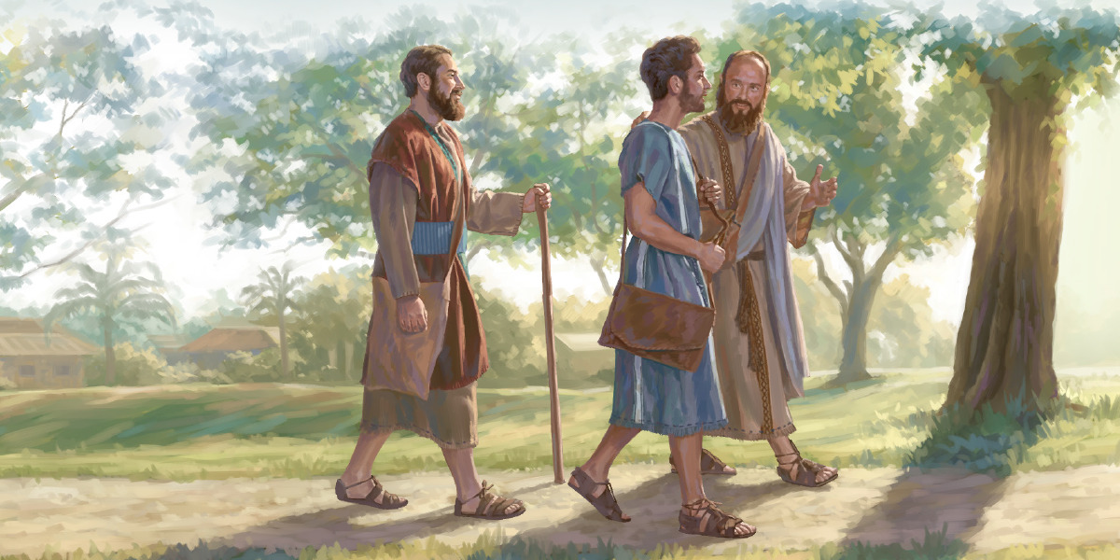
Timothy
²² You are familiar with Timothy’s proven character, how he serves the Good News with me,
like a son working with his father.
● Proven:
● Serves:
● Father:
Observed over time.
Focused on outcomes.
Mentorship in ministry.

Slide 8
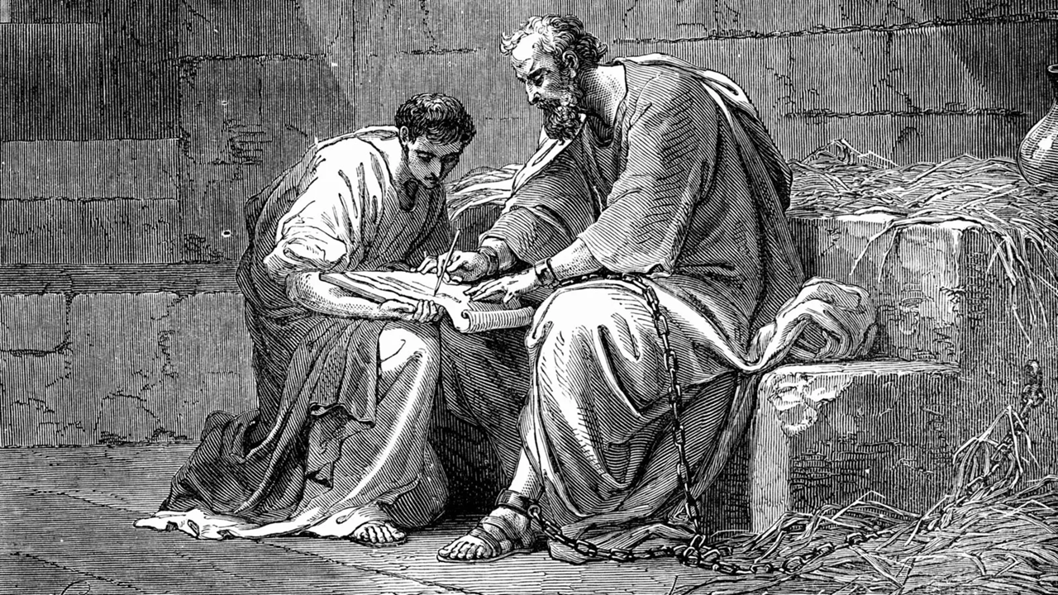
Mentorship in Ministry
Do these activities every time you meet, in person or online:
● Pray for wisdom (Jam 1:5).
● Listen to reports (Luke 10:17)
● Plan next steps to implement.
● Authorize to obey Jesus’ commands.
● Assign Bible reading.
● Intercede for others & outcomes.

Slide 9
Paul
²³ So, I hope to send him, as soon as I learn how things are with me.
²⁴ And I am convinced by the Lord that I myself shall soon come see you.
● Learn:
● Convinced:
● The Lord:
Details unpredictable.
Sense the future strongly.
Make him our companion.

Slide 10
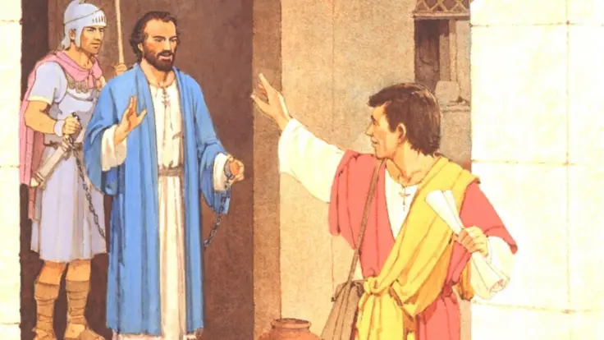
Epaphroditus
²⁵ And, I think it is best for me to send Epaphroditus back to you, whom you sent to take care of my practical needs,
although he has been like a brother to me, as well as a coworker and a fellow soldier.
● Sent:
● Coworker:
Literally, “your apostle.”
No ‘rank’ in kingdom work.

Slide 11
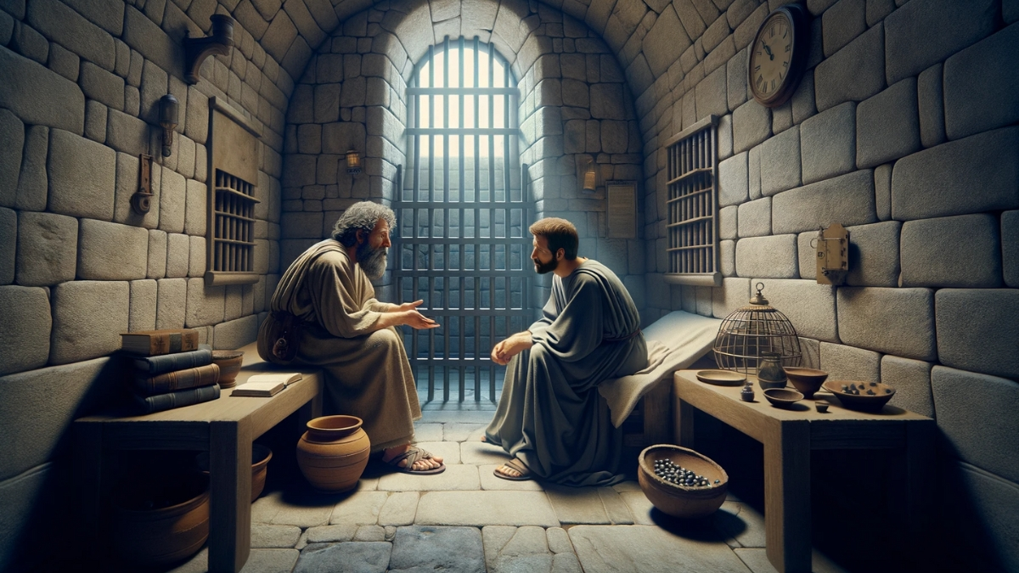
Epaphroditus
²⁶ This is because he has been longing to see you all, and has been distressed because you heard that he was sick.
²⁷ Indeed, he was very sick and nearly died.
● Longing:
● Sick :
● Died:
Belonging = a human need.
The human condition.
Always be ready to go!

Slide 12
Philippians
²⁸ Therefore, I am eager to send him, so that you will be glad to see him again, and that I will have less to worry about.
²⁹ So, please, welcome him with full joy in the Lord.
● Eager:
● Worry:
● Welcome:
Or ‘urgently’.
Or ‘anxiety’.
Or ‘accept’.

Slide 13
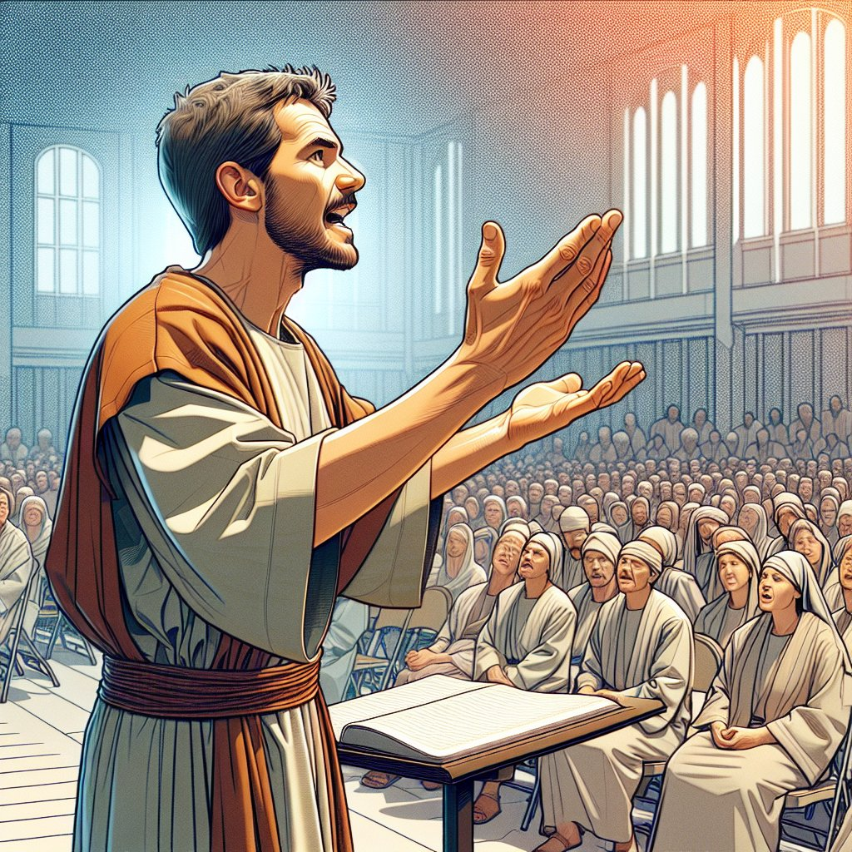
Epaphroditus
And honor men like him, ³⁰ because he nearly died to work for Christ.
He risked his life in order to complete what you were not to do in serving me.
● Honor:
● Risk:
● Serve:
Do not despise as a quitter.
The true cost of mission.
Lit., ‘liturgy’, service to God.

Slide 14
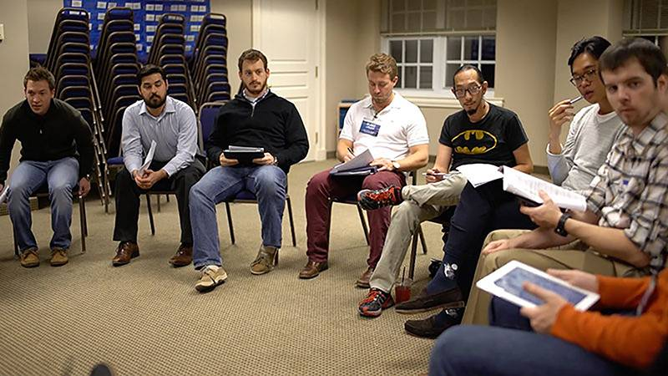
Discuss
What are some character traits to look for in missionary personnel?
● Apostolic missionaries
● Church-planter trainees
● Sending churches
● Short-termers

Slide 15
Assignment
● Read chapter 3 this week.
● Study 3:1-11 at www.netbible.org
● Visit http://philippians.site
● Memorize one verse.

Slide 16
Titre
● …
● ...
● ...
● ...
● ...

Slide 17
Titre
● …: …
● …: …
● …: …
● …: …
● …: …
● …: …
● …: …
● …: …

Slide 18
…
¹ …
¹ …
● …:
● …:
● …:
…
…
…

Slide 19
¹ Verse
¹ Verse
● Text: …

Slide 20
Discuss
?
● …
● …
● …
● …

