Slide 1
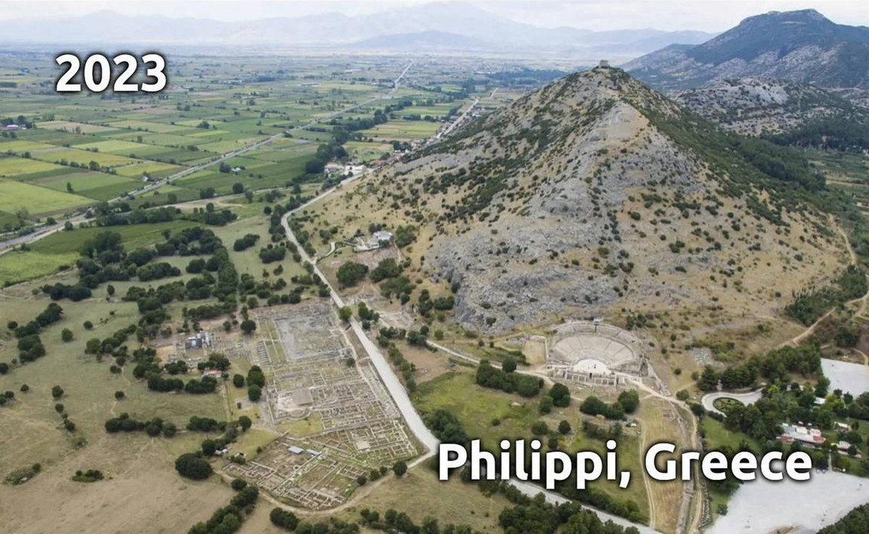
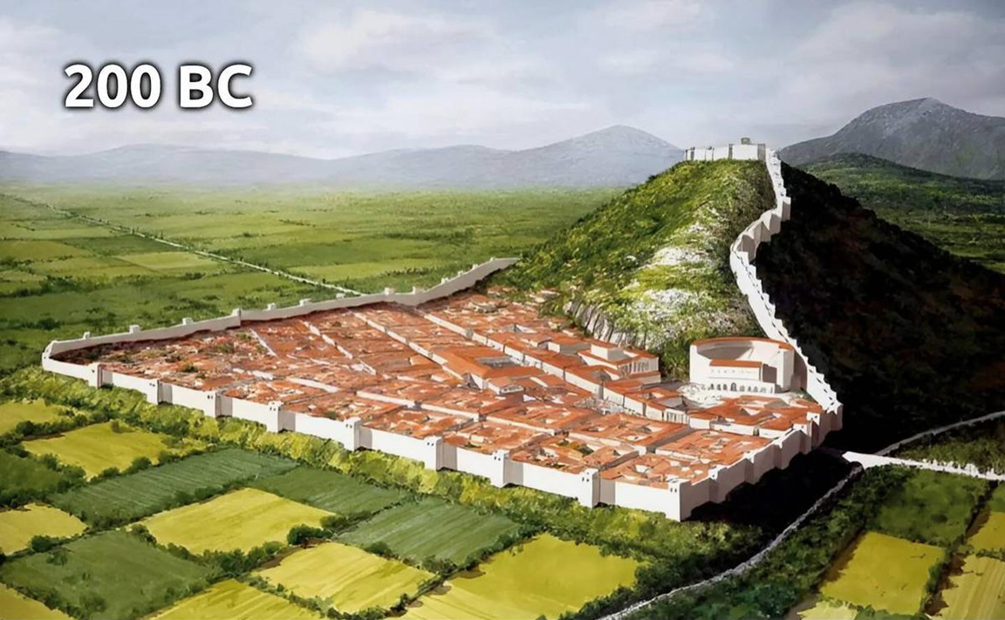
Epistle to the Philippians 3:1-11
A Short Course for Men

Slide 2
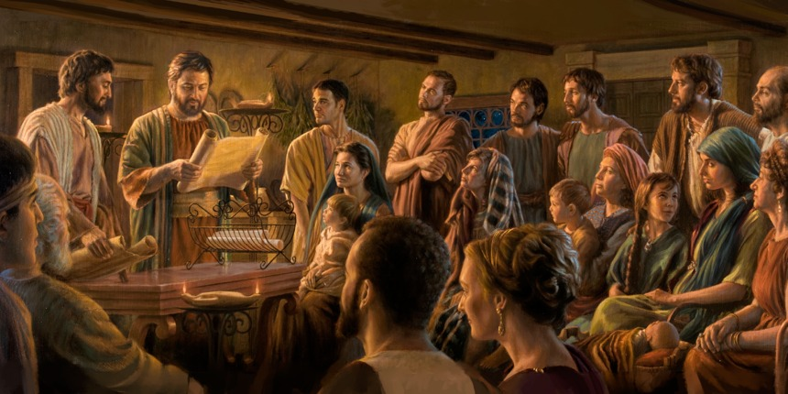
STRUCTURE
l. Thankful Prayer (1:1-11)
II. Paul's Missionary Report (1:12-26)
III. God’s Call to Be Holy (1.27–2:30)
IV. Doctrinal Polemics (3:1–4:1)
V. Joyful Partnership (4:2-23)

Slide 3
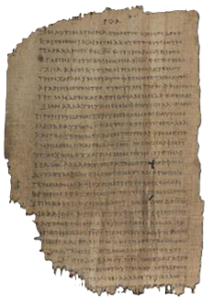
OUTLINE
Doctrinal Polemics (3:1–4:1)
On being right with God (3:1-11)
Rejoice 3:1
Beware 3:2-4a
Be done 3:4b-6
Be faithful 3:7-11
On believing God’s call (3:12–4:1)
Papyrus 𝔓46, circa 175–225

Slide 4
Rejoice
¹ In conclusion, dear friends, keep rejoicing in knowing the Lord.
To write these things to you is no bother for me, and it strengthens you.
● Keep:
● Bother:
● Strengthen:
Iterative present tense
Not hesitant.
Gk ‘asphalt’

Slide 5
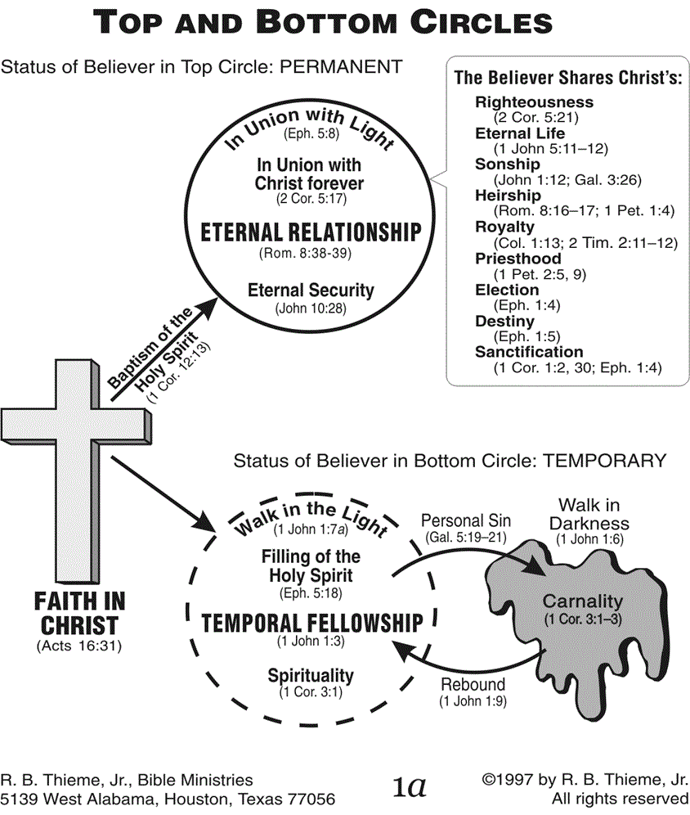

Slide 6
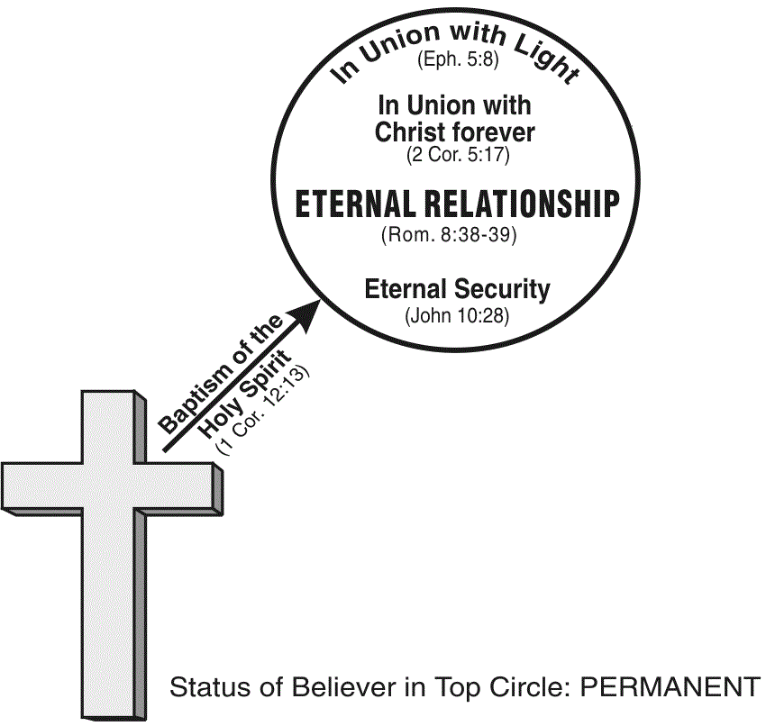

Slide 7
The Believer Shares Christ's:
1 Righteousness (2 Cor. 5:21)
2 Eternal Life (1 John 5:11-12)
3 Sonship (John 1:12; Gal. 3:26)
4 Heirship (Rom. 8:16-17; 1 Pet. 1:4)
5 Royalty (Col. 1:13; 2 Tim. 211-12)
6 Priesthood (1 Pet. 2:5, 9)
7 Election (Eph. 1:4)
8 Destiny (Eph. 1:5)
9 Sanctification (1 Cor. 1:2, 30; Eph. 1:4)

Slide 8
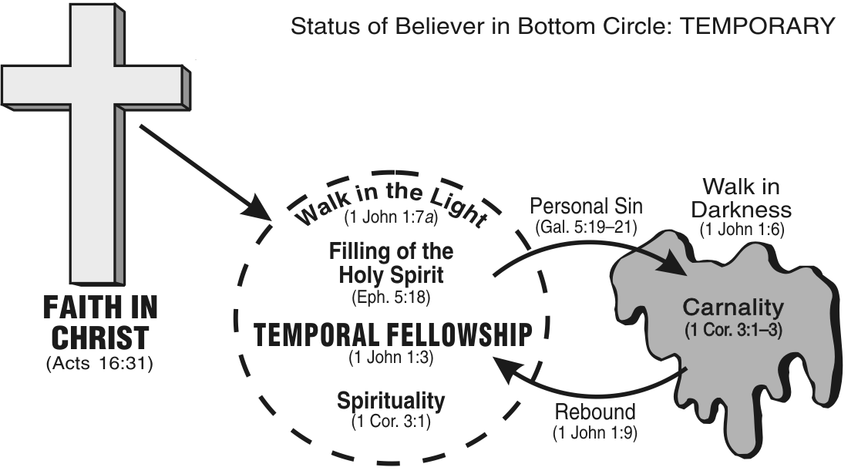

Slide 9
Beware
² As they say, Watch out for dogs! Watch out for evil doers!
Now I say, Watch out for mutilators!
● Watch:
● Dogs:
● Evil doers:
● Mutilators:
Continual tense.
Danger within towns.
Danger outside towns.
Danger in churches.

Slide 10
Be aware
³ This is because it is we who are the true circumcision, we who worship by God’s Spirit, and who boast about Messiah Jesus.
We have put no trust in our natural life.
● True:
● Worship:
● Life:
Spiritual vs. national Israel.
Serve and boast.
Gk ‘flesh’ destined to die.

Slide 11
Boast
⁴ Of course, I myself could trust in my natural life. If anybody trusts in his natural life, I could do so more:
● ⁵ Circumcised on the eighth day.
● Born a Jew in Benjamin’s tribe.
● Hebrew by race. (=Egyptian Habirbu?)
● Pharisee regarding God’s Law.
● Zealously persecuted Christians.

Slide 12
Blameless
⁶ … in legal righteousness I was blameless.
● Legal:
● righteous:
● Blameless:
● Discuss:
Mosaic law requirements.
Conformity to standards.
‘Of exceptional merit’.
What did OT ‘believers’ have to do to be ‘saved’?

Slide 13
Be faithful
⁷ But whatever advantage those things were for me,
I now consider all those things to be forfeit, because of Messiah.
● Advantage:
● Consider:
● Forfeit:
What real advantages?
Evaluate, believe…
Real but abandoned.

Slide 14
Be faithful
⁸ But in contrast, I consider all those things to be forfeit,
because of the superiority of knowing my Lord, Messiah Jesus.
● Consider:
● Superiority :
● Knowing:
● Lord:
Make determined choices.
Having power over.
Experience relationally.
Whom one fears & obeys.

Slide 15
Be faithful
Because of him, I forfeit all those things, and I consider them to be worthless,
so that I can take advantage of Messiah ⁹ and to belong to him.
● Worthless:
● Advantage:
● Belong:
Rubbish, loss.
Verbal form of ‘advantage’.
‘Be found in’.

Slide 16
I no longer hold to my own righteousness, which came from keeping the Law.
Instead, I hold to the righteousness which comes through Messiah’s faithfulness …
● Messiah’s faithfulness:
Gk, ‘faith of Messiah’. See Gal 2:16.

Slide 18
I no longer hold to my own righteousness, which came from keeping the Law.
Instead, I hold to the righteousness which comes through Messiah’s faithfulness …
● Messiah’s faithfulness:
Gk, ‘faith of Messiah’. See Gal 2:16.
Alternatively, ‘through (having) faith in Messiah’. See 2:7-8.

Slide 19
Be faithful
which is righteousness from God for faithful people.
¹⁰ This is how I know Messiah and experience God’s power which raised him back to life.
● From God:
● Faithful:
● Raised:
Alt, ‘which God gives’.
Gk, ‘upon (basis) faith’.
Gk, ‘his resurrection’.

Slide 20
Be faithful
I also share in the advantages of what he suffered,
by/while suffering in the same way in which he died, …
● Share:
● Suffered:
● Same way:
● Died:
Koinônia, ‘in common’.
How did Messiah suffer?
‘being-morphed-together’.
‘with his death’.

Slide 21
Be faithful
¹¹ since this is how I shall attain the resurrection which will bring dead people back to life.
● Since:
● How:
● Resurrection:
● Dead:
‘If’ 1st class condition.
Manner (no doubt).
Gk ‘out-up-standing’.
Physically deceased.

Slide 22
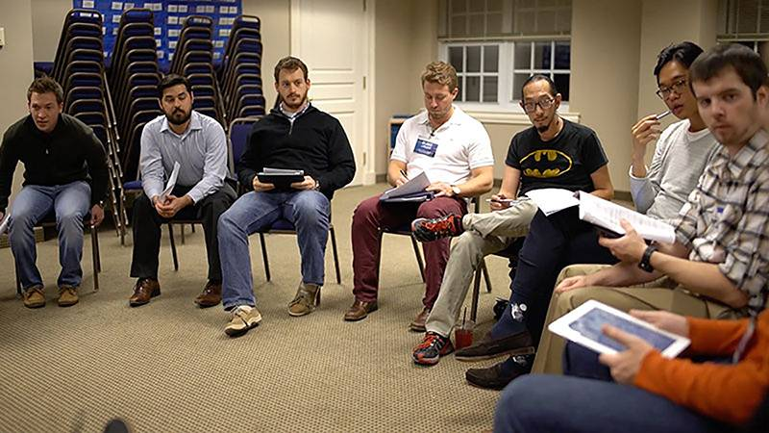
Discuss
What life principles can we draw from Paul’s teaching and testimonial?
● worship by God’s Spirit?
● consider all those things be forfeit?
● righteousness from God by faith?
● being conformed to his death?

Slide 23
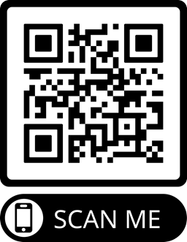
Assignment
● Read chapter 3 this week.
● Study 3:12–4:1 at www.netbible.org
● Visit http://philippians.site
● Memorize one verse.

Slide 24
Be faithful
¹ …
¹ …
● …:
● …:
● …:
…
…
…

Slide 25
Titre
● …
● ...
● ...
● ...
● ...

Slide 26
Titre
● …: …
● …: …
● …: …
● …: …
● …: …
● …: …
● …: …
● …: …

Slide 27
…
¹ …
¹ …
● …:
● …:
● …:
…
…
…

Slide 28
¹ Verse
¹ Verse
● Text: …

Slide 29
Discuss
?
● …
● …
● …
● …

