Slide 1
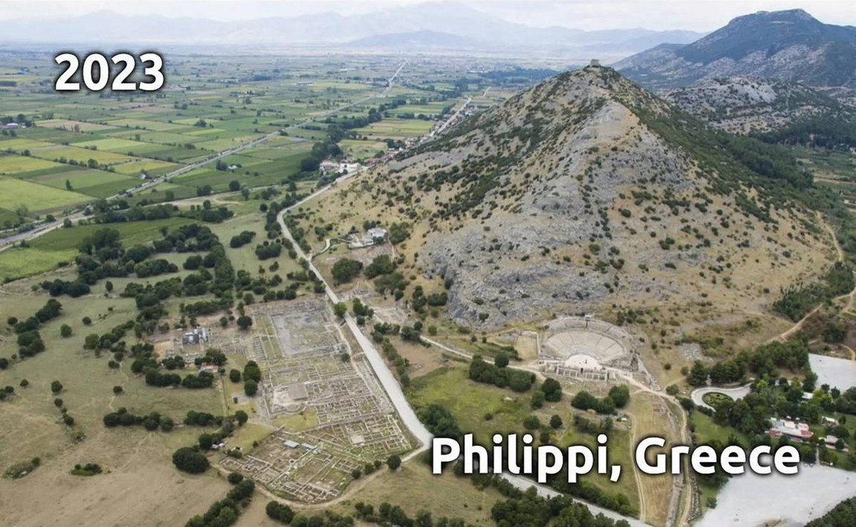
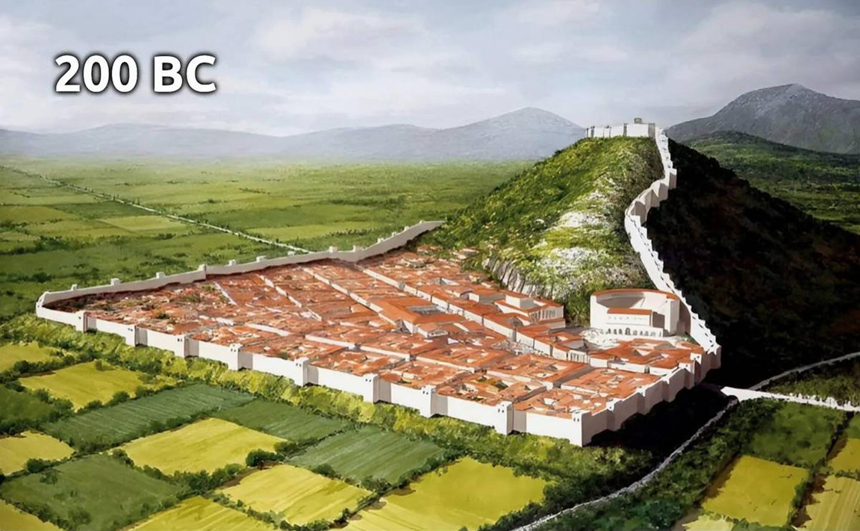
Epistle to the Philippians 3:12-21
A Short Course for Men

Slide 2
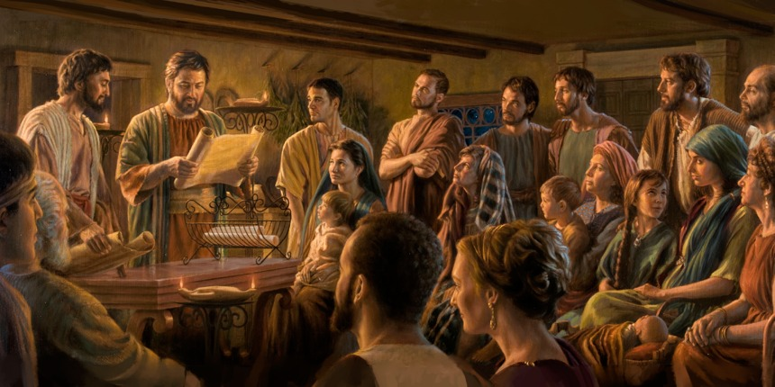
STRUCTURE
l. Thankful Prayer (1:1-11)
II. Paul's Missionary Report (1:12-26)
III. God’s Call to Be Holy (1.27–2:30)
IV. Doctrinal Polemics (3:1–4:1)
V. Joyful Partnership (4:2-23)

Slide 3
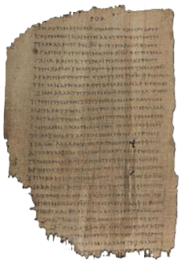
OUTLINE
Doctrinal Polemics (3:1–4:1)
On being right with God (3:1-11)
On believing God’s call (3:12–4:1)
Seized by Christ 12
Called by God 13-14
Revealed truth 15-16
Crucified Messiah 17-19
Coming Savior 20-21, 4:1
Papyrus 𝔓46, circa 175–225

Slide 4
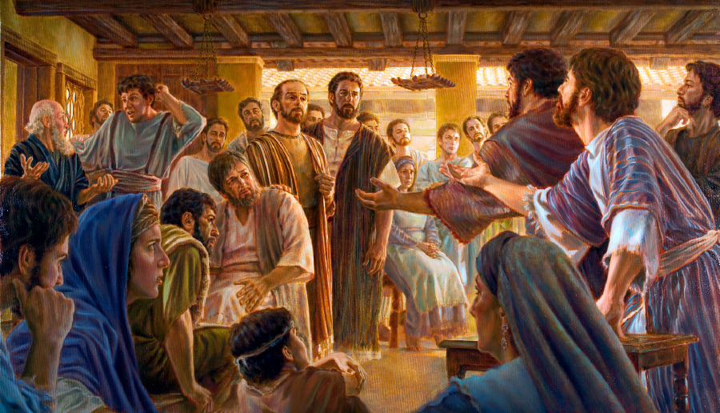
Paul’s antagonists
● Jerusalem authorities
● Synagogue Jews in other cities.
● Christian Judaizers in churches.
● Legalists who want you to keep rules.
● Mystics who like to feel superior.
● Perfectionists who are critical of others.
● Roman authorities

Slide 5
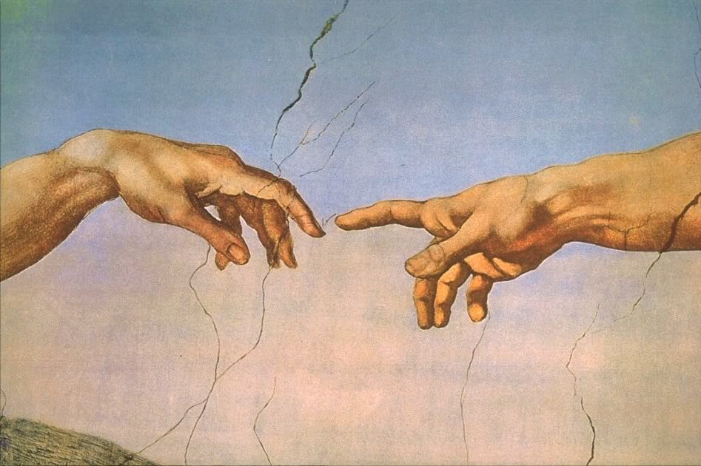
Seized by Christ
¹² I am not saying that I have already become like Jesus, or that I have already reached perfection.
But I keep trying to reach the goal for which Messiah Jesus has already reached me.
● Perfection:
● Trying:
● Reach:
= ‘reached the goal’.
Purpose + effort.
‘to make … one’s own’.

Slide 6
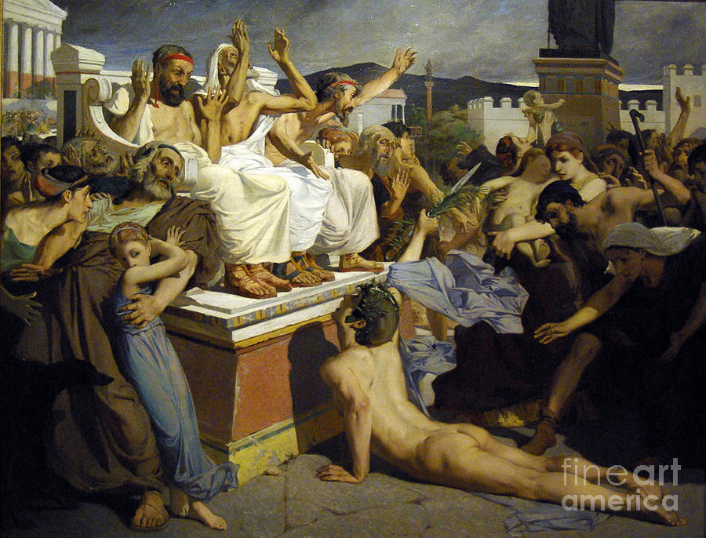
Called by God
¹³ My friends, I myself do not think that I have reached that goal. But I do this one thing:
forgetting my past goals, I keep straining ¹⁴ towards the goal ‘to win the prize’, when God will call to rise upwards those who belong to Jesus Messiah.
● Forgetting:
To forfeit, abandon.

Slide 7
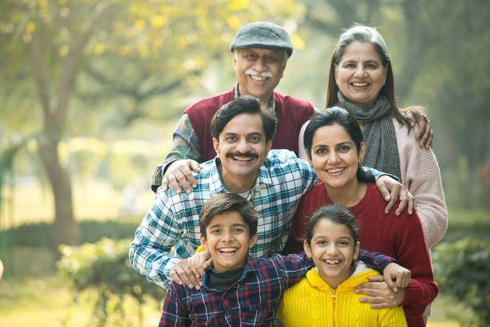
Revealed insight
¹⁵ So then, we who are mature, this is how we should think. And if any among you think differently,
then God will also reveal this to you.
● Mature:
● Think:
● Reveal:
● Discuss:
Reasonable, not reactive.
To reason, evaluate, choose.
Insight from the Holy Spirit.
How to hear from God?

Slide 8
Meanwhile
¹⁶ Whatever insight we have attained, we should live by it.
Literally: ‘Only, unto which we-have- attained, to-this to follow’?
● Attained:
● Live by:
● Variants:
Mature faith, insight?
Lit., ‘line up with’ this. Trying to clarify grammar.

Slide 9
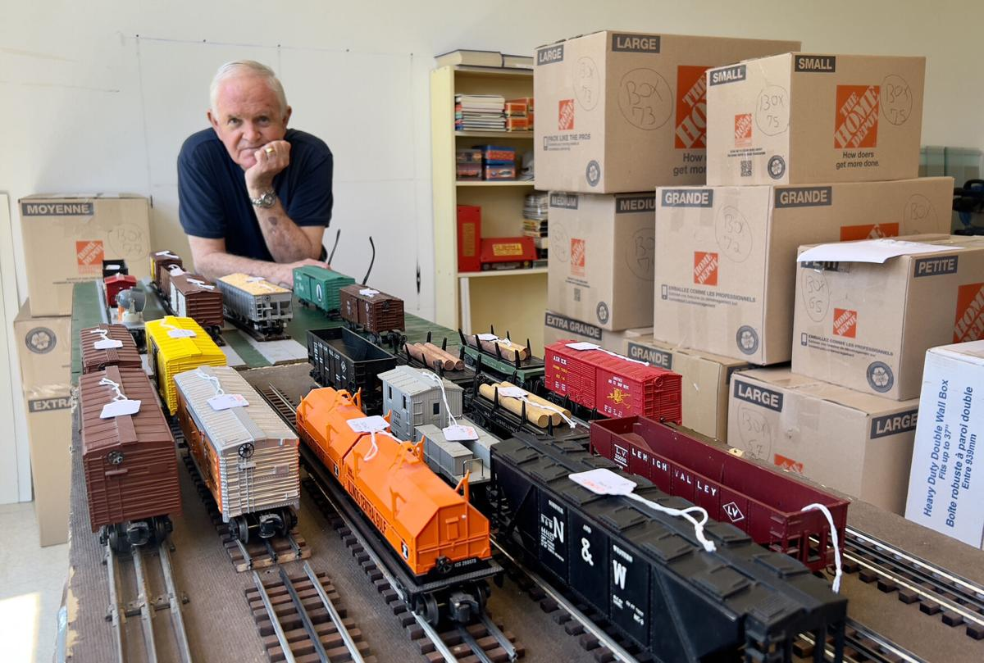
Imitate me
¹⁷ My brothers, imitate me, and watch those who behave as I do, since you have us as your model.
● Imitate:
● Behave:
● Have:
● Model:
Learn from proven leaders.
Daily life habits.
Lead others by example.
If they can, then we can, too.

Slide 10
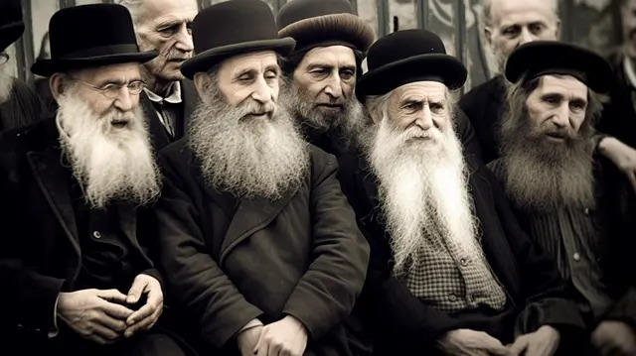
Crucified Messiah
¹⁸ I say this while weeping, just as I often warned you: there are people who behave as enemies
who are opposed to our faith in Messiah crucified.
● ‘Messiah will come in great power’.
● ‘Messiah will destroy Israel’s enemies’.
● ‘Messiah will make Israel great again’.
● ‘Messiah will be the greatest king’.

Slide 11
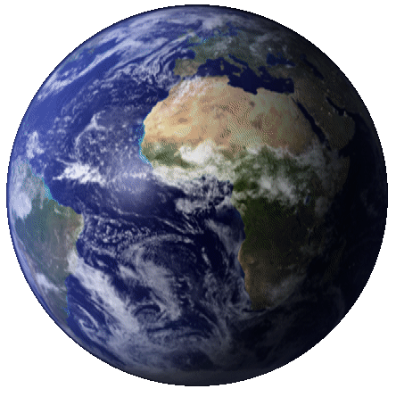
Destruction
¹⁹ Their ‘goal’ is destruction. Their own desires are their god.
They are proud of their shameful behavior. They only think about things on earth.
● Goal:
● God:
● Proud:
● Earth:
Destination, without ‘end’.
Created in their own image.
Glory … shame.
‘Cultural constructs’.

Slide 12
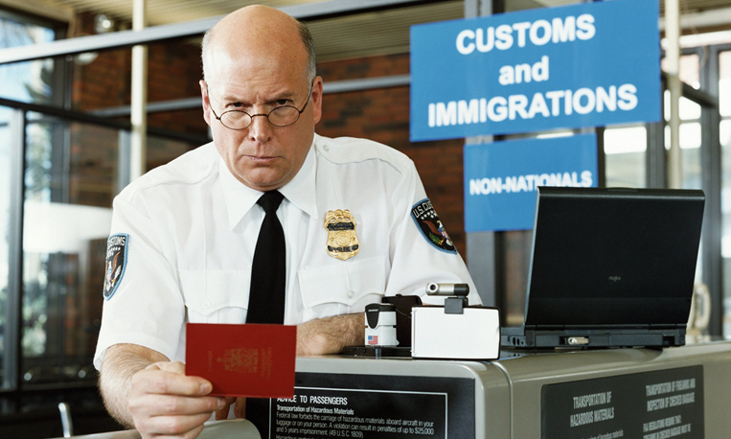
Coming Savior
²⁰ In contrast, we possess citizenship in the heavens,
from whence we are awaiting a Savior, our Lord Jesus Messiah.
● Citizenship:
● Contrast:
● Await:
● Savior:
Where we have rights!
Missionaries from Israel.
Why must we wait?
Save from/to what?

Slide 13
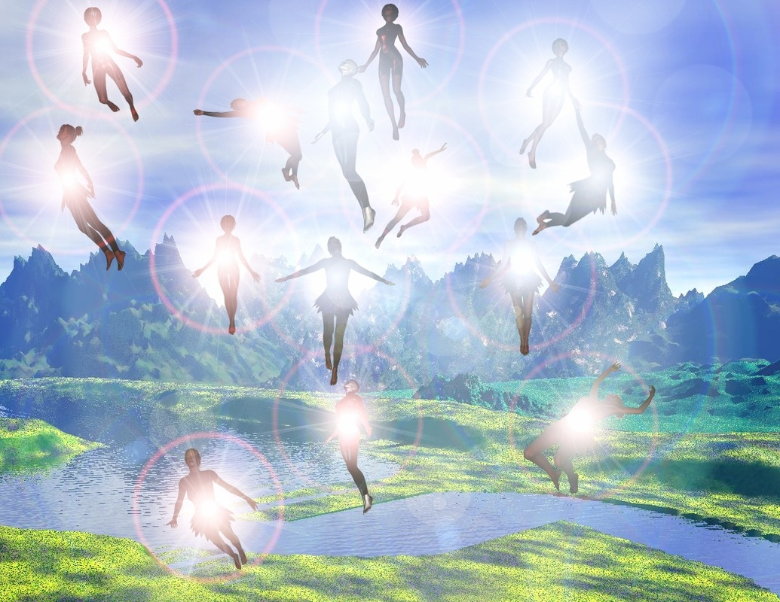
Glorified bodies
²¹ He will transform our weak bodies to be like his glorified body.
He will do this by employing his power to subject everything to himself.
● Weak:
● Glorified:
● Body:
● Subject:
What are our limits?
What is Jesus like, now?
Not whisps or ghosts.
Enable to enjoy everything.

Slide 14
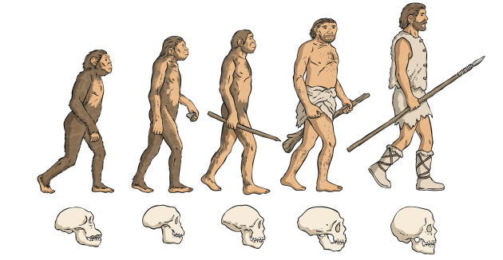
‘Evolution ‘ of the human body
A Created to reproduce and to rule.
B Subjected to physical death at the Fall.
C Shortened lifespan.
D Washed in baptism.
C’ Sanctified by the Holy Spirit.
B’ Resurrected at Jesus’ return.
A’ Transformed to be a glorified body.

Slide 15
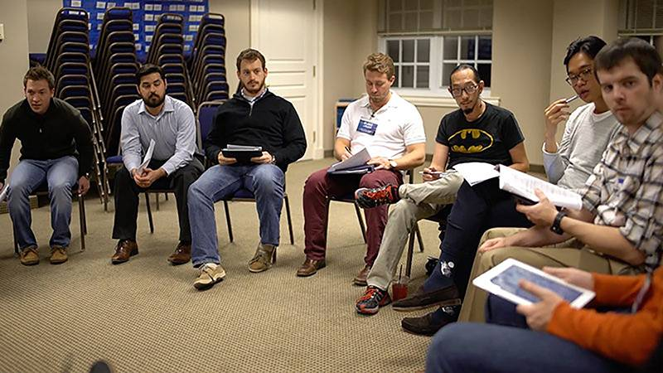
Discuss
What abiding belief or principle do you draw from this passage?
● Forgetting … straining forwards?
● This is how we should think?
● God will reveal this to you?
● Imitate me and watch good models?
● Live by what we have attained?
● Citizenship in the heavens?

Slide 16
Assignment
● Read chapter 3 this week.
● Study 4:2–9 at www.netbible.org
● Visit http://philippians.site
● Memorize one verse.

Slide 17
…
¹ …
¹ …
● …:
● …:
● …:
…
…
…

Slide 18
…
¹ …
¹ …
● …:
● …:
● …:
…
…
…

Slide 19
¹ Verse
¹ Verse
● Text: …

Slide 20
Titre
● …
● ...
● ...
● ...
● ...

Slide 21
Titre
● …: …
● …: …
● …: …
● …: …
● …: …
● …: …
● …: …
● …: …

Slide 22
Discuss
?
● …
● …
● …
● …

