Slide 1
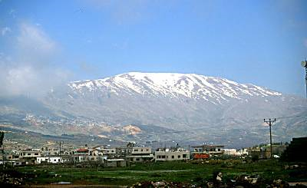
REVEЯSING HERMON
Lesson 0: Introduction
19 and 22 September 2024
Mount Hermon, Bashan Range (Golan Heights)

Slide 2
REVEЯSING HERMON
Enoch, the Watchers & the Forgotten Mission of Jesus Christ
Based the book by the late Dr. Michael S. Heiser.
Buy the book from Al McInturf or on Amazon.

Slide 3
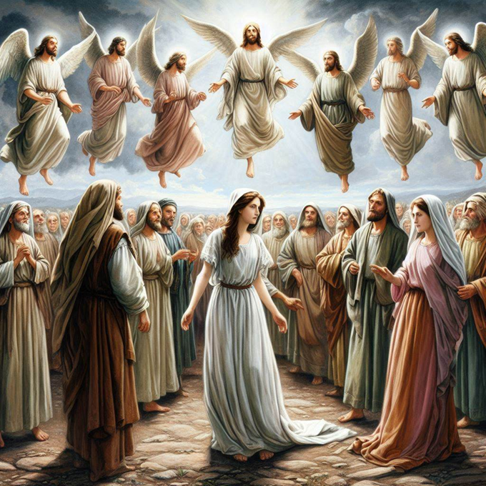
Learning objective 1 of 5
Understand Genesis 6:1-4 and the sin of the Watchers in their original context: the ancient Mesopotamian story of the Apkallu, as preserved in the Book of Enoch, setting the stage for Jesus Christ to reverse the effects of their evil deeds.

Slide 4
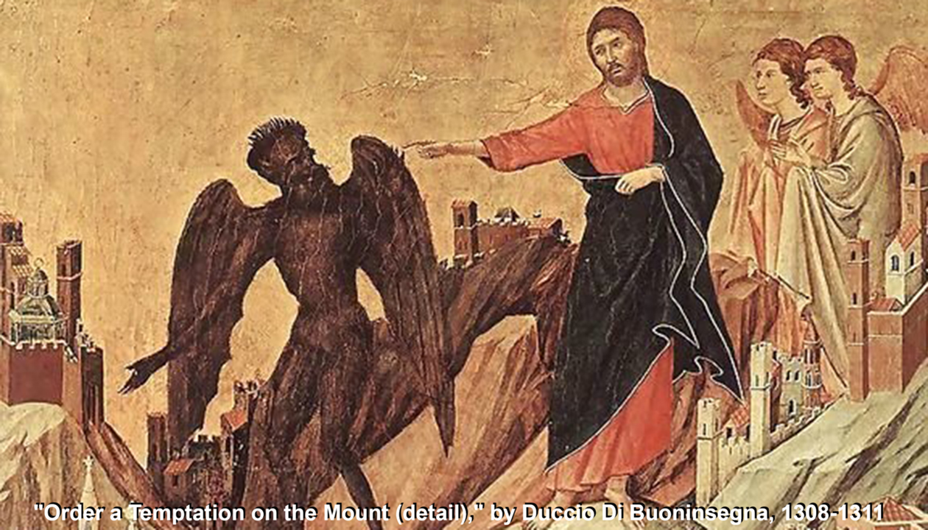
Learning objective 2 of 5
Describe how the theme of reversing the Watchers’ transgression colors the gospel accounts of Jesus’ birth, his genealogy, his temptation, his ministry, his transfiguration, his death, his resurrection, and his reign.

Slide 5
Learning objective 3 of 5
Explain how the epistles of Peter and of Paul allude to the sin of the Watchers, and present Jesus overturning the disastrous effects of their sins against humanity.

Slide 6
Learning objective 4 of 5
Demonstrate how the descriptions of the antichrist, how the end-times Day of the LORD, and how the final judgement connect to Genesis 6 and to the Nephilim.

Slide 7
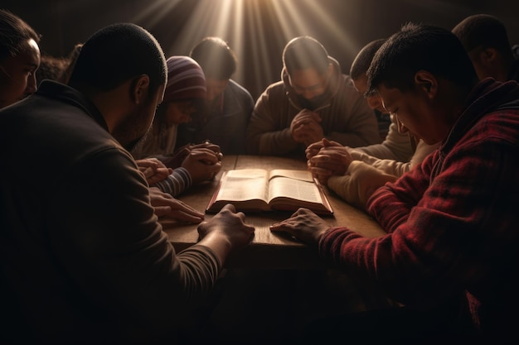
Learning objective 5 of 5
Pray more effectively to deliver persons and people groups from the tyrannical spirits who rule over nations, confidently standing against the global antichrist and his deceitful servants.

Slide 8
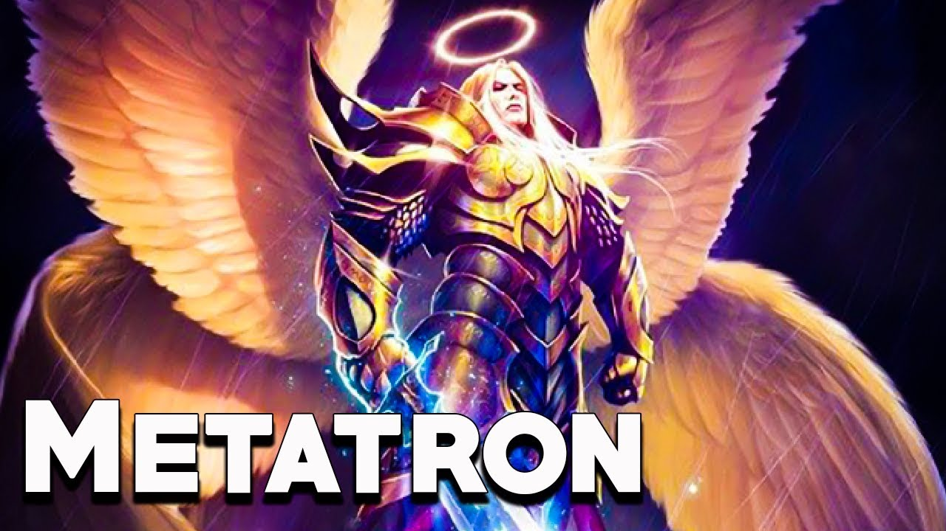
The Books of Enoch
● 1 Enoch: Third century BC, in Aramaic, translated into Greek, Ethiopic, etc.
● 2 Enoch: First century AD, in Greek, preserved in Slavonic. Stories about Enoch and Melchizedek.
● 3 Enoch: Second–5th centuries AD, in Hebrew. Stories about Enoch and how he became an angel named Metatron.

Slide 9
The Book of Enoch (1 Enoch)
● Third century BC, in Aramaic, a Semitic language similar to Hebrew.
● Second-temple period / literature (500 BC through 70 AD).
● Fragments found amongst the DSS, copied in 2nd century BC.
● 1 Enoch 6-16 recounts the watchers’ sin, which lies behind the NT.

Slide 10
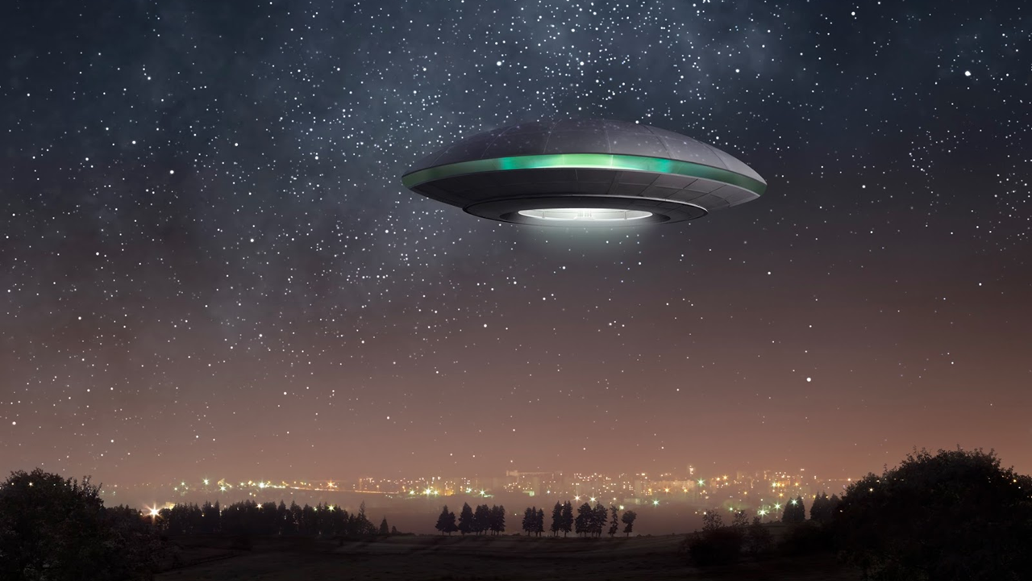
Who are the ‘watchers’?
● Mentioned in Daniel 4:13, 17, 23.
(Dan. 2:7–4:24 are written in Aramaic.)
● “Watchers … holy ones” (Dan 4:17 [14], ESV). “Messengers” (NIV).
● Watchers are good angels in Daniel, members of God’s entourage/council. Bad angels in Enoch, Jude and Peter.
● ^{ʕ}îr / ^{ʕ}îrîn = Protectors? City rulers?

Slide 11
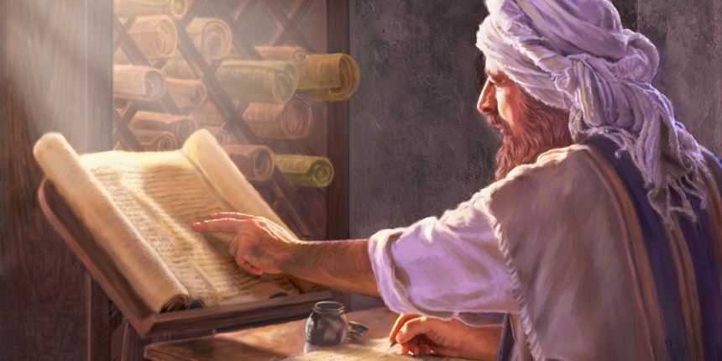
Jude 14-16 (AD) Enoch 1:9 (BC)
“See, the Lord is coming with ten thousands of his holy ones, to execute judgment on all and to convict all the ungodly of all the deeds of ungodliness that they have committed in such an ungodly way and of all the harsh things that ungodly sinners have spoken against him.” NIV
“Look, he comes with the myriads of his holy ones,
to execute judgment on all, and to destroy all the wicked, and to convict all humanity for all the wicked deeds that they have done, and the proud and hard words that wicked sinners
spoke against him.”
Nikelsburg & Vanderkamp, 1984.

Slide 12
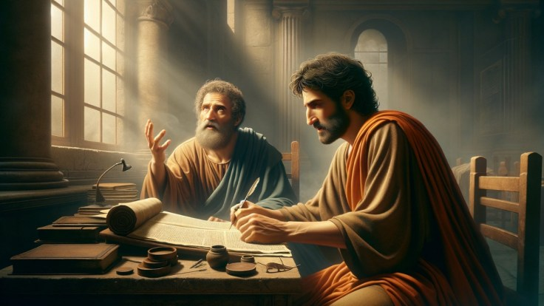
Jude 14-16 (AD) Enoch 1:9 (BC)
“Ἰδοὺ ἦλθεν κύριος ἐν ἁγίαις μυριάσιν αὐτοῦ, ποιῆσαι κρίσιν κατὰ πάντων καὶ ἐλέγξαι πάντας τοὺς ἀσεβεῖς περὶ πάντων τῶν ἔργων ἀσεβείας αὐτῶν ὧν ἠσέβησαν καὶ περὶ πάντων τῶν σκληρῶν ὧν ἐλάλησαν κατ’ αὐτοῦ ἁμαρτωλοὶ ἀσεβεῖς.”
“ὅτι ἔρχεται μετὰ τῶν ἁγίων μυριάδων αὐτοῦ κρῖναι πᾶσαν σάρκα καὶ ἀπολέσαι πάντας τοὺς ἀσεβεῖς περὶ πάντων ὧν ἠσέβησαν καὶ περὶ πάντων τῶν σκληρῶν ὧν ἐλάλησαν κατ’ αὐτοῦ ἁμαρτωλοὶ ἀσεβεῖς.”

Slide 13
Genesis 6:1-2 (NIV)
¹ When human beings began to increase in number on the earth and daughters were born to them, ² the sons of God saw that the daughters of humans were beautiful, and they married any of them they chose.
● Or ‘sons of the gods’ beney ha-’elohîm
● Enoch ‘watchers’ = Bible ‘sons of God’.

Slide 14
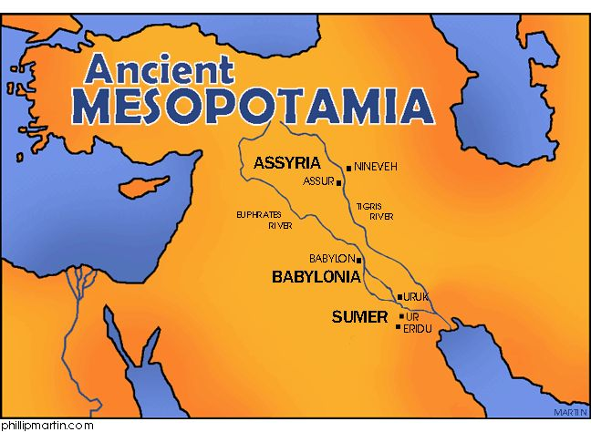
Mesopotamia (‘between rivers’)
● This was an important story in the second-temple period: 1 Enoch.
● Other nations had their own versions of this divine rebellion: Mesopotamia.
● New Testament writers allude to the divine rebellion, citing Enoch.
● The Bible provides a ‘polemic’ against pagan errors and distortions.

Slide 15
Implications
● The watchers story was already current in Mesopotamia in biblical times.
● The Genesis 6 account relates to that story in its original context.
● The ‘sons of Seth’ theory is recent and wrong: Western anti-supernaturalism.
● The watchers story partly explains the sinful human condition.

Slide 16
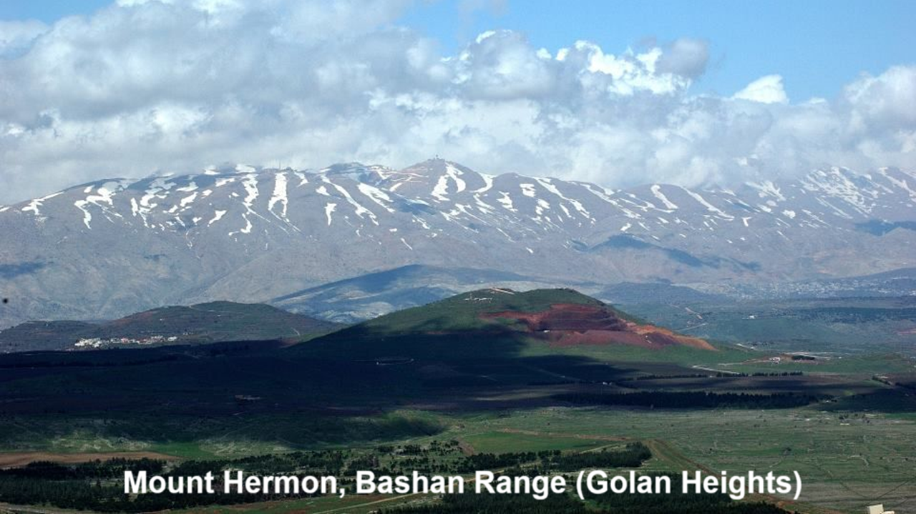
Mount Hermon (Enoch 6:5-6)
⁵ Then they all swore together and bound one another with a curse. ⁶ And they were, all of them, two hundred, who descended in the days of Jared onto the peak of Mount Hermon. And they called the mountain “Hermon” because they swore and bound one another with a curse on it. [From a root ḥrm, to ban.]

Slide 17
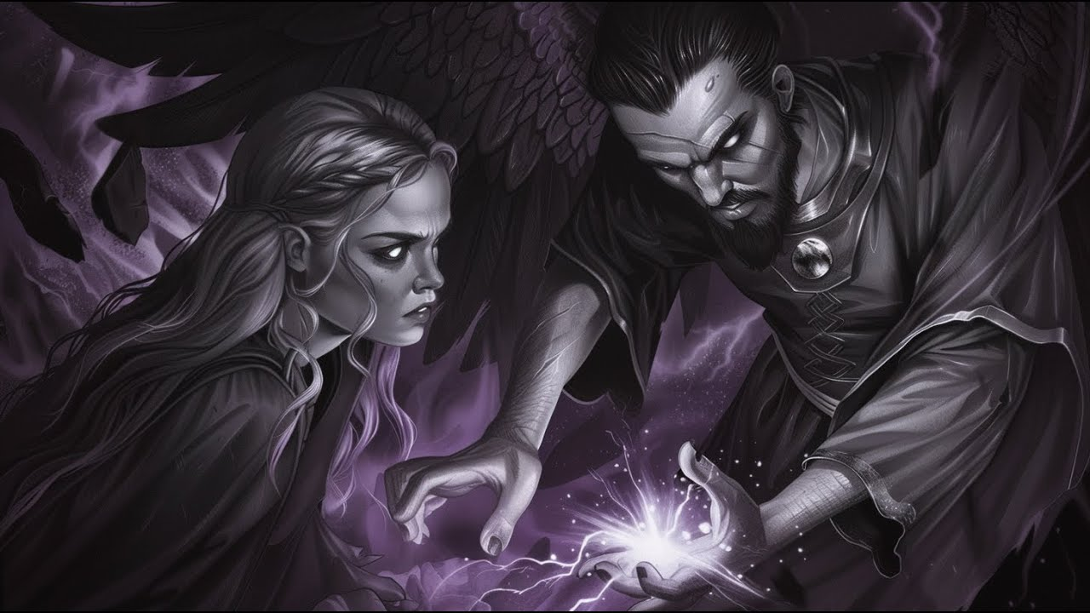
REVEЯSING HERMON
● The watchers infect the human race.
● They taught war, immorality & drugs.
● God damned the fallen watchers.
● The Nephilim souls became demons.
● Jesus came to restore Eden on earth, by redeeming humankind from its sin, and from under demonic authority, thereby ‘reversing Hermon’.

Slide 18
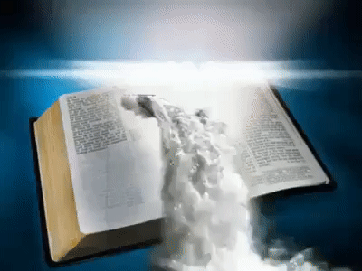
Is the Book of Enoch Scripture?
● Canon: A collection of writings that a church accepts as authoritative.
● Inspired: Books that are accurate and free of error, because the Holy Spirit guided their authors.
● Scripture: A canon of inspired writings.
● Enoch: Neither canonical nor inspired, although considered worthy to be read.

Slide 20
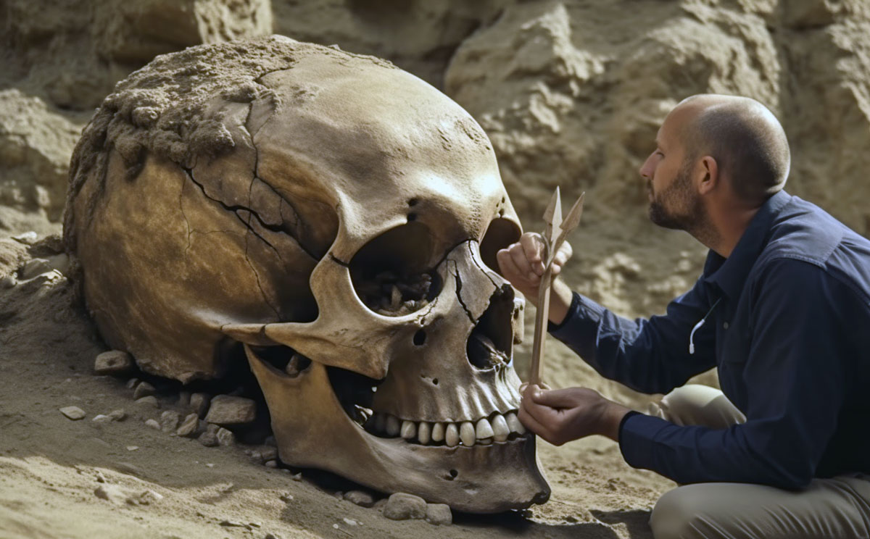
Main characters
● Sons of God: Members of God’s first entourage, in the ‘divine council’.
● Watchers: Aramaic equivalent.
● Nephilim: Giant offspring of the sons of God mating with human women.
● Apkallu: Mesopotamian counterparts.
● Noah: Fully-human ark builder.
● Gilgamesh: Part-human adventurer.

Slide 21
Hypothesis: Creatures in Eden
Created, corporal, earthly, reproducing
1. Watchers, including The Serpent.
2. Plants, including seed-bearing trees.
3. Beasts, which Adam later named.
4. Humans, including Adam and Eve.
● Both watchers and humans have body, mind and spirit.
● All four classes must not co-mingle!

Slide 22
REVEЯSING HERMON
Assignment
● Procure a copy of Reveяsing Hermon.
● Read the Introduction and Chapter 1.
● Visit www.reversinghermon.site for
— the previous session’s video.
— the next session’s assignments.
— downloads of related documents.
— links to videos and sites.

