Slide 1
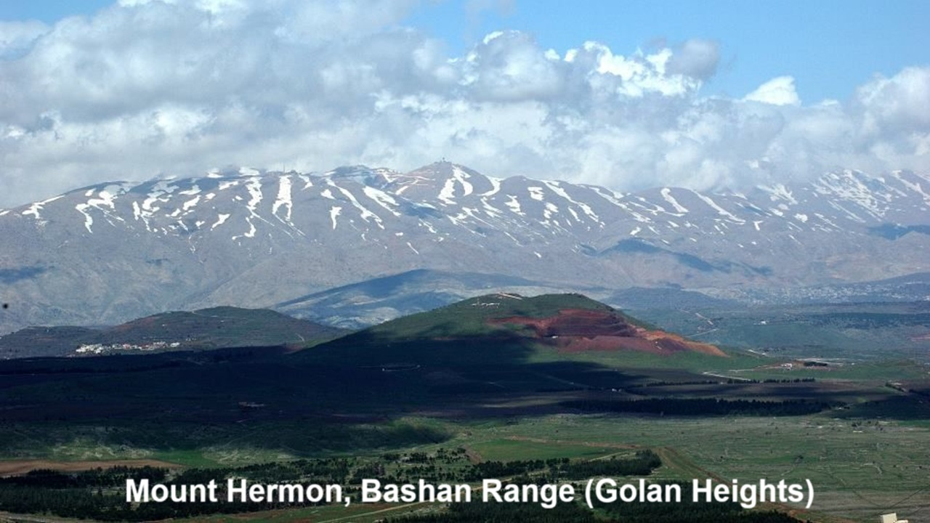
REVEЯSING HERMON
10: The Watchers, Nephilim & Antichrist
05 and 08 December 2024

Slide 2
Learning objectives
By the end of this session, we shall be able to explain:
● Early Jewish belief in an evil man.
● Early Christian beliefs about 666.
● A biblical profile of Antichrist.

Slide 3
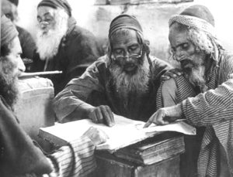
2nd temple Jewish views from:
● Prophetic expectations of a Messiah.
● Prophetic predications of opposition.
● Prophetic messages against Gog.
● Prophetic mention of an evil king.
● Speculation about Belial incarnated.
● Later literature warning of ‘a king of the kings of the earth’ Ass. Moses 8¹⁻³
● Prophetic predications of victory.

Slide 4
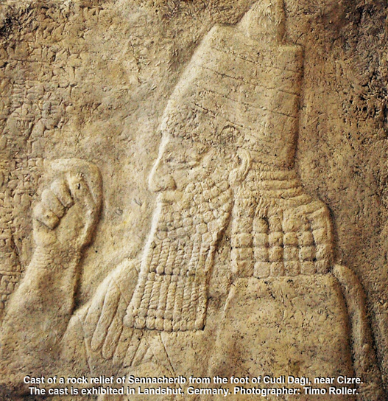
Naham 1:11 (7th century BCE)
¹¹ From you came one who plotted evil against the LORD, a worthless [Bilial] counselor… ¹³ I will break his yoke from off you and will burst your bonds apart.” …
¹⁵ Behold, upon the mountains, the feet of him who brings good news, who publishes peace!
● Originally, Sennacharib of Nineveh.

Slide 5
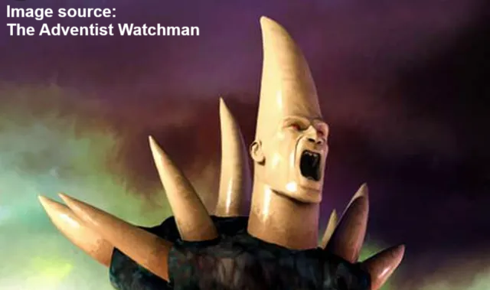
Daniel 7 (5th century BCE)
²⁰ The ‘horn’ … had eyes and a mouth that spoke great things, and that seemed greater than its companions.
²¹ As I looked, this horn made war with the saints and prevailed over them.
● Horn: Symbol of a king over an evil empire. Fulfillment = Seleucid Greek king Antiochus Epiphanes IV.

Slide 6
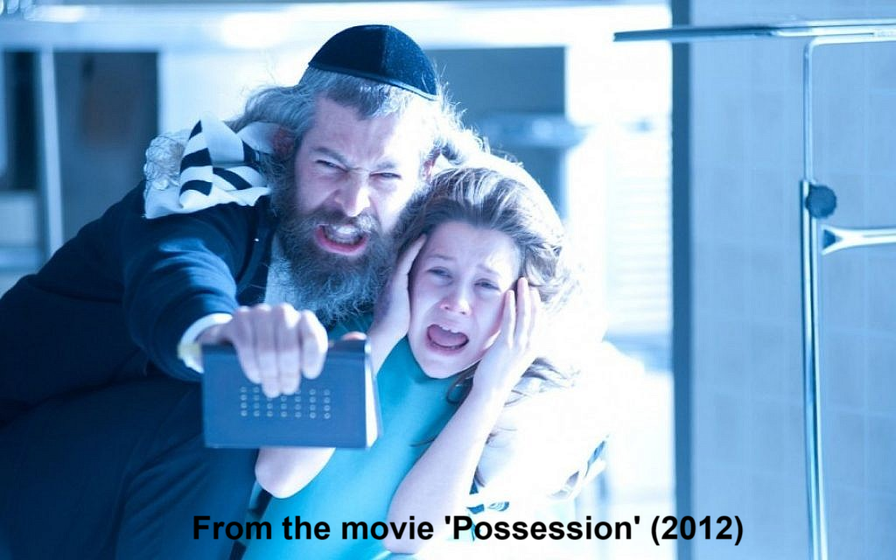
Jewish demonology
● Belief about Belial / Beliar (DSS), leader over the powers of darkness.
● Explains evil as a cosmic struggle between good and evil led by an evil angel, called Semihaza, Mastema, Belial, or ‘Prince of the darkness’.
● Spiritual oppression caused by demons who are spirits of dead Nephilim.

Slide 7
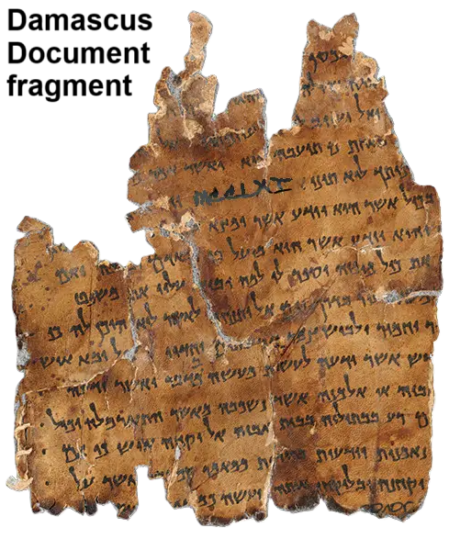
Jewish literature
● ‘Bilial, with his cunning, raised up Jannes and his brothers’, Dam. Doc. 5¹⁹
● The present age = ‘the days of Bilial’s dominion’, Rule Comm. 1QS 1¹⁸ 2¹⁹
● An end-times war between Messiah and Belial. War Scroll (1QM), War Rule (4Q285).

Slide 8
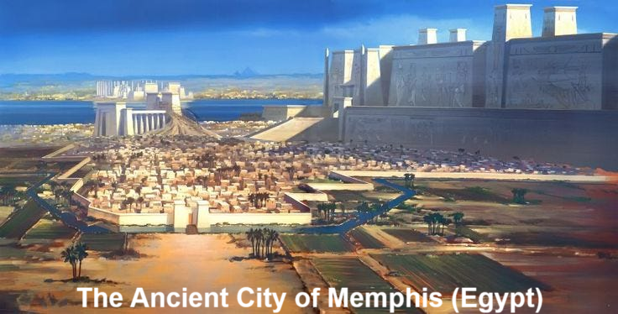
4QPseudo-Ezekiel (4Q386)
Yahweh said, “A son of Belial will plot to oppress my people… a multitude will be defiled, offspring will not remain. … The wicked man I will kill in Memphis, and I will make my sons go out of Memphis: I will turn myself towards their remnant.”

Slide 9
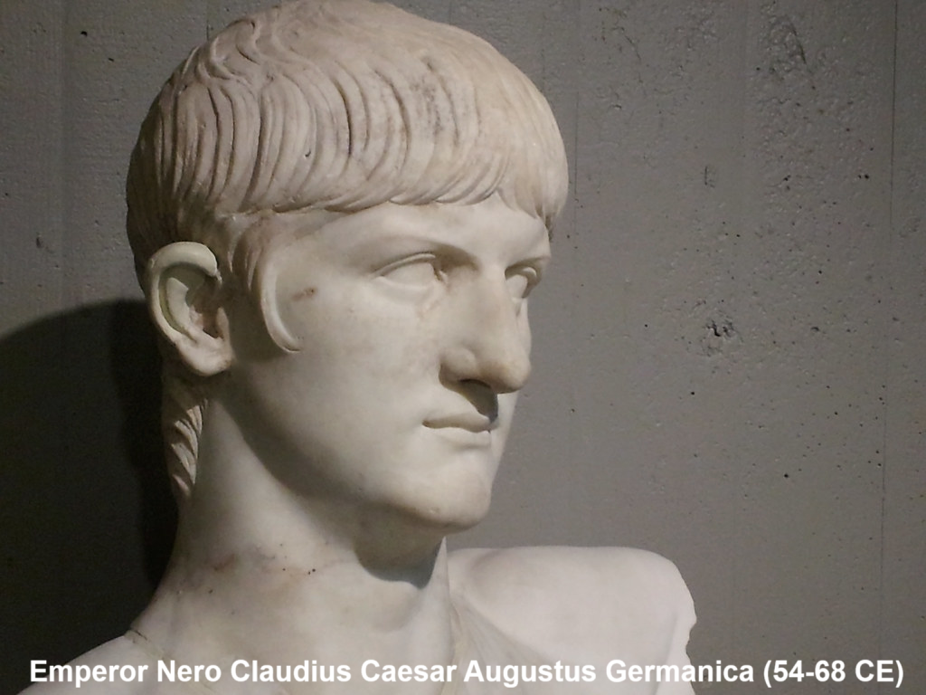
Sibyline oracles (from 150 BCE)
“Biliar will come from the Augusti [Nero’s lineage] … will perform signs for men … lead astray many of the faithful chosen Hebrews, and other lawless men who have not yet listened to the word of God.” Likely added after 70 CE.

Slide 10
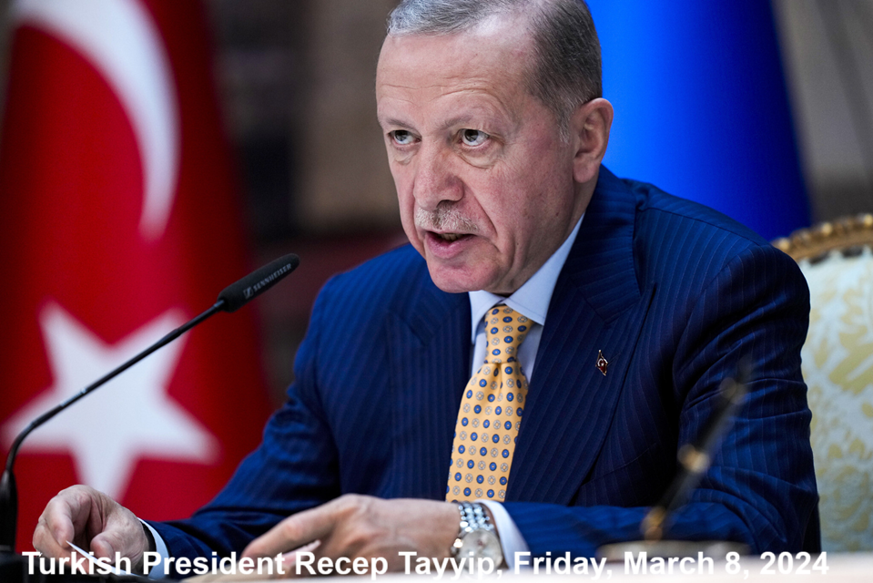
Inference
● Neither 1 Enoch nor the New Testament claims that the Antichrist will be a descendant or an incarnation of Satan, of a Watcher, or of a Nephilim spirit.
● Nor was he said to be a giant.
● However, some second-temple Jews inferred that an evil, end-time tyrant may be any of the above.

Slide 11
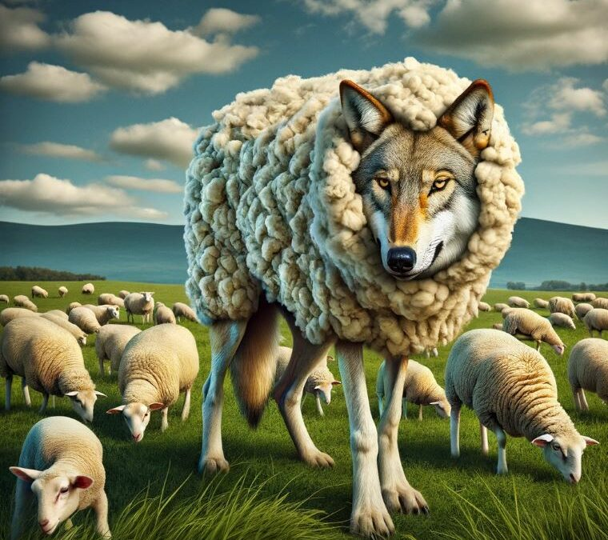
Matthew 24 (early 1st century)
²⁴ False christs and false prophets will arise and perform great signs and wonders, so as to lead astray, if possible, even the elect.
● False christs: pseudo-christos.
● Lead astray: Satan’s main tactic remains deceit, false ideas, dysinfor-mation, enforced by authorities.

Slide 12
2 Thessalonians 2 (Paul, c. 51 CE)
¹ The man of lawlessness is revealed, the son of destruction… ⁸ the lawless one will be revealed, whom the Lord Jesus will kill with the breath of his mouth and bring to nothing by the appearance of his coming.
⁹ The coming of the lawless one is by the activity of Satan with all power and false signs … all wicked deception…

Slide 13
John’ epistles (letters)
1:2¹⁸ You have heard that antichrist is coming… ²² This is the antichrist, anyone who denies the Father and the Son.
1:4³ This is the spirit of the antichrist, which you heard was coming and now is in the world already.
2:1⁷ Such a one is the deceiver and the antichrist.

Slide 14
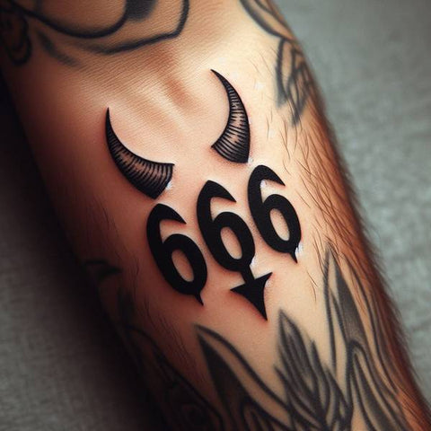
Revelation 13 (late 1st century)
¹⁸ Let the one who has understanding calculate the number of the beast, for it is the number of a man, and his number is 666.
● Beast: An evil empire first described in Daniel chapter 7.
● Gematria: Comparing words whose letters have a certain numerical value.

Slide 15
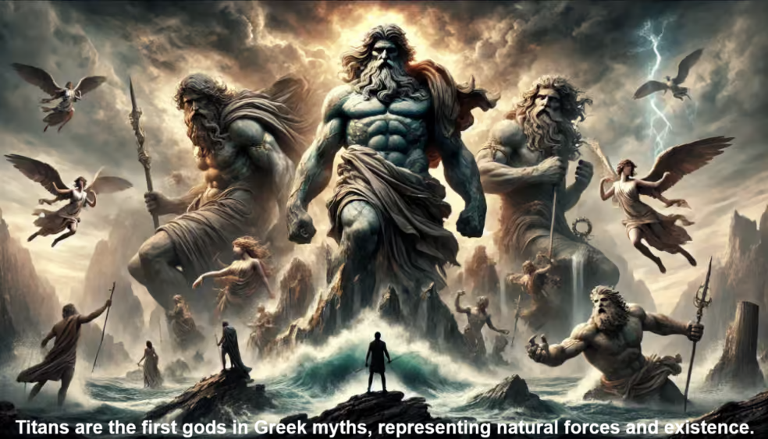
Greek mythology
● Titans: τίτανες, children of Sky and Earth who rebel against them. (LXX in 2 Sam 5:18 of Rephaim giants.)
● Giants: γίγαντες, blood from Sky’s wound fathers giants with Earth (LXX in Gen 6 of the Nephilim.)
● Tartarus: Τάρταρος, where Zeus imprisons the Titans. (NT 2 Pet 2:4)

Slide 16
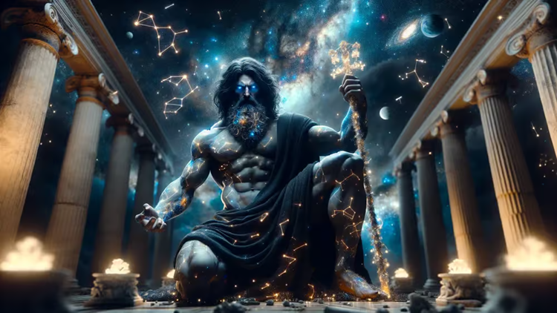
Irenaeus (130-202 CE)
He (Antichrist) pretends that he vindicates the oppressed… A name belonging to a tyrant… We infer, that perchance he who is to come shall be called “Titan.” Against Heresies 5:28-30
● Titan: τιτάν, in Greek mythology who rebelled against heavenly authority. Titanomachy and Gigantomachy

Slide 17
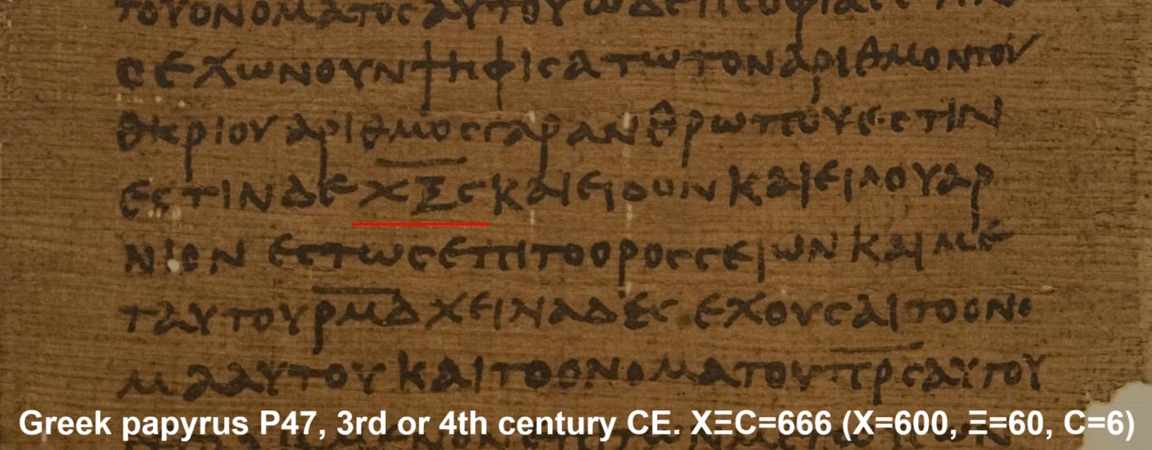
666 or 616?
The Book of Revelation was composed in Greek. The first generation of Christians were Greek reading Jews. They read 666 in their Greek Bible, and did their gematria from Greek. Nero Caesar's Greek name, ΝΕΡΟΝ ΚΑΙΣΑΡ, to equal 666 in Hebrew letters: (קסר‎ נרון = nrôn qsr, with one long ‘o’ vowel).

Slide 18
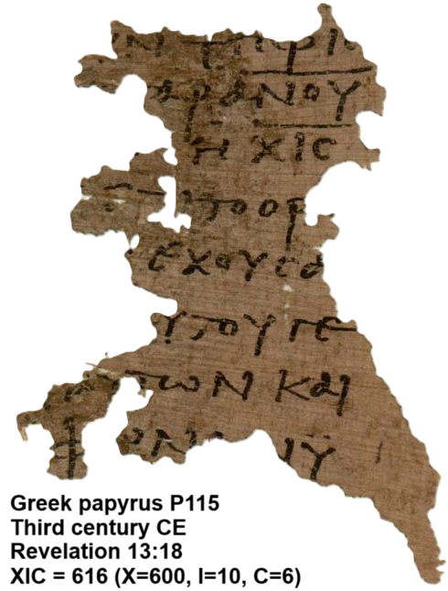
666 or 616?
A century later, many Christians were Gentiles who spoke Latin and did their gematria from Latin. They calculated Nero Caesar's Latin name, NERO CAESAR, to equal 616 in Hebrew letters: (נרו קסר‎ = nrô qsr, with one long ‘o’ vowel). So, someone altered a copy of the Book of Revelation to read 616.

Slide 19
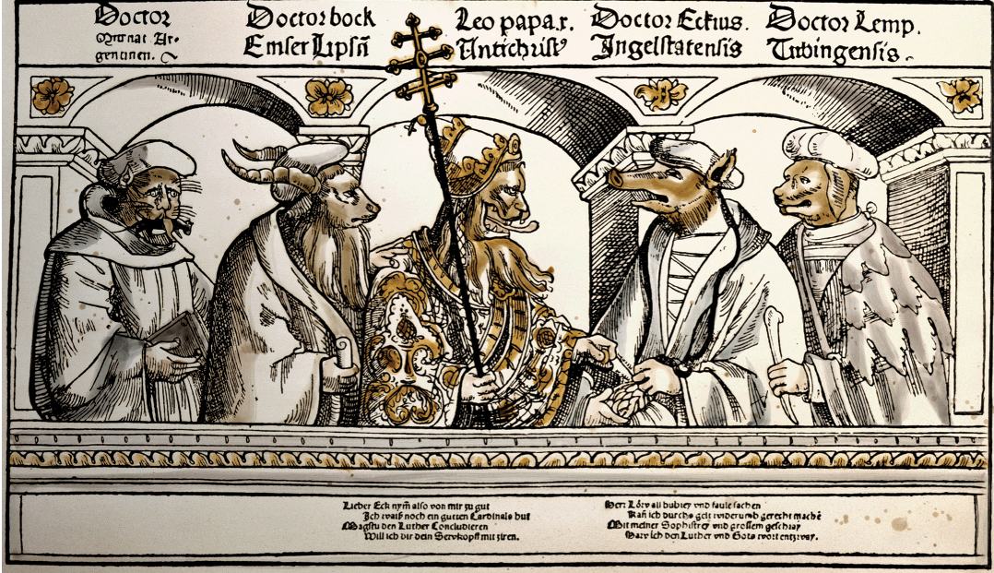
Christians’ interest in Antichrist
● Believed Nero Ceasar for two centuries.
● Waned when Christianity became legal.
● Protestants declared some Catholic popes to be (the) Antichrist.
● Islam invented an end-time Mahdi.
● The Holy Roman empire had a Kaisar.
● 20th century popularized the Antichrist.
● Christians declared Hitler an Antichrist.

Slide 20
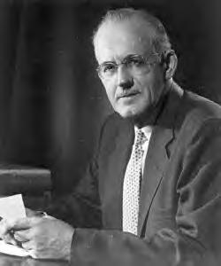
20th century dispensationalism
Christ Antichrist
Speaks Truth Speaks the Lie
The Holy One The Lawless One
A Man of Sorrows The Man of Sin
The Son of God Son of Destruction
Mystery of Godliness Mystery of Iniquity
Cleanses the Temple Desecrates it
The Lamb The Beast
A.W. Pink, The Antichrist (1923)

Slide 21
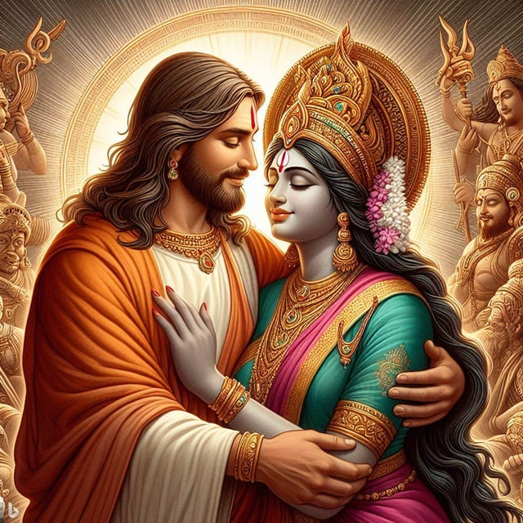
Is the Bible a collection of myths?
● Yes, true myths.
● Myth = story with divine beings in it.
● The Bible only contains the true parts of ancient, pagan myths.
● The Bible came in cultural language and forms, which we must parse.
²¹ Men spoke from God as they were carried along by the Holy Spirit. 1 Pet. 1

Slide 22
Assignment
● Read Reversing Hermon, chapter 11: “The Watchers’ Sin and the Apocalypse,” 163–181
● Visit ReversingHermon.site

Slide 23
Title
¹ Verse
● Text

