Slide 1
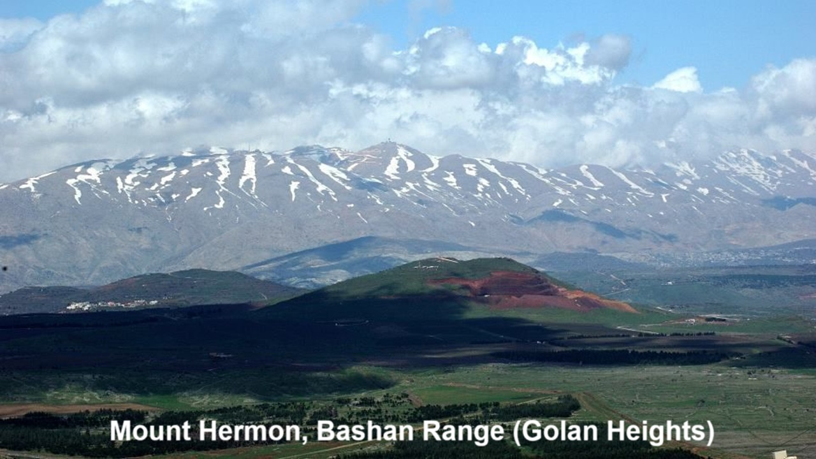
REVEЯSING HERMON
11: The Watchers’ Sin and the Apocalypse
12 and 15 December 2024

Slide 2
Learning objectives
By the end of this session, we shall be able to explain:
● How the Apocalypse reverses Hermon.
● The locusts from out of the pit.
● The final defeat of Gog and Magog.

Slide 3
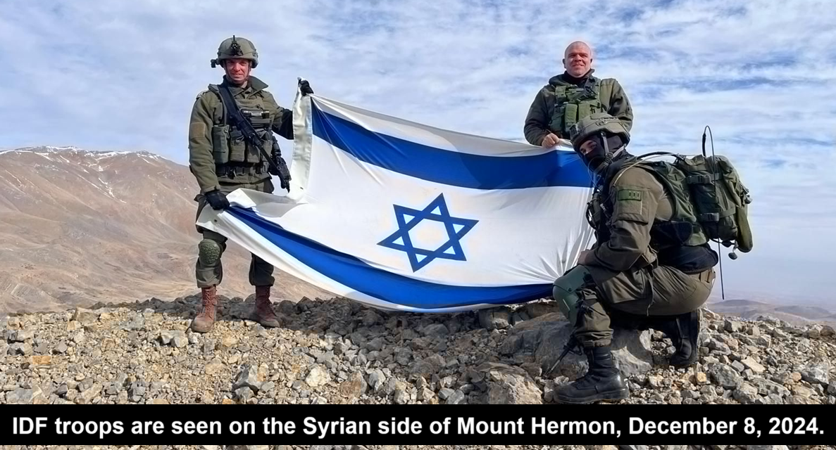
Last week
● The new leader, has adopted the pseudonym Abu Mohammad al-Julani.
● Julani in Arabic (جَوْلَانِ) means “from Golan”, the Syrian name for the Bashan range and Mount Hermon.
● So, has he aligned himself with the Watcher spirits?

Slide 4
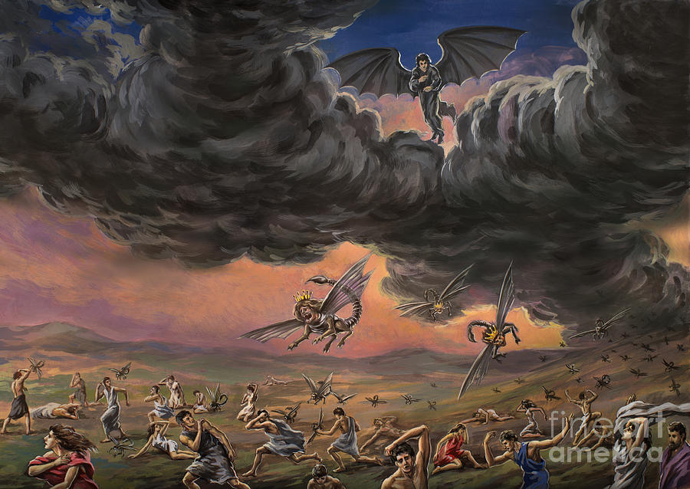
Revelation 9
¹ A star fallen from heaven … ² opened the shaft of the bottomless pit, and from the shaft rose smoke… ³ Then from the smoke came locusts on the earth, and they were given power like the power of scorpions of the earth.
● Pit: Called Tartarus in 1 En 20:2, hell in 2 Peter 2:4, where the Watchers are held.

Slide 5
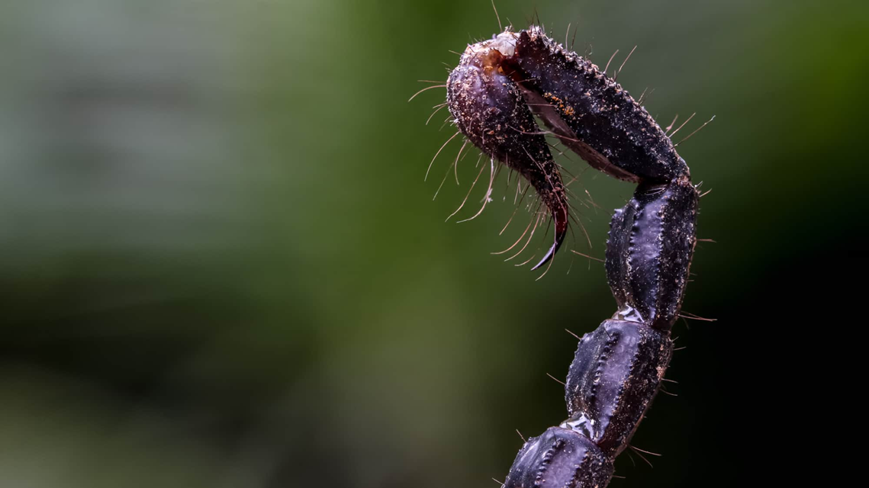
Revelation 9
¹⁰ Their power to hurt people for five months is in their tails. ¹¹ They have as king over them the angel of the bottom-less pit. His name in Hebrew is Abaddon, and in Greek he is called Apollyon.
● Heb & Grk: Destruction & Destroyer.
● Name: Uriel in 1 En 20:2. ‘God’s Light’.
● 5 months: Last months of 3½ years?

Slide 6
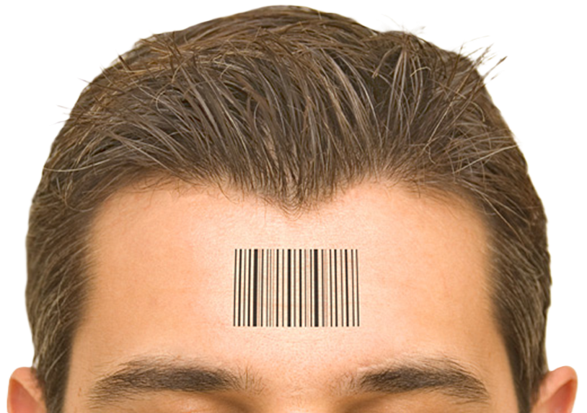
Revelation 7
³ “We have sealed the servants of our God on their foreheads.” ⁴ I heard the number of the sealed, 144,000, sealed from every tribe of the sons of Israel.
● Every tribe: The Dan tribe is missing, replaced by Joseph, father of Ephraim and of Manasseh.

Slide 7
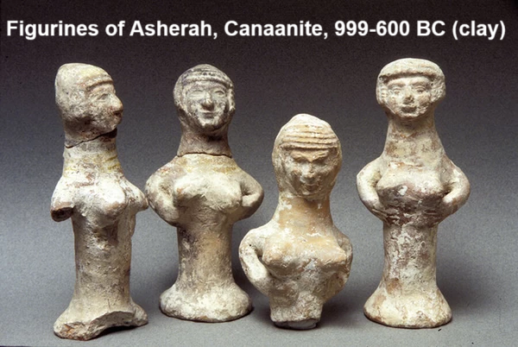
Judges 18
¹⁶ 600 men of the Danites, armed with their weapons of war … ¹⁷ took the carved image, the ephod, the household gods, and the metal image … ²⁷ and the priest… ³⁰ And the people of Dan set up the carved image for themselves…
Gershom, son of Moses, and his sons were priests to the tribe of the Danites until the day of the captivity of the land.

Slide 8
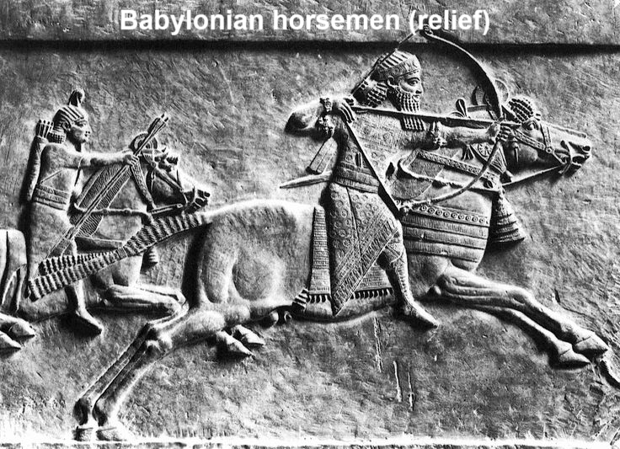
Jeremiah 8
¹⁴ We have sinned against the LORD… ¹⁵ We looked for peace, but no good came; for a time of healing, but behold, terror.
¹⁶ The snorting of their horses is heard from Dan; … the whole land quakes. They come and devour the land and all that fills it, the city and those who dwell in it.

Slide 9
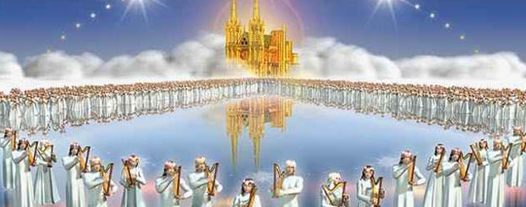
Revelation 14
¹ On Mount Zion stood the Lamb, and with him 144,000 … ³ singing a new song before the throne… ⁴ It is these who have not defiled themselves with women…
⁵ These have been redeemed from mankind … and in their mouth no lie was found, for they are blameless.
● Contrast these with the Watchers.

Slide 10
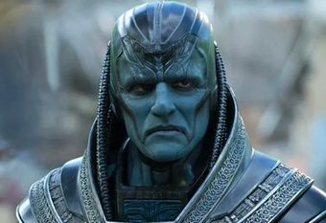
Will Antichrist be a Gentile?
John: ‘Antichrist’. ἀντί-, anti-:
I of Place, opposite, over against, ... in the presence of witnesses…
II of Time, … the same night…
III instead, in the place of…
Jesus: ‘Pseudochrist’. Ψεῦδος, pseudos: Falsehood.
https://logeion.uchicago.edu/ online Greek & Latin lexicons

Slide 11
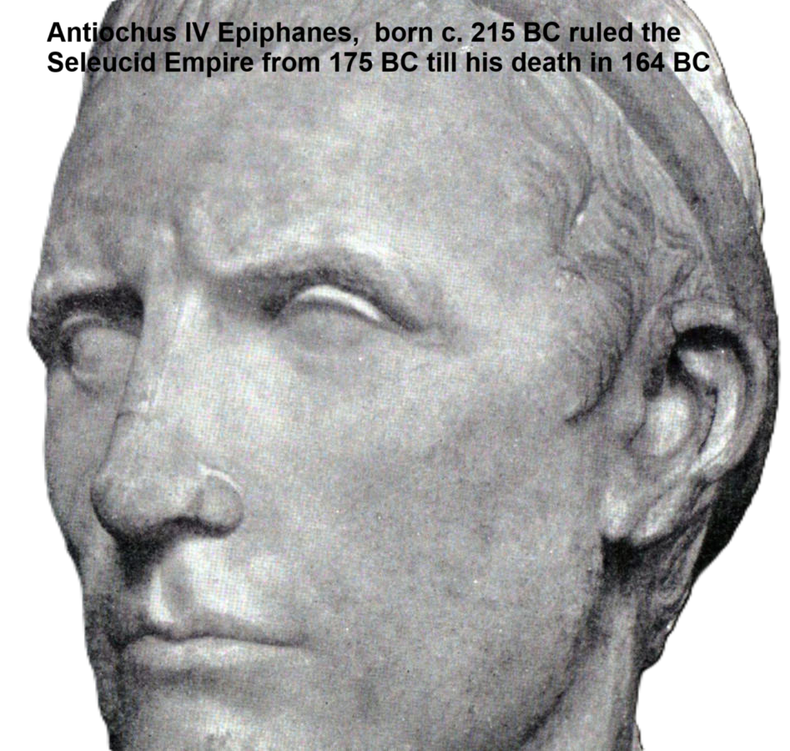
Will Antichrist be a Gentile?
In all Jewish literature, it is Gentiles who trouble Israel in the land.
● Philistines and the Goliath giants.
● The Assyrians and the Babylonians.
● Seleucid king Antiochus Epiphanes IV.
● Gog from Magog (in the north).*
● The king of Daniel 11:37ff*
*See below…

Slide 12
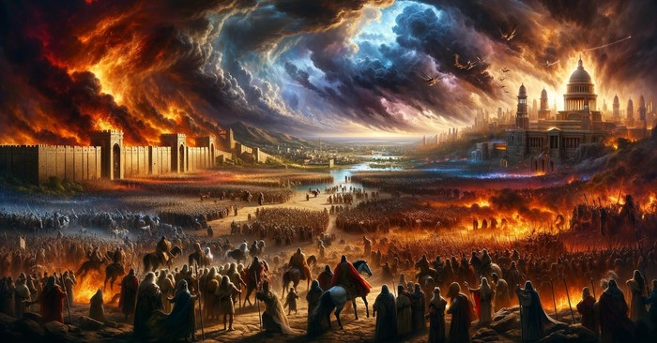
Ezekiel 39
¹ I am against you, O Gog, chief prince of Meshech and Tubal. ² And I will turn you about and drive you forward, and bring you up from the uttermost parts of the north, and lead you against the mountains of Israel…
⁶ I will send fire on Magog … and they shall know that I am the LORD.

Slide 13
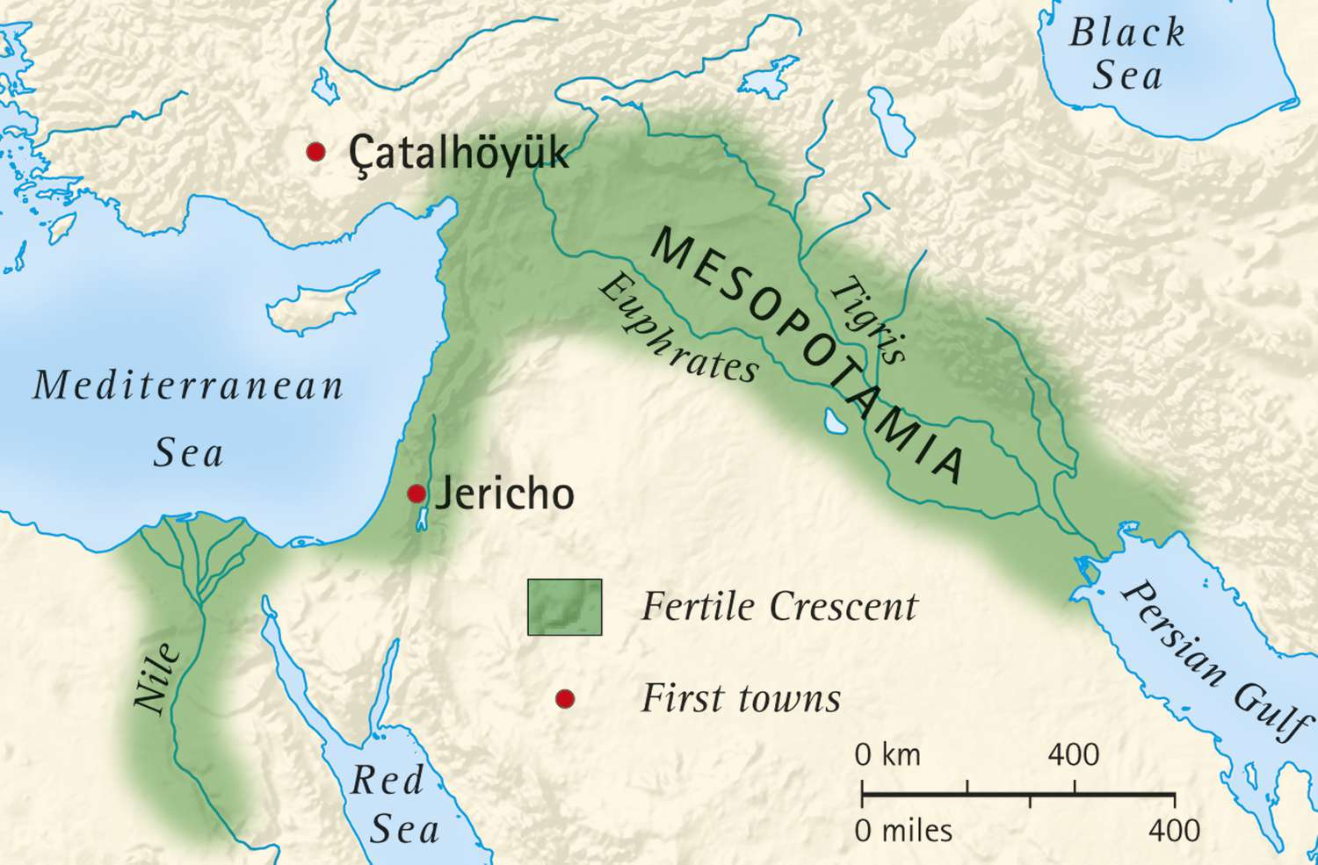
Gog and Magog
● Note: There is no direct evidence that Gog be the antichrist.
● Gog: a ‘chief prince’ (nasy^{ʔ} ro^{ʔ}š).
● Chief: ro^{ʔ}š, head, chief, leader.
● Ro’sh: No ancient people was called Rosh, nor does this mean Russia.
● North: All major invaders came from the north through ‘the fertile crescent.’

Slide 14
Invaders from the north
Bashan was Israel’s northern border.
● The Watchers from Hermon.
● The Assyrians from Ninevah.
● The Babylonians from Chaldea.
● The Greeks under Alexander.
● Antiochus IV and the Seleucids.
● Gog and Magog in the end-times.
● The end-times Antichrist? Dan 11:36?

Slide 15
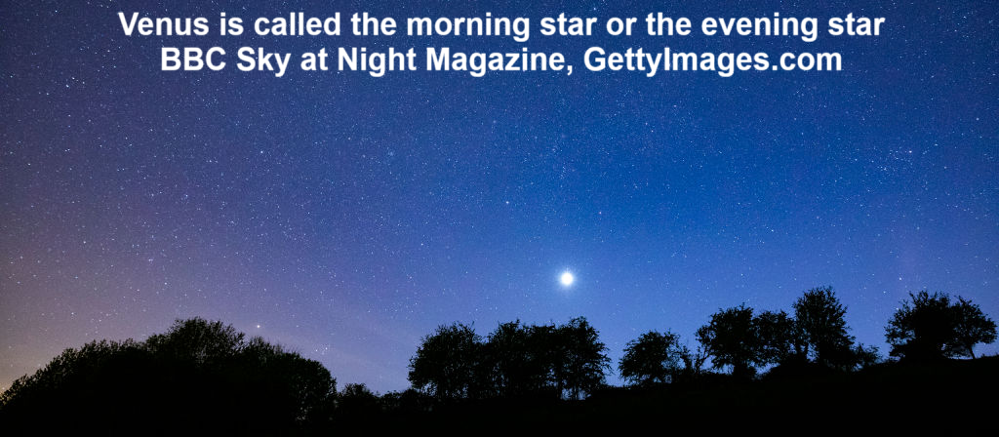
Isaiah 14
¹² You are fallen from heaven, O Day Star … cut down to the ground, you who laid the nations low! ¹³ You said in your heart, ‘I will ascend to heaven; above the stars of God I will set my throne on high;
I will sit on the mount of assembly in the far reaches of the north; ¹⁴ I will ascend above … the clouds; I will make myself like the Most High.’

Slide 16
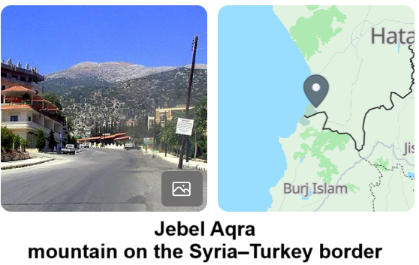
“O Day Star” (Latin ‘Lucifer’)
● Spoken to the king of Babylon (14:4).
● Compared to Satan’s pride.
● Day star & stars of God: angels.
● Mount: Jebel al-’Aqra‘, home of the god Ba’al, Ba’al-Zaphon, Baalzebub.
● Assembly: mo‘ed, root of ‘mageddo’.
● Far north: ts/zaphon, near the Syrian coast, important for navigation.

Slide 17
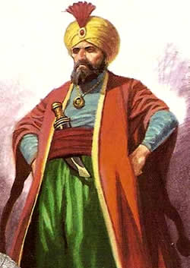
Daniel 11
³⁶ The king shall do as he wills. He shall exalt himself and magnify himself above every god, and shall speak astonishing things against the God of gods. He shall pay no attention to the gods of his fathers

Slide 18
“The king”
● A type of the man of lawlessness who “opposes and exalts himself against every so-called god” (2 Thess 2:4).
● Unlike 11:1-35, the details in 11:36–12:3 have not been fulfilled in history.
● “His fathers’ gods” implies a pagan, Gentile ancestry.

Slide 19
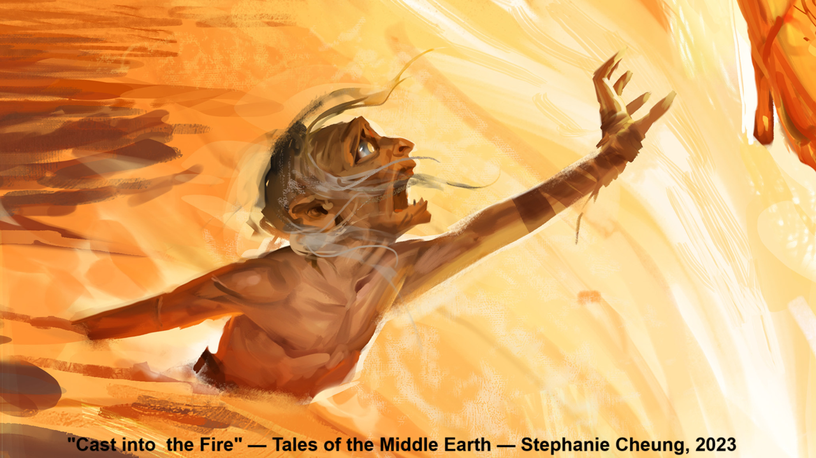
1 Enoch 10
⁴ Bind Azazel hand and foot, and cast him into the darkness… ⁶ On the day of the great judgement he shall be cast into the fire. …
¹¹ Go, bind Semjâzâ and his associates who have united themselves with women so as to have defiled them-selves with them in all their uncleanness.

Slide 20
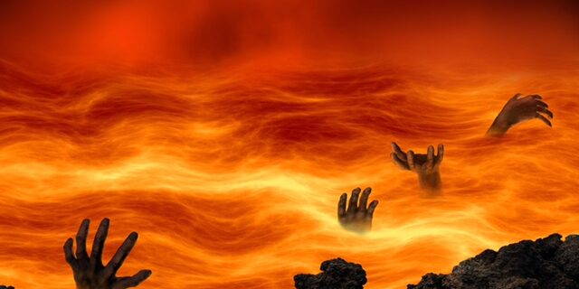
Matthew 25:41 & Revelation 19:20
⁴¹ “Depart from me, you cursed, into the eternal fire prepared for the devil and his angels.”
²⁰ The beast was captured, and with it the false prophet… These two were thrown alive into the lake of fire that burns with sulfur.

Slide 21
Revelation 21
¹ An angel … seized the dragon, that ancient serpent, who is the devil and Satan, and bound him for a thousand years …
⁷ when the thousand years are ended, Satan will be released from his prison ⁸ and will come out to deceive the nations …, Gog and Magog, to gather them for battle.
● Text

Slide 22
Revelation 21
¹⁰ The devil who had deceived them was thrown into the lake of fire … where the beast and the false prophet were, and they will be tormented day and night forever and ever…
¹⁴ Then Death and Hades were thrown into the lake of fire. This is the second death, the lake of fire.

Slide 23
Summary
The Apocalypse describes the reversing of Hermon by several antitypes:
● Redeemed Israelite humans who never sinned in the way in which the Watchers did.
● Imprisoned Watchers released for five months to torture the non-repentant.

Slide 24
Summary
● The devil, the Watchers, the antichrist and a false prophet thrown into a Lake of Fire.
● Satan released after a thousand years to lead a final human revolt, before all the wicked be cast into the Lake of Fire, which God has prepared for ‘the devil and his angels’.

Slide 25
Assignment
● Skim Reversing Hermon, Appendix IV: “NT Allusions to Pseudepigrapha, pages 203–256
● Visit ReversingHermon.site

