Slide 1
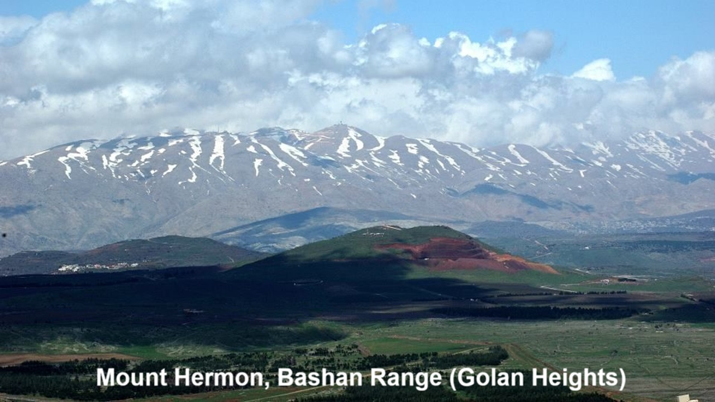
REVEЯSING HERMON
12: Conclusions
19 and 22 December 2024

Slide 2
Learning objectives
By the end of this session, we shall be able to express:
● What we have learned or doubt.
● Which passage now make good sense.
● How we now pray differently.

Slide 3
Share your current views about:
● What helpful insights did you gain?
● Which Bible passages make sense?
● How shall we pray differently?
● How to explain current news?
● How to understand our own elite?
● How to explain the purpose of history?
● What will happen in the end times?

Slide 4
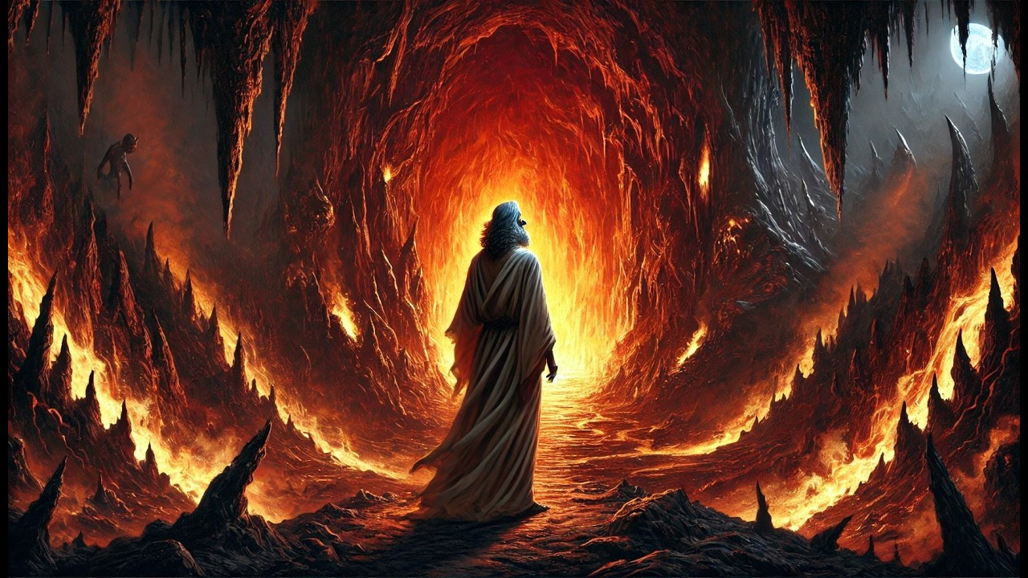
Assess Heiser’s ‘transparent facts’
Reveяsing Hermon, page 183:
1. “1 Enoch is a substantially pre- Christian literary work that enjoyed readership among Jews in the Second Temple Period.”
2. “Christianity was born out of Second Temple Judaism.”

Slide 5
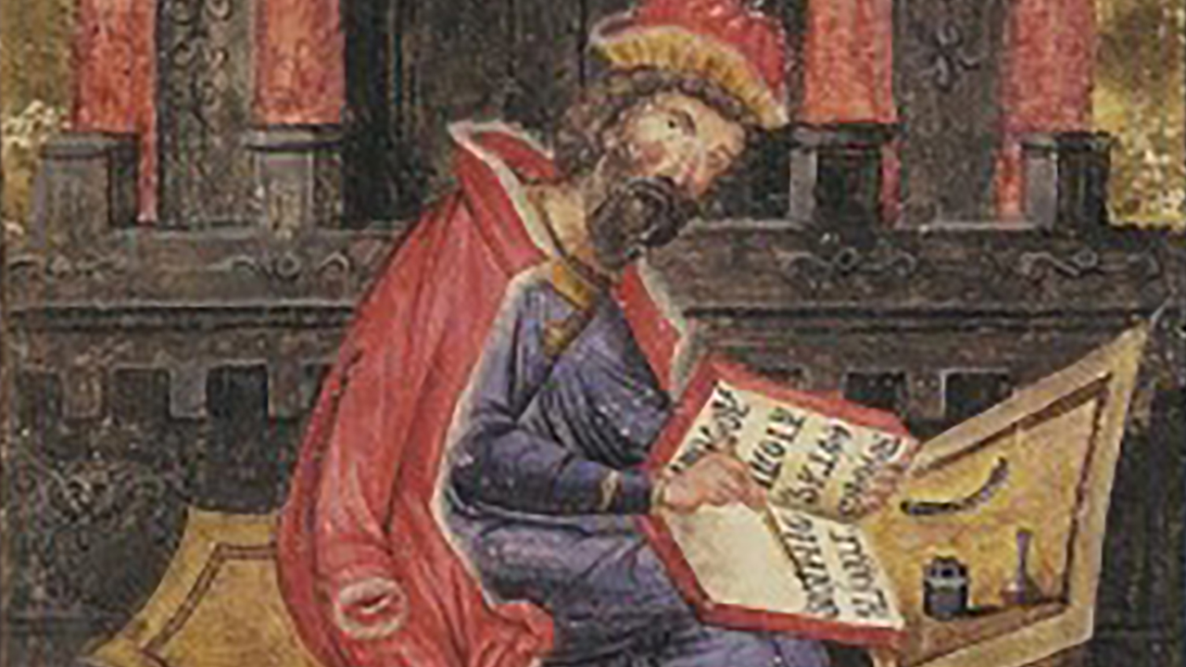
Assess Heiser’s ‘transparent facts’
3. “New Testament writers either presuppose or utilize its content in portions of their own writing.”
Thus:
● “The book we know as 1 Enoch was well known to early Christians.”

Slide 6
In your humble opinion …
● What does it matter that fragments of 1 Enoch were discovered amongst the Dead Sea Scrolls at Qumran?
● Should 1 Enoch be included in our Christian ‘canon’ of Scripture?
● Did God inspire the writer of 1 Enoch?
● What value is there in reading 1 Enoch?

Slide 7
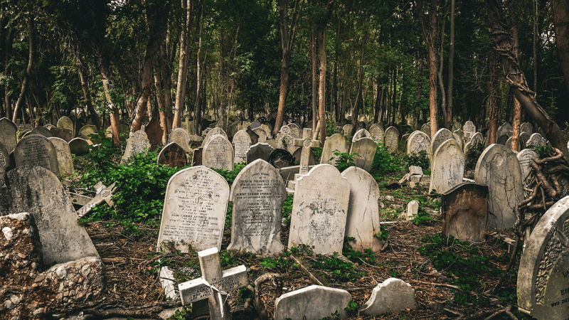
Are we born guilty of Adam’s sin?
“Just as sin entered the world through one man, and death through sin, and in this way death came to all people, because all sinned …” Romans 5:12 NIV
● How did sin enter into the world?
● What did sin bring with it?
● What happens to all people?
● What did/do ‘all people’?

Slide 8
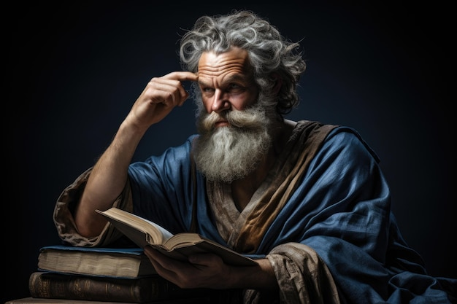
Greek grammar (Sorry!)
● Three verbs: ‘come-into’, ‘come-to’, and ‘sin’.
● English versions: use past tenses.
● Aorist verb form: timeless, tenseless.
● Context: determines English tense.
● Come into: Obviously historical past.
● Come to: Both past and present.
● Sin: On-going present reality.

Slide 9
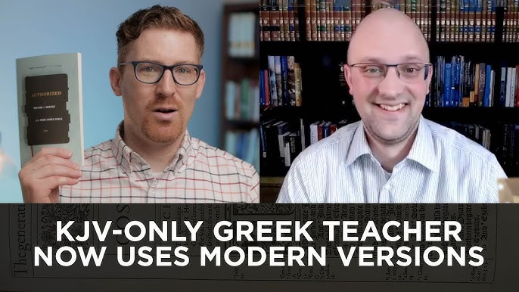
The aorist verb form
General rules:
● Verbs in the Koiné Greek aorist form should be understood to be generally true.
● Aorist verbs should be translated in the English present tense, unless their context indicates a past or future.

Slide 10
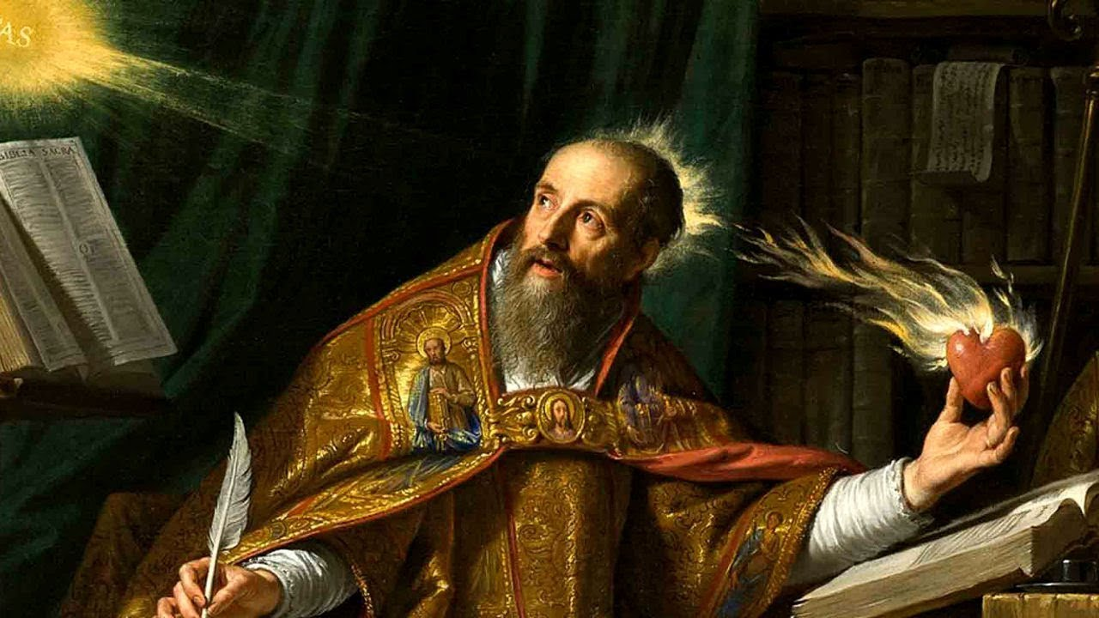
Augustine read:
● Latin: Propterea sicut per unum hominem in hunc mundum peccatum intravit et per peccatum mors et ita in omnes homines mors pertransiit in quo omnes peccaverunt. Romans 5:12 Latin Vulgate. Public domain.

Slide 11
“Because”
● English: “because all sinned.”
● Latin: “in quo omnes peccaverunt.” “in whom/which” (masc. or neut.).
● Greek: “ἐφʼ ᾧ πάντες ἥμαρτον.” “upon whom/which” (masc. or neut.).
● If masculine: “in (Adam) all sinned.”
● If neuter: “on (death) all sin.”

Slide 12
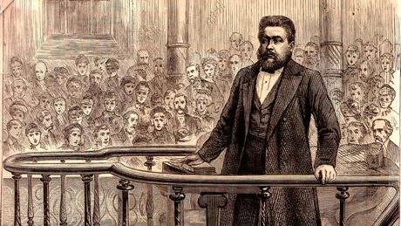
The crux
● Augustine: Read ‘in quo’ to mean ‘in Adam’ and a past tense for ‘sin’.
● Calvin, Spurgeon & Piper: Perpetuate this error in support of their doctrine of total depravity, inability to do good.
● Alternative: Read ἐφʼ ᾧ as ‘because’ or ‘indeed’, and ‘sin’ as a general truth.

Slide 13
Grammatical alternative
“Just as sin entered the world through one man, and death (entered) through sin, and in this way death comes to all people, because all sin.” Romans 5:12.
● Translators: Import their theology.
● Theologians: Believe their system.
● Publishers: Protect their market share.

Slide 14
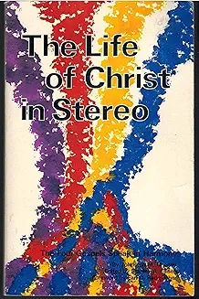
Assignment
● Visit http://LOCIS.site
● Download and install the Android device app.
● Read or listen through the LOCIS before January 6th. It will take about six hours.

