Slide 1
TEMPLATE
…
● …

Slide 2
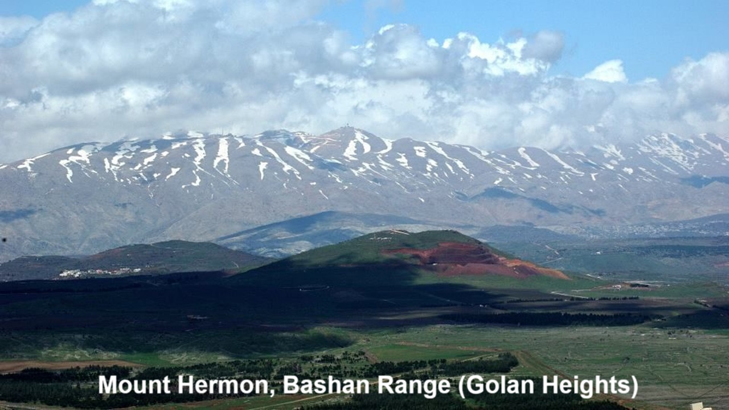
REVEЯSING HERMON
Chapter 1: “Sons of God and Nephilim”
26 and 29 September 2024

Slide 3
Chapter learning objectives
● Identify the “sons of God” in Scripture.
● Describe the Nephilim in their own Mesopotamian context.
● Define “second-temple” Judaism (from about 500 BC until AD 70).
● Adopt a supernatural, biblical worldview.

Slide 4
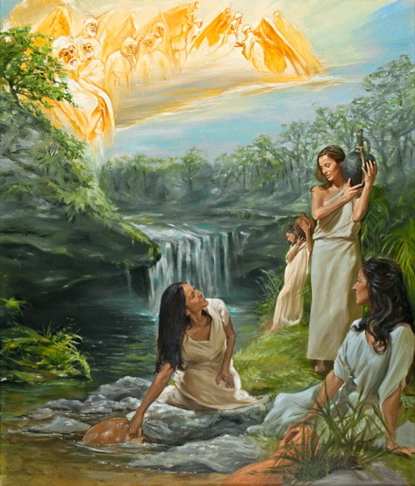
Genesis 6:1-4
¹ When people began to multiply on the face of the ground, and daughters were born to them, ² the sons of God saw that they were fair, and they took wives for themselves of all that they chose…
⁴ The Nephilim were on the earth in those days — and also afterward — when the sons of God went in to the daughters of humans, who bore children to them. These were the heroes that were of old, warriors of renown.

Slide 5
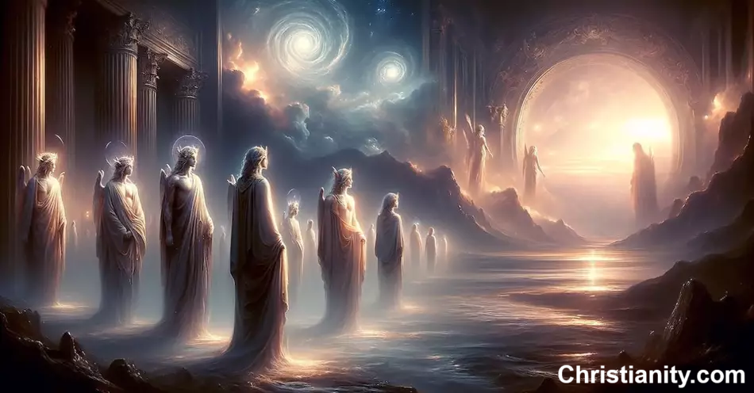
Preliminary queries
● Who are the “sons of God”?
● Are they divine (supranatural) or human?
● Who were the Nephilim?
● How were there Nephilim after the flood?

Slide 6
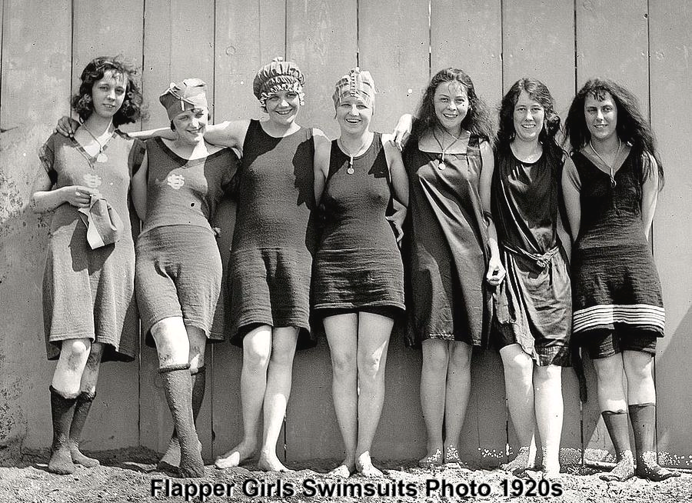
Sons of Seth interpretation
Hypothesis: Seth’s godly male descendants married Cain’s godless female descendants.
● Formulated in the 4th century AD.
● Appealing to Gen. 4:26, “Then he/they began to call on the name of the LORD.”
● This does not explain the Nephilim.
● Neither Seth nor Cain is named in Gen. 6.
● In OT, humans never called ‘sons of God’.
● These were daughters of ‘humankind’.

Slide 7
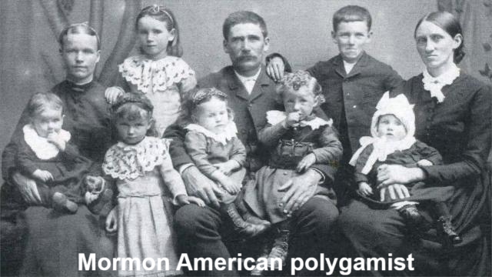
Divinized human kings interpretation
Hypothesis: In Psalm 82:6, God calls human men ‘gods’, who sinned by polygamy.
● Pagans believed their kings to be divinized.
● The passage says nothing about polygamy (which is not condemned in the OT).
● In the OT, ‘sons of God’ = divine beings.
● This theory = rationalist, anti-supernatural.
● Human believers will not be divinized (glorified) until our future resurrection.

Slide 8
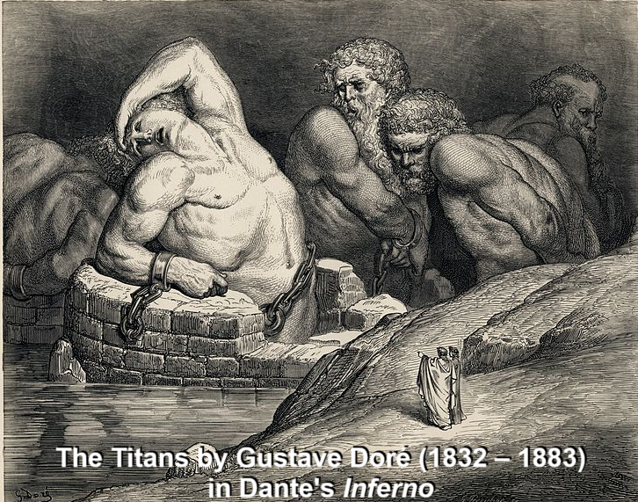
2 Peter 2:1-10
⁴ God did not spare the angels when they sinned but cast them into hell and committed them to chains of deepest darkness to be kept until the judgment…
● Angels: In biblical Greek, a general ‘catch word’ for different kinds of divine beings.
● Context: The great flood recounted in Genese 6 & 7 and Mesopotamian myths.
● Hell: Tartarus, made for the Greek titans.

Slide 9
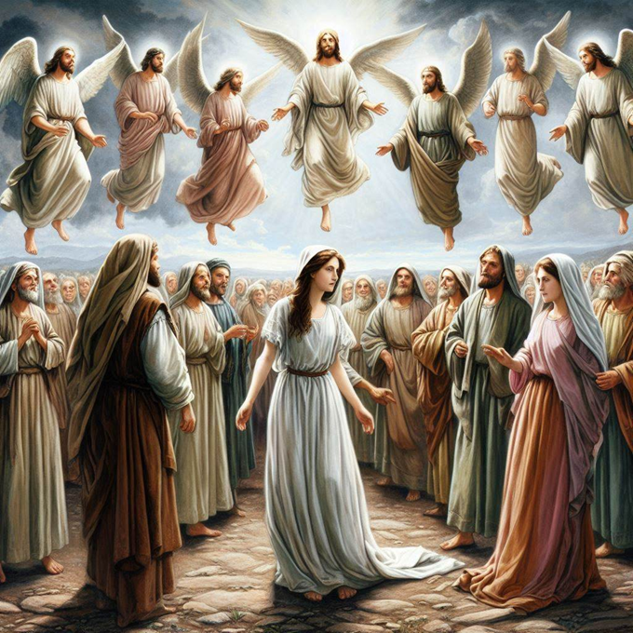
Jude 5-6
⁶ And the angels who did not keep their own position but deserted their proper dwelling, he has kept in eternal chains in deepest darkness for the judgment of the great day.
● Position: arḥé, assigned authority.
● Deserted: No other angelic rebellion is recorded in the Bible!
● Day: End of this age, after Jesus returns.

Slide 10
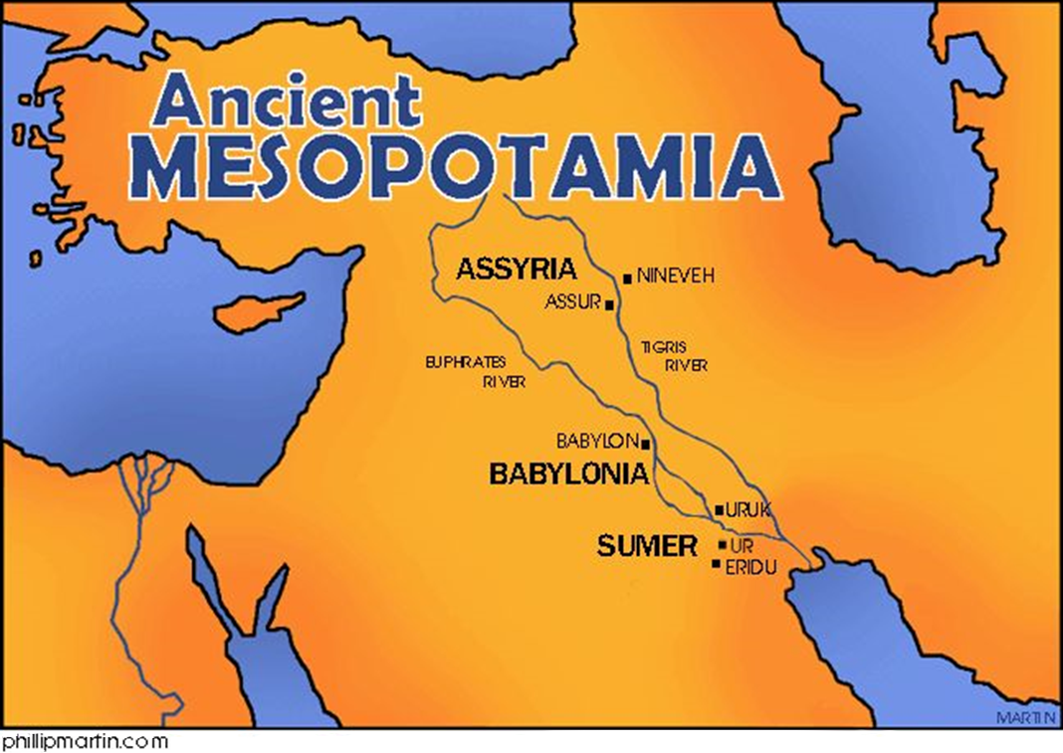
Biblical theology
The Bible writers’ theology came from:
● Supernatural, Mesopotamian worldview.
● Yahweh God’s own revealed words.
Their theology did not derive from:
● Early churches (2nd through 15th centuries.)
● Luther, Calvin or Wesley (16th–18th cents.).
● Dispensationalism (England, 19th century).
● Pentecostalism (USA, early 20th century).
● Evangelicalism (USA, mid-20th century).

Slide 11
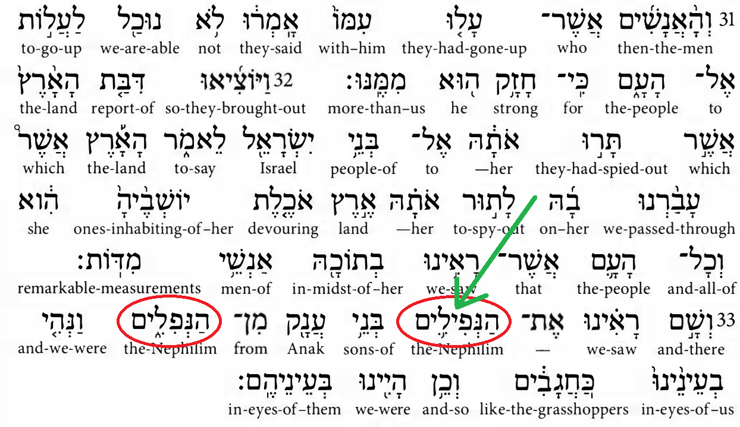
The Nephilim
● Nephilim: ‘giants’, the plural form of the Aramaic nafyla. (Not Hebrew nafal, ‘to fall’).
● Second Temple period: Giant offspring of rebellious ‘sons of God’. Book of Enoch.
● Septuagint (LXX): In the third century BC, Jews translated the OT into Greek, calling the Nephilim gigantes (from giga, giant).
● Giant: More than six feet (two meters) in height, unusually tall in antiquity.

Slide 12
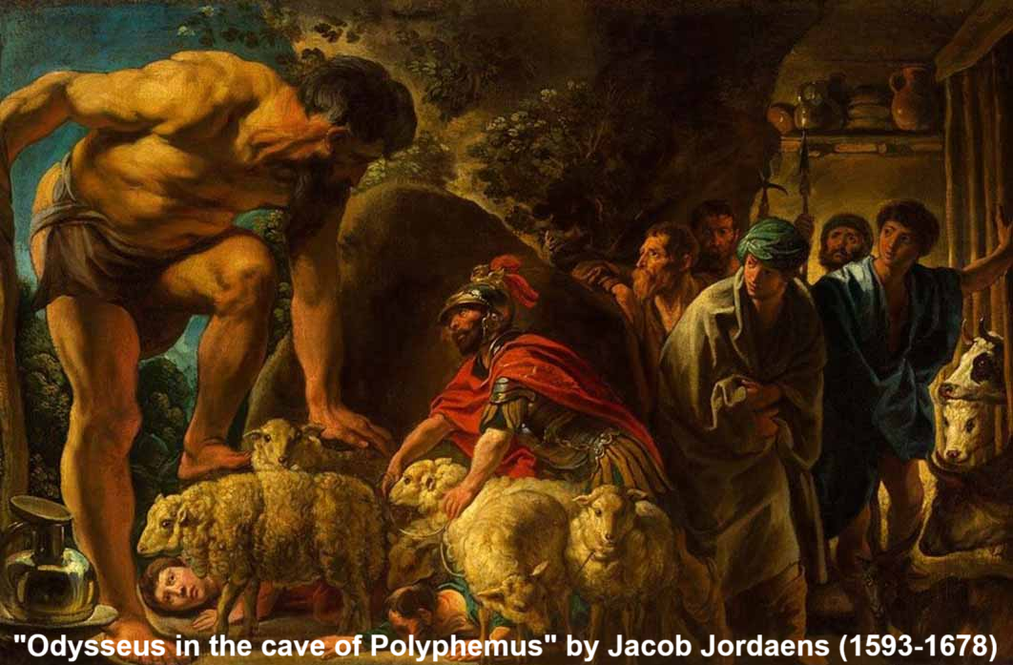
Origin of the Nephilim
Supernatural theory
● Divine beings belong in the sky (heaven).
● Some divine beings came down to earth.
● They assumed human flesh.
● They cohabited with human women.
● They fathered unusually big offspring.
● Giant clans were in Canaan after the flood.
Jesus: Angels in heaven do not marry, nor will believers after the resurrection. Mt 22:30

Slide 13
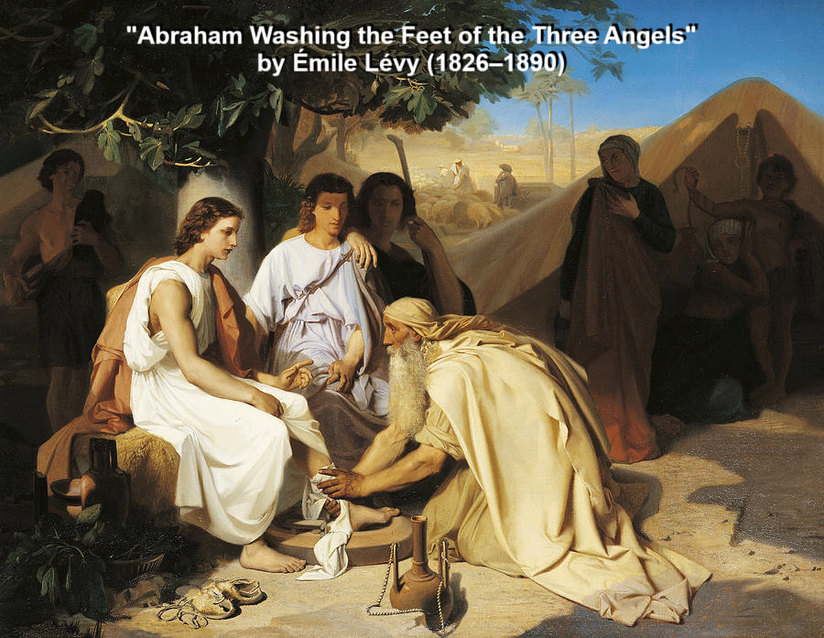
Divine beings who assumed humanity
● Yahweh ate a meal and conversed with Abraham (Gen. 18:1-10).
● Angels physically rescued Lot (Gen. 19:10).
● Jacob wrestled with a man who was an angel and God (Gen 32:24; Hos. 12:3-4).
● Angels physically touched Peter to waken him (Acts 12:7).
● God assumed human flesh by his own incarnation as Jesus (John 1:1 & 14).

Slide 14
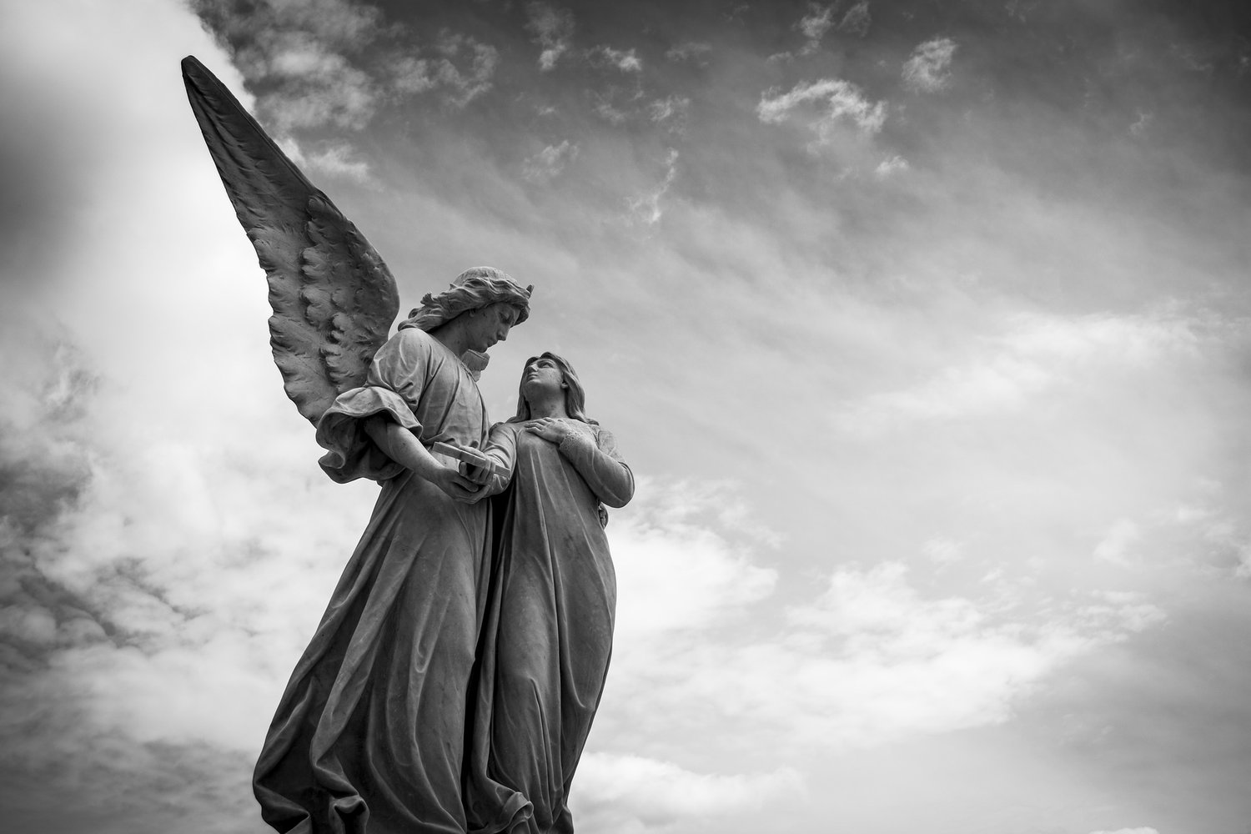
Four theories
● Divine beings assumed human flesh, mated with women, and fathered offspring.
● Divine beings appeared human, but used supernatural means to engender offspring.
● Divine beings used natural means to cause pregnancies by parthenogenesis.
● Divine beings already have bodies, so they are able to mate with human beings.

Slide 15
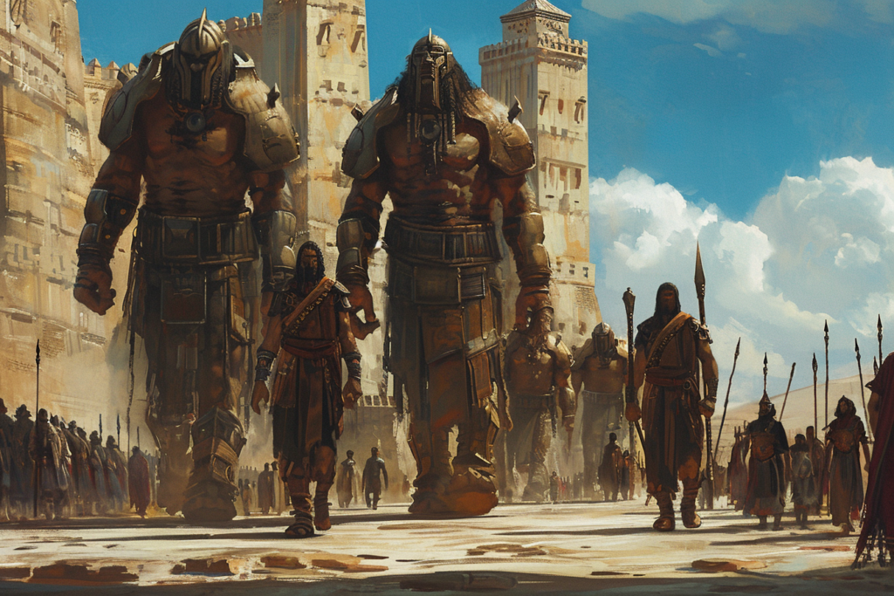
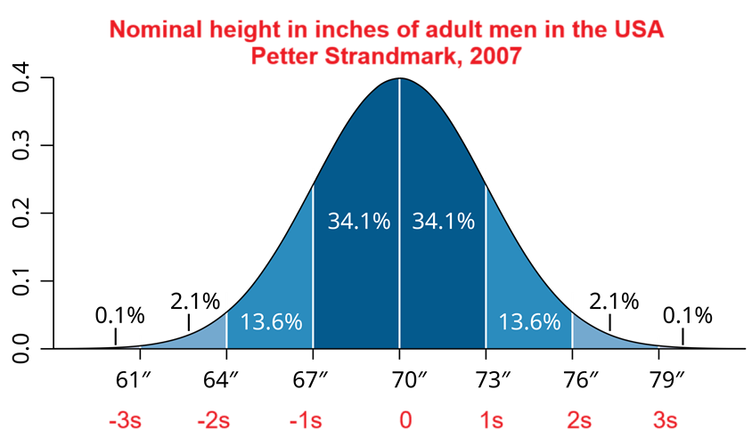
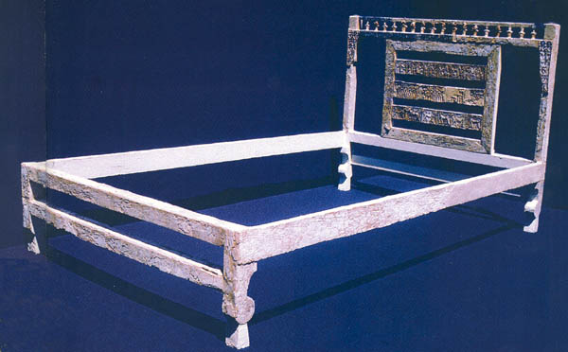
How tall were the Nephilim?
● Human heights a normal curve distribution.
● Archeology finds similar distributions amongst ancient societies.
● An Egyptian was 7½ feet tall (1 Chr. 11:23).
● Goliath was 4 ½ cubits tall (6’ 6”).
● Og’s bed (19X4 cubits) = exact dimensions of god Marduk’s cultic bed in the Etemenanki ziggurat.

Slide 16
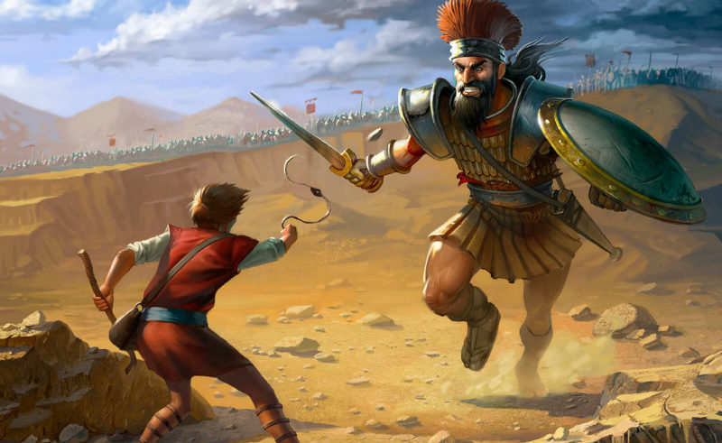
Nephilim after the flood
● “The Nephilim were on the earth in those days—and also afterwards…” (Gen. 6:4).
● “There we saw the Nephilim (the Anakites come from the Nephilim)…” (Num. 13:33).
●“None of the Anakim was left in the land of the Israelites; some remained only in Gaza, in Gath, and in Ashdod.” (Josh. 11:22)
● “Goliath, of Gath, whose height was four cubits and a span [6’ 6”]…” (1 Sam. 17:4).

Slide 17
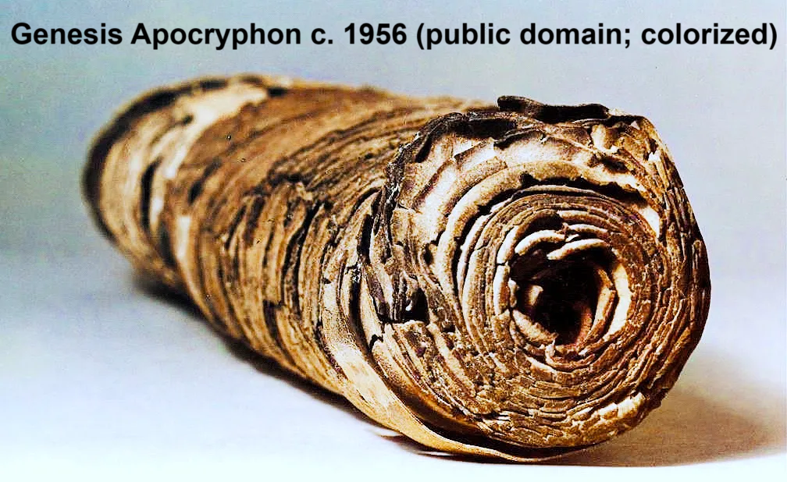
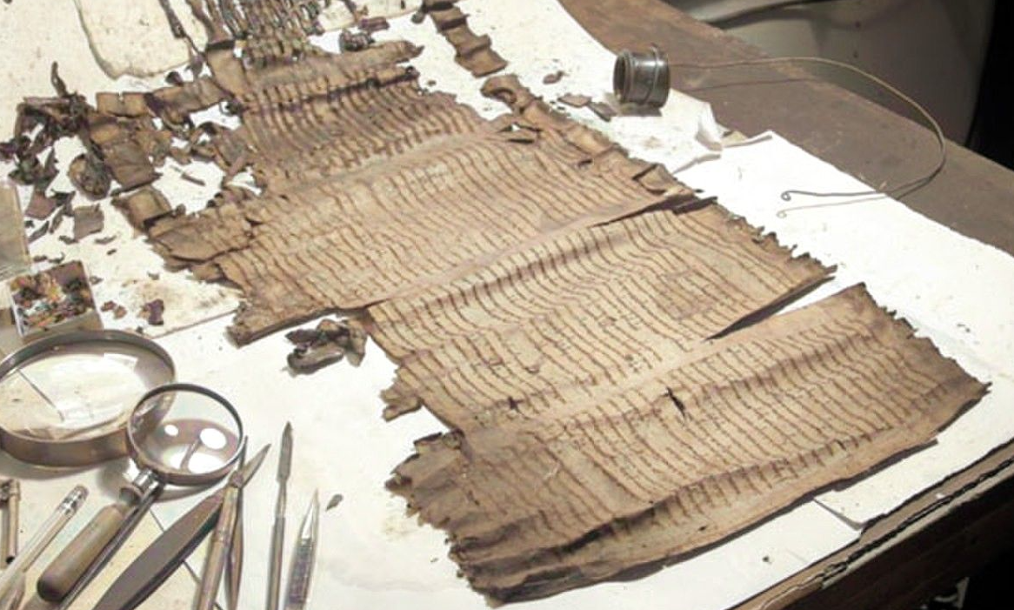
Five theories of Nephilim survival
● A local flood allowed some humans and Nephilim to survive.
● Two Nephilim were taken into the ark along with other creatures.
● Noah or a member of his family was part Nephilim. (DSS 1QApGen)
● Other sons of God made new Nephilim.
● Israelite spies were mistaken about the Anakim being descended from Nephilim.

Slide 18
Assignment
● Read Reversing Hermon, chapter 2: “The sin of the watchers in 1 Enoch and other Enochian texts,” pages 23-36.
● Visit reversinghermon.site to see the recommended materials.

