Slide 1
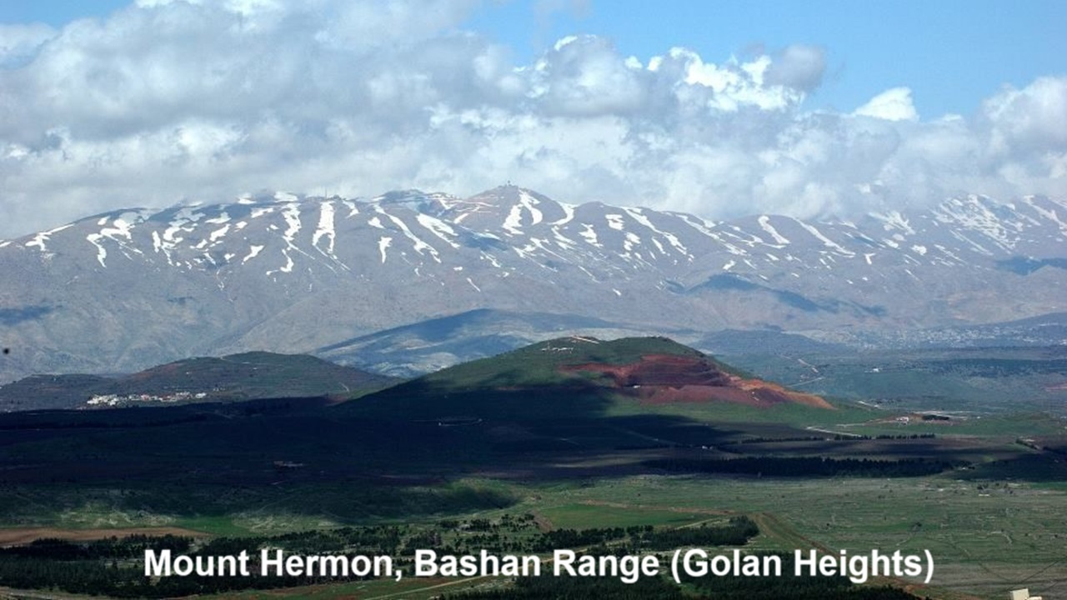
REVEЯSING HERMON
Chapter 2: The Watchers
03 and 06 October 2024

Slide 2
Must we believe the Book of Enoch?
No. We do not believe the Book of Enoch, because
● It is a fanciful depiction of popular mythology.
● It was never in the ‘canon’ of Scripture, except in the Ethiopian Orthodox church.
But we read it, because
● It is part of the Jewish cultural and literary background.
● Some New Testament writers quote from it.
● It informs us on how ancient readers understood the Bible.

Slide 3
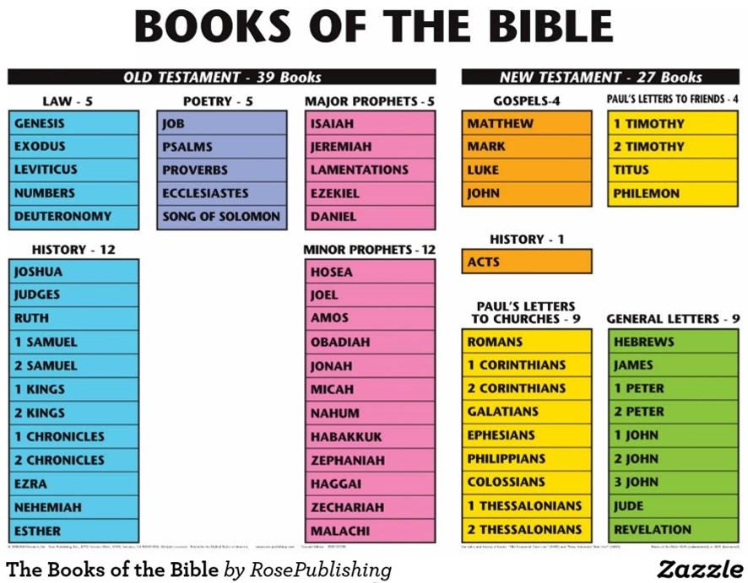
Our hypothesis
● “Second temple Jewish writers understood and preserved the original supernaturalist backstory from Mesopotamia.” REVEЯSING HERMON, page 23.
● This includes the parts of 1 Enoch which New Testament writers assume or include in their books.
● We accept onto our canon of Scripture only those books which meet the criteria of (1) apostolic authorship or (2) approval, and (3) approval by all Christian churches’ agreement.

Slide 4
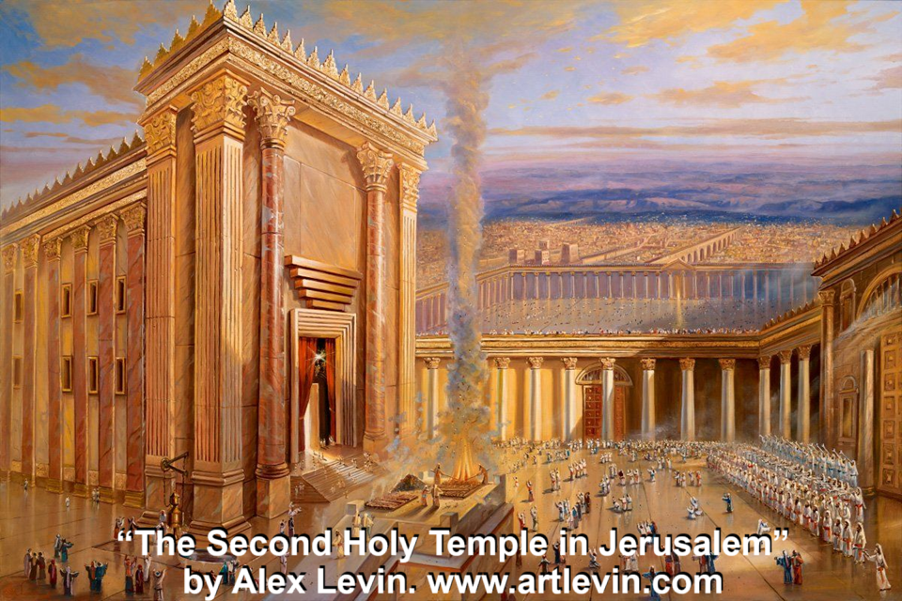
Biblical temples
● Eden: from creation until the great flood.
● Altars: from the flood till the exodus from Egypt.
● Tabernacle: from Egypt till Solomon (10th cent.).
● First: from Solomon till the 6th century BCE.
● Second: from Ezra until 70 CE (2nd temple times).
● Spiritual: from Jesus until the present.
● Third: from Jesus’ return through the millennium.
● Everlasting: from the New Jerusalem forever.

Slide 5
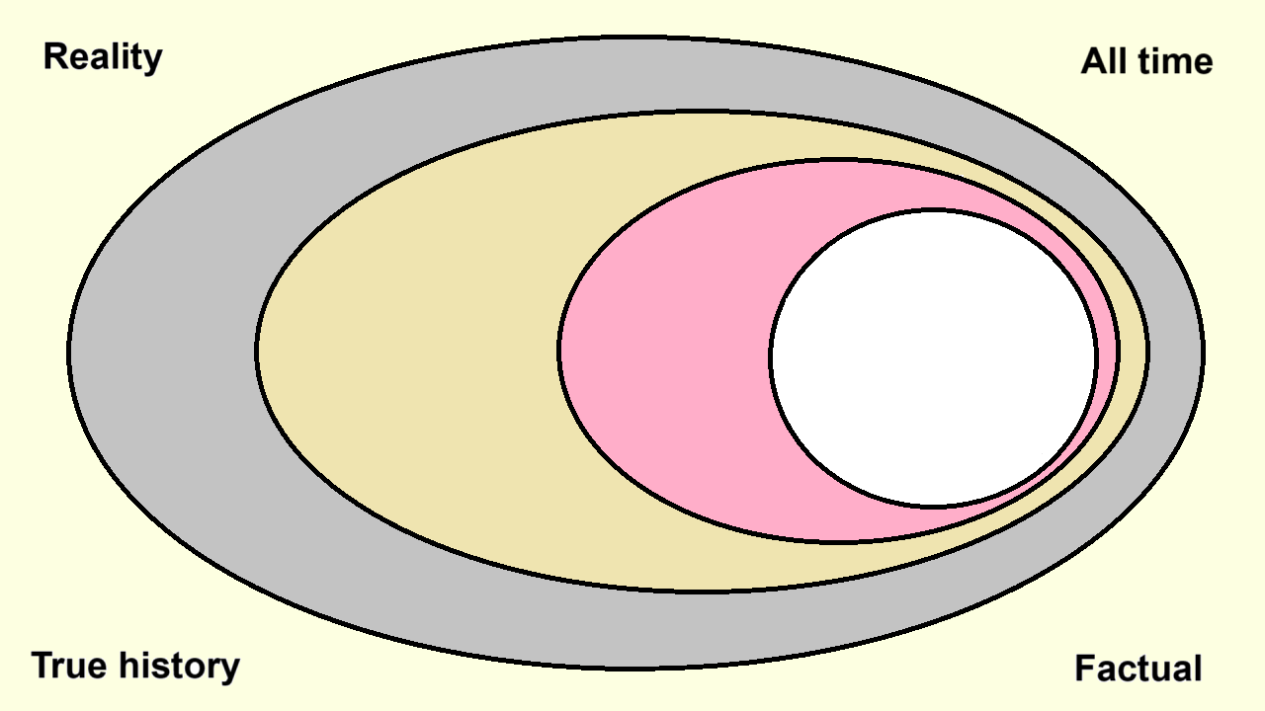
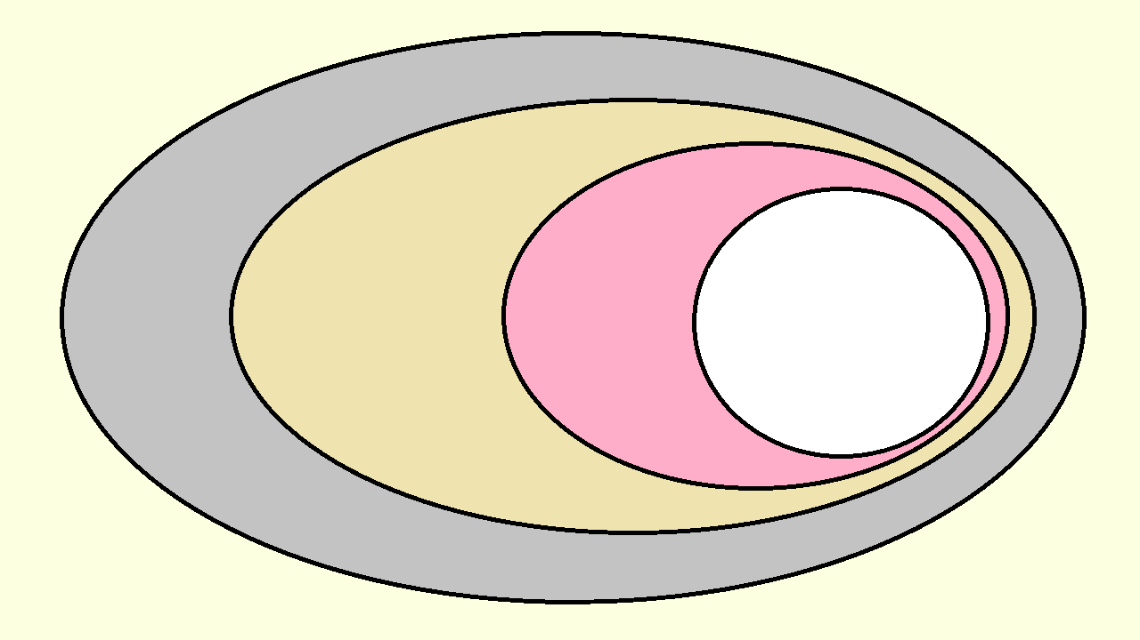
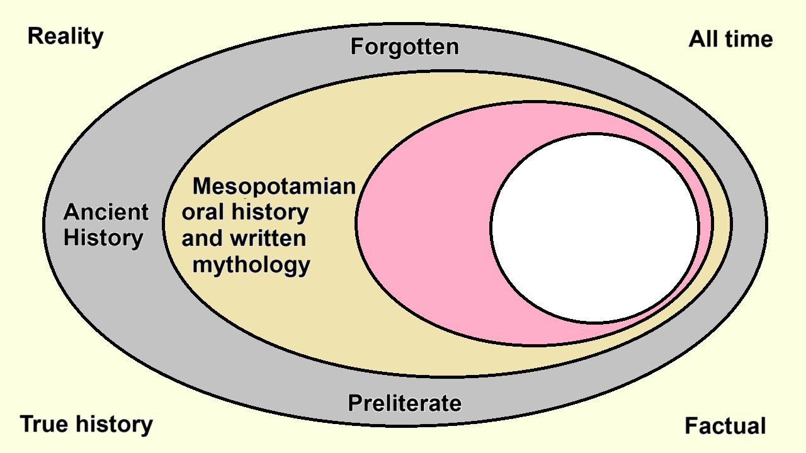
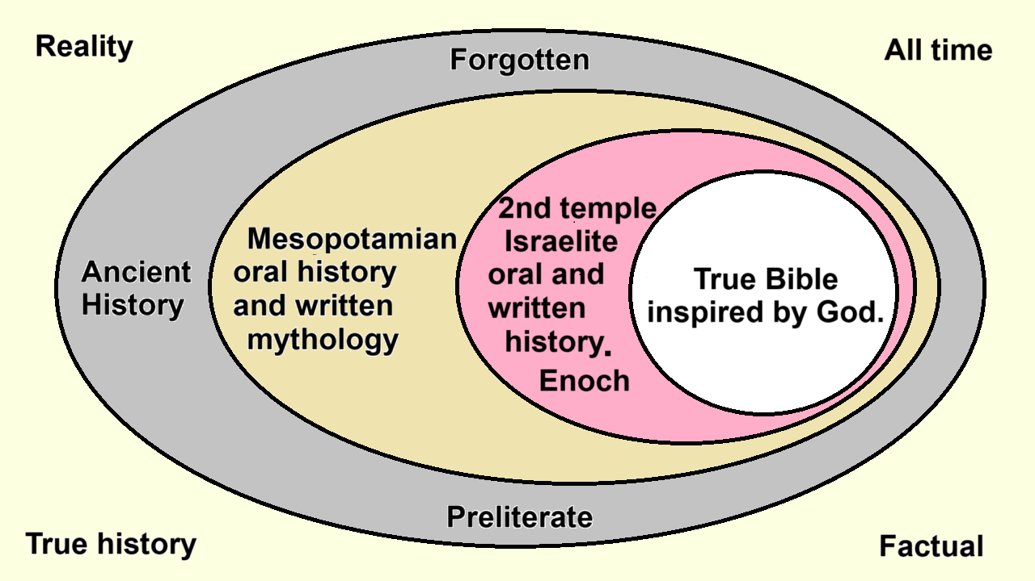
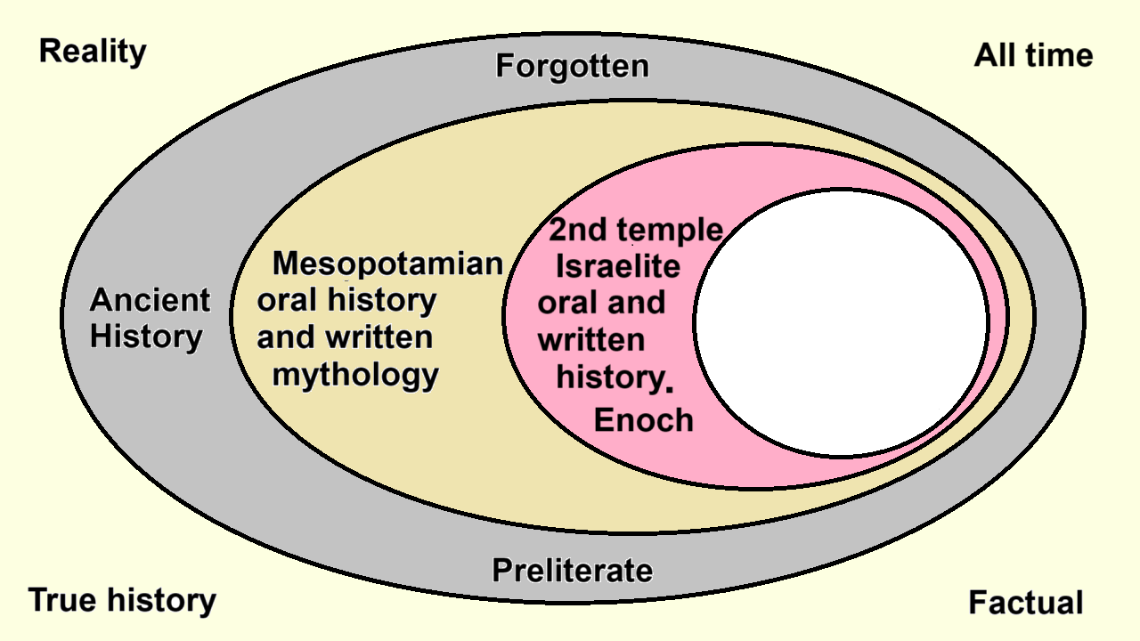

Slide 6
Archai rulers in 1 Enoch 6:7-8
⁷ Καὶ ταῦτα τὰ ὀνόματα τῶν ἀρχόντων αὐτῶν· Σεμιαζά, οὗτος ἦν ἄρχων αὐτῶν. ⁸ οὗτοί εἰσιν ἀρχαὶ αὐτῶν οἱ ἐπὶ δέκα.
⁷ And these are the names of their ruling ones: Semiaza, he was their ruling one. ⁸ These are their rulers [archai] over tens.
● Ruling one(s): Participle of the verb (ἄρχω archô).
● Rulers: Noun (pl. ἀρχαὶ archai, sg. ἀρχή arché ).
● Hebrew ‘sons of God’ = Aramaic ‘watchers’ = LXX Greek ‘ruler’ = NT ‘angels/rulers’.

Slide 7
Archai rulers in the New Testament
“Neither … angels nor rulers…” Rom. 8:38
“He disarmed the rulers and authorities” Col. 2:15
“In the heavenly places, far above every ruler and authority and power and dominion” Eph. 1:20-21
“The rulers and authorities in the heavenly places” 3:10
“Against the rulers, … the cosmic powers over this present darkness, … the spiritual forces of evil” 6:8
“Destroying every ruler and every authority and power … all his enemies” 1 Cor. 15:24-25

Slide 8
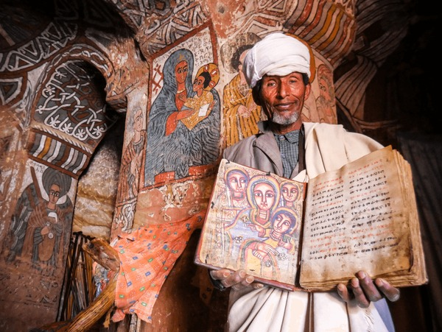
1 Enoch
● Consists of several sections written during the third century BCE through the first century CE.
● Written in Aramaic or both Aramac and Hebrew.
● Translated into Greek and Ethiopic (Ge‘ez). (Ethiopians believe it was written in Ethiopic.)
● Widely copied and read in Jewish communities.
● In the 20th century, large portions of 1 Enoch were found in Aramaic amongst the Dead Sea Scrolls.
● Many NT passages use words, phrases, ideas and legends from 1 Enoch and similar writings.

Slide 9
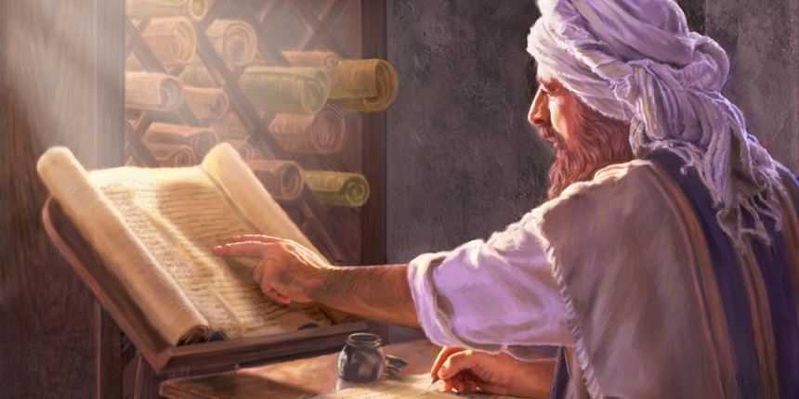
Jude 14-16 (AD) Enoch 1:9 (BC)
“See, the Lord is coming with ten thousands of his holy ones, to execute judgment on all and to convict all the ungodly of all the deeds of ungodliness that they have committed in such an ungodly way and of all the harsh things that ungodly sinners have spoken against him.” NIV
“Look, he comes with the myriads of his holy ones,
to execute judgment on all, and to destroy all the wicked, and to convict all humanity for all the wicked deeds that they have done, and the proud and hard words that wicked sinners
spoke against him.”
Nikelsburg & Vanderkamp, 1984.

Slide 10
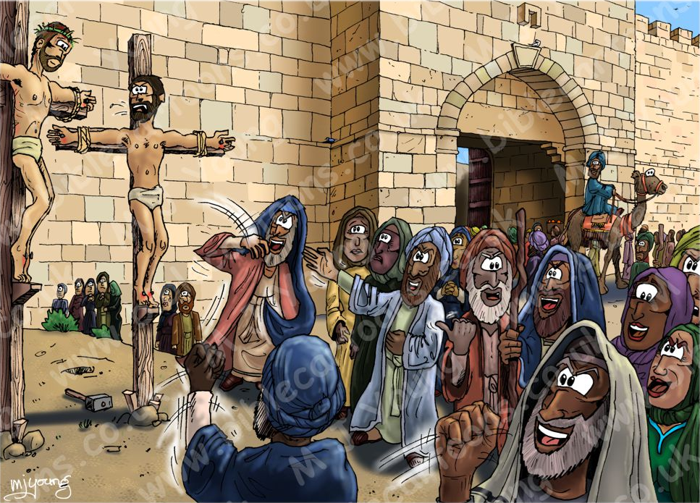
Coming Judgement Day
“When the Righteous One appears…” Enoch 38:2
“The sinners who deny the Name of the Lord of Spirits … will thus be kept for the Day of Affliction and Distress… On that day the Chosen One will sit on the Throne of Glory…” Enoch 45:2-3
“The rulers scoffed at him, saying, ‘He saved others; let him save himself, if he is the Christ of God, his Chosen One!’” Luke 23:35
“The Righteous One, whom you have now betrayed and murdered.” Acts 7:52

Slide 11
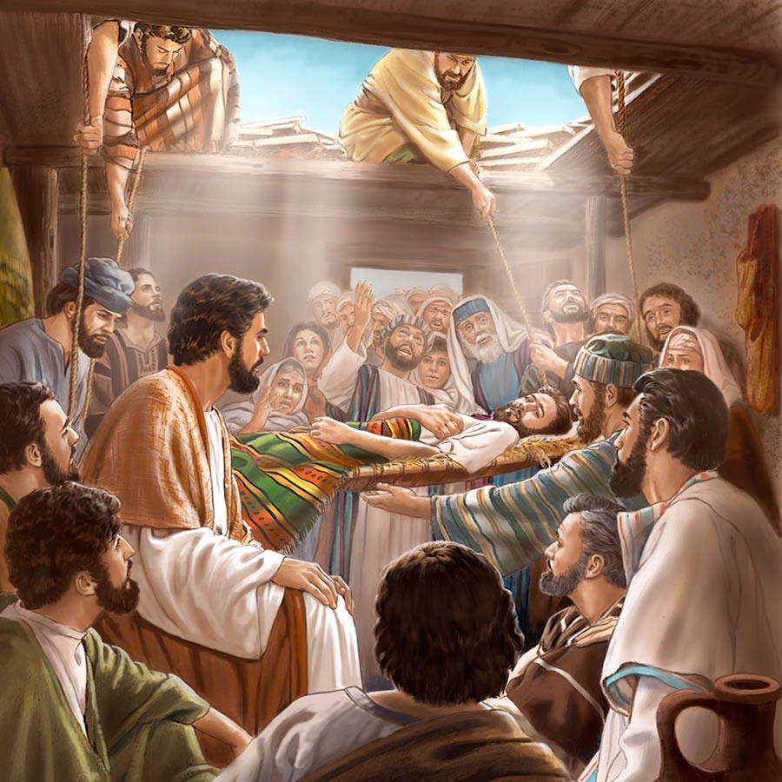
“Son of Man”
“And there I saw one who had a ‘Head of Days’ and his head was white like wool. And with him there was another whose face had the appearance
of a man...” Enoch 46:1
“This is the Son of Man who has righteousness and with whom righteousness dwells.” Enoch 46:3
“Know that the Son of Man has authority on earth to forgive sins!” Luke 5:24
“They will see the Son of Man coming in a cloud with power and great glory.” Luke 21:27

Slide 12
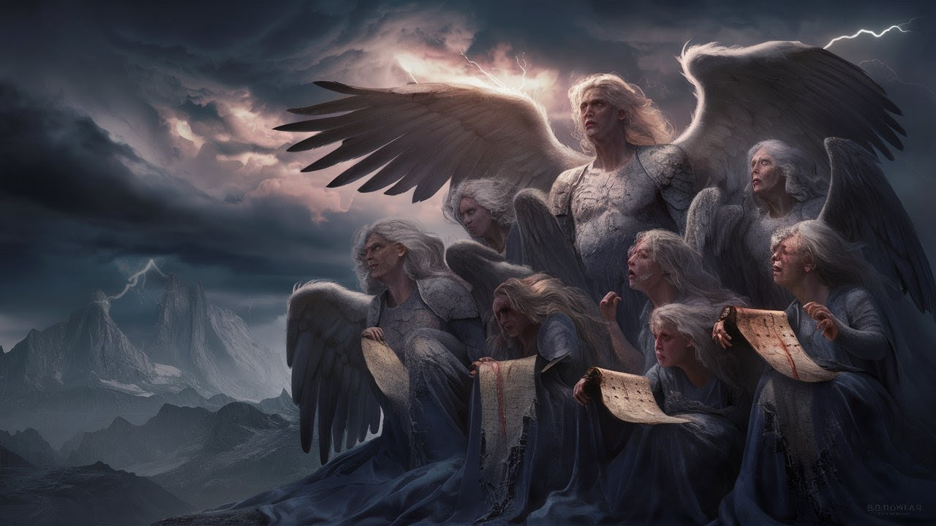
What are Watchers?
“The king saw a watcher, a holy one, coming down from heaven…” Dan. 4:23 [4:20 in Aramaic]. (‘Watchers’ in 4:13 [10], 17 [14].)
● Watcher: ^{ʕ}îr, Watchman, guardian (angel).
● Holy: Some watchers remained good angels.
1 Enoch 6–16 Watchers sinned against God by:
● Abandoning their realm for the human domain.
● Revealing hidden knowledge.
● Mating with human women.
● Fathering giants who terrorized the world.

Slide 13
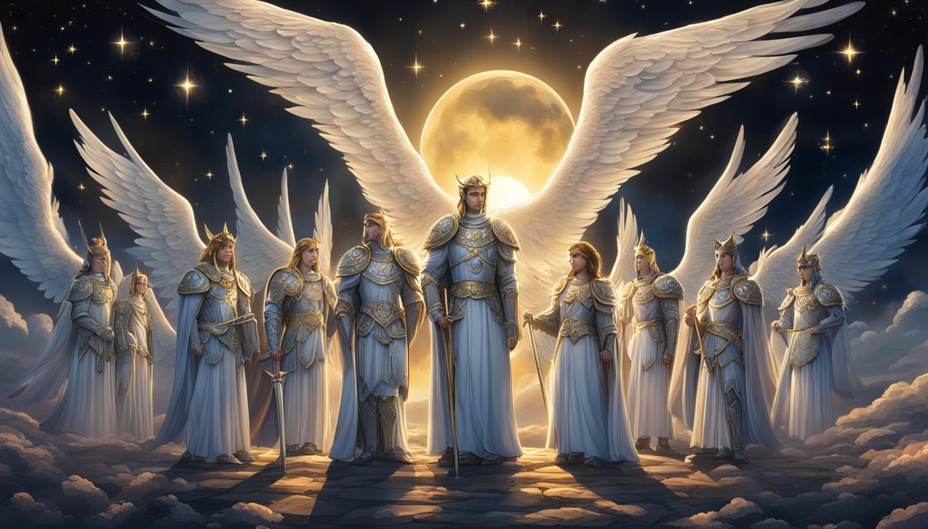
Enoch 6 commentary on Genesis 6
¹ And it came to pass, when the sons of men had increased, that in those days there were born to them fair and beautiful daughters.
² And the Angels, the sons of Heaven, saw them and desired them. And they said to one another: “Come, let us choose for ourselves wives, from the children of men, and let us beget, for ourselves, children.”
● Angels: As in Jude 1:6; 2 Pet 2:4
● Sons of Heaven: “sons of God” Gen 6:2

Slide 14
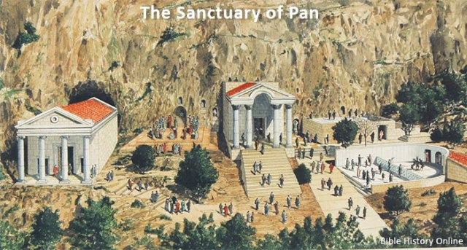
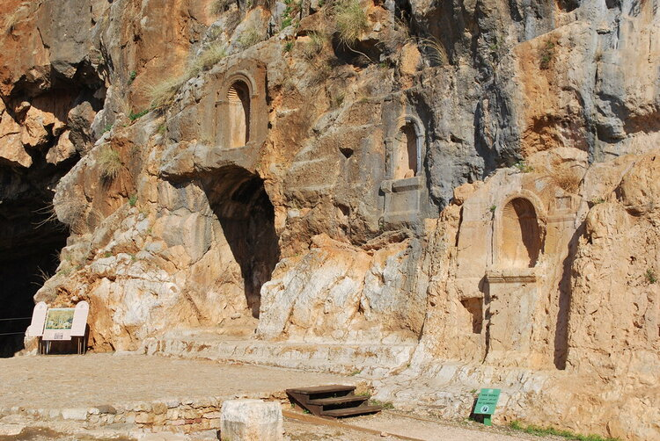
Mount Hermon
“Let us all swear an oath, and bind one-another with curses, so not to alter this plan, but to carry out this plan effectively. Then they all swore together and all bound one another with curses to it. And they were, in all, two hundred and they came down on … the summit of Mount Hermon. Dead Sea scroll 4QEn(a) has these two terms:
● Curse: Aramaic חרם ḥrm. (Arabic & Wolof حـرم)
● Hermon: Aramaic חרמון ḥrmôn.
These are the same in Aramaic and in Hebrew.

Slide 15
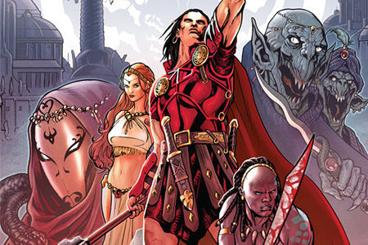
The Watchers other sins (Enoch 7 & 8)
“And they taught them charms and spells, and they showed them the cutting of roots and trees…
“And Azazel taught men to make swords, and daggers, and shields, and breastplates.
“And the art of making up the eyes, and of beautifying the eyelids…
“And there was great impiety, and much forni-cation … cast spells … astrology … blood shed…”
● Spells: Greek pharmakeia, ‘sorcery’, which includes the use of drugs and of magic.

Slide 16
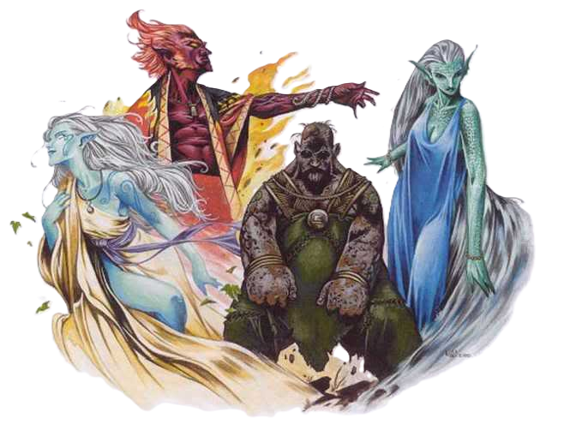
Implications for humanity
Fallen angels have an agenda:
● To become like the Most High God.
● To rule the earth for their own glory.
● To suborn humans to do their bidding.
● To rule over humans through astrology.
● To depopulate nations by warfare, perversion and pharmaceutics.
● To delay the final Day of Judgement.
● To prevent the coming of ‘the Son of Man’.
These fallen, heavenly rulers are not the demons.

Slide 17
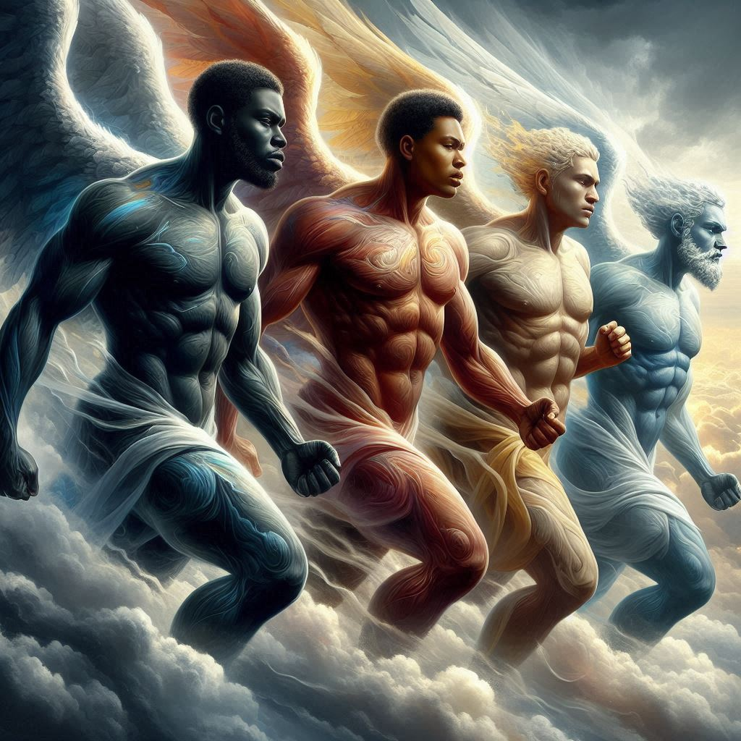
Four archangels instruct Noah, bind Azazel
“Michael, Gabriel, Suriel and Uriel, looked down from Heaven and saw the mass of blood that was being shed on the earth and all the iniquity that was being done on the earth…
“And then the Most High, the Great and Holy One, spoke… ‘Say to [Noah] in my name; hide yourself! And reveal to him the end, which is coming, because the whole earth will be destroyed… Bind Azazel by his hands and his feet and throw him into the darkness.’”

Slide 18
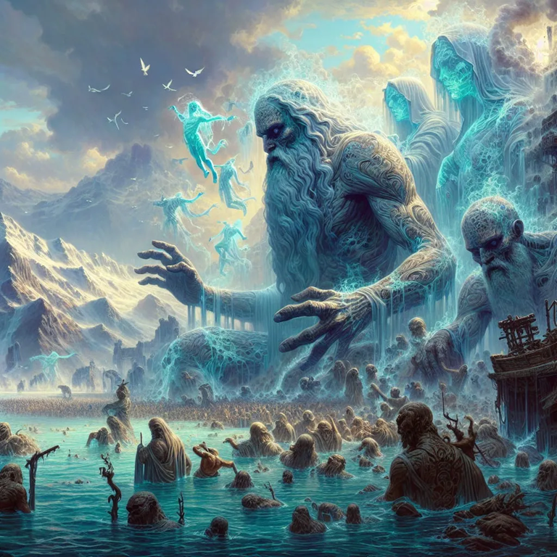
Giant’s souls become the demons
“The giants who were born from body and flesh will be called Evil Spirits on the Earth… The spirits of the giants do wrong, are corrupt, attack, fight, break on the Earth, and cause sorrow. And they eat no food, do not thirst, and are not observed.” Enoch 15:8-11
● Evil spirits: pneumata ponéra = Luke 7:21; 8:2; Acts 19:12, 13.
● Deliverance: You have authority, from the Lord Jesus Christ, to expel evil spirits. Use it often!

Slide 19
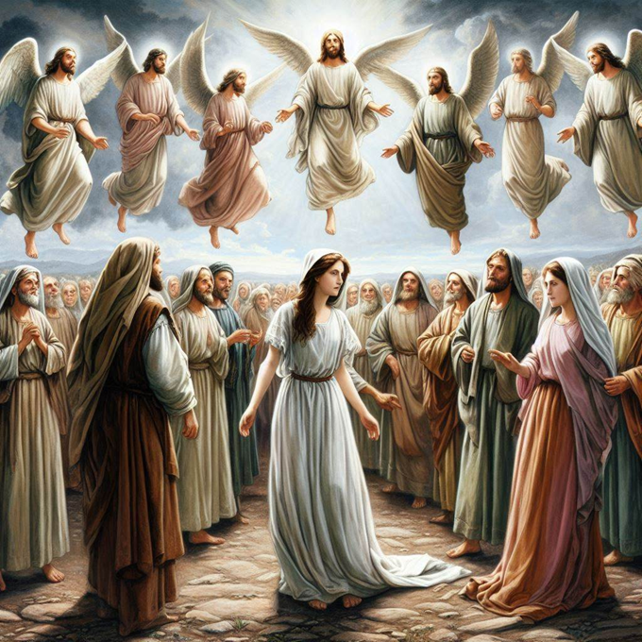
Are Watchers (archai) still in the world?
Rulers [archai] before the flood
● “The rulers [archai] saw the daughters of men that they were beautiful, and they took wives for themselves, each choosing for himself.” 1 En 6:2
● “And the rulers [archai] who have sinned will be judged and condemned at the end of times.” 15:9
● “And Uriel said to me: ‘These are the rulers [archai] who have led men astray and taught them magic and enchantments.’” 19:1

Slide 20
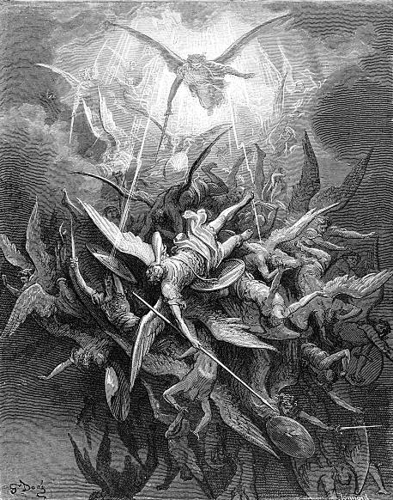
Are Watchers (archai) still in the world?
The first rulers (angels) after the flood
“The angels who did not stay within their own position of authority, but left their proper dwelling, he has kept in eternal chains under gloomy dark-ness until the judgment of the great day.” Jude 6
“God did not spare angels when they sinned, but cast them into hell and committed them to chains of gloomy darkness to be kept until the judgment.” 2 Peter 2:4

Slide 21
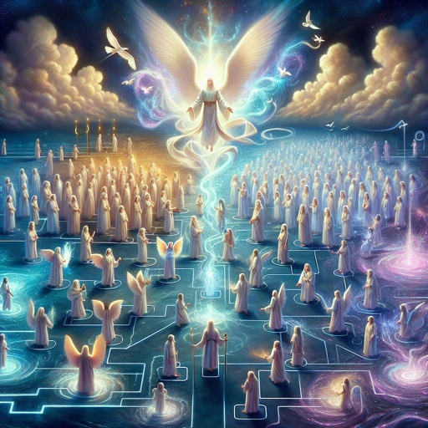
Are Watchers (archai) still in the world?
New rulers (sons of God) after the flood
“When the Most High gave to the nations their inheritance, when he divided mankind, he fixed the borders of the peoples according to the number of the sons of God.” Deut. 32:8
“They stirred him to jealousy with strange gods.” Deut. 32:16
● “sons of God”: DDS, 2nd century BCE.
● “sons of Israel”: Masoretic text, 10th century CE.

Slide 22
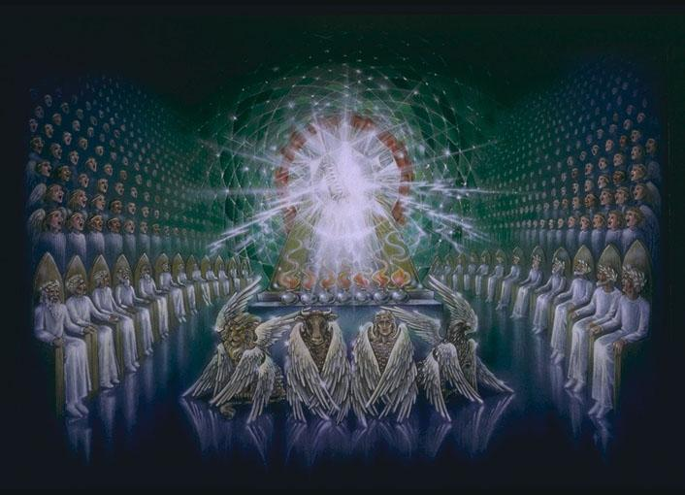
Are Watchers (archai) still in the world?
Failed rulers (gods) after the flood
“God has taken his place in the divine council; in the midst of the gods he holds judgment… I said, ‘You are gods, sons of the Most High, all of you; nevertheless, like men you shall die, and fall like any prince.’” Psalm 82:1-8
● “council”: Created beings who report to Elohîm.
● “gods”: elohîm, divine beings.
● “sons”: angels whom God created (not fathered).

Slide 23
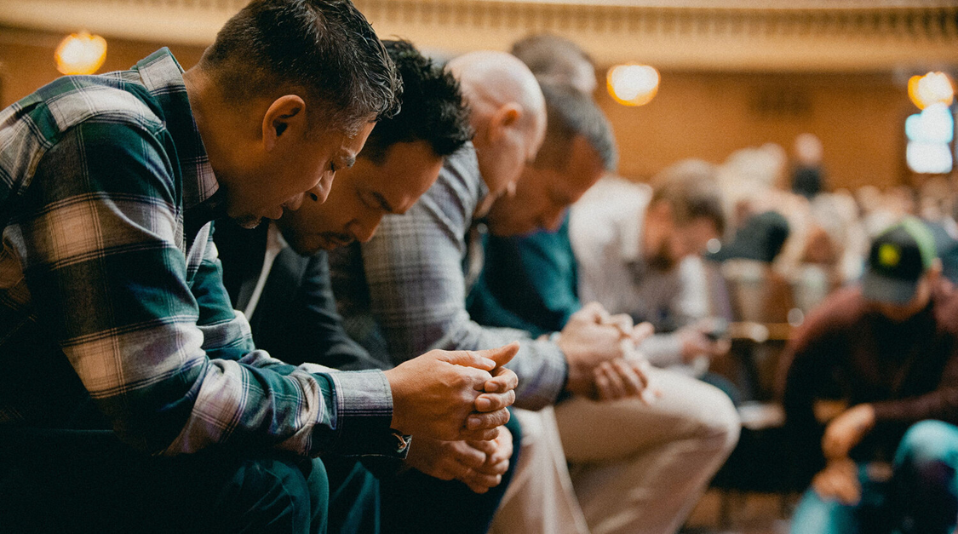
Are Watchers (archai) still in the world?
Our struggle against rulers in high places
“Neither … angels nor rulers [archai] … will be able to separate us.” Rom. 8:38-39.
“We … wrestle against … the rulers [archai] , against the authorities, against the cosmic powers over this present darkness.” Eph 6:12
“He delivers the kingdom to God the Father after destroying every ruler and every authority and power. For he must reign until he has put all his enemies under his feet. 1 Cor. 15:24-25

Slide 24
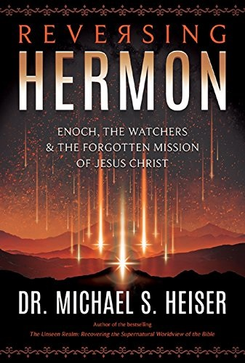
Assignment
● Read Reversing Hermon, chapter 3: “The Mesopotamian Apkallu, the Watchers and the Nephilim,” pages 37-52.
● Visit ReversingHermon.site

