Slide 1
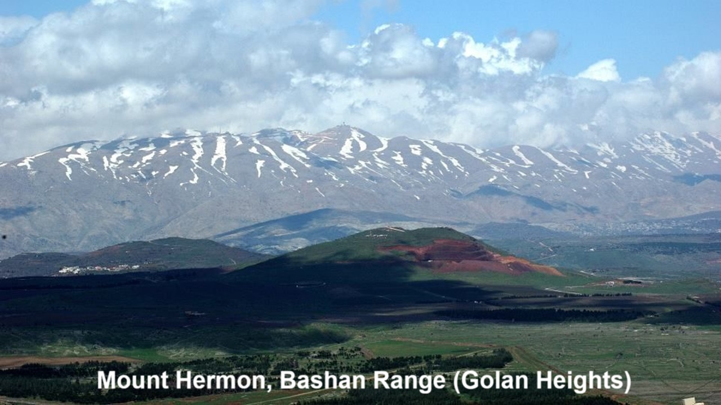
REVEЯSING HERMON
Chapter 3: The Apkallu
10 and 13 October 2024

Slide 2
Learning objectives
At the end of this session we shall:
● Know why Genesis includes verses 1-4 about angels, giants and a flood.
● Identify the apkallu with the watchers.
● Contrast Genesis 6 with Mesopotamian mythology.
● Explain why Jesus had to ‘reverse hermon’.

Slide 3
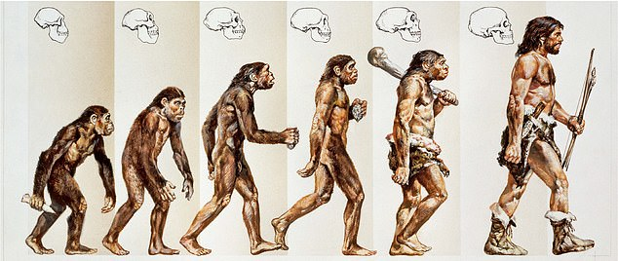
Mesopotamian apkallu myths
Israelites listened to pagan myths all the time. So, did the Hebrew Bible writers:
● borrow from those creation, angel, and flood myths?
● make up their own similar myths?
● or have some other reason for including Genesis 6:1-4 in their Scriptures?
A modern myth

Slide 4
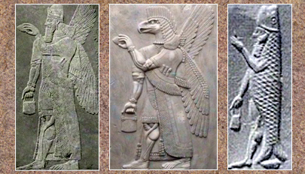
Apkallu origins & depictions
● Created in the “river”, the primeval deep, the Apsu (abyss), in the underworld. Depicted as fishmen.
● Responsible for right functioning of the heaven and earth.
● Had access to the gods in heaven. Depicted as birdmen.
Apkallu carrying ‘banduddu’ bag containing a purification pine cone.

Slide 5
Prediluvian Mesopotamian kings
King Reign Apkallu
Alulim 28,800 Uanna
Alalgar 36,000 Uannedugga
Enmenluanna 43,200 Enmedugga
Enmengalana 28,800 Enmegalamma
Dumuzi 36,000 Enmebulugga
Ensipadzidana 13,800 An-Enlilda
Ubara-Tutu 18,600 Utuabzu

Slide 6
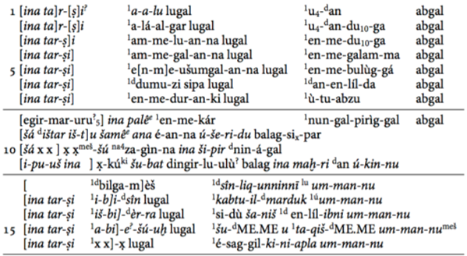
Ancient apkallu descriptors
1 Uanna: “who finished the plans for heaven and earth”
2 Uannedugga: “who was endowed with comprehensive intelligence”
3 Enmedugga: “who was allotted a good fate”
4 Enmegalamma: “who was born in a house”
5 Enmebulugga: “who grew up on pasture land”
6 An-Enlilda: “the conjurer of the city of Eridu”
7 Utuabzu: “who ascended to heaven”

Slide 7
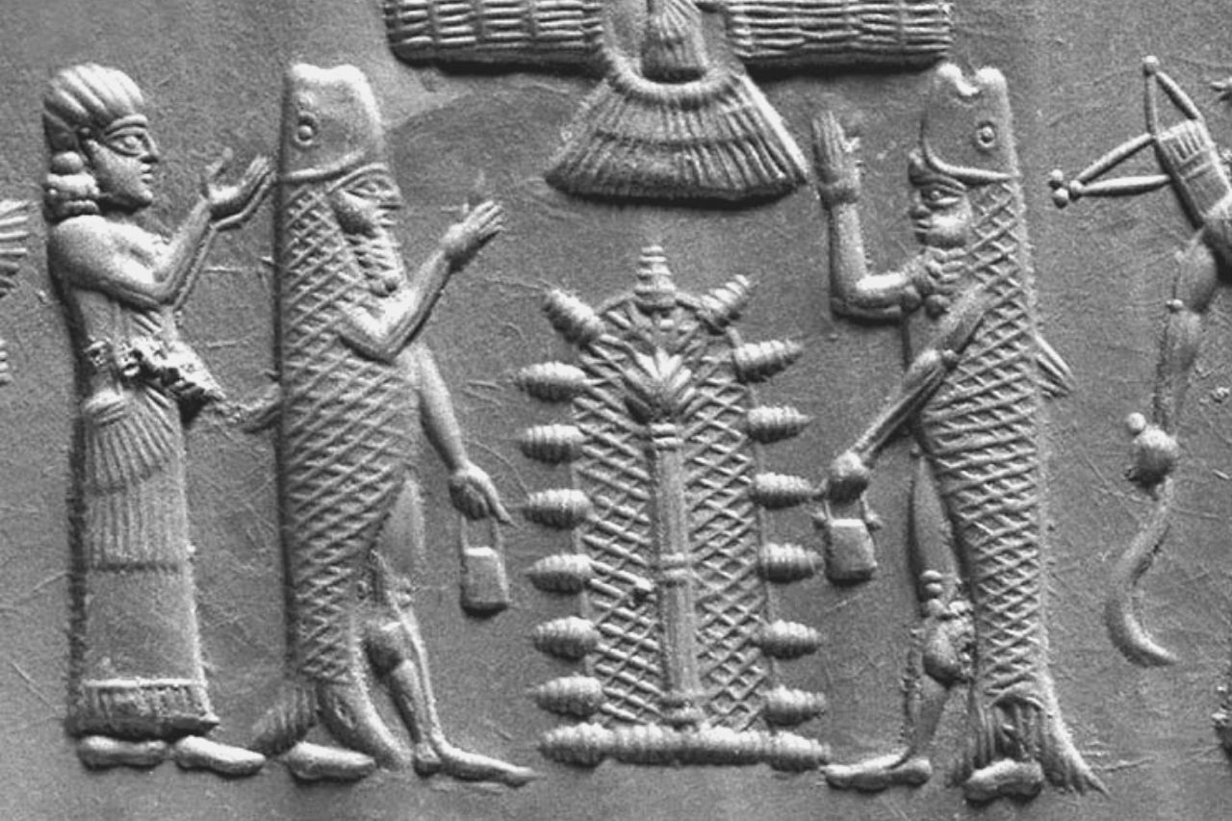
Pre- and post-flood apkallu
Pre-flood (≈ Watchers) ● Divine beings
● Access to the gods
● Receive knowledge for human society
Post-flood (≈ Nephilim)
● Four are named in tablets
● Part divine, part human
● Human sages (wise men)

Slide 8
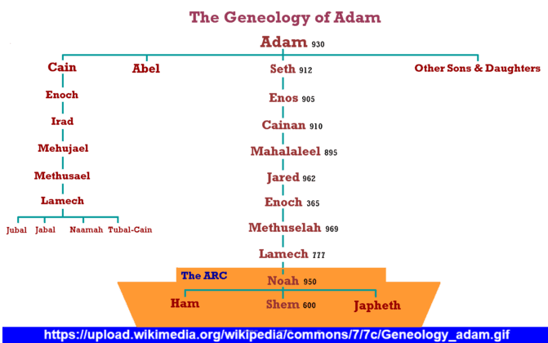
The biblical Enoch in Genesis 5
²¹ When Enoch had lived 65 years, he fathered Methuselah. ²² Enoch walked with God after he fathered Methuselah 300 years and had other sons and daughters. ²³ Thus all the days of Enoch were 365 years. ²⁴ Enoch walked with God, and he was not, for God took him.

Slide 9
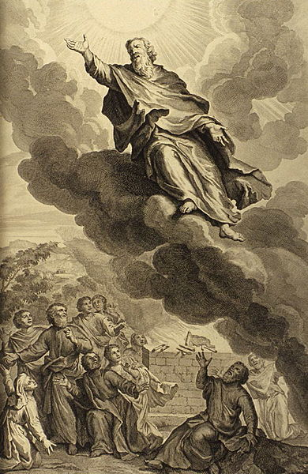
The biblical Enoch in Hebrews 11
⁵ By faith Enoch was taken up so that he should not see death, and he was not found, because God had taken him. Now before he was taken he was commended as having pleased God. ⁶ And without faith it is impossible to please him.

Slide 10
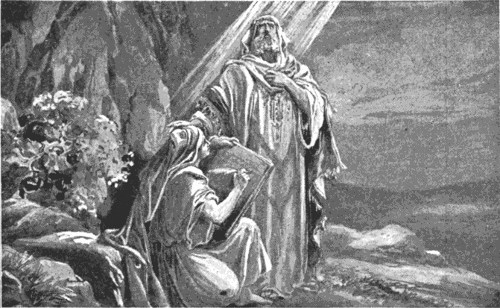
The biblical Enoch in Jude 1:14-15
¹⁴ It was also about these that Enoch, the seventh from Adam, prophesied, saying, “Behold, the Lord comes with ten thousands of his holy ones, ¹⁵ to execute judgment on all and to convict all the ungodly of all their deeds of ungodliness that they have committed.

Slide 11
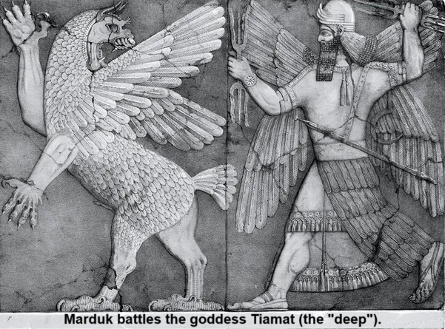
Bible Mesopotamia
● Yahweh.
● Enoch, 7th gener- ation from Adam.
● Walked with God.
● God took him up into heaven.
● Divine watchers sinned.
● Marduk and gods.
● Enmeduranki, 7th antediluvian king.
● Learned from gods
● Ascended into heaven.
● Divine apkallu have wisdom.

Slide 12
Bible Mesopotamia
● Watchers mated with women.
● Watchers father Nephilim giants.
● Nephilim violent.
● Nephilim perish.
● Watchers in hell.
● Apkallu mated with human women.
● Apkallu fathered part-human kings.
● Apkallu are wise.
● Teach survivors.
● Scribes transmit divine wisdom.

Slide 13
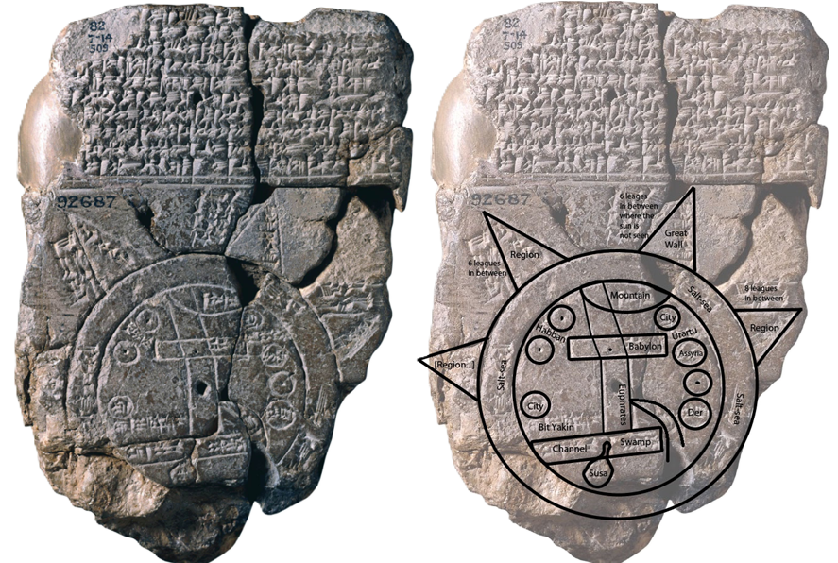
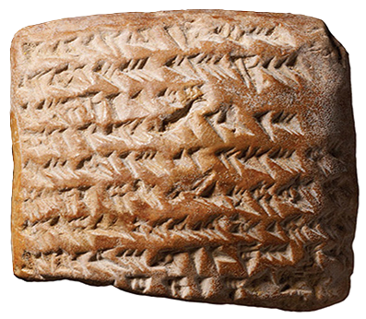
Secret knowledge
Mesopotamian apkallu (cuneiform texts)
● Make and keep the nation great.
● Through divination and horoscopy.
● Applied to technology & handicraft.
Biblical watchers (1 Enoch 8 and 10)
● Instruments of war
● Seductive cosmetology
● Sorcery and spells

Slide 14
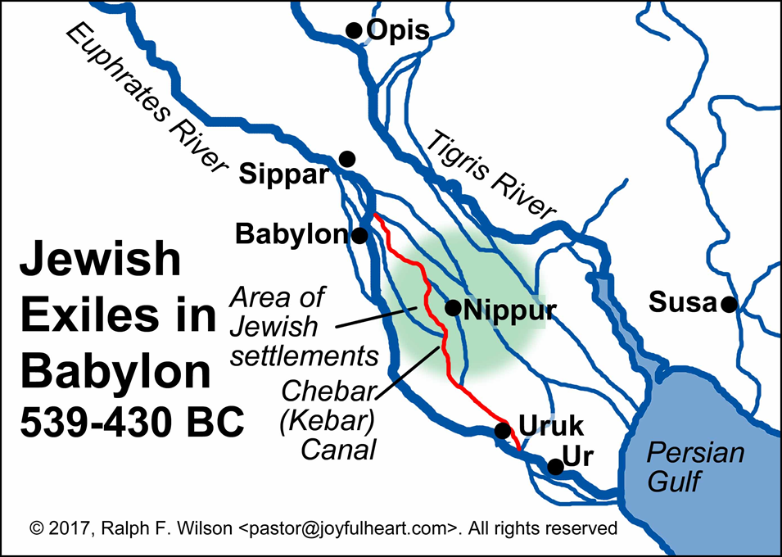
Ezekiel
2 ¹ I was among the exiles by the Chebar canal [Babylonia], the heavens were opened, and I saw visions of God…
28 ¹³ You were in Eden, the garden of God… ¹⁴ an anointed guardian cherub …
¹⁶ I cast you as a profane thing from the mountain of God… 38 ⁹ all the trees of Eden.

Slide 15
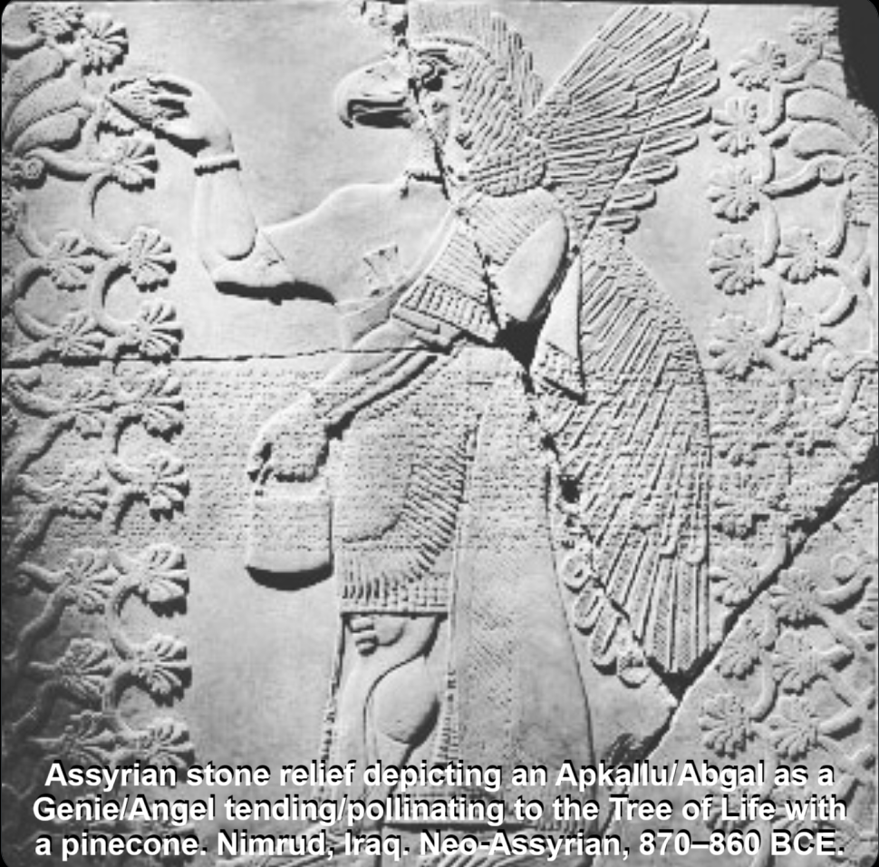
Watchers’ duties
Before they sinned, the watchers
● ascended onto earth (Jub 4:18) and
● instructed humans to judge righteously
● worked as (tree) gardeners (DSS 4Q530)
According to Mesopotamian texts, their only sin was to cohabit with human women. Their knowledge lived on among humans through their hybrid offspring.

Slide 16
Apkallu giants, men of renown
⁴ The Nephilim were on the earth in those days, and also afterward… the mighty men who were of old, the men of renown (Gen 6).
● The fourth post-flood apkallu is described as being “two-thirds apkallu” (Cuneiform bīt mēsri texts).

Slide 17
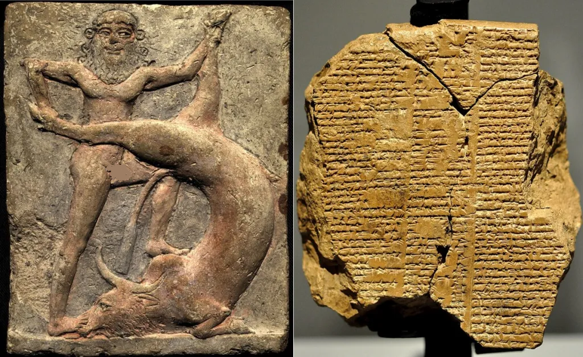
Was Noah Gilgamesh?
Noah a righteous pre-flood human man.
Gilgamesh was said to be:
● a post-flood apkallu.
● “two thirds divine, one-third human.”
● of gigantic stature (11 cubits ≈ 17 feet).
● a bearer of a pre-flood message.
● a giant who is weaker than heavenly beings (Book of Giants, 4Q531).

Slide 18
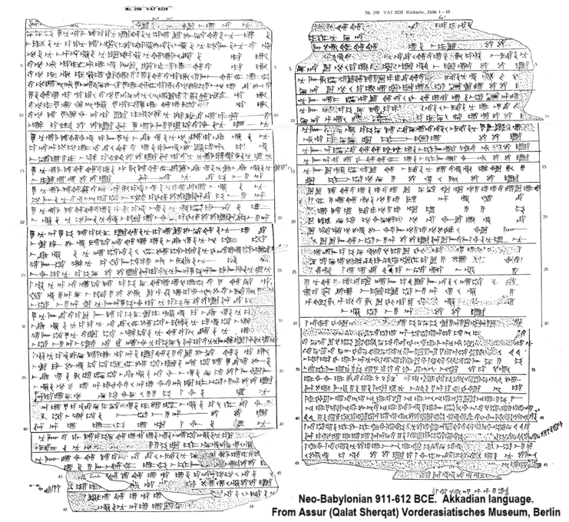
Apkallu = Watchers
● Apkallu could be good or evil.
● Watchers could be good or evil.
● Text KAR 298 from Assur prescribes the making of applalu figurines, quoting, attunu ṣalmē apkallē maṣṣarē, “You are the apkallu-figures, the watchers.”
● Akkadian êru ‘be awake’ ≈ Aramaic ^{ʕ}īr ‘to guard’ ≈ Hebrew ^{ʕ}wr ‘be awake’.

Slide 19
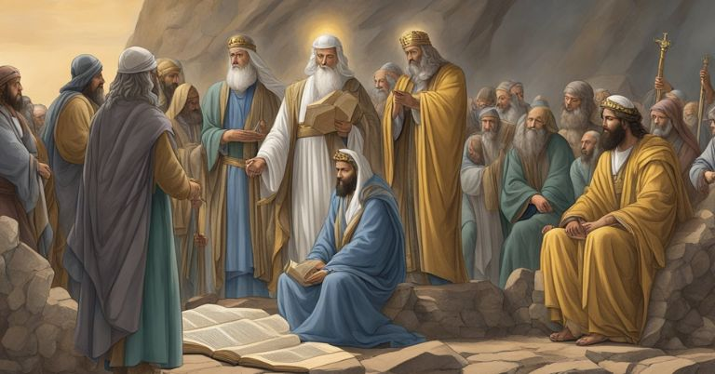
Mesopotamian myths prove that…
● All elements of Genesis 6:1-4 corres-pond to ancient myths about the flood.
● These parallels are preserved in the second-temple book 1 Enoch.
● Non-biblical details in 1 Enoch are consistent with Genesis 6:1-4.
● Jude and Peter rightly incorporated 1 Enoch in their theological thinking.

Slide 20
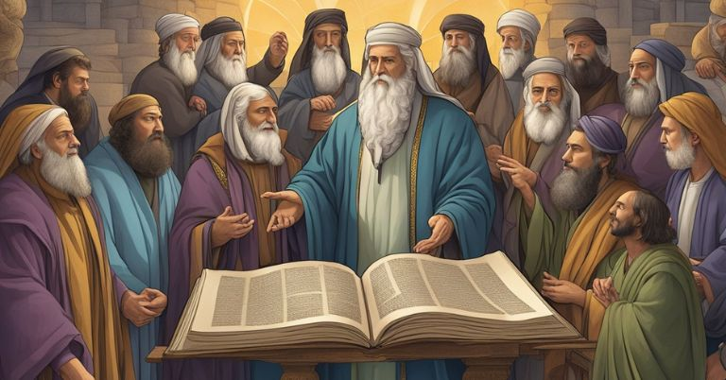
Conclusion
Why did Genesis include 6:1- 4?
● To challenge Babylonian superiority over other nations.
● Showing that Mesopotamian ‘apkallu’ were really evil ‘watchers’ and giants who corrupted human beings.
● As a ‘polemic’ argument for the superiority of Yahweh over Marduk.

Slide 21
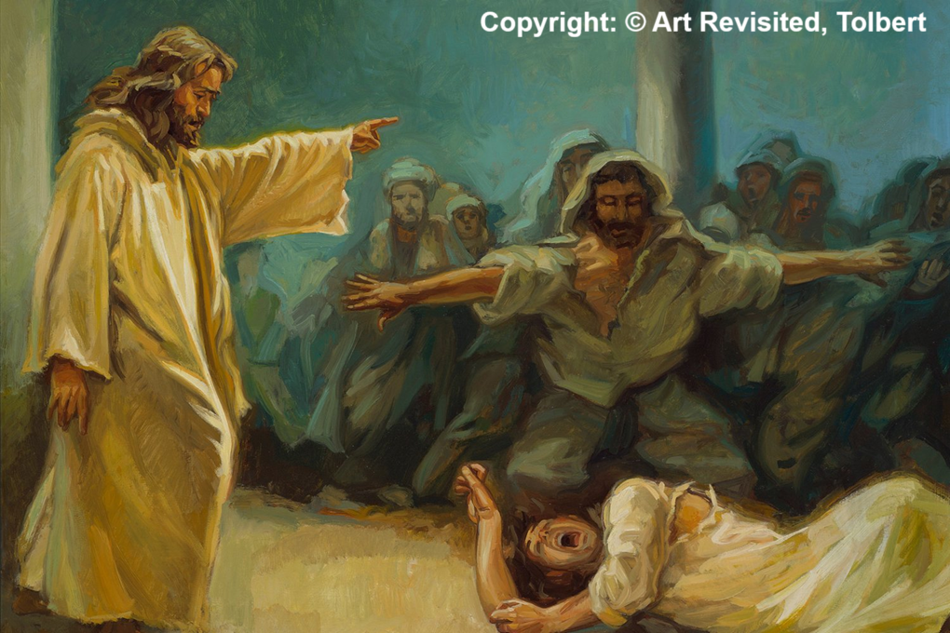
How will Messiah Jesus
● Undo the effects of Satan’s deceit?
● Secure forgiveness for human sins?
● Solve the problem of human death?
● Keep humans from total depravity?
● Help Christians to live righteously?
● Get rid of the evil spirits who deceive governments and nations?
● Reverse ‘Hermon’ worldwide?

Slide 22
Assignment
● Read Reversing Hermon, chapter 4: “The Watchers sin and Jesus’ Birth,” pages 53-70.
● Visit ReversingHermon.site

