Slide 1
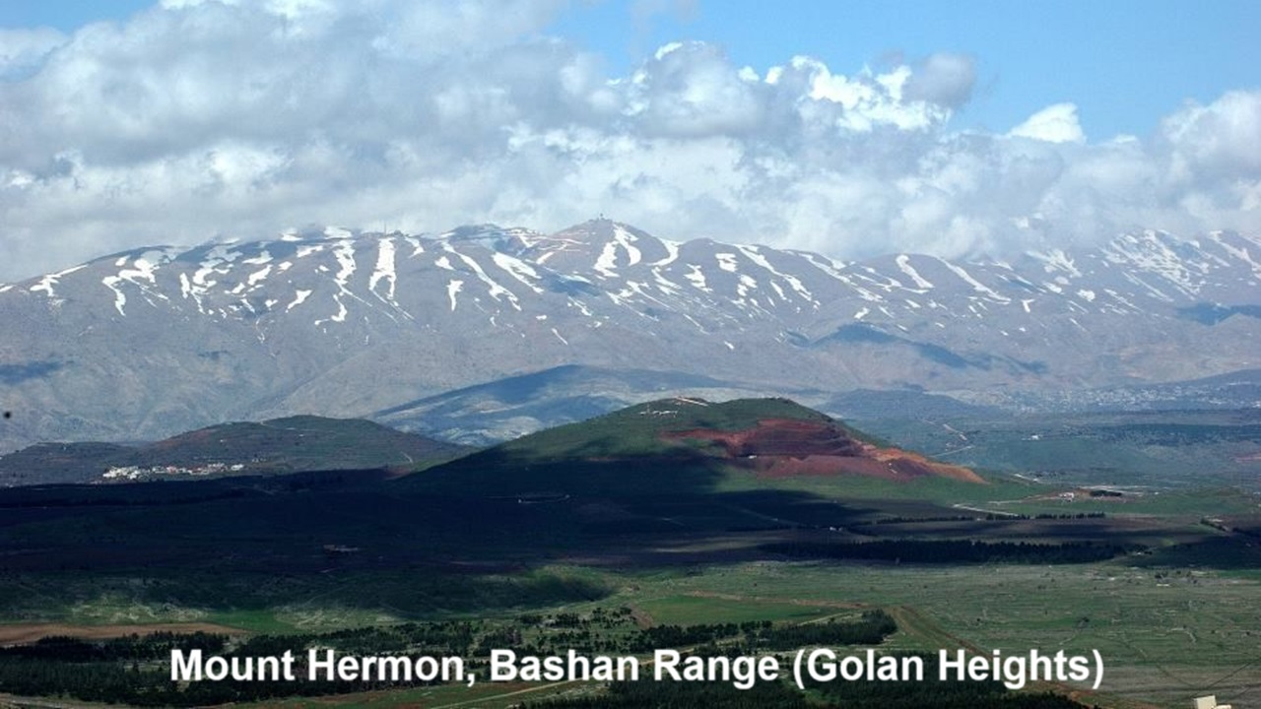
REVEЯSING HERMON
Session 4: The Watchers’ Sin & Jesus’ birth
17 and 20 October 2024

Slide 2
Learning objectives
At the end of this session we shall:
● Understand how Jesus’ birth ensures the Watcher’s defeat.
● Explain astro-theology from the First and the New Testaments.
● Defend the 11th of September 3 BCE date for Jesus’ birth.

Slide 3
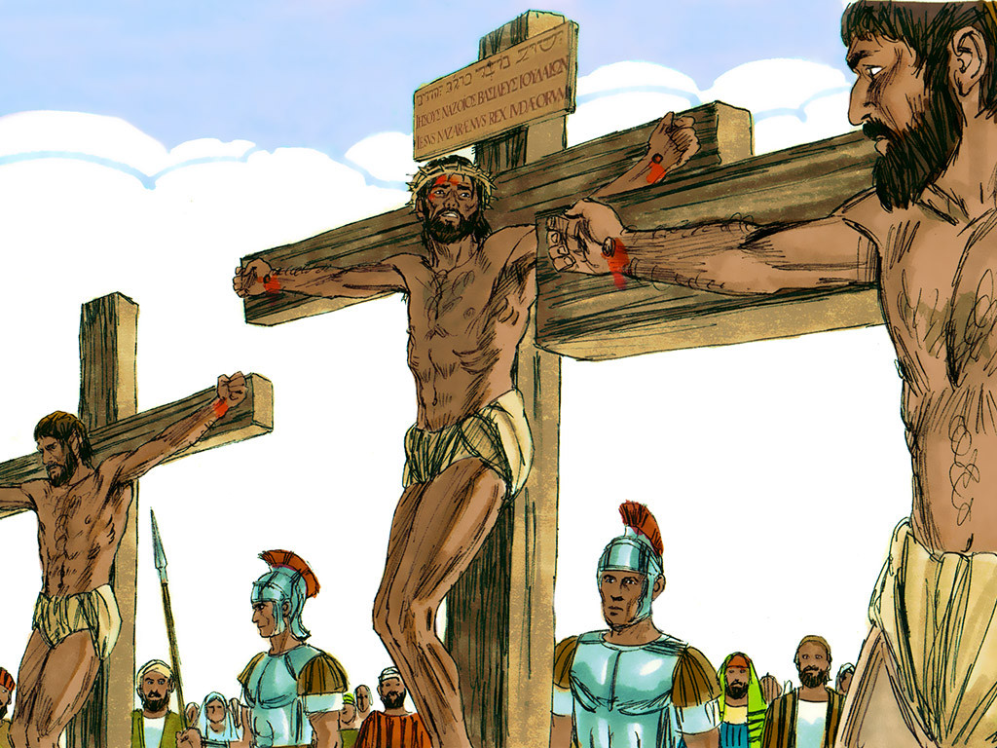
Summary preview
Jesus undoes what the watchers did.
● By his birth, death and resurrection.
● The Watchers did not understand this.
● The apostles expected Jesus to do this immediately.
● Astro theology demonstrates Jesus’ victory over evil and chaos.

Slide 4
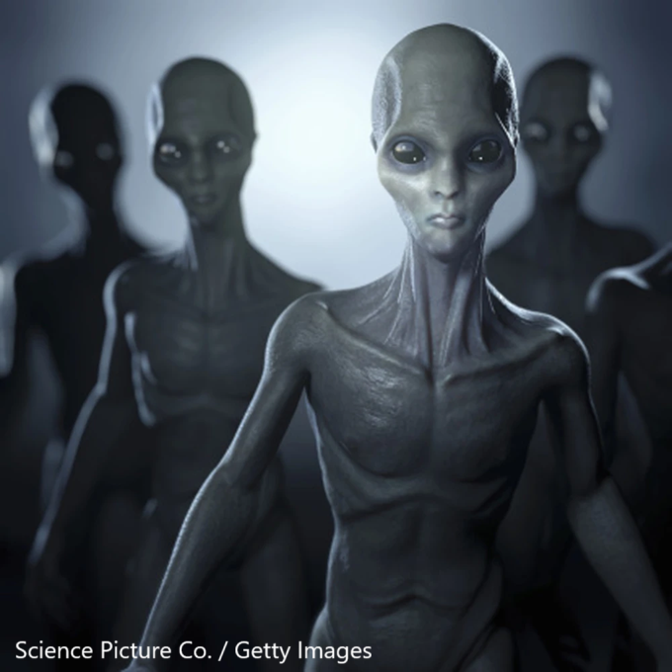
1 Corinthians 2:7-8
“We impart a secret, hidden wisdom of God, which God decreed before the ages for our glory. None of the rulers of this age understood this, for if they had (understood it), they would not have crucified (Jesus) the Lord of glory.”
● Rulers: The spirit beings (Watchers) who deceive governments and people.

Slide 5
Romans 10:13-18
¹³ “Everyone who calls on the name of the LORD will be saved.” ¹⁴ How then will they call on him in whom they have not believed? And how are they to believe in him of whom they have never heard? …
● LORD: In OT = Yahweh; in NT = Jesus.
● Saved: Raised back to life to enjoy God’s kingdom forever.

Slide 6
Romans 10:13-18
¹⁷ So faith comes from hearing, and hearing through the word (about) Christ. ¹⁸ But I ask, have they not heard? Indeed they have, for “Their voice has gone out to all the earth, and their words to the ends of the world” [Psa. 19:4].
● Where did they hear?
● How did they hear?

Slide 7
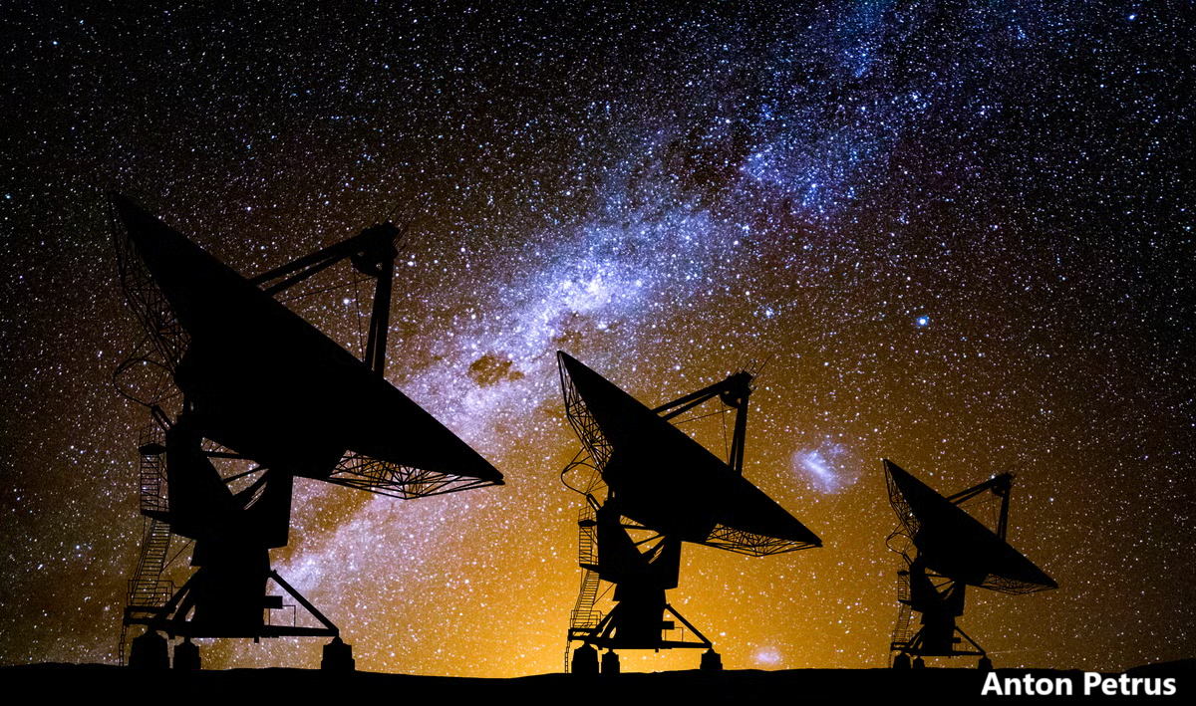
Psalm 19:1-4
¹ The heavens declare the glory of God, and the sky above proclaims his handiwork.
² Day to day pours out speech, and night to night reveals knowledge.
³ There is no speech, nor are there words, whose voice is not heard.

Slide 8
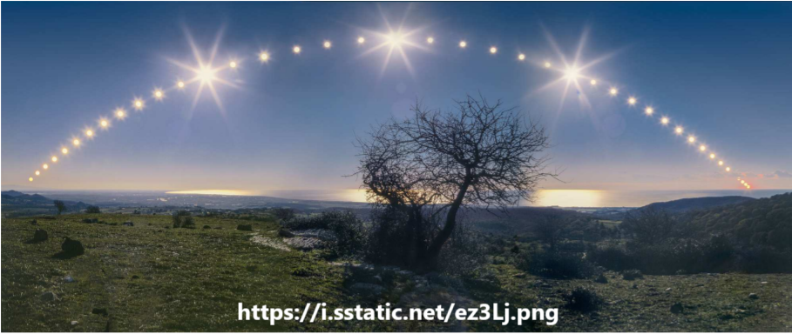
Psalm 19:1-4
⁴ Their voice goes out through all the earth, and their words to the end of the world.
● Voice: In LXX, phloggos, ‘sound’.
In Hebrew, qâw, ‘line, string’.
The ecliptic, astronomical path?
● What did Paul mean, ‘They heard’?
● What NT evidence is there for this?

Slide 9
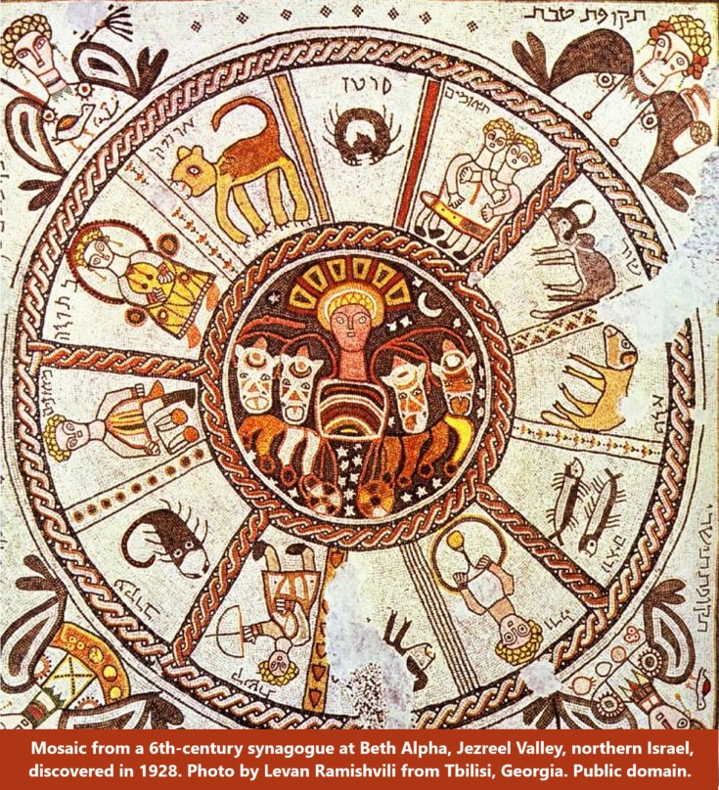
Genesis 1:14-15
¹⁴ Let there be lights in the expanse of the heavens to separate the day from the night. And let them be for signs and for seasons, and for days and years, ¹⁵ and let them be lights in the expanse of the heavens to give light upon the earth.”
● Seasons: Heb. mô^{ʕ}ed, appointed time, season, festival, sacred event.

Slide 10
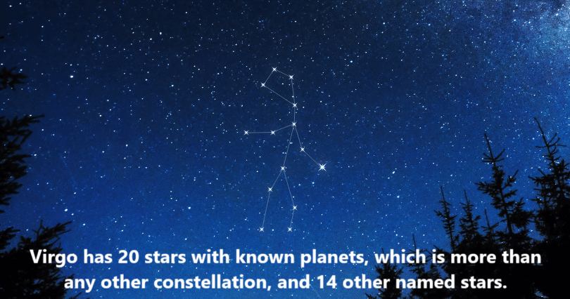
Constellation Virgo (the virgin)
Every year, in the constellation Virgo:
● The sun appears in her middle (womb).
● Between 150 and 170 ecliptic degrees.
● For a 20-day period.
● Evoking mother-goddesses for pagans.
● Reminding Jews that “the virgin shall conceive and bear a son” (Isa. 7:14).
● NOTE: Occurs too often to be a sign.

Slide 11
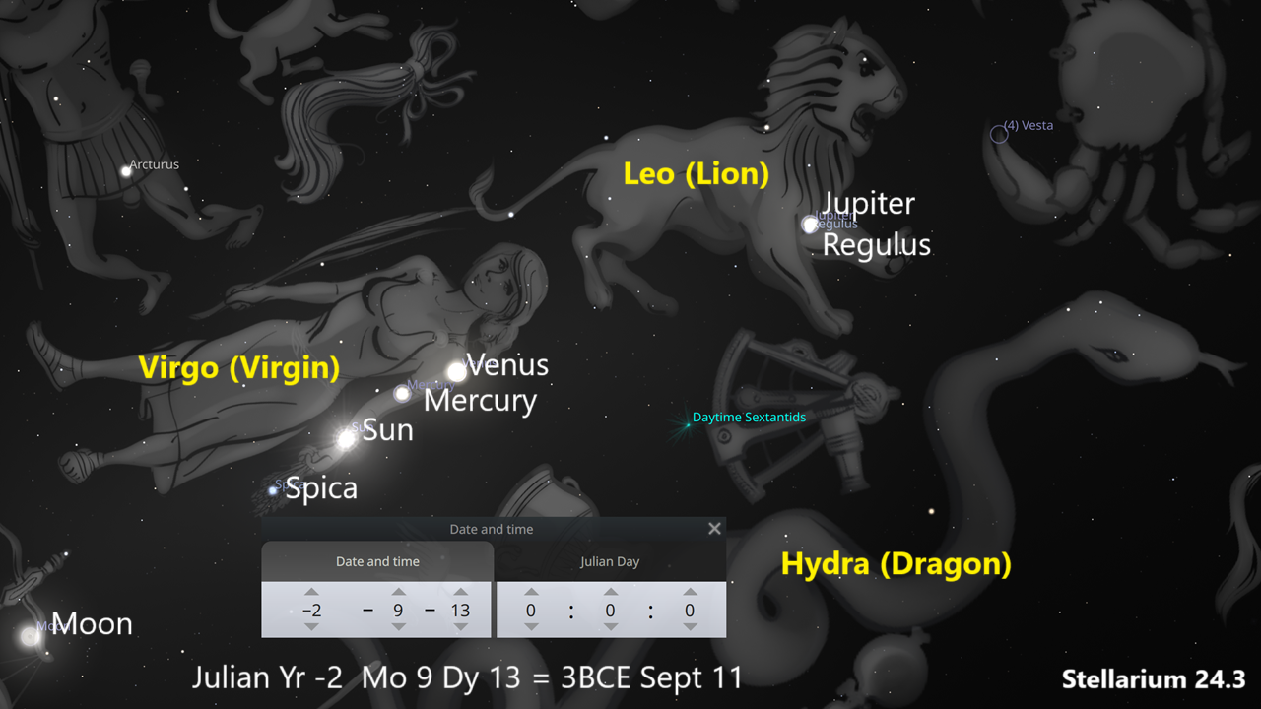
Revelation 12
¹ A great sign appeared in heaven: a woman clothed with the sun, with the moon under her feet, and on her head a crown of twelve stars.
² She was pregnant and was crying out in birth pains and the agony of giving birth.
● Woman: Whom does she represent?

Slide 12
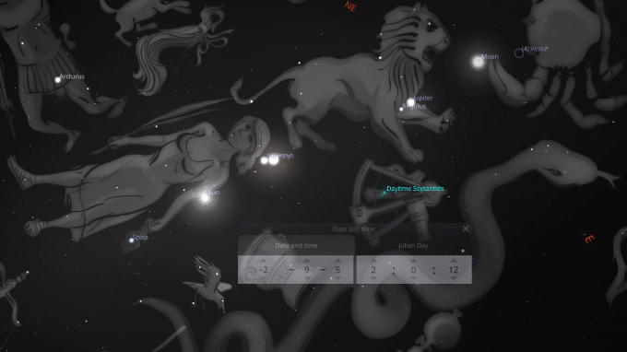
The King star, the King planet
Gentiles honoured Regulus as the ‘King Star’ and Jupiter as the “King Planet”.
● These came together in Virgo.
● For a 90-minute period.
● Moon at her feet for 80 minutes.
● Viewed from Western Asia (ANE).
● On one particular date:
September 11, 3 BC.

Slide 13
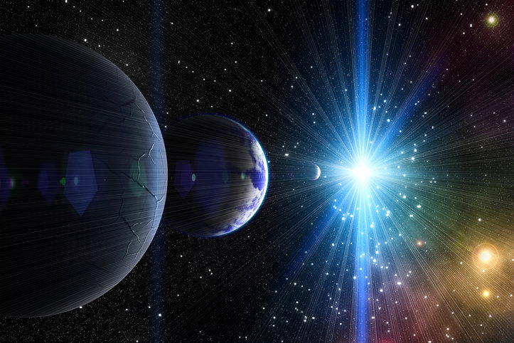
Sun moon and stars, various views
● Jacob, his wife, and their 12 sons.
● Abraham, Sara, and all Israel.
● God, Jesus Christ, and Christians.
● The sun, moon, stars and planets as viewed from earth.

Slide 14
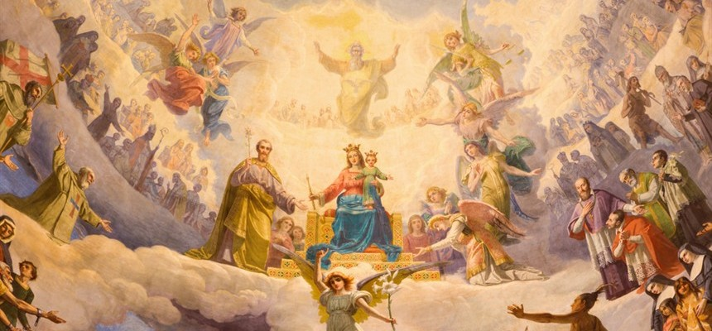
The woman, various views
● Mary, mother of Jesus.
● Mary, queen of heaven.
● Mary, queen of earth.
● The virgin mother of Isaiah 7:14.
● National Israel.
● Faithful Israel.

Slide 15
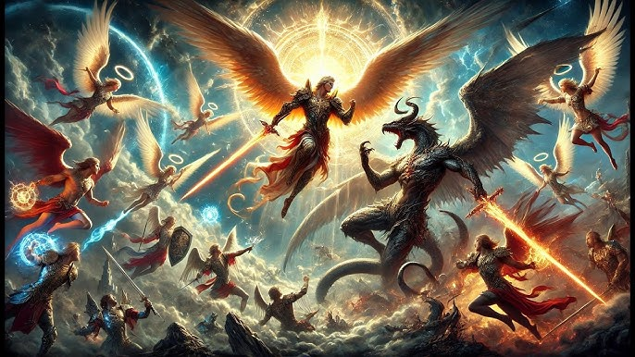
Revelation 12
³ And another sign appeared in heaven: behold, a great red dragon, with seven heads and ten horns, and on his heads seven diadems.
⁴ His tail swept down a third of the stars of heaven and cast them to the earth.
● Stars: Good angels abused by the dragon, the ‘serpent’ of Genesis 3.

Slide 16
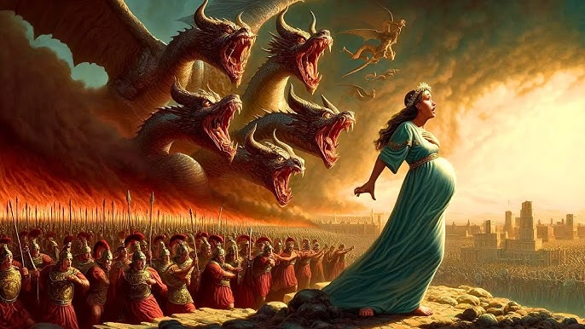
Revelation 12
And the dragon stood before the woman who was about to give birth, so that when she bore her child he might devour it.
● Who is the dragon?
● Who is the woman?
● Who is the child?

Slide 17
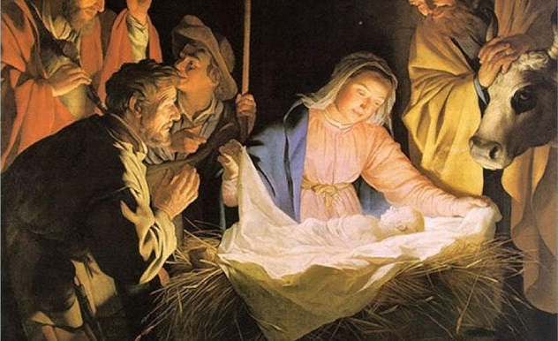
Revelation 12
⁵ She gave birth to a male child, one who is to rule all the nations with a rod of iron, but her child was caught up to God and to his throne, ⁶ and the woman fled into the wilderness, where she has a place prepared by God, in which she is to be nourished for 1,260 days.
● Caught up: Resurrection + ascension.
● Rule: Replace what other rulers?

Slide 18
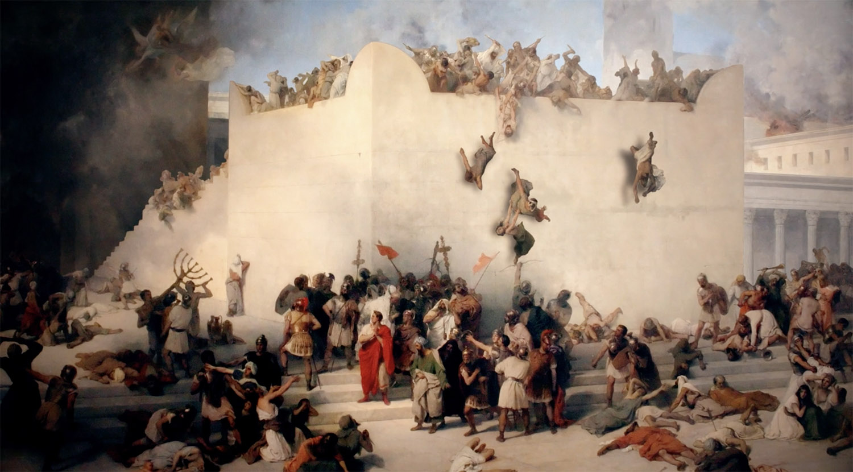
The woman fled, various views
● Israel’s exodus from Egypt.
● Israelite prophets fleeing from kings.
● Faithful Israelites fleeing from Roman invaders.
● Christians escaping from Jerusalem to Pella in AD 66.
● Christians or Jews escaping from a future tribulation.

Slide 19
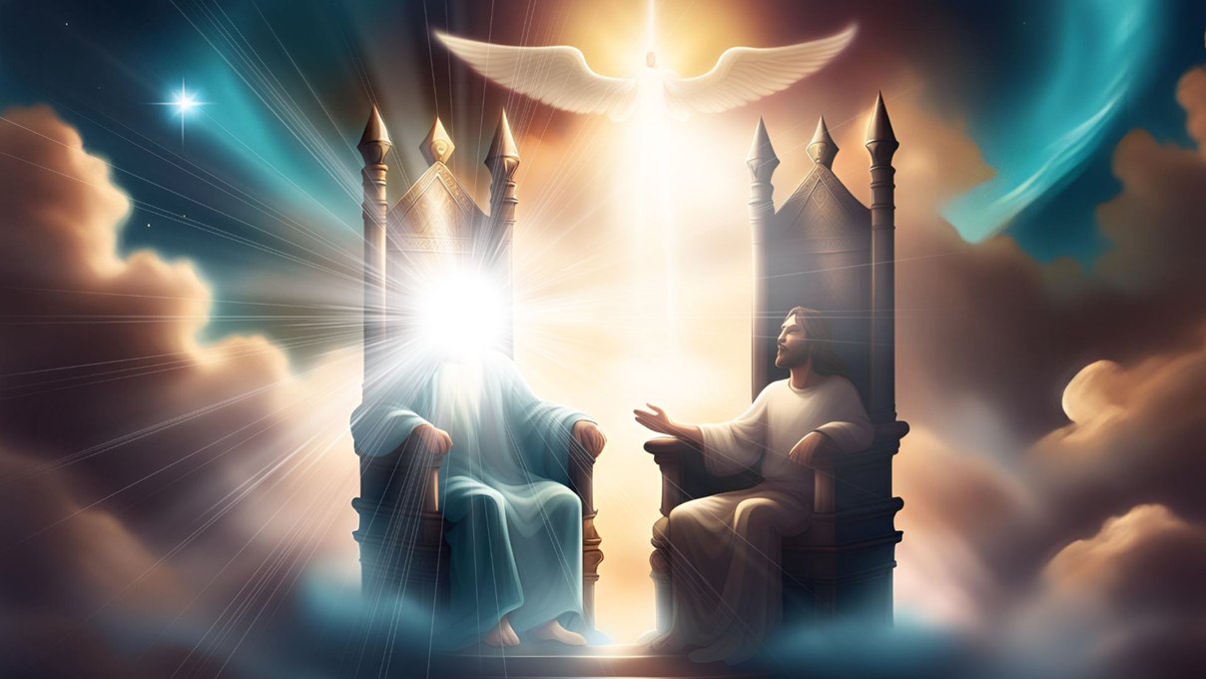
Psalm 2:7-9
⁷ I will tell of the decree: The LORD said to me, “You are my Son; today I have begotten you. ⁸ Ask of me, and I will make the nations your heritage, and the ends of the earth your possession. ⁹ You shall break them with a rod of iron and dash them in pieces like a potter’s vessel.”
● Son: Son of God, a messianic title.

Slide 20
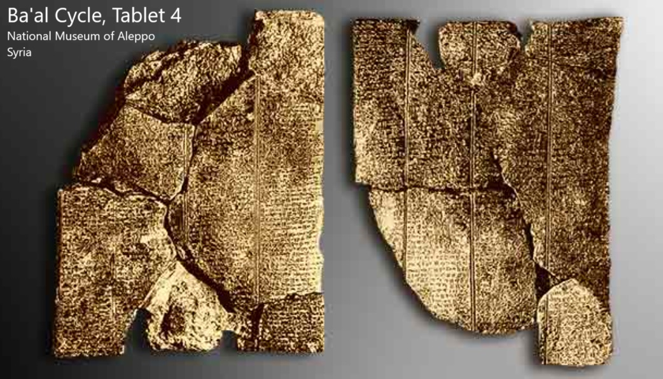
The Ugaritic Ba‘al Cycle
“What foe has risen up against Baal,
what enemy has risen against the Rider of the Clouds? Surely I destroyed Yamm (the sea), beloved of El (God), surely I made an end of River, the mighty god. Surely I lifted up the Dragon . . . I destroyed the Crooked Serpent, the Tyrant with the seven heads.”

Slide 21
The sea monster and chaos
● Defeated at creation
You [Yahweh] divided the sea by your might; you broke the heads of the sea monsters on the waters. You crushed the heads of Leviathan. Psalm 74:13-14
You crushed Rahab like a carcass. 84:10
You …pierced the dragon? Isa 51:9

Slide 22
The sea monster and chaos
● Defeated by evangelism
Jesus said: “I saw Satan fall like lightning from heaven. Behold, I have given you authority to tread on serpents and scorpions, and over all the power of the enemy, and nothing shall hurt you.” Luke 10:18-19

Slide 23
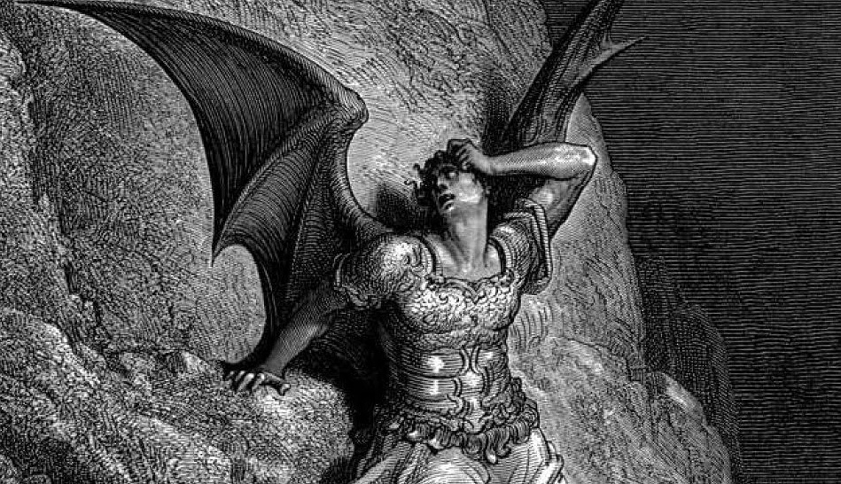
The sea monster and chaos
● Defeated at the end time
In that day the LORD with his hard and great and strong sword will … slay the dragon that is in the sea. Isaiah 27:1
He seized the dragon, that ancient serpent, who is the devil and Satan, and bound him. Revelation 20:2
Leviathan the monster… 1 Enoch 60:7

Slide 24
More astronomical events
Which other constellations?
● Not Draco (Dragon) near the North Pole.
● Hydra, ancient Scorpia, divided from Libra by the Greeks circa 237 BCE.
● Leo (Lion), recalling: “Weep no more; behold, the Lion of the tribe of Judah, the Root of David, has conquered” (Rev. 5:5).

Slide 25
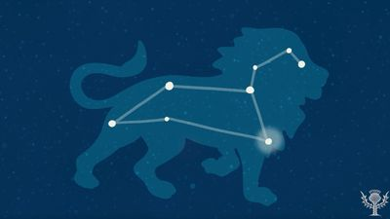
Leo, the Lion constellation
“Judah is a lion's cub… He stooped down; he crouched as a lion and as a lioness; who dares rouse him? The scepter (kingship) shall not depart from Judah, nor the ruler's staff from between his feet… and to him shall be the obedience of the peoples.” Genesis 49:9

Slide 26
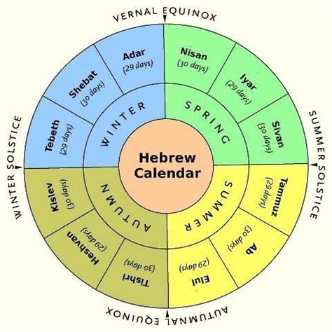
First day of Tishri month
● First day of creation (with harvest)
● Noah’s 600th birthday.
● Start of the great flood (end Nephilim).
● Jewish New Year, rosh ha-shana.
● Start of harvest (See Rev. 14:14-19).
● Inauguration day for new kings.
● Expected renewal of creation.
● Birth of Jesus on 11 September 3 BCE.

Slide 27
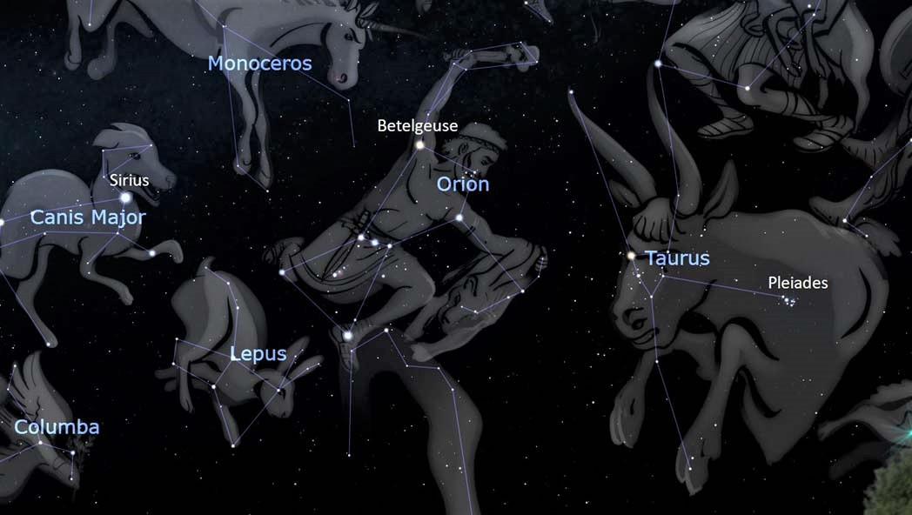
Pleiades and Orion
“He who made the Pleiades and Orion, and turns deep darkness into the morning and darkens the day into night, who calls for the waters of the sea and pours them out on the surface of the earth, the LORD (Yahweh) is his name.” Amos 5:8

Slide 28
Pleiades and Orion
‘God … who made the Bear and Orion,
the Pleiades… Job 9:9
“God will not turn back his anger; beneath him bowed the helpers of Rahab. 9:13
“Can you bind the chains of the Pleiades or loose the cords of Orion?” 38:31

Slide 29
Orion
“The giant [Orion] retired to the island of … Crete where he became a hunting companion of the goddess Artemis. After his death he was placed amongst the stars as the constellation Orion.” (Greek mythology.) https://www.theoi.com/Gigante/GiganteOrion.html
● Giant: Greek meaning of Nephilim.

Slide 30
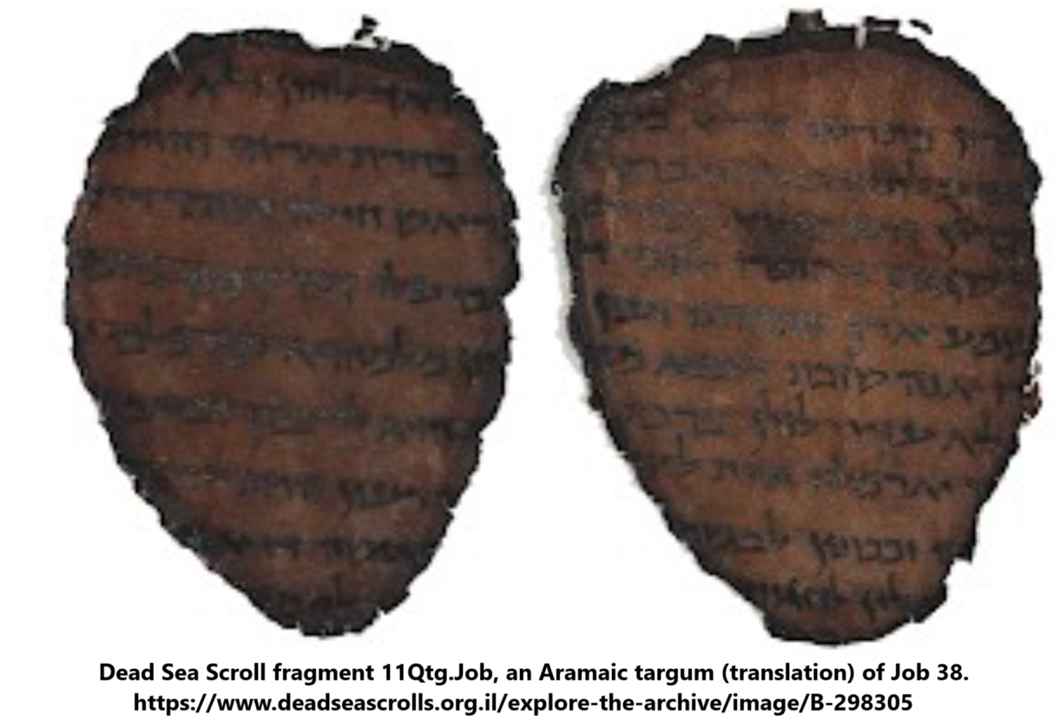
Orion
● In Dead Sea Scroll 11Qtg.Job, an Aramaic translation of Job, the word for Orion is נפל naphila from which Nephilim נפיל derives.
● In Mesopotamian astronomy, Orion was “the true sheperd of Anu,” evoking the shepherd-ruler motif.

Slide 31
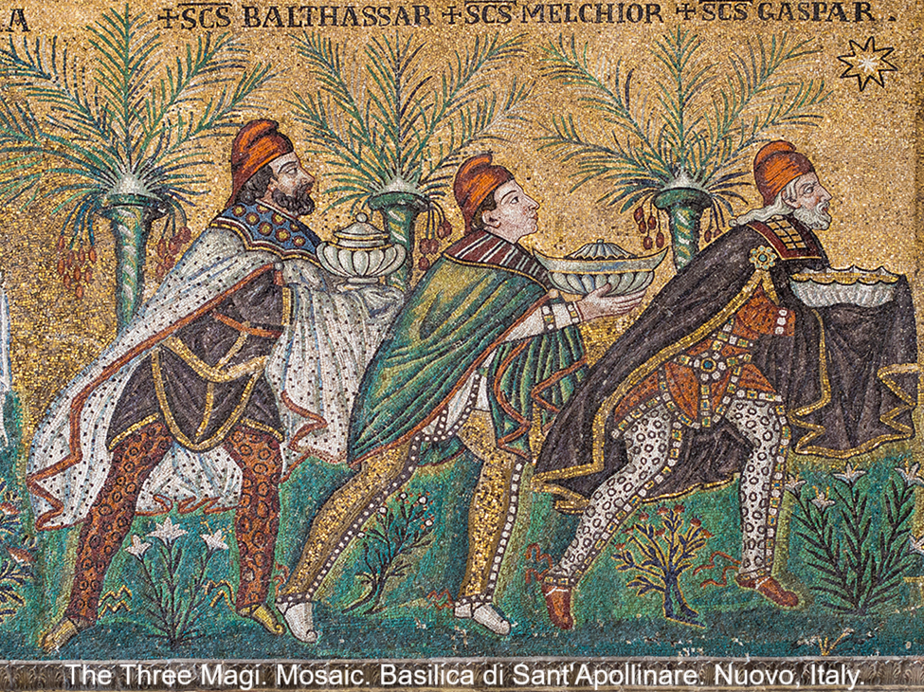
Ezekiel 34:23
“I will set up over them one shepherd, my servant David, and he shall feed them: he shall feed them and be their shepherd.”
● Written from Mesopotamia.
● Messiah would be a descendant of King David. (King David resurrected?)
● In the future kingdom, there will be no more Watcher-rulers deceiving nations.

Slide 32
Assignment
● Read Reversing Hermon, chapter 5: “The Watchers sin and Jesus’ Geneology,” pages 71-86.
● Visit ReversingHermon.site

Slide 33
…
…
● …

