Slide 1
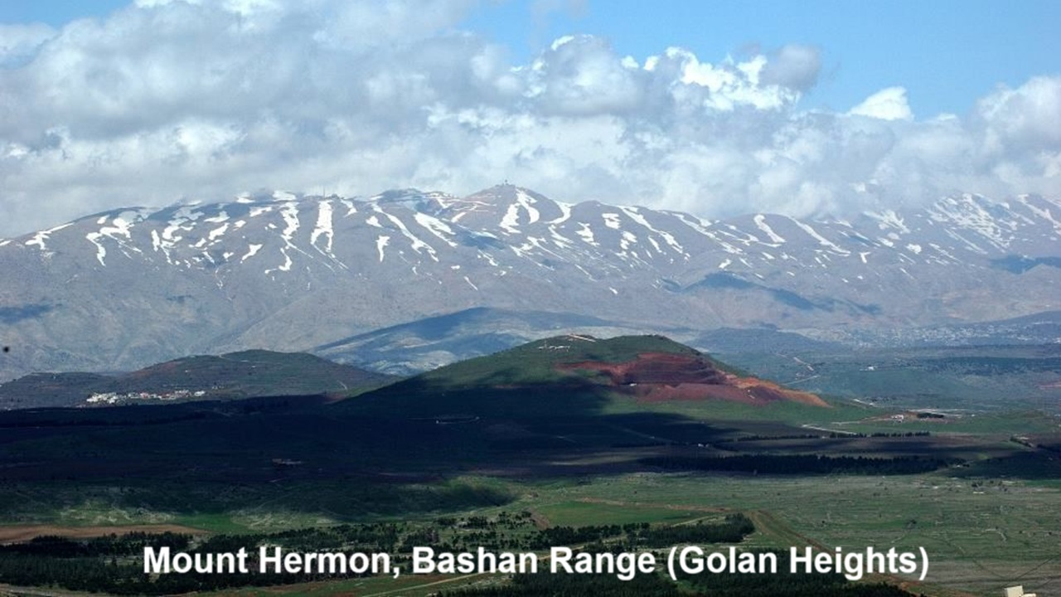
REVEЯSING HERMON
Session 5: The Watchers & Jesus’ genealogy
24 and 27 October 2024

Slide 2
Learning objectives
By the end of this session, we shall be able to:
● Describe the ‘Enochian template’.
● Explain why Matthew mentions four women in Jesus’ genealogy.
● Recount the stories of Tamar, Rahab, Ruth, and Bathsheba.

Slide 3
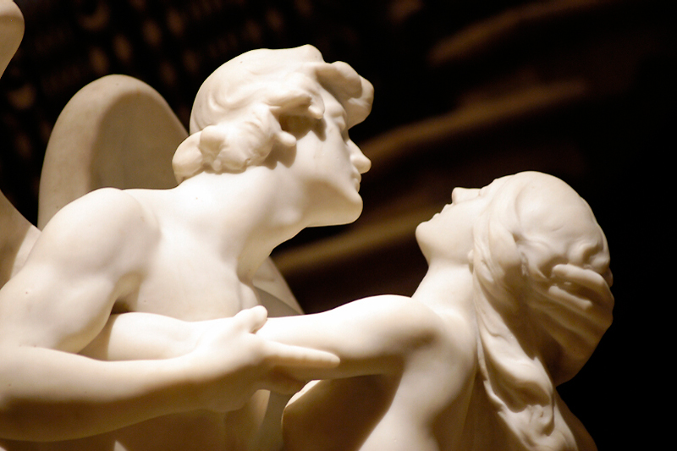
Preview
Jesus undoes what the watchers did.
● By being born in the lineage of fallen, sinful human beings.
● By reversing the effects of the Watchers’ sin in real human lives.
● By exalting fallen women as ancestors of the divine Messiah.

Slide 4
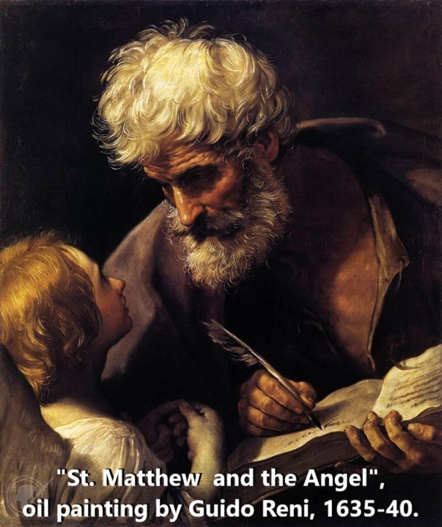
Matthew 1, Jesus’ genealogy
¹ The book of the genealogy of Jesus Christ, the son of David, the son of Abraham.
² Judah [was] the father of Perez and Zerah by Tamar…
³ Salmon [was] the father of Boaz by Rahab, and Boaz the father of Obed by Ruth…

Slide 5
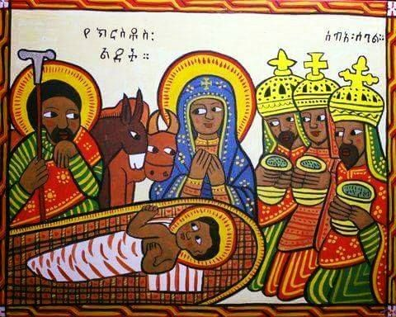
Matthew 1, Jesus’ genealogy
⁶ David was the father of Solomon by the wife of Uriah…
¹⁶ Jacob the father of Joseph the husband of Mary, of whom Jesus was born, who is called Christ.

Slide 6
Background to Matthew
● Matthew nowhere directly quotes from the Book of 1 Enoch.
● He does not include righteous women such Sara, Rebecca or Rachael.
● A second-temple Jew, he was familiar with the Enochian story.
● He mentions women who illustrate the ‘Enochian template’.

Slide 7
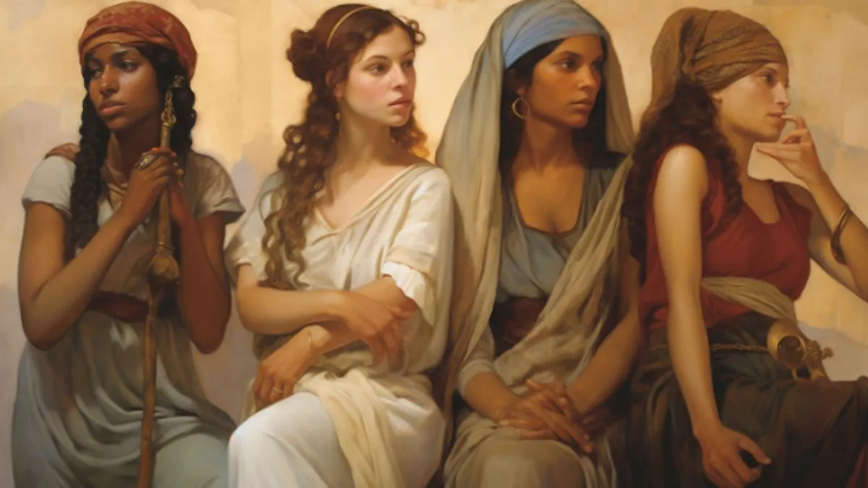
Why these four women?
To connect Jesus’ coming with:
● God’s grace for Gentiles and sinners.
● First Testament narratives.
● God’s covenant with Abraham.
● God’s covenant with David.
● Jewish mission to Gentiles (28:18-20).
● The ‘Enochian template’.

Slide 8
THE WATCHERS’ TEMPLATE
Before the Flood, divine beings:
● Left their proper domain in the air.
● Violated the human domain on earth.
● Saw, took, mated with human women.
● Fathered giants, who became demons.
● Taught women seductive cosmetics.
● Taught humans astrology, warfare, sorcery, drugs and idolatry.

Slide 9
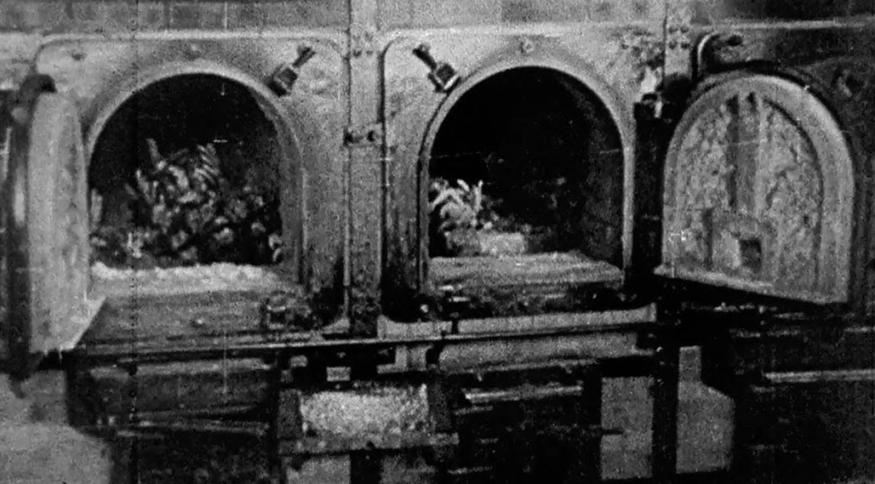
Sources of human evil
1 The devil’s defection in Eden. Isa. 14:14
2 Our first parents’ disobedience. Gen. 3
3 The Watchers’ illicit teaching. Gen. 6:1-5
4 Demons parading as gods. Deut. 32:17
5 Spiritual rulers over nations. Eph. 6:12
6 The fallen human ‘heart’. Mark 7:20-23
7 Satan’s temptations. 1 Corinthians 7:5
8 Personal lust. James 1:13-15

Slide 10
Enoch 6
¹ And it came to pass when the children of men had multiplied that in those days were born unto ² them beautiful and comely daughters. And the angels, the children of the heaven, saw and lusted after them, and said …: “Come, let us choose us wives from among the children of men ³ and beget us children.”

Slide 11
Enoch 8
¹ And Azazel taught men to make swords, and knives, and shields, and breastplates, and made known to them the metals of the earth and the art of working them, and bracelets, and ornaments, and the use of antimony, and the beautifying of the eyelids, and all kinds of costly stones…

Slide 12
Enoch 8
¹ And there arose much godlessness, and they committed fornication, and they ³ … became corrupt in all their ways. [The Watchers] taught enchantments, … root-cuttings, … resolving of enchant-ments, … astrology, … the constel-lations, … knowledge of the clouds, … signs of the earth, … sun … moon.

Slide 13
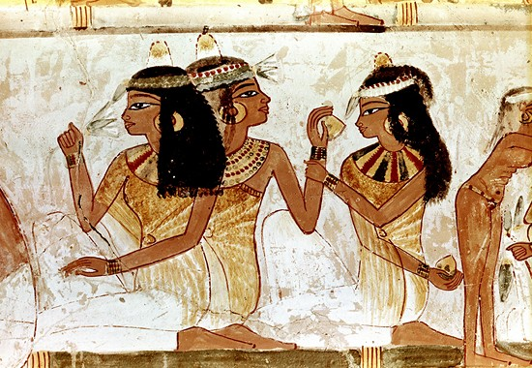
In each woman’s history
She employs one or more illicit arts:
● Beautification and seduction.
● Suspected or illicit sexual encounter.
● Interaction with an angel messenger.
● Questions about children’s paternity.
● The nature of her offspring.

Slide 14
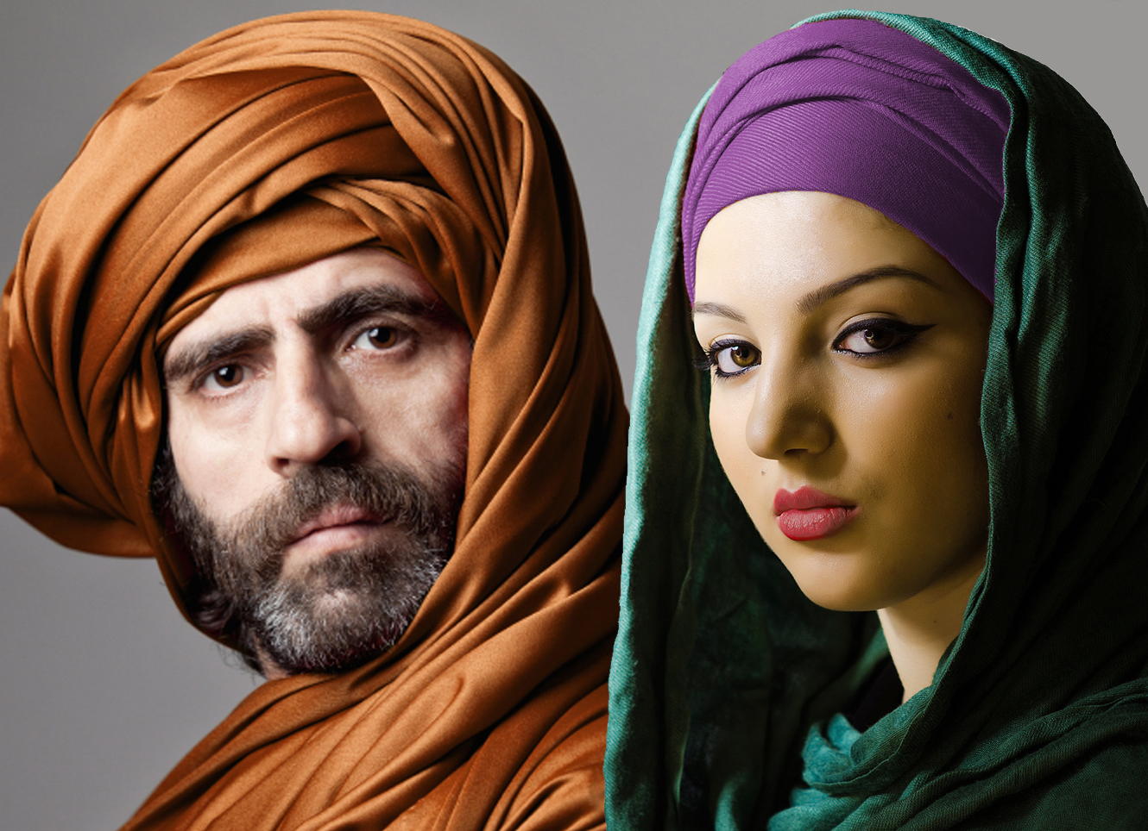
Genesis 38:1-19 (Tamar)
¹ Judah went down from his brothers and turned aside to a certain Adullamite, whose name was Hirah. ² There Judah saw the daughter of a certain Canaanite whose name was Shua. He took her and went in to her, ³ and she conceived and bore a son, and he called his name Er.

Slide 15
Genesis 38:1-19 (Tamar)
¹³ Tamar … covered herself with a veil, wrapping herself up, and sat at the entrance to Enaim… ¹⁵ When Judah saw her, he thought she was a prostitute, for she had covered her face. ¹⁶ He turned to her at the roadside… he went in to her, and she conceived by him.

Slide 16
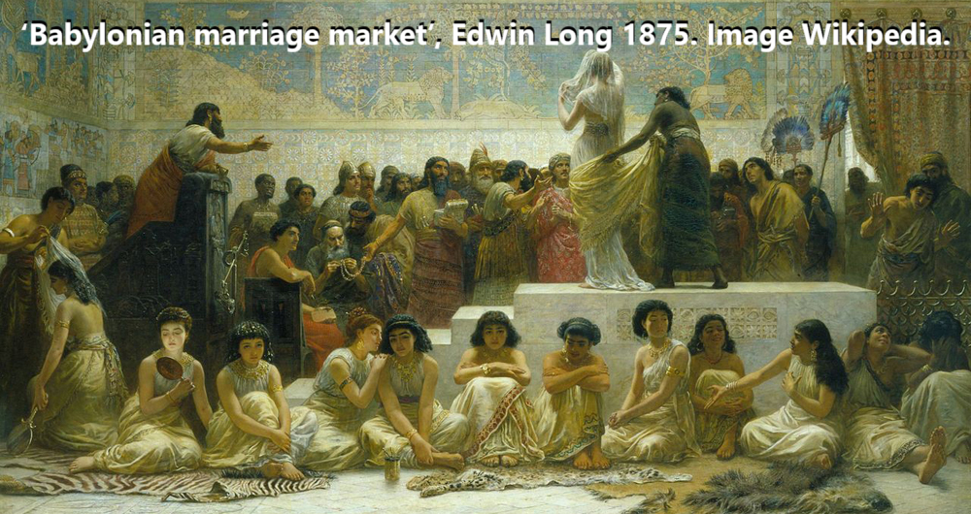
Tamar and the Watchers’ template
● Forbidden Canaanite woman.
● Used veil to seduce Judah.
● As a sacred prostitute (qodeshah).
● Judah saw, took, and mated with her.
● She conceived and bore a mixed son.
● Named her son Er (< root ‘r, watcher).

Slide 17
Joshua 2:1-15 (Rahab)
¹ And Joshua the son of Nun sent two men secretly from Shittim as spies, saying, “Go, view the land, especially Jericho.” And they went and came into the house of a prostitute whose name was Rahab and lodged there.

Slide 18
Joshua 2:1-15 (Rahab)
³ Then the king of Jericho sent to Rahab, saying, “Bring out the men who have come to you, who entered your house, for they have come to search out all the land.” ⁴ But the woman had taken the two men and hidden them.

Slide 19
Joshua 2:1-15 (Rahab)
⁹ She said to the men, “I know that [Yahweh] has given you the land, and that the fear of you has fallen upon us, and that all the inhabitants of the land melt away before you… ¹¹ For [Yahweh] your God, he is God in the heavens above and on the earth beneath.”

Slide 20
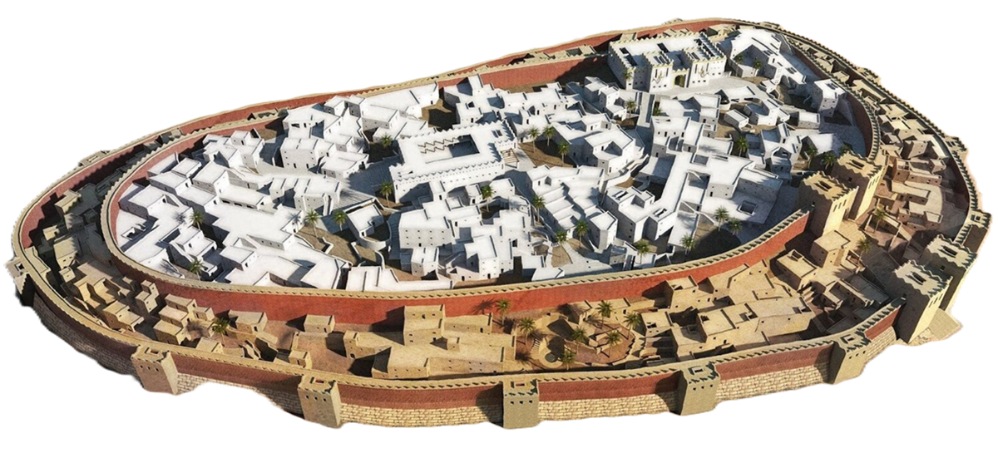
Rahab and the Watchers’ template
● Named after the rakhab monster?
● A seductive sex worker.
● Jericho was under the kherem (Hermon) ban because of the Anakim giants.
● In 6:25, the spies are called ‘angels’ (mel’akim), and in James 2:25 (aggeloi), as in 1 Enoch, because they left their own camp to enter a pagan city.

Slide 21
Ruth 1
³ Elimelech, the husband of Naomi, died, and she was left with her two sons.
⁴ These took Moabite wives; the name of the one was Orpah and the name of the other Ruth. They lived there about ten years, ⁵ and both Mahlon and Chilion died.

Slide 22
Ruth 1
¹⁴ Orpah kissed her mother-in-law, but Ruth clung to her. ¹⁵ And she said, “See, your sister-in-law has gone back to her people and to her gods; return after your sister-in-law.” ¹⁶ But Ruth said, .. “Where you go I will go, and where you lodge I will lodge. Your people shall be my people, and your God my God.”

Slide 23
Ruth 3
⁶ So she went down to the threshing floor and did just as her mother-in-law had commanded her. ⁷ And when Boaz had eaten and drunk, and his heart was merry, he went to lie down at the end of the heap of grain. Then she came softly and uncovered his feet and lay down.

Slide 24
Ruth 3
⁸ At midnight the man was startled and turned over, and behold, a woman lay at his feet! ⁹ He said, “Who are you?” And she answered, “I am Ruth, your servant. Spread your wings over your servant, for you are a redeemer.”

Slide 25
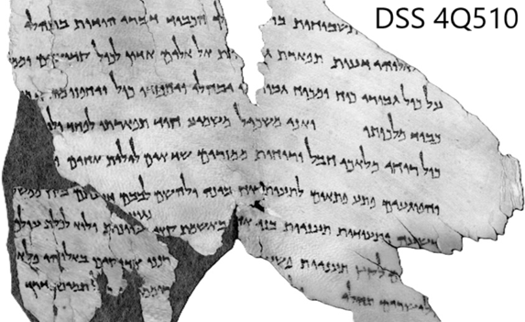
Ruth and the Watchers’ template
● Ruth was a Gentile from Moab (7X).
● Moab was known for illicit sex (incest, orgies), and idolatry (Chemosh).
● Ruth used seductive tactics with Boaz.
● ‘Feet’ = metonymy for lower body.
● ‘Mixed’ children exclude from Israel.
● Boaz reverses the Enochian template as a family ‘redeemer’.

Slide 26
2 Samuel 11
¹ In the spring of the year, the time when kings go out to battle, David sent Joab, and his servants with him, and all Israel. And they ravaged the Ammonites and besieged Rabbah.
But David remained at Jerusalem.

Slide 27
2 Samuel 11
² It happened, late one afternoon, when David arose from his couch and was walking on the roof of the king's house, that he saw from the roof a woman bathing; and the woman was very beautiful. ³ And David sent and inquired about the woman. And one said, …

Slide 28
2 Samuel 11
“Is not this Bathsheba, the daughter of Eliam, the wife of Uriah the Hittite?”
⁴ So David sent messengers and took her, and she came to him, and he lay with her... ⁵ And the woman conceived, and she sent and told David, “I am pregnant.”

Slide 29
“The wife of Uriah the Hittite”
Why did Matthew not tell her name?
● Judah’s wife was called Bathshua (Shua’s daughter). 1 Chron. 2:3
● Bathsheba is also called Bathshua* (Shua’s [grand]daughter). 1 Chron. 3:5
● Thus Bathsheba was likely a Gentile.
*One Hebrew manuscript, the Latin Vulgate, and the Greek LXX, later say Bathsheba.

Slide 30
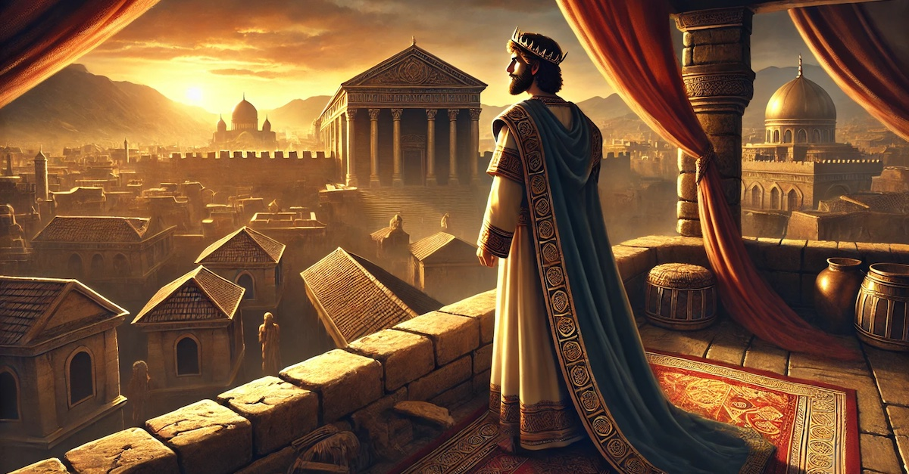
Bathsheba & the Watchers’ template
● Israel was at war with Ammonites.
● Uriah was a gibbor, which 1 Enoch used for the Nephilim. 2 Sam 23:22, 39
● Bathsheba seduced David.
● David looked down, saw a beautiful foreign woman, took her, and mated.
● David plotted to have Uriah die in war.
● Bathsheba’s first child died.

Slide 31
Summary
● Effects of the Watchers’ sin endure.
● Those effects plagued Israel’s lineage.
● Conversion of Yahweh saves.
● Boaz illustrates how a godly Israelite redeemer can reverse the effects.
● Matthew’s genealogy connects Jesus to the Enochian template.
● Humanity needs a powerful Redeemer.

Slide 32
Assignment
● Read Reversing Hermon, chapter 6: “The Watchers sin and Jesus’ Ministry,” pages 87-102.
● Visit ReversingHermon.site

