Slide 1
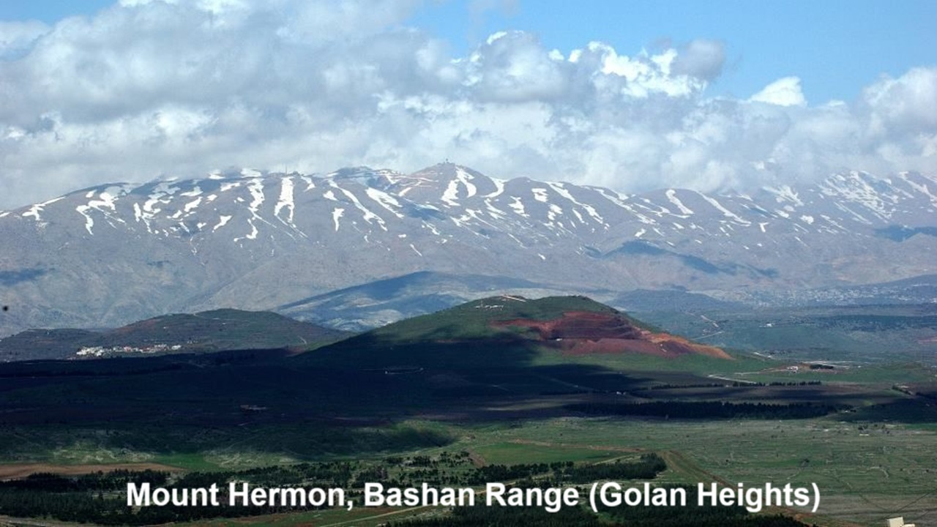
REVEЯSING HERMON
Session 6: The Watchers & Jesus’ ministry
30 October & 10 November 2024

Slide 2
Learning objectives
By the end of this session, we shall be able to explain why:
● Jesus expelled demons from humans.
● Jesus led his apostles up Mt. Hermon.
● Jesus conversed with Moses and Elijah, when he was transfigured.

Slide 3
Origin of the Ancient Giants

Slide 4
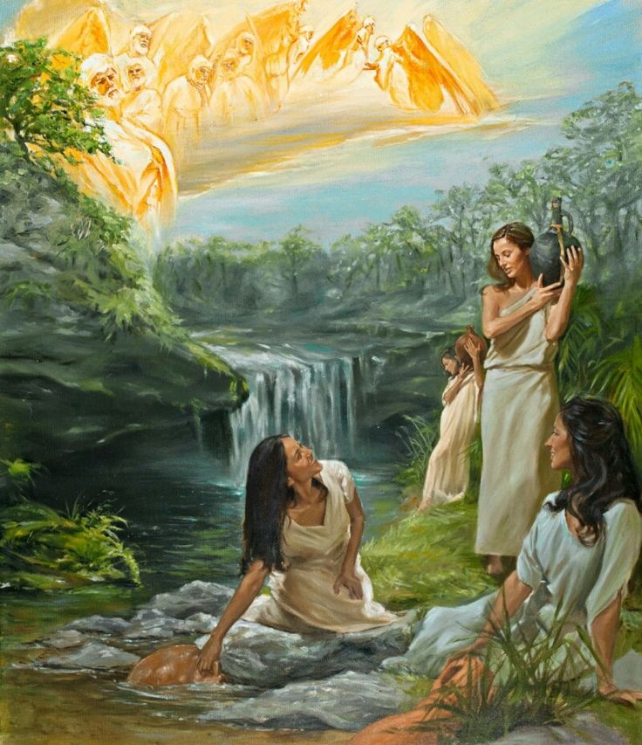
Angels and giants in Genesis 6
“¹ When man began to multiply on the face of the land and daughters were born to them, ² the sons of God saw that the daughters of man were attractive. And they took as their wives any they chose. … ⁴ The Nephilim were on the earth in those days, and also afterward.”

Slide 5
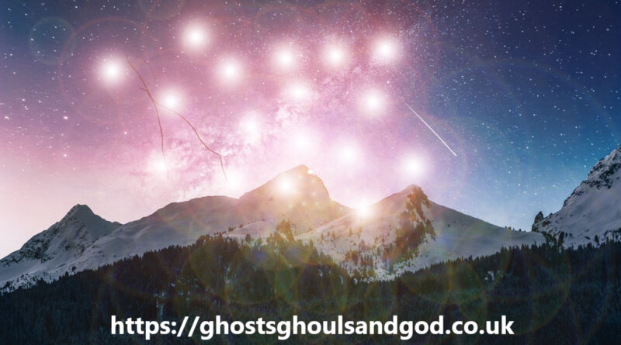
Angels and giants in 1 Enoch 6
“⁶ The [Watchers] were, all of them, two hundred, who descended in the days of Jared onto the peak of Mount Hermon. And they called the mountain ‘Hermon’ [curse] because they swore and bound one another with a curse on it.”
● Curse: (triliteral root) ḥerem.
● Hermon: (with local suffix) ḥermôn.

Slide 6
Amorite ‘giants’ in Mesopotamia
Pre-exodus: “They shall come back here in the fourth generation, for the iniquity of the Amorites is not yet complete.” Gen 15:16
Post-exodus: “It was I who destroyed the Amorite before them, whose height was like the height of the cedars and who was as strong as the oaks.” Amos 2:9

Slide 7
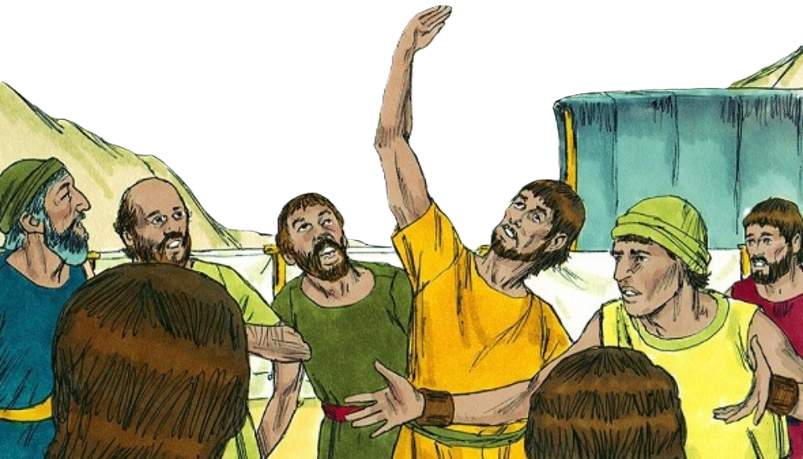
Giants in the Land
“³¹ We are not able to go up against the people, for they are stronger than we are… ³² All the people that we saw in it are of great height. ³³ And there we saw the Nephilim (the sons of Anak, who come from the Nephilim)…” Num 13
● Nephilim: (Aramaic) ‘giants’, that is, stronger and taller.

Slide 8
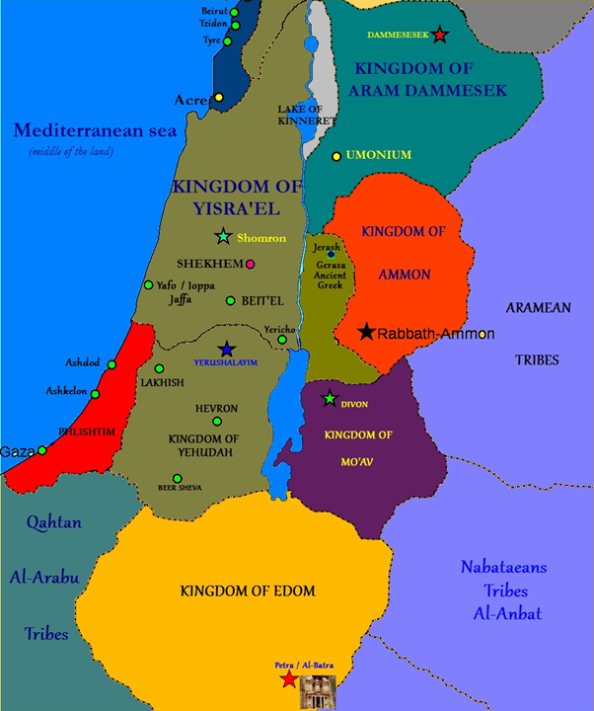
Esau and the Amorites Giants
“⁹ Esau ridded his regions of the Amorites … ¹⁰ a people great and many, and tall as the Anakim… ¹² The people of Esau dispossessed them and destroyed them from before them and settled in their place” [east of the Jordan river]. Dt 2
● Anakim: A giant clan dwelling in Canaan (Mesopotamia) in ancient times.

Slide 9
Giant king Og (Deut 3:11)
“Only Og the king of Bashan was left of the remnant of the Rephaim. Behold, his bed was a bed of iron. Is it not in Rabbah [City] of the Ammonites? Nine cubits was its length, and four cubits its breadth, according to the common cubit.”
● Bed: 13 by 6 feet. Royal bed for cultic love making. (Same as at Babel.)

Slide 10
Ba’al, Lord of dead apkallu kings
King Ahaziah fell … and lay sick… So he sent messengers, telling them, “Go, inquire of Baal-zebub, the god of Ekron, whether I shall recover from this sickness.” 2 Kings 1:2 (9th cent. BC)
Jesus said: “They have called [me] the master of the house Beelzebul…” Matthew 10:25 (AD 33)

Slide 11
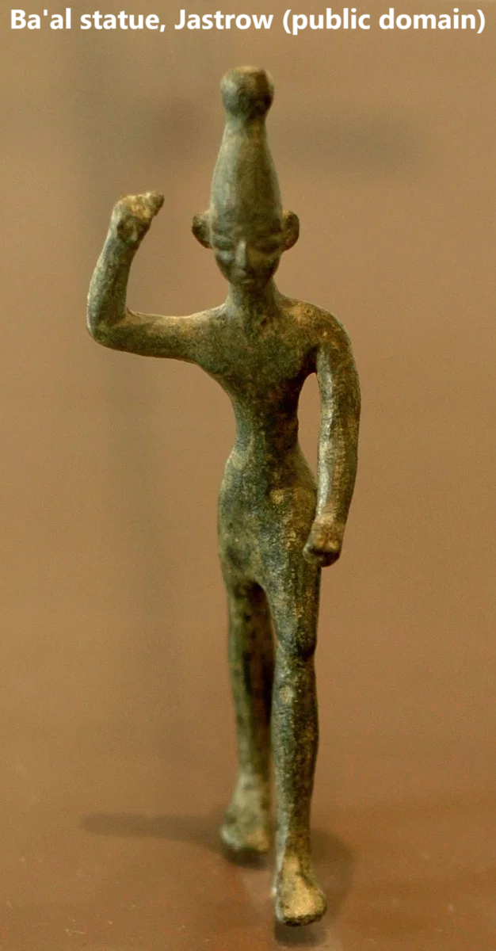
Ba’al, Lord of dead apkallu kings
● Baal: Mesopotamia, the god Baal was called ba^{ʕ}al zebul ^{ʔ}arṣ, “Prince Ba‘al of the underworld.”
● Underworld: the place where demons and dead rulers must go to await their Judgement.

Slide 12
Jesus and Evil Spirits

Slide 13
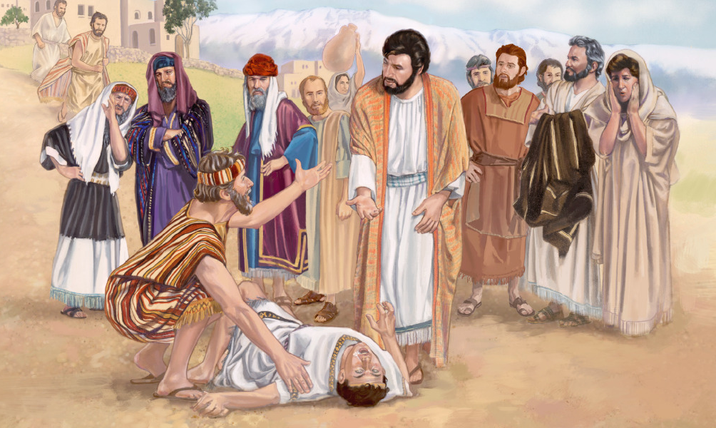
Origin of evil spirits (demons)
“⁸ The giants who were begotten by the spirits and [human] flesh— their dwelling will be on the earth… ⁹ Evil spirits they will be on the earth, and evil spirits they will be called… ¹² These spirits (will) rise up against the sons of men and against the women, for they have come forth from them.” 1 Enoch 15

Slide 14
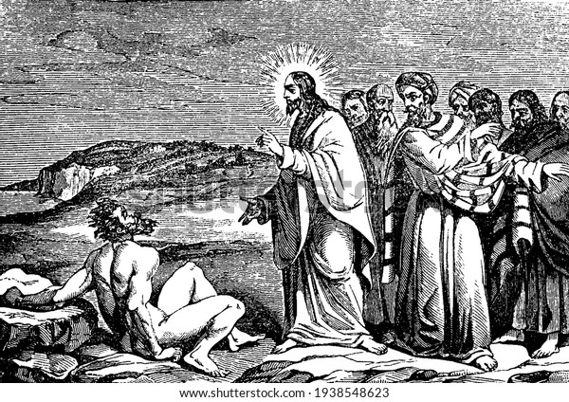
Jesus expels demons from Gentiles
¹ They came to the other side of the sea, to the country of [Bashan]. ² There met him out of the tombs a man with an unclean spirit… ⁴ No one had the strength to subdue him… ⁶ When he saw Jesus from afar, he ran and fell down before him. ⁷ He cried out with a loud voice, “Jesus, Son of the Most High God! Mark 5

Slide 15
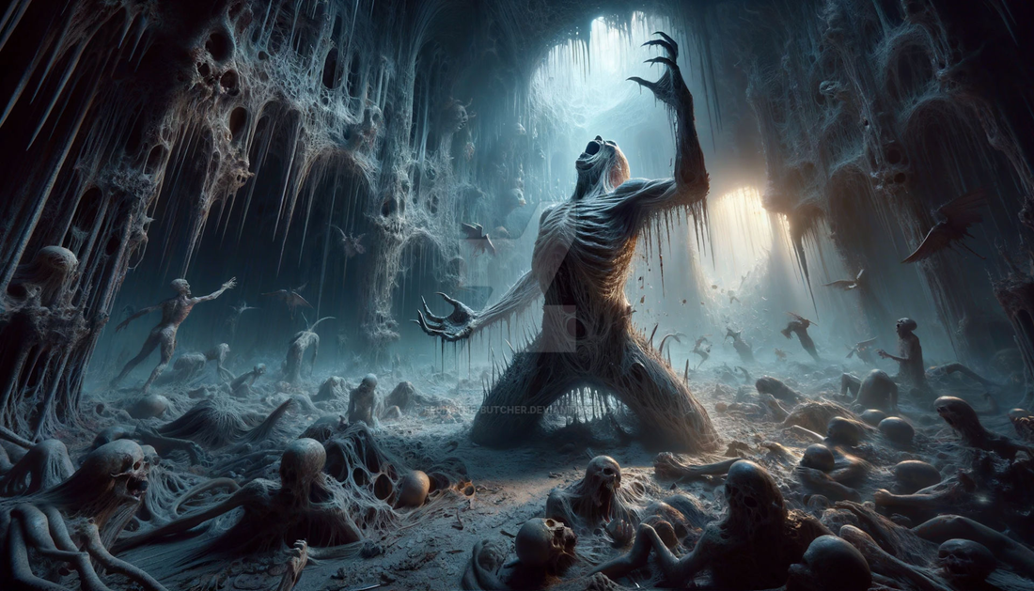
Jesus expels Watcher spirits
… I adjure you by God, do not torment me…” ¹⁰ And he begged him earnestly not to send them out of the country.
● Son of the Most High: See Psalm 82:6.
● Strength: Nephilim spirits.
● Torment: Their destiny. Ps 82:7 Mt 25:41
● Send out: ‘Rulers in heavenly places’. Eph 5:10

Slide 16
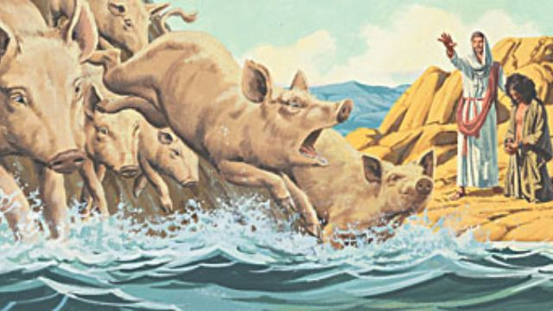
Jesus expels Nephilim spirits
¹³ The unclean spirits came out and entered the pigs; and the herd, number-ing about two thousand, rushed down the steep bank into the sea and drowned in the sea.
● Pigs: Unclean. The spirits are demoted.
● Drowned: As their divine-human bodies had drowned in the great flood.

Slide 17
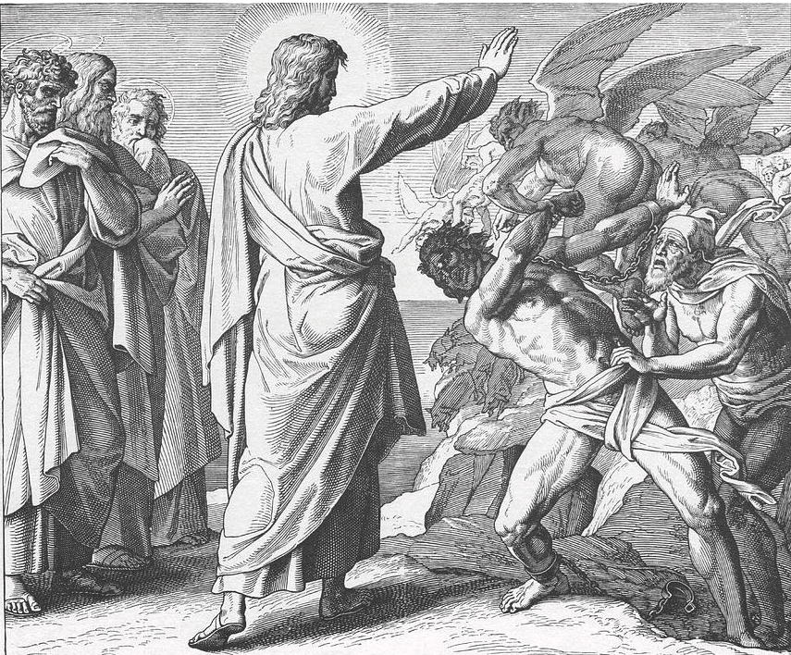
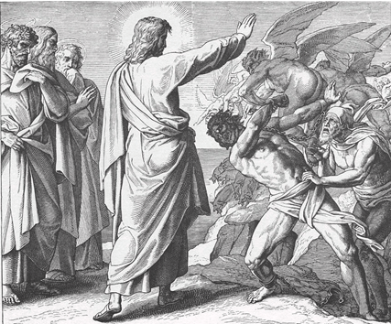
Jesus expels evil spirits from Israel
²³ There was in their synagogue a man with an unclean spirit. And he cried out, ²⁴ “What have you to do with us, Jesus of Nazareth? Have you come to destroy us? I know who you are—the Holy One of God.” Mark 5

Slide 18
Jesus Reverses Hermon

Slide 19
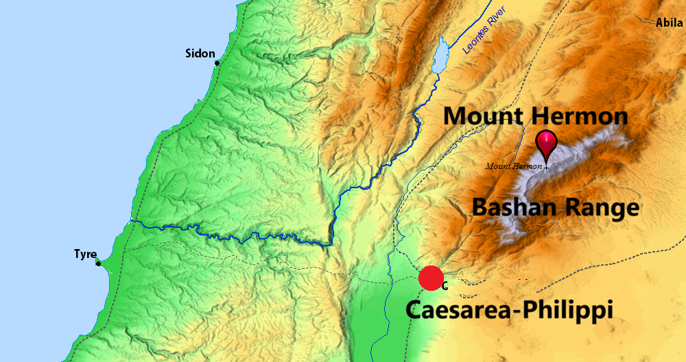
Mount Hermon, Bashan Range
¹⁵ O mountain of God, mountain of Bashan; O many-peaked mountain, mountain of Bashan!
¹⁶ Why do you look with hatred, O many-peaked mountain, at the mount that God desired for his abode, yes, where the LORD will dwell forever? Psalm 68

Slide 20
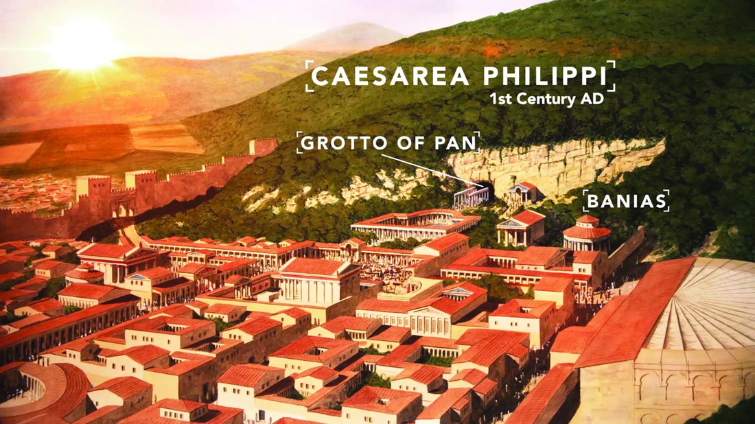
Jesus reverses Hermon’s effects
¹³ When Jesus came into the district of Caesarea Philippi, he asked his disciples … ¹⁵ “Who do you say that I am?”
¹⁶ Simon Peter replied, “You are the Christ, the Son of the living God.” ¹⁷ And Jesus answered him, … “Flesh and blood has not revealed this to you, but my Father who is in heaven.”

Slide 21
Jesus reverses Hermon’s effects
“¹⁸ And I tell you, you are Peter [petros], and on this rock [petra] I will build my church, and the gates of hell shall not prevail against it.
“¹⁹ Whatever you [Peter (singular)] bind on earth shall be bound in heaven, and whatever you loose on earth shall be loosed in heaven.” Matthew 16

Slide 22
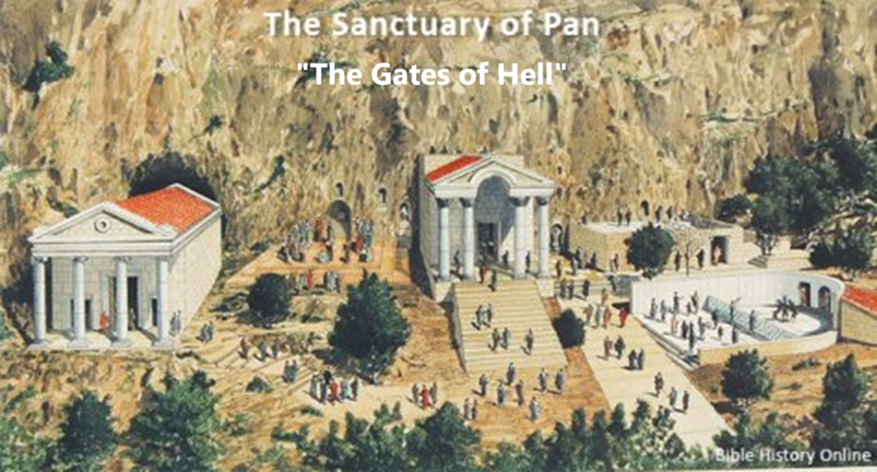
The Gates of Hell
Three current interpretations:
● Traditional: Persecution against Christians in church history.
● Scholarly: The Grotto of Pan at Bashan near Caesarea Philippi.
● Ancient: Satan = Lord of the dead.

Slide 23
Different views on the ‘rock’
● R. Catholic: Peter, the first pope.
● Evangelical: Peter’s confession.
● Protestant: Christ (1 Cor. 10:4).
● Contextual: Mt. Herman.
“I say to you [apostles (plural)], what-ever you bind on earth shall be bound in heaven, and whatever you loose on earth shall be loosed in heaven.” Matt. 18:18

Slide 24
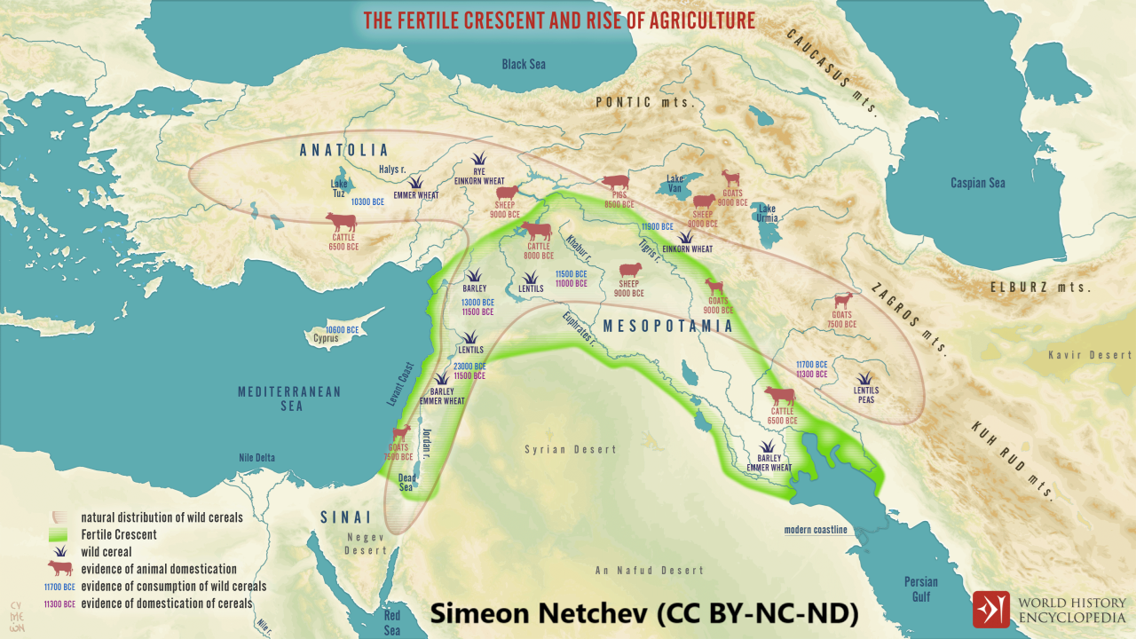
Other Watchers rule over nations
“⁸ When the Most High gave to the nations their inheritance, when he divided mankind, he fixed the borders of the peoples according to the number of the sons of God [Watchers]. ⁹ But the Yahweh’s portion is his people, Jacob his allotted heritage.”
● Sons of God: Genesis 6:1-4; Psalm 82.

Slide 25
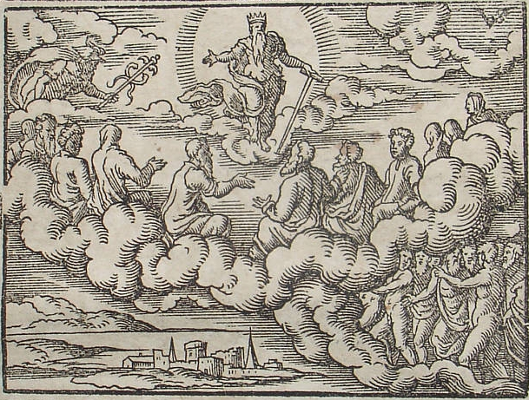
Watchers are disobedient rulers
“¹ God [will take] his place in the divine council; in the midst of the gods he holds judgment… ‘How long will you judge unjustly and show partiality to the wicked?... ⁶ I said, ‘You are gods, sons of the Most High, all of you; ⁷ nevertheless, like men you shall die, and fall like any prince.’” Psalm 82

Slide 26
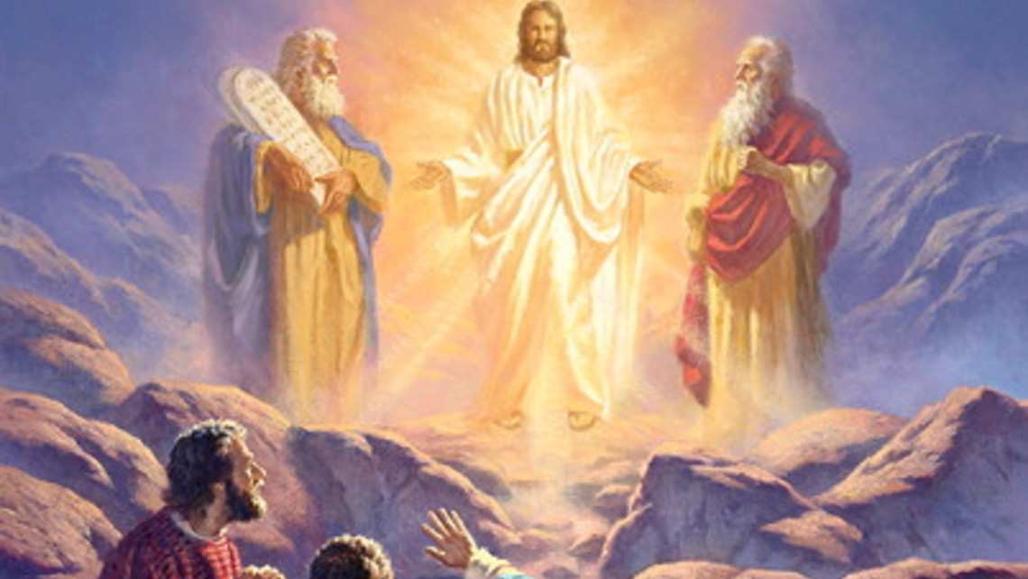
Jesus’ transfigured atop Hermon
“²⁸ Jesus took with him Peter, John and James and went up on the mountain. ²⁹ As he was praying, the appearance of his face was altered, and his clothing became dazzling white. ³⁰ Suddenly, Moses and Elijah appeared in glory talking with him, ³¹ about his departure.” Luke 9

Slide 27
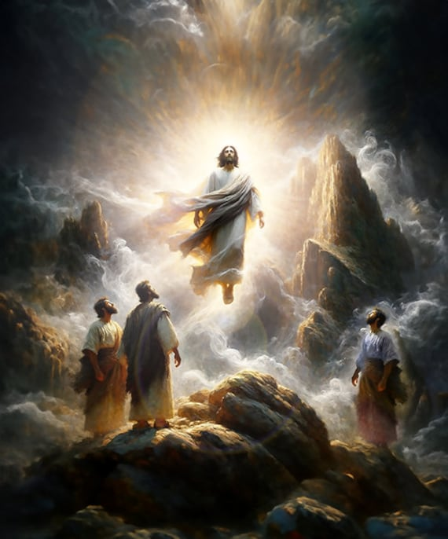
Jesus’ transfigured
“³⁴ A cloud came and overshadowed them, and they were afraid as they entered the cloud. ³⁵ And a voice came out of the cloud, saying, “This is my Son, my Chosen One; listen to him!” ³⁶ And when the voice had spoken, Jesus was found alone.” Luke 9

Slide 28
Jesus reclaims Hermon as his own
Implications
● Mountain: Bashan range. Mt. Hermon?
● Appearance: A human-divine being.
● Moses & Elijah: Divinized messengers.
● Voice: The Most High God.
● Son: Who inherits heaven & earth.
● Chosen one: Watchers displaced.
● Listen: Watchers must now obey Jesus.

Slide 29
Jesus empowers his church
You ascended on high, leading a host of captives … and receiving gifts among men… Psa 68:18
When he ascended on high he led a host of captives, and he gave gifts to men… Eph 4:8
among the rebellious
to equip the saints
Tribute
Distribute

Slide 30
Assignment
● Read Reversing Hermon, chapter 7: “The Watchers sin and Human Depravity,” pages 103-122.
● Visit ReversingHermon.site

