Slide 1
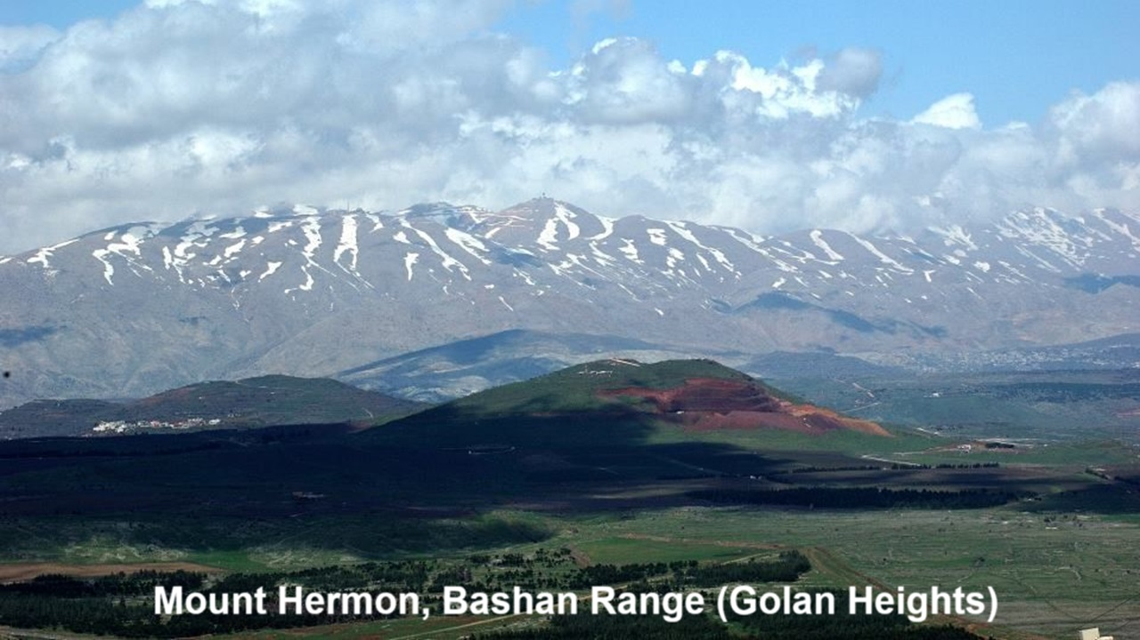
REVEЯSING HERMON
7: The Watchers’ Sin & Human Depravity
07 & 17 November 2024

Slide 2
Learning objectives
By the end of this session, we shall be able to explain:
● Several causes of human depravity.
● Why God gave written laws.
● How Jesus counteracts our depravity.

Slide 3
Two sources of human depravity
Human Demoniacal

Slide 4
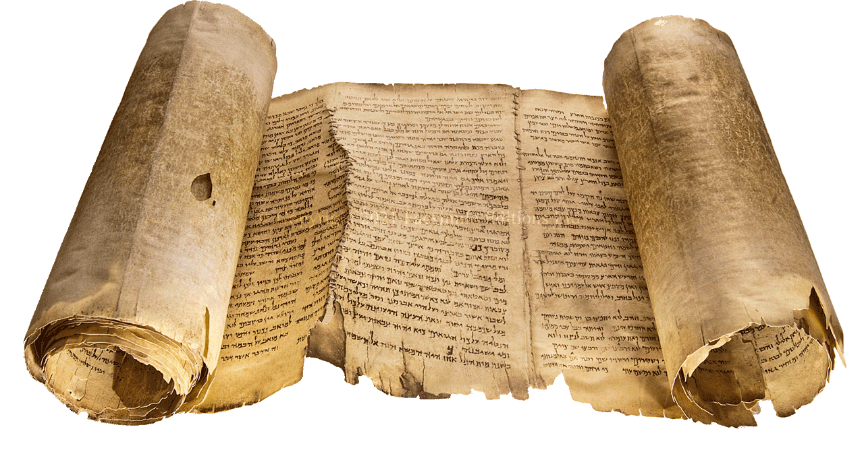
Human source (Dead Sea Scrolls)
“²¹ I am a creature of clay, fashioned with water, ²² a foundation of shame and a source of impurity, an oven of iniquity and a building of sin, a spirit of error and depravity without ²³ knowledge, terrified by your just judgments.” 1QHa IX.21–23

Slide 5
Human source (James 1)
“¹⁴ Each person is tempted when he is lured and enticed by his own desire.
¹⁵ Then desire when it has conceived gives birth to sin, and sin when it is fully grown brings forth death. ¹⁶ Do not be deceived, my beloved brothers.”

Slide 6
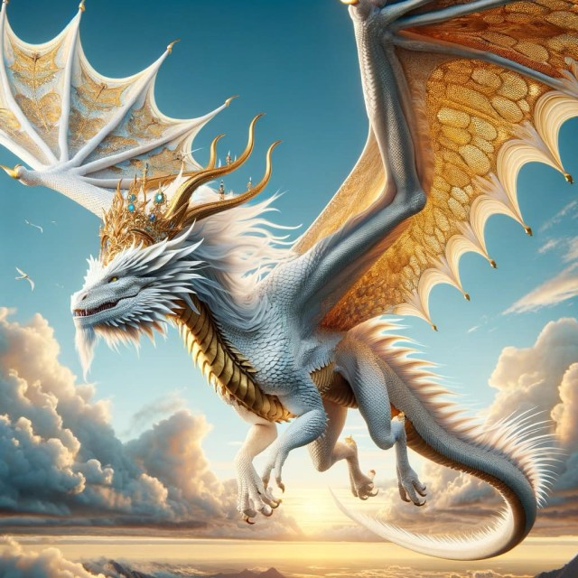
Demonic source (Genesis 3)
“⁴ The serpent said to the woman, “You will not surely die. ⁵ For God knows that when you [both] eat of it your eyes will be opened, and you will be like God, knowing good and evil…”
¹⁷ To Adam, Yahweh said, … ¹⁹ “You shall … return to the ground, for out of it you were taken.”

Slide 7
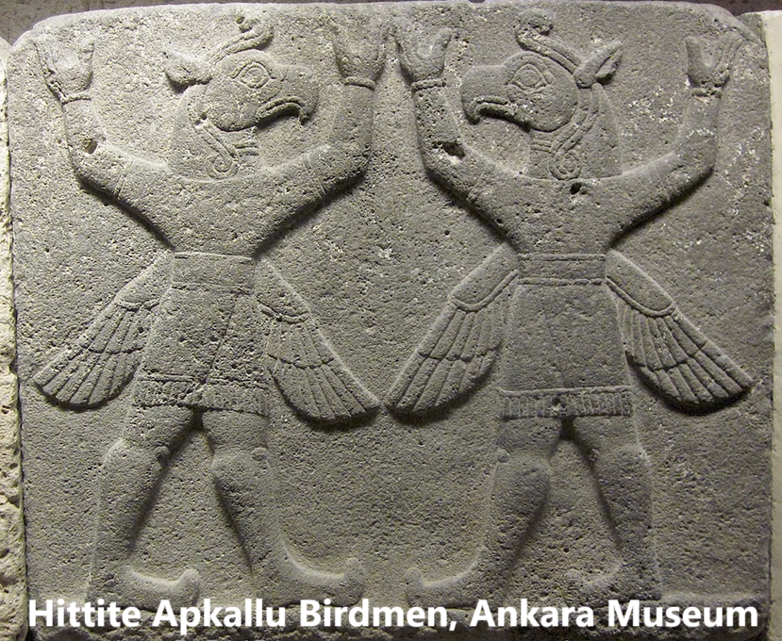
Demonic source (Genesis 6)
⁴ The Nephilim were on the earth in those days, and also afterward, when the sons of God came in to the daughters of man and they bore children to them…
⁵ The LORD saw that the wickedness of man was great in the earth, and that every intention of the thoughts of his heart was only evil continually.

Slide 8
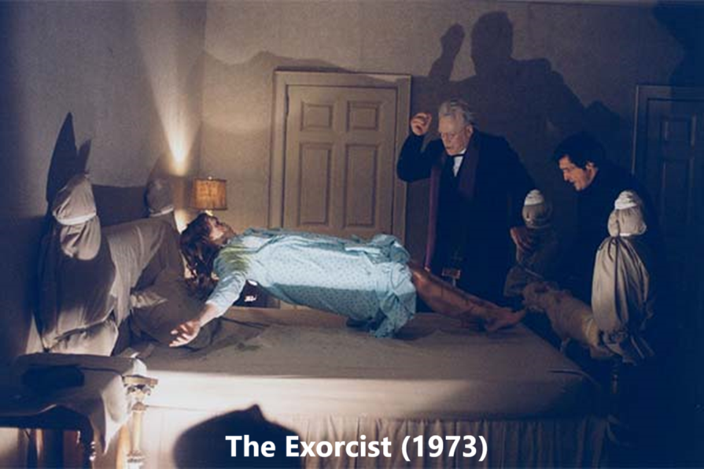
Demonic source (1 Enoch 15)
“⁸ The giants who were begotten by the spirits and flesh—they will call them evil spirits upon the earth… ⁹ From the holy watchers was the origin of their creation. ¹¹ And the spirits of the giants lead astray, do violence, make desolate, and attack and wrestle and hurl upon the earth and cause illnesses.”

Slide 9
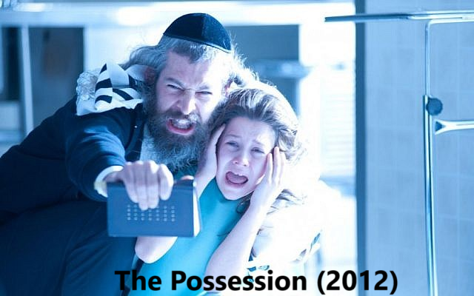
Demonic source (Dead Sea Scrolls)
“⁴ Declare the splendour of (God’s) radiance in order to frighten and terrify ⁵ all the spirits of the ravaging angels and the bastard spirits, demons, Lilith, owls and [jackals…] ⁶ and those who strike unexpectedly to lead astray the spirit of knowledge.” 4Q510 (4QShirª)

Slide 10
Demonic source (Ephesians 6)
“¹² We do not wrestle against flesh and blood, but against the rulers, against the authorities, against the cosmic powers over this present darkness, against the spiritual forces of evil in the heavenly places. ¹³ Therefore take up the whole armor of God, that you may be able to withstand in the evil day.”

Slide 11
Why God Gave Written Laws

Slide 12
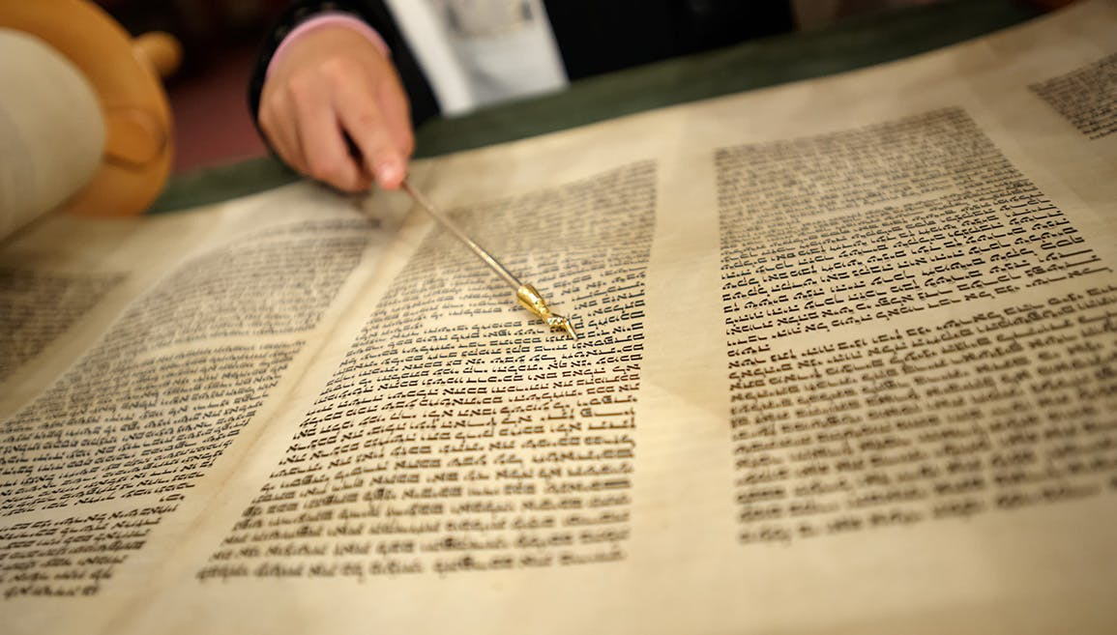
Why then the law? (Galatians 3)
“¹⁸ The law, which came 430 years afterwards, does not annul a covenant previously ratified by God… ¹⁹ Why then the law? It was added because of transgressions, until the offspring should come to whom the promise had been made.”
● Whose transgressions?

Slide 13
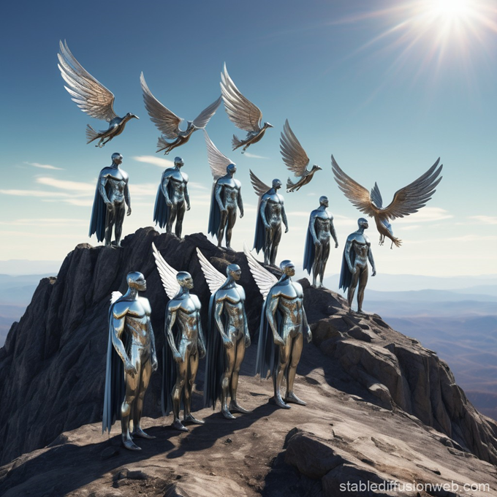
Whose transgressions?
Romans 5 ¹³ Sin is not counted where there is no law. ¹⁴ Yet death reigned from Adam to Moses, even over those whose sinning was not like the transgression of Adam.
Jude 1 ⁶ The angels who did not stay within their own position of authority, but left their proper dwelling…

Slide 14
Cosmic history 1
God | Angels | Humans
Creates | Sons of God | Adam & Eve
Warns |  | Adam & Eve
 | Serpent | Transgresses
 | Watchers transgress | Birth ‘giants’
 | Watchers teach | War & illicit arts
Damns | Those Watchers | Giants drown

Slide 15
Cosmic history 2
God | Angels | Humans
Appoints | Other Watchers as gods | Over Gentiles
Promises |  | To Abraham
Covenants | Mediated by angels | With Israel
 | Watchers empower | Giant clans
Gives Law |  | To suppress sin
Inspires |  | Holy prophets

Slide 16
Cosmic history 3
God | Angels | Humans
Sends | To announce birth | Of Messiah Jesus
Jesus | Resists Satan | As the ‘second Adam’
Jesus | Casts out demons | Sets humans free
Jesus | Defeats Watchers | Redeems sinners
Jesus | Sends angel helpers | Builds his church
Jesus | Subjects enemies | Prepares a kingdom

Slide 17
The Watchers’ career
1 Creation
2 Eden
3 Serpent
4 Fall
5 Jered
6 Flood
7 Gentiles
Singing
Gardeners
Sedition, temptation
Guard tree of life
Transgressions
These damned
Others rule

Slide 18
The Watchers’ career
8 Divine council
9 Jesus’ birth
10 Crucifixion
11 Church age
12 Christ returns
13 Kingdom age
14 New earth
Social injustice
Infanticide
Regicide
False religion
Armies assemble
Prepare revolt
Lake of fire

Slide 19
We Need a Powerful Mediator

Slide 20
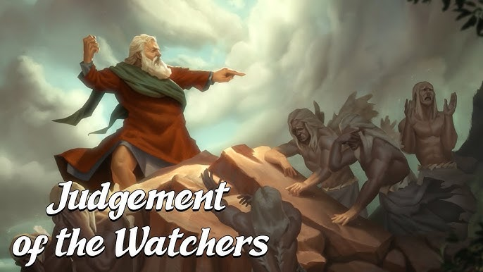
Enoch, a failed mediator
1 Enoch 15 ¹ Enoch… ² Go and say to the watchers of heaven, who sent you to petition in their behalf, “You should petition in behalf of humans…
16 ³ A stolen mystery you learned… Through this mystery the women and men are multiplying evils on the earth.” ⁴ Say to them, “You will have no peace.”

Slide 21
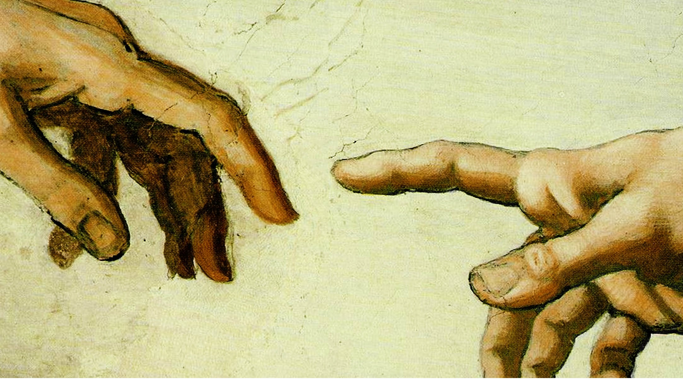
The successful mediator
Galatians 4 ⁴ When the fullness of time had come, God sent forth his Son, born of woman, born under the law, ⁵ to redeem those who were under the law.
1 Timothy 2 ⁵ There is one God, and there is one mediator between God and men, the man Christ Jesus, ⁶ who gave himself as a ransom for all.

Slide 22
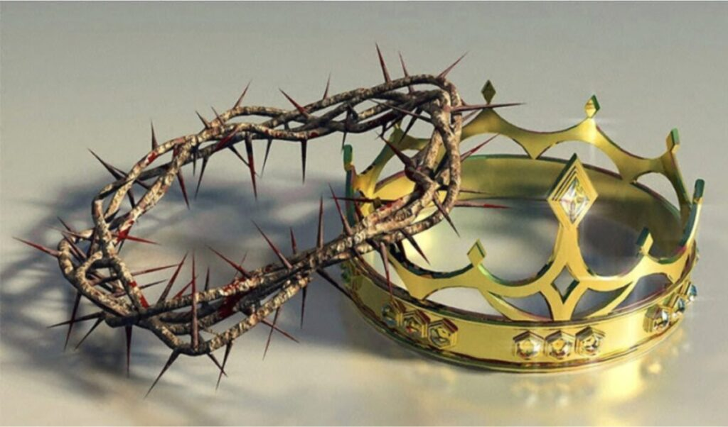
The superiority of Jesus Christ
Colossians 1 ¹⁶ By him all things were created, in heaven and on earth, visible and invisible, whether thrones or dominions or rulers or authorities—all things were created through him and for him. ¹⁷ And he is before all things, and in him all things hold together.

Slide 23
Jesus’ unique titles (7 of 99)
1 The Word John 1:1
2 Only Son John 3:16
3 The Savior John 4:42
4 The Way John 14:6
5 Only Name Acts 4:12
6 One Mediator 1 Timothy 2:5
7 One sacrifice Hebrews 10:12

Slide 24
Assignment
● Read Reversing Hermon, chapter 8: “The Watchers and Head Covering,” pages 123-136.
● Visit ReversingHermon.site

