Slide 1
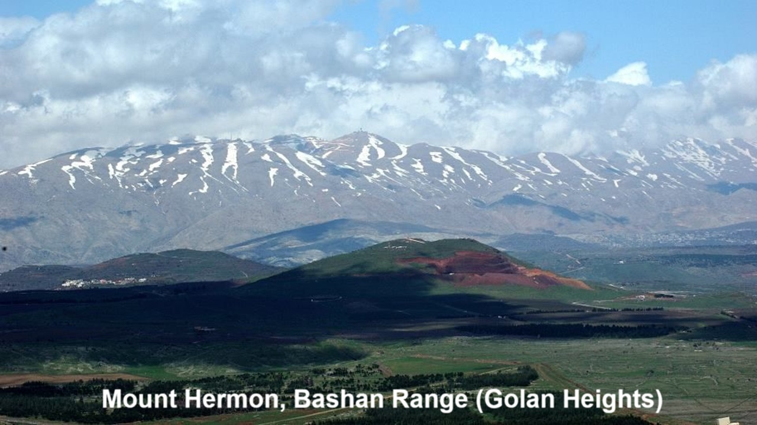
REVEЯSING HERMON
8: Watchers & Women’s Head Covering
14 & 24 November 2024

Slide 2
Learning objectives
By the end of this session, we shall be able to explain:
● Head covering in 1 Cor. 11:10.
● “Because of the angels.”
● Pre-scientific ideas found in the Bible.

Slide 3
Question about Christian worship

Slide 4
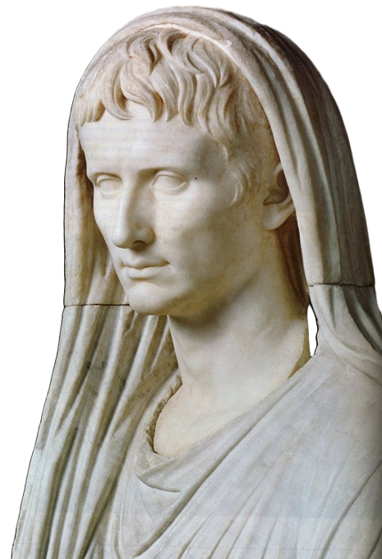
Caesar Augustus
This statue of Emperor Augustus (r. 63 BC – AD 14) was discovered at Corinth. He covered his head only when praying or sacrificing to the gods.

Slide 5
1 Corinthians chapter 11
³ Every husband’s chief is Christ, every wife’s chief is her husband, and Christ’s chief is God.
● Husband: anér = man, husband, Adam.
● Wife: gyné = adult woman, wife, Eve.
● Chief: kephalé = head, leader, protector.

Slide 6
…
^{n} …
● …: …
● …: …

Slide 7
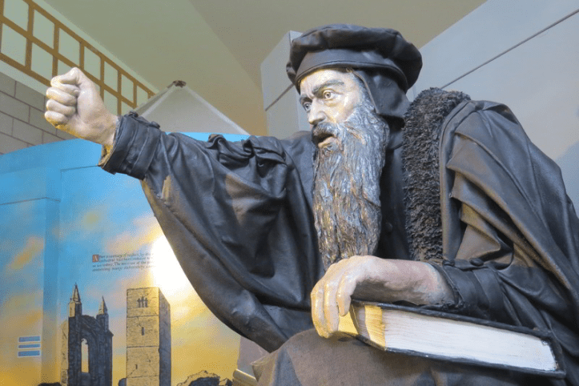
1 Corinthians chapter 11
⁴ Any man praying or prophesying with his head covered dishonors his chief.
● Covered: Christian Gentile men were not to cover their head, as the pagans did, for they had direct access to God by faith in Jesus. (Christian Jews were free to cover their head.)

Slide 8
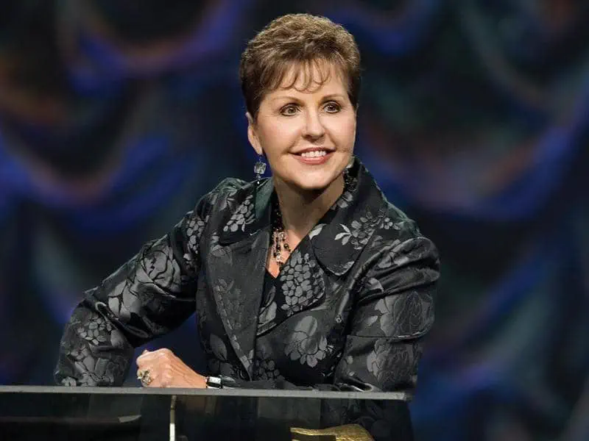
1 Corinthians chapter 11
⁵ And any woman praying or prophesying with her head uncovered dishonors her chief, because she is the same as a shaven woman.
● Prophesy: Speak aloud in a gathering.
● Shaven: A sign of shame or disgrace, which reflects badly on her husband.

Slide 9
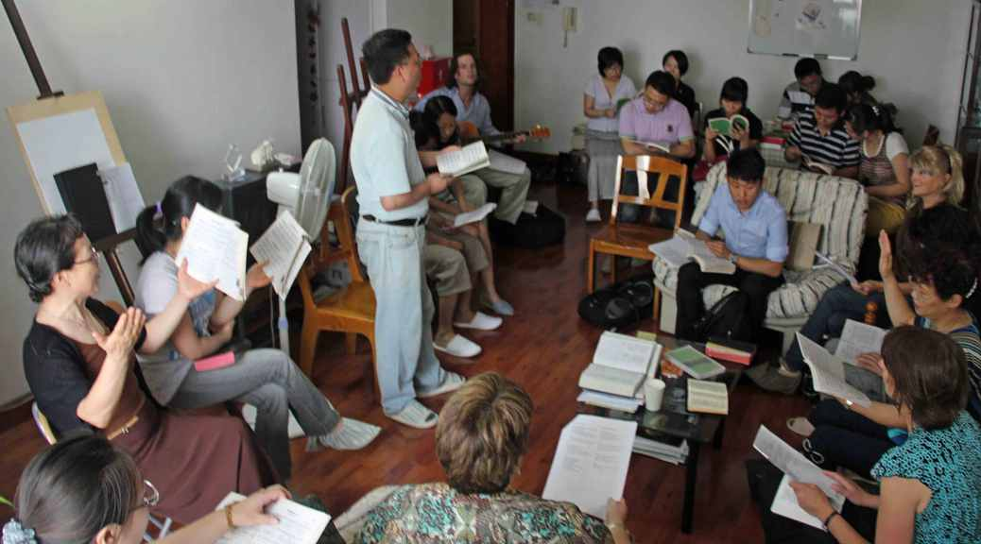
1 Corinthians 14
²⁶ My brothers and sisters… When you come together, each one has a hymn, a lesson, a revelation, a tongue, or an interpretation.
● Together: Christian men and women worship together. All may prophesy.
(However, couples do not have to sit together.)

Slide 10
1 Corinthians 14
³⁴ Women [plural] should be silent in the churches. For they are not permitted to chatter but should be subordinate, as civil law also says.
● Silent: Not chattering as a group, and not asking random questions.
● Subordinate: Following the same instructions which men follow.

Slide 11
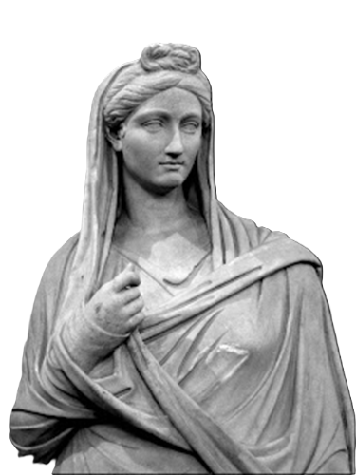
1 Corinthians chapter 11
“⁶ I mean, if a woman does not cover her head, then she may as well shave her head. But if she would feel ashamed to cut or shave her hair, then she should cover her head.
● If: Assumed to be so.

Slide 12
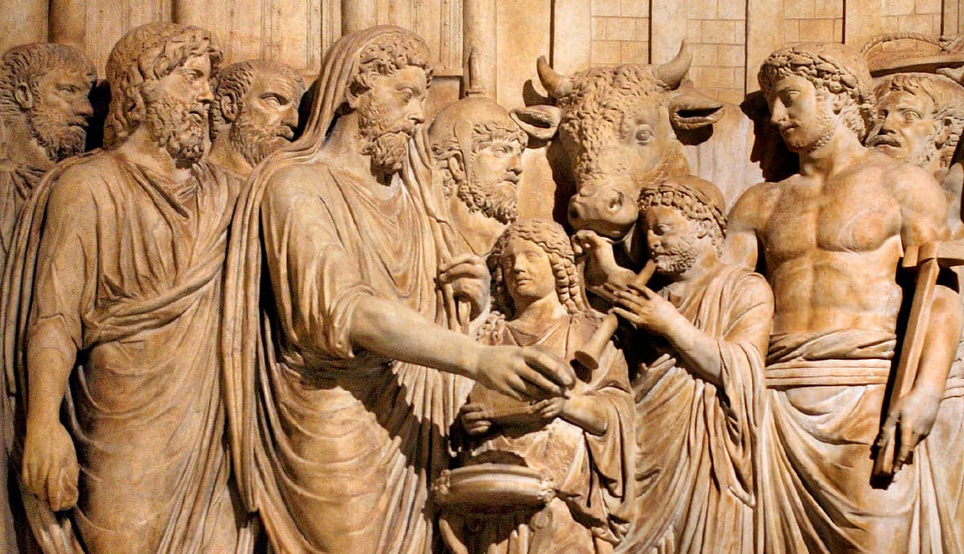
1 Corinthians chapter 11
⁷ So, a man ought not to cover his head, since he reflects God’s image and glory, and a wife reflects her husband’s glory.
● In Greco-Roman polytheism, both men and women covered their head when praying or sacrificing.
● Gentile Christian men broke with that tradition.

Slide 13
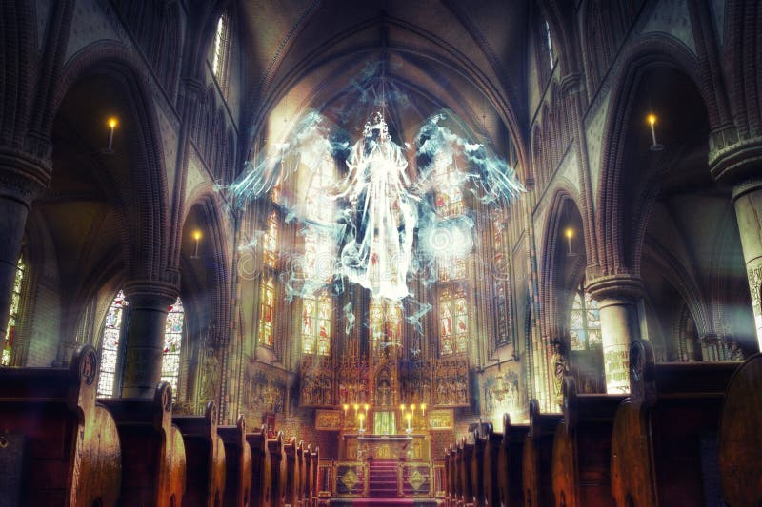
1 Corinthians chapter 11
“⁸ Remember, Adam was not made from Eve, rather Eve from a man. ⁹ And God did not create the man because of the woman but the woman because of the man. ¹⁰ This is why a wife ought to have an authority sign on her head because of the angels.

Slide 14
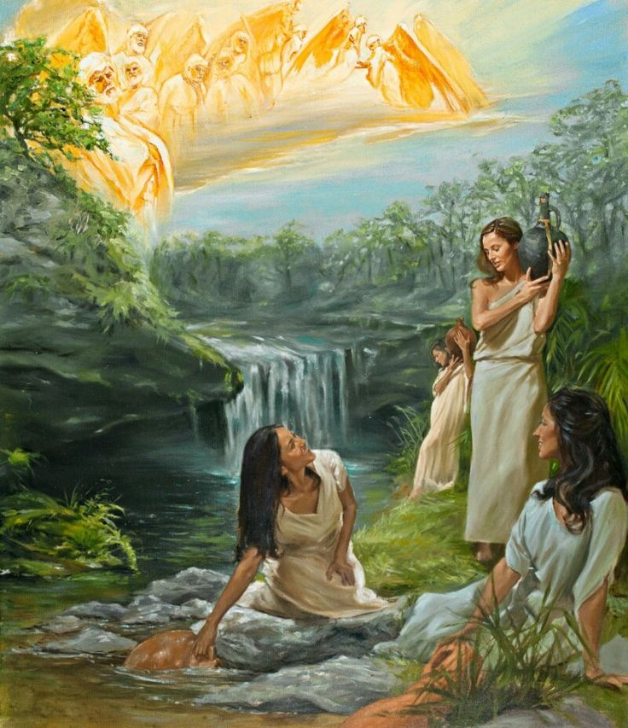
Because of the angels
Current theories
● Messengers: From other churches.
● Guardians: Angels assigned to ensure worship and moral purity in churches.
● Seraphim: Christians join with angels who are worshipping God in heaven.
● Watchers: Spirit-beings like those who sinned with human women in antiquity.

Slide 15
1 Corinthians chapter 11
¹¹ Anyway, a wife is no greater than her husband, nor a husband greater than his wife. ¹² Likewise, as God made Eve from Adam, so men are born from women, and God made everything.
● Eve: Paul again appeals to the Book of Genesis.

Slide 16
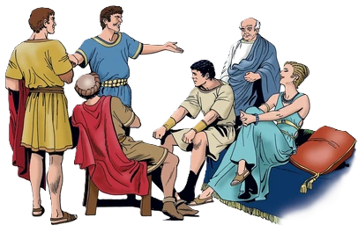
1 Corinthians chapter 11
¹³ Judge for yourselves: is it proper for a wife to pray to God with her head uncovered?
● Judge: Each church decides its own customs.

Slide 17
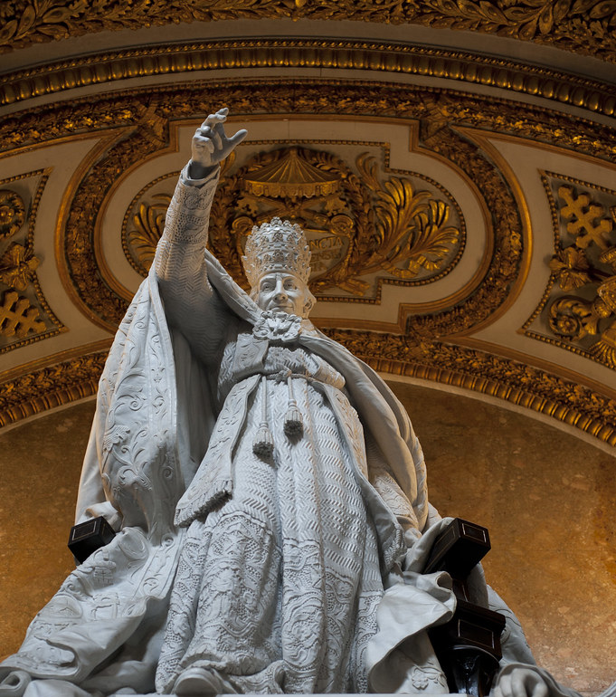
Levels of authority in churches
1. Jesus’ or apostles’ commands: We obey these. E.g., baptize believers.
2. Apostles’ practices: We may follow these if they are culturally acceptable. E.g., baptize same day they believe.
3. Church traditions: We may follow these if they do not hinder obeying level 1. E.g., immerse three times.

Slide 18
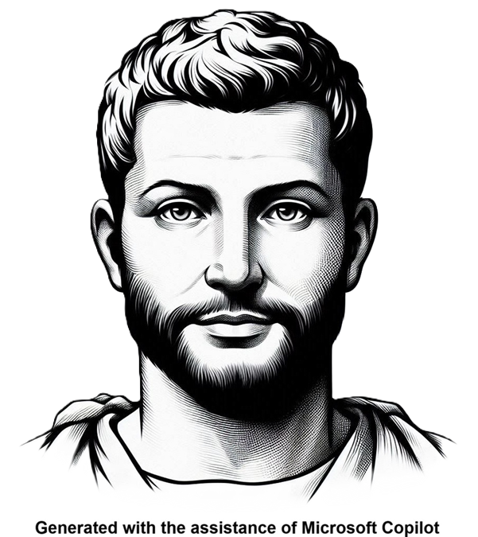
1 Corinthians chapter 11
¹⁴ And society itself teaches you, on the one hand, that people dishonor men who have long hair, …
● Society: physis, ‘nature’ = (1) how things are, (2) accepted cultural traits.
● Dishonor: Men with long hair were viewed as weak, effeminate, easily conquered.

Slide 19
1 Corinthians chapter 11
¹⁵ and, on the other hand, that people honor women who have long hair.
● Long hair: It was commonly believed that women’s long hair was part of her gender. Therefore, women were to treat their long hair with modesty.

Slide 20
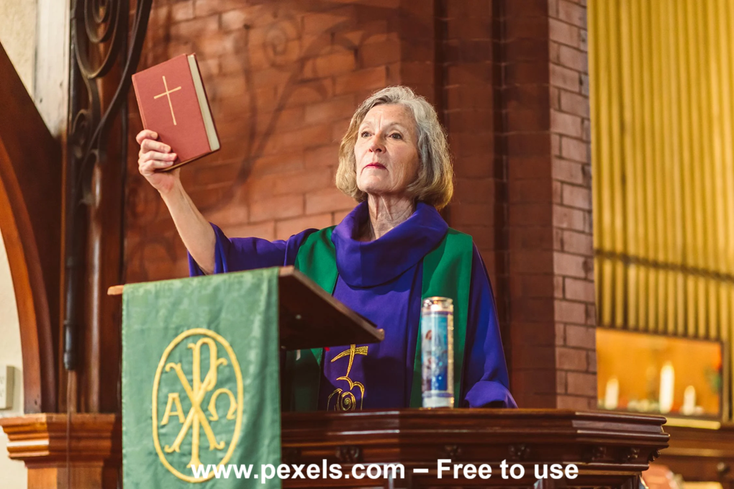
1 Corinthians chapter 11
¹⁶ Now, if anyone seems to want to oppose this, then inform him that we apostles have no other hair custom, nor do God’s other churches.
● We: Emphatic pronoun (hémeis) = we who are writing this letter to you.

Slide 21
Abusive uses of head covering
● Ecclesial: Christian women must submit to church tradition.
● Marital: Christian women must submit to fathers and husbands.
● Legalist: God commanded it, so women must do it.
● Religious: Women must submit to a religious male, to be saved by God.

Slide 22
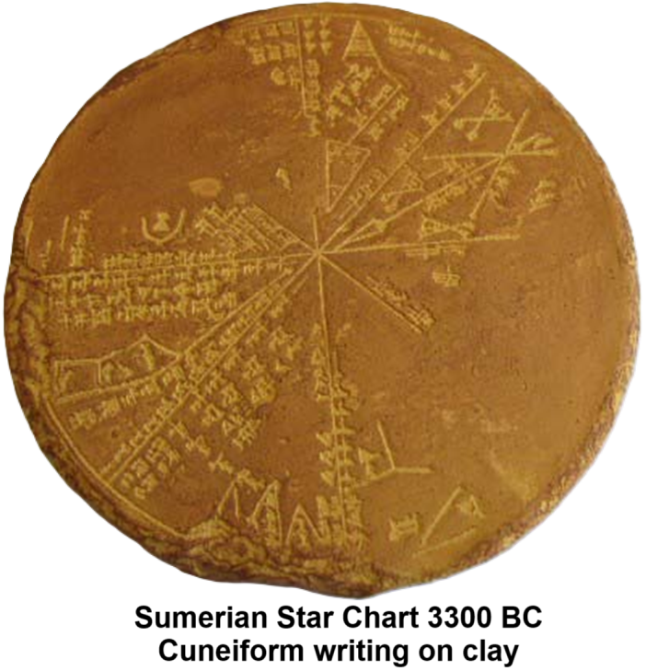
Prevalent beliefs in Mesopotamia
● Polytheism: Multiple gods having…
● Divine control: Weather, fertility, health.
● Afterlife: Gloom in the underworld.
● Omens & divination: Certain objects and rites reveal the future.
● Astrology: Celestial movements influence human and natural events.
● Divine retribution: Gods punish sin.

Slide 23
Prevalent practices in Mesopotamia
● Honor-shame: Main motivator.
● Communal: Group decision taking.
● Patriarchal: Older men preside.
● Ritual purity: Restoring access to gods.
● Divine kingship: Honor kings as gods.
● Idolatry: Gods inhabit objects, places.
● Sacrifice: Destroying things or lives to honor or to placate gods.

Slide 24
Mesopotamian worldview in the Bible
● Creation: Six days. Adam and Eve.
● Flood: Destroy watchers from heaven.
● Babel: Causing languages to multiply.
● Miracles: Healing, water walking.
● Cosmology: Flat earth and sky dome.
● Spirits: Gods, angels, ghosts, demons.
● Prophecy: Foretelling the future.
● Incarnation: Gods becoming human.

Slide 25
Interpretive challenge
● Language: Morphology, phonology, phonemics, semantics, syntax, etc.
● Literature: Style, discourse, logic, purpose, cultural conventions.
● Translation: Find equivalent meanings.
● Worldview: Belief about unseen reality.
● Application: Extract truth from ancient literature for modern worldviews.

Slide 26
Assignment
● Read Reversing Hermon, chapter 9: “The Watchers’ Sin and Baptism,” pages 137-146.
● Visit ReversingHermon.site

