Slide 1
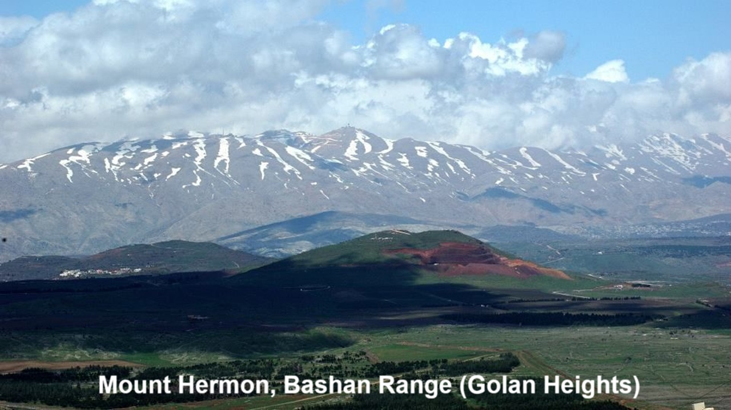
REVEЯSING HERMON
9: The Watchers’ Sin & Christian Baptism
21 November & 01 December 2024

Slide 2
Learning objectives
By the end of this session, we shall be able to explain:
● Early Christian baptismal pledges.
● Who were the ‘spirits in prison’.
● How baptism saves.

Slide 3
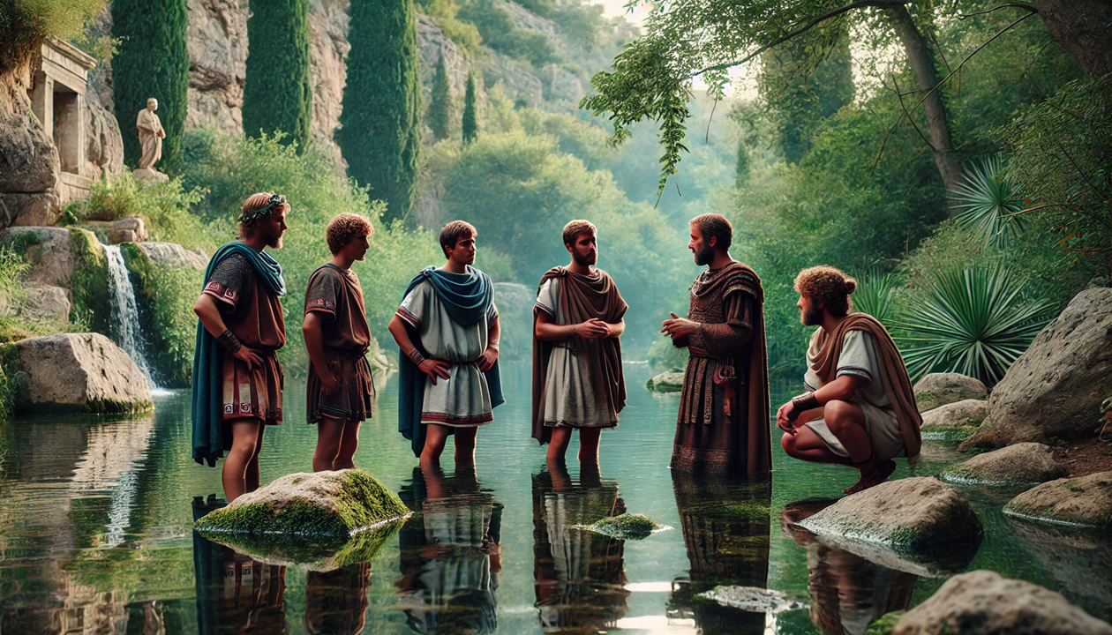
Hippolytus, early 3rd century
“When the person being baptized goes down into the water, the one baptizing shall put his hands on him, saying:
Do you renounce Satan, and all his works? And the person being baptized shall say: I do renounce them.”

Slide 4
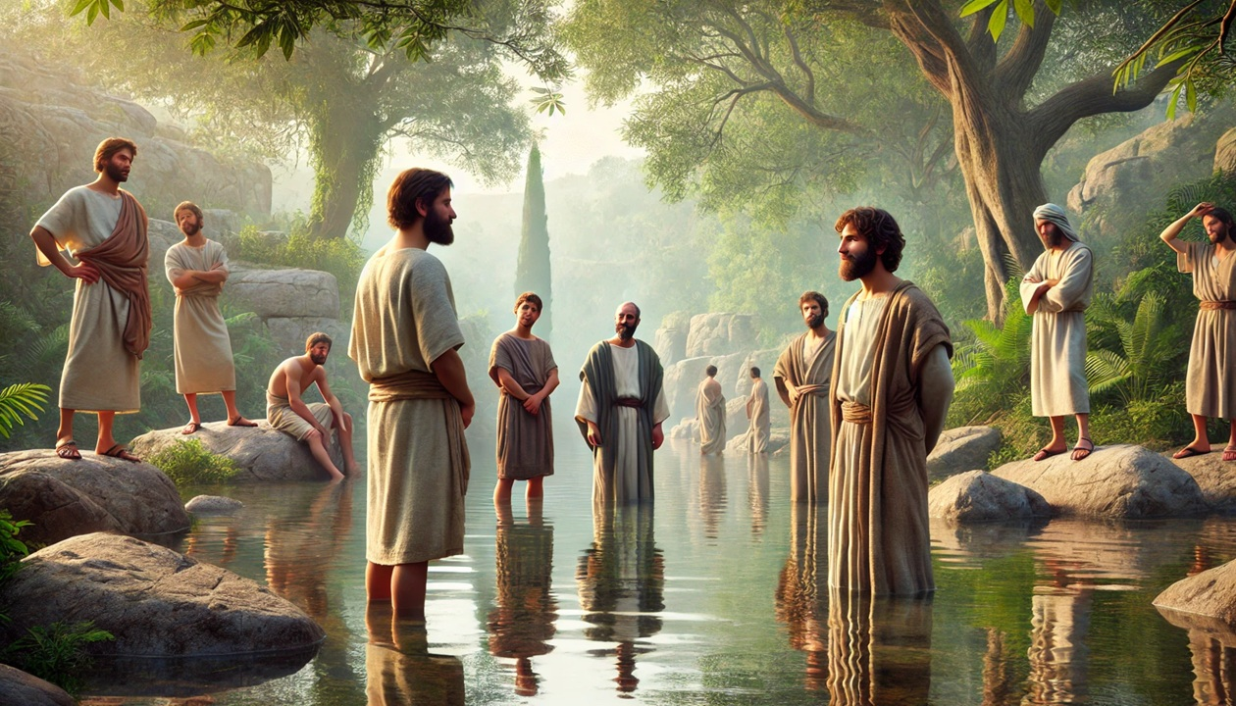
Tertullian, late 2nd century
“When we are going to enter the water, … in the presence of the congregation and under the hand of the president, we solemnly profess that we disown the devil, and his pomp, and his angels. Hereupon we are thrice immersed.” in De Corona

Slide 5
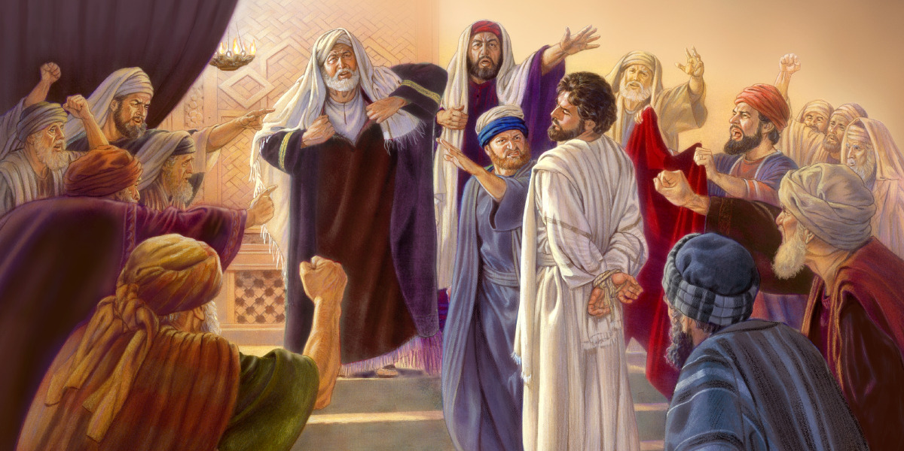
1 Peter 3:14-22, mid-1st century
¹⁴ If you ever have to suffer because you are righteous, then God will reward you. So, ‘Do not be frightened or distressed by their threats. ¹⁵ Instead, honor’ Christ ‘as Lord’ in your heart… [Isa. 8:12-13]
● If: With optative verb = unlikely future.
Reward: Traditionally, ‘are blessed’.
● Lord: in Isa. 8:12-13 Lord = Yahweh.

Slide 6
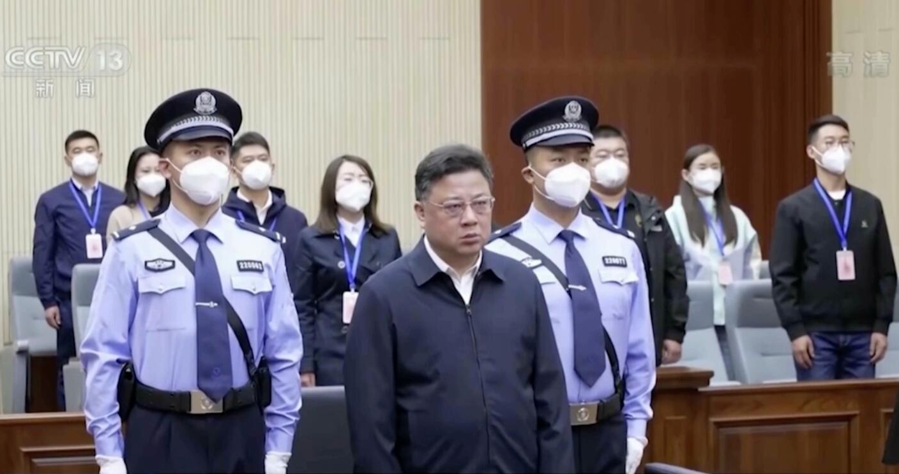
1 Peter 3:14-22, mid-1st century
by always being ready to give a reason to anyone asking for your testimony about your hope.
Reasons:
● Christ died to forgive me everything.
● Christ rose to give me his new life.
● His Holy Spirit gives me joy and hope.
● What else?

Slide 7
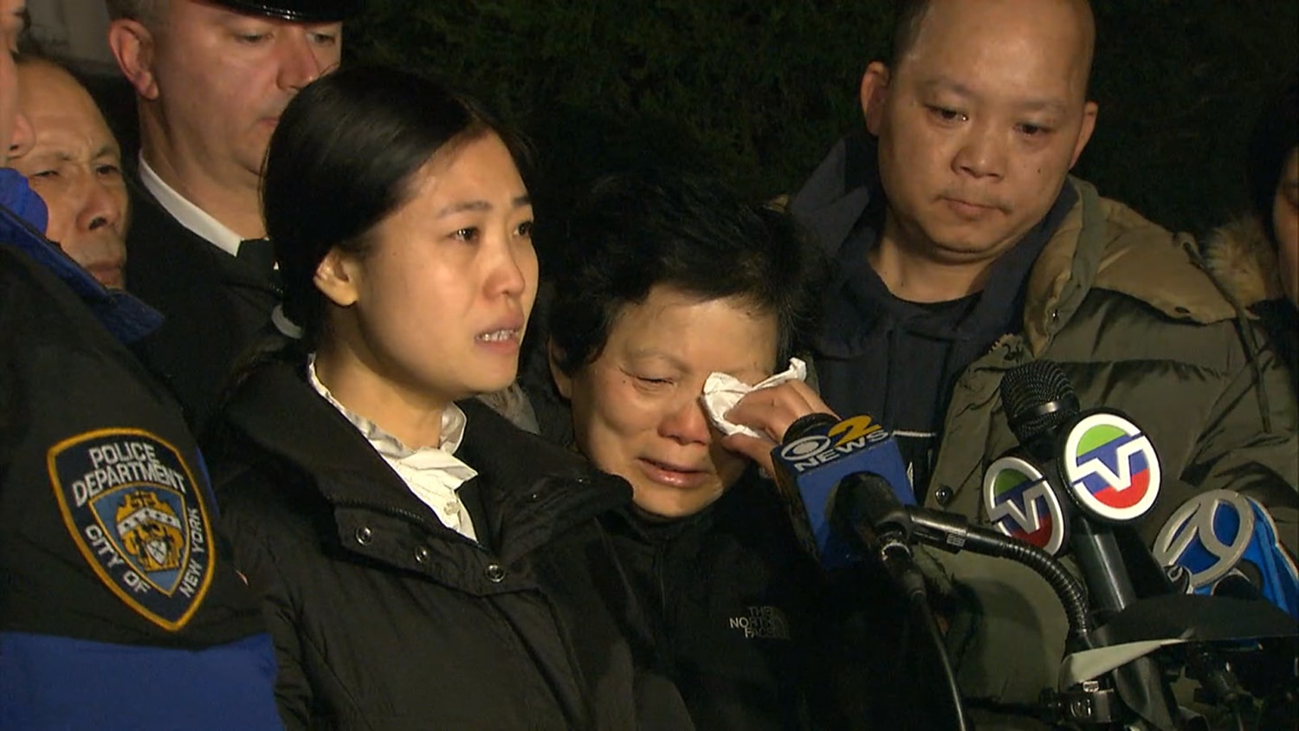
1 Peter 3:14-22, mid-1st century
¹⁶ And do so calmly and respectfully, because you have a good conscience. As a result, those who abuse you will be ashamed of having slandered your good Christian behavior.
● Calmly: Only God can convince.
● Conscience: Confident assurance.
● Abuse: Insults, beatings, fines…

Slide 8
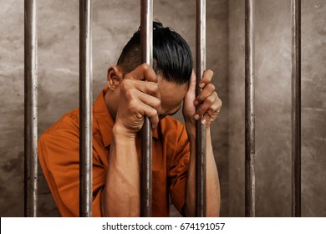
1 Peter 3:14-22, mid-1st century
¹⁷ Remember, it is better to suffer for doing good — if God ever allows it — than for doing bad.
● Suffer: Always seems meaningless.
● Better: There is a divine purpose.
● Good: By biblical standards.
● Bad: By biblical and social standards.

Slide 9
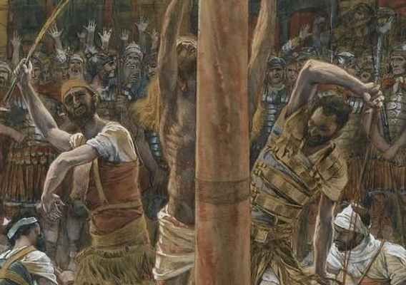
1 Peter 3:14-22, mid-1st century
¹⁸ Christ once suffered because of our sins, the Righteous One on behalf of us non-righteous ones, in order to bring us to God. Although his body died, his spirit remained alive.
● Suffer: With divine purpose.
● Died: Gk. ‘was put to death in flesh’.
● Alive: Gk. ‘was made alive in spirit’.

Slide 10
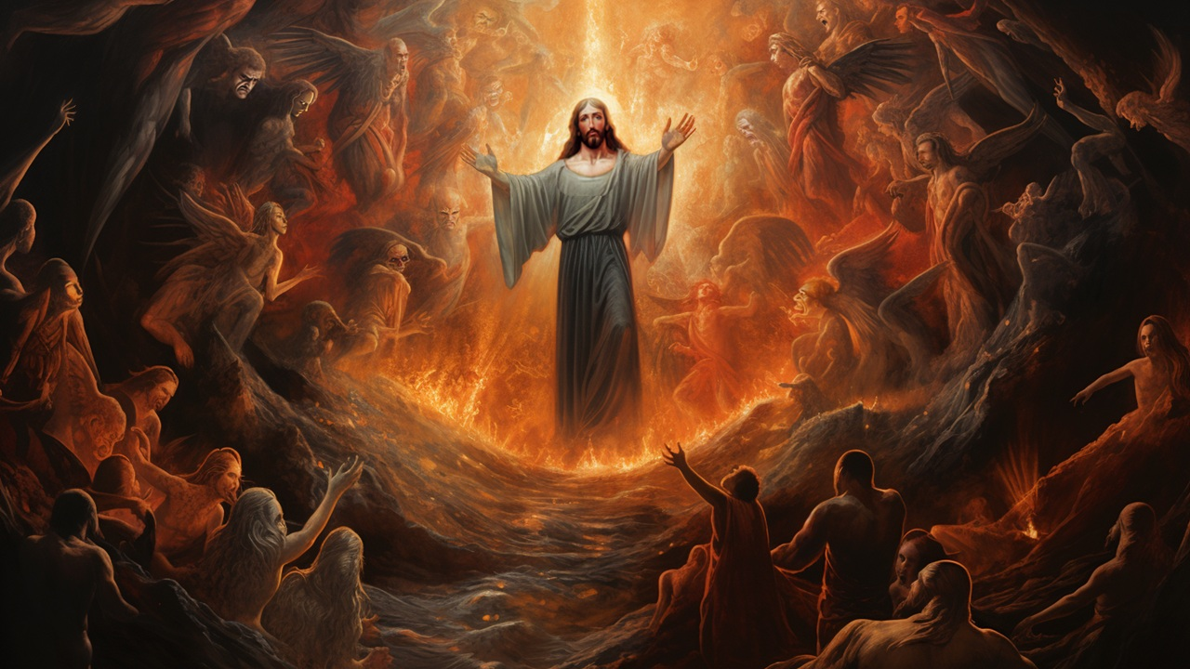
1 Peter 3:14-22, mid-1st century
¹⁹ Thus, he went and made an announce-ment to the Watcher spirits who are in prison. ²⁰ The spirits who disobeyed …
● Thus: Gk. = ‘in which’
● Spirits: pneuma. Usually non-human.
● Prison: Never for departed believers.
● Disobeyed: Intermixed with humans.

Slide 11
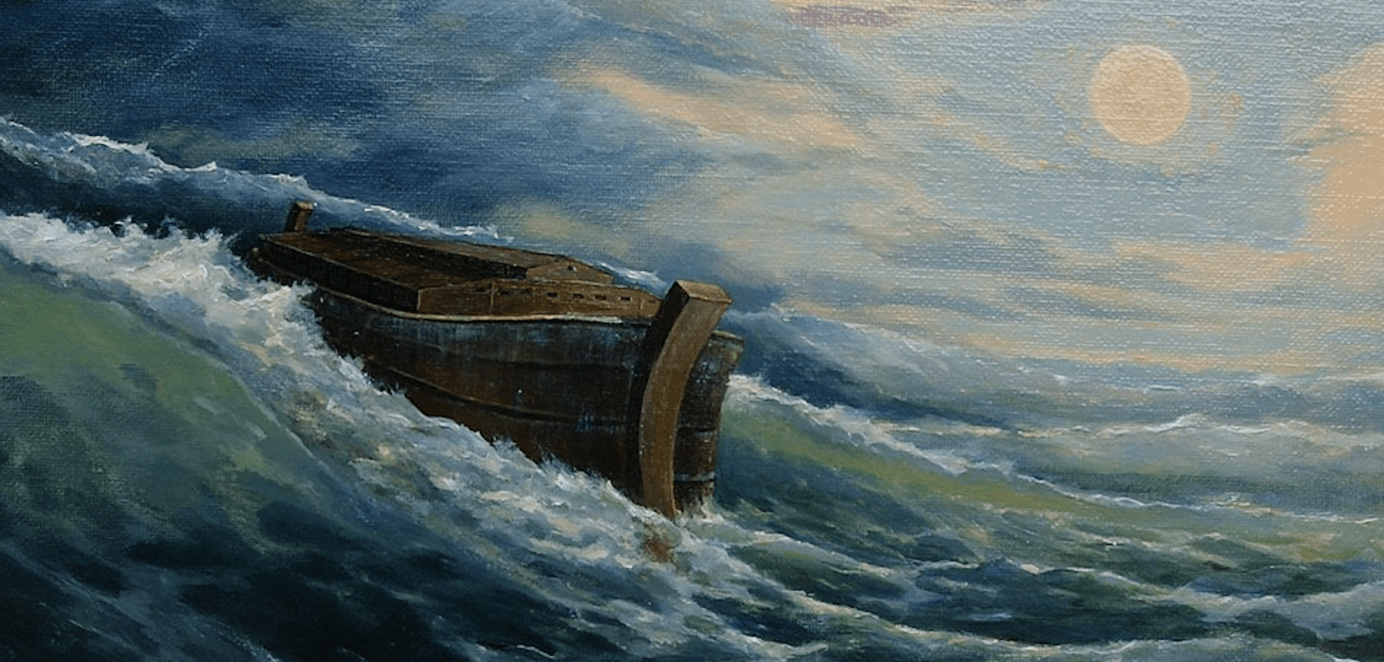
1 Peter 3:14-22, mid-1st century
back in the days of Noah. God patiently waited while Noah was building the boat in which God saved only eight persons through the flood waters.
● Boat : Box, chest, barge, ‘ark’.
● Save: The water lifted the boat.
● Person: psyché. Human soul.
● Through: (a) Means, or (b) medium.

Slide 12
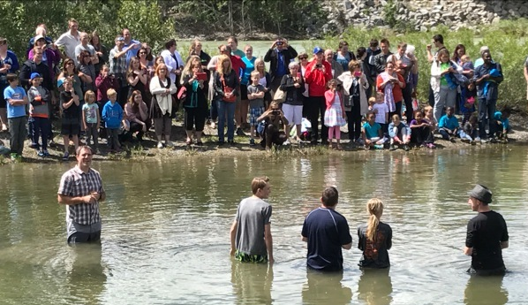
1 Peter 3:14-22, mid-1st century
²¹ By analogy, baptism in water now saves you, not by washing away fleshly uncleanness, but by your conscientious pledge of loyalty to God.
● Analogy: antítypos.
● Pledge: (a) promise, or (b) by your request to God (for a good/clear conscience).

Slide 13
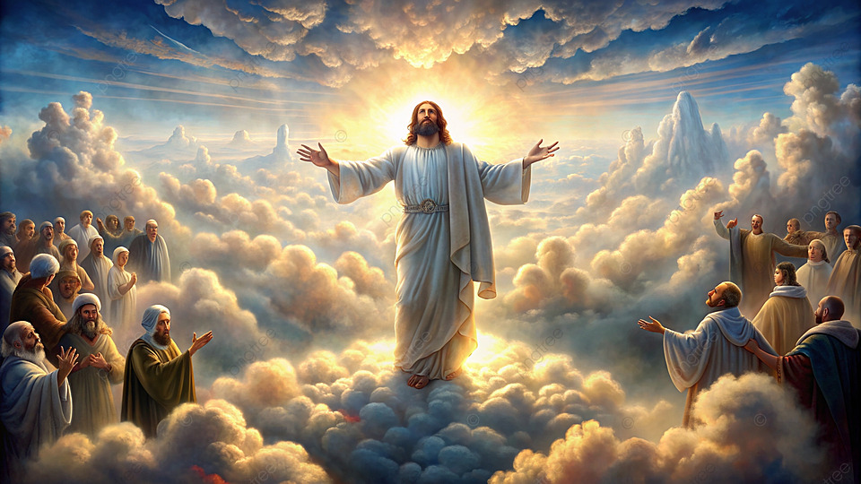
1 Peter 3:14-22, mid-1st century
Baptism saves you through Messiah Jesus’ resurrection from death. ²² After he subjected to himself Watcher angels, authorities and powers, he went into heaven where he sits at God’s right side.
● Resurrection: from death and hell.
● Subject: victory over enemy spirits.
● Right side: authority over everything.

Slide 14
Spirits in prison
Watchers? Nephilim? Humans? All?
Spirit (pneuma) can be any of these.
Person (psyché 3:20) always human.
Prison (phylaké) never used of departed humans in NT or in 1 Enoch.
Satan in prison 1000 years. Rev 20⁷
Watchers in prison forever. 1 En 14:5
Jewish readers understood Gen 6:2.

Slide 15
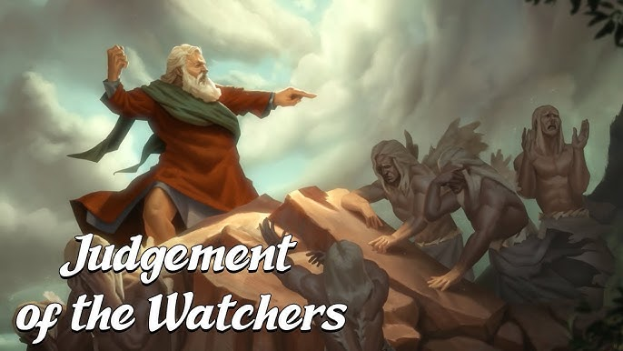
The Watchers in prison
“You will not obtain your petition for all the days of eternity; but judgment has been consummated in the decree against you, that from now on you will not ascend into heaven for all the ages; and it has been decreed to bind you in bonds in the earth for all the days of eternity.” 1 En 14.4-5

Slide 16
Type (event) & antitype (analogy)
God was patient
Eight souls
Ark being prepared
Disobedient spirits
In prison
Boat in water
Lifted by water
Were saved
Messiah suffered
You (many)
Proclaim message
Angels subjected
Jesus went in spirit
Baptism
Jesus’ resurrection
Saves you

Slide 17
Watcher spirit terminology
● Sons of God, of heaven. Gen 6:2; Job 1:6; Dt 32:8; Ps 82:1, 6; 1 En 14:3
● Angels. 1 En 6:2; Jud 6; 1 Pt 3:22; 2 Pt 2:4; Mt 25:41; Rev 12:9
● Watchers. 1 En 12:2, 4; 14:3; Dan 4:17
● Spirits. 1 En 15:4, 6, 8; 1 Pet 3:19
● Rulers, authorities, powers, forces. Rom 8:36; Ep 3:10, 6:12; Pt 3:22

Slide 18
14 Biblical ‘types’ (analogies)
1 Adam: Christ the ‘2nd Adam’.
2 God: Sabbath rest.
3 Ark: Water baptism.
4 Hagar & Ishmael: Legal bondage.
5 Sara & Isaac: Promise and freedom.
6 Exodus: Jesus’ return from Egypt.
7 Serpent on a pole: Son lifted up

Slide 19
14 Biblical ‘types’ (analogies)
8 Passover: The Lamb of God.
9 Sacrifices: Crucifixion.
10 Immanuel: Jesus’ virgin conception.
11 Wilderness rebels: Warning to us.
12 Church elders: The Chief Shepherd.
13 Law: Heavenly realities.
14 Yahweh Victor: Christ victor.

Slide 20
“Baptism now saves you”
²¹ By analogy, baptism in water now saves you, not by washing away fleshly uncleanness, but by your conscientious pledge of loyalty to God, through Messiah Jesus’ resurrection from death.
● Save: Not the rite but resurrection.
● Pledge: Allegiance to God in Christ.
● Loyalty: Renounce Satan & his angels.

Slide 21
Model baptismal pledge
Form groups of two or three.
Take four minutes to:
List out fundamental points of saving faith in Jesus Christ.
Formulate a baptismal pledge for candidates.

Slide 22
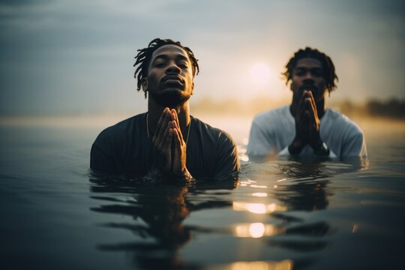
Model baptismal pledge
Do you believe that:
● Jesus is the Christ, the Son of God?
● Jesus died to forgive you your sins?
● Jesus rose back to life the third day?
● God gives to you everlasting life?
Do you:
● Pledge your loyalty to Jesus Christ?
● Renounce the devil and his angels?

Slide 23
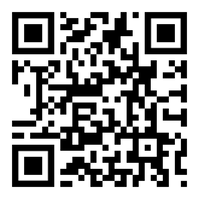
Assignment
● Read Reversing Hermon, chapter 10: “Watchers Nephilim and Antichrist,” 145-162.
● Visit ReversingHermon.site

