Slide 1
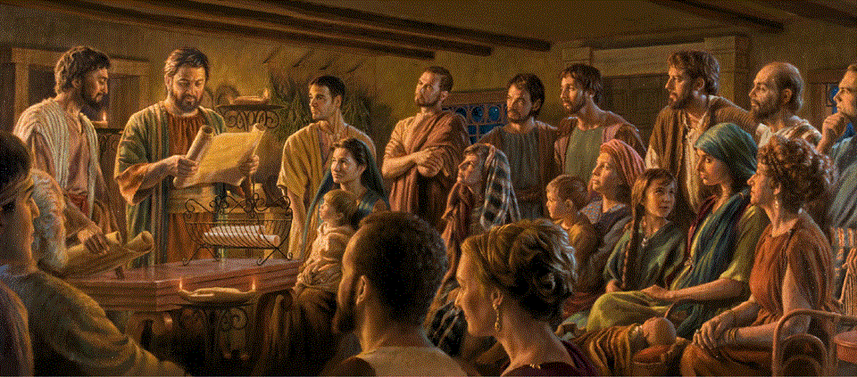
Epistle to the Romans 1:1-7
A Short Course for Men

Slide 2
Romans 1:1-7 ESV
¹ Paul, a servant of Christ Jesus, called to be an apostle, set apart for the gospel of God,
² which he promised beforehand through his prophets in the holy Scriptures,
³ concerning his Son, who was descended from David according to the flesh …

Slide 3
⁴ and was declared to be the Son of God in power according to the Spirit of holiness by his resurrection from the dead, Jesus Christ our Lord,
⁵ through whom we have received grace and apostleship to bring about the obedience of faith for the sake of his name among all the nations, …

Slide 4
⁶ including you who are called to belong to Jesus Christ,
⁷ To all those in Rome who are loved by God and called to be saints:
Grace to you and peace from God our Father and the Lord Jesus Christ.
● Why one long sentence?
● Why such dense language?

Slide 5
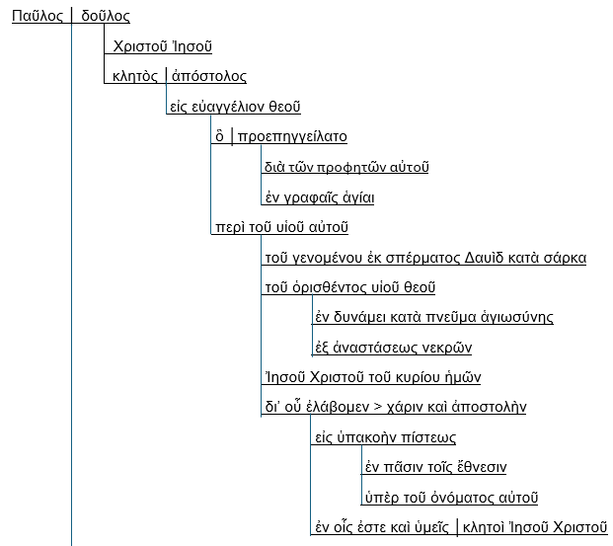

Slide 6
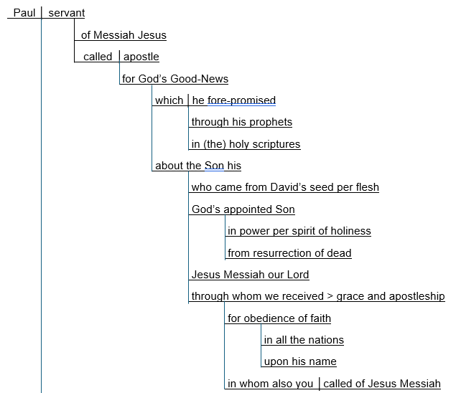

Slide 7
Romans 1:1-7 CEV
¹ From Paul, a servant of Christ Jesus.
God chose me to be an apostle, and he appointed me to preach the good news
² that he promised long ago
by what his prophets said in the holy Scriptures.
³⁻⁴ This good news is about his Son, our Lord Jesus Christ! …

Slide 8
As a human, he was from the family
of David. But the Holy Spirit proved that Jesus is the powerful Son of God, because he was raised from death.
⁵ Jesus was kind to me and chose me to be an apostle, so that people of all nations would obey and have faith. ⁶ You are some of those people chosen by Jesus Christ. …

Slide 9
⁷ This letter is to all of you in Rome. God loves you and has chosen you to be his very own people.
I pray that God our Father and our Lord Jesus Christ will be kind to you and will bless you with peace!
● Which version was clearer?
● Which version was more enjoyable?

Slide 10
Group fun
1 Appoint a secretary.
2 Read the displayed query.
3 Each one give one reply.
4 Repeat step 3 until exhausted.
5 Report one reply to the whole room.
6 Let other groups report.
7 Repeat steps 5 & 6 until exhausted.
● No one guy or group dominates.

Slide 11
What do verses 1-7 tell us about …
GOD
● chooses, appoints, sends apostles.
● promised gospel long ago.
● has a Son.
● raised him from death.
● loves and chooses people.
● is the Father of Jesus.
● is kind and blesses people with peace.

Slide 12
What do verses 1-7 tell us about …
JESUS
● is the Messiah (Christ).
● is God’s Son, our Lord.
● was descended from David.
● was raised from death.
● had a holy (human) spirit (?).
● chooses people.
● is kind and blesses people with peace.

Slide 13
What do verses 1-7 tell us about …
THE HOLY SPIRIT
● was Jesus’ spirit of holiness (?).
= ר֣וּחַ קָדְשֹׁ֑ו, rûªḥ qad^{e}šô (Isa. 63:10, 11)
= Spirit (of) his-holiness
= presence of Yahweh

Slide 14
What do verses 1-7 tell us about …
THE GOSPEL
● was promised long ago.
● by God’s prophets.
● in the holy Scriptures.
● is about his Son.
● was (preached by) Paul.
● (See 1:16-17).

Slide 15
What do verses 1-7 tell us about …
PAUL’S PERSON
● servant of Messiah Jesus.
● called to be an apostle.
● set apart for the gospel (good news).
● received grace and apostleship.*
● (prays for) grace and peace.
* = grace to do apostolic work.

Slide 16
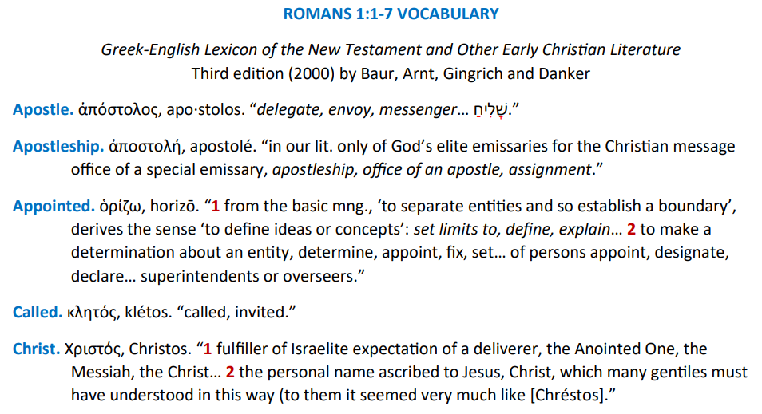

Slide 17
What do verses 1-7 tell us about …
PAUL’S MISSION
● to serve Messiah Jesus.
● by apostleship.
● to bring about the obedience of faith.*
● for the sake of Jesus’ name.
● among all the nations.
* = ‘obedient faith’ or ‘faithful obedience’ or ‘faith (which leads to) obedience’.

Slide 18
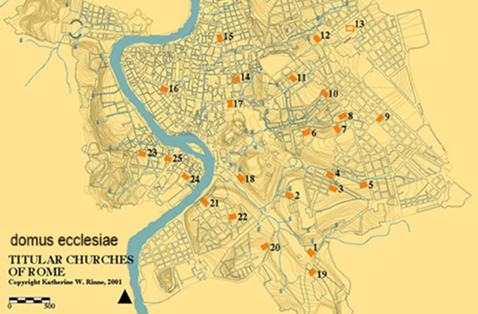
What do verses 1-7 tell us about …
THE ROMANS CHRISTIANS
● obedience of faith.
● among all the nations.
● called by Jesus Christ
● loved by God.
● called to be saints.
● receive grace and peace from God.

Slide 19
What can we infer from 1:1-7?
● One may know what God has called him to do.
● The gospel was revealed in the Tanakh.
● It is about God’s Son, the Messiah.
● This epistle will help us to discern our mission.
● It will illustrate the importance of sending apostolic missionaries.

Slide 20
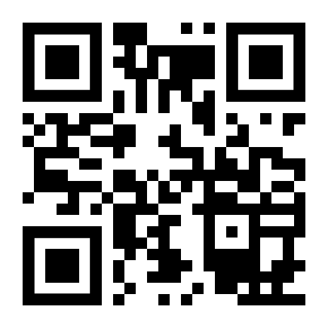
http://romans.forum

