Slide 1
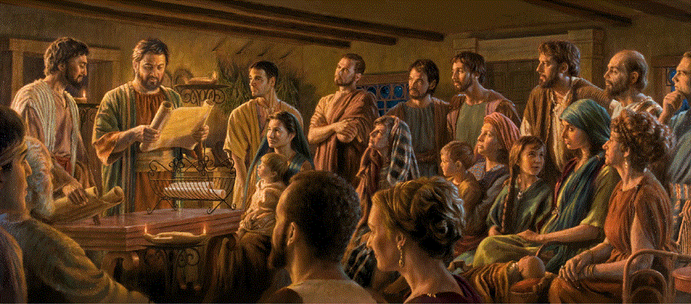
Epistle to the Romans, 1:18-32
A Short Course for Men

Slide 2
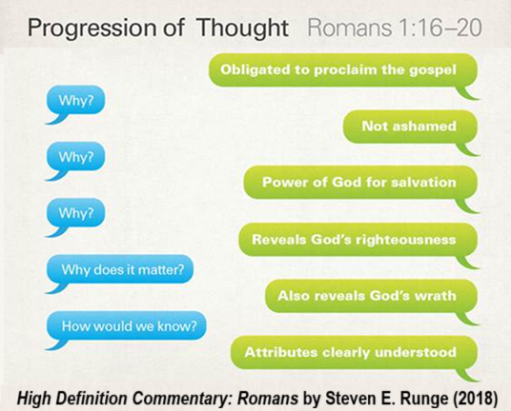
Session Outline
¹⁸ God’s wrath is being revealed. (Why?)
²⁰ The divine nature is understood … so, they are without excuse.
²⁴ So, God gave them over. (How?)
● To impurity: Exchanged God (22)
● To passion: Exchanged truth (25)
● To evil: Exchanged nature (26)
³² So, they deserve to die.

Slide 3
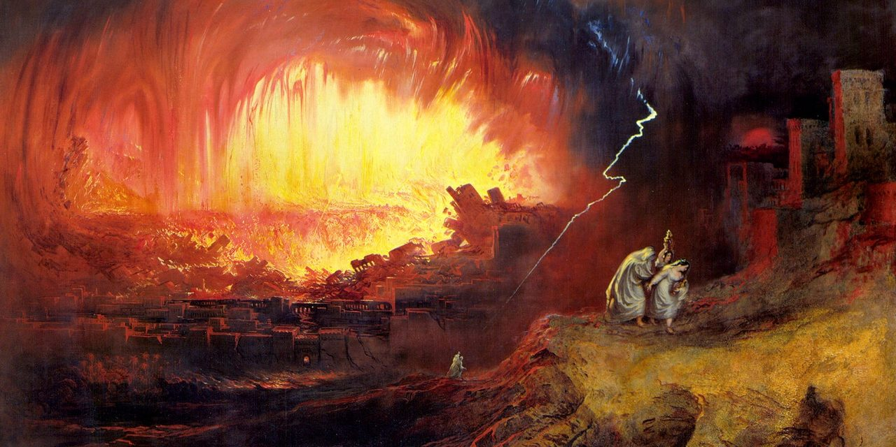
Romans 1:18-23
¹⁸ For the wrath of God is revealed from heaven against all ungodliness and injustice of those who by their injustice suppress the truth.
¹⁹ For what can be known about God is plain to them, because God has made it plain to them.
● Revealed: Present tense verb.
● “For …”: Gk gar, explains or expands.

Slide 4
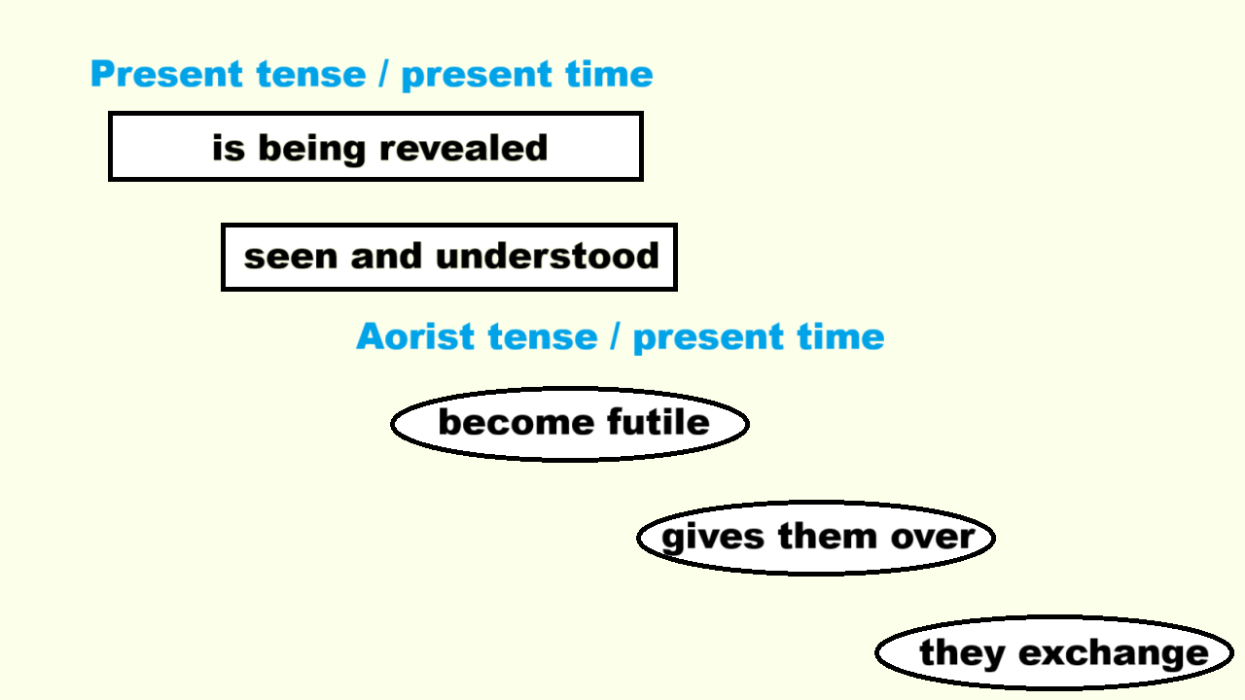
Grammatical Note
● Greek present tense normally implies continuous action or state of being.
● Greek aorist tense is normally timeless, requiring time references.
● Aorist verbs following a present tense verb, retain that verb’s time.
● “Is being revealed” = present tense.
● So, following aorists are present time.

Slide 6

²⁰ Ever since the creation of the world God’s eternal power and divine nature, invisible though they are, have been seen and understood through the things God has made.
● Eternal: Precedes creation.
● Power: Creative will and design.
● Deity: Non-created, living, intelligent.
● Invisible: Must be inferred or deduced.

Slide 7
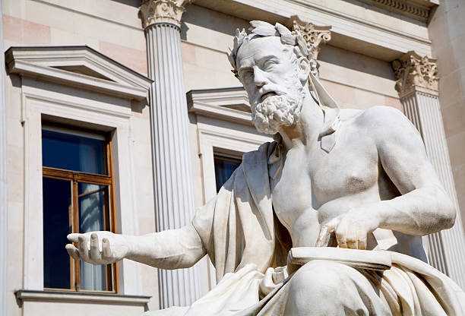
Ontological Argument
● Xenophanes (c. 570–475 BCE).
● Criticized anthropomorphic gods.
● Proposed a singular, eternal, immobile deity who perceives and governs all.
● Divinity must be unlike humans.
● A move toward monotheism, grounded in the nature of being itself.

Slide 8
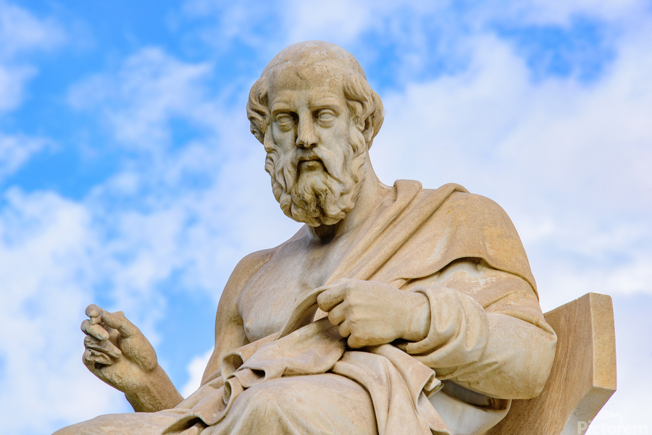
Teleological Argument
● Plato (c. 428–348 BCE).
● A Demiurge ordered the cosmos with intelligence and purpose.
● Harmony and order of the universe implied a rational designer.
● The Demiurge shaped matter to mirror eternal ‘forms’ or ideals.
● (Early instance of ‘intelligent design’.)

Slide 9
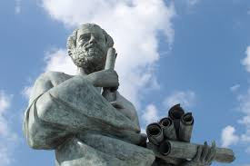
Cosmological Argument
● Aristotle (384–322 BCE).
● Posited the Unmoved, Prime Mover.
● A necessary first cause.
● Pure actuality, eternal, and immaterial.
● Though not a personal creator…
● The metaphysical ground of all motion and change.

Slide 10
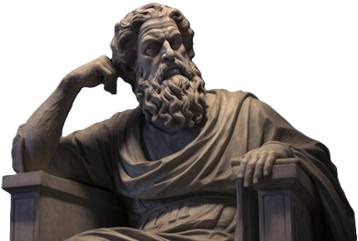
Moral Argument
● Zeno of Citium (c. 334–262 BCE).
● The universe as permeated by Logos,
a rational, divine principle.
● The moral order and rationality of nature points to a divine intelligence.
● The Logos is both immanent and transcendent, guiding fate and virtue.
● Philo of Alexandria (c. 20 BCE – c. 50 CE).

Slide 11
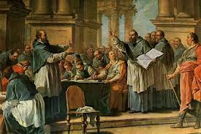
Romans 1:18-23
So they are without excuse, ²¹ for though they knew God, they did not honor him as God or give thanks to him,
but they became futile in their thinking, and their senseless hearts were darkened.
● Honor: with praise, forsaking all gods.
● Thinking: outer debating, dialoging.
● Heart: inner motives and emotions.

Slide 12
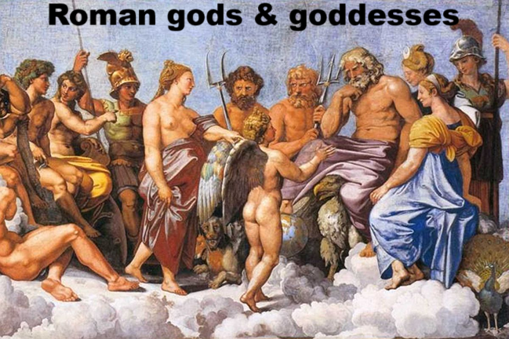

²² Claiming to be wise, they became fools, ²³ and they exchanged the glory of the immortal God for images
resembling a mortal human or birds or four-footed animals or reptiles.
● Claim: Asserting the imaginable.
● Exchange: Replacement theology.
● Immortal: Eternal, persistent, active.
● Mortal: Pagan gods die or die out.

Slide 13
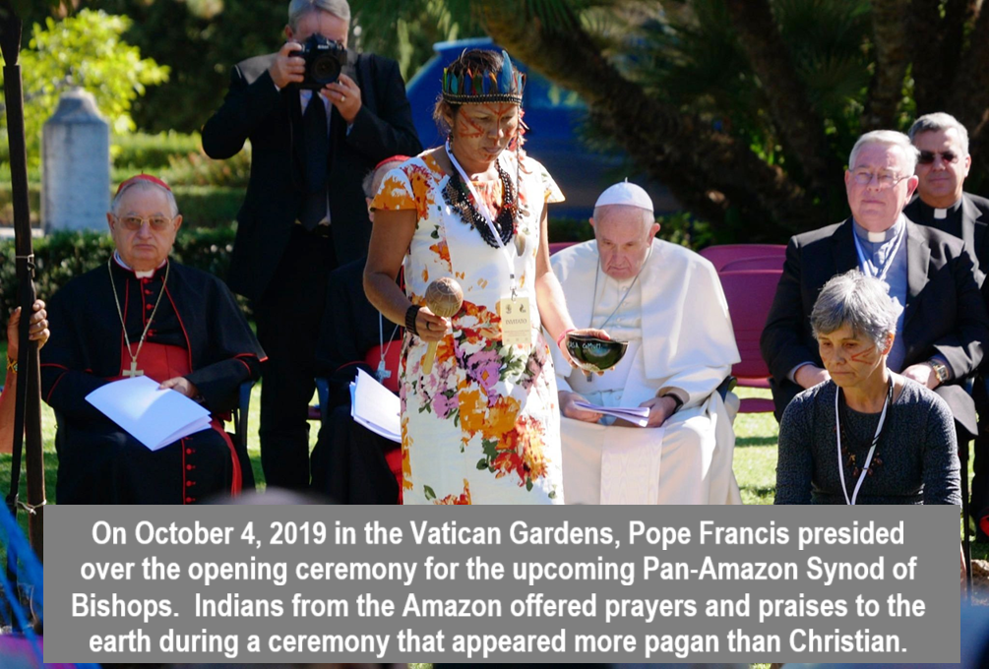
Romans 1:24-25
²⁴ Therefore God gave them over in the desires of their hearts to impurity, to the dishonoring of their bodies among themselves.
²⁵ They exchanged the truth about God for a lie and worshiped and served the creature rather than the Creator, who is blessed forever! Amen.
● Creator: Essential quality of Deity.

Slide 14

Romans 1:26-27
²⁶ For this reason God gave them over to dishonorable passions. Their females exchanged natural intercourse for unnatural,
²⁷ and in the same way also the males, giving up natural intercourse with females, were consumed with their passionate desires for one another.
Males committed shameless acts with males and received in their own persons the due penalty for their error.

Slide 15
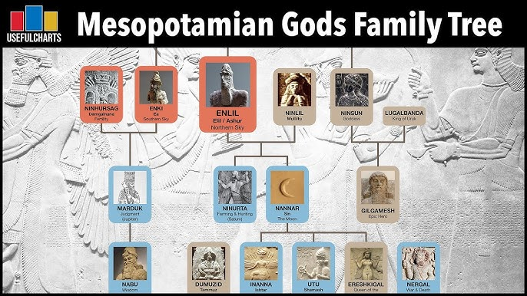
Greco-Roman Primordial Deities
Chaos: Formless First Principle.
Night: Birthed Day.
Gaia/Tellus: Earth who birthed Sky & Sea.
Tartarus: Abyss, metaphysical boundary.
Eros: Creative cohesion impulse.
Phanes: Radiance, manifestation, unity.
The One: Source of all reality.
Logos: Divine reason, organization.

Slide 16

Romans 1:28-32
²⁸ And since they did not see fit to acknowledge God, God gave them over to an unfit mind and to do things that should not be done.
²⁹ They were filled with every kind of injustice, evil, covetousness, malice.
● See fit: to test in order to approve.
● Unfit: tested and disapproved.

Slide 17

Full of envy, murder, strife, deceit, craftiness, they are gossips, ³⁰ slanderers, God-haters, insolent, haughty, boastful,
inventors of evil, rebellious toward parents, ³¹ foolish, faithless, heartless, ruthless.
³² They know God’s decree, that those who practice such things deserve to die, yet they not only do them but even applaud others who practice them.

Slide 18
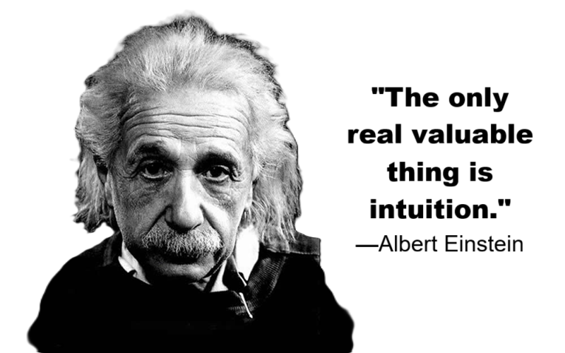
Intuitional Argument
● All cultures have a high-God concept.
● Most religions offer redemptive rites.
● All human beings have a conscience.
● All societies enforce moral standards.
● Many folk seek spiritual guidance.
● Many folk report dreams or visions.
● Many folk believe without persuasion.
● Inference: The Creator reveals Itself.

Slide 19

Christian Argument
● Jesus’ miracles and resurrection.
● Fulfilled biblical predictions.
● Baptism confers the Holy Spirit.
● Believers have power over evil spirits.
● God manifests the fruit of the Spirit.
● God manifests spiritual gifts.
● God grants answers to prayer.
● Inference: Jesus reveals God.

Slide 20

Conclusions
● Everyone has an awareness of God, even if they deny his existence.
● God’s attributes can be inferred from the intricate design seen in creation.
● Societies which deny God become morally degraded.
● Everyone is aware of their own failures, those of others, and they fear death.

Slide 21

http://romans.forum

