Slide 1
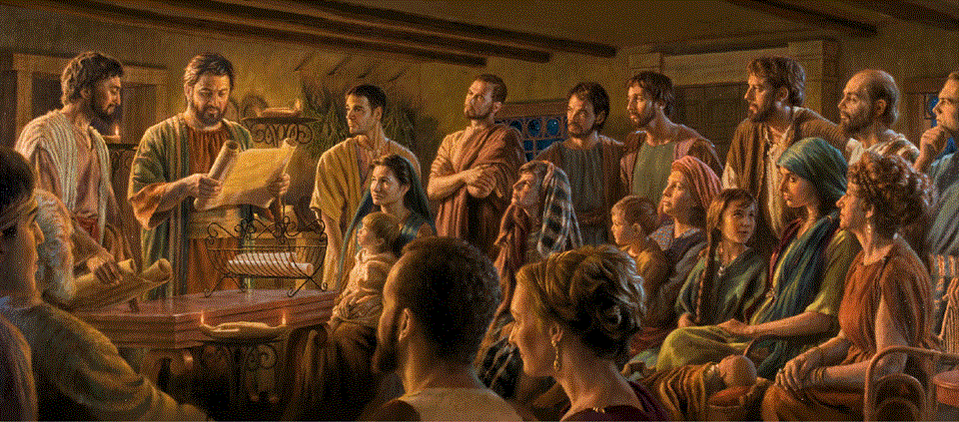
Epistle to the Romans, 1:8-17
A Short Course for Men

Slide 2
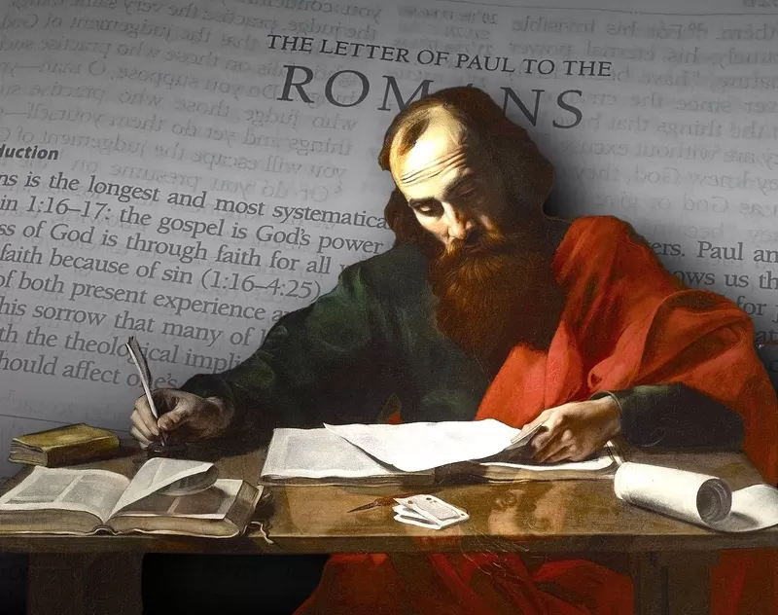
Romans 1:8-15 (NRSVue)
⁸ First, I thank my God through Jesus Christ for all of you, because your faith is proclaimed throughout the world.
⁹ For God, whom I serve with my spirit by announcing the gospel of his Son,
is my witness that without ceasing
I remember you always in my prayers, …

Slide 3
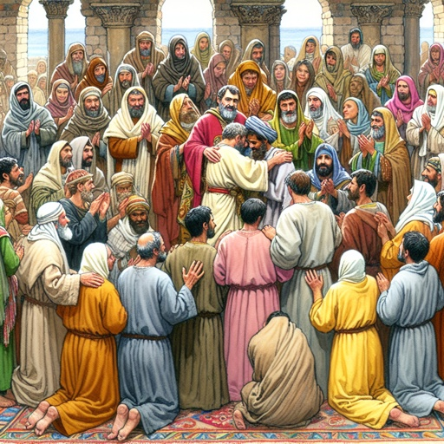
¹⁰ asking that by God’s will I may somehow at last succeed in coming
to you.
¹¹ For I long to see you so that I may share with you some spiritual gift so that you may be strengthened—
¹² or rather so that we may be mutually encouraged by each other’s faith, both yours and mine. ¹³ I do not want you to be unaware, brothers and sisters, …

Slide 4
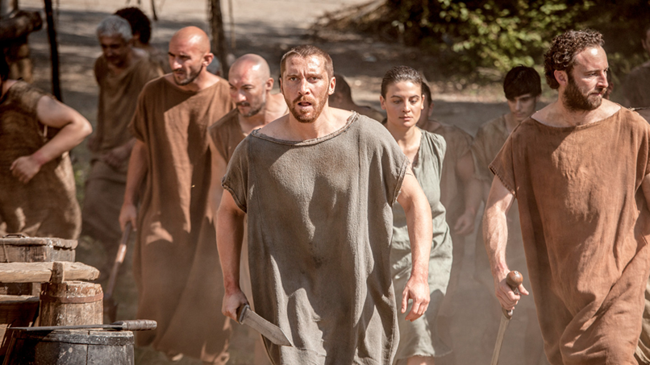
that I have often intended to come to you (but thus far have been prevented),
in order that I may reap some harvest among you, as I have among the rest
of the gentiles.
¹⁴ I am obligated both
to Greeks and to barbarians, both to the wise and to the foolish, hence my eagerness to proclaim the gospel to you also who are in Rome.

Slide 5
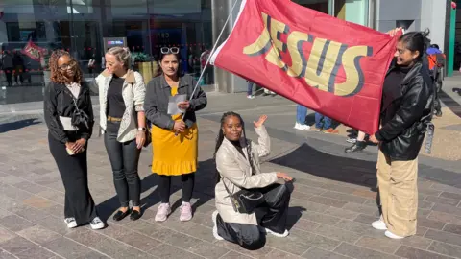
Modes of evangelism
● Apologetic: present evidence (J McDowell)
● Charity: do good in Jesus’ name (Catholics)
● Literature: novels or explanations (CS Lewis)
● Personal: share with others (Navigators)
● Power: Healing and deliverance (Pentecostals)
● Prayer: beg God to save folk (Hyde)
● Proclamation: preach in public (C Kirk)
● Pulpit: speak in churches (Clergy)
● Scripture: distribute Gospels (Gideons)

Slide 6
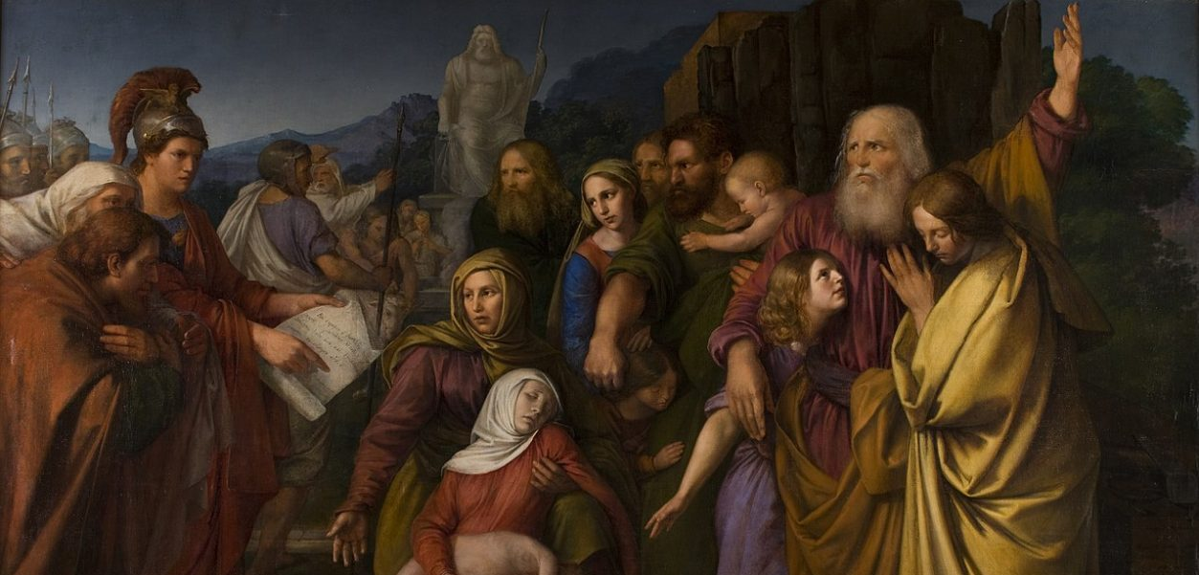
Romans 1:6-17 (NRSVue)
¹⁶ For I am not ashamed of the gospel; it is God’s saving power for everyone who believes, for the Jew first and also for the Greek.
¹⁷ For in it the righteous-ness of God is revealed through faith for faith, as it is written, “The one who is righteous will live by faith.”

Slide 7

Habakkuk 2.4
Hebrew: וְצַדִּ֖יק בֶּאֱמוּנָתֹ֥ו יִחְיֶֽה = ‘but (who is) righteous by my faithfulness lives’.
Greek LXX: ὁ δὲ δίκαιος ἐκ πίστεώς μου ζήσεται. = ‘and the (one) righteous by my faith will live’.
Romans: ὁ δὲ δίκαιος [μου] ἐκ πίστεώς ζήσεται. = ‘and the [my] righteous (one) by faith will live’.

Slide 8
Romans 1:8-15 (CEV)
⁸ First, I thank God in the name of Jesus Christ for all of you. I do this because people everywhere in the world are talking about your faith.
● Thank: Kind words for kind deeds.
● God—Jesus Christ: How they relate.
● World: Cities within the empire.
● Faith: That / what you profess.

Slide 9
⁹ God has seen how I never stop praying for you, while I serve him with all my heart and tell the good news about his Son.
● Seen: How to enjoy intimacy with God.
● Serve: Gk: liturgy in action.
● Heart: Gk: ‘spirit’, inner-outer life.
● Good news: See in the Book of Acts.
● Son: Jewish title for the Messiah.

Slide 10
¹⁰ In all my prayers, I ask God to make it possible for me to visit you.
● Prayers: Fixed prayer times.
● Ask: Request outcomes.
● God: Not some spirit or dead saint.
● Possible: God knows how.
● Visit: How did this eventually happen?
● You: Whom? Why?

Slide 11
¹¹ I want to see you and share with you the same blessings that God’s Spirit has given me. Then you will grow stronger
in your faith.
● Want: legitimate desires.
● Share: Gifts are for sharing, not for fun.
● Blessing: Unearned, undeserved ‘gift’.
● Spirit: Energized by God’s Holy Spirit.
● Me: How to know your spiritual gifts?

Slide 12
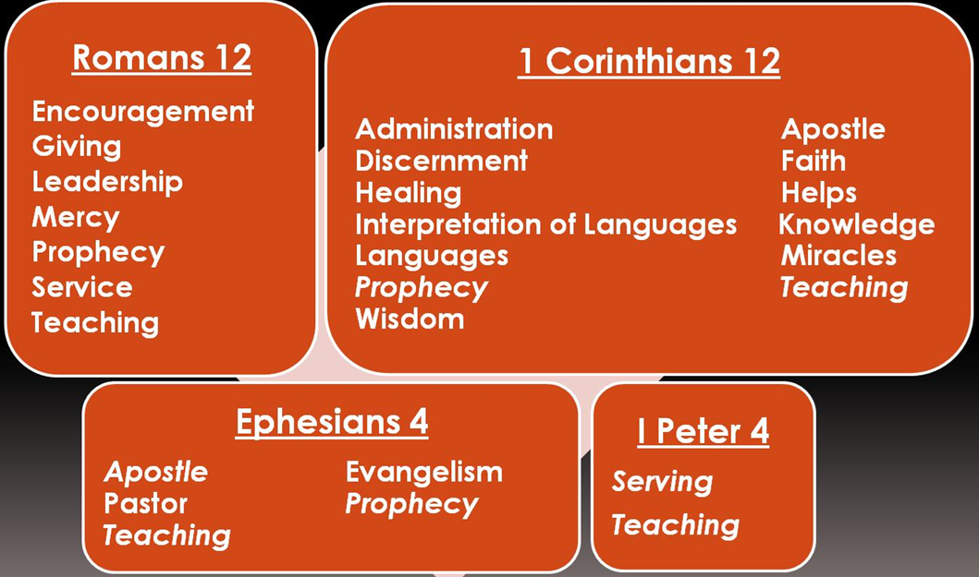
Know your spiritual gifts
● Serve others in different ways.
● Using your gifts will give you joy.
● Using your gifts will bless others.
● You have a growing desire to serve.
● Church leaders will affirm your gifts.
● Others will invite you to minister.
● And others will follow your example.

Slide 13
¹² What I am saying is that we can encourage each other by the faith that is ours.
● Encourage: Speak words which build confidence in the Lord.
● Each other: Listen carefully.
● Faith: Tell what you believe to be true.
● Ours: Experienced ministers and neophytes believe in the same Lord.

Slide 14
¹³ My friends, I want you to know that
I have often planned to come for a visit. But something has always kept me from doing it.
● Why: Dispel mistaken notions.
● Planned: Thought out and saved up.
● Kept from: What kinds of things?
● Visit: What would he have done whilst amongst the Romans?

Slide 15
I want to win followers to Christ in Rome, as I have done in many other places.
● Want: An evidence of spiritual gifting.
● Win: Never use incentives.
● Places: Where, for example?
● Many: A winning ‘track record’.
● So: What would be a good pre-test of a missionary candidate’s success?

Slide 16
¹⁴⁻¹⁵ It doesn’t matter if people are civilized and educated, or if they are uncivilized and uneducated. I must tell the good news to everyone.
● Civilized: Cultural distinctives.
● Educated: Literacy and worldview.
● Good news: What same message?
● Everyone: Personally and through others whom your train and coach.

Slide 17
¹⁶ I am proud of the good news! It is God’s powerful way of saving all people who have faith, whether they are Jews or Gentiles.
● Proud: Gk, ‘never disappointed’.
● Power: He, not we, makes it happen.
● Save: What does God do in believers?
● Faith: Believe, obey, remain loyal.
● Are: Every ethnicity and background.

Slide 18
¹⁷ The good news tells how God accepts everyone who has faith, but only those who have faith.
● Good: Brings benefits.
● Accepts: Declares to be innocent.
● Faith: Gk: ‘from faith unto faith’
● From: Paul’s way to say, ‘by faith’.
● Unto: Only here in the NT. In the Greek OT it means, ‘reliable’ or ‘faithful’.

Slide 19
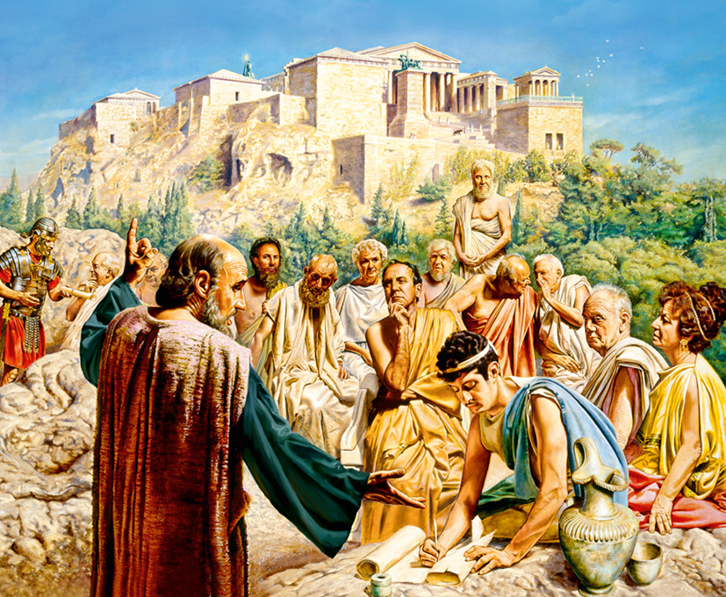
Paul’s good news message
● Israel’s promised Messiah has come.
● Jesus taught to be faithful to him.
● Jesus died as a sacrifice to God.
● Jesus rose victorious over death.
● God declares believers to be innocent.
● God gives to us his Holy Spirit.
● Jesus will raise us to life at his return.
● We will reign over the world with him.

Slide 20
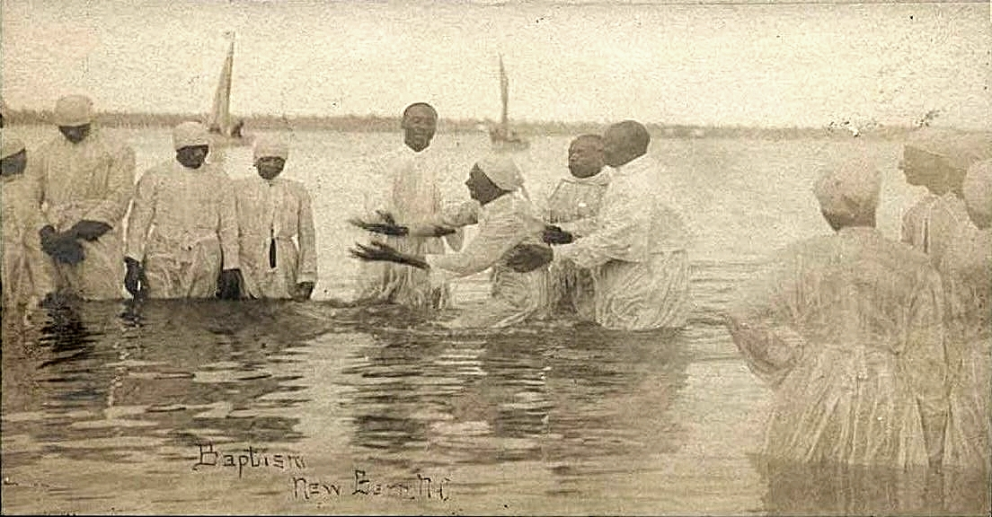
How to be saved forever
● Learn about Jesus’ life, death and resurrection, warnings and promises.
● Pray to Jesus to forgive you all your sins, and to give you everlasting life.
● Ask Christians to baptize you in water.
● Learn Jesus’ teachings about how to live now and forever.
● Remain faithful to him till you die.

Slide 21
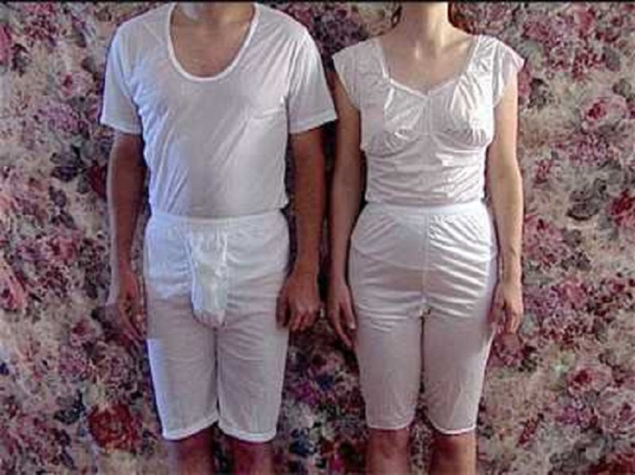
How not to be saved
● Try hard to lead a perfect life.
● Deny that Jesus lived or returned to life.
● Wear special undergarments.
● Pray at fixed times every day.
● Go on a long, expensive pilgrimage.
● Beat women & children to submission.
● Kill those who believe differently.
● Practice spiritual rituals or magic.

Slide 22
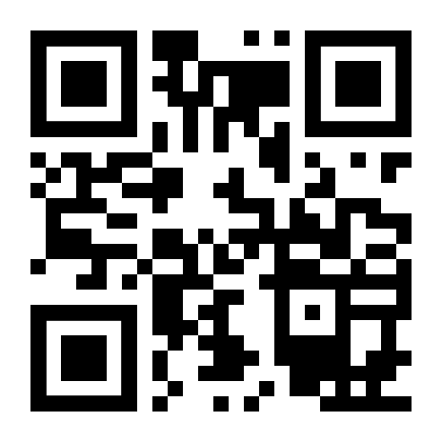
http://romans.forum

