Slide 1
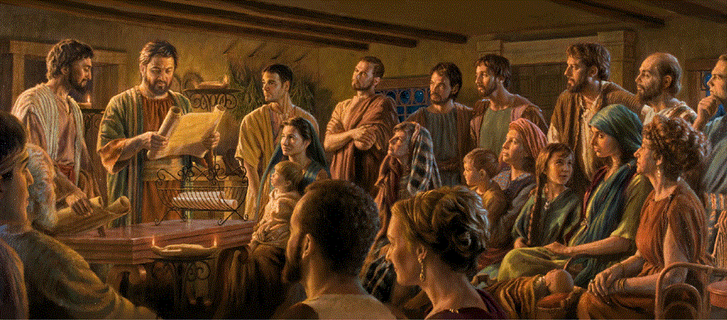
Epistle to the Romans, 2:1-16
A Short Course for Men

Slide 2
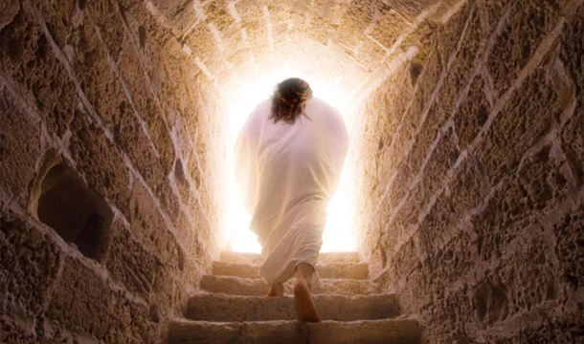
Chapter 1 Main Points
1:3 God raised Jesus the Messiah to life.
1:14 God requires I tell the Good News.
1:16 God ‘saves’ faithful people.
1:17 God is revealing his righteousness.
1:18 God is revealing his wrath.
1:24 God abandons those who reject him.
1:25 Abandoned people reject God.
1:32 God has decreed evil doers must die.

Slide 3
2.1 Διὸ
ὦ ἄνθρωπε │ εἶ | ἀναπολόγητος
πᾶς ὁ κρίνων
γὰρ
κατακρίνεις > σεαυτὸν
ἐν ᾧ
κρίνεις > τὸν ἕτερον
γὰρ
ὁ κρίνων | πράσσεις > τὰ γὰρ αὐτὰ
2.2 δὲ
οἴδαμεν> ὅτι τὸ κρίμα τοῦ θεοῦ | ἐστιν
κατὰ ἀλήθειαν
ἐπὶ τοὺς πράσσοντας > τὰ τοιαῦτα
2.3 δὲ
ὦ ἄνθρωπε | λογίζῃ > τοῦτο
ὁ κρίνων
τοὺς πράσσοντας > τὰ τοιαῦτα
καὶ ποιῶν > αὐτά
ὅτι
σὺ | ἐκφεύξῃ > τὸ κρίμα τοῦ θεοῦ
2.4 ἢ
[ὦ ἄνθρωπε] | καταφρονεῖς > τοῦ πλούτου
τῆς χρηστότητος αὐτοῦ καὶ τῆς ἀνοχῆς καὶ τῆς μακροθυμίας
ἀγνοῶν > ὅτι
τὸ χρηστὸν τοῦ θεοῦ | ἄγειεἰς > σε εἰς μετάνοιάν
2.5 δὲ
[ὦ ἄνθρωπε] | θησαυρίζεις < σεαυτῷ > ὀργὴν
ἐν ἡμέρᾳ ὀργῆς καὶ ἀποκαλύψεως δικαιοκρισίας τοῦ θεοῦ
2.6 ὃς | ἀποδώσει < ἑκάστῳ
κατὰ τὰ ἔργα αὐτοῦ
2.7 μὲν
> ζωὴν αἰώνιον
< τοῖς ζητοῦσιν > δόξαν καὶ τιμὴν καὶ ἀφθαρςίαν
καθʼ ὑπομονὴν ἔργου ἀγαθοῦ
2.8 δὲ
ὀργὴ καὶ θυμός
< τοῖς ἀπειθοῦσιν > τῇ ἀληθείᾳ
ἐξ ἐριθείας
καὶ πειθομένοις > τῇ ἀδικίᾳ
2.9 θλῖψις καὶ στενοχωρία
< ἐπὶ πᾶσαν ψυχὴν ἀνθρώπου
τοῦ κατεργαζομένου > τὸ κακόν
Ἰουδαίου τε πρῶτον καὶ Ἕλληνος
δὲ
2.10 δόξα καὶ τιμὴ καὶ εἰρήνη
< παντὶ τῷ ἐργαζομένῳ > τὸ ἀγαθόν
Ἰουδαίῳ τε πρῶτον καὶ Ἕλληνι·
2.11 γάρ
προσωπολημψία | οὐ ἐστιν παρὰ τῷ θεῷ.
2.12 γάρ
Ὅσοι | ἀνόμως ἥμαρτον καὶ ἀνόμως ἀπολοῦντα
καὶ
ὅσοι | ἐν νόμῳ ἥμαρτον | διὰ νόμου κριθήσονται
2,13 γάρ
οἱ ἀκροαταὶ > νόμου | οὐ | δίκαιοι παρὰ [τῷ] θεῷ
ἀλλʼ
οἱ ποιηταὶ > νόμου δικαιωθήσονται
2.14 γάρ
οὗτοι | ἑαυτοῖς εἰσιν | νόμος
μὴ ἔχοντες > νόμον
γὰρ
ὅταν
ἔθνη | ποιῶσιν φύσει > τὰ τοῦ νόμου
τὰ μὴ ἔχοντα > νόμον
2.15
οἵτινες | ἐνδείκνυνται > τὸ ἔργον τοῦ νόμου γραπτὸν
ἐν ταῖς καρδίαις αὐτῶν
τῆς συνειδήσεως αὐτῶν | συμμαρτυρούσης
καὶ τῶν λογισμῶν |κατηγορούντων
μεταξὺ ἀλλήλων ἢ καὶ ἀπολογουμένων
2.16 ἐν ⸂ἡμέρᾳ ὅτε
ὁ θεὸς | κρίνει > τὰ κρυπτὰ τῶν ἀνθρώπων
διὰ ⸉Χριστοῦ Ἰησοῦ
κατὰ τὸ εὐαγγέλιόν μου

Slide 4

2:1 Those who judge others condemn themselves

Slide 5
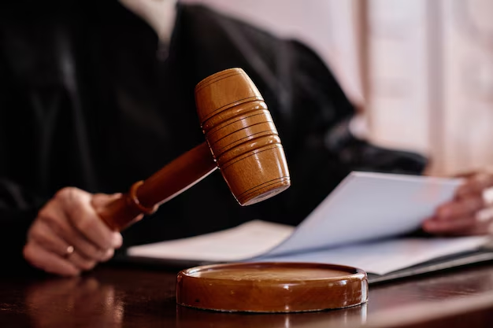
Romans 2 (NRSVue)
¹ Therefore you are without excuse, whoever you are, when you judge others, for in passing judgment on another
you condemn yourself, because you, the judge, are doing the very same things.
● Excuse: A legal or moral defense.
● Same: From the set of offenses listed in chapter 1, which deserve death.

Slide 6
2:2 God judges those who do such things.

Slide 7
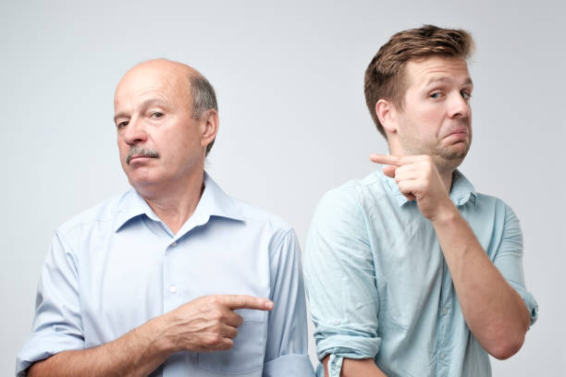
² We know that God’s judgment on those who do such things is in accordance with truth.
³ Do you imagine, whoever you are, that when you judge those who do such things and yet do them yourself, you will escape the judgment of God?
● Truth: Our real motives and deeds.
● Such: Many laws but one Law-Giver.
● Imagine: To reason, to argue.

Slide 8
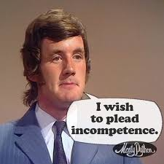
Lame excuses
● There is no God and no divine laws.
● I had a just cause: revenge.
● Others are worse offenders than am I.
● I was under duress, or the influence.
● I did not know these laws.
● International law allows us to do this.
● We are only human, cannot help it.
● I belonged to the right/best religion.

Slide 9
2:4 God’s is good and wants people to repent.

Slide 10
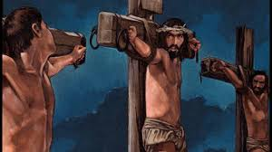
⁴ Or do you despise the riches of his kindness and forbearance and patience?
Do you not realize that God’s kindness is meant to lead you to repentance?
● Despise: consider not to be important.
● Kindness: Not deserved
● Forbearance: Tolerance, clemency
● Patience: Delaying action
● Repentance: To change mind & action.

Slide 11
2:5 God will repay everyone’s bad deeds.

Slide 12
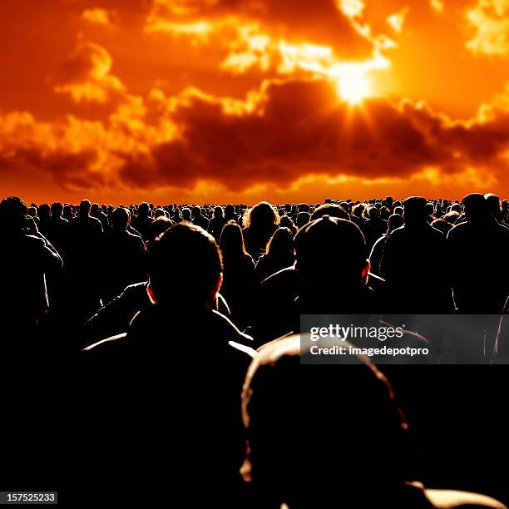
⁵ But by your hard and impenitent heart you are storing up wrath for yourself on the day of wrath, when God’s righteous judgment will be revealed.
⁶ He will repay according to each one’s deeds: …
● Wrath: (a) anger, (b) indignation.
● Righteous: According to standards.
● Day: End-time, after Jesus’ return.
● Repay = Psa 62:12; Jer. 17:12; Mt 16:27

Slide 13
2:7 Whether everlasting life ...

Slide 14
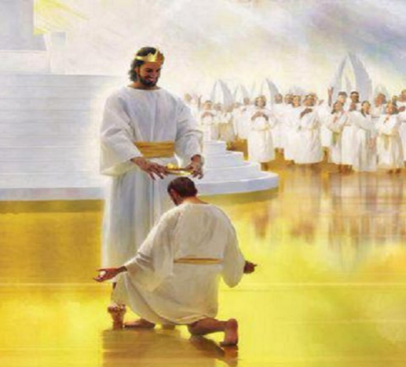
⁷ to those who by patience in well-doing seek for glory and honor and immortality, he will give eternal life;
⁸ but for those who are self-seeking and do not obey the truth, but obey unrighteousness, there will be wrath and fury.
● Glory: fame, renown, prestige.
● Honor: esteem, conferred, privilege.
● Immortality: No second death.

Slide 15
2:9 … or trouble and distress

Slide 16
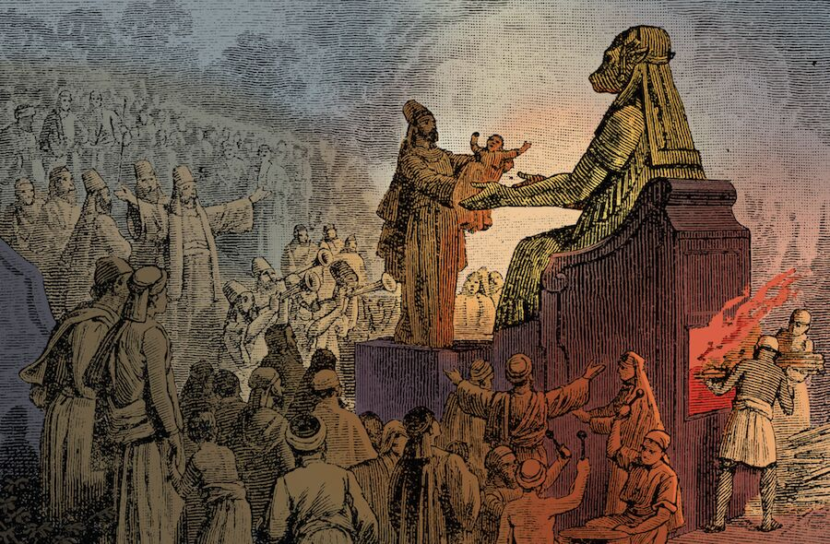
⁹ There will be tribulation and distress for every human being who does evil, the Jew first and also the Greek,
¹⁰ but glory and honor and peace for everyone who does good, the Jew first and also the Greek.
¹¹ For God shows no partiality.
● ‘The evil’: kat·ergazō, to accomplish.
● ‘The good’: ergazō, to work.
● Partiality: ‘accept face’.

Slide 17
2:12 God rewards doers, not hearers

Slide 18
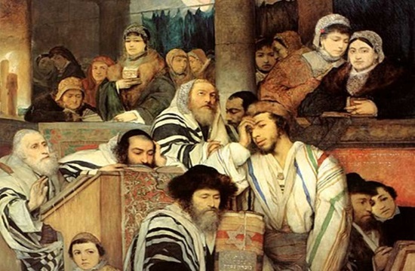
¹² For all who have sinned without the law will also perish without the law, and all who have sinned under the law will be judged by the law.
¹³ For it is not the hearers of the law who are righteous before God, but the doers of the law who will be justified.
● Without law: Violate conscience.
● Doers: How many obeyed flawlessly?

Slide 19
2:14 Gentiles’ conscience is their law

Slide 20
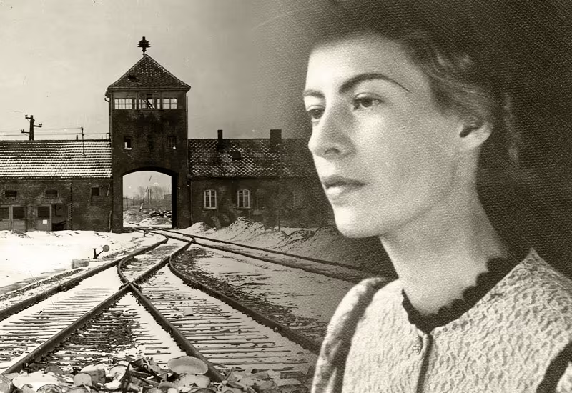
¹⁴ For when Gentiles, who do not have the law, by nature do what the law requires, they are a law to themselves, even though they do not have the law.
● Nature: Human beings, created as God’s imagers, have a conscience.
● Do: All humans sometimes obey their conscience, though they also violate it.
● To: Gk, no prep. Dative case: to, by, for.

Slide 21
2:15 God judges everyone’s secret deeds

Slide 22
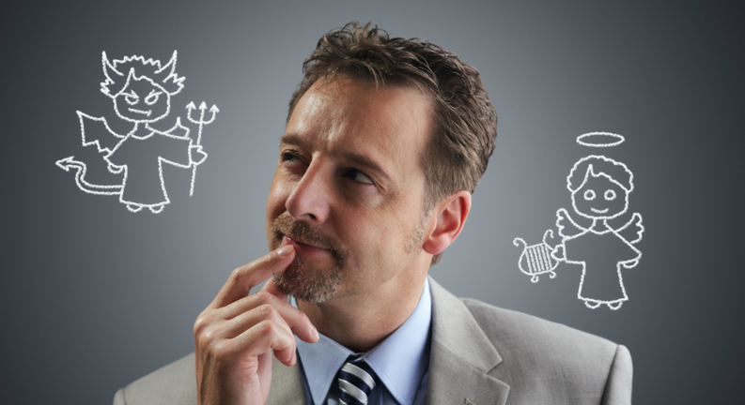
¹⁵ They show that the work of the law is written on their hearts, while their conscience also bears witness, and their conflicting thoughts accuse or even excuse them
¹⁶ on that day when, according to my gospel, God judges the secrets of men by Christ Jesus.
● Gospel: Both warnings and promises.
● Secrets: Hidden only from other men.

Slide 23
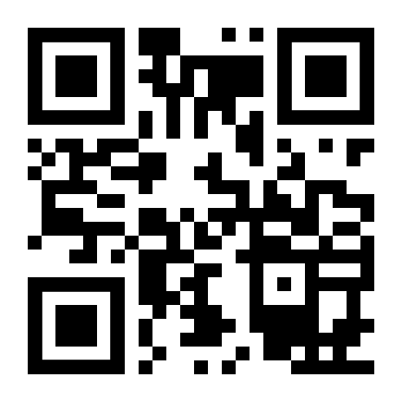
http://romans.forum

