Slide 1
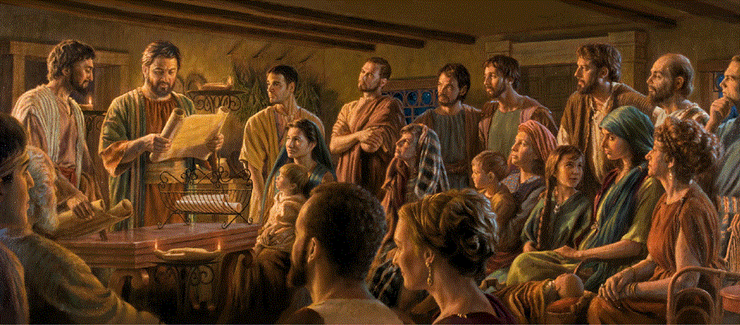
Epistle to the Romans, 2:17-29
A Short Course for Men

Slide 2
Romans 2:1-16 Main Points
2:1 He who judges condemns himself.
2:2 God judges evildoers.
2:4 God is good and wants to save.
2:5 God repays everyone’s deeds…
2:7 Some with everlasting life…
2:9 Others with trouble and distress.
2:12 God rewards doers, not hearers only.
2:14 Gentiles’ conscience is their law.

Slide 3

2:25 μὲν γὰρ
περιτομὴ | ὠφελεῖ
ἐὰν
[σὺ] | πράσσῃς > νόμον
δὲ
σὺ] | ᾖς | παραβάτης νόμου
ἡ περιτομή σου | γέγονεν | ἀκροβυστία
2:26 οὖν
ἐὰν
ἡ ἀκροβυστία | φυλάσσῃ > τὰ δικαιώματα τοῦ νόμου
ἡ ἀκροβυστία αὐτοῦ | οὐχ λογισθήσεται | εἰς περιτομὴν?
2:27 καὶ
ἡ ἀκροβυστία | κρινεῖ > σὲ τὸν παραβάτην > νόμου
διὰ γράμματος καὶ περιτομῆς
τελοῦσα > τὸν νόμον ἐκ φύσεως
2:28 γὰρ
οὐ
ὁ | ἐστιν | Ἰουδαῖός
ἐν τῷ φανερῷ
οὐδὲ
ἡ | [ἐστιν] | περιτομή
ἐν τῷ φανερῷ ἐν σαρκὶ
2:29 ἀλλʼ
ὁ | [ἐστιν] | Ἰουδαῖος
ἐν τῷ κρυπτῷ
καὶ
[ἡ] | [ἐστιν] | περιτομὴ
ἐν πνεύματι οὐ γράμματι
οὗ
ὁ ἔπαινος | [ἐστιν]
οὐκ ἐξ ἀνθρώπων
ἀλλʼ ἐκ τοῦ θεοῦ.
2.17 δὲ
Εἰ
ἐπονομάζῃ | Ἰουδαῖος
καὶ
ἐπαναπαύῃ < νόμῳ
καὶ
σὺ | καυχᾶσαι < ἐν θεῷ
2:18 καὶ
γινώσκεις > τὸ θέλημα
καὶ
δοκιμάζεις > τὰ διαφέροντα
κατηχούμενος ἐκ τοῦ νόμου
τε
2:19 πέποιθάς > σεαυτὸν εἶναι | ὁδηγὸν τυφλῶν
φῶς τῶν ἐν σκότει
2:20 παιδευτὴν ἀφρόνων
διδάσκαλον νηπίων
ἔχοντα > τὴν μόρφωσιν
τῆς γνώσεως καὶ τῆς ἀληθείας ἐν τῷ νόμῳ
2:21-23
οὖν
ὁ διδάσκων > ἕτερον | οὐ διδάσκεις > σεαυτὸν?
ὁ κηρύσσων > μὴ κλέπτειν | κλέπτεις?
ὁ λέγων > μὴ μοιχεύειν | μοιχεύεις?
ὁ βδελυσσόμενος > τὰ εἴδωλα | ἱεροσυλεῖς?
ὃς καυχᾶσαι ἐν νόμῳ | ἀτιμάζεις > τὸν θεὸν
διὰ τῆς παραβάσεως τοῦ νόμου
2:24 γὰρ
καθὼς γέγραπται
τὸ γὰρ ὄνομα τοῦ θεοῦ | βλασφημεῖται
δι’ὑμᾶς ἐν τοῖς ἔθνεσιν.

Slide 4

2:17-18. What are some advantages to being a Jew?

Slide 5
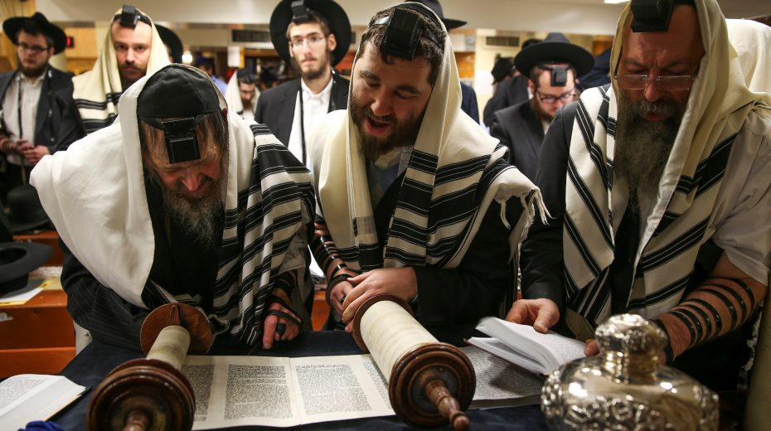
Romans 2 (NRSVue)
¹⁷ But if you call yourself a Jew and rely on the law and boast of your relation to God
¹⁸ and know his will and determine what really matters because you are instructed in the law…
● What are some advantages to Jews?
● How does one gain those advantages?

Slide 6
2:19-20. What are some advantages to knowing the Scriptures?

Slide 7
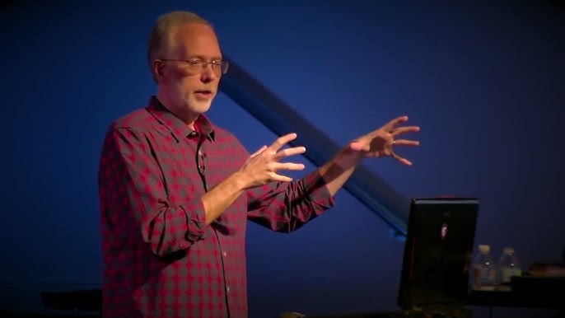
¹⁹ and if you are sure that you are a guide to the blind, a light to those who are in darkness,
²⁰ a corrector of the foolish, a teacher of children, having in the law the embodiment of knowledge and truth, …
● What are some advantages to those who know the Scriptures well?
● Whom do you teach from Scripture?

Slide 8
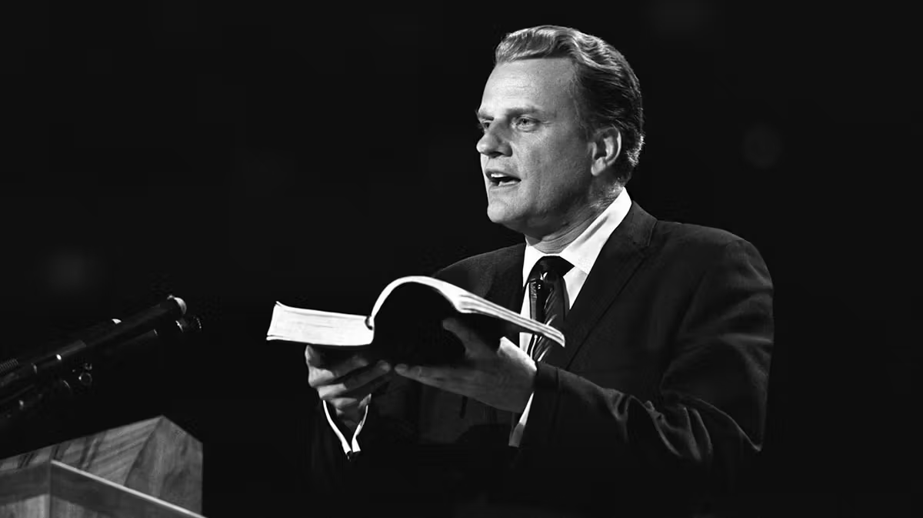
The Scriptures
● The (Holy) Bible
● The Word (of God)
● The Canon
● The Old and New Testaments
● The Law, Prophets, Psalms, Writings
● The Gospels, Acts, Epistles, Revelation
● The Sword of the Spirit
● The inspired writings / texts

Slide 9
2:21-22. How to identify a hypocritical Bible teacher?

Slide 10
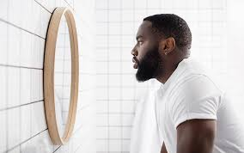
²¹ you, then, who teach others, will you not teach yourself? You who preach against stealing, do you steal?
²² You who forbid adultery, do you commit adultery? You who abhor idols, do you rob temples?
● To recognize someone’s hypocrisy?
● What is wrong robbing pagan shrines?

Slide 11
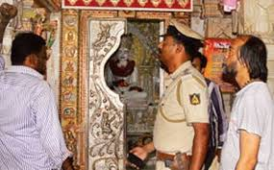
Did Jews rob temples?
● In Antiquities 18.81-84, Josephus recounts a scandal in Rome (c. AD 19). Four Jewish men convinced a Gentile woman to donate to the Jerusalem temple, but they embezzled the funds.
● So Emperor Tiberius expelled 4,000 Jews from Rome. Roman law treated temple robbery as a capital offense.

Slide 12
Did Jews rob temples?
● Roman satirists and historians, Tacitus and Juvenal, expressed disdain for Jewish customs, often accusing Jews of secrecy, misanthropy, and financial exploitation.
● There is no extant record of Jews who robbed pagan temples of shrines.
● Rabbis insisted on Jews maintaining scrupulous conduct towards temples.

Slide 13
2:23-24. How might a Bible teacher dishonor God?

Slide 14

²³ You who boast in the law, do you dishonor God by your transgression of the law?
²⁴ For, as it is written, “The name of God is blasphemed among the gentiles because of you.”
● Written: Isaiah 52:5 (c. 740-680 BC).
● Blaspheme: To insult or to disrespect.
● Law: Jews counted 613 laws in the Tanach (First/Old Testament).

Slide 15
2:25-26. Should we circumcise baby Howey?

Slide 16
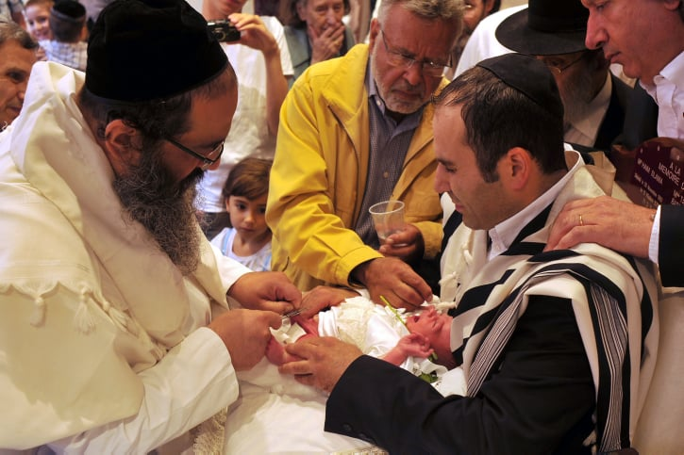
²⁵ Circumcision indeed is of value if you obey the law, but if you are a trans-gressor of the law your circumcision has become uncircumcision.
²⁶ So, if the uncircumcised keep the requirements of the law, will not their uncircumcision be regarded as circumcision?
● Value: What value? Religion, hygiene, ethnicity. For males only!

Slide 17
2:27-28. When can circumcision be hypocrisy?

Slide 18
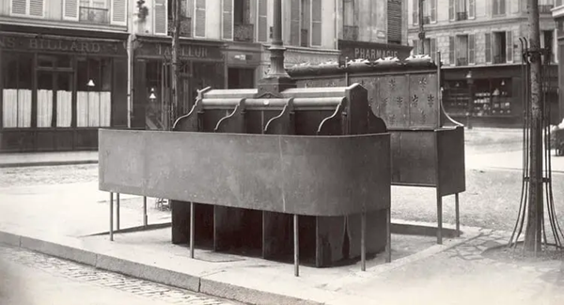

²⁷ Then the physically uncircumcised person who keeps the law will judge you who, though having the written code and circumcision, are a transgressor of the law.
²⁸ For a person is not a Jew who is one outwardly, nor is circumcision something external and physical.
● Will judge: How? When? Why?
● Keeps: Yes, some people keep the law.

Slide 19
2:29. What makes someone a real Jew?

Slide 20
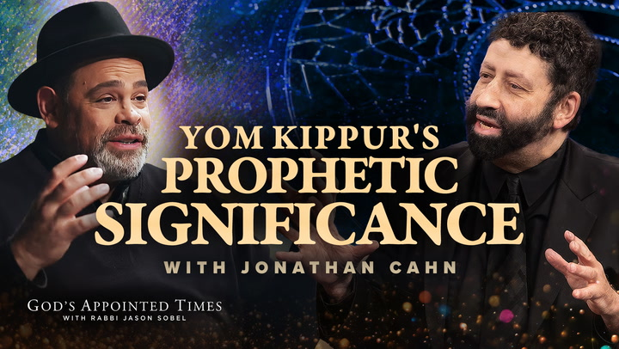
²⁹ Rather, a person is a Jew who is one inwardly, and circumcision is a matter of the heart, by the Spirit, not the written code.
Such a person receives praise not from humans but from God.
● Inwardly: Where is that? Not?
● Spirit: What or who is the Spirit?
● Written: What code?
● Praise: Who praises whom?

Slide 21

Christian legal codes
● Clothing: Plain, old-fashioned clothes.
● Clergy: Who may preach, teach, opine, baptize, serve communion. Gender?
● Liturgy: Rituals, music, leadership.
● Bible: Acceptable language, version, edition, notes, publisher, cover.
● Doctrine: What happens in baptism, communion, preaching, prayer…

Slide 22
What do you take from this Scripture passage?

Slide 23
What will you change or do because of this text?

Slide 24
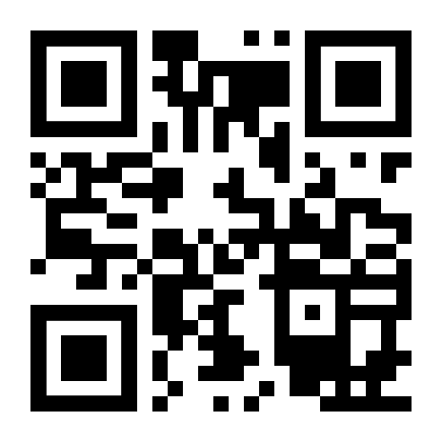
http://romans.forum

