Slide 1
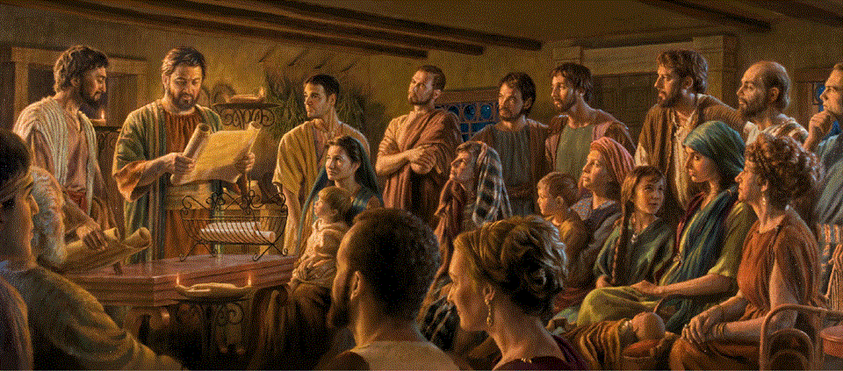
Epistle to the Romans, 3:1-20
A Short Course for Men

Slide 2
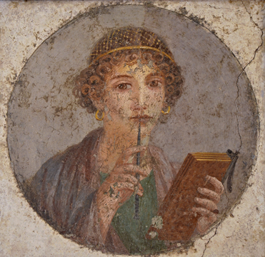
3,19
δὲ
[ημεις] | οἴδαμεν
ὅτι
ὁ νόμος | λέγει > ὅσα
[ὁ νόμος] | λέγει < τοῖς ἐν τῷ νόμῳ
ἵνα
πᾶν στόμα | φραγῇ
καὶ
πᾶς ὁ κόσμος | γένηται | γένηται τῷ θεῷ
3,20
διότι
πᾶσα σὰρξ | οὐ δικαιωθήσεται
ἐξ ἔργων
ἐνώπιον αὐτοῦ
γὰρ
ἐπίγνωσις ἁμαρτίας ι [ερχεται]
διὰ γὰρ νόμου
3,10
καθὼς γέγραπται
ὅτι
δίκαιος | οὐκ ἔστιν — οὐδὲ εἷς
3,11
ὁ συνίων | οὐκ ἔστιν ὁ συνίων
ὁ ⸀ἐκζητῶν > τὸν θεόν | οὐκ ἔστιν
3,12
πάντες | ἐξέκλιναν ἅμα ἠχρεώθησαν
ὁ ποιῶν > χρηστότητα | οὐκ ἔστιν
ἕως ἑνός | [οὐκ ἔστιν]
3,13
ὁ λάρυγξ αὐτῶν | τάφος ἀνεῳγμένος
[αυτοι] | ἐδολιοῦσαν
ταῖς γλώσσαις αὐτῶν
ἰὸς ἀσπίδων | [εστι] ὑπὸ τὰ χείλη αὐτῶν
3,14
ὧν
τὸ στόμα | γέμει > ἀρᾶς καὶ πικρίας
3,15
οἱ πόδες αὐτῶν | ὀξεῖς ἐκχέαι > αἷμα
3,16
σύντριμμα καὶ ταλαιπωρία | [εστιν]
ἐν ταῖς ὁδοῖς αὐτῶν
3,17
καὶ
[αυτοι] | οὐκ ἔγνωσαν > ὁδὸν εἰρήνης
3,18
φόβος θεοῦ | οὐκ ἔστιν
ἀπέναντι τῶν ὀφθαλμῶν αὐτῶν
3,5
δὲ
εἰ
ἡ ἀδικία ἡμῶν θεοῦ | συνίστησιν > δικαιοσύνην
ἐροῦμεν | τί
ὁ θεὸς | μὴ ἄδικος
ὁ ἐπιφέρων > τὴν ὀργήν?
([εγω] | λέγω κατὰ ἄνθρωπον.)
3,6
μὴ γένοιτο!
ἐπεὶ πῶς
ὁ θεὸς | κρινεῖ > τὸν κόσμον?
3,7
δὲ
εἰ ἡ ἀλήθεια τοῦ θεοῦ | ἐπερίσσευσεν
ἐν τῷ ἐμῷ ψεύσματι
εἰς τὴν δόξαν αὐτοῦ
τί ἔτι
κἀγὼ | κρίνομαι | ὡς ἁμαρτωλὸς?
3,8
καὶ μὴ
καθὼς | βλασφημούμεθα
καὶ
τινες | φασίν > ἡμᾶς λέγειν
ὅτι
ποιήσωμεν > τὰ κακά
ἵνα
τὰ ἀγαθά | ἔλθῃ
ὧν
τὸ κρίμα | ἐστιν | ἔνδικόν
3,9
Τί οὖν?
[ημεις] | προεχόμεθα?
οὐ πάντως
γὰρ
[ημας] | προῃτιασάμεθα > πάντας | εἶναι
ὑφʼ ἁμαρτίαν
3,1
οὖν
τὸ περισσὸν τοῦ Ἰουδαίου | τί?
ἢ
ἡ ὠφέλεια τῆς περιτομῆς | τίς?
3,2
πολὺ κατὰ πάντα τρόπον | [τί]
πρῶτον μὲν [γὰρ]
ὅτι
[αυτοι] | ἐπιστεύθησαν > τὰ λόγια τοῦ θεοῦ
3,3
τί γάρ?
εἰ
τινες | ἠπίστησάν
ἡ ἀπιστία αὐτῶν | καταργήσει > τὴν πίστιν τοῦ θεοῦ?
3,4
[αυτος] | μὴ γένοιτο!
δὲ
ὁ θεὸς | γινέσθω | ἀληθής
δὲ
πᾶς ἄνθρωπος | ψεύστης
καθὼς | γέγραπται
[συ] | ἂν δικαιωθῇς
ὅπως
ἐν τοῖς λόγοις σου
καὶ
[συ] | νικήσεις

Slide 3
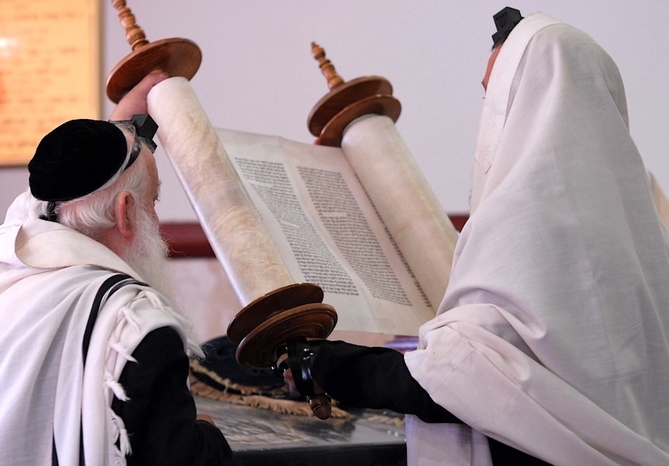
Romans 3:1-20
¹ Then what advantage has the Jew? Or what is the value of circumcision?
² Much, in every way. For in the first place, the Jews were entrusted with the oracles of God
● Jew:
● Circumcision:
● Oracles:
Naturally born Hebrew.
Includes conversion.
Scripture, the Tanakh.

Slide 4
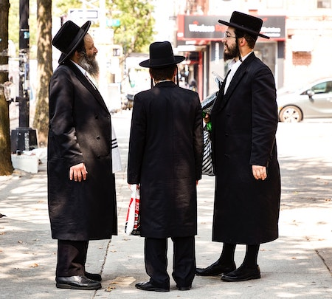
Jews’ advantages
● Adopted by Yahweh God.
● Covenants with Yahweh God.
● Oracles and laws from Yahweh God.
● History with Yahweh God.
● Yahweh God’s prophets and Scriptures.
● Yahweh God’s temple and glory.
● Yahweh God’s coming Messiah.
● A glorious future with the Gentiles.

Slide 5
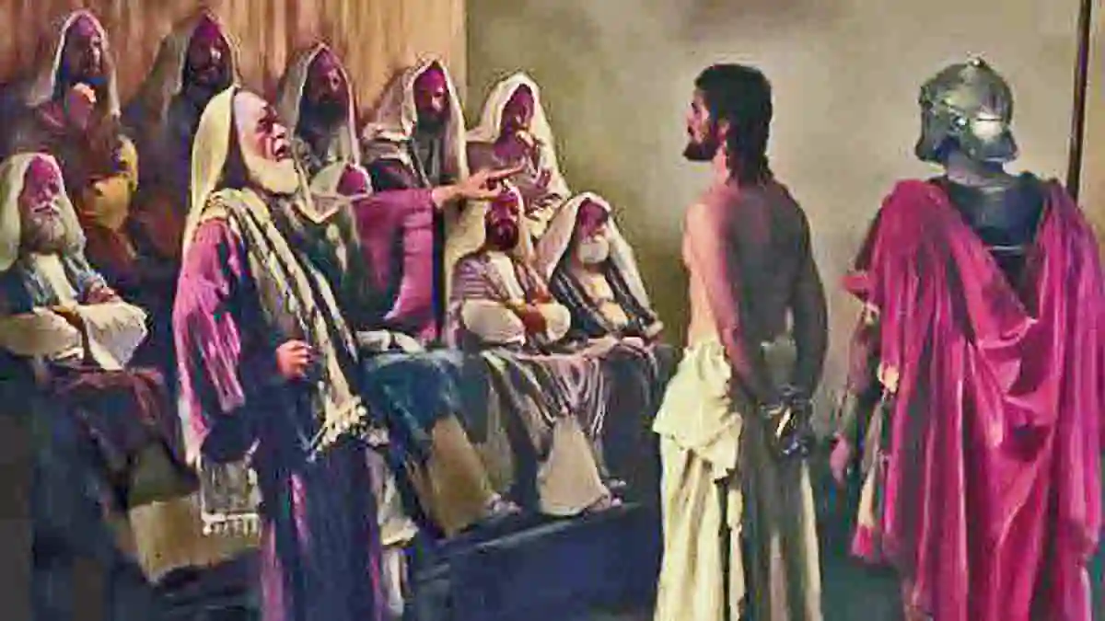
³ What if some were unfaithful? Will their faithlessness nullify the faithfulness
of God?
⁴ By no means! Although every human is a liar, let God be proved true, as it is written,
“So that you may be justified in your words, and you will prevail when you go to trial.” Ps 51.4; 116.11
● Faithfulness:
● Justified:
Keep one’s promises.
Declared innocent.

Slide 6
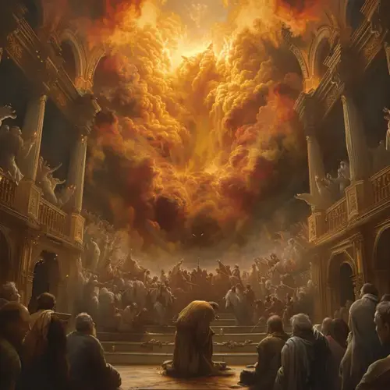
⁵ But if our injustice serves to confirm the justice of God, what should we say? That God is unjust to inflict wrath on us? (I speak in a human way.)
⁶ By no means! For then how could God judge the world?
● Injustice:
● Justice:
● Unjust:
● Judge:
Adikia, habitual wrongdoing.
Dikaiosuné, always right.
Adikos, crooked, unfair.
Inflict wrath on real evil.

Slide 7
God is …
Judge
Just
King
Light
Living
Lord
Love
Able
Among us
Awesome
Defender
Exalted
Faithful
Fire
For us
Giver
Glorified
Good
Gracious
Great
Holy

Slide 8
God is …
Majestic
Merciful
One
Present
Protector
Refuge
Rock
Savior
Shield
Sovereign
Spirit
Strong
With us
Witness
NOTE
There are more than 100 divine names and titles in the Tanakh and the N.T.

Slide 9
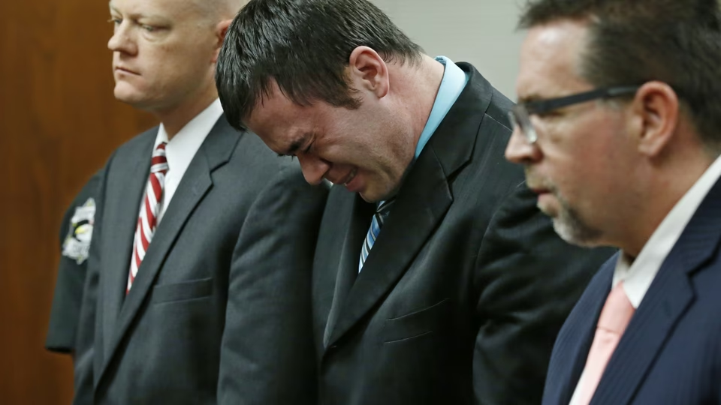
⁷ But if through my falsehood God’s truthfulness abounds to his glory,
why am I still being judged as a sinner?
⁸ And why not say (as some people slander us by saying that we say),
“Let us do evil so that good may come”? Their judgment is deserved!
● Judged:
● Deserved:
By law or by a standard.
Gk., 1. just. 2. penalty.

Slide 10
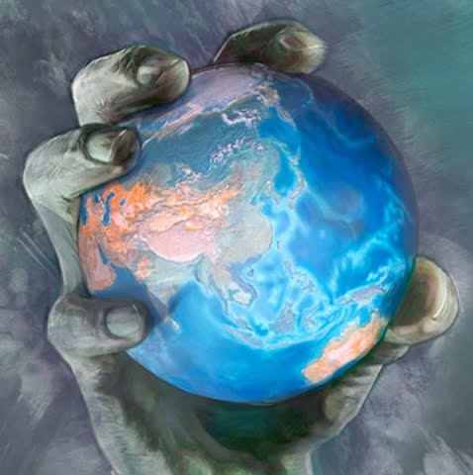
⁹ What then? Are we any better off? No, not at all, for we have already charged that all, both Jews and Greeks, are under the power of sin, …
● We:
● Better off:
● Already:
● All:
● Under sin:
Gentiles? Christians?
How? Innocent?
1:18; 2:12; 3:10
= ‘both’
Power? Desire? Guilt?

Slide 11
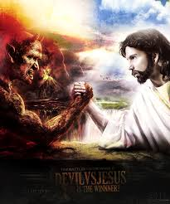
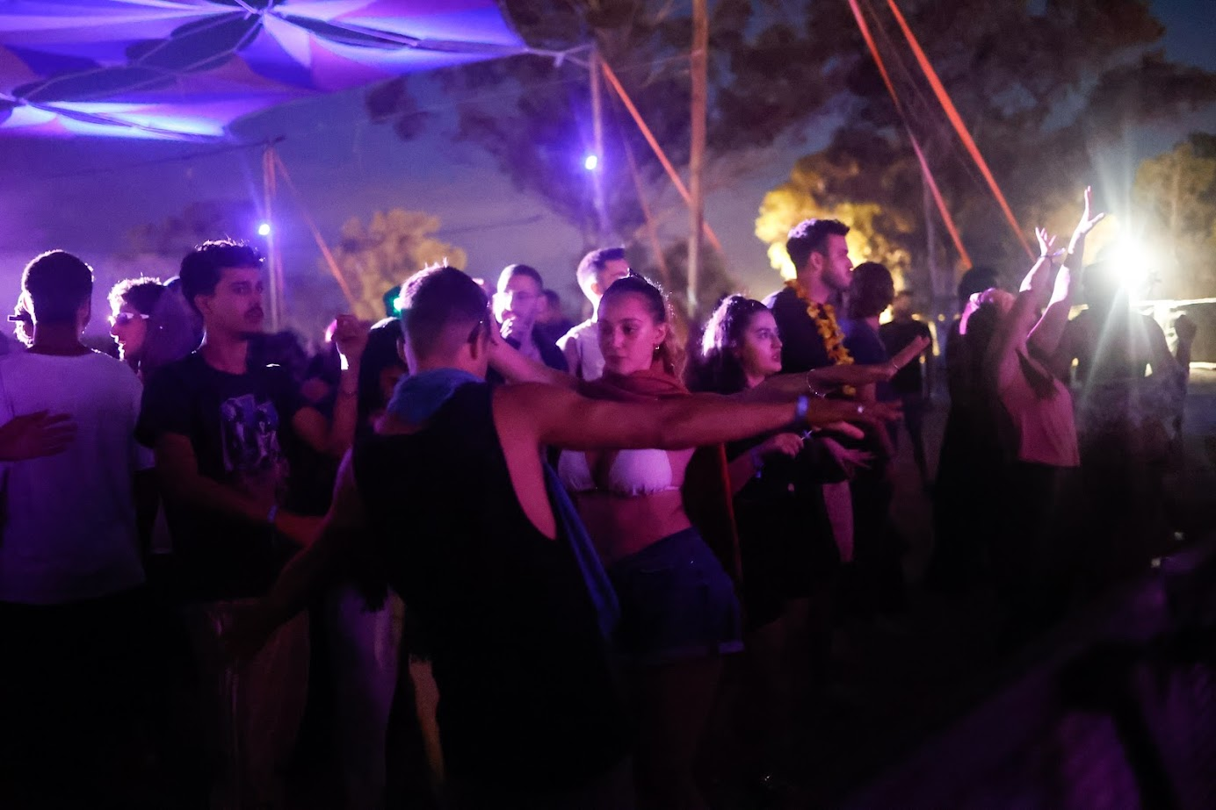
What is sin?
● Wrong actions and deeds.
● Desire for the forbidden.
● Violation of divine laws.
● Non-submission to legitimate authority.
● The innate capacity to rebel.
● An indwelling unclean spirit.
● State of spiritual death.
● Hatred towards God and neighbor.

Slide 12
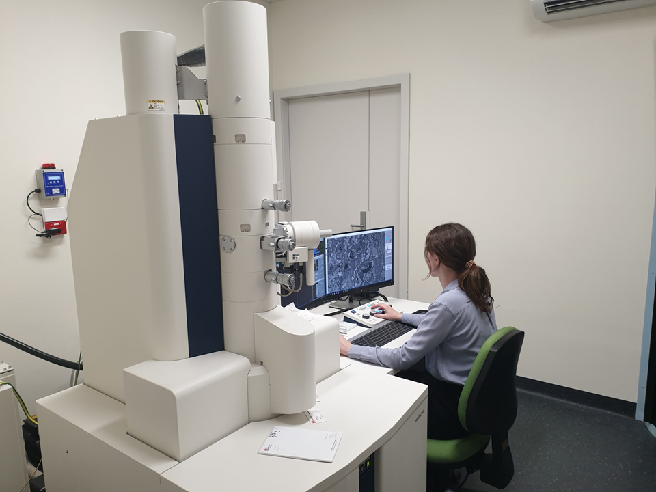
¹⁰ as it is written:
“There is no one who is righteous, not even one;
¹¹ there is no one who has understanding; there is no one who seeks God.
● Written:
● Understanding:
● No one:
● Seek:
Psalm 14:1-3
Realization.
Who seeks whom?
Lit, ‘seek out’.

Slide 13
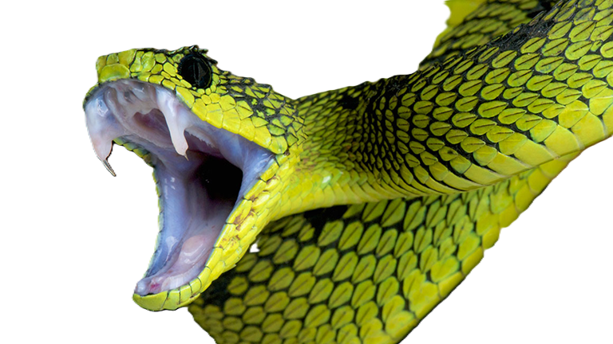
¹² All have turned aside;
together they have become worthless;
there is no one who shows kindness;
there is not even one.”
¹³ “Their throats are opened graves;
they use their tongues to deceive.”
“The venom of vipers is under their lips.”
Psalm 5:9

Slide 14

¹⁴ “Their mouths are full of cursing and bitterness.”
¹⁵ “Their feet are swift to shed blood;
Isaiah 59:7
¹⁶ ruin and misery are in their paths,
¹⁷ and the way of peace they have not known.”
¹⁸ “There is no fear of God before their eyes.”

Slide 15

¹⁹ Now we know that, whatever the law says, it speaks to those who are under the law,
so that every mouth may be silenced and the whole world may be held accountable to God.
● Know:
● Under law:
● Every … whole:
● Accountable :
How? Romans 2:12
Tanakh as authority.
Yes, Jews also, & we.
‘Under indictment’.

Slide 16
Under …
● Under the law. 2.12 3.19 4.16
● Under sin. 3.9
● Poison under their lips. 3.13
● Not under the law. 6.14,15
● Under grace. 6.14,15
● Not under the old written code. 7.6
● Not under obligation. 8.12
● Satan under your feet. 16.20

Slide 17

²⁰ For no human will be justified before him by deeds prescribed by the law,
for through the law comes the knowledge of sin.
● Human
● Justified:
● Deeds:
● Knowledge:
● Sin:
Sarx, flesh without spirit.
Declared innocent (by God)
Ergon, human effort.
Mental and experiential.
Rebellion, violation, death.

Slide 18
Justification
An instantaneous legal act of God
in which he
(1) thinks of our sins as forgiven and Christ's righteousness as belonging
to us, and
(2) declares us to be righteous in his sight.
Wayne Gruden, Bible Doctrine (1999), p. 486

Slide 19
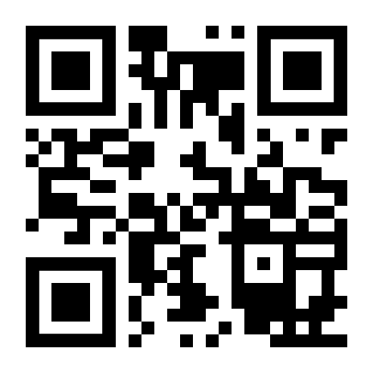
http://romans.forum

