Slide 1
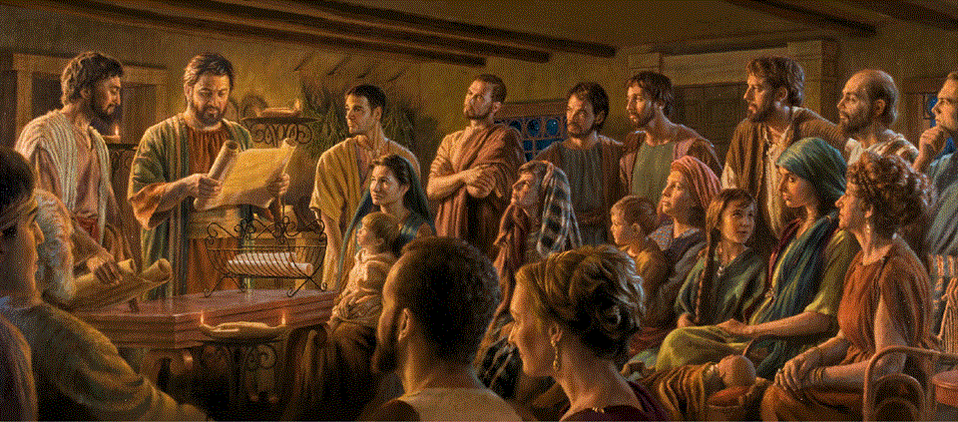
Epistle to the Romans, 3:21-31
A Short Course for Men

Slide 2
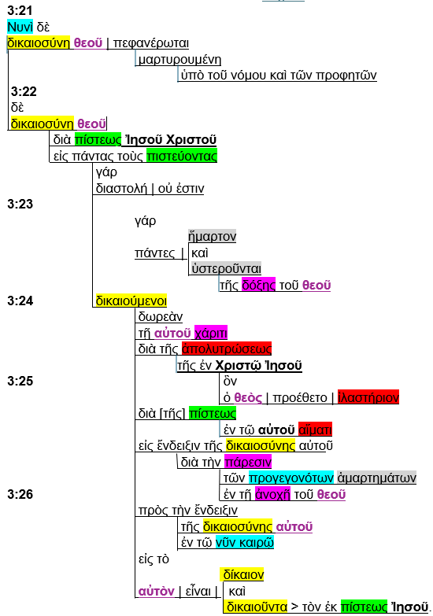

Slide 3
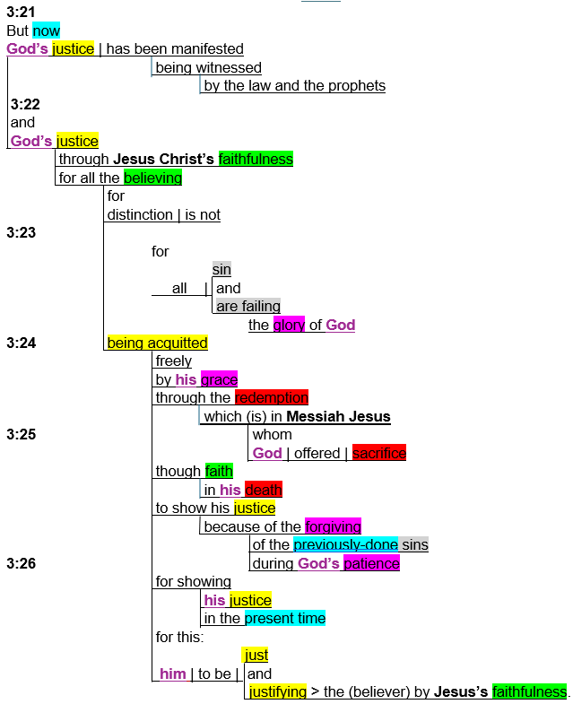

Slide 4
Themes
● God, his. 8x
● Just, justice, justify, acquit. 7x
● Jesus, Christ, his. 6x
● Believe, faith, faithfulness. 4x
● Patience, grace, forgive, glory. 4x
● Redemption, sacrifice, death. 3x
● Manifest, show, showing. 3x
● Previous, now, present. 3x

Slide 5
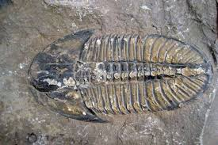
Outline
God has manifested his justice. 3:21
In the Tanakh. 3:21
By Messiah’s faithfulness. 3:22
For all the faithful. 3:22
All sin and fail to attain glory. 3:23
But God acquits all the faithful. 3:24
How? 3:25
Why? 3:25-26

Slide 6
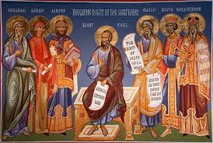
Romans 3:21-26 (NRSVue)
²¹ But now, apart from the law, the righteousness of God has been disclosed and is attested by the Law and the Prophets,
²² the righteousness of God through the faith of Jesus Christ for all who believe.
● Righteousness: God acquits sinners.
● Faith/believe: Faithfulness, loyalty.

Slide 7
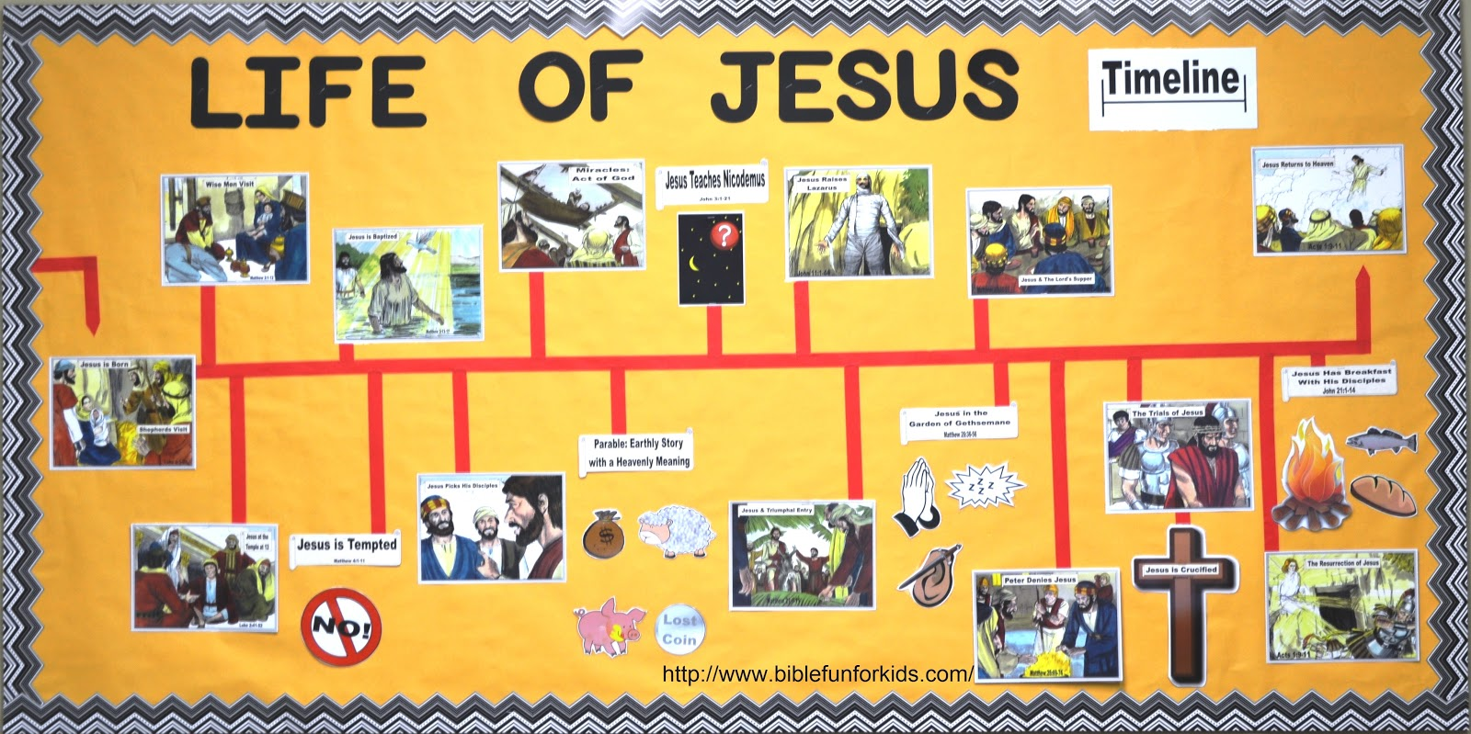
Romans 3:21-26 (GJC)
²¹ But now, apart from our keeping his laws, God has displayed how he acquits, as promised in the Scriptures.
²² God acquits all who are faithful to him, because Messiah Jesus was faithful.
● Display: Jesus’ life, death, resurrection.
● Scriptures: Examples and promises.
● Because: Substitutionary perfection.

Slide 8
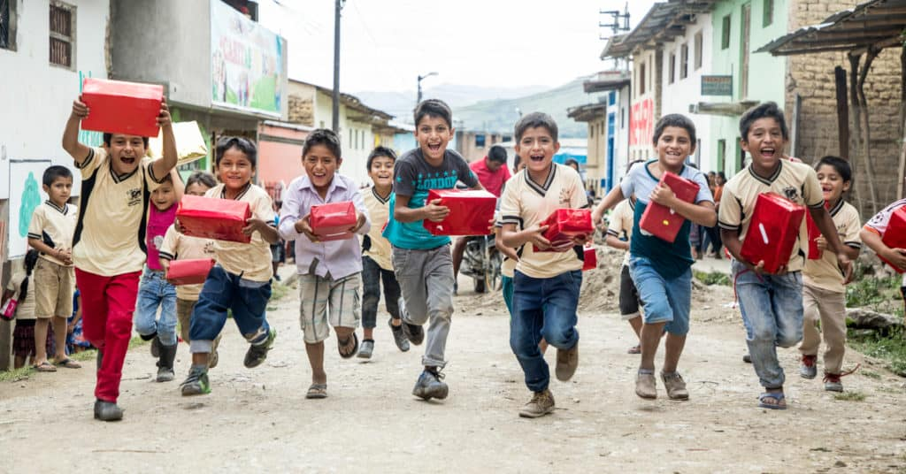
For there is no distinction, ²³ since all have sinned and fall short of the glory of God;
²⁴ they are now justified by his grace as a gift, through the redemption that is in Christ Jesus, …
● Sinned: Timeless aorist = always true.
● Glory: Honor & everlasting life. 2:7, 12
● Justified: Acquitted.
● Redemption: Act of setting free.

Slide 9
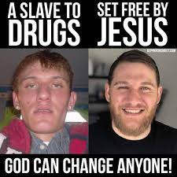
God has no favorites, ²³ since everyone sins and fails to earn the everlasting life which God promised.
²⁴ So, God freely and graciously acquits everyone, setting people free because of what Messiah Jesus has done.
● Sins: Cause — Prone to do evil.
● Fails: Effect — Excluded from life.
● Free: Remedy — See verse 25.

Slide 10
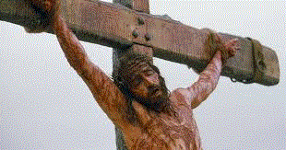
²⁵ whom God put forward as a sacrifice of atonement by his blood, effective through faith.
He did this to demonstrate his righteousness, because in his divine forbearance he had passed over the sins previously committed; …
● Passed: As he forgave David’s evil.
● Demo: Do fallen spirits charge God with favoritism to fallen humans?

Slide 11
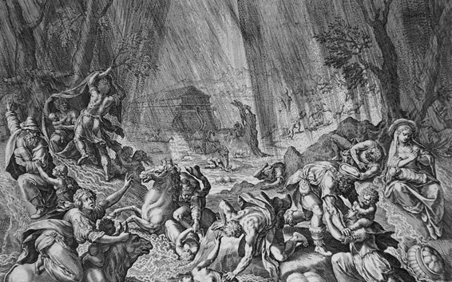
No forgiveness for fallen spirits
● Tanakh: Gen. 6:1-4; Isa. 14; Ezek. 28
● 2nd temple: 1 Enoch 6–16
● N.T.: Rev. 20:10; Jude 6; 2 Pet. 2:4
● Church: Apo. Abraham; Test. Soloman
● Talmud: Little interest in spirits.
Bible readers wonder about how a just God could forgive unjust humans, long before Jesus died to forgive sinners.

Slide 12
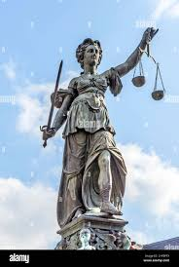
²⁵ God sent Jesus to die as a sacrifice to forgive those who are faithful to him. This shows that God was still just, when he forgave people’s sins before Jesus died.
²⁶ God did that because he is very tolerant.
● Forgive: Release others. Accept loss.
● Just: Reliable, legitimate authority.
● Tolerant: Tolerance ≠ approval.

Slide 13
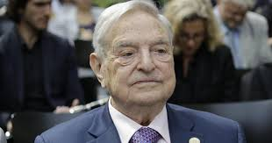
²⁶ it was to demonstrate at the present time his own righteousness, so that he is righteous and he justifies the one who has the faith of Jesus.
● Demonstrate: To humans and to spirits.
● Righteous: Still perfectly honest.
● Justifies: Acquitting the guilty!
● One: Anyone. Faithful to Jesus.
● Jesus: Who died so that we may live!

Slide 14
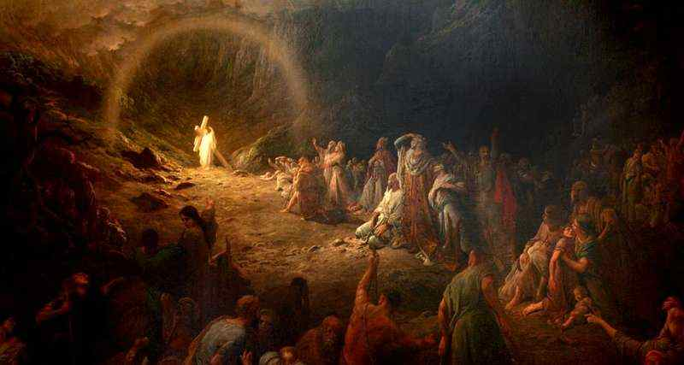
²⁶ God did this to show, from now on, that he is always a just judge, even when the acquits guilty people who are faithful to Jesus who suffered death so that we humans may live forever.
● Now: The ultimate turning point.
● Just: Always does what is right.
● Guilty: And those who die innocent.
● Jesus: Carried our sins into hell.

Slide 15

Romans 3:27-31 (NRSVue)
²⁷ Then what becomes of boasting? It is excluded. Through what kind of law? That of works? No, rather through the law of faith.
²⁸ For we hold that a person is justified by faith apart from works prescribed by the law.
● Law: Yahweh requires faithfulness.
● Works: Required but often violated.

Slide 16
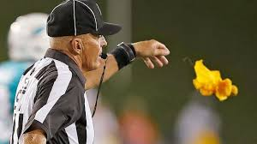
Romans 3:27-31 (GJC)
²⁷ Is anyone good enough to boast about keeping God’s laws? No! Everyone violates God’s written rules. So, we must obey his one law to remain faithful.
²⁸ We conclude that God acquits those who remain faithful, without having to keep all his written rules.
● Faithful: Hab. 2:4; Psa. 50:5.

Slide 17
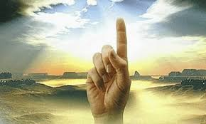
²⁹ Or is God the God of Jews only? Is he not the God of gentiles also? Yes, of gentiles also,
³⁰ since God is one, and he will justify the circumcised on the ground of faith and the uncircumcised through that same faith.
● Circumcised: Religiously Jewish.
● Uncircumcised: Ethnically Gentile.
● Same faith: Gk, ‘through the faith.’

Slide 18
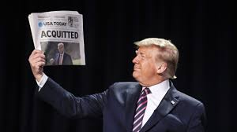
²⁹ Is God only for Jews? No. Is God also for Gentiles? Yes.
³⁰ There is only One True God. He acquits Jews who are faithful to him, and he also acquits Gentiles who are faithful to him.
● One: Unique, no equals, known by intuition, deduction, or revelation.
● To him: Messiah for Jews, and Lord for everyone.

Slide 19
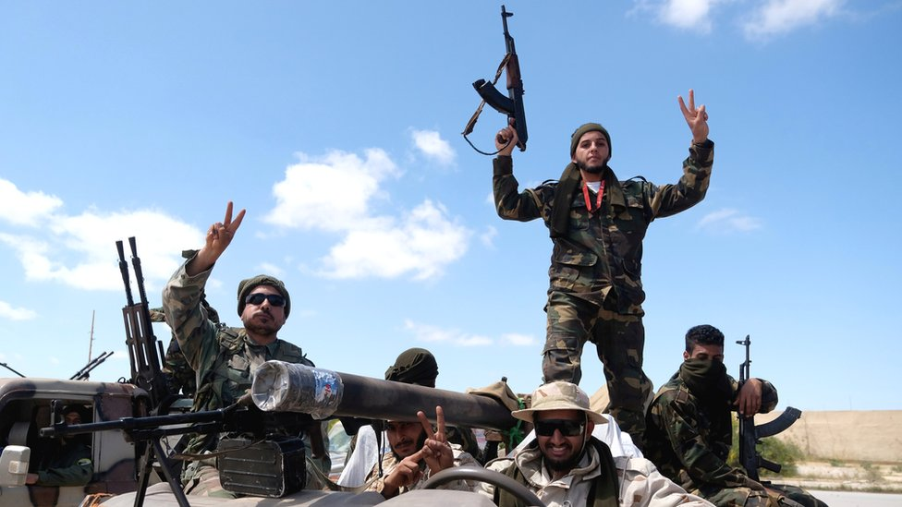
³¹ Do we then overthrow the law through this faith? By no means! On the contrary, we uphold the law.
³¹ By only being faithful, we do not cancel God’s laws. Instead, we confirm God’s laws.
● Overthrow: Abolish it or ignore it.
● Uphold: Defend it or learn from it.

Slide 20
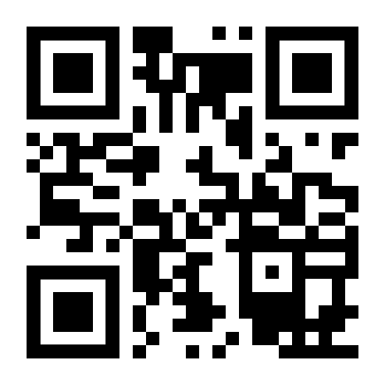
http://romans.forum

