Slide 1
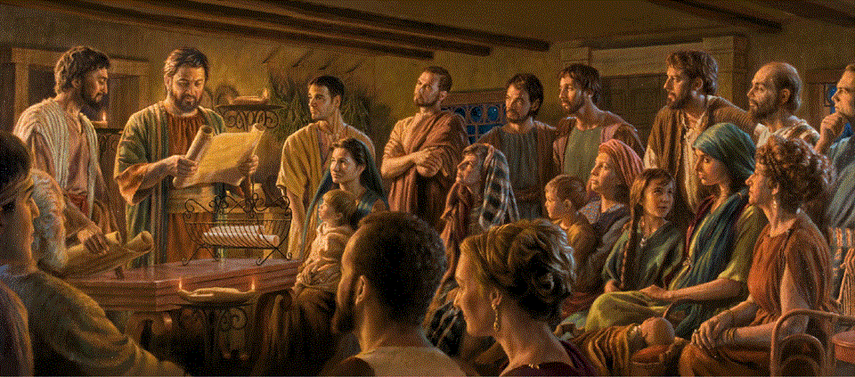
Epistle to the Romans, 5:1-11
A Short Course for Men

Slide 2
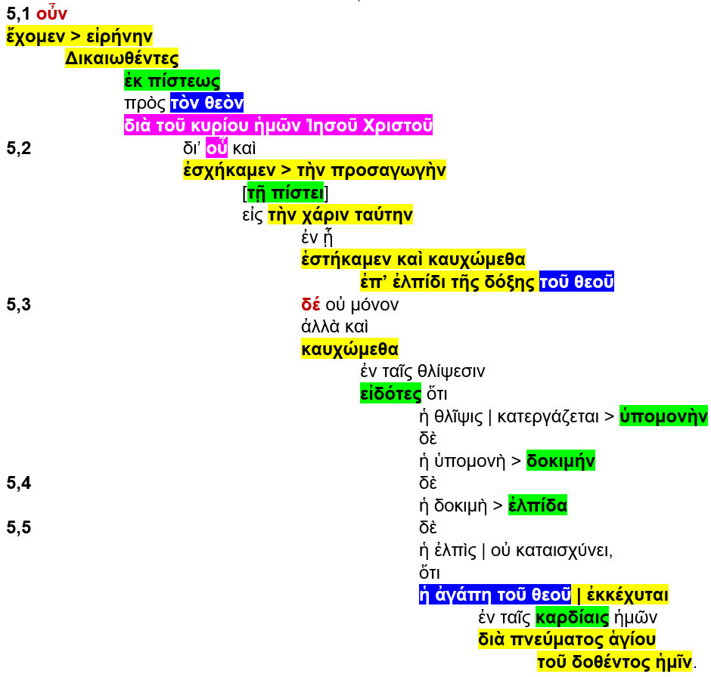

Slide 3
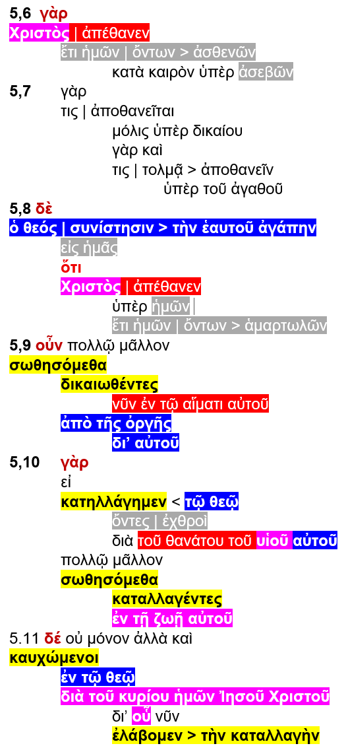

Slide 4
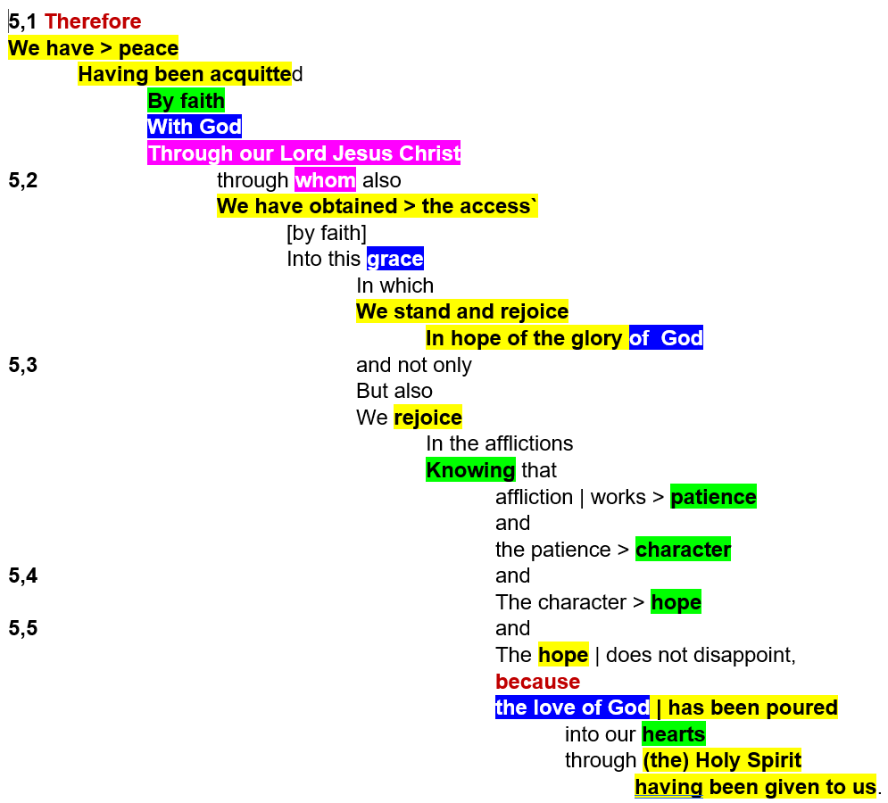

Slide 5
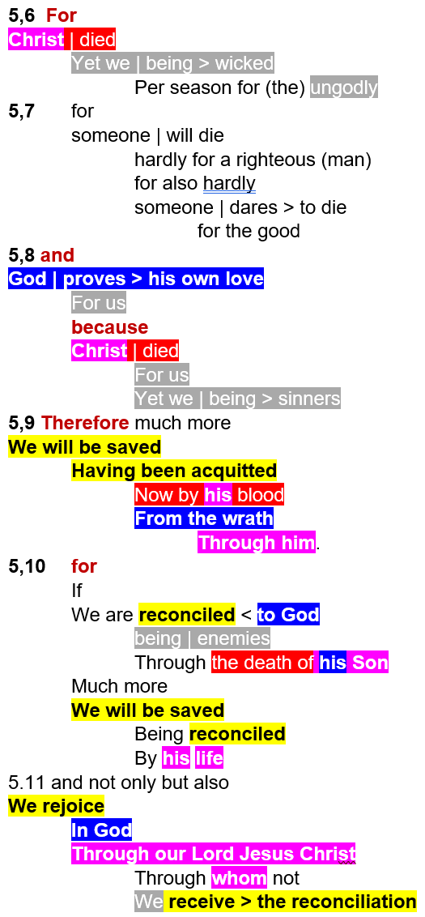

Slide 6
Themes
● God, prove, love, wrath, grace, glory.
● Christ, Lord, Son, died, blood, life.
● Holy Spirit, given, poured out.
● We, wicked, ungodly, sinners, enemies.
● Faith, know, patience, character, hope.
● Peace, access, stand, rejoice, saved.
● Reconciled, acquitted.

Slide 7
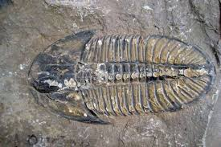
Outline
Peace with God. 5:1-5
Having been acquitted.
Access through Jesus Christ.
God’s love for us.
For Christ died for us. 5:6-11
God proves his love for us.
We will be saved from wrath.
We are reconciled and we rejoice.

Slide 8
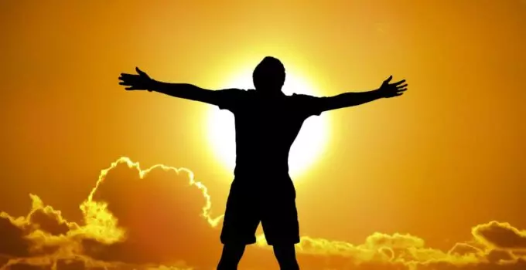
Romans 5:1-5 (NRSVue)
¹ Therefore, since we are justified by faith, we have peace with God through our Lord Jesus Christ,
² through whom we have obtained access to this grace in which we stand, and we boast in our hope of sharing the glory of God.
● Therefore:
● Stand:
Because of chapters 1-4.
Positional salvation.

Slide 9
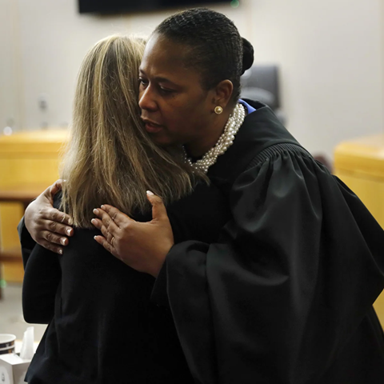
Romans 5:1-11 (GJC)
¹ Therefore, since God has acquitted us who believe him, we are at peace with Him, because our Lord Jesus the Messiah died for us.
● Acquitted:
● Believe:
● Died:
● Lord:
Declared innocent.
Lit., ‘from faith’.
Rom 4:25; 5:6, 8, 10.
We obey his commands.

Slide 10
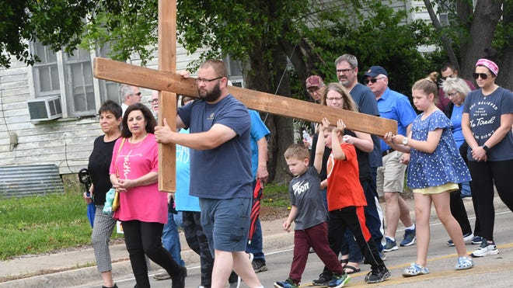
Romans 5:1-11 (GJC)
² By our faith in Jesus, we have also received access into this kindness,
in which we have taken our stand.
And we boast about expecting to share in the glorious future which God promises.
● Received:
● Taken:
● Boast:
Perfect tense = on going.
Perfect tense = permanent.
Present tense = actively.

Slide 11
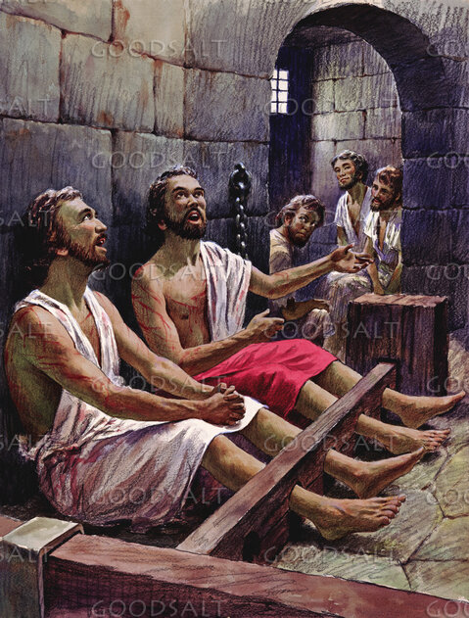
³ And not only that, but we also boast in our afflictions, knowing that affliction produces endurance,
⁴ and endurance produces character, and character produces hope, ⁵ and hope does not put us to shame, …
● Boast:
● Produces:
● Shame:
Present tense, continually.
Lit., works, accomplishes.
≠ 1:16. Here = disappoint.

Slide 12
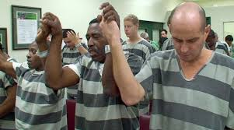
³ And we keep on boasting during times of trouble, because we know that troubles teach us to endure,
⁴ test our character and strengthen our resolve.
● Boast:
● Endure:
● Character:
● Resolve:
Brag about Jesus.
Follow Jesus’ example.
Loving obedience.
To remain faithful to the end.

Slide 13
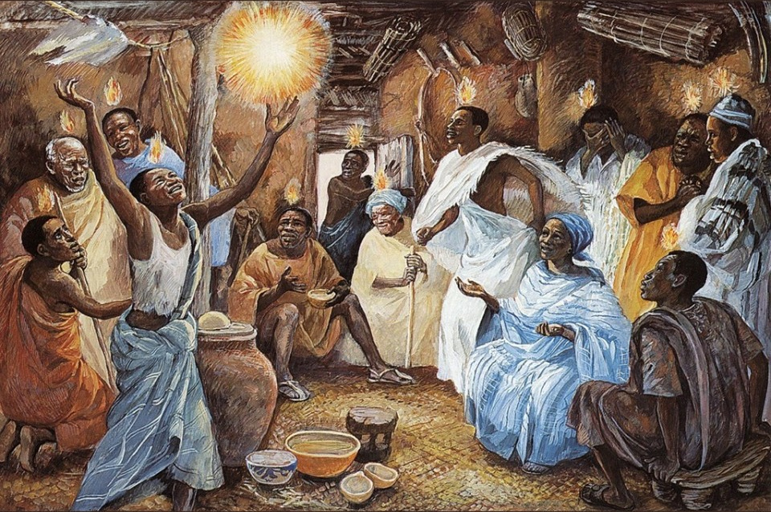
⁵ and hope does not put us to shame, because God’s love has been poured into our hearts through the Holy Spirit that has been given to us.
● Hope:
● Love:
● Heart:
● Given:
Reasonable expectation.
To value above all else.
Inner thoughts, emotions.
Personally, and corporately.

Slide 14
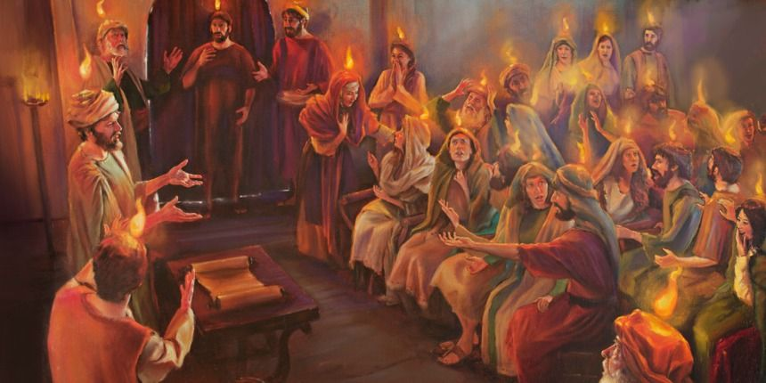
⁵ And waiting for what we expect causes us to want it even more.
This is because God has given to us his Holy Spirit who causes us to experience the love which God has for us.
● Wait:
● Want:
● Experience:
● For us:
Upon Jesus’ return.
Life disappoints everyone.
In the midst of troubles.
More than ours for him.

Slide 15
The Holy Spirit in/among us
● Helper: While Jesus is away from us.
● Assurance: That we belong to Jesus.
● Fruit: Attitude and character change.
● Gifts: Ability to serve, to speak truth.
● Miracles: Messages, healing, freedom.
● Holiness: Evil spirits flee.
● Prayer: He speaks to God within us.

Slide 16
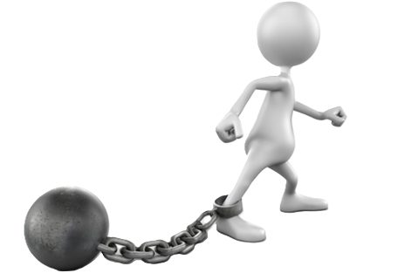
Romans 5:6-11 (NRSVue)
⁶ For while we were still weak, at the right time Christ died for the ungodly.
⁷ Indeed, rarely will anyone die for
a righteous person—though perhaps for a good person someone might actually dare to die.
● Weak:
● Ungodly:
Unable to obey, please God.
Ruled by human desires.

Slide 17
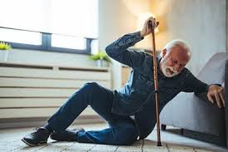
Romans 5:6-11 (GJC)
⁶ Although we were unable to obey God, at his appointed time, the Messiah came and died to help ungodly people.
⁷ (Hardly anybody would die for an honest person, although someone might dare to die for the public good.)
● Unable:
● Appointed:
Ignorant and unwilling.
Revealed in the Tanach.

Slide 18
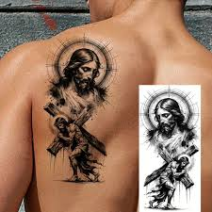
⁸ But God proves his love for us in that while we still were sinners Christ died for us.
⁹ Much more surely, therefore, since we have now been justified by his blood, will we be saved through him from the wrath of God.
● Prove:
● Sinners:
● Blood:
Demo’ed in time & space.
The world, the flesh, the devil.
Metonymy, sacrificial death.

Slide 19
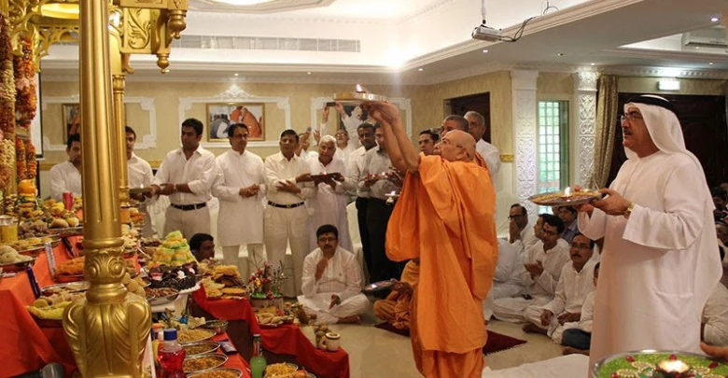
⁸ But God is proving his love for us, in that the Messiah died for us while we were still sinful.
⁹ More than that, then, after acquitting us now, because he died for us, the Messiah will save us from God’s wrath.
● Died:
● Now:
● Will:
Accomplished in past time.
Acquitted in the present time.
Anticipated in the future time.

Slide 20
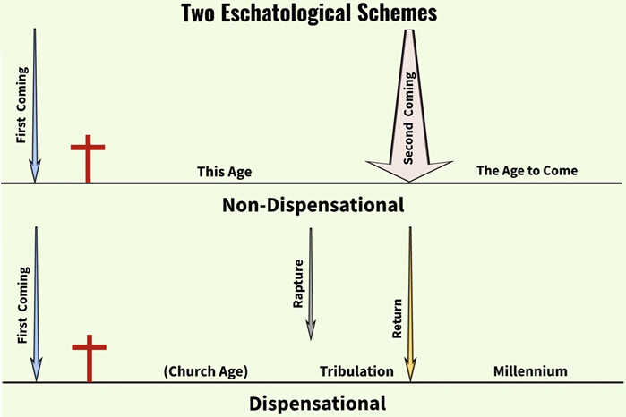
¹⁰ For if while we were enemies we were reconciled to God through the death of his Son, much more surely, having been reconciled, will we be saved by his life.
● Reconcile:
● Death:
● Son:
● Saved:
Eden fellowship restored.
Substitutionary atonement.
Tanach title for Messiah.
Future resurrection.

Slide 21

Tenses of Salvation
● Past perfect:
● Simple past:
● Present:
● Future:
You have been saved (Eph 2:8). Forgiven!
He saved us (Tit 3:5). Received the Holy Spirit.
We are being saved
(2 Cor 1:18). New life.
We will be saved (Rom 5:10). Resurrected.

Slide 22
¹⁰ God reconciled us to himself while we were still his enemies, because his Son Jesus died for us.
So, after having reconciled us, he will certainly save us, by giving to us Jesus’ resurrection life.
● God:
● Enemies:
● Certainly:
● Life:
At his initiative.
Under satanic dominion.
Salvation = a package deal.
Substitutionary life.

Slide 23
¹¹ But more than that, we even boast in God through our Lord Jesus Christ, through whom we have now received reconciliation.
¹¹ And not only will we be saved in the future, but our Lord Jesus Messiah causes us to be boasting about God even now,
because we have accepted to be reconciled to him.

Slide 24
From Romans 5:1-11
1 What struck you as amazing?
2 What answered a question for you?
3 What still puzzles you?
4 What will you think about, today?

Slide 25
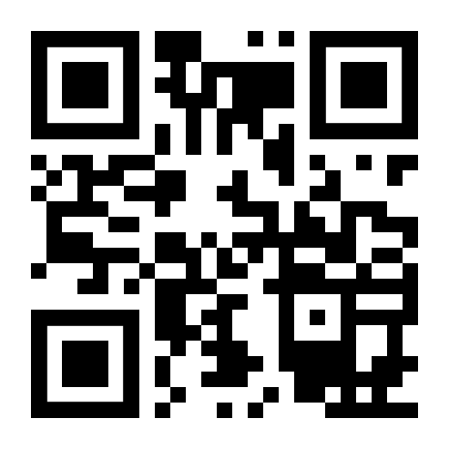
http://romans.forum

