Slide 1
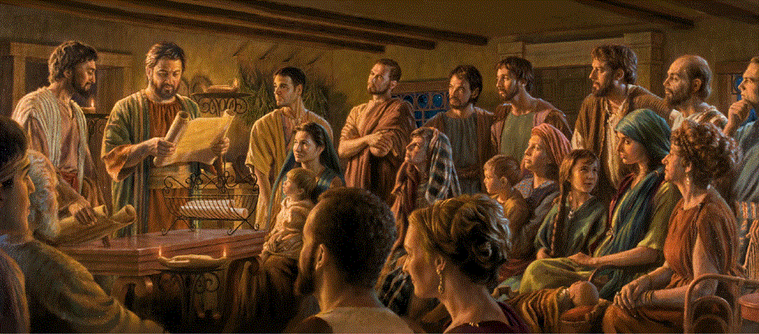
Epistle to the Romans, 5:12-21
A Short Course for Men

Slide 2
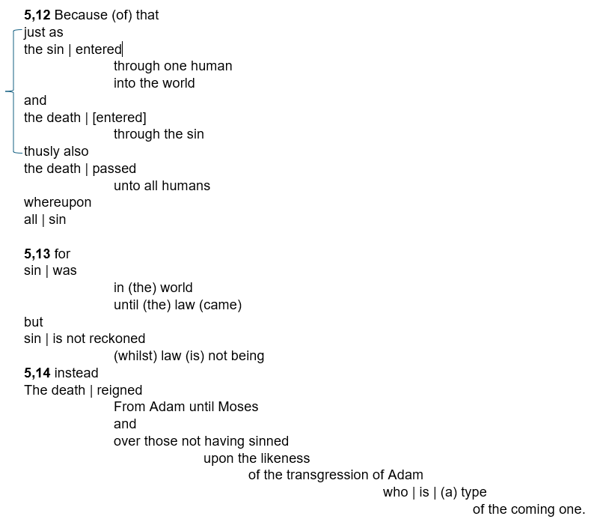

Slide 3
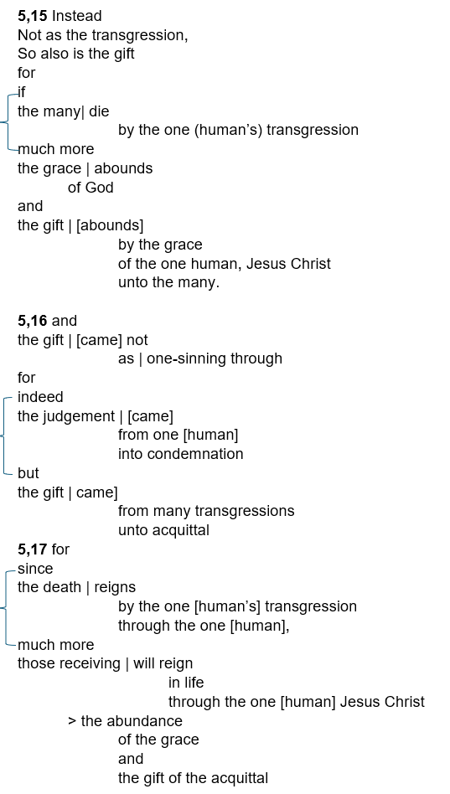

Slide 4
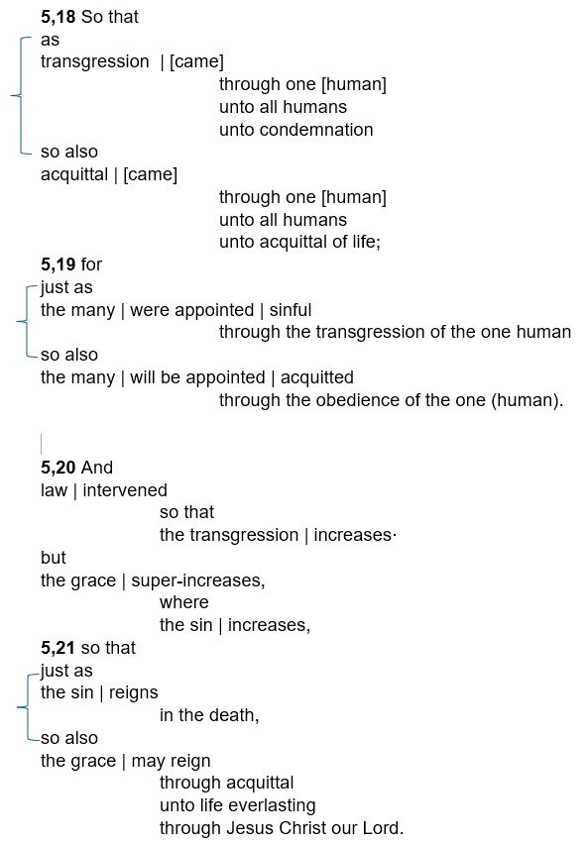

Slide 5
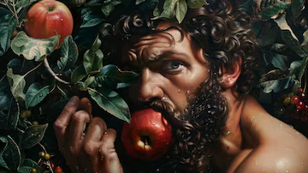
Romans 5:12-21 (NRSVue)
¹² Therefore, just as sin came into the world through one man, and death came through sin, and so death spread to all because all have sinned —
¹³ for sin was indeed in the world before the law, but sin is not reckoned when there is no law.
● Past:
● Present:
Historical aorist: came, was.
Truth aorist: spreads, all sin.

Slide 6
Remedial Greek verb tenses
● Imperfect: what was happening.
● Perfect: what happened with results.
● Present: what is happening.
● Future: what will happen.
● Aorist*: with adverb = past event.
w/o adverb = general truth.
context = any time.
*timeless. See, e.g., Rom. 8:30.

Slide 7
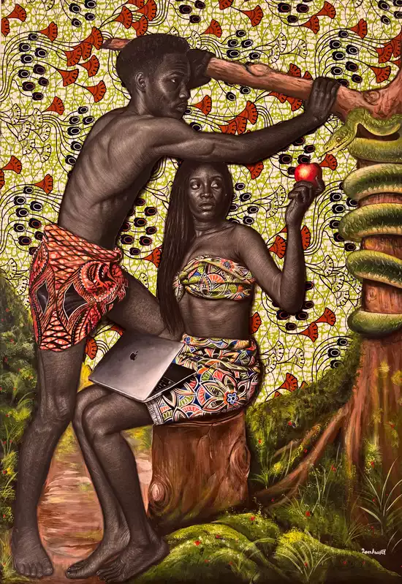
Romans 5:12-21 (GJC)
¹² Sin came into humanity by what one human, Adam, did, followed by death. That is how death comes to all humans,
in that all humans sin.
¹³ Thus, before God revealed his laws, sin was already
in humanity…
● Adam sinned and died.
● We have sinned and must die.

Slide 8
“because all sin” (Romans 5:12)
● Greek: ἐφʼ ᾧ, ef’hoi, “upon which” may be causal (because) or resultant. AD 56
● Latin: in quo, “in whom/which”. 384
● Augustine interpreted Latin “all sinned in Adam” ➔ All inherit Adam’s guilt. 430
● Augustine ➔ Calvin ➔ total depravity.
● But it is death, not guilt, which passed to all humans.

Slide 9
Implications
1 Adam in Eden = innocent ➔ immortal.
2 Adam = able to sin + able not to sin.
3 Devil tempts Adam ➔ must choose.
4 Adam = mortal + sins ➔ guilt ➔ died.
5 All humans = able to sin. (not to sin?)
6 World + flesh + devil ➔ all are tempted.
7 All humans sin ➔ guilt ➔ die.
8 Law ➔ conscience ➔ sin ➔ more guilt.

Slide 10
9 Adam ➔ Jesus = mortal + tempted.
10 If Adam’s guilt ➔ all humans, then Jesus guilty ➔ various theologies.
11 Jesus = human: able to sin
+ divine: able not to sin.
12 Jesus ➔ obedient ➔ died innocent.
13 Faith in Jesus ➔ forgiven ➔ saved.
14 Reject Jesus ➔ guilt ➔ die forever.
15 Innocent humans ➔ no guilt ➔ saved.

Slide 11
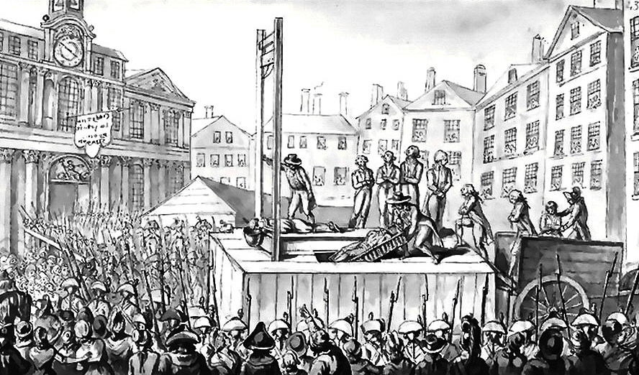
¹⁴ Yet death reigned from Adam to Moses, even over those who did not sin in the likeness of Adam, who is a pattern of the one who was to come.
● Death:
● Moses:
● Sin:
● Pattern:
● One:
Spirit ➔ body ➔ forever.
Written laws ➔ sin ➔ guilt.
Disobey God’s revealed will.
Consequences for everyone.
Eve’s, Abe’s & Dave’s ‘seed’.

Slide 12

¹⁵ But the free gift is not like the trespass. For if the many died through the one man’s trespass,
[then] much more surely have the grace of God and the gift in the grace of the one man, Jesus Christ, abounded for the many.
● Free gift:
● Aorist:
● Gift:
First mention. Known idea.
General truths ‘die … abound’
Father’s grace, Son’s gift.

Slide 13
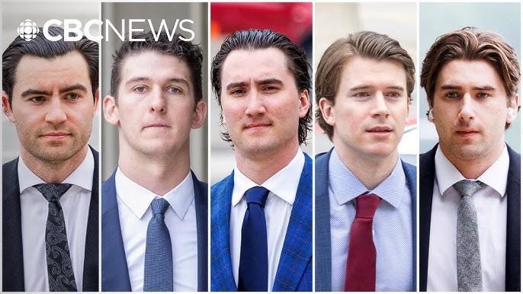
¹⁶ And the gift is not like the effect
of the one man’s sin. For the judgment following one trespass brought condemnation,
but the gift following many trespasses brings justification.
● Gift:
● Sin:
● Gift:
● Trespass:
dōrea, object or privilege.
Pres. part. = sinful action.
charisma, act of grace.
Violation ➔ acquittal.

Slide 14

¹⁷ If, because of the one man’s trespass, death reigned through that one,
much more surely will those who receive the abundance of grace and the gift of righteousness reign in life through the one man, Jesus Christ.
● Reign:
● receive:
● Will:
Aorist: “is reigning”.
Present: “are receiving”.
Temporal or logical future.

Slide 15
¹⁸ Therefore just as one man’s trespass led to condemnation for all,
so one man’s act of righteousness leads to justification and life for all.
● Trespass:
● Condemn:
● One act:
● Justify:
● For all:
Disobeyed one command.
Spiritual & physical death.
Endured death on a cross.
Acquittal ➔ everlasting life.
For all ➔ to all who believe.

Slide 16
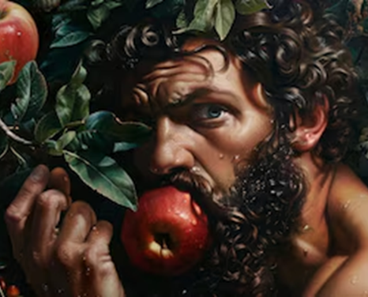
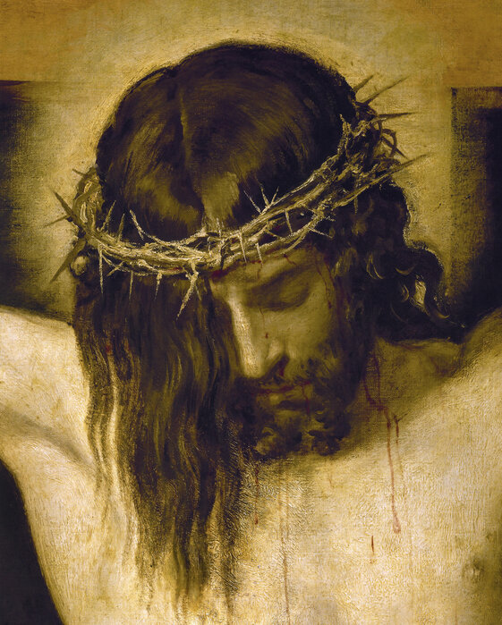
¹⁹ For just as through the one man’s disobedience the many were made sinners,
so through the one man’s obedience the many will be made righteous.
● The one man:
● The many:
● Made sinners:
● Made righteous:
(a) Adam, (b) Christ.
In contrast to ‘one’.
This is unfair!
This is unfair!

Slide 17
“All”
● All, without exception.
● Almost everyone, or everything.
● All those which we are talking about.
● All those which I am thinking about.
● All, with certain exceptions.
➔ When the Bible says ‘all’, always ask, “All which?” or “Which all?”

Slide 18
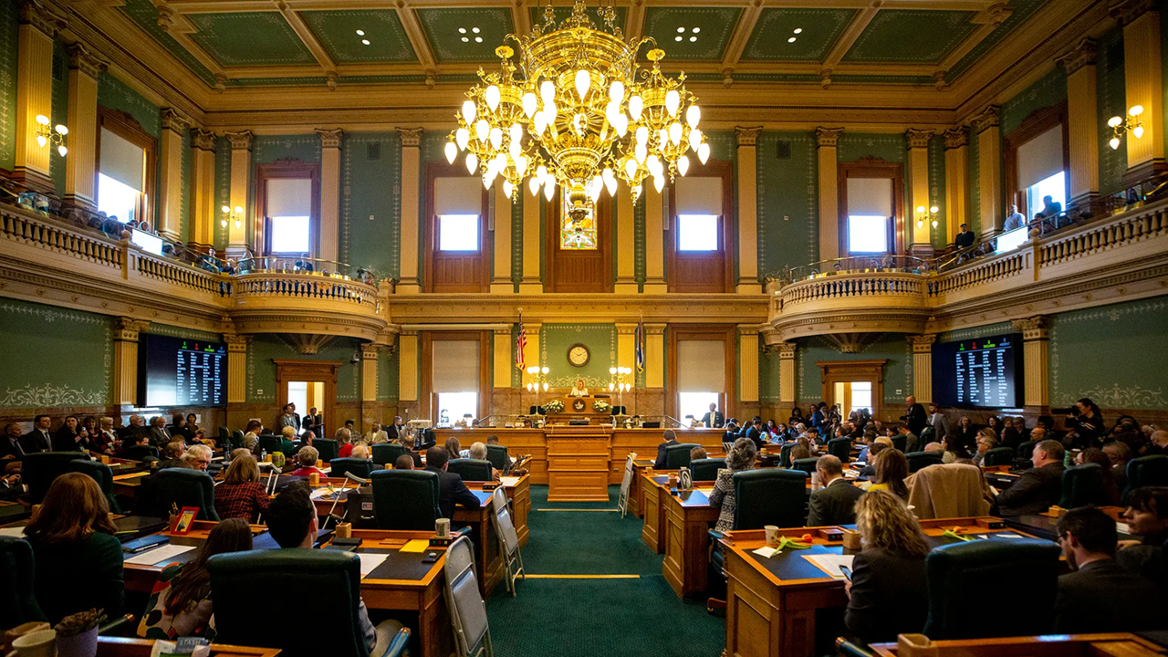
²⁰ But law came in, so that the trespass might increase, but where sin increased, grace abounded all the more,
²¹ so that, just as sin reigned in death, so grace might also reign through justification leading to eternal life through Jesus Christ our Lord.
● Increase:
● Eternal:
⬅ The severity of sin & death.
Far surpasses short lifetime.

Slide 19

http://romans.forum

