Slide 1
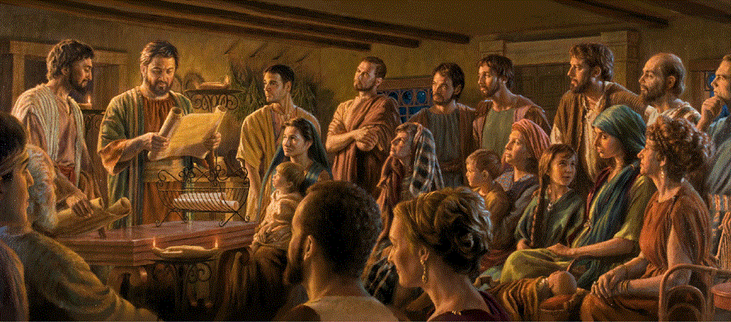
Epistle to the Romans, Intro
A Short Course for Men

Slide 2
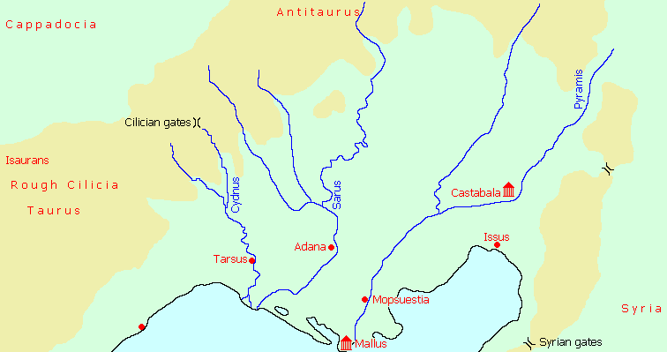
Author: Who wrote Romans?
¹ Paul, a servant of Christ Jesus, called to be an apostle…
● Saul, from Tarsus, Cilicia.
● Born circa AD 5, martyred AD 67.
● Greek-speaking diaspora Jew.
● Pharisee, student of Gamaliel.
● Persecutor of early Jewish Christians.
● Converted to Christ circa AD 35.

Slide 3
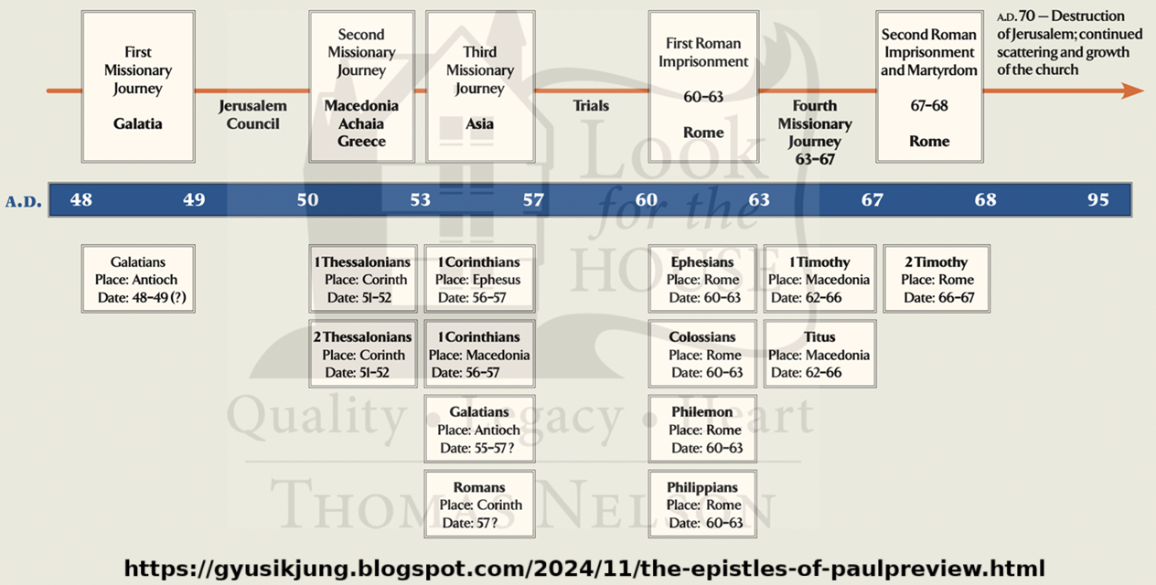

Slide 4
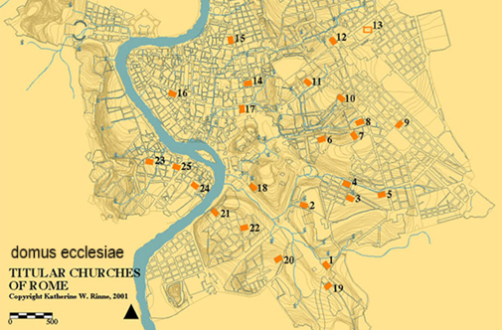
Recipients: Who were the Romans?
● House-based gatherings in Rome.
● Gentile converts of the Petrine mission.
● Jewish Christians from Pentecost.
● Converts from the Pauline mission.
● Banished from Rome by Claudius in AD 49, Jews returned upon his death in 54.
● Mixed freemen and slaves.
● 20th century archeology & documents.

Slide 5
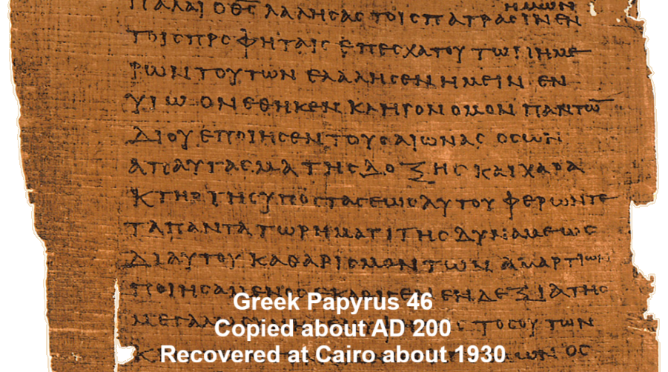
History: Proof for Romans
● Composed in Greek at Corinth or nearby at Cenchreae around AD 57.
● Papyrus 46, c. 175–225 CE, fragments of chapters 5-6, 8-15.
● Greek codices Vaticanus (c AD 335), Sinaiticus (c 345, Alexandrinus (c 420).
● Cited by the earliest Christian writers.
● Accepted by all churches as canonical.

Slide 6
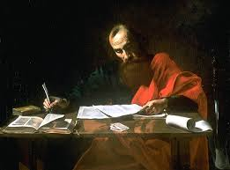
Purpose: Why did Paul write it?
● To explain from Scripture Paul’s doctrines about salvation (1:16).
“The gospel … is God’s saving power for everyone who believes, for the Jew first and also for the Greek. For in it the righteousness of God is revealed through faith for faith.”

Slide 7
Purpose: Why did Paul write it?
● To strengthen relations between Jewish and Gentile Christians (9:24)
“He has done so in order to make known the riches of his glory for the objects of mercy, which he has prepared beforehand for glory—including us whom he has called, not from the Jews only but also from the gentiles.”

Slide 8
Purpose: Why did Paul write it?
● To defend Paul’s apostolic call to evangelize Gentiles (11:13).
“Now I am speaking to you gentiles. Inasmuch as I am an apostle to the gentiles, I celebrate my ministry in order to make my own people jealous and thus save some of them.”

Slide 9
Purpose: Why did Paul write it?
● To solicit material support for Paul’s mission to Spain (15:24).
“I desire, as I have for many years, to come to you 24 when I go to Spain. For I do hope to see you on my journey and to be sent on by you, once I have enjoyed your company for a little while.”

Slide 10

Importance: Why does it matter?
● Romans remains the longest, most systematic of Paul’s extant epistles.
● Ancient and modern Christian theologies appeal to this epistle.
● Romans was a major source of ideas for the Protestant Reformation.
● It is frequently cited by conservative Christians for doctrine and comfort.

Slide 11
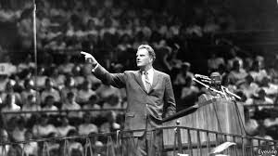
Themes: What is Romans about?
● God’s message about his Son (1:1-3).
● God’s righteousness = (a) his loyalty to his covenant; (b) always doing the right thing or judging wrong things.
● Righteousness from God = (a) reckoned true for the repentant (“justification”),
(b) making sinful people right with God.

Slide 12
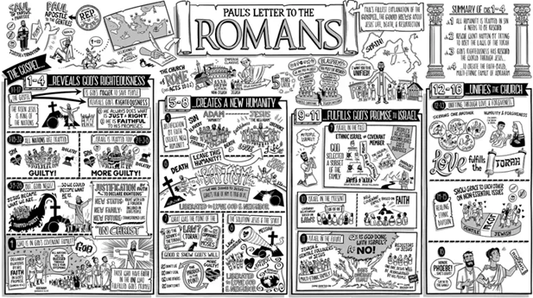
Structure: What are its sections?
● Chapters 1-4: The appearance of the Messiah & the content of his message.
● Chapters 5-8: Christian victory over sin & experience new life by God’s Spirit.
● Chapters 9-11: Israel’s failure and God’s mercy for all who believe.
● Chapters 12-16: Christian behavior, mission and Jewish-Gentile relations.

Slide 13
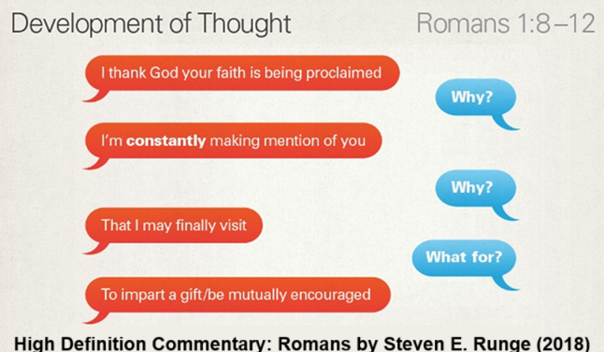
Style: How does Paul write?
● Having no authority in Rome, Paul writes in a kind, gentle, indirect manner.
● He employs many Greco-Roman rhetorical devices:
● He digresses often, anticipating readers’ queries or objections.
● He often appeals to the Tanakh, Israel’s & early Christians’ sacred scriptures.

Slide 14

Accusations: What do skeptics say?
● Paul transformed Jesus’ teaching into a new, different religion.
● Paul explained Jesus’ crucifixion with pagan sacrificial ideas.
● By replacing Israel, Paul laid the basis for antisemitism.
● Justification by faith alone leads to lawless, immoral behavior.

Slide 15

This course: Our objectives
● To provide content for discussion groups in homes and churches.
● To inform lay ministers in house churches and emerging congregations.
● Not a substitute for academic courses or for scholarly commentaries.
● To experience courage and hope through the holy Scriptures (15:4).

Slide 16
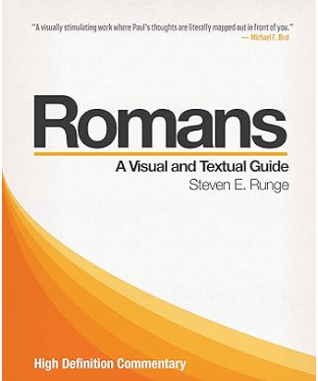
Commentaries: What does it mean?
● There are many. Read in one which you find helpful.
● Scholars use ones by James D. G. Dunn (2015) and by D. J. Moo (2018).
● We shall follow Steven E.Runge (2014)
● And consult N. T. Wright (2002)

Slide 17
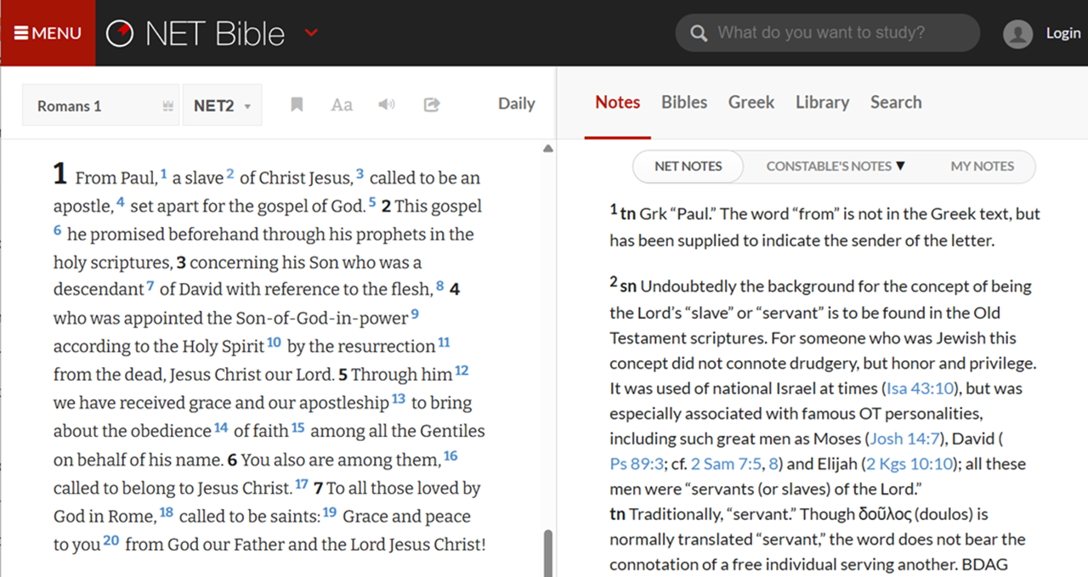
Versions: Which translation?
● Read in any versions which you enjoy.
● Compare versions at biblehub.com
● Find helpful notes, Greek text and commentary at netbible.org
● Consult the on-line Greek-English interlinear New Testament for Romans.
● Galen will (sometimes) provide a ‘dynamic equivalent’ translation.

Slide 18

Assignment: How to prepare?
● Read Romans chapter 1 in different versions or languages.
● Ponder, outline, analyze Romans 1:1-7.
● Prepare comment and queries which you may share with your group.
● Pray briefly each day for the Holy Spirit to enlighten us all with God’s words.
● Visit our web site at: …

Slide 19
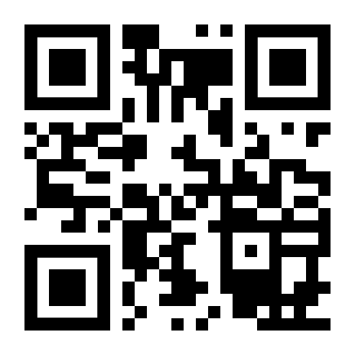
http://romans.forum

Slide 21
…
¹ Verse
¹ Verse
● Text: …

Slide 22
¹ Verse
¹ Verse
● Text: …

Slide 23
Titre
● …: …
● …: …
● …: …
● …: …
● …: …
● …: …
● …: …
● …: …

Slide 24
Titre
● …
● ...
● ...
● ...
● ...

Slide 25
Discuss
?
● …
● …
● …
● …

Slide 26
…

