Slide 1
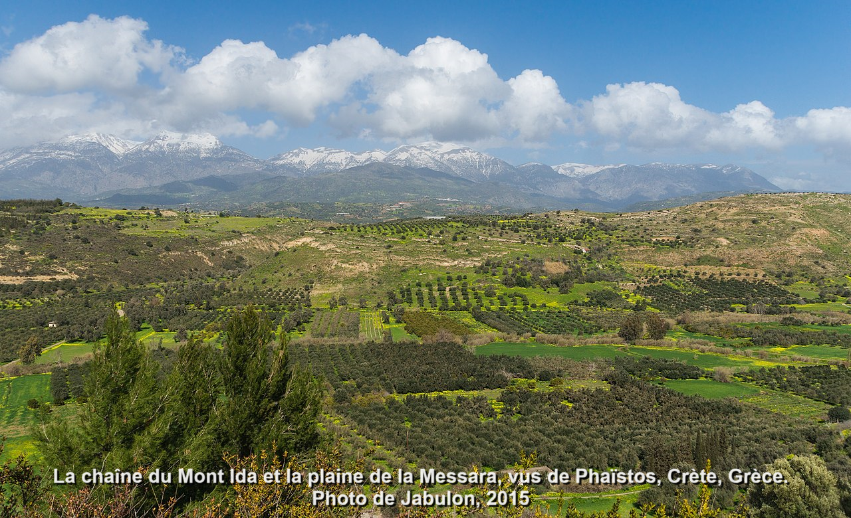
Paul’s Epistle to Titus
Introduction and Chapter 1
29 August 2024

Slide 2
History of Crete Island
Century BC
5 Pirate city-states
4 War between city-states
3 Hellenization by Madedon & Rhodes
2 Rise of Ierapetra
1 Roman wars and annexation
Century AD
1 Christian mission

Slide 3
Paul’s mission to Crete
Eusebius: “Second imprisonment … wrote second epistle to Timothy…” Ecclesiastical History, 2:22:2 (3rd cent.).
Hypothesis: Following his first imprisonment in Rome, Paul went to Spain and to Crete, between AD 62 and 66, with Titus as his coworker.

Slide 4
Titus
Accompanied Paul to Jerusalem (Gal. 2:1-3). Paul sent him to Corinth (2 Cor. 7:13, 8:23, 2 Tim. 4.10), later to Dalmatia.
● A ‘Greek, he resisted circumcision when under pressure from Judaizers.
● A ‘brother’, ‘child’, partner, coworker, and of a ‘same spirit’ to Paul.
● Marked by ‘joy’ and ‘earnest care’.

Slide 5
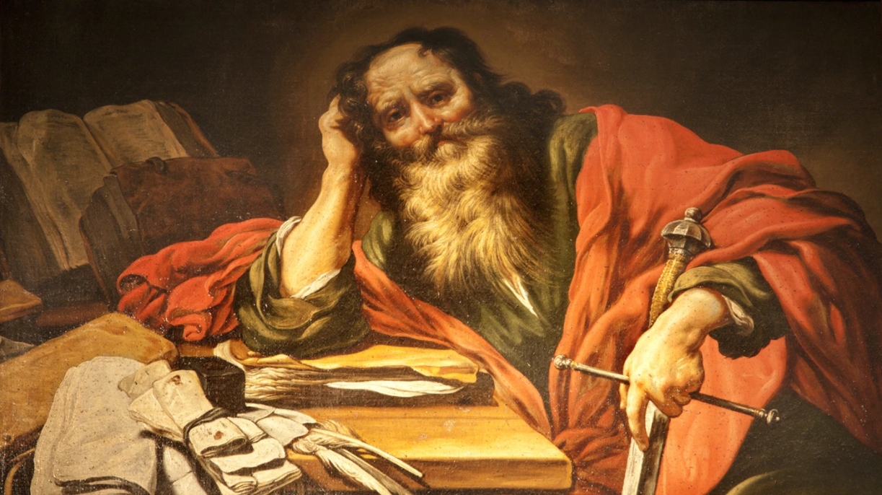
Is this epistle pseudepigrapha?
Do differences between Paul’s general epistles and the pastorals imply forgery?
● Existing pseudepigrapha do not include ‘apostolic’ epistles.
● The early churches recognized the pastorals as authentic.
● They are personal and more technical.
● They may be written by amanuensis.

Slide 6
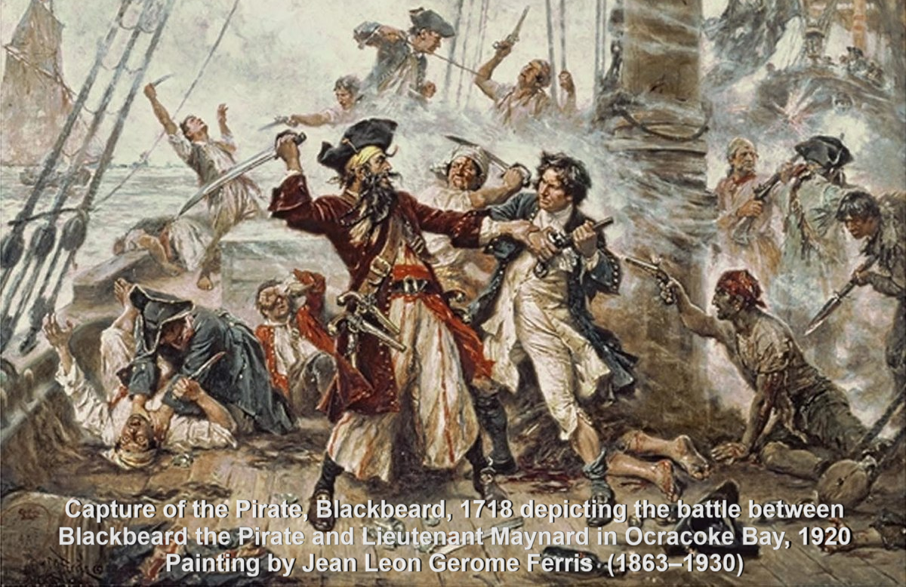
Titus, in an undisciplined society
Chapter 1. CHRISTIAN MINISTRY.
1. Ministry message, 1:1-4
2. Ministry task, 1:5
3. Ministry qualifications, 1:6-9
4. Ministry challenge, 1:10-16
Chapter 2. CHRISTIAN PRESENCE.
Chapter 3. CHRISTIAN IDENTITY.

Slide 7
Titus: Our message
¹ Paul, a servant of God and an apostle of Jesus Christ to further the faith of God’s elect and their knowledge of the truth that leads to godliness —
● Servant:
● Apostle:
● Elect:
● Godliness:
Love servant, Deut 15:16-17.
Envoy sent with authority.
Chosen to receive life.
Deep respect for deity.

Slide 8
Titus: Our message
² in the hope of eternal life, which God, who does not lie, promised before the beginning of time, …
● Hope:
● Eternal:
● Promised:
● Before:
Promise ➔ expectation.
‘Of the (coming) age’
Where in the Hebrew Bible?
Lit., ‘before eternal ages’.

Slide 10
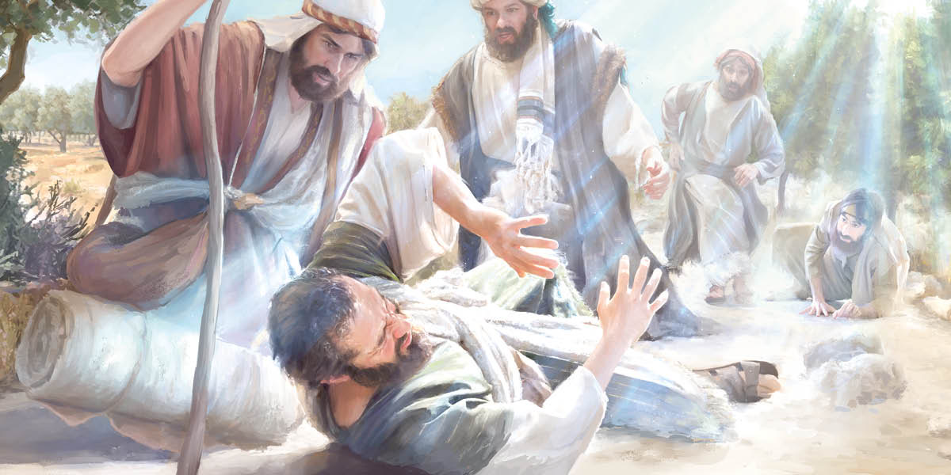
Titus: Our message
³ and which now at his appointed season he has brought to light through the preaching entrusted to me by the command of God our Savior, …
● Season:
● Preaching:
● Entrust:
● Command:
Lit., ‘own times’. (Whose?)
Public declaration (sermon?)
Assumes loyal faith (pistis).
Fake apostles self-appoint.

Slide 11
Titus: Our message
⁴ To Titus, my true son in our common faith:
Grace and peace from God the Father and Christ Jesus our Savior.
● True son:
● Common:
● Grace:
● Peace:
Common title for disciples.
Shared (koinos).
Kindness that empowers.
Harmonious relations.

Slide 12
Titus: Our task = empower others
⁵ The reason I left you in Crete was that you might put in order what was left unfinished and appoint elders in every town, as I directed you.
● Order:
● Appoint:
● Elder:
● Town:
Straighten, correct.
‘Put’. Neither hire nor elect.
‘Older’. Official.
No central authority (yet).

Slide 13
The Pauline Church-Planting Cycle
Acts 14:21-24
1 Announce Gospel in several places.
2 Make disciples (quickly).
3 Return to each place repeatedly.
4 Strengthen the disciples’ faith.
5 Appoint elders.
6 Pray to commit them to the Lord.
7 Go do the same elsewhere.
⬅ The work had halted.

Slide 14
Titus: domestic qualifications
⁶ An elder must be blameless, faithful to his wife, a man whose children believe and are not open to the charge of being wild and disobedient.
● Blameless:
● Faithful:
● Whose:
● Charge:
Perfect? Then what?
‘Man of one woman’.
‘Having children who...’
Accused, accusable.

Slide 15
Titus: ethical qualifications
⁷ Since an overseer manages God’s household, he must be blameless— not overbearing, not quick-tempered, not given to drunkenness, not violent, not pursuing dishonest gain.
● Overseer:
● Manages:
● Drunken:
Episkopos, ‘overseer’.
Oikonomon, ‘steward’.
2 parts water, 1 part wine.

Slide 16
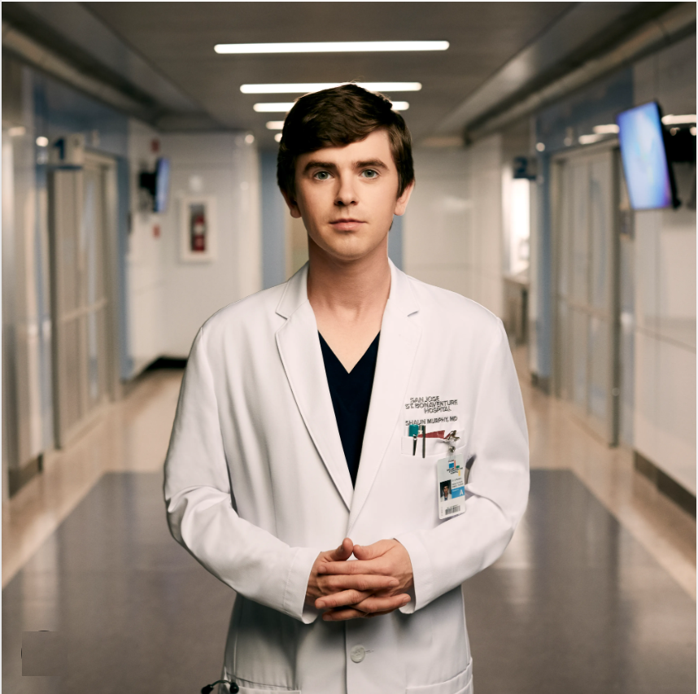
Titus: personal qualifications
⁸ Rather, he must be hospitable, one who loves what is good, who is self-controlled, upright, holy and disciplined.
● Hospitable:
● Controlled:
● Upright:
● Holy:
● Disciplined:
Care for the needy.
Wise minded. (ideas)
Law abiding. (limits)
God fearing. (faith)
Inner strength. (appetites)

Slide 17
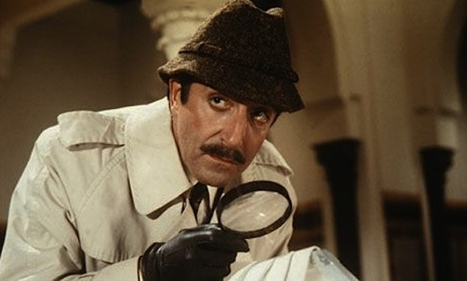
Titus: doctrinal qualifications
⁹ He must hold firmly to the trustworthy message as it has been taught, so that he can encourage others by sound doctrine and refute those who oppose it.
● Taught:
● Encourage:
● Sound:
● Doctrine:
Noun: content from Jesus.
‘Invite’ to embrace reality.
Correct, free from error.
As transmitted by apostles.

Slide 18
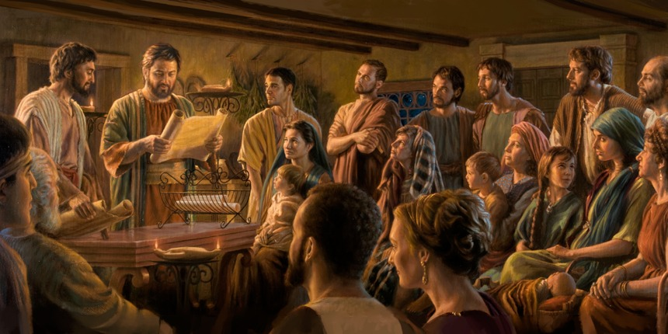
Titus: house-churches
¹⁰ For there are many rebellious people, full of meaningless talk and deception, especially those of the circumcision group. ¹¹ They must be silenced, because they are disrupting whole households [house-churches] by teaching things they ought not to teach—and that for the sake of dishonest gain.

Slide 19
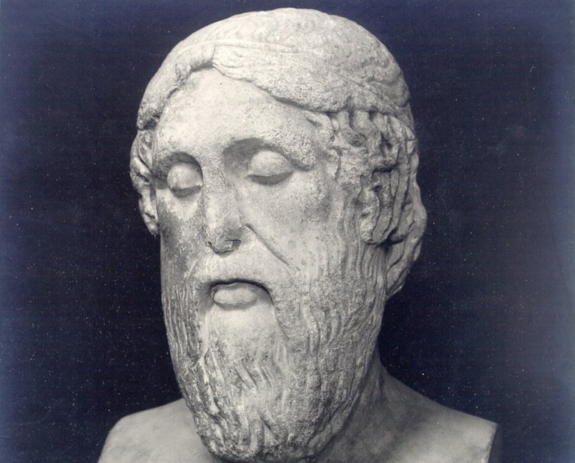
Titus: Epimenides
¹² One of Crete’s own prophets has said it: “Cretans are always liars, evil brutes, lazy gluttons.”
Epimenides (7th or 6th century BCE) in his work titled Cretica, quoted in Callimachus’ Hymn to Zeus. The Cretan lie was to teach that Zeus was mortal.

Slide 20
Titus: Rebuke them
¹³ This saying is true. Therefore rebuke them sharply, so that they will be sound in the faith ¹⁴ and will pay no attention to Jewish myths or to the merely human commands of those who reject the truth.
Hellenistic Jews were prolific writers, expanding on biblical accounts. The Book of Enoch is even quoted in the NT.

Slide 21
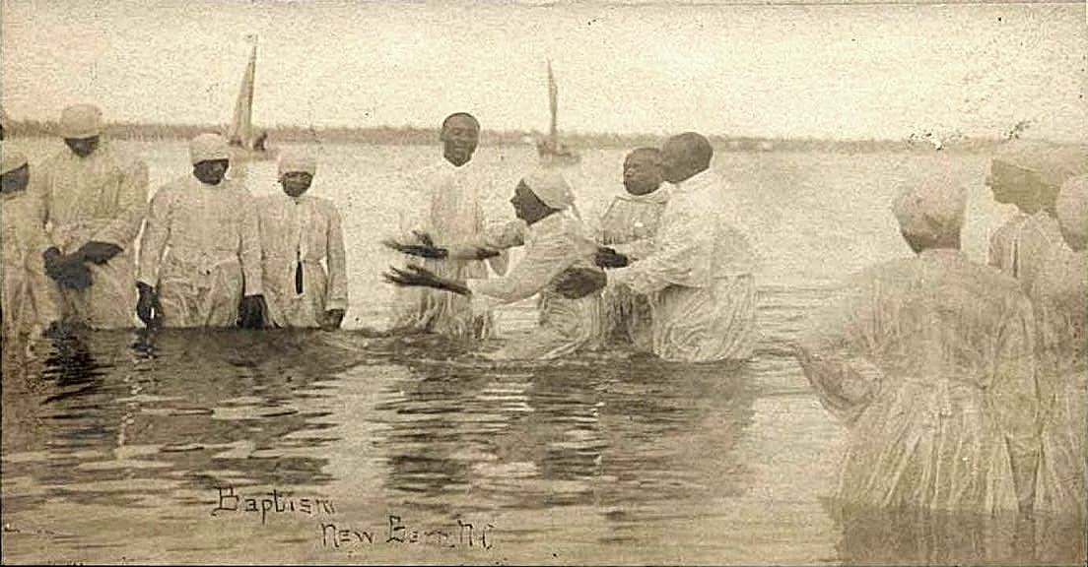
Titus: the pure
¹⁵ To the pure, all things are pure, but to those who are corrupted and do not believe, nothing is pure. In fact, both their minds and consciences are corrupted.
● Pure:
● Corrupted:
Baptized, forgiven believers.
Non-believers who pretend to abide by rules.

Slide 22
Titus: unfit for doing good
¹⁶ They claim to know God, but by their actions they deny him. They are detestable, disobedient and unfit for doing anything good.
● Detestable:
● Disobedient:
● Unfit:
Justify the wicked. Pr 17¹⁵
To Jesus’ commands.
adokimos. Failed a test.

Slide 23
React:
● What did you learn from this passage?
● From another study participant?
● What do you want to remember?
● What do you want to do about it?
● What could we do together?

