Slide 1
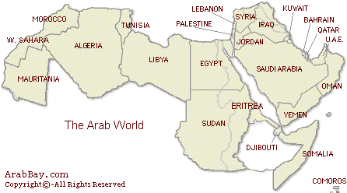
The Arab Spring
Arabic: ‎, al-Thawrāt al-ʻArabiy
(literally “the Arabic Rebellion” or “the Arab Revolution”) © Wikipedia
Understand the Arab World Seminar - www.kingdomconnect.info – Cell 302 388 2728

Slide 2
It is important to realize that due to the Sykes-Picot agreement of 1916 the colonial regimes controlled much of the Arabic speaking world until the second half of the 20th century.
This helps explain why there is an attitude of resentment towards the West and a fear of the reestablishment of their authority over this area.
Understand the Arab World Seminar - www.kingdomconnect.info – Cell 302 388 2728

Slide 3
Year of Independence
Country Year Colonial Power
Algeria 1962 France
Bahrain 1971 Great Britain
Egypt 1922 Great Britain
Iraq 1958 Great Britain
Israel 1948 Great Britain
Lebanon 1943 France
Libya 1951 Italy
Mauritania 1960 France
Morocco 1956 France
Qatar 1971 Great Britain
Saudia Arabia 1972 Great Britain
Sudan 1956 Great Britain
Syria 1946 France
Tunisia 1956 France
United Arab Republic 1971 Great Britain
Yemen 1967 Great Britain
Understand the Arab World Seminar - www.kingdomconnect.info – Cell 302 388 2728

Slide 4
Ideologies in the Arab World 1900-2010
During the last 100+ years, a strong series of ideological movements have swept across the face of the Arab World. Here is a brief outline of some of the major ideological trends often occurring at the same time.
“The only true Ottoman is a Turk”: Arab nationalism movements began at the beginning of the 20th century, as a reaction to the Young Turks’ redefinition of who an Ottoman was, in their efforts to revive the Ottoman Empire in its last ten years (1908-1918).
Understand the Arab World Seminar - www.kingdomconnect.info – Cell 302 388 2728

Slide 5
The Ideologies in the Arab World 1900-2010
Pan-Arab Socialism was promoted by Abdul Nasser the ruler in Egypt for decades. This was to be a Socialism that was Arab led.
Nassarism was a movement which grew out of Pam Arab Socialism due to the iconic influence Nasser had in the Arab World as he stood up to former colonialist powers (Nationalizing the Western Oil companies in Egypt and winning the Suez crisis in 1956).
Understand the Arab World Seminar - www.kingdomconnect.info – Cell 302 388 2728

Slide 6
The Ideologies in the Arab World 1900-2010
Bathism: A secular Socialistic movement which grew out the Baath Party in Syria and Iraq in the 50-70’s.
Materialism: The impact of a booming economy across the Arab world made Arabs really begin to live for the stuff that brought comfort.
Understand the Arab World Seminar - www.kingdomconnect.info – Cell 302 388 2728

Slide 7
The Ideologies in the Arab World 1900-2010
Islamic Fundamentalism as seen in the Muslim Brotherhood (1928), Wahabisim/ Salufism (1740) and Al-Qaeda (1990’s) “Returning to the original faith (of Muhammad) in order to reestablish the Caliphate. The Al-qaeda/Jihadist movement looks at Wahabisim in Saudia Arabia as a “compromised Islam” due to its contact with Western governments and has declared war on it also.
Understand the Arab World Seminar - www.kingdomconnect.info – Cell 302 388 2728

Slide 8
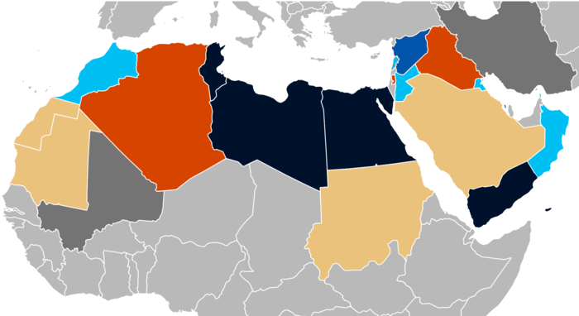
Government overthrown Sustained civil disorder and governmental changes Protests and governmental changes Major protests Minor protests Related crises outside the Arab world
Understand the Arab World Seminar - www.kingdomconnect.info – Cell 302 388 2728

Slide 9
“The Arab Spring”
A Revolt Against Perceived Misrule by Entrenched Extended Families in Countries Across the Arabic Speaking Region -December 18, 2010 to the Present ( 1 Year and 7 months). © Wikipedia
Understand the Arab World Seminar - www.kingdomconnect.info – Cell 302 388 2728

Slide 10
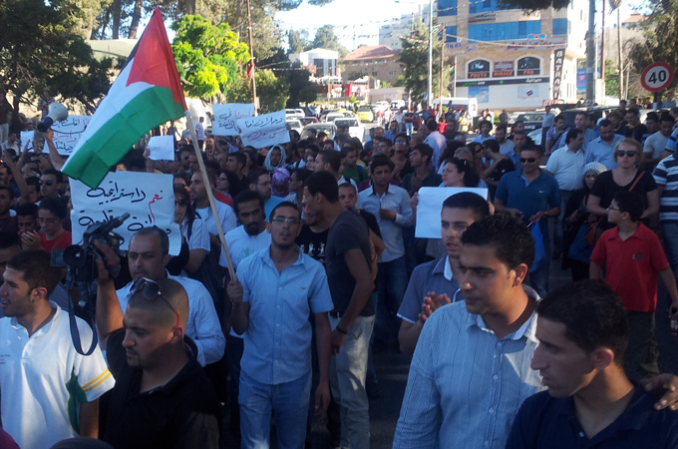
The Event Which Sparked the “Arab Spring”
It was sparked by the first protests that occurred in Tunisia on 18 December 2010 in Sidi Bouzid, following Mohamed Bouazizi's self-immolation in protest of police corruption and ill treatment. ©Wikipedia
Understand the Arab World Seminar - www.kingdomconnect.info – Cell 302 388 2728

Slide 11
Some Causes for the Arab Spring “Rebellion”
Authoritarian states
Demographic structural factors
Government corruption
Human rights violations
Inflation
Kleptocracy
Sectarianism
Unemployment
Understand the Arab World Seminar - www.kingdomconnect.info – Cell 302 388 2728

Slide 12
Prayer Pause #1
Proverbs 29:26
“Men seek out a ruler but justice is from the Lord”
We will now pray for the Arab World at this time of great insecurity and uncertainty. Islamic Arab society government in general is based on a Koranic oligarchical model of government. People grow comfortable with the absolute rule for it provides a sense of security. The Arab Spring has generated a lot of social turmoil and economic chaos.
Understand the Arab World Seminar - www.kingdomconnect.info – Cell 302 388 2728

Slide 13
Prayer Pause #1
“Father you know what you have allowed to happen. In your goal to draw all men to yourself use this social and economic insecurity to draw man and women to cry out to you to find justice. Also reveal your Son to them through dreams and visions. In Jesus name. Amen.”
Understand the Arab World Seminar - www.kingdomconnect.info – Cell 302 388 2728

Slide 14
Goals of Organizers of the Protests © Wikipedia
Democracy
Free and fair elections
Human rights
Regime change
Understand the Arab World Seminar - www.kingdomconnect.info – Cell 302 388 2728

Slide 15
Prayer Pause #2
God’s Church
The Christians in the Middle East have experienced attacks and suffering where there is a lack of a strong secular government, which often favors the Christian church like Saddam did in Iraq, to balance out the power of the Islamic or Communist influences in their particular country. Yet this is purifying when handled correctly.
Understand the Arab World Seminar - www.kingdomconnect.info – Cell 302 388 2728

Slide 16
Prayer Pause #2
“Father you know what you have allowed to happen. In your goal to draw all men to yourself use this social and economic insecurity to draw man and women to cry out to you to find justice. Also reveal your Son to them through dreams and visions. In Jesus name. Amen.”
Understand the Arab World Seminar - www.kingdomconnect.info – Cell 302 388 2728

Slide 17
The Methods Being Used By the Protestors to Promote the Overthrow of Arab Regimes © Wikipedia
Civil disobedience
Civil resistance
Defection
Demonstrations
Online activism
Protest camps
Rebellion
Revolution
Understand the Arab World Seminar - www.kingdomconnect.info – Cell 302 388 2728

Slide 18
The Methods Being Used By the Protestors to Promote the Overthrow of Arab Regimes © Wikipedia
Riots
Self-immolations
Strike actions
Uprising
Urban warfare
Understand the Arab World Seminar - www.kingdomconnect.info – Cell 302 388 2728

Slide 19
Casualties
Death(s) 45,857–52,566+
(International estimate) © Wikipedia
The Estimated Death Totals of the “Arab Spring” Protests During the last 19 months since December 2010
Understand the Arab World Seminar - www.kingdomconnect.info – Cell 302 388 2728

Slide 20
Ongoing Protests (As of July 2012)
Ongoing protests in Saudi Arabia, Sudan, Mauritania and some other countries (c)Wikipedia:
Tunisian President Ben Ali ousted, and government overthrown.
Egyptian President Hosni Mubarak ousted, and government overthrown.
Libyan leader Muammar Gaddafi killed after a civil war with foreign military intervention, and government overthrown.
Understand the Arab World Seminar - www.kingdomconnect.info – Cell 302 388 2728

Slide 21
Ongoing Protests (As of July 2012)
Ongoing protests in Saudi Arabia, Sudan, Mauritania and some other countries (c)Wikipedia:
Yemeni President Ali Abdullah Saleh ousted, and hands power to a national unity government.
Syria experiences armed conflict between the government and opposition forces.
Civil uprising against the government of Bahrain, despite government changes.
Understand the Arab World Seminar - www.kingdomconnect.info – Cell 302 388 2728

Slide 22
Ongoing Protests (As of July 2012)
Ongoing protests in Saudi Arabia, Sudan, Mauritania and some other countries (c)Wikipedia:
Kuwait, Lebanon, and Oman implementing government changes in response to protests.
Morocco and Jordan implementing constitutional reforms in response to protests.
Understand the Arab World Seminar - www.kingdomconnect.info – Cell 302 388 2728

Slide 23
Prayer Pause #3
John 12:28
“I have glorified Myself and I will
Glorify Myself again”
The Arab Spring has created the probability of change economically, politically, religiously and socially. This is not necessarily positive change as the organizers of the ‘social media revolution’ intended. Yet God did allow it and God is determined to glorify his name so we can be confident that he will use the stresses and struggle to draw people into his kingdom.
Understand the Arab World Seminar - www.kingdomconnect.info – Cell 302 388 2728

Slide 24
Prayer Pause #3
Because all of us have experienced His guiding hand, we have confidence that God is wiser than we are and that he is God in all of his purposes.
Understand the Arab World Seminar - www.kingdomconnect.info – Cell 302 388 2728

Slide 25
Prayer Pause #3
“Father we know your ways are beyond our understanding, yet we see around this world miracles of your changing power in the lives of individuals and families. We know you are determined to glorify your name and we ask to work all across this region known as the Arab world to do just that and we will continue to trust in your sovereignty. Amen”
Understand the Arab World Seminar - www.kingdomconnect.info – Cell 302 388 2728

