Slide 1
Repentance
“Change your ways!”
June 2024
Reference

Slide 2
A biblical theology
1. Read through the Scripture.
2. Identify recurring themes.
3. Assemble passages dealing with a theme.
4. Analyse and compare those passages.
5. Outline their content.
6. Formulate a tentative teaching.
7. Ask others to assess that teaching.
8. Share that teaching humbly.

Slide 3
Repentance, definition (BDAG)
Noun
● Metanoia: meta = ‘change’ + noia = ‘mind’
● Meaning: ‘turning about, conversion’
Verb
● Metanoeō: meta = ‘change’ + noeō = ‘think’
● Meaning: 1 to change one’s mind.
2 to feel remorse [sorry], to repent, to be converted.

Slide 4
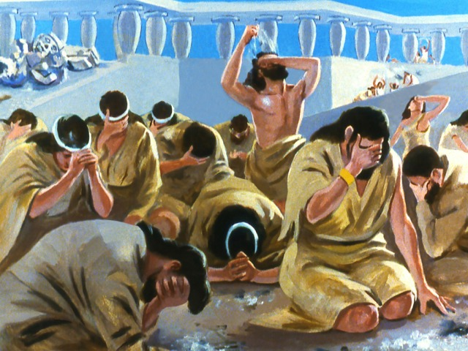
First Testament repentance
● When in captivity (1 Kings 8:47)
● Any man (Psa. 7:11-12)
● Jerusalemites (Jer. 5:3; 8:4-5; 15:7; 26:3)
● Israelite idolators (Eze. 14:5-7; )
● Israelite transgressors (Eze. 18:30-32; 33:11)
● Israel nation (Isa. 9:13)

Slide 5
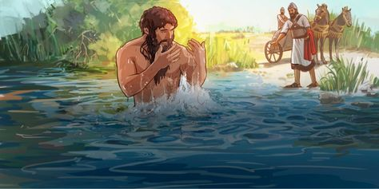
First Testament examples
● Job (a righteous man, Job 42:6)
● Rahab (a pagan woman, Josh. 2:11)
● Jonah (a prophet of God, Jon. 2:7)
● Ninevites (wicked people, Jon. 3:8; Lk 11:32)
● David (a believing king, Psa. 51)
● Ruth (a pagan widow, Ruth 1:14-15)
● Naaman (a pagan soldier, 2 Kings 5:17b)

Slide 6
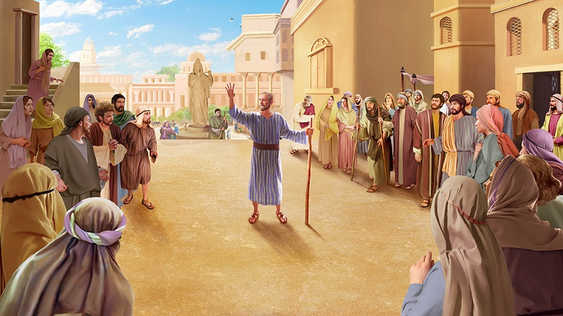
The Ninevites
⁴ Jonah began to go through the city one day's walk; and he cried out and said, “Yet forty days and Nineveh will be overthrown.”
⁵ Then the people of Nineveh believed in God; and they called a fast and put on sackcloth from the greatest to the least of them.

Slide 7
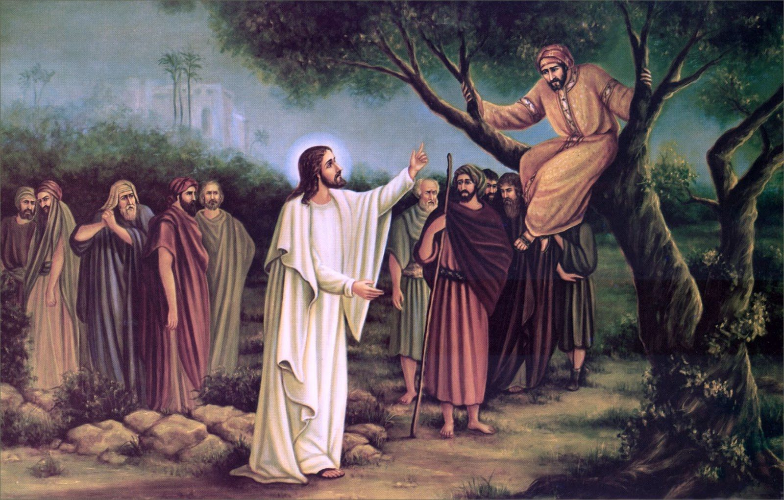
New Testament examples
● Zacchaeus (a dishonest taxman, Luke 19:8)
● Religious folk (Matt. 3:1-2)
● Galileans (turning to God, Matt. 4:17)
● Judeans (who crucified Jesus, Acts 2:36-38)
● Saul/Paul (anti-christian, Acts 9:17-18)
● Thief (convicted felon, Luke 23:41-43)
● Pagans (idolators, 1 Thess. 1:9-10)

Slide 8
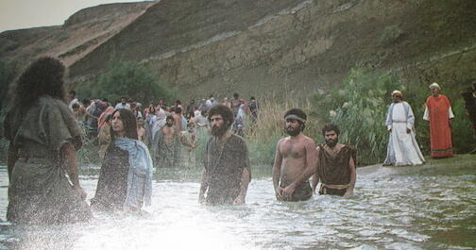
John’s ministry
John appeared, baptizing in the wilderness and proclaiming a baptism of repentance for the forgiveness of sins. (Mark 1:4)
Bear fruit in keeping with repentance. (Matt. 3:8)
The crowds … tax collectors … soldiers …. Said to him, “What shall we do?” (Luke 3:10-14)

Slide 9
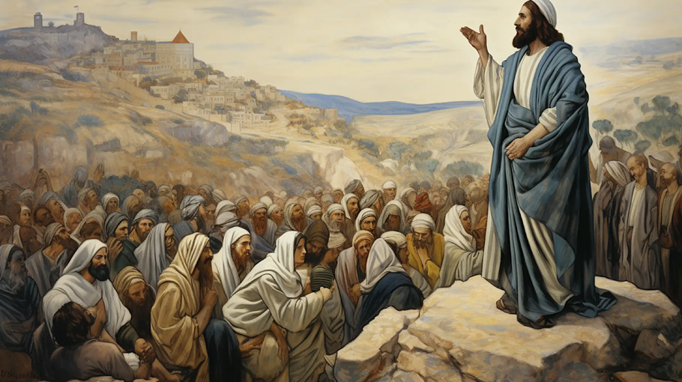
Jesus’ ministry
“The time is fulfilled, and the kingdom of God is at hand; repent and believe in the gospel.” (Mark 1:15)
“I have not come to call the righteous but sinners to repentance.” (Luke 5:32)
He began to denounce the cities where most of his mighty works had been done, because they did not repent. (Matt. 11:20)

Slide 10
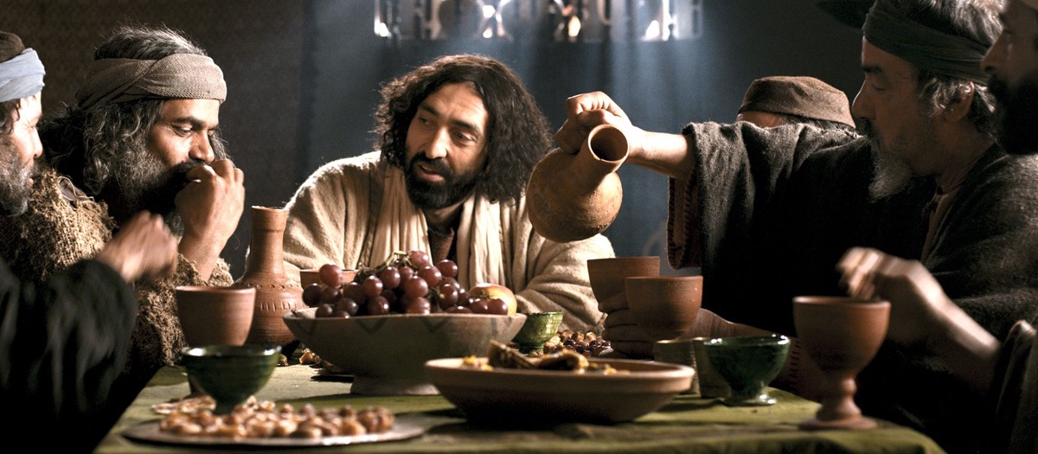
Jesus’ ministry
“I tell you; but unless you repent, you will all likewise perish.” (Luke 13: 3, 5)
“There will be more joy in heaven over one sinner who repents.” (Luke 15:7, 10)
“Repentance for the forgiveness of sins should be proclaimed in his name to all nations, beginning from Jerusalem.” (Luke 24:47)

Slide 11
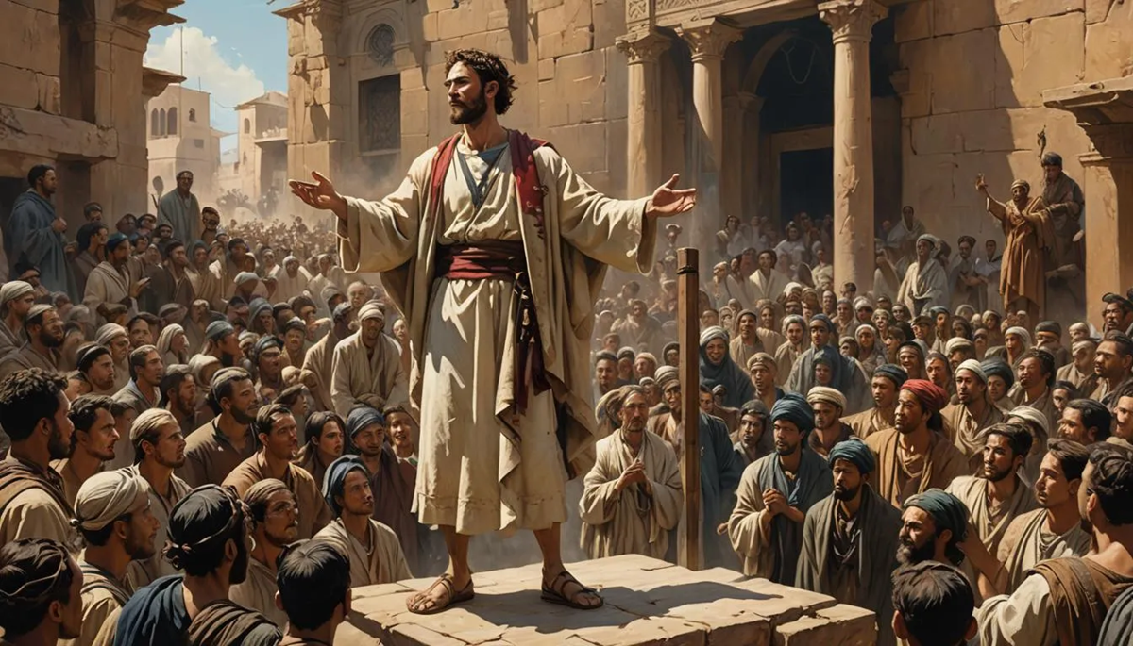
People repent
³⁶ “Therefore let all the house of Israel know for certain that God has made Him both Lord and Christ—this Jesus whom you crucified.“
³⁷ Now when they heard this, they were pierced to the heart, and said to Peter and the rest of the apostles, "Brethren, what shall we do?"

Slide 12
People repent
³⁸ Peter said to them, “Repent, and each of you be baptized in the name of Jesus Christ for the forgiveness of your sins; and you will receive the gift of the Holy Spirit.” …
⁴⁰ And with many other words he solemnly testified and kept on exhorting them, saying, “Be saved from this perverse generation!” (Acts 2:36-40)

Slide 13
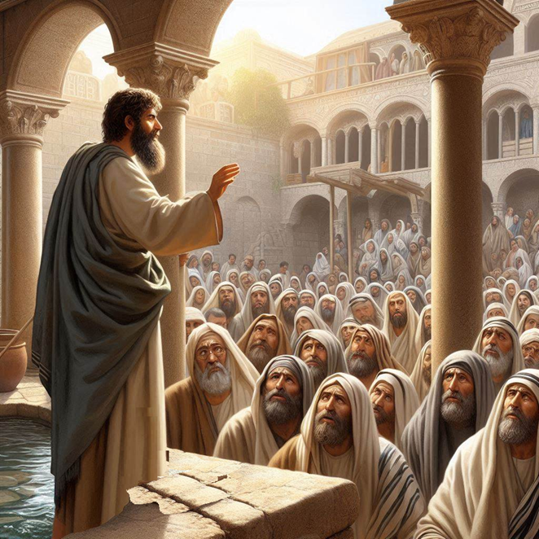
The apostles’ ministry
“Repent and be baptized every one of you in the name of Jesus Christ for the forgiveness of your sins, and you will receive the gift of the Holy Spirit…” (Acts 2:38)
“To the Gentiles also God has granted repentance that leads to life.” (11:18)
“God … commands all people everywhere to repent.” (17:30)

Slide 14
New Testament epistles
“God’s kindness is meant to lead you to repentance?” (Rom. 2:4)
“Godly grief produces a repentance that leads to salvation without regret.” (2 Cor 7:10)
“The Lord … is patient toward you, not wishing that any should perish, but that all should reach repentance.” (2 Peter 3:9)

Slide 15
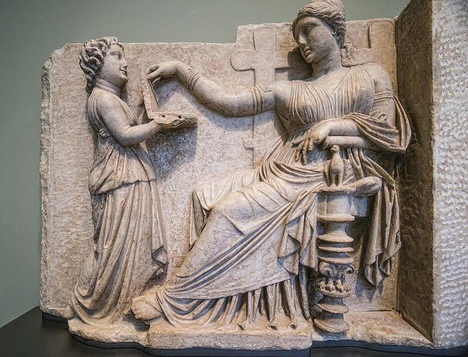
Repent from what?
“The people … still refused to repent of their evil deeds and turn to God. They continued to worship demons and idols…. And they did not repent of their murders or their witchcraft* or their sexual immorality or their thefts.” (Rev. 9:20-21 NLT)
*Gk. pharmakon, drugs, potions (BDAG, Gk-En Lexicon)

Slide 16
Repent unto what?
“Bear fruit in keeping with repentance.” (Matt. 3:8; Luke 3:8)
“Repent and believe in the gospel.” (Mark 1:15)
“Repent and be baptized every one of you in the name of Jesus Christ for the forgiveness of your sins, and you will receive the gift of the Holy Spirit.” (Acts 2:38)

Slide 17
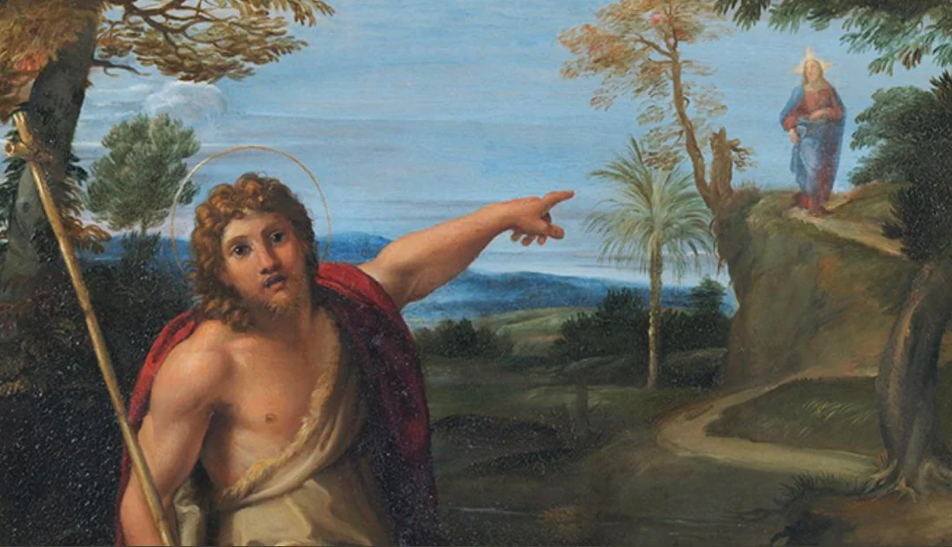
Repent unto what?
“To the Gentiles also God has granted repentance that leads to life.” (Acts 11:18)
“Telling the people to believe in the one who was to come after him, that is, Jesus.” (Acs 19:4)
“Performing deeds in keeping with their repentance.” (Acts 26:20)

Slide 18
Repent unto what?
“Godly grief produces a repentance that leads to salvation without regret.” (2 Cor. 7:14)
“Performing deeds in keeping with their repentance.” (Acts 26:20)
Believers, “Do the works you did at first.” (Rev. 2:5)
“The name of God … repent so as to give Him glory.” (Rev.16:9)

Slide 19
Repentance & faith for salvation
1. We leave our former beliefs and sins.
2. We put our trust in the Lord Jesus Christ.
3. God forgives us everything we ever did.
4. We get baptized and join a church.
5. God gives to us his indwelling Holy Spirit.
6. We learn to please God by how we live.
7. When we mess up, we repent and return.

Slide 20
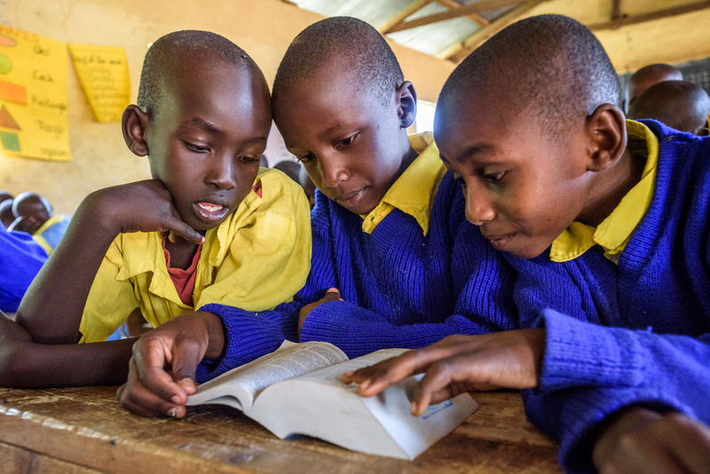
Repentance & faith in evangelism
1. In Bible studies, ask readers what they have learned about sin.
2. Explain how God will forgive those who regret and abandon their sins & beliefs.
3. Recount how Jesus died and rose to life to save forever those who trust in him.
4. Offer God’s Spirit and everlasting life.
5. Invite them to quit their big sins, to trust in Jesus, and to be baptized.

