Slide 1

Where Our Bible Came From
Material Origins of the Two Testaments
https://giphy.com/gifs/bible-aAfKYv1ScWDuM

Slide 2
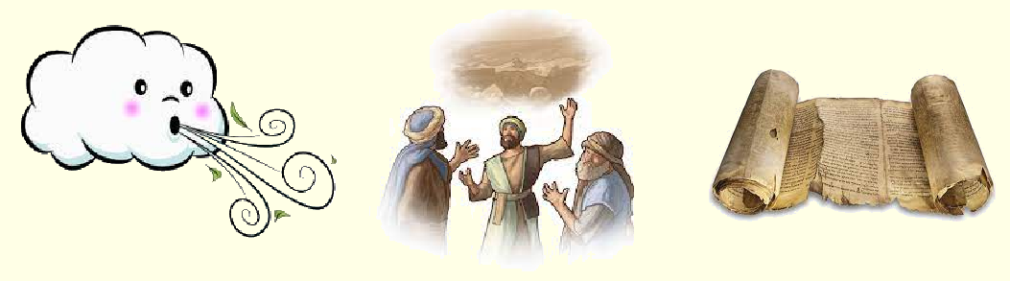
Spiritual origins of the Two Testaments
“Prophecy of Scripture came about [as] prophets, though human, spoke from God as they were carried along by the Holy Spirit.”
2 Pet. 1:20-21 NIV
“All scripture is inspired by God and is useful for teaching, for reproof, for correction, and for training in righteousness.” 2 Tim. 3:16 NRSV

Slide 3

Dan Brown, The Da Vinci Code, page 251
“Aha!” Teabing burst in with enthusiasm. “The fundamental irony of Christianity! The Bible, as we know it today, was collated by the pagan Roman emperor Constantine the Great.”

Slide 4
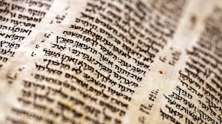
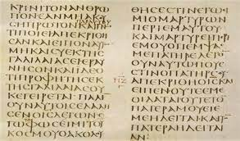
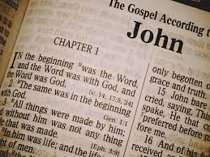

Learning objectives
● Trace: 3 streams of First Testament origins
● Affirm: Reliability of First Testament texts
● Trace : 3 streams of New Testament origins
● Affirm : Reliability of New Testament texts
Hebrew Bible + Greek New Testament ➔ Modern Bible

Slide 6
The Hebrew Bible
Called ‘Tanakh’ or Old/First Testament
● Growth: During more than 1000 years.
● Language: Hebrew and some Aramaic.
● Deity: YHWH (Yahweh) or the LORD.
● Message: Messiah will one day rule peacefully over the whole world.

Slide 7

The Hebrew Bible
Three ‘streams’ of growth
1. Prophetic messages
2. Community memory
3. Cultural knowledge

Slide 8
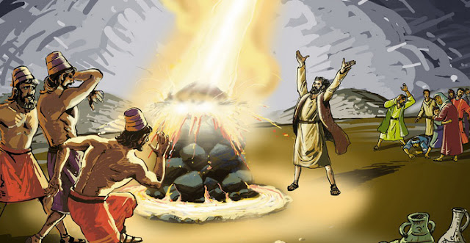
1. Prophetic messages, oral & written
(from before 12th cent BCE)
● “Thus says the LORD …” Isaiah 1:11 (417x)
● “The LORD spoke to Moses … Moses spoke to Aaron and to his sons and to all the sons of Israel.” Leviticus 21:18, 24
● “Moses wrote down all the words of the LORD.” Exodus 24:4
● “The men of Hezekiah, king of Judah, transcribed.” Proverbs 25:1

Slide 9
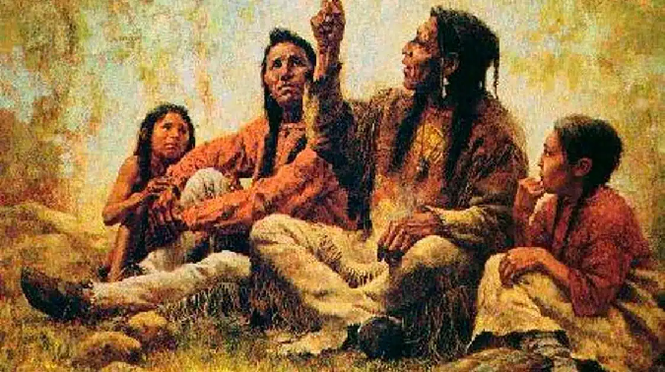
2. Community memory, oral & written
(from before 12th cent BCE)
● “Remember this day!” Exodus 13:3
● “according to their genealogies.”
Genesis 10:32
● “the records are ancient.”
1 Chronicles 4:22
● “Tell your children of it!” Joel 1:3

Slide 10
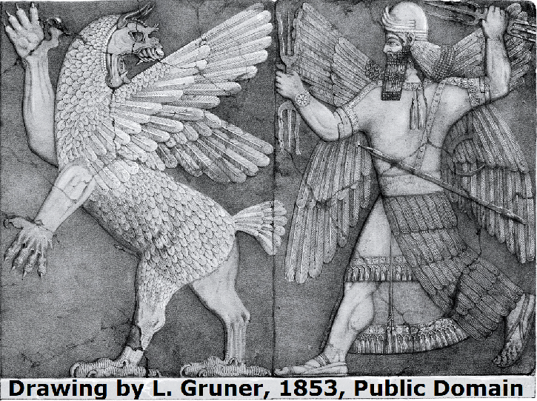
3. Cultural knowledge, oral & written
(from before 2nd millennium BCE)
● “You broke the heads of the sea monsters on the waters.” Psalm 74:13
● “of old, the men of renown” Genesis 6:4
● “New gods that had come recently”
Deuteronomy 32:17
● “God has taken his place in the divine council” Psalm 82:1

Slide 11
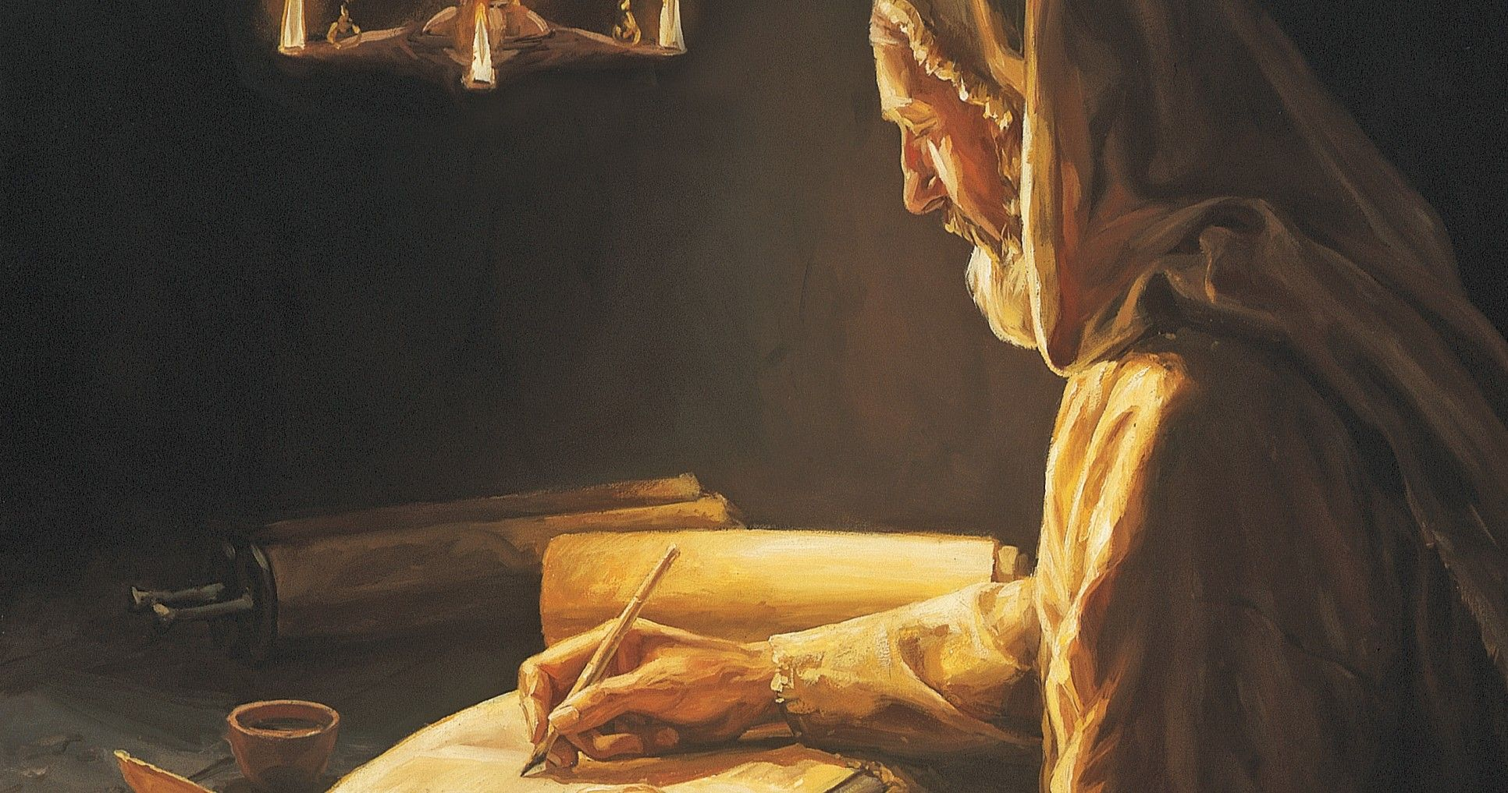
Compilers and Editors
(from before the 8th century BCE)
● “Take a scroll and write on it all the words that I have spoken” Jeremiah 36:2
● “the sons of the prophets” 2 Kings 2:3
● “Jonathan … a man of understanding
and a scribe” 2 Chronicles 27:32
● “Ezra had set his heart to study the Law of the LORD” Ezra 7:10

Slide 12
Versions of the Hebrew Bible
Hebrew versions
● Judean (from before 12th cent BCE)
● Samaritan (from 8th cent BCE)
● Babylonian (From 6th cent BCE)
● Essene (Qumran, from 1st cent BCE)

Slide 13
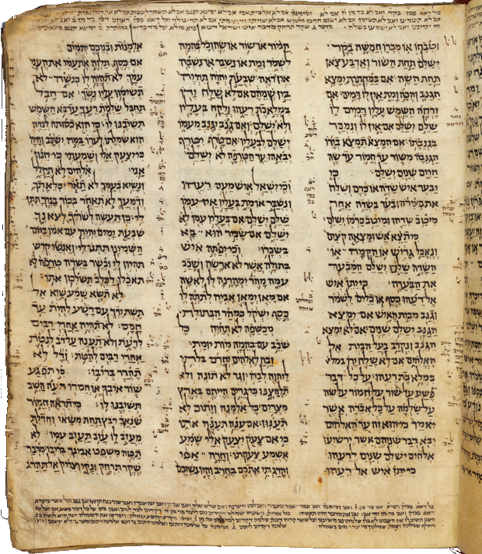
Versions of the Hebrew Bible
Hebrew scribes (copyists)
● Kings and priests (from 10th cent BCE)
● Scribes (51x, from 10th cent BCE)
● Sons of the prophets (from 8th cent BCE)
● Synagogues (from 6th century BCE)
● Masoretes (from 7th century CE)
Codex Sassoon, a Masoretic codex comprising all 24 books of the Hebrew Bible, dated to the 10th century CE

Slide 14
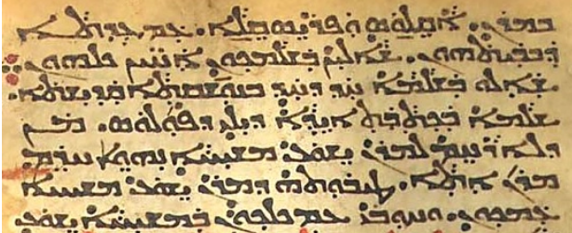
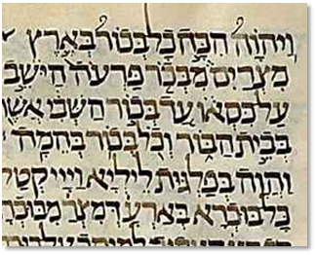
Language versions
Other language translations
● Syrian Aramaic (from 7th cent BCE)
● Judean Aramaic (from 5th cent BCE)
● Common Greek (from 3rd cent BCE)
● Classical Latin
(from 5th cent CE)

Slide 15
Oldest extant copies
● Inscriptions (from 10th century BCE)
● Dead Sea Scrolls (from 1st century BCE
to 1st century CE)
● Greek codices (from 4th century CE)
● Aramaic Targums (from medieval CE)
● Masoretic scrolls (from 10th century CE)
● Critical editions (20th century CE)
Biblia Hebraica Quinta, Genesis, 2015.

Slide 17
The New Testament
Gospels, Acts, Epistles and Revelation
● Growth: During fewer than 100 years.
● Language: Common koiné Greek.
● Deity: The God of the Hebrew Bible.
● Message: Messiah came, taught, died, rose back to life, rose into the sky, and is to return to rule over the earth.

Slide 18
The New Testament
Three ‘streams’ of growth
1. Historic persons
2. Jewish literature
3. The Greek Bible

Slide 19
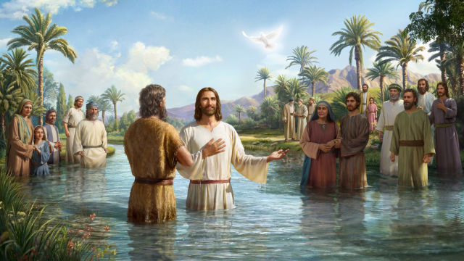
1. Historic personages
(1st century CE)
● “John appeared, baptizing in the wilderness” Mark 1:4
● “This is [Jesus] my beloved Son, with whom I am well pleased” Matt 3:17
● “[The Spirit] will guide you [apostles] into all the truth” John 16:13
● [Eye-witnesses] “most of whom are still alive” 1 Cor 15:6

Slide 20
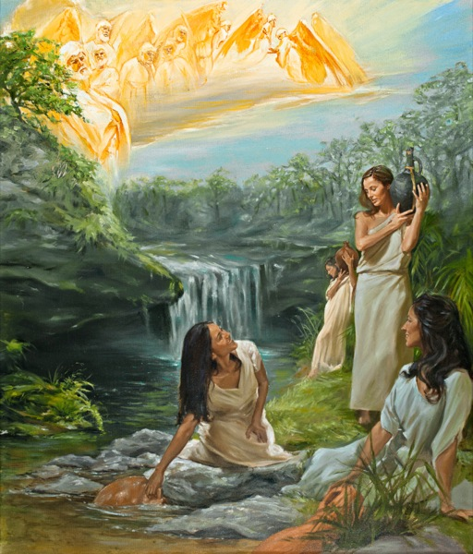
2. ‘Second Temple Period’ Literature
(from 5th cent BCE to 70 CE))
● Apocrypha: “Maccabees”
● Jewish texts: Enoch, Jubilees, Wisdom
● Greek poets and philosophers: “for we are indeed his offspring” Acts 17:28
● Jewish sects (Pharisees, Sadducees, Hellenists, Essenes)

Slide 21
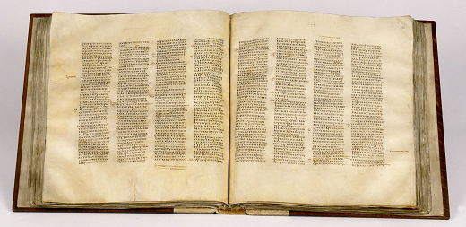
3. The Greek Bible (Septuagint)
(from 3rd century BCE)
Quotations: “In the Law it is written …”
1 Cor 14:21
Allusions: “to meet together” Heb 10:25 from 2 Macc 2:7; compare 2 Thess 2:1
Proof texts: “since it is written” 1 Pet 1:16
Vocabulary and style: “Therefore it says” Eph 4:8 from Psa 68:18

Slide 22
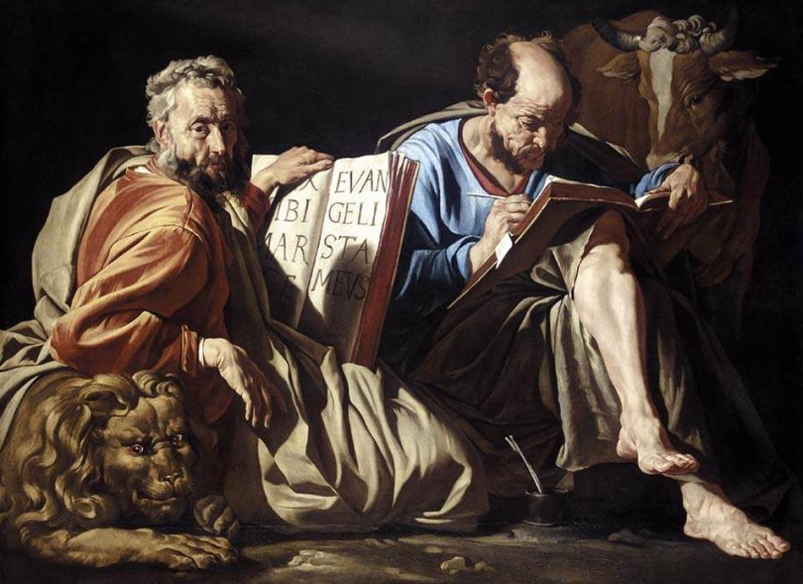
Textual History
(From 1st century CE)
● Memory: “we were with him” 2 Pet 1:18
● Epistles: “to the churches” Gal 1:2
● Testimonies: “Luke … Mark … the books … parchments” 2 Tim 4:11-13
● Books: Gospels, Acts & Revelation
● Copies: Recopied and carried to cities across the Roman empire.
● Translation: Aramaic, Latin, Coptic, etc

Slide 23
The Greek New Testament
Copyists’ errors & habits
● Omit words
● Insert words
● Replace words
● Update words
● Abbreviate names
● Correct errors
● Mis-correct non-errors

Slide 24
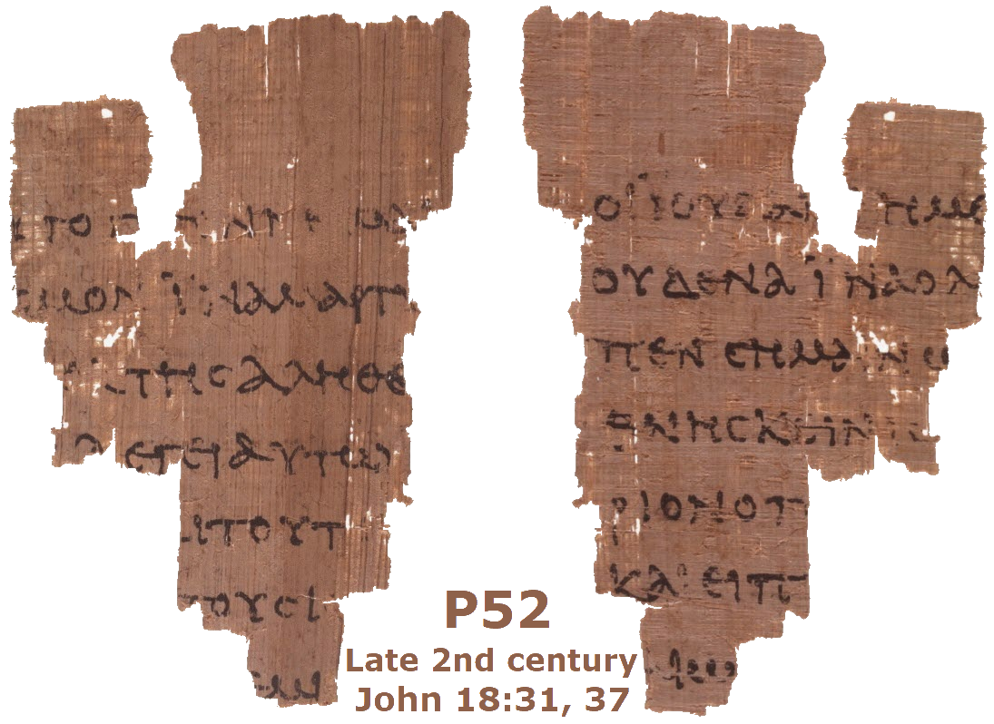
The Greek New Testament
5500+ extant manuscripts and fragments
● Papyrus fragments (from 2nd cent CE)
● Whole books (from 3rd century CE)
● Canonized (from 3rd century CE)
● Bound together (from 4th century CE)
● Printed editions (from 16th cent CE)
● Critical editions (from 19th cent CE)
● Computer generated (from 21st cent CE)

Slide 25
Where Our Bible Came From
Conclusion
● The First Testament grew for 1000 years. Copies date from 100 BCE.
● The New Testament was written in the first century as eye-witness accounts .
● It was copied, recopied and translated 1000s of times in different places.
● Its original wording is 97% certain.
● Its original message is 100% certain.

Slide 26
Where Our Bible Came From
● Emanuel Tov, Textual Criticism of the Hebrew Bible, 3rd ed., Fortress, 2012.
● K. & B Aland, The Text of the NT, Eerdmans, 1989.
● B.M. Metzger, The Text of the NT, 2nd ed., Oxford, 1968.
● Metzger, The Early Versions of the NT, Clarendon, 1977.
● N.R. Lightfoot, How We Got the Bible, 3rd ed., MJF Books, 2003.
● E. Hixon & P.J. Gurry, eds., Myths and Mistakes in NT Textual Criticism, IVP Academics, 2019.
● A. Saenz-Badillos, A History of the Hebrew Language, Cambridge, 1993.

Slide 27

Download these slides & document from
galencurrah.online
Material Origins of the Two Testaments
www.freepik.com

