Slide 1
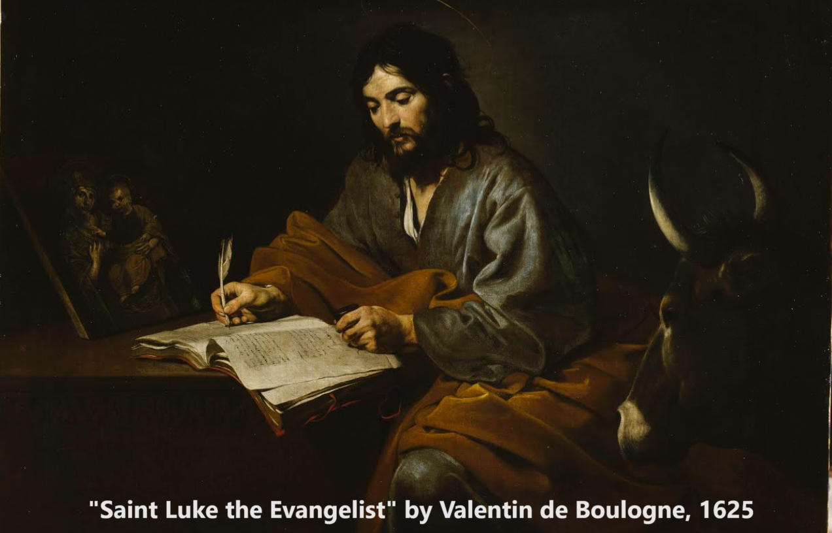
Gospel of Luke 14:15–15:37
‘Attitudes that matter forever’
24 & 28 December 2023

Slide 2
Structure of Luke’s Gospel
1 Preface: Sponsor, method and purpose.
2 Birth narratives: Dawn of the promised new era.
3 John’s mission: Introduce the Messiah.
4 Jesus’ mission: Messiah’s message and work.
5 Journey to death: Messianic signs and teaching.
6 Jerusalem: Confront Israelite and Roman rulers.
7 Crucifixion: Last supper, arrest, trials, death.
8 Resurrection: Alive, appearance, and proofs.
9 Ascension: Gives Holy Spirit, mission to nations.

Slide 3
Human attitudes matter forever
1. Attitudes toward Jesus: “Not one of those who were invited will get a taste of my banquet” (Luke chapter 14).
2. Attitudes towards others: “There is rejoicing in the presence of the angels of God over one sinner who repents” (Luke chapter 15).

Slide 4
Attitudes toward Jesus Luke 14:15-35

Slide 5
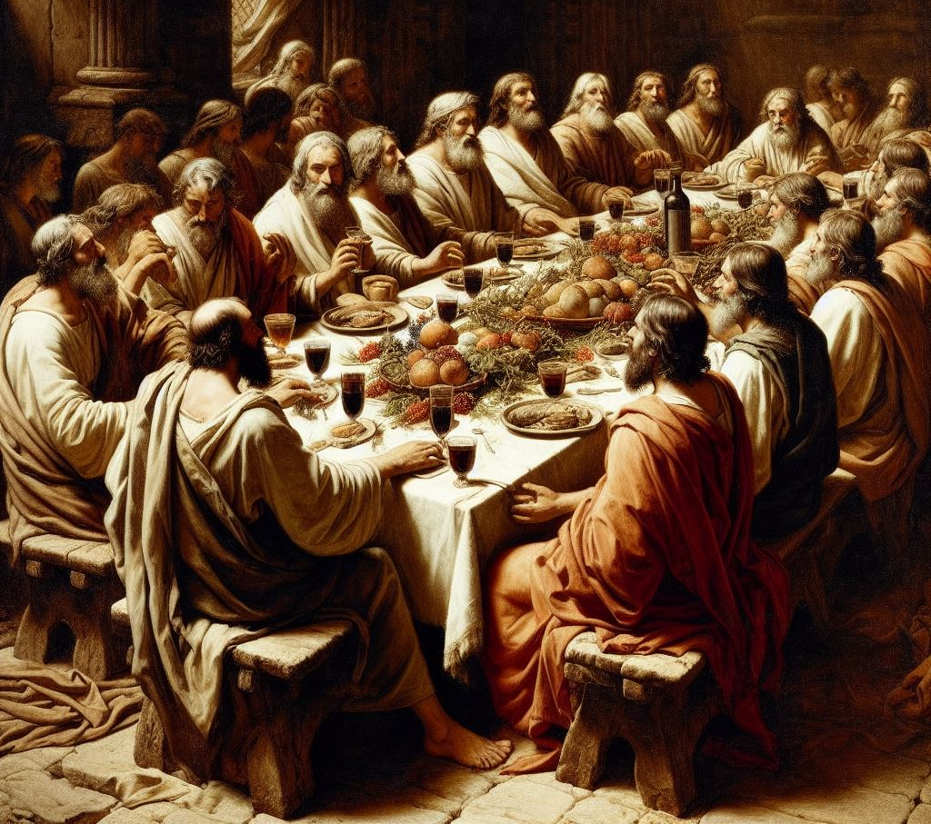
Human attitudes matter
14 ¹⁵ When one of those at the table with him heard this, he said to Jesus, “Blessed is the one who will eat at the feast in the kingdom of God!”
● ‘The one’: In biblical languages = everyone.
● ‘Blessed’: happy! As a poor man enjoying a feast with friends.
Generated with Bing AI, 22 December 2023

Slide 6
‘Kingdom of God’: meanings
● God is Creator and King over everything.
● God judges lesser gods, kings, and everyone else.
● God was the national Protector over Israel.
● In Jesus’ day, believers were waiting for a Messiah-king who would defeat Israel’s enemies and make Israel great again.
● When Jesus came, he taught that he is Messiah, and that those who obey him are in God’s kingdom.
● In Christianity, King Jesus lives in us, giving us guidance, hope, joy and self-control.

Slide 7
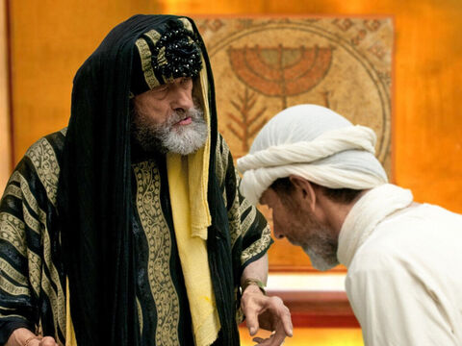
None of those guests
¹⁶ Jesus replied: “A certain man was preparing a great banquet and invited many guests. ¹⁷ At the time of the banquet he sent his servant to tell those who had been invited, ‘Come, for everything is* now ready.’ ¹⁸ “But they all alike began to make excuses.
* Some mss read, ‘things are’.
freebibleimages.org

Slide 8
None of those guests
The first said, ‘I have just bought a field, and I must go and see it. Please excuse me.’
¹⁹ “Another said, ‘I have just bought five yoke of oxen, and I’m on my way to try them out. Please excuse me.’
²⁰ “Still another said, ‘I just got married, so I can’t come.’
Generated with Bing AI, 22 December 2023

Slide 9
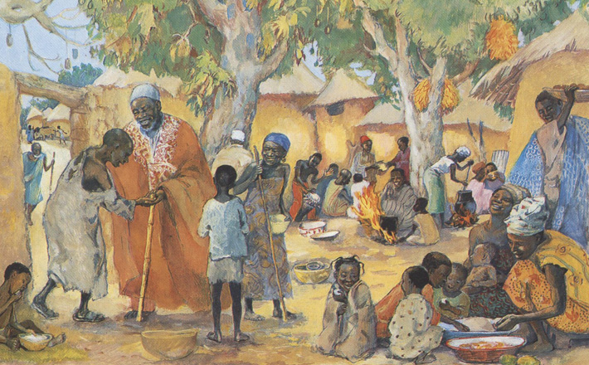
What do you think of their excuses?
“I must go see the field that I bought.”
“I must go try out my new oxen.”
“I have just got married.”
What do they have in common?
● Ordinary affairs of everyday life.
● No one would buy property sight unseen.
● None counted either the master or his servant worthy of their respect.

Slide 10
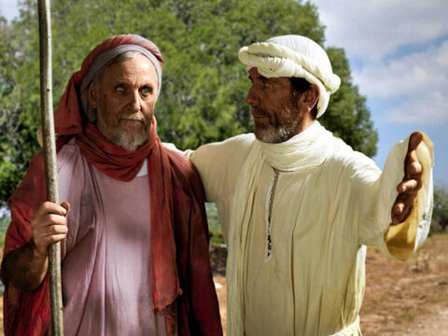
None of those guests
²¹ “The servant came back and reported this to his master. Then the owner of the house became angry and ordered his servant, ‘Go out quickly into the streets and alleys of the town and bring in the poor, the crippled, the blind and the lame.’
²² “‘Sir,’ the servant said, ‘what you ordered has been done, but there is still room.’
freebibleimages.org

Slide 11
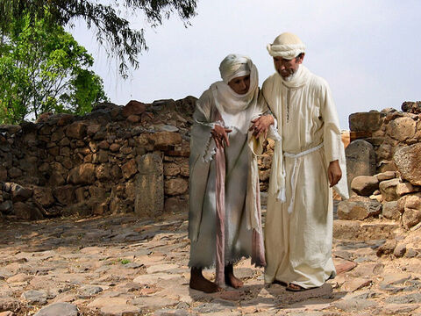
None of those guests
²³ “Then the master told his servant, ‘Go out to the roads and country lanes and compel them to come in, so that my house will be full. ²⁴ I tell you, not one of those who were invited will get a taste of my banquet.’”
● To whom was Jesus comparing this story?
● Why might people today choose to refuse Jesus’ offer of forgiveness and eternal life?
freebibleimages.org

Slide 12
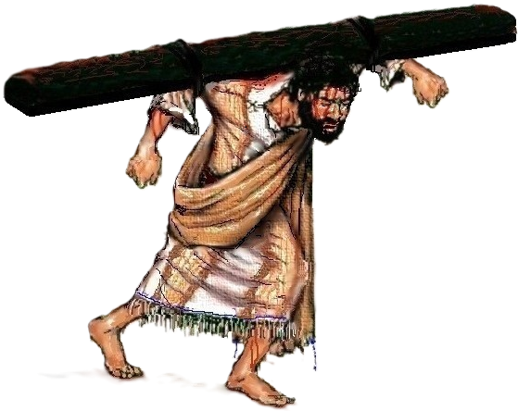
“If anyone comes to me”
²⁵ Large crowds were traveling with Jesus, and turning to them he said: ²⁶ “If anyone comes to me and does not hate father and mother, wife and children, brothers and sisters—yes, even their own life—such a person cannot be my disciple. ²⁷ And whoever does not carry their cross and follow me cannot be my disciple.
From Wikimedia Commons, the free media repository

Slide 13
“If anyone comes to me”
● Hyperbole: “Obvious, intentional exaggeration” (dictionary.com).
● What does this hyperbole suggest about our loyalty to Jesus?
● What does it mean to take up one’s cross?
“I have been crucified with Christ and I no longer live, but Christ lives in me. The life that I now live in the body, I live by faith in the Son of God, who loved me and gave himself for me.”

Slide 14
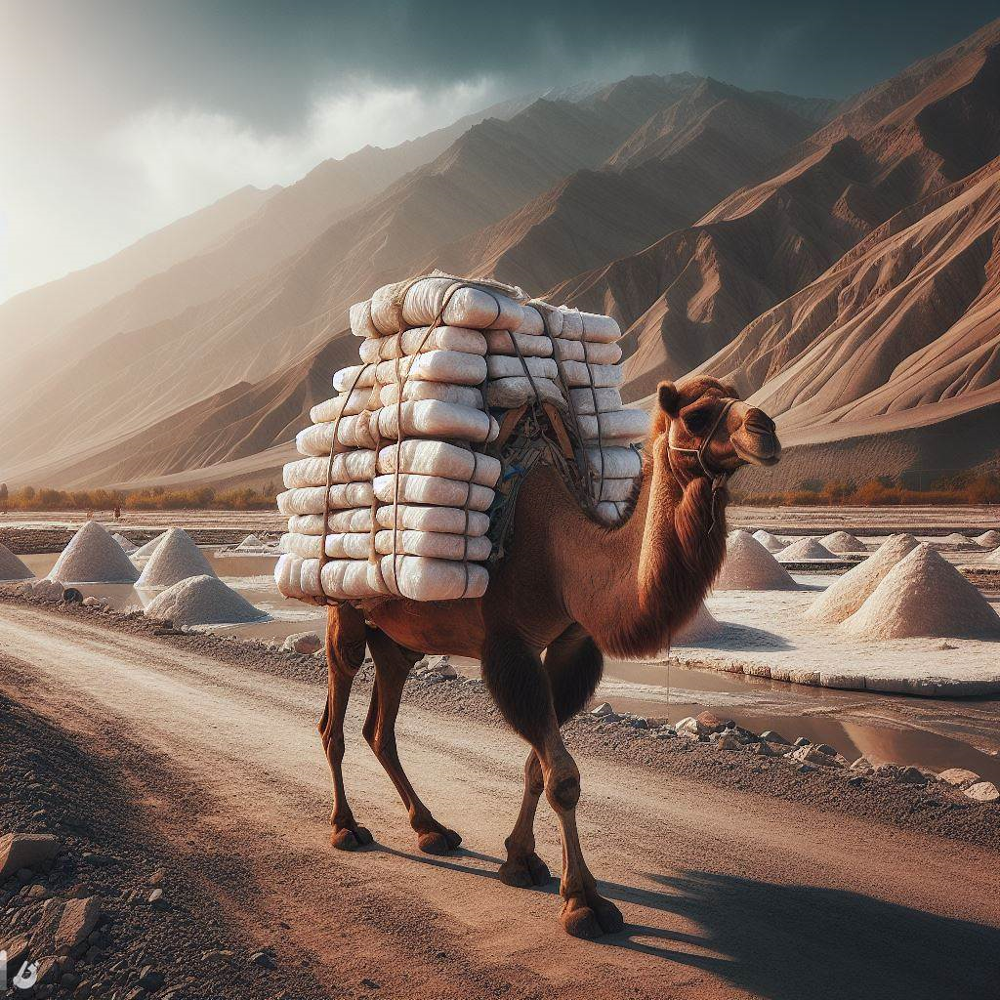
“If anyone comes to me”
³³ In the same way, those of you who do not give up everything you have cannot be my disciples.
³⁴ “Salt is good, but if it loses its saltiness, how can it be made salty again? ³⁵ It is fit neither for the soil nor for the manure pile; it is thrown out. “Whoever has ears to hear, let them hear.”
Generated with Bing AI, 22 December 2023

Slide 15
Attitudes toward others 15:1-32

Slide 16
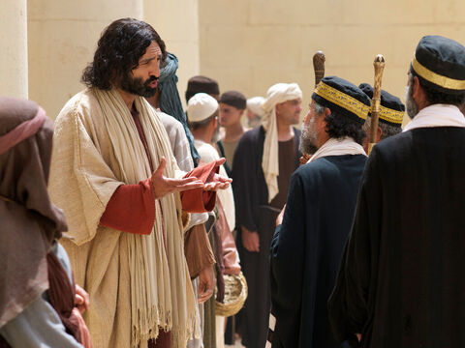
“If anyone comes to me”
15 ¹ Now the tax collectors and sinners were all* gathering around to hear Jesus. ² But the Pharisees and the teachers of the law muttered, “This man welcomes sinners and eats with them.”
³ Then Jesus told them this parable: …
*Some mss omit ‘all’.
freebibleimages.org

Slide 17
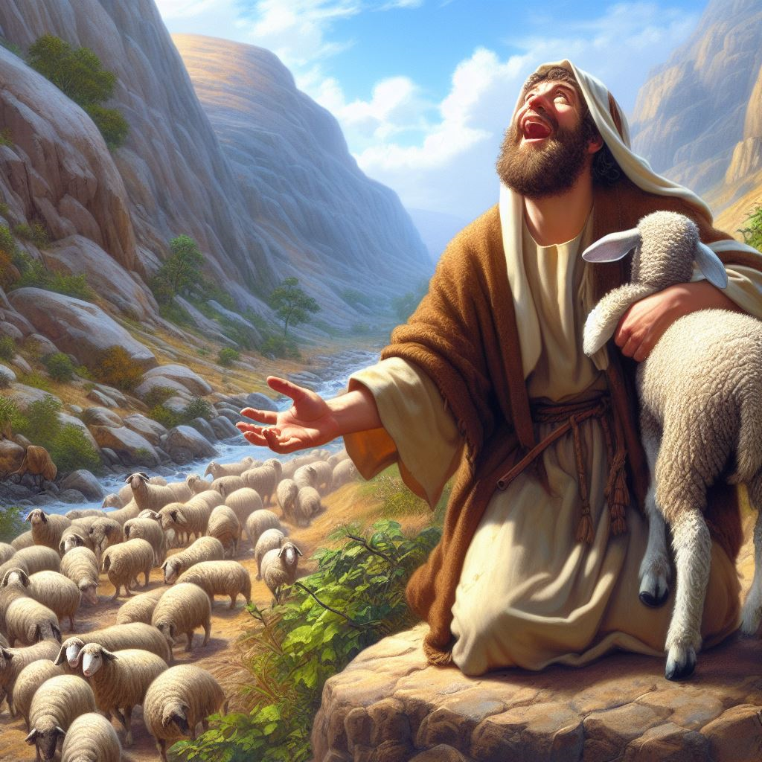
Rejoicing in heaven
³ Then Jesus told them this parable: ⁴ “Suppose one of you has a hundred sheep and loses one of them. Doesn’t he leave the ninety-nine in the open country and go after the lost sheep until he finds it? ⁵ And when he finds it, he joyfully puts it on his shoulders ⁶ and goes home.
Generated with Bing AI, 22 December 2023

Slide 18
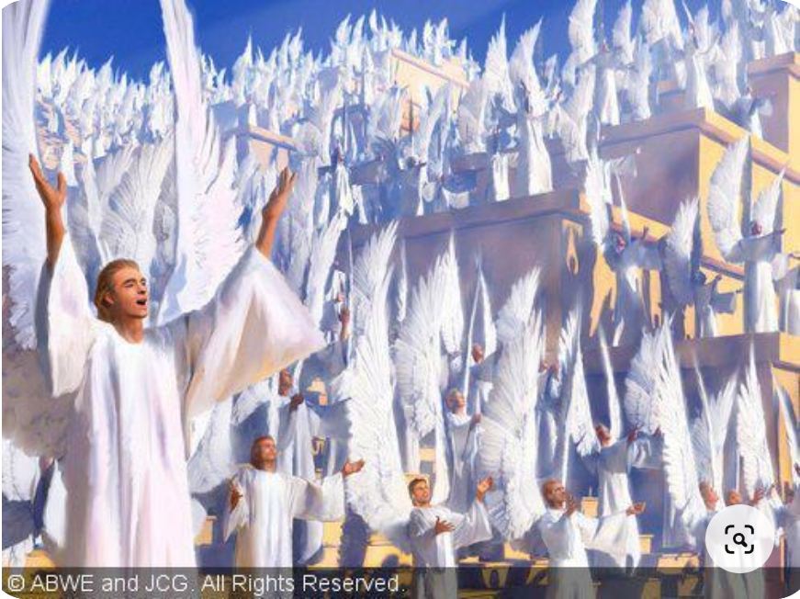
Rejoicing in heaven
Then he calls his friends and neighbors together and says, ‘Rejoice with me; I have found my lost sheep.’ ⁷ I tell you that in the same way there will be more rejoicing in heaven over one sinner who repents than over ninety-nine righteous persons who do not need to repent.
Generated with Bing AI

Slide 19
Heaven = real place
● Heaven: Where God, Jesus, angels and we ‘saved’ folk dwell together.
● Rejoicing: happy, fulfilled, new bodies, relationships reconciled.
● Holy: No sin, evil, disease, death, demons.
● Busy: Power, intelligence, learning and skills to become all that God wants for us.
● Rewards: We will reign and rule over the world, over nations, and over angels.

Slide 21
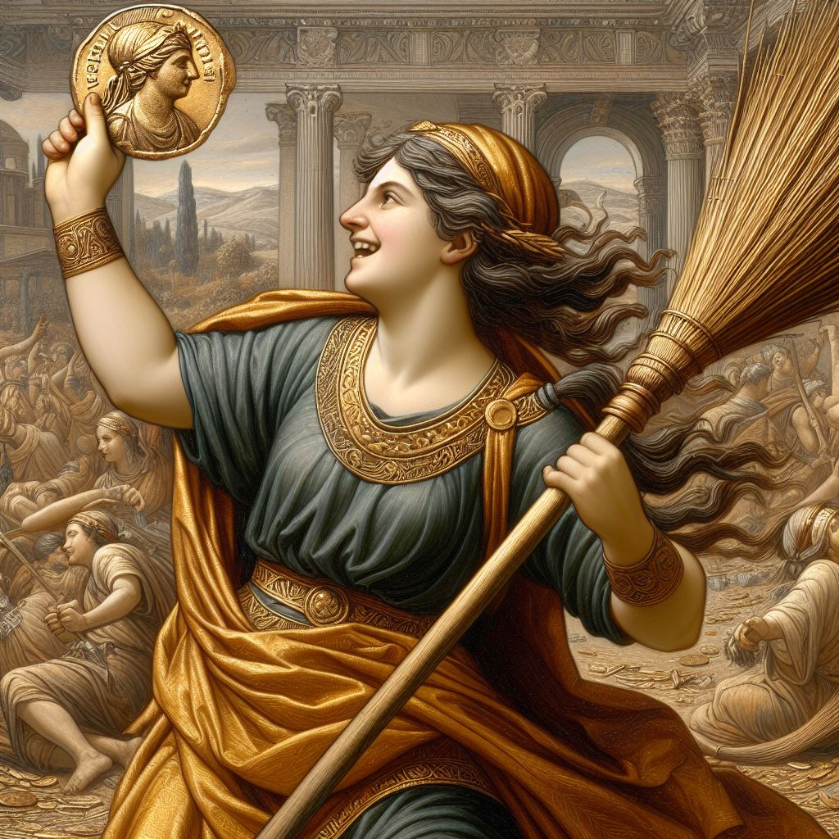
Rejoicing in heaven
⁸ “Or suppose a woman has ten silver coins and loses one. Doesn’t she light a lamp, sweep the house and search carefully until she finds it? ⁹ And when she finds it, she calls her friends and neighbours together and says, ‘Rejoice with me; I have found my lost coin.’ ¹⁰ In the same way, I tell you, there is rejoicing in the presence of the angels of God over one sinner who repents.”
Generated with Bing AI, 22 December 2023

Slide 22
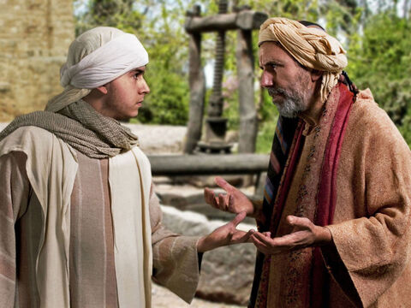
Two sons
¹¹ Jesus continued: “There was a man who had two sons. ¹² The younger one said to his father, ‘Father, give me my share of the estate.’ So he divided his property between them.
¹³ “Not long after that, the younger son got together all he had, set off for a distant country and there squandered his wealth in wild living.
freebibleimages.org

Slide 23
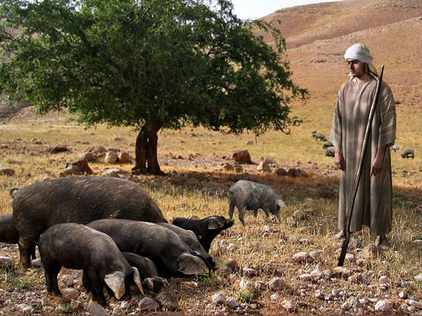
Two sons
¹⁴ After he had spent everything, there was a severe famine in that whole country, and he began to be in need. ¹⁵ So he went and hired himself out to a citizen of that country, who sent him to his fields to feed pigs. ¹⁶ He longed to fill his stomach with the * pods that the pigs were eating, but no one gave him anything. *Or: ‘some of the pods.’
freebibleimages.org

Slide 24
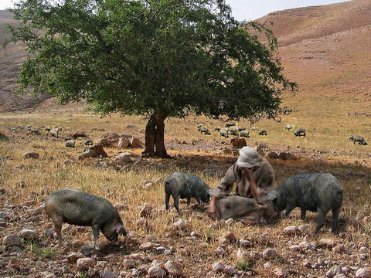
Two sons
¹⁷ “When he came to his senses, he said, ‘How many of my father’s hired servants have food to spare, and here I am starving to death! ¹⁸ I will set out and go back to my father and say to him: Father, I have sinned against heaven and against you. ¹⁹ I am no longer worthy to be called your son; make me like one of your hired servants.’ ²⁰ So he got up and went to his father.
freebibleimages.org

Slide 25
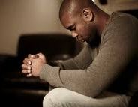
Repentance
1. Think rationally: ‘I have messed up’.
2. ‘Jesus offers what I need’.
3. ‘I will speak to Jesus’:
● ‘I have sinned against God and others’.
● ‘I admit that I deserve nothing’.
● ‘Please, accept me’.
● ‘I will obey your commands’.
4. Start now.
Lightstock

Slide 26
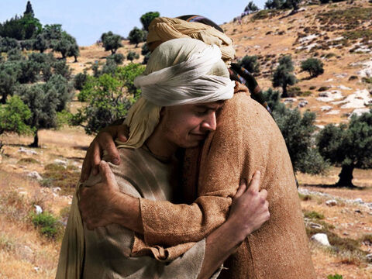
Two sons
²⁰ “But while he was still a long way off, his father saw him and was filled with compassion for him; he ran to his son, threw his arms around him and kissed him…
²² “The father said to his servants, ‘Let’s have a feast and celebrate… ²⁴ For this son of mine was dead and is alive again; he was lost and is found.’ So they began to celebrate.”
freebibleimages.org

Slide 27
Non-converted Christians
1. Denominations teach, ‘Trust the church and its ceremonies’.
2. Evangelicals teach, ‘Just accept Jesus,’ or, ‘Say this little prayer’.
3. Bible teaches, ‘Repent & be baptized’.
In the Bible:
● Repentance = ‘Change of allegiance’.
● Faith = faithfulness, loyalty, trust.
Repentance saves us; faith keeps us saved.

Slide 28
(Tentative) Ordo salutis
1. Chosen in Christ before creation
2. Set apart from mother’s womb
3. Heard the Gospel of our salvation
4. Convicted of sin and of righteousness
5. Called by the Father
6. Godly sorrow for sins
7. Repentance leading to life

Slide 29
(Tentative) Ordo salutis
8. Confessed sins, faith in Christ
9. Baptized for a good conscience
10. Past sins forgiven, no condemnation
11. United with Christ, death, resurrection
12. Received the Spirit, sealed, sanctified
13. Chosen, elect, ordained for glory
14. Foreknown, predestined, justified

Slide 30
(Tentative) Ordo salutis
15. Faithful to Christ
16. Saved by grace, being saved
17. Obedience, fruitfulness
18. Go be with Jesus in New Jerusalem
19. Inheritance, everlasting life
20. Resurrection, will be saved
21. Glorified, will reign with Christ

Slide 31
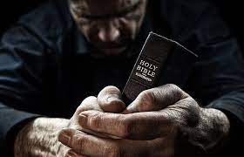
Discover
● Truths to affirm?
● Promises to claim?
● Commands to obey?
Assignment
● Read: Luke chapters 16 & 17
● Visit: luke.currah.download
● Compile: insights, queries & observations.

