Slide 2
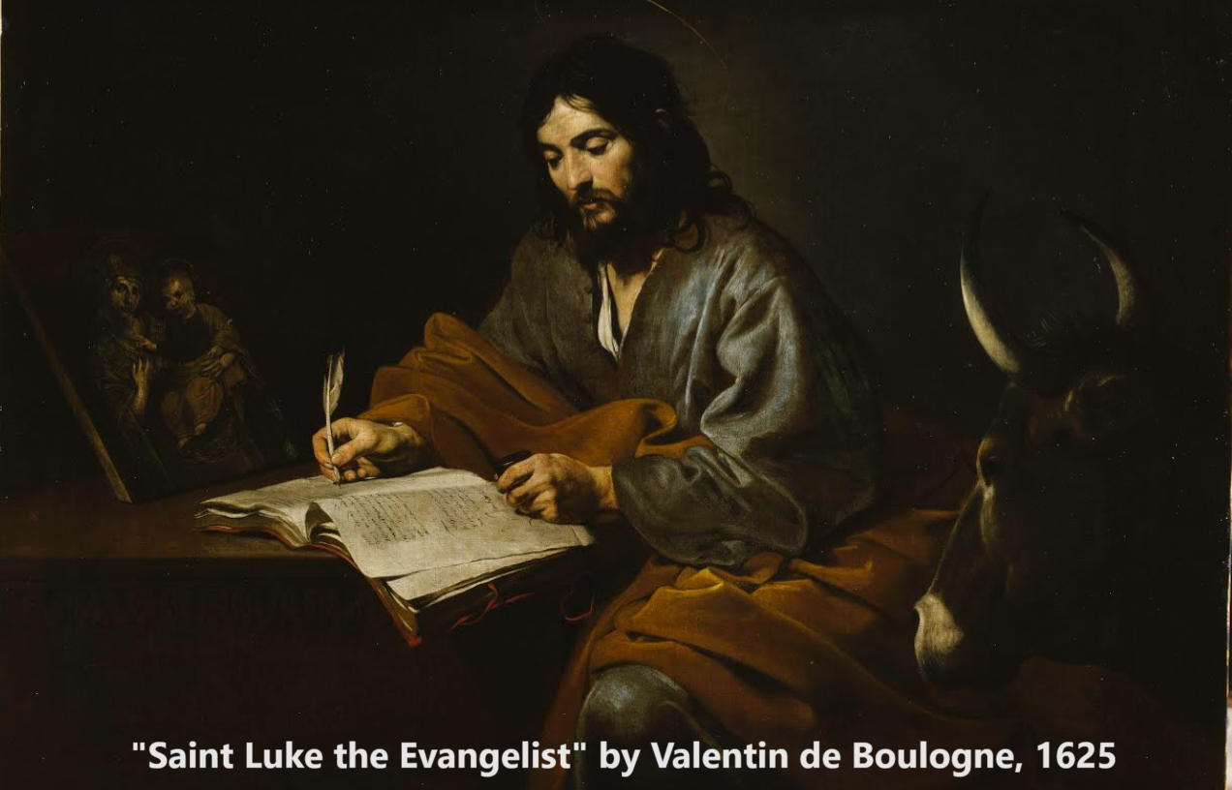
Gospel of Luke 18
‘In the age to come, eternal life!’
14 & 18 January 2024

Slide 3
Seven proofs of everlasting life
1. Cry out to God till Jesus come. 18:1-8.
2. Humble ourselves before God. 18:9-14.
3. Receive life by simple faith. 18:15-17.
4. Come follow Me. 18:18-25.
5. Follow Jesus at all costs. 18:26-30.
6. Jesus’ death and resurrection. 18:31-34.
7. Trust Jesus the Messiah. 18:35-43.

Slide 4
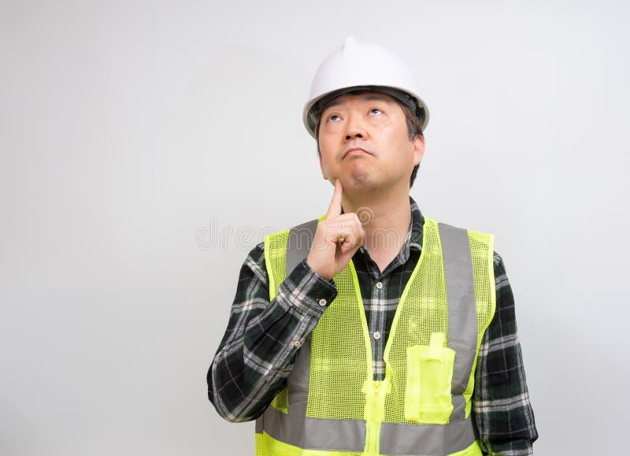
During this lesson
Discover at least ONE new idea:
● A truth to believe.
● A promise to claim.
● A command to obey.
www.dreamstime.com

Slide 5
1. Cry out to God for justice 18:1-8

Slide 6
A secular judge and persistent widow
¹ Jesus told his disciples a parable to show them that they should always pray and not give up. ² He said: “In a certain town there was a judge who neither feared God nor cared what people thought. ³ And there was a widow in that town who kept coming to him with the plea, ‘Grant me justice against my adversary.’

Slide 7
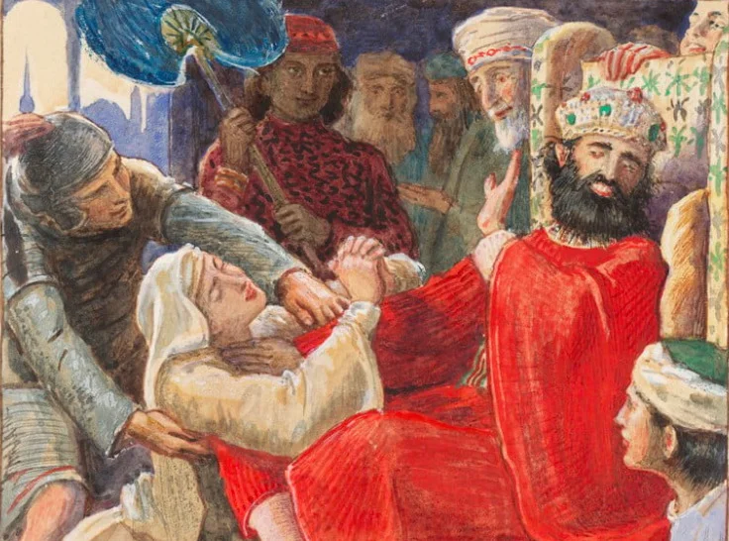
“I will see that she gets justice”
⁴ “For some time he refused. But finally he said to himself, ‘Even though I don’t fear God or care what people think, ⁵ yet because this widow keeps bothering me, I will see that she gets justice, so that she won’t eventually come and attack me [~wear me out]!’”
⁶ And the Lord said, “Listen to what the unjust judge says…
John Everett Millais, British (1829–1896)

Slide 8
God will bring about justice
⁷ And will not God bring about justice for his chosen ones, who cry out to him day and night? Will he keep putting them off? ⁸ I tell you, he will see that they get justice, and quickly. However, when the Son of Man comes, will he find faith on the earth?”
● What is the main faith task of Christians?
● What do American churches do least?

Slide 9
2. Humble ourselves before God 18:9-14

Slide 10
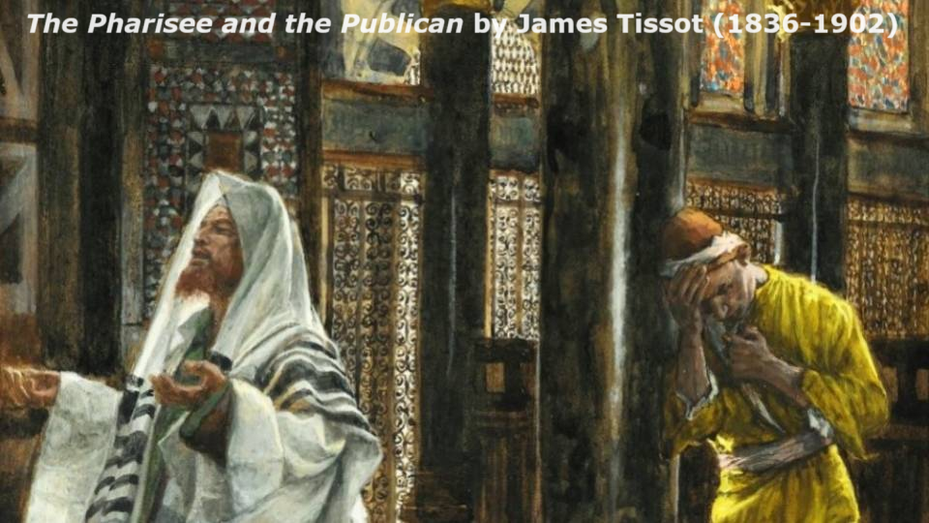
Two men pray to God
⁹ To some who were confident of their own righteousness and looked down on everyone else, Jesus told this parable: ¹⁰ “Two men went up to the temple to pray, one a Pharisee and the other a tax collector.

Slide 11
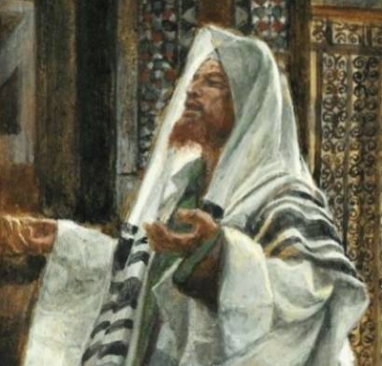
A self-righteous conservative
¹¹ The Pharisee stood by himself and prayed: ‘God, I thank you that I am not like other people—robbers, evildoers, adulterers — or even like this tax collector. ¹² I fast twice a week and give a tenth of all I get.’

Slide 12
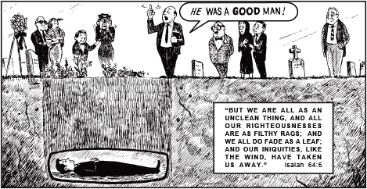
“I fast twice a week.”
● Some pious Jews fasted food and water Mondays and Thursdays.
● Didache 8:1 (between 50 and 150 CE): “Do not fast the same days as the hypocrites do. For they fast the second and fifth days after the Sabbath, but you must fast the third day and during the preparation day for the Sabbath.”

Slide 13
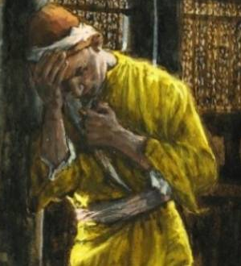
A guilty sinner
¹³ “But the tax collector stood at a distance. He would not even look up to heaven, but beat his breast and said, ‘God, have mercy on me, a sinner.’
¹⁴ “I tell you that this man, rather than the other, went home justified before God.

Slide 14
Atonement and justification
¹³ “God, have mercy on me.” hiláskomai
¹⁴ “justified before God.” dikaióō
“All are justified freely by his grace through the redemption that came by Christ Jesus. God presented Christ as a sacrifice of atonement, through the shedding of his blood.” Romans 3:24-25

Slide 15
How, then, must we worship?
For all those who exalt themselves will be humbled, and those who humble themselves will be exalted.”
Religious folk
● Wash themselves and wear nice clothes.
● Perform rituals and say certain prayers.
● Feel proud and despise other faiths.
● May turn violent when they feel offended.

Slide 16
3. Receive life by simple faith 18:15-17

Slide 17
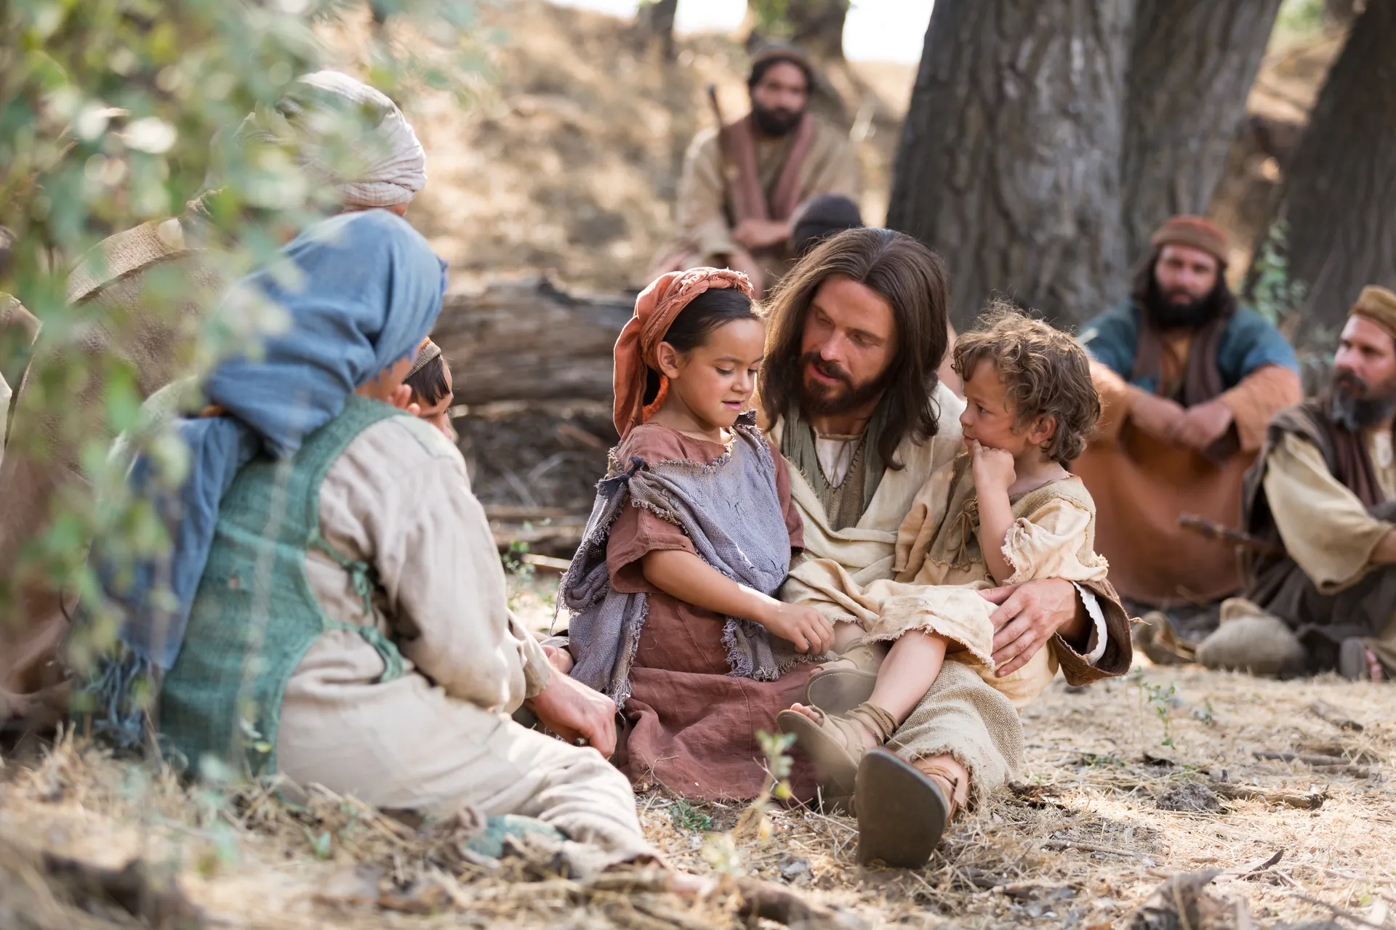
Little children
¹⁵ People were also bringing babies to Jesus for him to place his hands on them. When the disciples saw this, they rebuked them. ¹⁶ But Jesus called the children to him and said, “Let the little children come to me, and do not hinder them, for the kingdom of God belongs to such as these.

Slide 18
Receive the kingdom
¹⁷ Truly I tell you, anyone who will not receive the kingdom of God like a little child will never enter it.”
● What quality of children must we have?
● At what age can children believe in Jesus?
● At what age do children receive the Spirit?
● At what age can children serve the Lord?
● Where to infants go when the die?

Slide 19
4. Come follow Me! 18:18-25

Slide 20
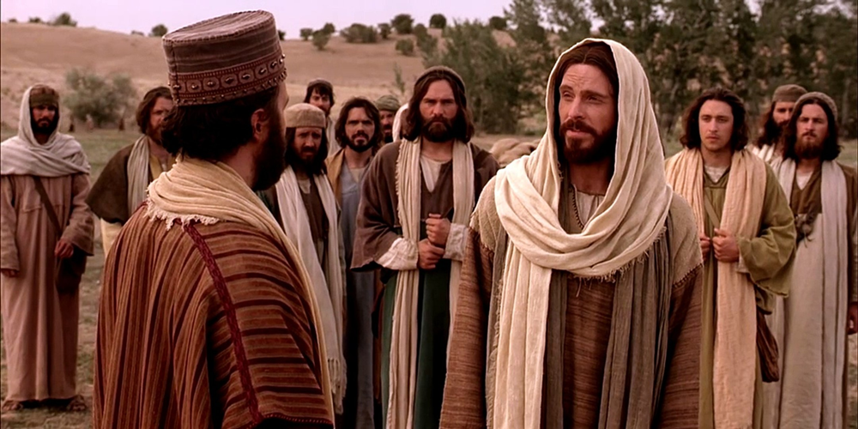
Inherit everlasting life
¹⁸ A certain ruler asked him, “Good teacher, what must I do to inherit eternal life?” … Jesus answered …
²⁰ “You know the commandments: ‘You shall not commit adultery, you shall not murder, you shall not steal, you shall not give false testimony, honor your father and mother.’”

Slide 21
“You still lack one thing”
²¹ “All these I have kept since I was a boy,” he said.
²² When Jesus heard this, he said to him, “You still lack one thing. Sell everything you have and give to the poor, and you will have treasure in heaven. Then come, follow me.”

Slide 22
A
²³ When he heard this, he became very sad, because he was very wealthy. ²⁴ Jesus looked at him and said, “How hard it is for the rich to enter the kingdom of God! ²⁵ Indeed, it is easier for a camel* to go through the eye of a needle than for someone who is rich to enter the kingdom of God.”
*kamelon, ~”rope” kamilon.

Slide 23
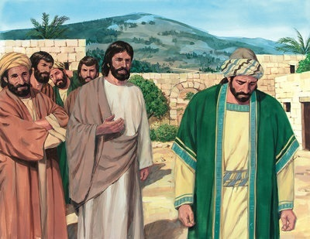
Why?
● Why did Jesus require this man to sell everything (but not others)?
(Ancient philosophers used to test students in this way.)
● Does poverty ensure everlasting life?
● Does ‘keeping the rules’ ensure life?
● What was the ‘one thing’ that this man lacked for everlasting life?
● What is the lasting lesson we must learn?
Image © Lifeway Collection at Goodsalt.com

Slide 24
5. Follow Jesus at all costs. 18:26-30

Slide 25
“Who can be saved?”
²⁶ Those who heard this asked, “Who then can be saved?”
²⁷ Jesus replied, “What is impossible with man is possible with God.”

Slide 26
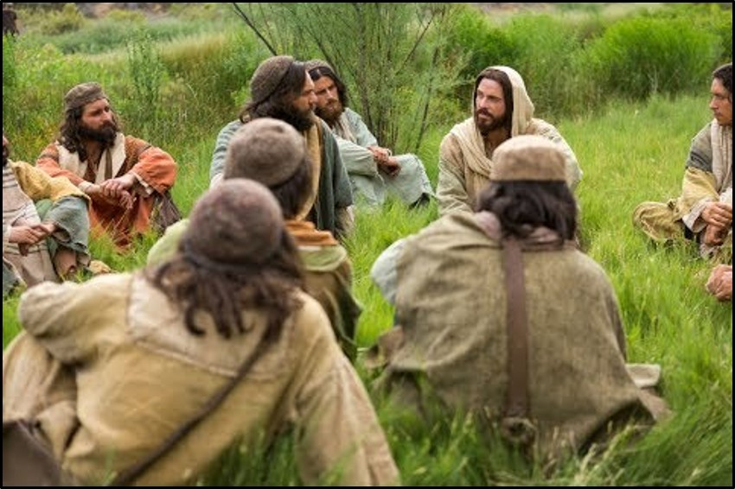
What advantages
²⁸ Peter said to him, “We have left all we had to follow you!” ● What advantages come to real Christians?
²⁹ “Truly I tell you,” Jesus said to them, “no one who has left home or wife or brothers or sisters or parents or children for the sake of the kingdom of God ³⁰ will fail to receive many times as much in this age, and in the age to come eternal life.”

Slide 27
What do we get ‘in this age”?
³⁰ “Many times as much in this age.”
When will we get it?
“Praise be to the God and Father of our Lord Jesus Christ! In his great mercy he has given us new birth into a living hope through the resurrection of Jesus Christ from the dead, and into an inheritance that can never perish, spoil or fade. This inheritance is kept in heaven for you…” 1 Peter 1:3-4

Slide 28
6. Jesus’ death and resurrection 18:31-34

Slide 29
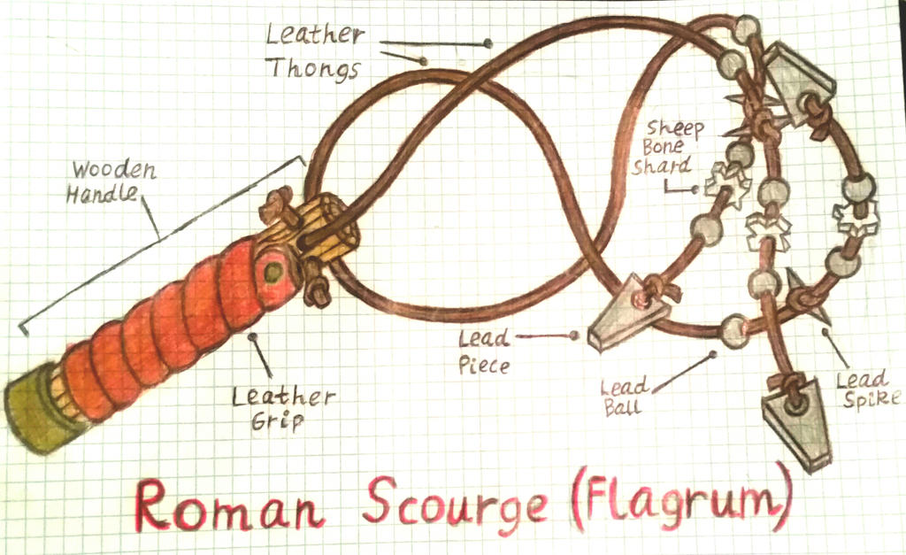
Jesus Predicts His Death a Third Time
³¹ Jesus took the Twelve aside and told them, “We are going up to Jerusalem, and everything that is written by the prophets about the Son of Man will be fulfilled. ³² He will be delivered over to the Gentiles. They will mock him, insult him and spit on him; ³³ they will flog him and kill him. On the third day he will rise again.”
By Romulan64 on DeviantArt

Slide 30
What?
³⁴ The disciples did not understand any of this. Its meaning was hidden from them, and they did not know what he was talking about.
Why did they not understand any of this?
● They expected the Messiah to be a king.
● It was “my servant” who, Isaiah said, would suffer, not “the Son of Man”.
● The Holy Spirit had not yet come to them.

Slide 31
7. Trust Jesus the Messiah 18:35-43

Slide 32
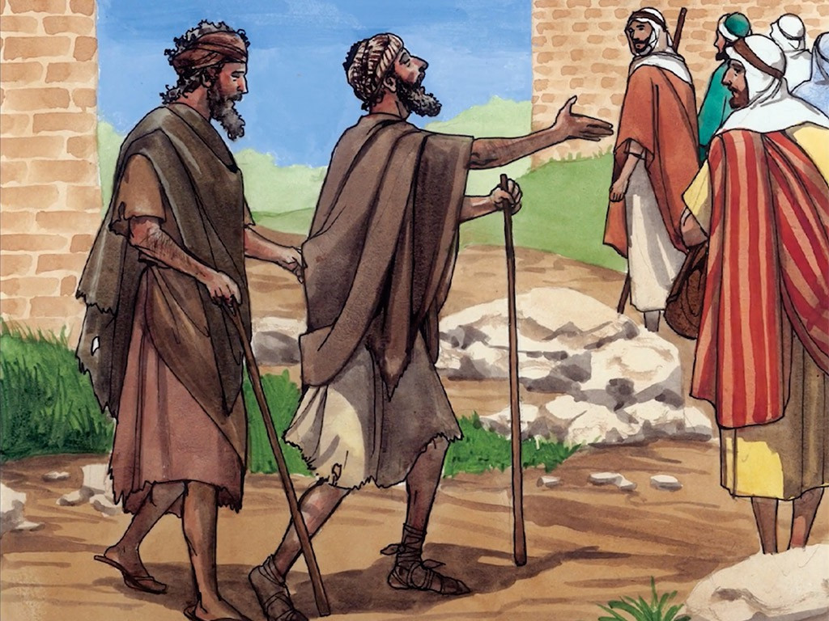
“Son of David!”
³⁵ As Jesus approached Jericho, a blind man was sitting by the roadside begging. ³⁶ When he heard the crowd going by, he asked what was happening. ³⁷ They told him, “Jesus of Nazareth is passing by.”
³⁸ He called out, “Jesus, Son of David, have mercy on me!”
● What is significant about the title “Son of David”?
freebibleimages.org

Slide 33
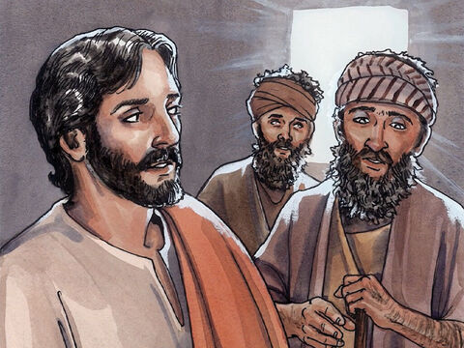
“Lord, I want to see!”
³⁹ Those who led the way rebuked him and told him to be quiet, but he shouted all the more, “Son of David, have mercy on me!”
⁴⁰ Jesus stopped and ordered the man to be brought to him. When he came near, Jesus asked him, ⁴¹ “What do you want me to do for you?”
“Lord, I want to see [~again],” he replied.
freebibleimages.org

Slide 34
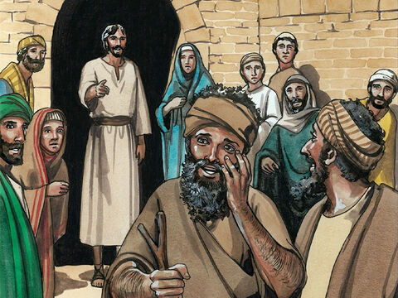
“Lord, I want to see!”
⁴² Jesus said to him, “Receive your sight; your faith has healed you.” ⁴³ Immediately he received his sight and followed Jesus, praising God. When all the people saw it, they also praised God.
Faith can mean:
● Believe in myself.
● Adopt others’ ideas.
● Trust someone else.
freebibleimages.org

Slide 35
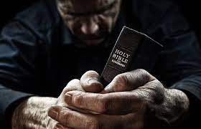
What did you discover?
● Truths to affirm?
● Promises to claim?
● Commands to obey?
Assignment
● Read: Luke chapter 19
● Visit: luke.currah.download
● Compile: insights, queries & observations.

