Slide 1
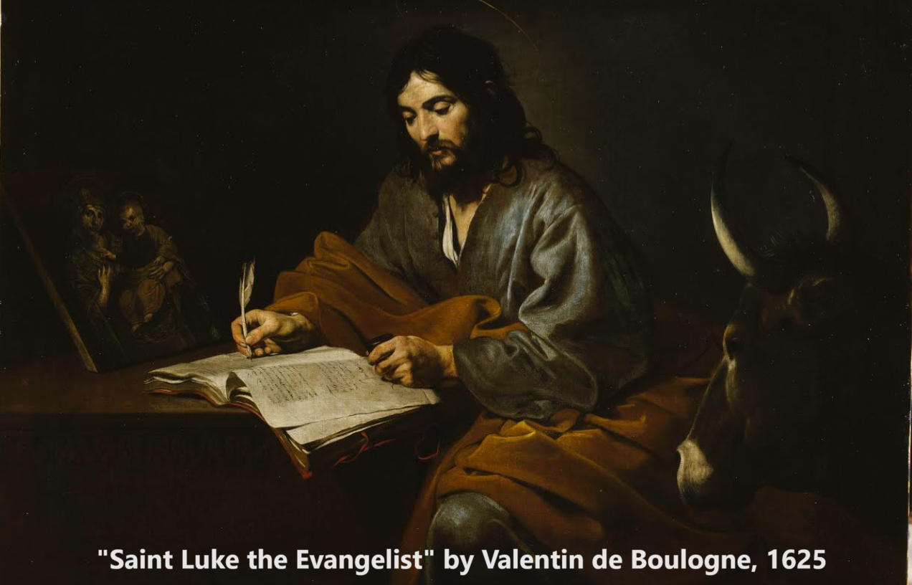
Gospel of Luke 19:45–20:47
‘David’s son becomes his Lord’
28 January & 01 February 2024

Slide 2
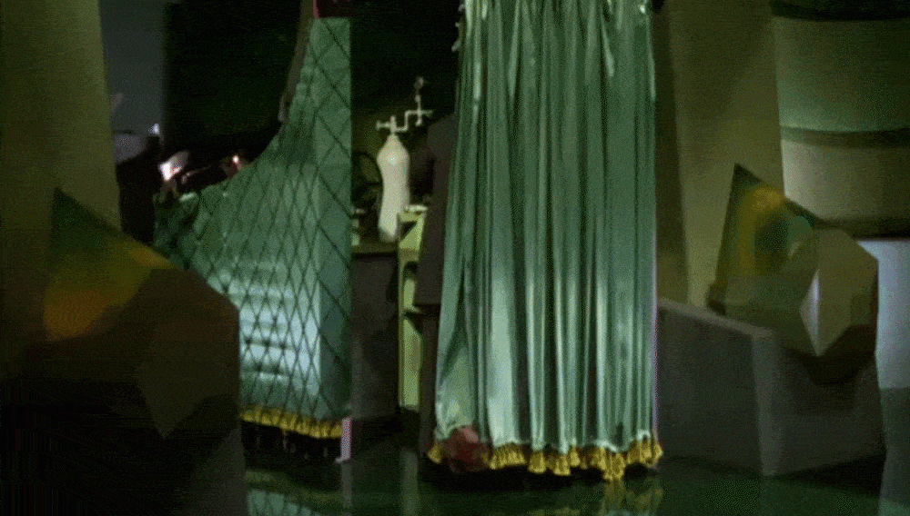
Why learn from Jesus?
● Today, we and our youth have become subject to the tactics and strategies of cognitive warfare.
● This includes neuro-linguistic programming, leading to mass psychosis.
● Powerful, non-elect men are actively manipulating our thoughts, beliefs and emotions.
● These psychological operations make us fearful, compliant, or obedient to unseen authorities.
● The Gospel of Jesus remains our best defense, providing us with credible, alternative truth.

Slide 3
Lesson outline:
1. Leaders seek to kill Jesus, 19:45-48
2. Leaders doubt Jesus’ authority, 20:1-8
3. Jesus doubts leaders’ authority, 20:9-19
4. Leaders seek to entrap Jesus, 20:20-26
5. Jesus corrects leaders’ beliefs, 20:27-39
6. Jesus queries leaders’ beliefs, 20:41-44
7. Jesus warns his disciples, 20:45-47

Slide 4
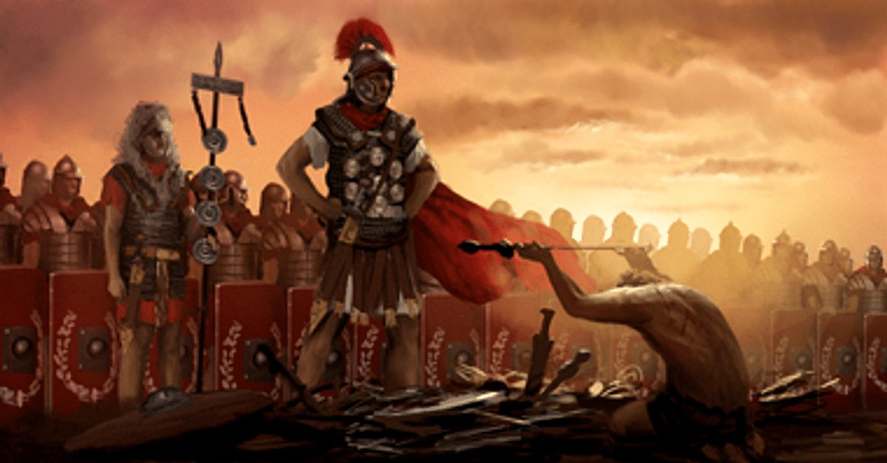
Background and historical notes
● Religious leaders sought to suppress popular preachers.
● Everyone remembered the disastrous tax revolt of year 6 CE.
● Wealthy absentee landowners rented out land to tenant farmers.
● If a man died in a vineyard, then this would defile the fruit.
Roman Victory copyright by CA

Slide 5
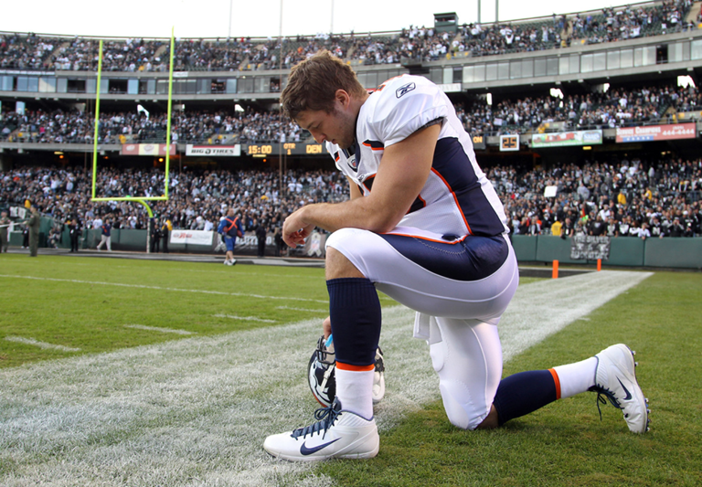
Background and historical notes
● Foreign coins bore the emperor’s image and the divine status that they claimed.
● Jews believed that angels do not procreate because God can create new ones.
● Jews understood that many psalms spoke about their awaited Messiah.
● God deplores those who perform religious duties to be seen by others.

Slide 6
1. Leaders seek to kill Jesus 19:45-48

Slide 7
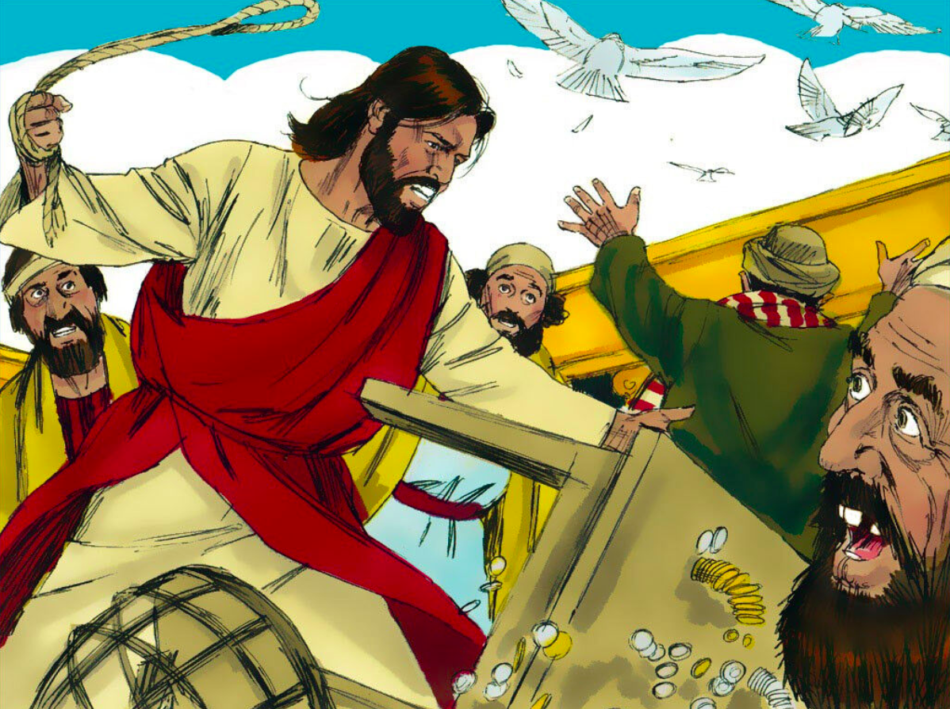
“It is written”
19 ⁴⁵ When Jesus entered the temple courts, he began to drive out those who were selling. ⁴⁶ “It is written,” he said to them, “‘My house will be a house of prayer’; but you have made it ‘a den of robbers.’”
● “It is written”: Quoted from the F.T./H.B.
● “My house…”: Isaiah 56:7 (9th cent. BCE).
● “Den of robbers”: Jeremiah 7:11 (6th BCE).

Slide 8
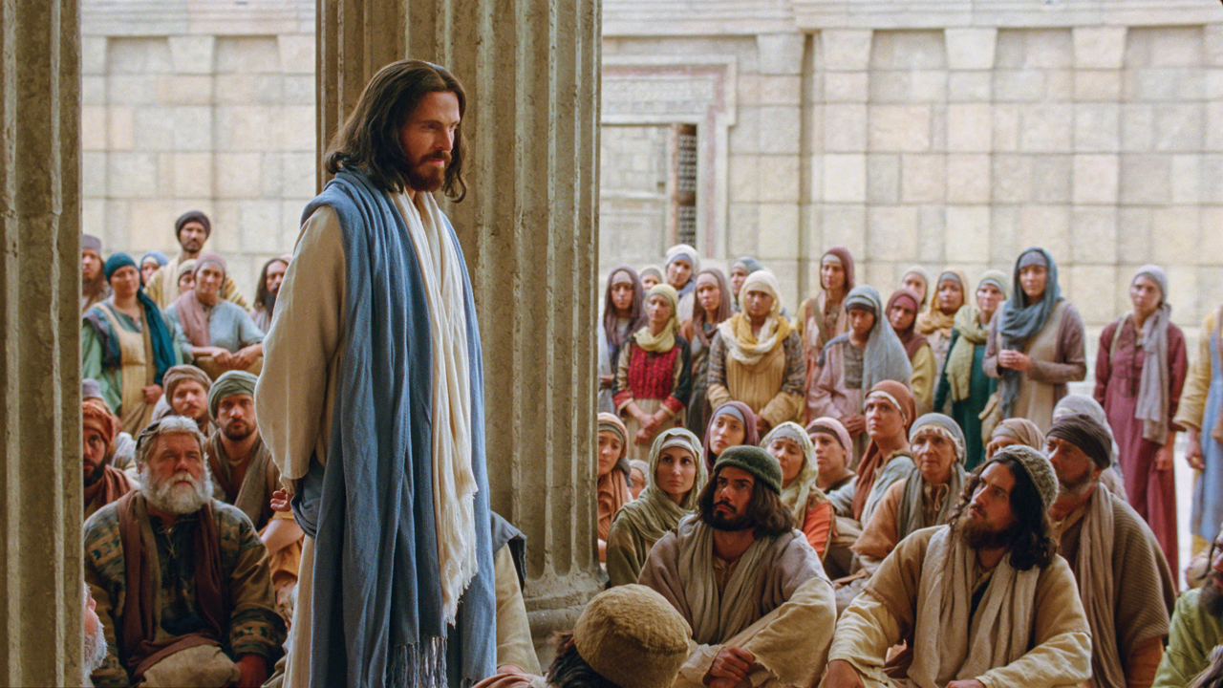
“Trying to kill him”
⁴⁷ Every day he was teaching at the temple. But the chief priests, the teachers of the law and the leaders among the people were trying to kill him. ⁴⁸ Yet they could not find any way to do it, because all the people hung on his words.
● “Kill him”: Why? What for?
He claimed to be the awaited Messiah.
They feared the Romans would intervene.

Slide 9
2. Leaders doubt Jesus’ authority, 20:1-8

Slide 10
“By what authority”
20 ¹ One day as Jesus was teaching the people in the temple courts and proclaiming the good news, the chief priests and the teachers of the law, together with the elders, came up to him. ² “Tell us by what authority you are doing these things,” they said. “Who gave you this authority?”

Slide 11
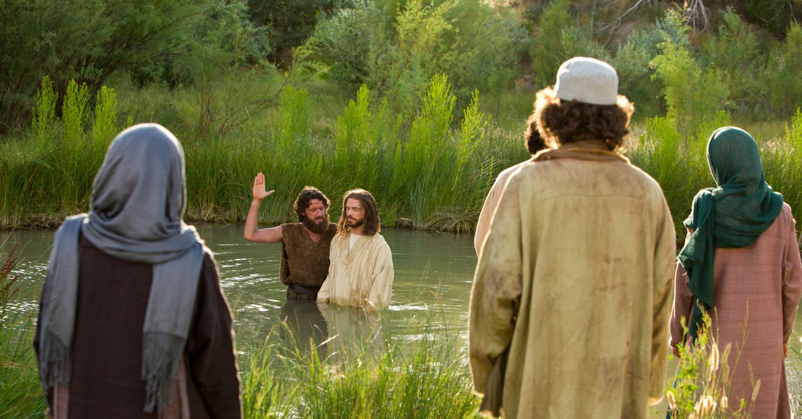
“John’s baptism”
³ He replied, “I will also ask you a question. Tell me: ⁴ John’s baptism — was it from heaven, or of human origin?”
⁵ They discussed it among themselves and said, “If we say, ‘From heaven,’ [then] he will ask, ‘Why didn’t you believe him?’ ⁶ But if we say, ‘Of human origin,’ [then] all the people will stone us, because they are persuaded that John was a prophet.”

Slide 12
“We don’t know”
⁷ So they answered, “We don’t know where it was from.”
⁸ Jesus said, “Neither will I tell you by what authority I am doing these things.”
● Why did Jesus decline to assert his authority?
He had already demonstrated it.
They had already rejected him.
He enjoyed outwitting the arrogant.

Slide 13
3. Jesus doubts their authority, 20:9-19

Slide 14
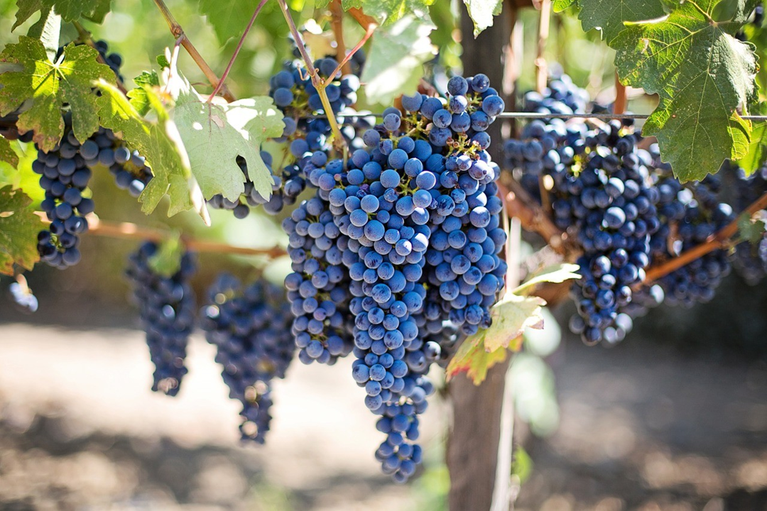
“Planted a vineyard”
⁹ He went on to tell the people this parable: “A man planted a vineyard, rented it to some farmers and went away for a long time. ¹⁰ At harvest time he sent a servant to the tenants so they would give him some of the fruit of the vineyard. But the tenants beat him and sent him away empty-handed.

Slide 15
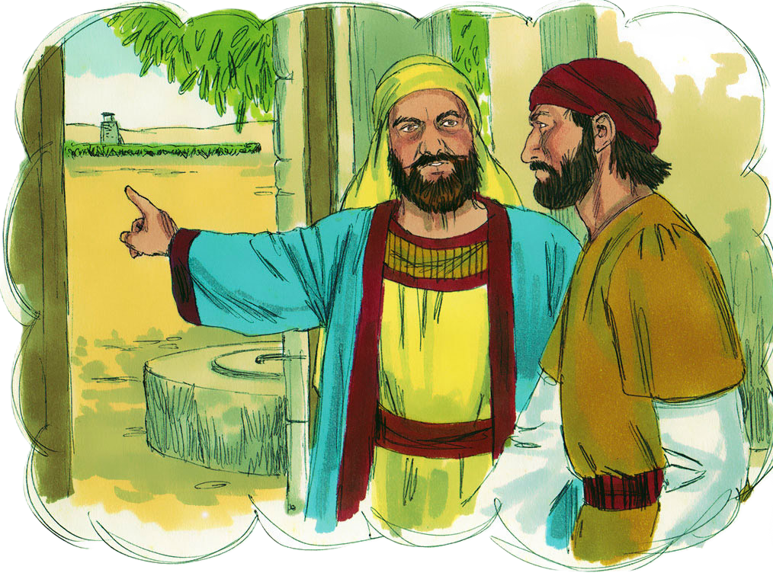
“My son whom I love”
¹² He sent still a third, and they wounded him and threw him out.
¹³ “Then the owner of the vineyard said, ‘What shall I do? I will send my son, whom I love; perhaps they will respect him.’
“God so loved the world that he gave his one and only Son, that whoever believes in him shall not perish but have eternal life.”

Slide 16
“This is the heir”
¹⁴ “But when the tenants saw him, they talked the matter over. ‘This is the heir,’ they said. ‘Let’s kill him, and the inheritance will be ours.’ ¹⁵ So they threw him out of the vineyard and killed him.
● Why throw him out, then kill him?

Slide 17
“What will the owner do? ”
“What then will the owner of the vineyard do to them? ¹⁶ He will come and kill those tenants and give the vineyard to others.”
When the people heard this, they said, “God forbid!”

Slide 18
“The cornerstone”
¹⁷ Jesus looked directly at them and asked, “Then what is the meaning of that which is written:
“‘The stone the builders rejected has become the cornerstone’?
¹⁸ Everyone who falls on that stone will be broken to pieces; anyone on whom it falls will be crushed.”
Isaiah 8:14,15

Slide 19
“He had spoken this against them”
¹⁹ The teachers of the law and the chief priests looked for a way to arrest him immediately, because they knew he had spoken this parable against them. But they were afraid of the people.

Slide 20
4. Leaders seek to entrap Jesus, 20:20-26

Slide 21
“Hand him over”
²⁰ Keeping a close watch on him, they sent spies, who pretended to be sincere. They hoped to catch Jesus in something he said, so that they might hand him over to the power and authority of the governor.
²¹ So the spies questioned him: …
● The governor: Pontius Pilatus, 5th Prefect of Judaea, In office c. 26–36 CE. Appointed by Roman Emperor Tiberius.

Slide 22
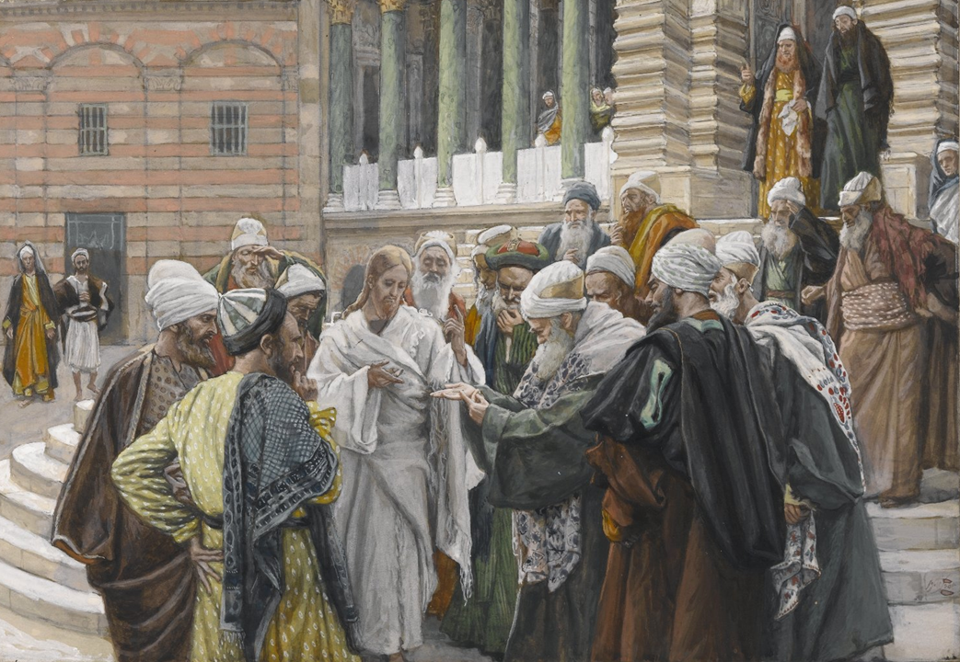
“Denarius”
“Teacher, we know that you speak and teach what is right, and that you do not show partiality but teach the way of God in accordance with the truth. ²² Is it right for us to pay taxes to Caesar or not?”
²³ He saw through their duplicity and said to them, ²⁴ “Show me a denarius. Whose image and inscription are on it?”
“Caesar’s,” they replied.

Slide 23
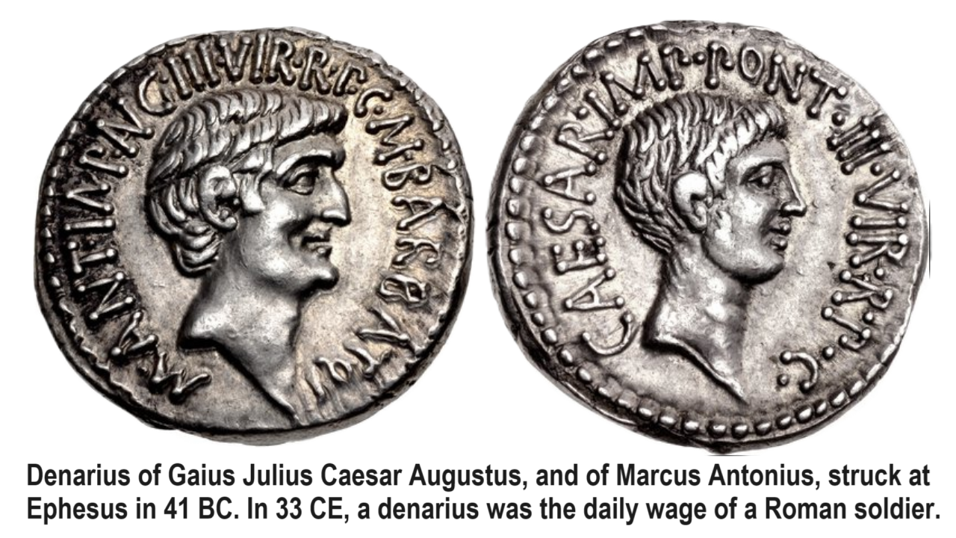
“Unable to trap him ”
²⁵ He said to them, “Then give back to Caesar what is Caesar’s, and to God what is God’s.”
²⁶ They were unable to trap him in what he had said there in public. And astonished by his answer, they became silent.

Slide 24
5. Jesus corrects leaders’ beliefs, 20:27-39

Slide 25
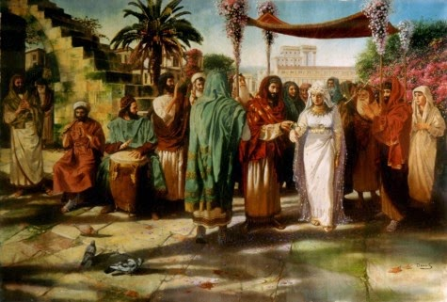
“The resurrection”
²⁷ Some of the Sadducees, who say there is no resurrection, came to Jesus with a question. ²⁸ “Teacher,” they said, “Moses wrote for us that if a man’s brother dies and leaves a wife but no children, the man must marry the widow and raise up offspring for his brother.
³³ Now then, at the resurrection whose wife will she be?

Slide 26
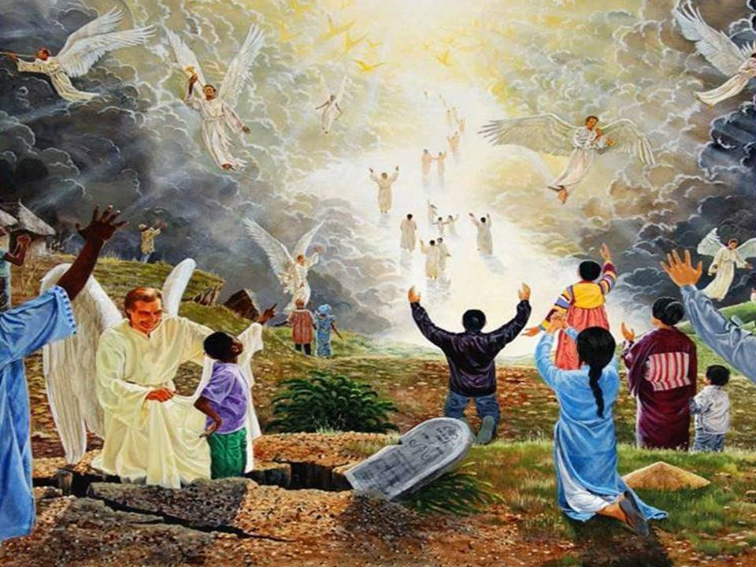
“God’s children”
³⁵ But those who are considered worthy of taking part in the age to come and in the resurrection from the dead will neither marry nor be given in marriage, ³⁶ and they can no longer die… They are God’s children [Greek: ‘sons of God’].
● Who were the ‘sons of God’ in the F.T.?
● Who were the ‘sons of God’ in the N.T.?

Slide 27
6. Jesus queries leaders’ beliefs, 20:41-44

Slide 28
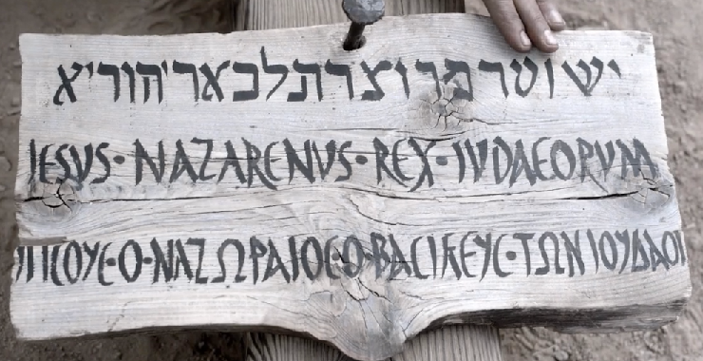
Messianic titles used by Luke
1. King of the Jews 23:37-38
2. Lord 2:11; 20:42
3. Messiah (=Christ) 9:20; 24:46
4. Savior 2:11; 19:10
5. Son of David 18:38, 39
6. Son of God 4:41
7. Son of Man 18:31; 24:7

Slide 29
“The Lord said to my Lord”
⁴¹ Then Jesus said to them, “Why is it said that the Messiah is the son of David? ⁴² David himself declares in the Book of Psalms:
“‘The Lord said to my Lord: “Sit at my right hand ⁴³ until I make your enemies a footstool for your feet.”’

Slide 30
Psalm 110:1
נאם יהוה לאדני
שׁב לימיני
עד אשׁית איביך
הדם לרגליך
ne^{ʔ}um yehwah l·^{ʔ}adoni shev l·imini ^{ʕ}ad- ^{ʔ}ashith ^{ʔ}oyeveyka hadom le·ragley·ka.
Declaration of Yahweh to my lord: “Sit at my right hand
until I make your enemies
a footstool for your feet.”

Slide 31
“The LORD said to my Lord”
⁴⁴ David calls him ‘Lord.’ How then can he be his son?”
[El, Elohim (singular/plural = Israel’s God]
1 The LORD (Yahweh = God’s own Name)
[Adonay (plural = God)]
2 Adon·i (singular ‘my Lord’ = Messiah)
3 David
4 David’s son (Messiah)

Slide 32
7. Jesus warns his disciples, 20:45-47

Slide 33
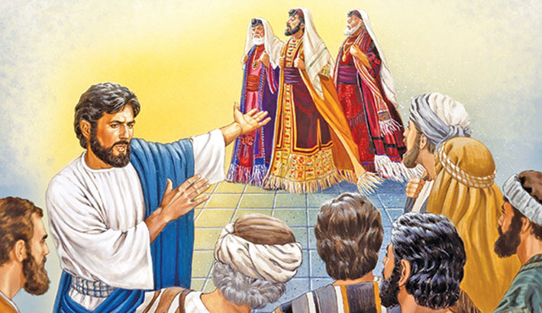
“Teachers of the law”
⁴⁵ While all the people were listening, Jesus said to his disciples, ⁴⁶ “Beware of the teachers of the law. They like to walk around in flowing robes and love to be greeted with respect in the marketplaces and have the most important seats in the synagogues and the places of honor at banquets.

Slide 34
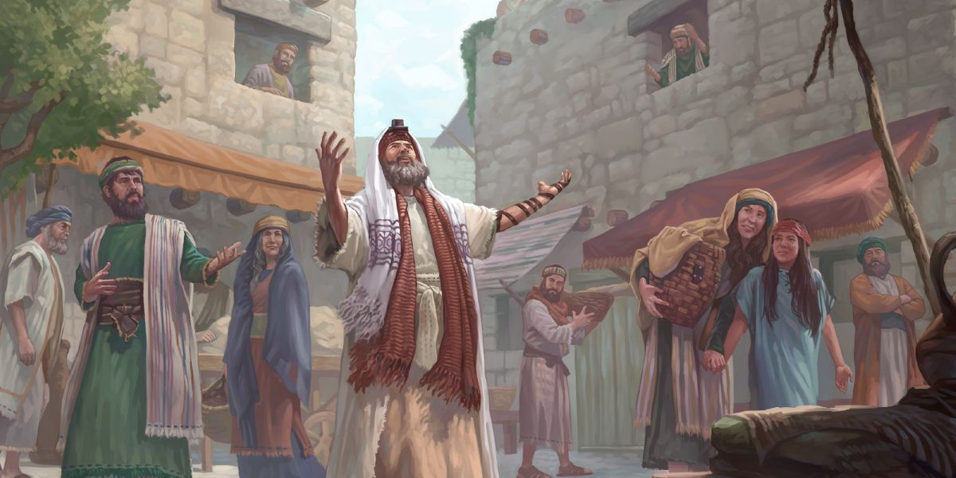
“Punished most severely”
⁴⁷ They devour widows’ houses and for a show make lengthy prayers. These men will be punished most severely.” ● Punished: Why? When? Where? How?
“The wages of sin is death, but the gift of God is eternal life in Christ Jesus our Lord.” Romans 6:23

Slide 35
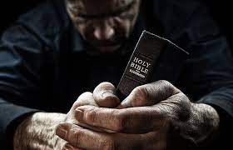
What did you discover?
● Truths to affirm?
● Promises to claim?
● Commands to obey?
Assignment
● Read: Luke chapter 21
● Visit: luke.currah.download
● Compile: insights, queries & observations.

