Slide 1
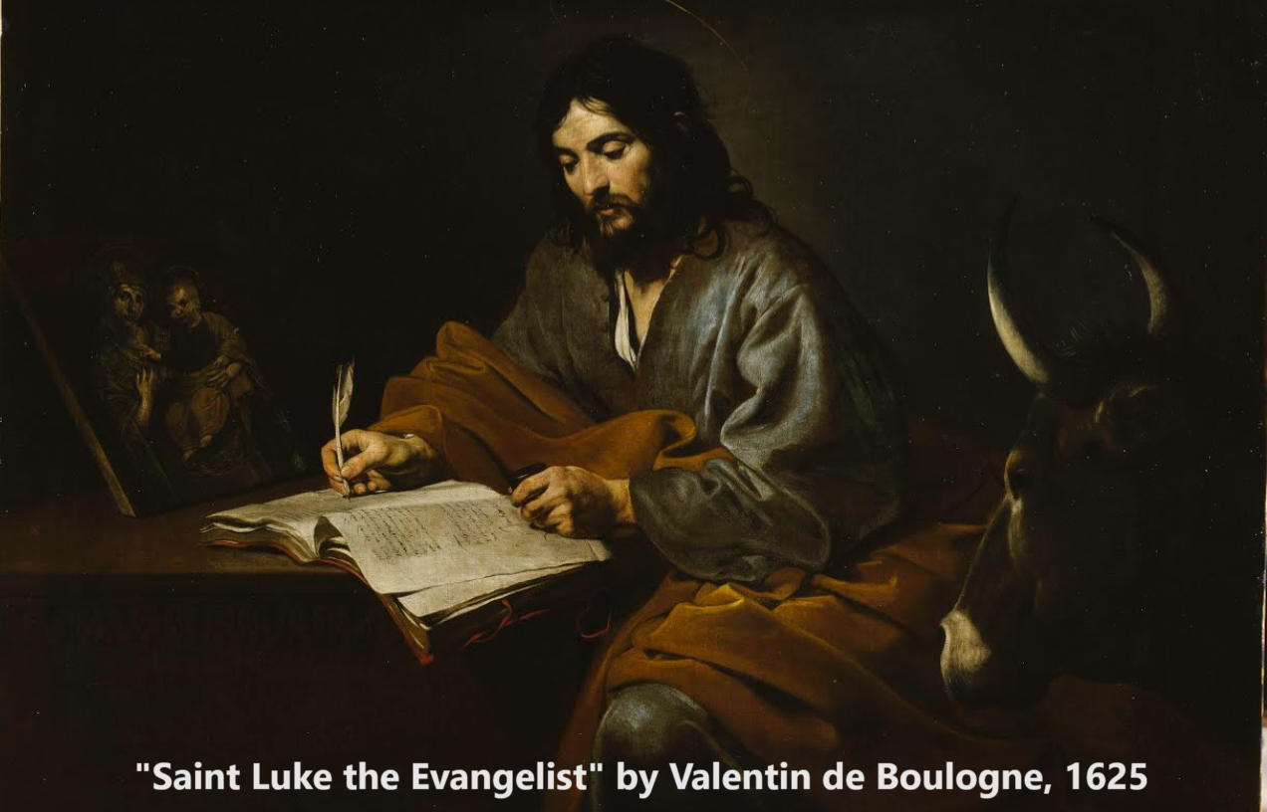
Gospel of Luke 22
“Are you the Son of God?”
11 & 15 February 2024

Slide 2
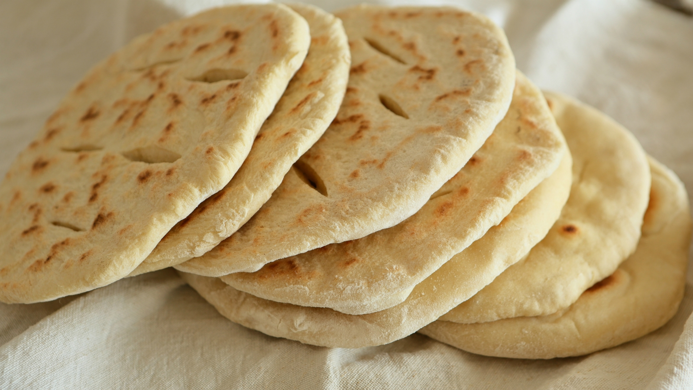
Background notes 1
● Passover immediately preceded the Bread Feast.
● A Passover sheep was sacrificed at the temple, then taken home for a family feast.
● Though it was women who carried water jars, wealthy households would send a man servant.
● Every evening meal during Passover week could be called ‘the Passover’.
● The Roman military garrison in Jerusalem blew a trumpet every morning, which the population termed ‘cockcrow’ or ‘a rooster crowing’.

Slide 3
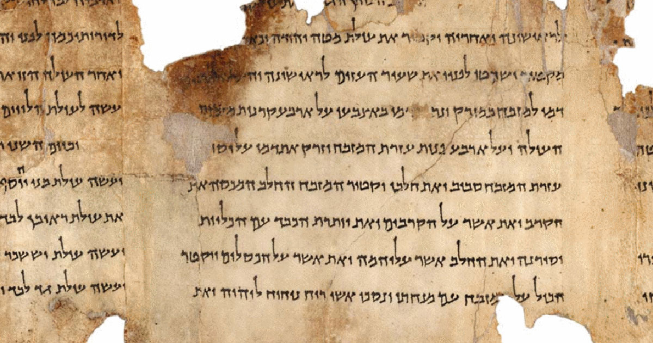
Background notes 2
● Ancient rabbis, the DSS, and Josephus report priestly abuses similarly to the NT.
● Ancient covenants were ratified by blood, but no one ever drank that blood.
● Passover remembered and celebrated Israel’s departure from Egypt, when they sacrificed a lamb and households ate it together in a meal with unleavened bread.

Slide 4
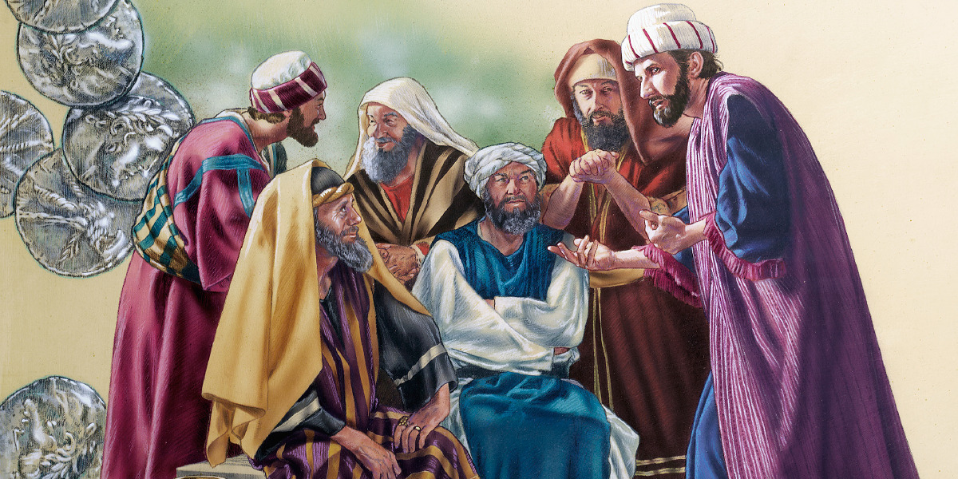
Structure
1. Judas conspires with the temple leaders (1-6 ).
2. Jesus and his disciples celebrate Passover (7-16).
3. Jesus institutes the Lord’ Table (17-23).
4. Jesus settles a dispute for his apostles (24-30).
5. Jesus issues instructions to his apostles (31-38).
6. Jesus prays that the Father's will be done (39-46).
7. Judas leads officials who arrest Jesus (47-53).
8. Peter denies knowing Jesus three times (54-62).
9. Jesus reveals to temple leaders who he is (63-71).

Slide 5
1. Judas conspires with the temple leaders (1-6)

Slide 6
Judas plots to betray Jesus
¹ Now the Festival of Unleavened Bread, called the Passover, was approaching, ² and the chief priests and the teachers of the law were looking for some way to get rid of Jesus, for they were afraid of the people. ³ Then Satan entered Judas, called Iscariot, one of the Twelve.
● Passover: The bread festival + Passover, could be called by either name.
HolyLandSite.com

Slide 7
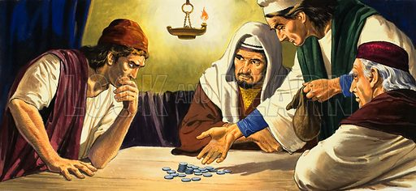
Judas plots to betray Jesus
⁴ Judas went to the chief priests and the officers of the temple guard and discussed with them how he might betray Jesus. ⁵ They were delighted and agreed to give him money. ⁶ He consented, and watched for an opportunity to hand Jesus over to them when no crowd was present.

Slide 8
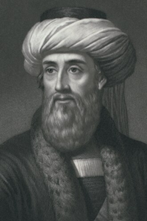
Flavius Josephus, Antiquities 18.63-64
“There was about this time Jesus, a wise man, … a doer of wonderful works, a teacher of such men as receive the truth with pleasure. He drew over to him both many of the Jews and many of the Gentiles… When Pilate, at the suggestion of the principal men amongst us, had condemned him to the cross… The tribe of Christians, so named from him, are not extinct at this day.”
Josephus (37-100), by Emmet, 1880. digitalcollections.nypl.org

Slide 9
2. Jesus and his disciples celebrate Passover (7-16)

Slide 10
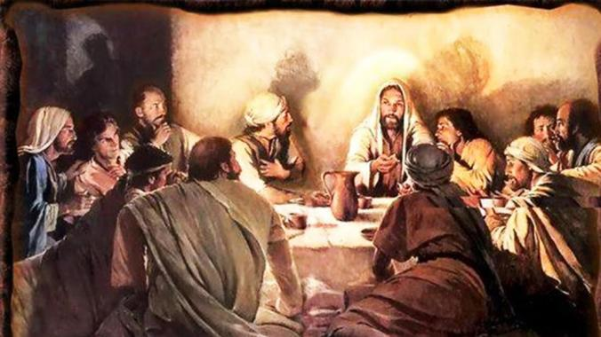
Passover feast
¹⁴ When the hour came, Jesus and his apostles reclined at the table. ¹⁵ And he said to them, “I have eagerly desired to eat this Passover with you before I suffer. ¹⁶ For I tell you, I will not eat it again until it finds fulfillment in the kingdom of God.”
● Fulfillment: It was commonly believed that Messiah’s kingdom would start with a great worldwide Passover feast.

Slide 11
3. Jesus institutes the Lord’ Table (17-23)

Slide 12
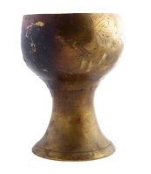
Passover feast
¹⁷ After taking the cup, he gave thanks and said, “Take this and divide it among you. ¹⁸ For I tell you I will not drink again from the fruit of the vine until the kingdom of God comes.”
● Query: When would the kingdom come?

Slide 13
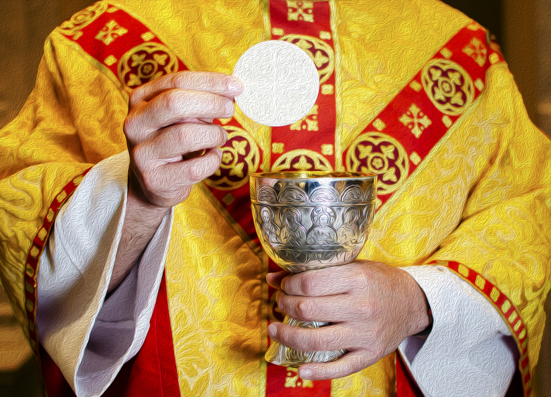
“Communion” theories
● Presence: The Holy Spirit in our midst.
● Trans-substance: The bread and drink become Jesus’ physical body.
● Con-substance: The bread and drink bring Jesus’ physical or mystical body.
● Symbol: The bread and drink are only a powerless memorial that does nothing.
● Commandment: Do this! All Christians do.
● Communion: Personal experience.

Slide 14
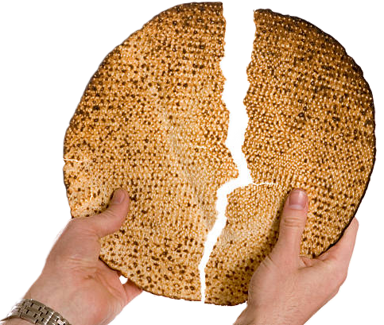
Passover feast
¹⁹ And he took bread, gave thanks and broke it, and gave it to them, saying, “This is my body given for you; do this in remembrance of me.”
● Remembrance: ~Reminder. Jesus shifts the people’s focus away from the Passover lamb to himself as our memorial sacrifice.

Slide 15
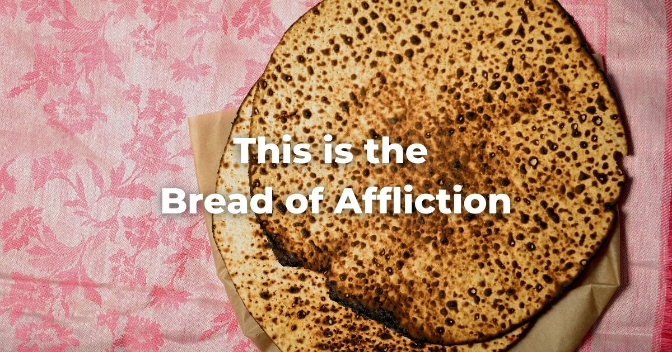
Passover feast
● Origin: “This day shall be a day of remembrance for you. You shall celebrate it as a festival to the LORD.” Exodus 12:14
● Judaism: “This is the bread of affliction our ancestors ate when they came from Egypt.”
● Gospel: “How can this man give us his flesh to eat?” John 6:52

Slide 16
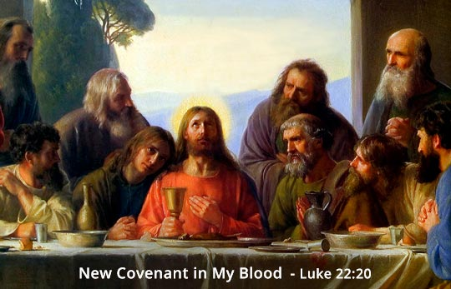
Blood
* ²⁰ In the same way, after the supper he took the cup, saying, “This cup is the new covenant in my blood, which is poured out for you.
● Blood: (1) Material: Circulatory fluid.
(2) Emotional: Strong feelings & values.
(3) Metaphorical: Sacrificial death.
(4) Ceremonial: Purification agent.
* A minority of manuscripts omit 19b-20

Slide 17
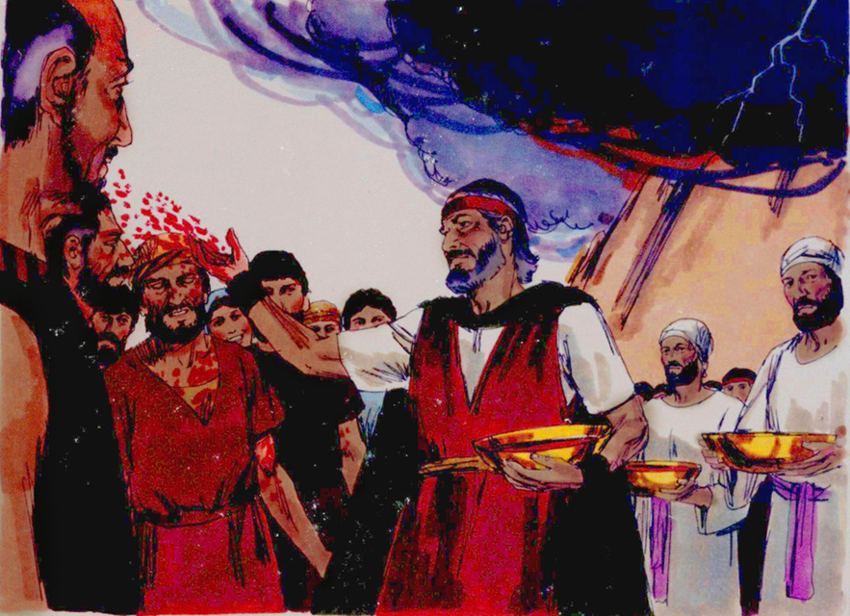
Blood rules
● You shall not eat the blood of any creature… Whoever eats it shall be cut off. Lev. 17:14
● Moses took the blood and dashed it on the people, and said, “Here is the blood of the covenant that the LORD has made with you.” Exo. 24:8
● “I will make a new covenant with the house of Israel and the house of Judah.” Jer. 31:31
● “This cup is the new covenant in my blood . Do this, as often as you drink it, in remembrance of me.” 1 Cor. 11:25

Slide 18
4. Jesus settles a dispute for his apostles (24-30)

Slide 19
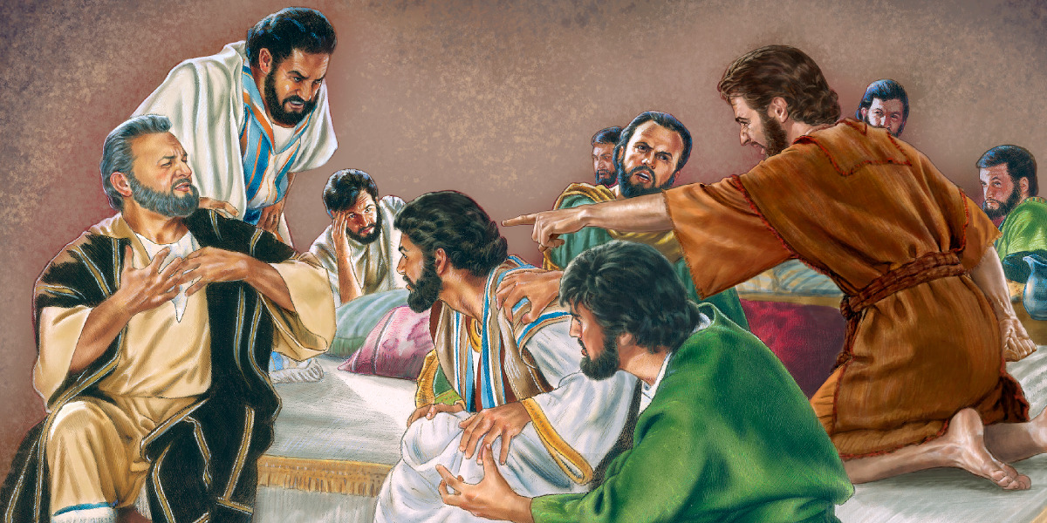
Who will be the greatest?
²⁴ A dispute also arose among them as to which of them was considered to be greatest. ²⁵ Jesus said to them, … ²⁶ “The greatest among you should be … like the one who serves… ²⁷ I am among you as one who serves… ²⁹ And I confer on you a kingdom … judging the twelve tribes of Israel...
³² Strengthen your brothers.”

Slide 20
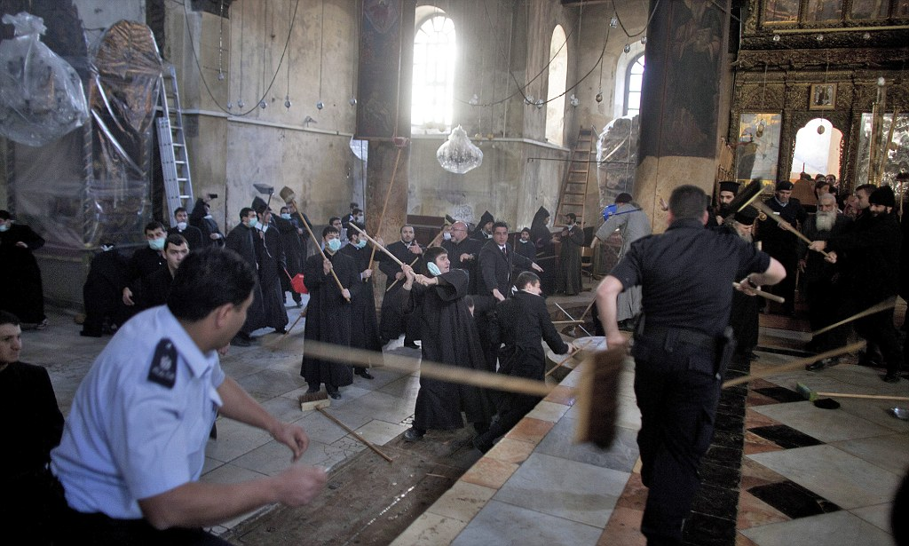
‘Christian’ disputes
● Catholic: Who is the real pope? ➔ wars.
● Orthodox: Which metropolitan has more authority? ➔ excommunication.
● Protestant: Which is the true theology? ➔ books.
● Evangelical: Who has more of the Holy Spirit? ➔ sheep stealing, ➔ stagnation, ➔ merger.
● Missionary: Which mode of baptism? ➔ split.
● Church: Which colour for new carpets? ➔ quit.
The 2011 annual cleaning of the Church of the Nativity in Bethlehem descended into a battle between the rival Christian denominations that share it. Riot police are forced to defend themselves from broom-wielding holy men.

Slide 21
5. Jesus issues instructions to his apostles (31-38)

Slide 22
Change of tactics
³⁵ Then Jesus asked them, “When I sent you without purse, bag or sandals, did you lack anything?”
“Nothing,” they answered.
³⁶ He said to them, “But now if you have a purse, take it, and also a bag; and if you don’t have a sword, sell your cloak and buy one.
● Query: Why a sword? (The Romans had disarmed the population, forbidding weapons.)

Slide 23
With transgressors
³⁷ It is written: ‘And he was numbered with the transgressors’; and I tell you that this must be fulfilled in me. Yes, what is written about me is reaching its fulfillment.”
³⁸ The disciples said, “See, Lord, here are two swords.”
“That’s enough!” he replied.
● Query: Enough what? Swords? Talk?
● Query: What transgressors? He was sinless.

Slide 24
6. Jesus prays that the Father's will be done (39-46)

Slide 25
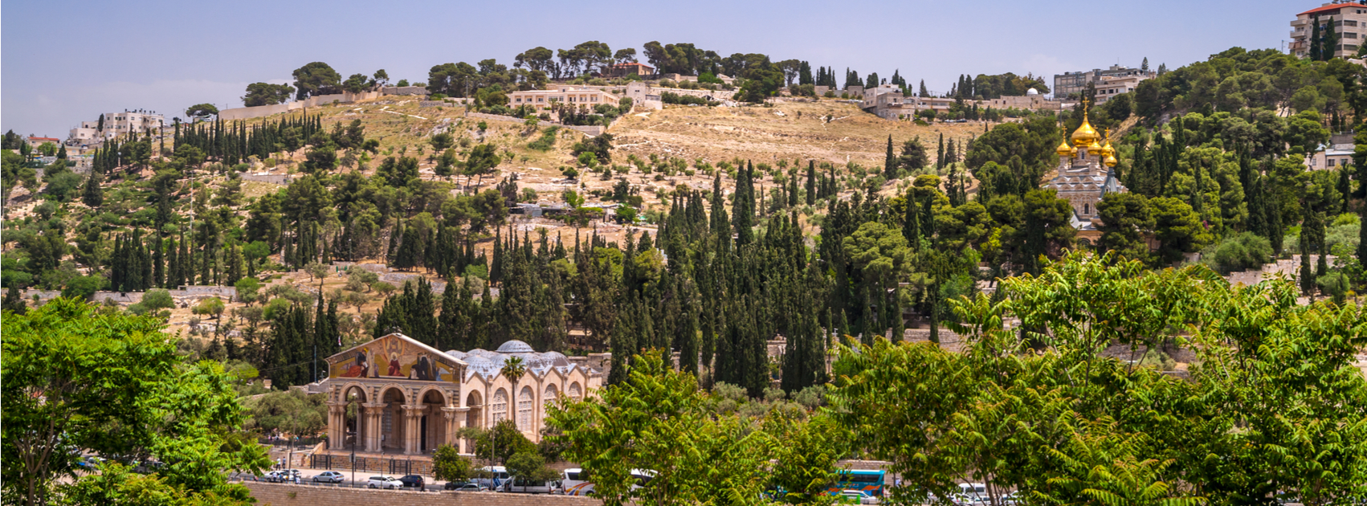
Temptation/test/trial = opportunity
³⁹ Jesus went out as usual to the Mount of Olives, and his disciples followed him. ⁴⁰ On reaching the place, he said to them, “Pray that you will not fall into temptation.”
● 15 to 20 minutes’ walk.
● “Do not bring us to the time of trial.” 11:4
● When the devil had finished every test, he departed from him until an opportune time. 4:13
Mount of Olives today. myolivetree.com

Slide 26
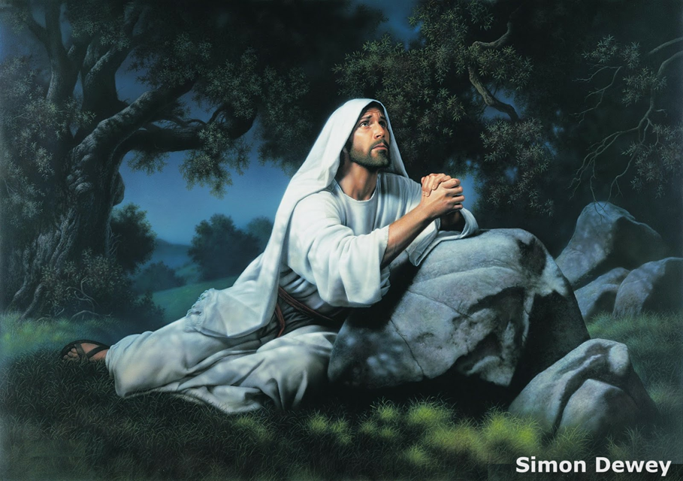
Temptation/test/trial = opportunity
⁴¹ He withdrew about a stone’s throw beyond them, knelt down and prayed, ⁴² “Father, if you are willing, take this cup from me; yet not my will, but yours be done.” [⁴³ An angel from heaven appeared to him and strengthened him. ⁴⁴ And being in anguish, he prayed more earnestly. ]
● The oldest manuscript & others omit 43-44.

Slide 27
7. Judas leads officials who arrest Jesus (47-53)

Slide 28
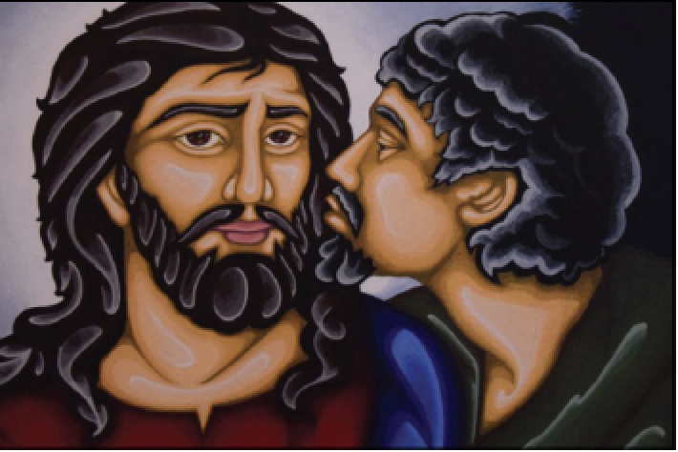
Jesus arrested
⁴⁷ While he was still speaking a crowd came up, and the man who was called Judas, one of the Twelve, was leading them. He approached Jesus to kiss him, ⁴⁸ but Jesus asked him, “Judas, are you betraying the Son of Man with a kiss?”
● Kiss: An embrace, not a smooch.
● Why: Jesus said, “the Son of Man”
Judas kissing Jesus from L'Osservatore Romano, 2021

Slide 29
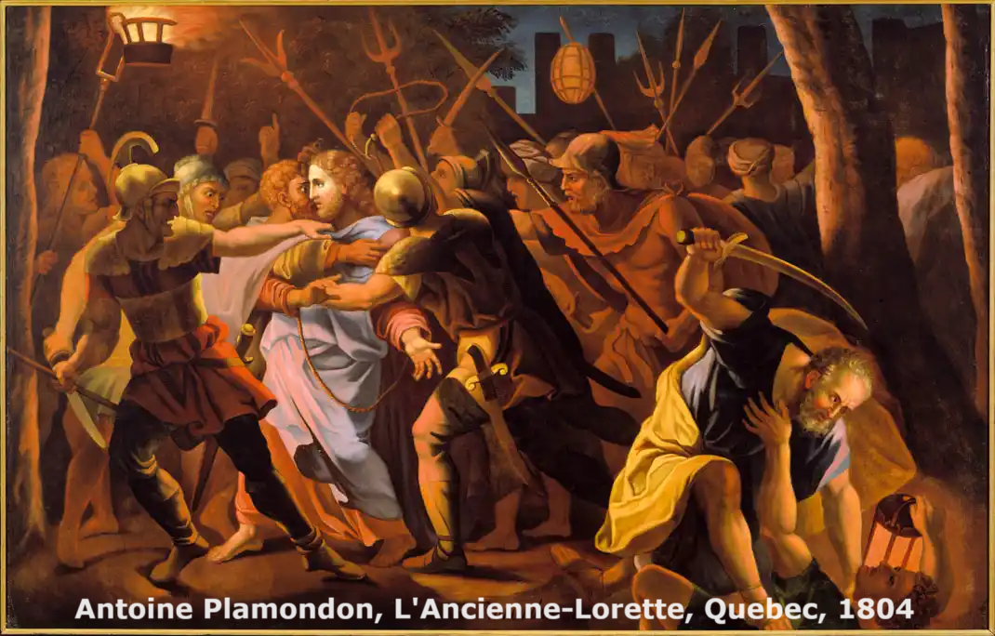
Jesus arrested
⁵² Then Jesus said to the chief priests, the officers of the temple guard, and the elders, who had come for him, “Am I leading a rebellion, that you have come with swords and clubs? ⁵³ Every day I was with you in the temple courts, and you did not lay a hand on me. But this is your hour —when darkness reigns.”

Slide 30
“This is your hour”
● Darkness: Night was commonly associated with evil and crime, the time when demons ruled and witchcraft operated.
● Psalm 91:5-6: “You will not fear the terror of the night, nor the arrow that flies by day, nor the pestilence that stalks in darkness, nor the destruction that wastes at noonday.”

Slide 31
8. Peter denies knowing Jesus three times (54-62)

Slide 32
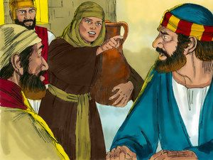
“This man was with him!”
⁵⁴ Then seizing him, they led him away and took him into the house of the high priest. Peter followed at a distance. ⁵⁵ And when some there had kindled a fire in the middle of the courtyard and had sat down together, Peter sat down with them. ⁵⁶ A servant girl saw him seated there in the firelight. She looked closely at him and said, “This man was with him.”

Slide 33
“I don’t know him!”
⁵⁷ But he denied it. “Woman, I don’t know him,” he said.
⁵⁸ A little later someone else saw him and said, “You also are one of them.”
“Man, I am not!” Peter replied.
⁵⁹ About an hour later another asserted, “Certainly this fellow was with him, for he is a Galilean.”

Slide 34
“You will disown me three times.”
⁶⁰ Peter replied, “Man, I don’t know what you’re talking about!” Just as he was speaking, the rooster crowed. ⁶¹ The Lord turned and looked straight at Peter. Then Peter remembered the word the Lord had spoken to him: “Before the rooster crows today, you will disown me three times.” ⁶² And he went outside and wept bitterly.

Slide 35
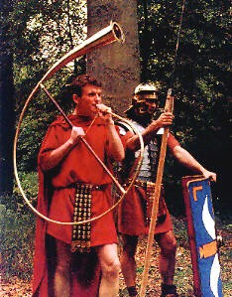
A mistake in the Gospel?
● Problem: Live chickens were not allowed in Jerusalem. Mishnah (m.Bava Kamma 7:7)
● Solution: The temple had a morning crier, and the Romans military a trumpet sound called Gallicinium (cock crowing).

Slide 36
9. Jesus reveals to temple leaders who he is (63-71)

Slide 37
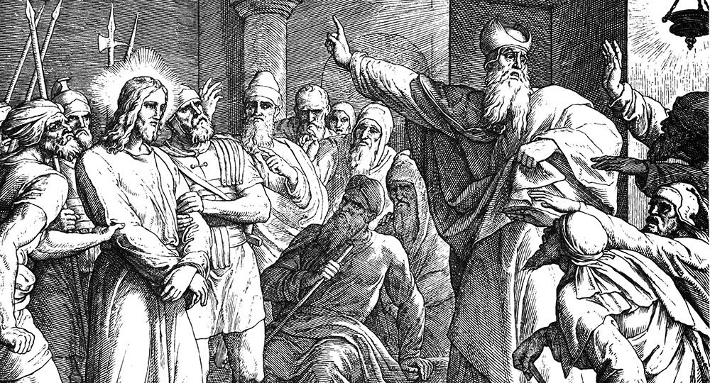
“If you are the Messiah”
⁶⁶ At daybreak the council of the elders of the people, both the chief priests and the teachers of the law, met together, and Jesus was led before them. 67 “If you are the Messiah,” they said, “tell us.”
● Scoffers: “Jesus never said, ‘I am God’!”
(Instead, he showed who he was.)
● Jesus: He often claimed to be the Messiah.

Slide 38
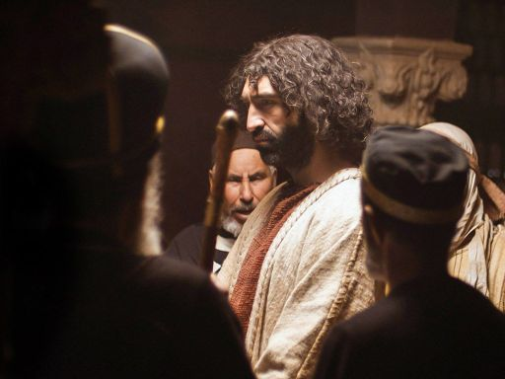
“If I tell you”
Jesus answered “If I tell you, you will not believe [or release*], me, ⁶⁸ and if I asked you, you would not answer. ⁶⁹ But from now on, the Son of Man will be seated at the right hand of the mighty God.” *inserted by some early manuscripts
● Seated: “The awaited kingdom starts now, and you guys are not in it!”

Slide 40
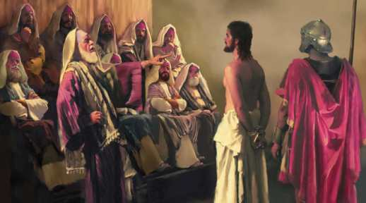
“Are you the Son of God”
⁷⁰ They all asked, “Are you then the Son of God?”
[Jesus] replied, “You say that I am.”
⁷¹ Then they said, “Why do we need any more testimony? We have heard it from his own lips.”
● All asked: They all agreed to ask.
● “You say”: Jesus’ answer is taken as affirmative: “Yes, I am.”

Slide 41
“Son of God”
● Son of God: A well-known title used of the awaited Messiah.
● Origin: Yahweh said to David about his son Solomon, “I will establish the throne of his kingdom forever. I will be to him a father, and he shall be to me a son.”2 Sam. 7:14
● Meaning: “He claims to be Messiah, a king.” Luke 23:3

Slide 42
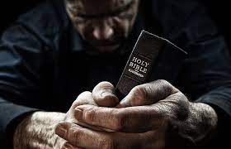
What did you discover?
● Truths to affirm?
● Promises to claim?
● Commands to obey?
Assignment
● Read: Luke chapter 23
● Visit: luke.currah.download
● Compile: insights, queries & observations.

