Slide 1
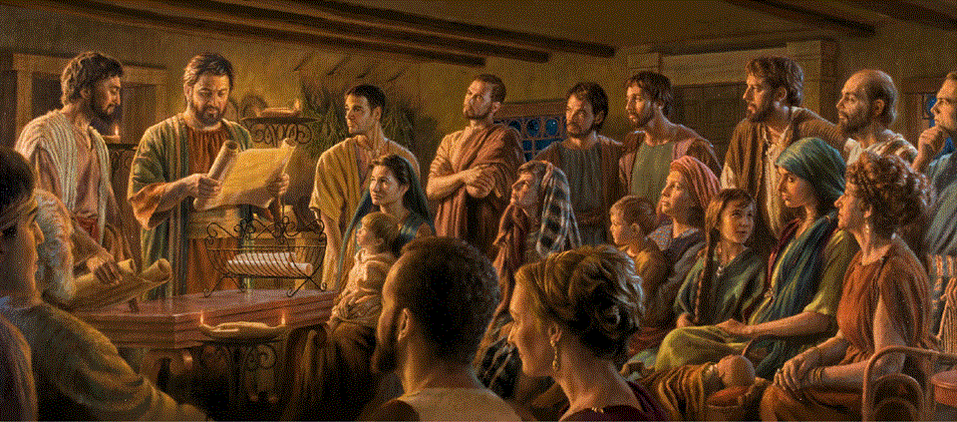
Romans 10:1-21 (NRSVue)
A Short Course for Men

Slide 2
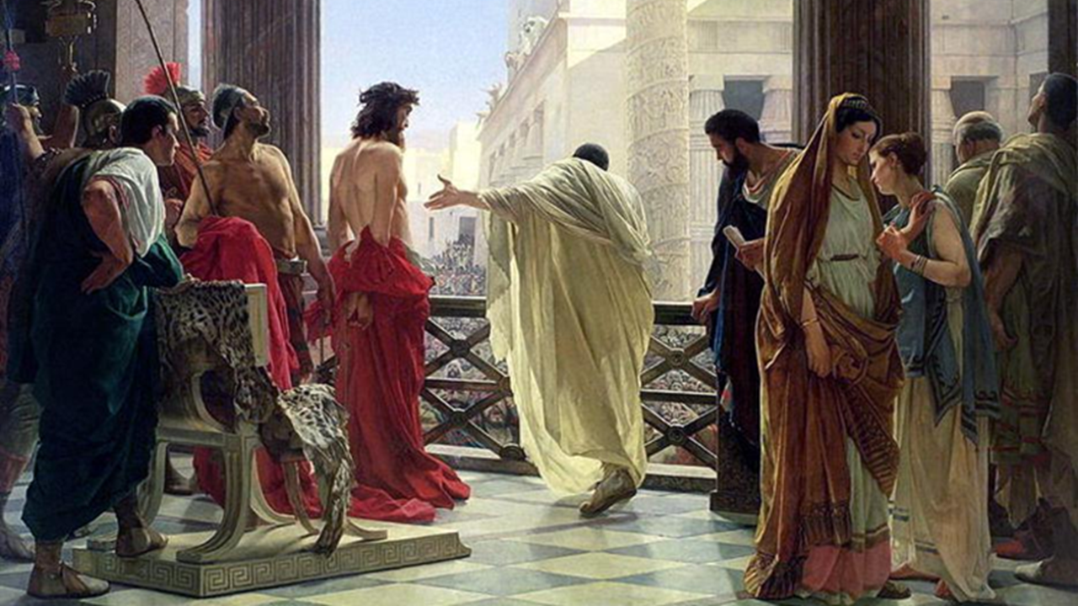
Romans 10 Outline
Where did Israel go wrong?
A. Israelites, zealous but mistaken (1-4).
B. Written revelation (5-11).
C. One Lord for all (12-15).
B’ Audible revelation (16-18).
A’ Israel, disobedient (19-21).
“Jews, Romans,
and one Lord of all”

Slide 3
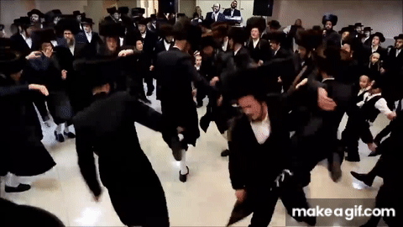
A. Zealous but mistaken
¹ Brothers and sisters, my heart’s desire and prayer to God for [Israelites] is that they may be saved.
² For I can testify that they have a zeal for God, but it is not based on knowledge.
● Israelites:
● Zeal:
● Knowledge:
Descendants of Jacob.
Dedicated (for or against).
Accurate understanding.

Slide 4

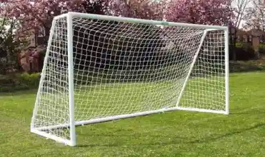
³ Not knowing the righteousness of God and seeking to establish their own,
they have not submitted to God’s righteousness.
⁴ For Christ is the culmination of the law so that there may be righteousness for everyone who believes.
● Submit:
● Culmination:
To yield or to obey.
Telos, goal or outcome.

Slide 5
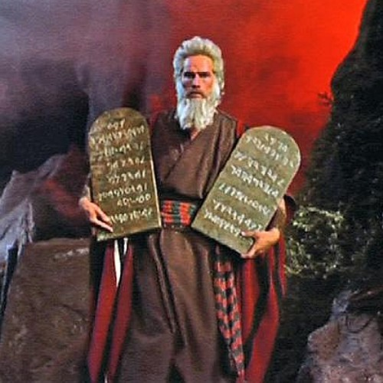
B. Written revelation
⁵ Moses writes concerning the righteousness that comes from the law, that “the person who does these things will live by them.”
⁶ But the righteous-ness that comes from faith says, “Do not say in your heart, ‘Who will ascend into heaven?’ ”
● Moses:
Lev. 18:5; Deut. 30:12-14

Slide 6
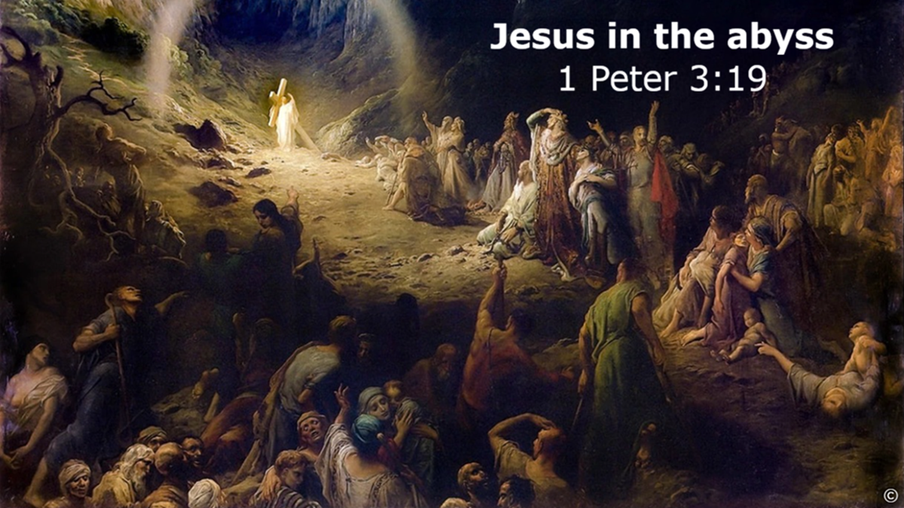

⁷ “or ‘Who will descend into the abyss?’” (that is, to bring Christ up from the dead).
⁸ But what does it say?
“The word is near you, in your mouth and in your heart” (that is, the word of faith that we proclaim), …
● Say:
● Mouth:
● Heart:
Deut. 30:14
Public admission.
Inner commitment.

Slide 7
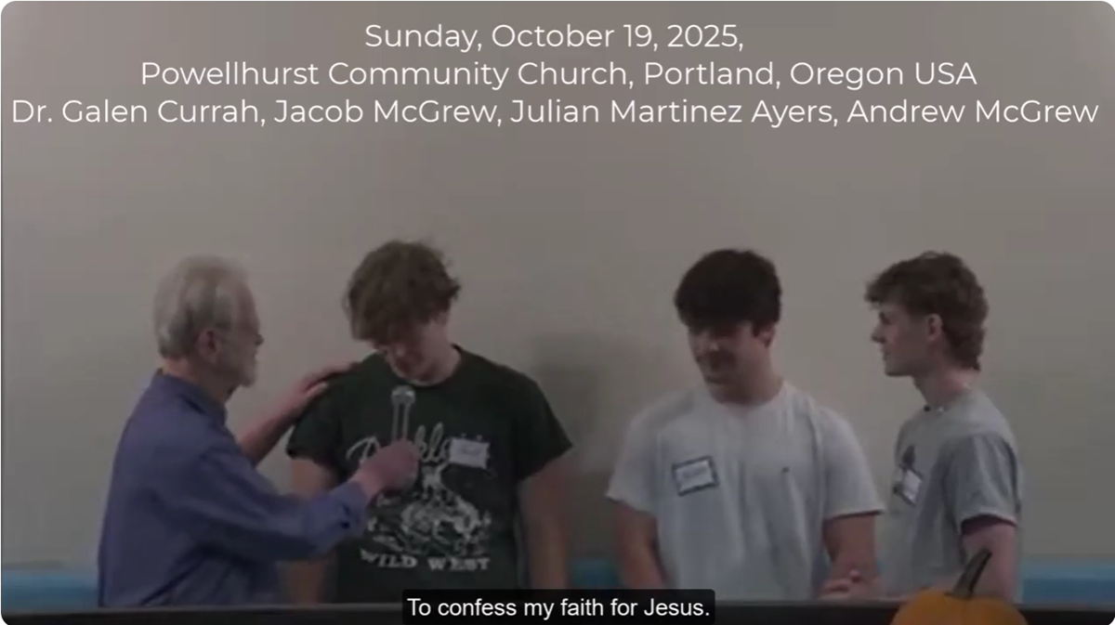

⁹ because if you confess with your mouth that Jesus is Lord and believe in your heart that God raised him from the dead, [then] you will be saved.
● If:
● Confess:
● Believe:
● Raised:
● Saved:
Salvation is conditional.
From baptism onwards.
Trust and remain faithful.
Out of hell into his body.
Receive what Jesus promised.
“Confess with your mouth
that Jesus is Lord!”

Slide 8
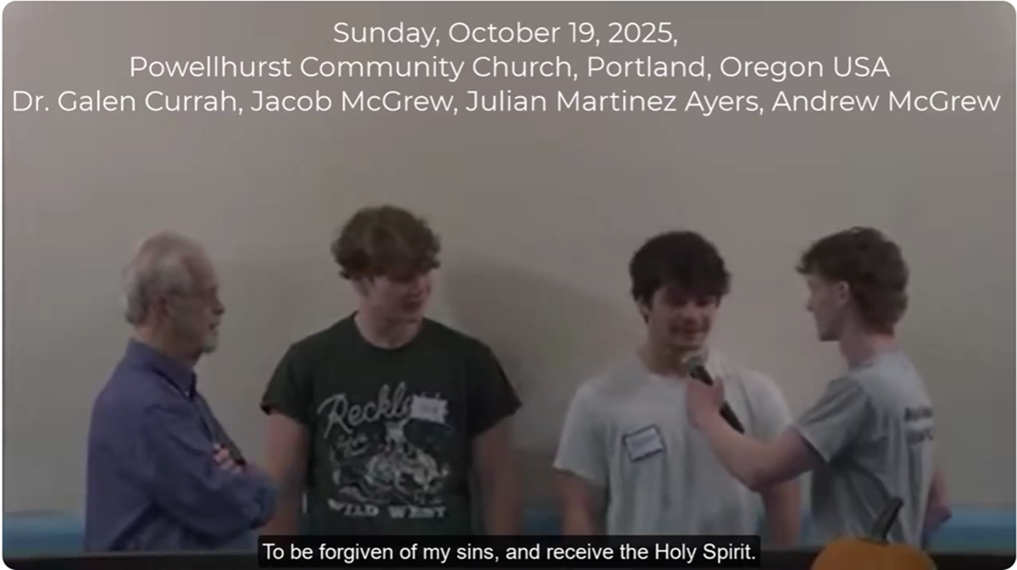
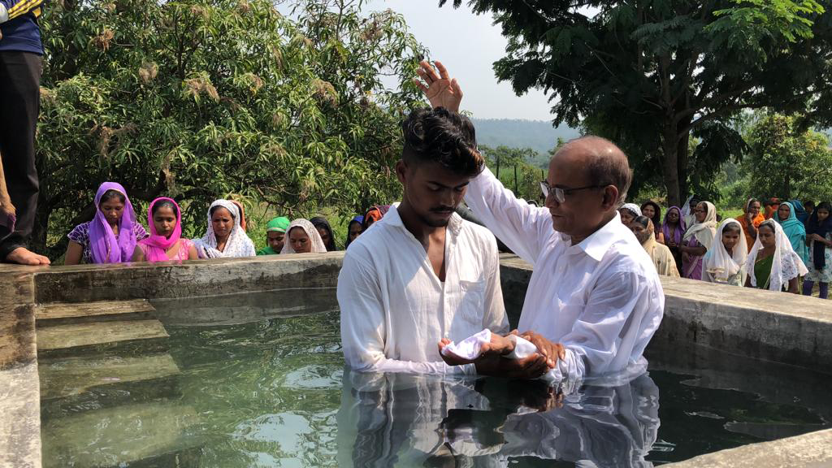
¹⁰ For one believes with the heart, leading to righteousness, and one confesses with the mouth, leading
to salvation.
¹¹ [For] the scripture says,
“No one who believes in him will be put to shame.”
● Righteousness:
● Salvation:
● Shame:
Acquitted ➔ neutral.
All that Jesus promised.
Exposed. Isa. 28:16.
“One believes with the heart leading to righteousness”

Slide 9

C. One Lord for all
¹² For there is no distinction between Jew and Greek; the same Lord is Lord of all and is generous to all who call on him.
“Everyone who calls on the name of the Lord shall
be saved.”
Joel 2:32
¹³ For “everyone who calls on the name of the Lord shall be saved.”
● Generous:
● Call:
● Lord:
To share wealth.
To higher authority. Joel 2.32
Jesus (v. 9) = Yahweh (v. 13).

Slide 10
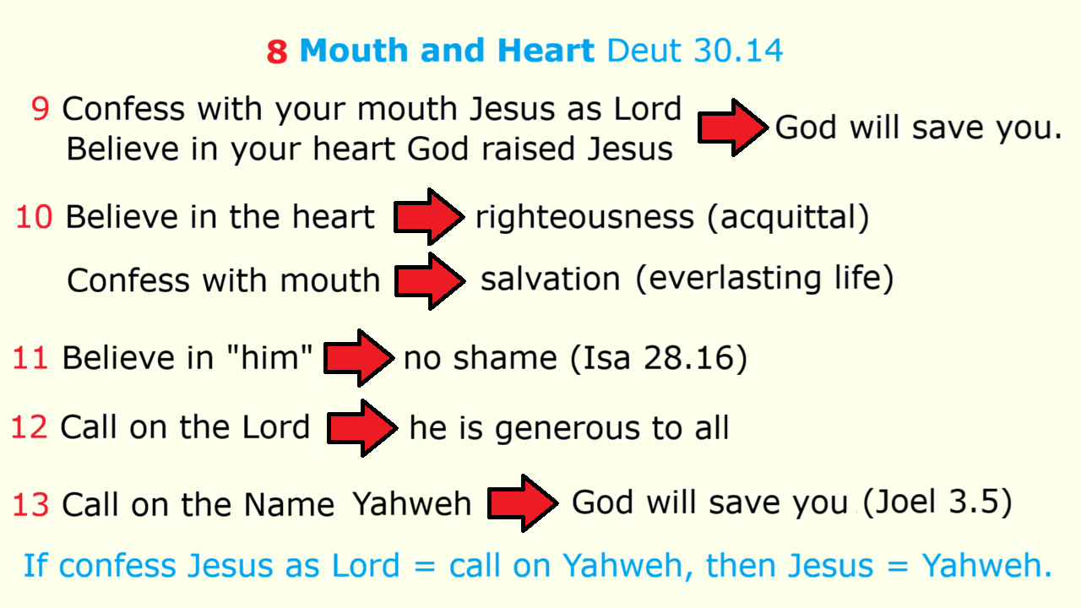

Slide 11

¹⁴ But how are they to call on one in whom they have not believed?
And how are they to believe in one of whom they have never heard?
And how are they to hear without someone to proclaim him?
¹⁵ And how are they to proclaim him unless they are sent?
As it is written, “How beautiful are the feet of those who bring good news!”

Slide 12
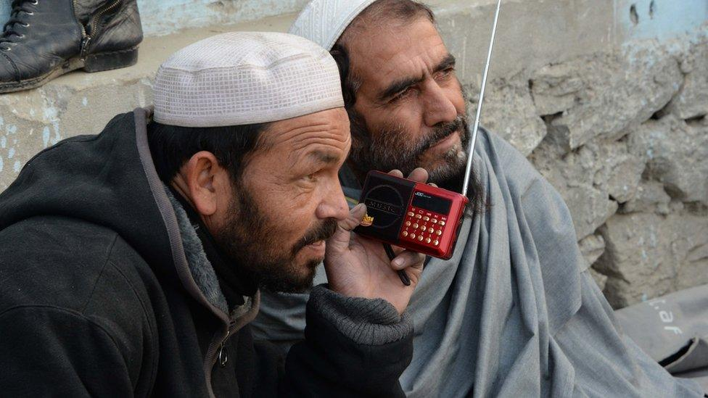
B’ Audible revelation
¹⁶ But not all have obeyed the good news, for Isaiah says, “Lord, who has believed our message?”
¹⁷ So faith comes from what is heard, and what is heard comes through the word of Christ.
● Obey:
● Message:
● Word:
“Repent and believe!” Mk 1:15
Akoé, audible.
Hréma, speech.
“Faith comes from what is heard”

Slide 13
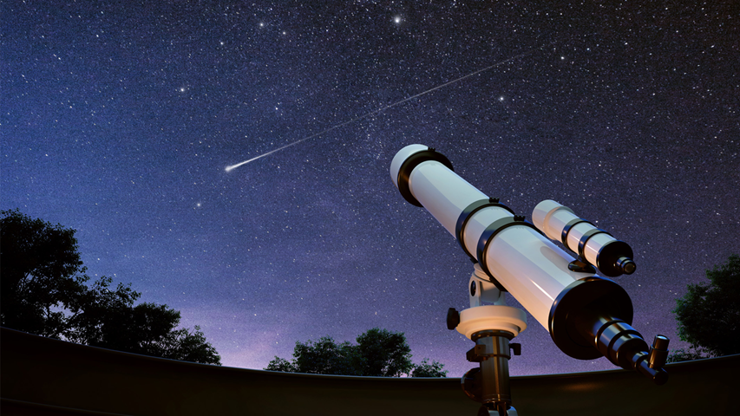

¹⁸ But I ask, have they not heard?
Indeed they have:
“Their voice has gone out to all the earth
and their words to the ends of the world.”
● Voice:
● Earth:
● Ends:
● World:
Psalm 19:4, of sky and law.
Gén, the land, ancient Israel.
Acts 1:8, limits of the land.
Oikoumené, Roman empire.
“The heavens declare the glory of God,
and the sky above proclaims his handiwork.” Psalm 19:1

Slide 14
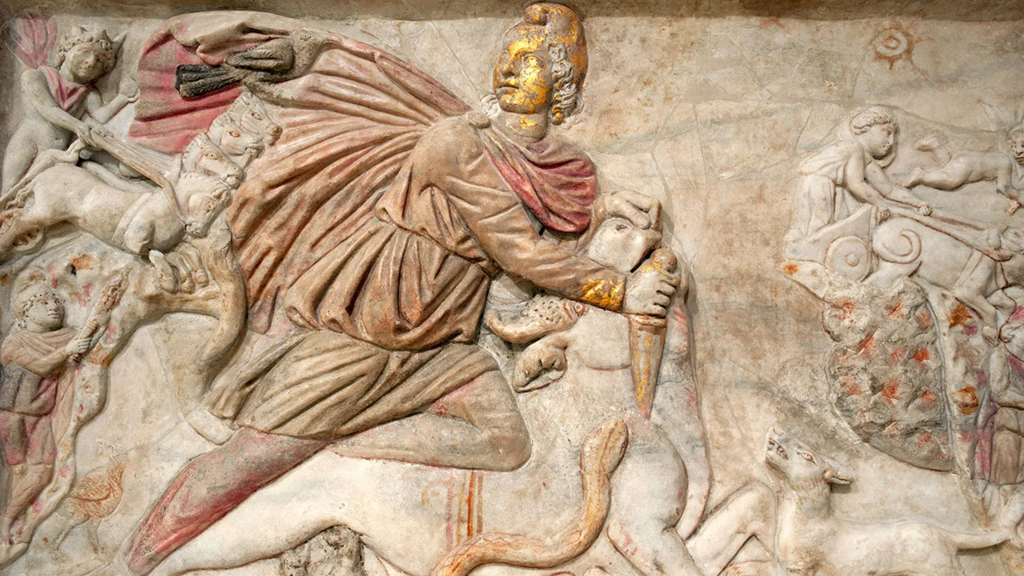

A’ Israel, disobedient
¹⁹ Again I ask, did Israel not understand? First Moses says,
“I will use those who are not a nation to make you jealous;
with a foolish nation I will provoke you.”
● Moses:
● Nation:
● Provoke:
Deut 32.21
‘am = people, gôy = nation.
To anger, like Yahweh’s anger
“A foolish nation”

Slide 15
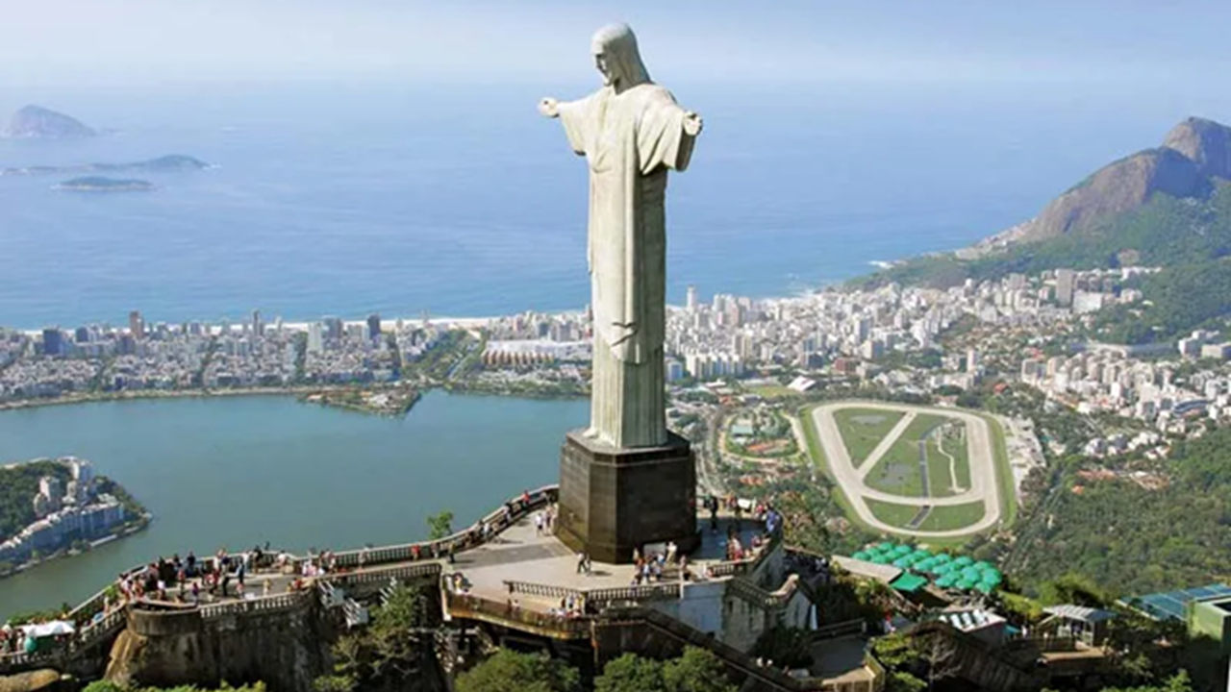

²⁰ Then Isaiah is so bold as to say,
“I have been found by those
who did not seek me;
I have shown myself to those
who did not ask for me.”
²¹ But of Israel he says,
“All day long I have held out my hands to a disobedient and contrary people.”
“All day long I have held out my hands
to a disobedient and contrary people.”
Isaiah 65:2
● Isaiah:
65:1-2.

