Slide 1
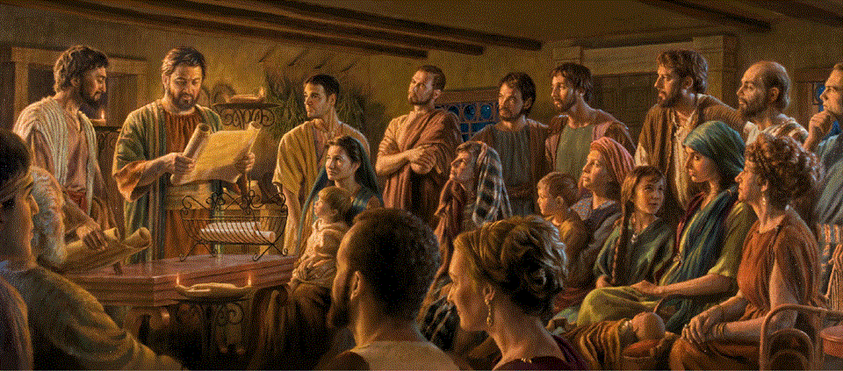
Epistle to the Romans, 11:1-36
A Short Course for Men

Slide 2
Israel and Salvation
A. The Remnant, 1-11
B. The Olive Tree, 12-24
C. The Mystery, 25-31
D. The Wisdom, 32-36
● Thesis:
Israel has lost its privilege as God’s mission to the Gentiles.

Slide 3
The Remnant 11:1-11

Slide 4
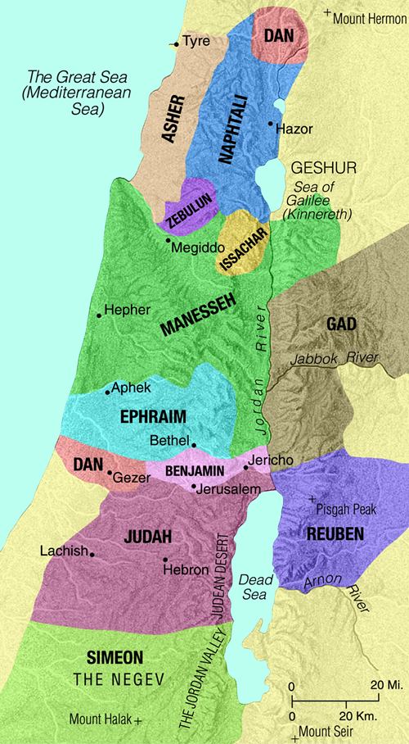
¹ I ask, then, has God rejected his people? By no means! I myself am an Israelite, a descendant of Abraham, a member of the tribe of Benjamin.
“The LORD will not forsake his people; he will not abandon his heritage” (Psa. 94:14)
² God has not rejected his people whom he foreknew. [NRSVue, 2021]
● Reject:
● Benjamin:
● Foreknow:
Never! Psalm 94.14.
Remained with Judah.
Chosen for future glory.

Slide 5

Do you not know what the scripture says of Elijah, how he pleads with God against Israel?
³ “Lord, they have killed your prophets, they have demolished your altars; I alone am left, and they are seeking my life.” [1 Kings 19.10]
● Scripture:
● Prophets:
● Seeking:
Inspired holy writings.
Jezebel (1 Kings 18.13).
Jezebel (1 Kings 19.2).

Slide 6
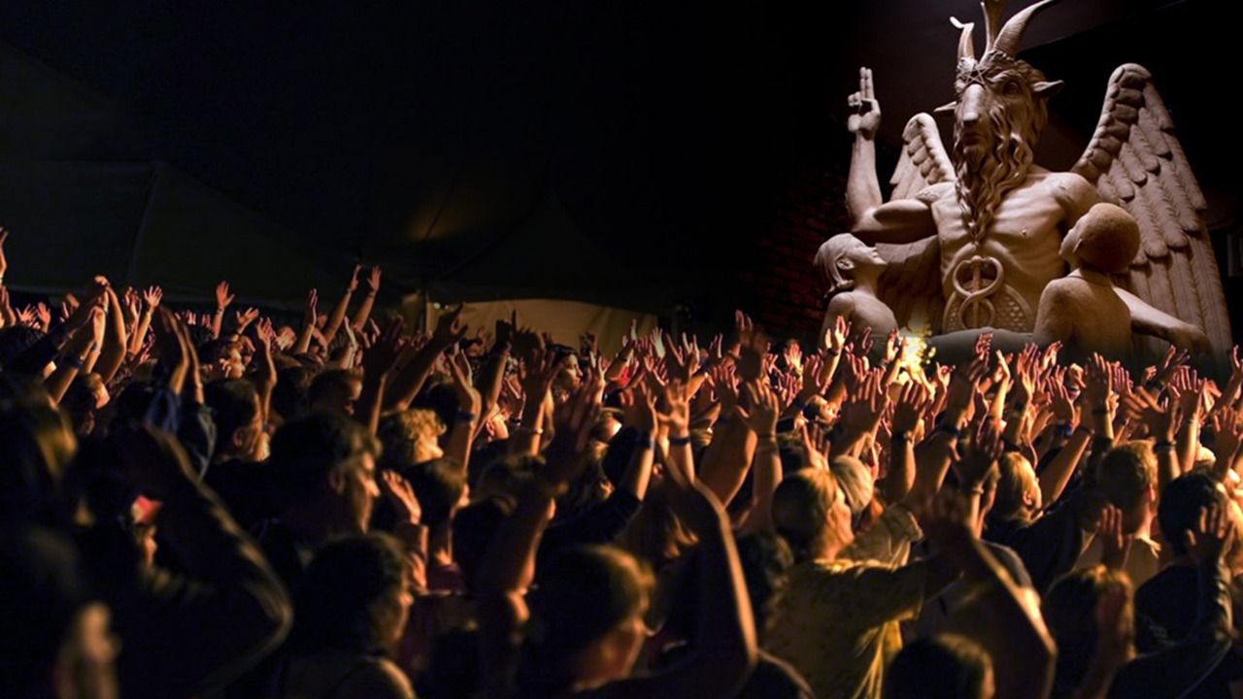
⁴ But what is the divine reply to him? “I have kept for myself seven thousand who have not bowed the knee to Baal.”
⁵ So, too, at the present time there is a remnant chosen by grace.
● Kept:
● Remnant:
● Chosen:
● Grace:
Lit., ‘I have left for myself’.
Faithful, already there.
God choses whom? How?
I.e., not by human works.

Slide 7
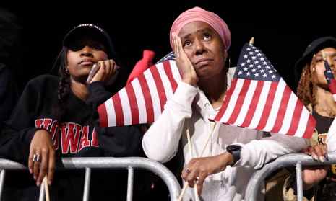
⁶ But if it is by grace, it is no longer on the basis of works, otherwise grace would no longer be grace.
⁷ What then? Israel has not achieved what it was pursuing. The elect have achieved it, but the rest were hardened, …
● Elect:
● Achieve:
● Hardened:
The faithful group.
= to obtain, to gain.
Effect of prolonged disbelief.

Slide 8
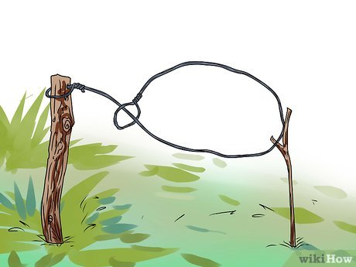
⁸ as it is written, “God gave them a sluggish spirit, eyes that would not see and ears that would not hear, down to this very day.” [Moses, Deut 29.4]
⁹ And David says, “Let their table become a snare and a trap, a stumbling block and a retribution for them; ¹⁰ let their eyes be darkened so that they cannot see, and keep their backs forever bent.” [Psa 69]

Slide 9

¹¹ So I ask, have they stumbled so as to fall? By no means! But through their stumbling salvation has come to the gentiles, so as to make Israel jealous.
● Stumble:
● Fall:
● Salvation:
● Jealous:
Over ‘the stumbling stone’.
Not permanent.
Direct access, w/o Israel.
Will eventually want Jesus.

Slide 10
The Olive Tree 11:12-24

Slide 11

¹² Now if their stumbling means riches for the world and if their loss means riches for gentiles, how much more will their full inclusion mean!
“To have lawsuits at all with one another is already a defeat for you” (1 Cor 6:7)
● Riches:
● World:
● Loss:
● Gentiles:
● Inclusion:
Knowing God as Father.
Geography and society.
Or defeat. 1 Cor 6:7
Non-Israelite ethnicities.
‘Fulness’, future restoral.

Slide 12
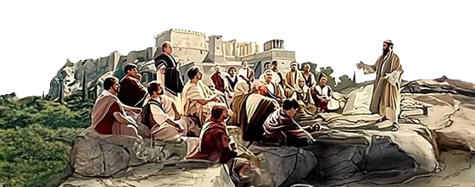
¹³ Now I am speaking to you gentiles. Inasmuch as I am an apostle to the gentiles, I celebrate my ministry
¹⁴ in order to make my own people jealous and thus save some of them.
“There are varieties of service, but the same Lord” (1 Cor 12:5)
● Ministry:
● Own people:
● Save:
● Some:
‘Deaconate’, i.e., service.
‘Flesh’, biological ‘race’.
We cooperate with God.
Anyone may repent.

Slide 13
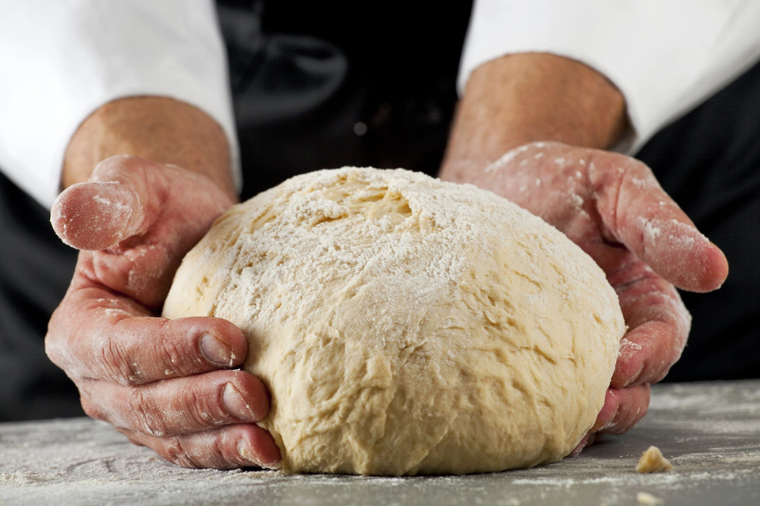
¹⁵ For if their rejection is the reconciliation of the world, what will their acceptance be but life from the dead?
¹⁶ If the part of the dough offered as first fruits is holy, then the whole batch is holy; and if the root is holy, then the branches also are holy.
● Rejection:
● Holy:
‘Loss’ of privilege.
Israel is still in God’s plans.

Slide 14
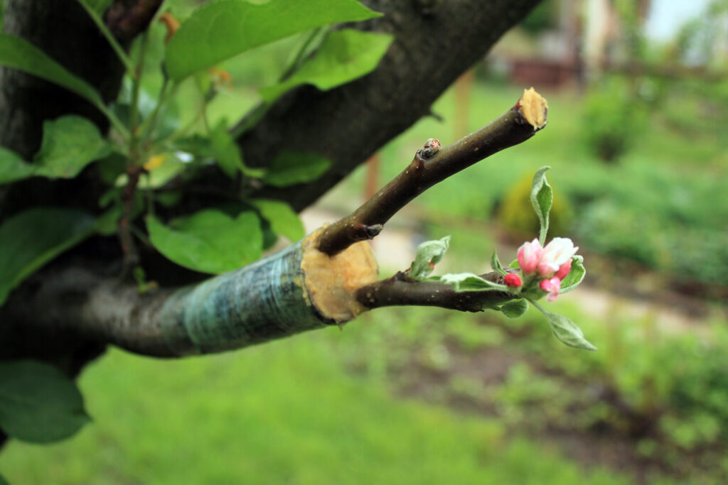
¹⁷ But if some of the branches were broken off, and you, a wild olive shoot, were grafted among the others to share the rich root of the olive tree,
“The LORD once called you ‘a green olive tree, beautiful with good fruit’” (Jer. 11:16)
¹⁸ do not boast over the branches. If you do boast, remember: you do not support the root, but the root supports you.
● Olive tree:
● Root:
Ancient symbol of Israel.
Also what grows from roots.

Slide 15
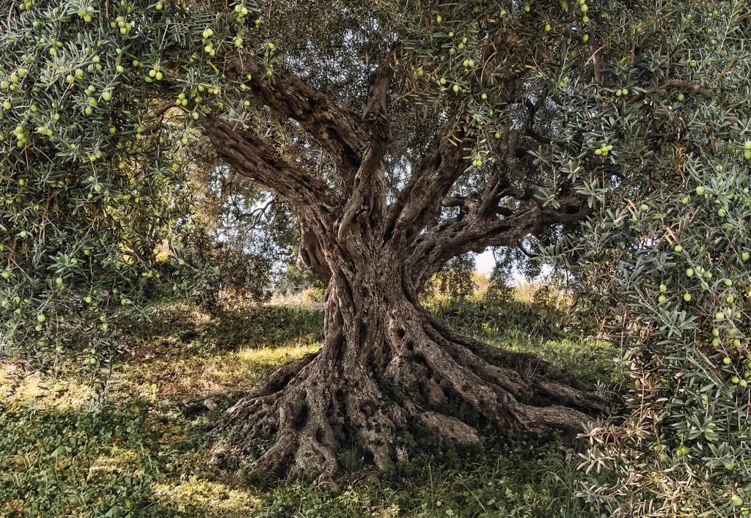
¹⁹ You will say, “Branches were broken off so that I might be grafted in.”
²⁰ That is true. They were broken off on account of unbelief, but you stand on account of belief. So do not become arrogant, but be afraid.
● You / I:
● Broken:
● Afraid:
Individual Gentiles.
Individuals who disbelieve.
Humble belief.

Slide 16
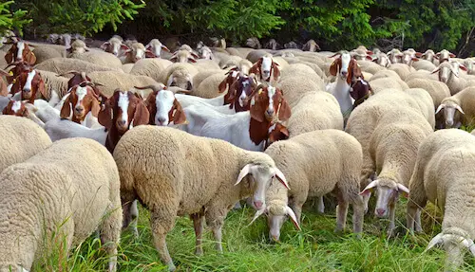
²¹ For if God did not spare the natural branches, neither will he spare you.
²² Note then the kindness and the severity of God: severity toward those who have fallen but God’s kindness toward you, if you continue in his kindness; otherwise you also will be cut off.
● If:
Remain faithful; apostacy is possible.

Slide 17
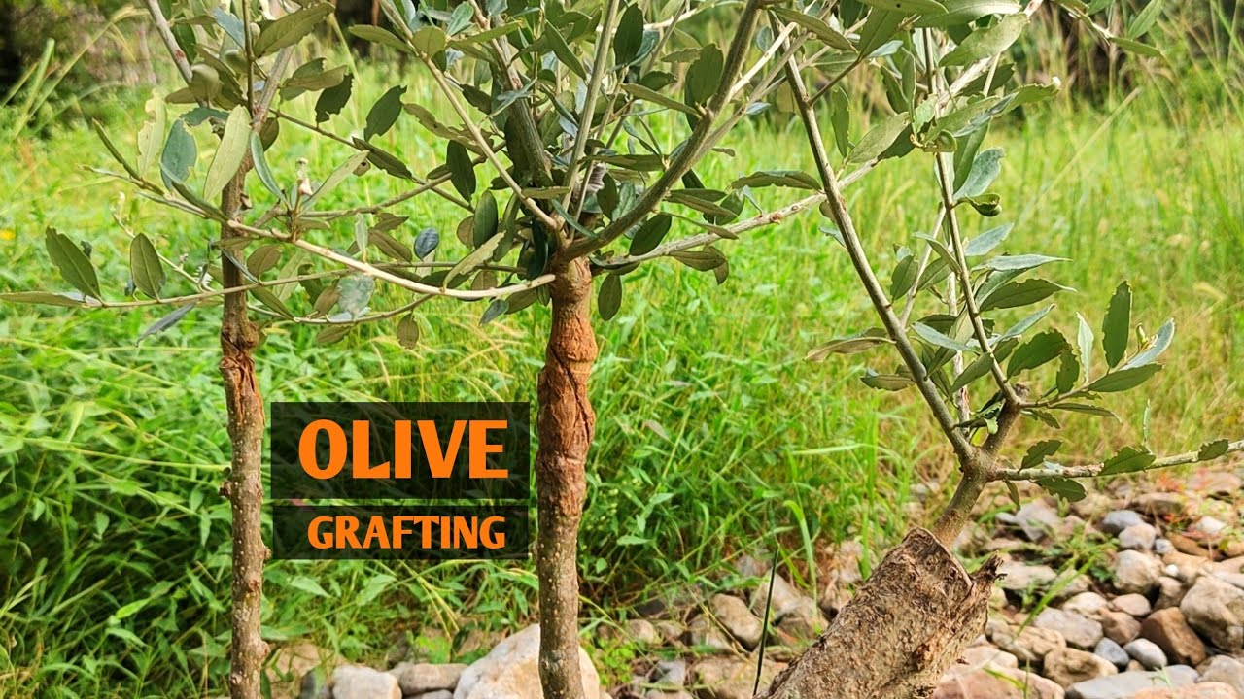
²³ And even those of Israel, if they do not continue in unbelief, will be grafted in, for God has the power to graft them in again.
²⁴ For if you have been cut from what is by nature a wild olive tree and grafted, contrary to nature, into a cultivated olive tree, how much more will these natural branches be grafted back into their own olive tree.

Slide 18
The Mystery 11:25-32

Slide 19
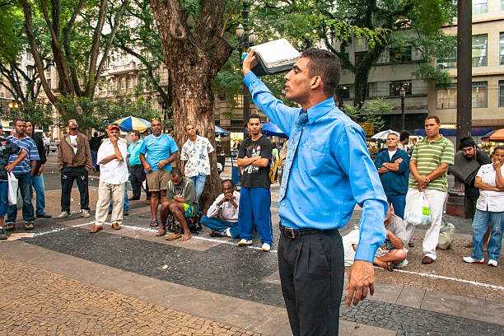
²⁵ I want you to understand this mystery, brothers and sisters, so that you may not claim to be wiser than you are:
“This gospel of the kingdom will be proclaimed throughout the whole world as a testimony to all nations, and then the end will come.” (Matt 24:14)
a hardening has come upon part of Israel until the full number of the gentiles has come in.
● Mystery:
● Full number:
● Come in:
Divine revelation.
From every ethnicity.
And then?

Slide 20
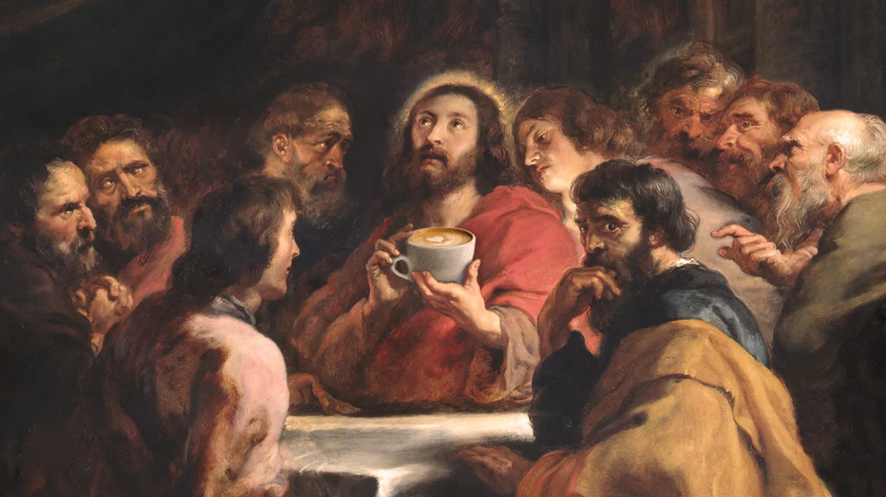
²⁶ And in this way all Israel will be saved, as it is written,
“From the west, and …
from the rising of the sun” (Isa 59:19)
“Those who were lost in the land of Assyria” (Isa 27:9)
“I will make a new covenant with the house of Israel and the house of Judah” (Jer. 31:31)
“Out of Zion will come the Deliverer; he will banish ungodliness from Jacob.”
²⁷ “And this is my covenant with them, when I take away their sins.” [Isa 59.20-21]
● All Israel:
● Deliverer:
● Covenant:
Israel and Judah.
Messiah Jesus has come!
The New Covenant.

Slide 21
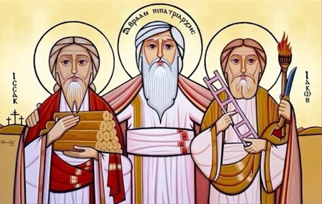
²⁸ As regards the gospel they are enemies for your sake, but as regards election they are beloved for the sake of their ancestors,
²⁹ for the gifts and the calling of God are irrevocable.
● Your sake:
● Election:
● Beloved:
● Irrevocable:
Gentiles saved w/o Israel.
Election is not salvation.
God loves to save Israelites.
God is still calling.

Slide 22
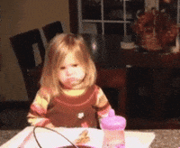
³⁰ Just as you were once disobedient to God but have now received mercy because of their disobedience,
³¹ so also they have now been disobedient in order that, by the mercy shown to you, they also may now receive mercy.
“All have sinned and fall short of the glory of God” (Rom. 3:23)
● Disobedient:
● Mercy:
● As … also:
All who survive childhood.
To meet real needs.
Israelites & Gentiles alike.

Slide 23
The Wisdom ll:33-36

Slide 24
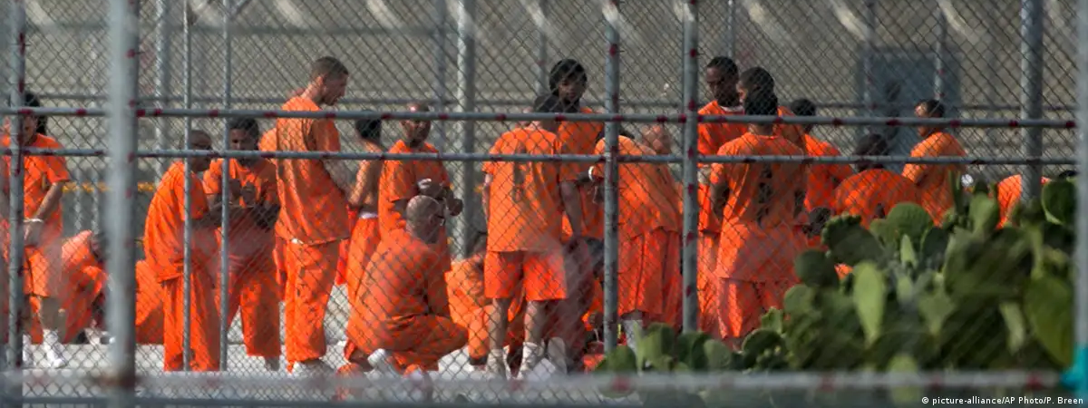
³² For God has imprisoned all in disobedience so that he may be merciful to all.
³³ O the depth of the riches and wisdom and knowledge of God! How unsearchable are his judgments and how inscrutable his ways!
● Imprisoned:
● All:
Result of disobedience.
All ethnicities, individuals.

Slide 25
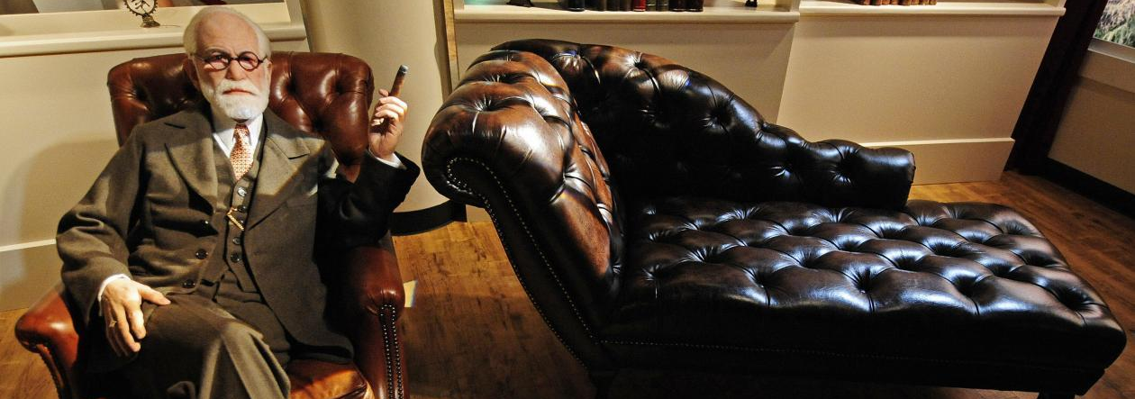
³⁴ “For who has known the mind of the Lord? Or who has been his counselor?”
³⁵ “Or who has given a gift to him, to receive a gift in return?”
³⁶ For from him and through him and to him are all things. To him be the glory forever. Amen.
● “Repent and believe the Good News!

Slide 26
Summary
1 “Salvation comes from the Jews.”
2 But national Israel rejects the Messiah.
3 “All Israel” saved at Pentecost.
4 Jesus appoints Paul apostle to Gentiles.
5 God removes Israel as Light to Gentiles.
6 Gentiles are being saved without Israel.
7 Israelites are saved by faith in Messiah.
8 Zionist Israel is awaiting Messiah.

Slide 27
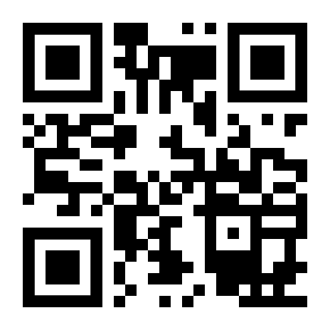
http://romans.forum

